Slide 1
Privileged Features Distillation at Taobao Recommendations --KDD 2020 Accept Paper
Team Students: Jiang Yuchen, Li Yuanzhao, Chen Jiyuan, Shang Jihao
Paper Writer:Chen Xu*, Quan Li*, Junfeng Ge, Jinyang Gao, Xiaoyong Yang, Changhua Pei, Fei Sun, Jian Wu,
Hanxiao Sun, and Wenwu Ou
Alibaba Group, Beijing, China

Slide 2

Outline
Background
System Design
IV. Experiment Result
V. Summary

Slide 3

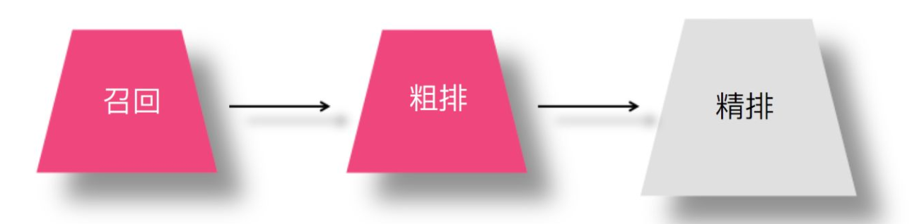
I. Background
Search Engine
More of a initiative action for user. The key words inputed by users will be the key features to rank the top N favourable results.
Nowadays we suffer greatly from Information Overload(信息过载).
Thus two handy tricks come to rescue.
Search Engine------IR
Recommendation System
Recommend System
This is more used when people don't have a specific target when surfing the Internet. The algorithm takes in the historical interests and some statistics features of user to rank the more preferable results for user.

Slide 4
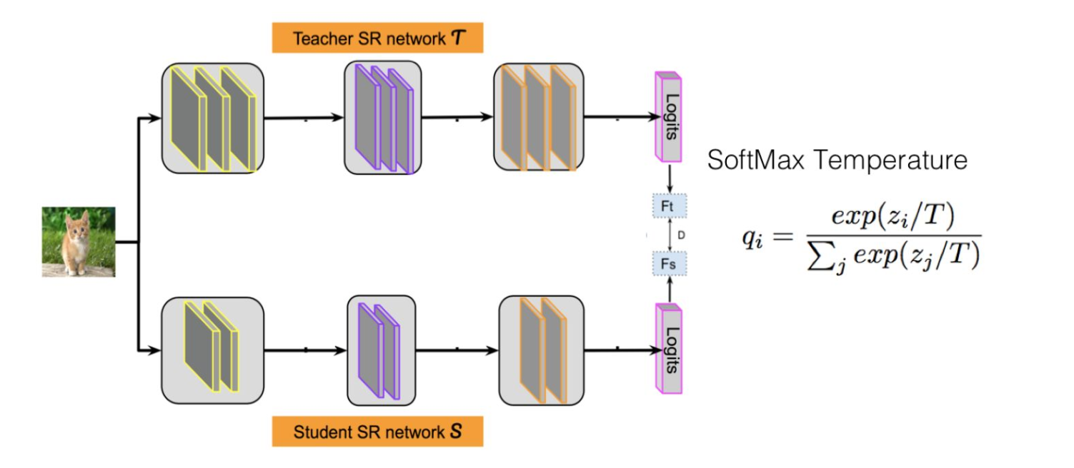
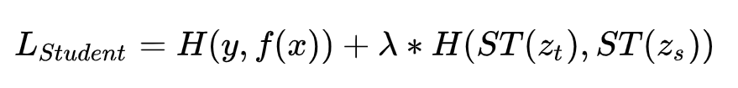
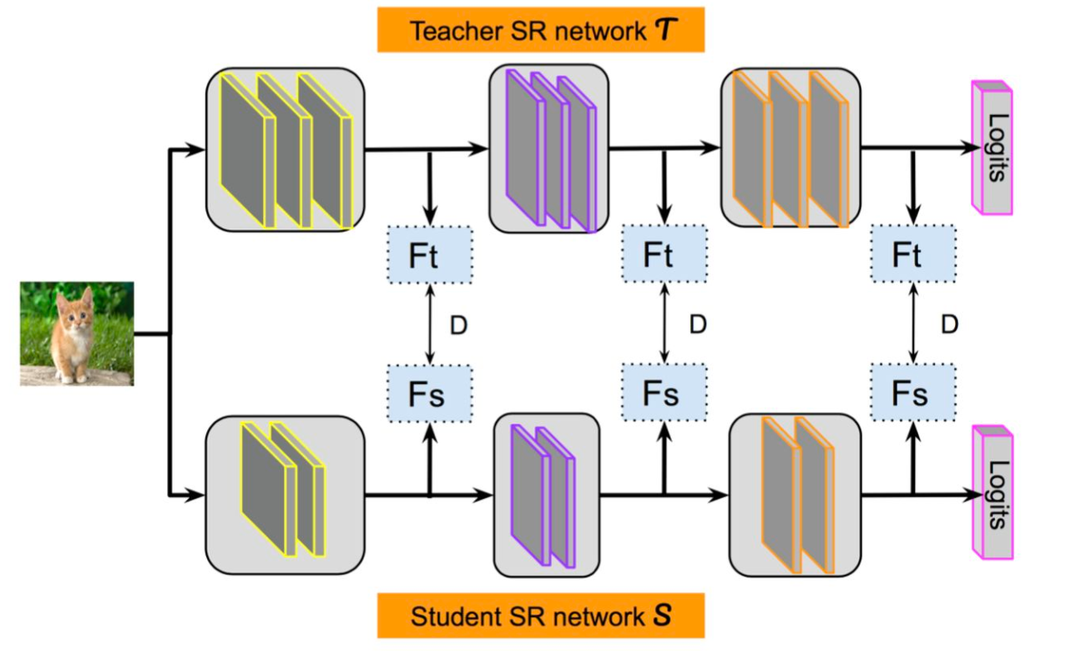
Basics of Knowledge Distillation
There are two main implementation for Teacher-Student model
A general trend is that, with the development of DNN like ResNet, the parameters in the network are increasing terribly, which results in a situation that the models or frameworks are becoming slower and slower, blocking them from being applied online.
Knowledge Distillation (mainly teacher-student model) comes to rescue.
The teacher is more complicated and learns more than the student model. But it's too heavy to run online. So it somehow teaches some dark knowledge to a smaller and simpler model (student) offline to enhance its generalization ability so that it can run fast and well online.

Slide 5
I. Background
Privileged Features(优势特征) means that the data which are discriminative but can only be extracted offline, which are only available at training time.
These features essentially determine the upper-bound of the model performance. （Trash in, Trash out）
In this paper, for example, dwell time (the time we stay in the detailed page of commodity) is a priviledged feature.
So, the model they proposed is basically adding priviledged feature to the train of teacher. Of course some other improvements are also implemented.

Slide 6
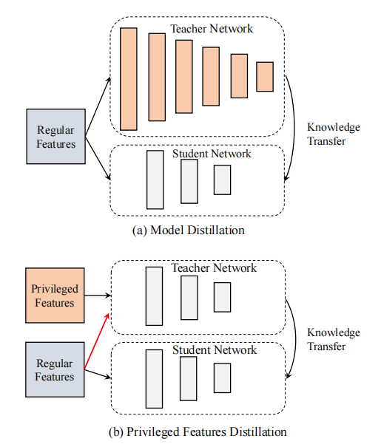
II. System Design
Model distillation mainly focus on non-linear layers in Teacher Network
Privileged features distillation mainly focus on using both privileged features and regular features for Teacher Network
Figure.2 Two kinds of Distillation

Slide 7
II. System Design
Compare with MTL(Multi-Task Learning), PFD(Privileged Features Distillation) mainly has two advantages.
On the one hand, the privileged features are combined in a more appropriate way for the prediction task. Generally, adding more privileged features will lead to more accurate predictions.
On the other hand, PFD only introduces one extra distillation loss no matter what the number of privileged features is, which is much easier to balance.
Figure.2 Two kinds of Distillation

Slide 8
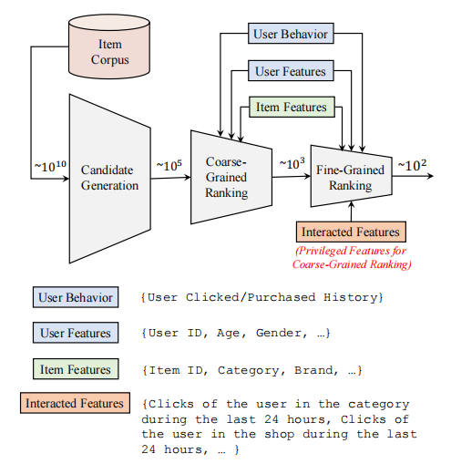
II. System Design
In e-commerce recommendations, one of the main aims is to maximize the Gross Merchandise Volume (GMV), which can be decomposed into
CTR(Click-Through Rate) × CVR(ConVersion Rate) × Price.
Figure.3 Overview of Taobao Recommend System

Slide 9
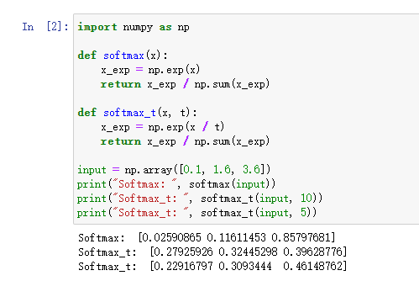
II. System Design
Distillation: Softmax with Temporature
Smooth the result of original softmax result
Help student to “think widely” about the input
Figure.4 Softmax with Temporature

Slide 10
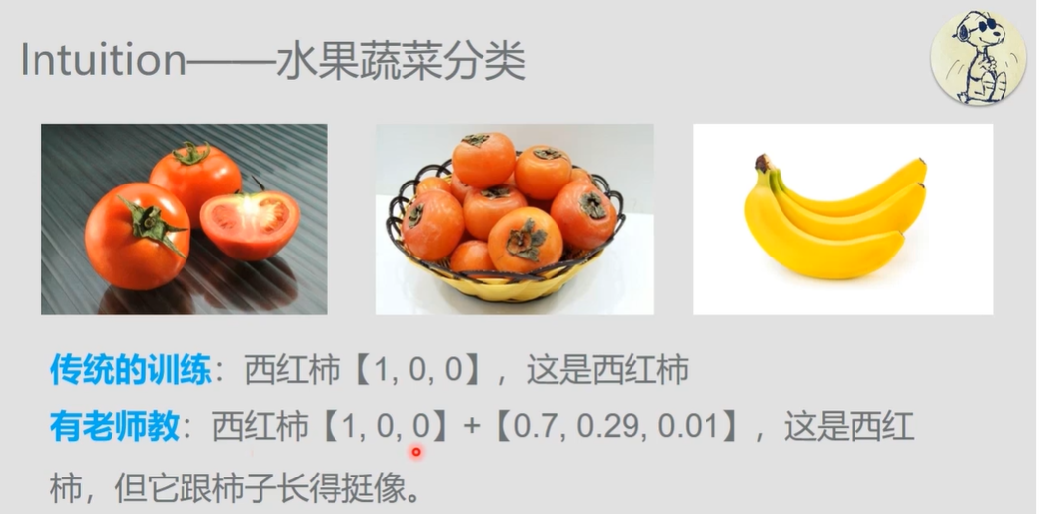
II. System Design
Figure.5 Example

Slide 11
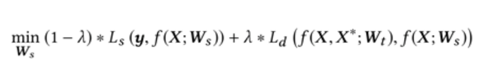
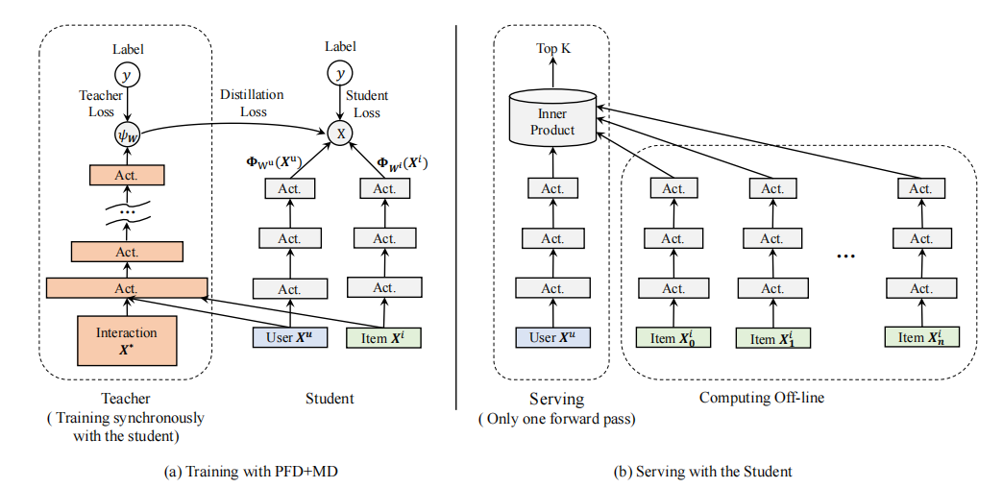
II. System Design
Unified Distillation
Training the whole network with PFD+MD
The training results which are finished offline will be provided for student network
Figure.6 Unified Distillation

Slide 12
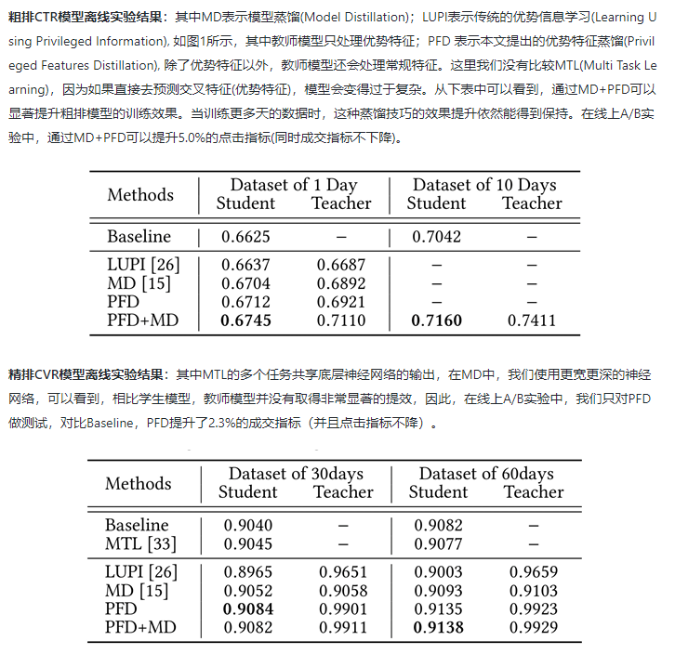
III. Experiment
PFD + MD performs better than any other traditional model.
Figure.7 Explanation of experiment result

Slide 13
IV. Summary
So what does this paper do?
privileged feature distillation - training synchronization - combined with MD
Innovations
MD: use the same input PFD: use extra privileged features for teacher
MD: Teacher is more complex than the student.
PFD:The network structures are the same for student and teacher.
This model successfully takes use of privileged features in recommend system and and get a better performance both theoretically and practically.
This kind of model may also be used in not only recommend system but also other field which also need to take use of posterior data.
Futher: maybe we can still combine logits and feature distillation together?

Slide 14
Reference
[1] https://developer.aliyun.com/article/768970
[2]https://www.bilibili.com/video/BV1s7411h7K2?from=search&seid=18388162510226540460

Slide 15

Thanks for watching！

