Slide 1
Modelling a Cold Atom using a Driven Gyroscope
Project by Edward Taylor and Charlotte Dodd
22/02/2018

Slide 2
Aims
Drive a gyroscope using a motor
Produce a torque with electromagnetism causing the gyroscope to process
Measure the angular velocity of the rotation and procession
Analyse the accuracy of the gyroscope as a model for the cold atom with the Bloch sphere model.

Slide 3
Theory
Bloch sphere
Biot-Savart
Helmholtz coil

Slide 4
Feasibility studies
Driving the rotor of the gyroscope with a current
With small conducting magnets
Tachometer and motor arrangement

Slide 5
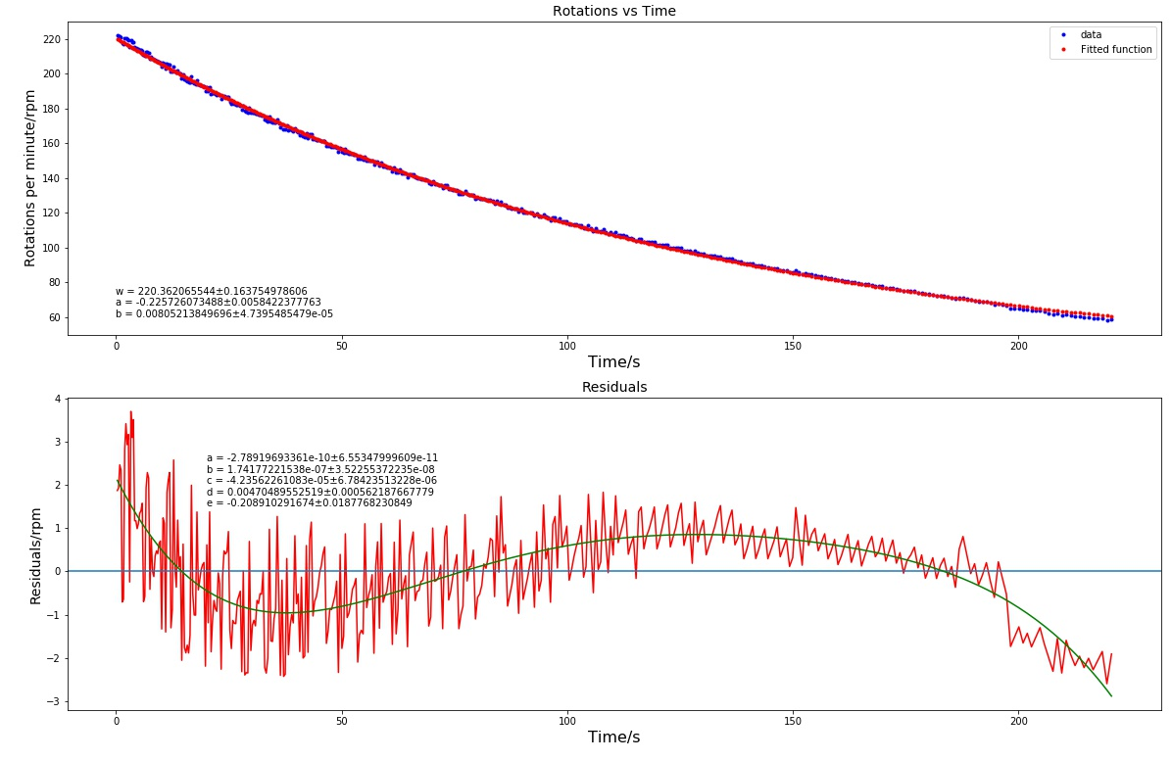
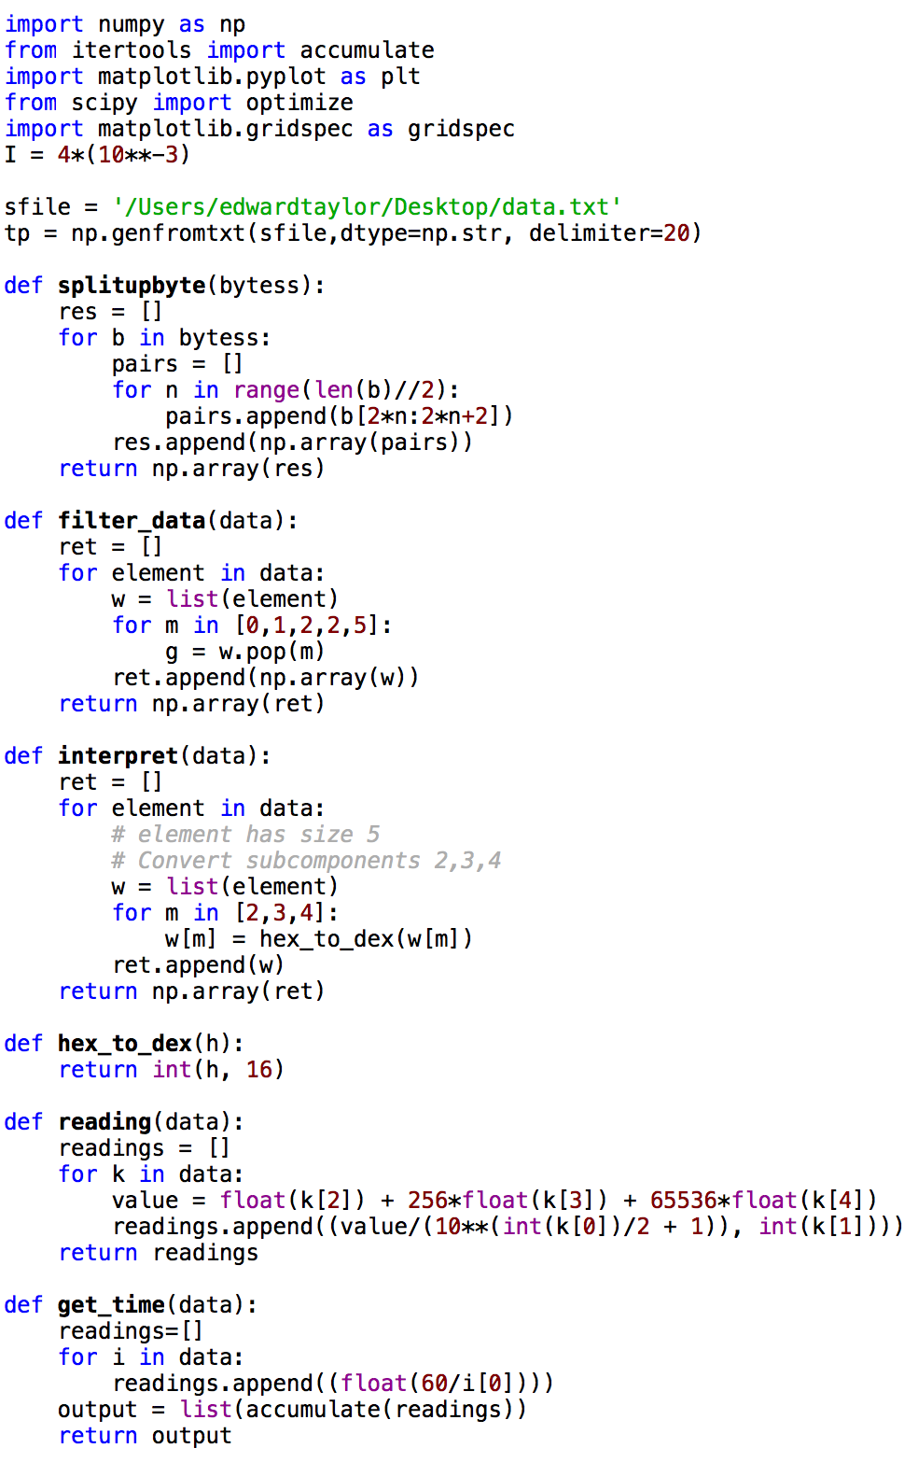
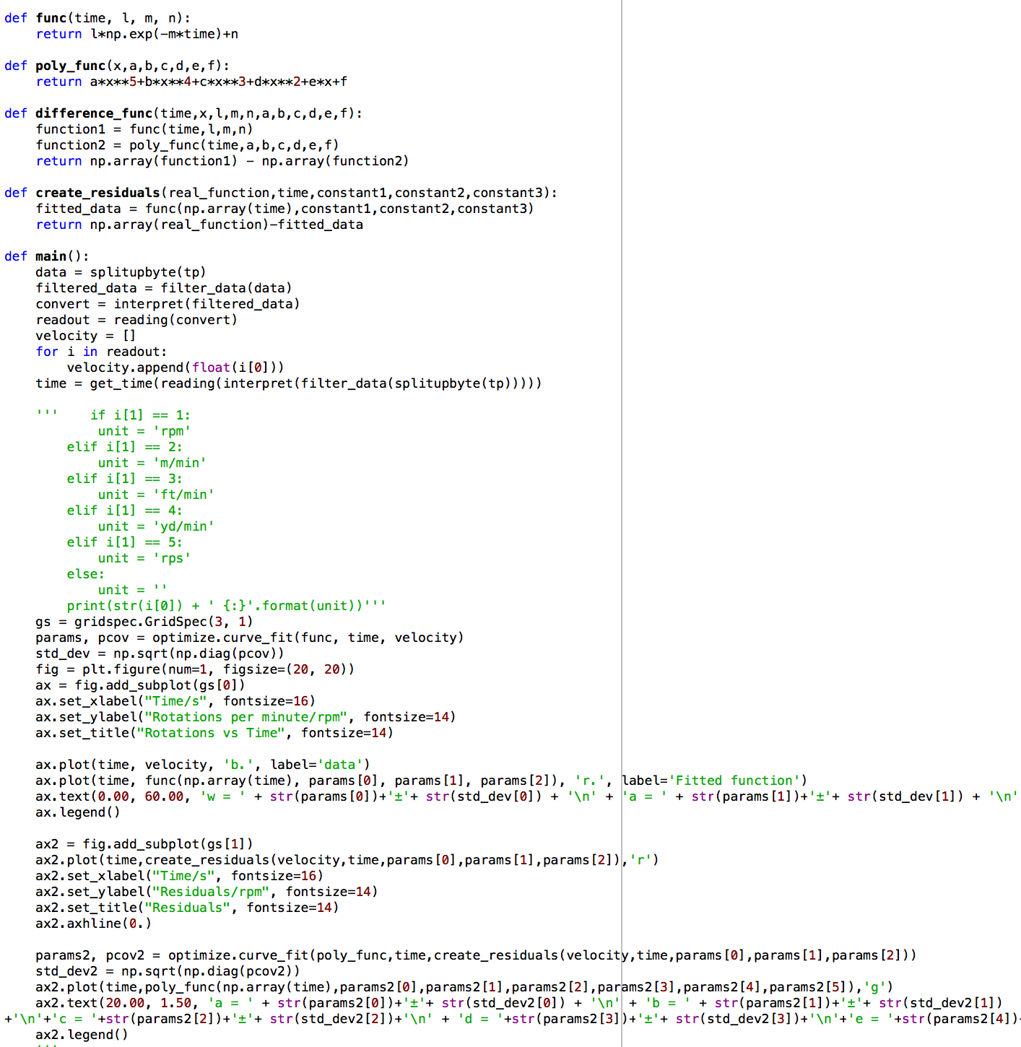

Programming

Slide 6
Data manipulation
Data input: 0D020001014DA6560000
Put data in pairs: ['0D', '02', '00', '01', '01', ’4D', 'A6', ’56’, ’00’, '00']
Keep pairs needed: ['02' '01' 'A6' '56' '00']
Converted to decimal (from hex): [02, 01, 166, 86, 0]
Find rpm (without unit): float(k[2]) + 256*float (k[3]) + 65536*float(k[4]) = 221.82
Create rpm + decimal place: readings.append((value/(10**(int(k[0])/2 +1),int(k[1])))
Get rpm with unit: [(221.82, 1),…] → 221.82 rpm

Slide 7
Graphing the data
Finding time when reading taken: [(221.82, 1),…]
Loop over pairs creating list of times cumulatively adding previous time of measurement
readings.append((float(60/k[0]))) → returns a time → list(accumulate(readings) → summing them up
E.g readings.append(float(60/221.82)) → [0.27, a, b, c] → [0.27, 0.27+a, 0.27+a+b, 0.27+a+b+c, …]
Use an arbitrary fit function: params, pcov = optimize.curve_fit(func, time, velocity)
Plot velocity vs time
Extract fit parameters: standard_deviation = np.sqrt(np.diag(pcov))

Slide 8
Plans
Currently in workshop having motor fitted
Magnet analysis and attachment
Weeks 9-10 is testing
Finishing and report writing

Slide 9
Method
Tachometer
…

Slide 10
So far
Research and design of Faraday Disk
Redesign and proposal
Motor design
Code being written to interpret results from the tachometer
Magnet analysis

Slide 11
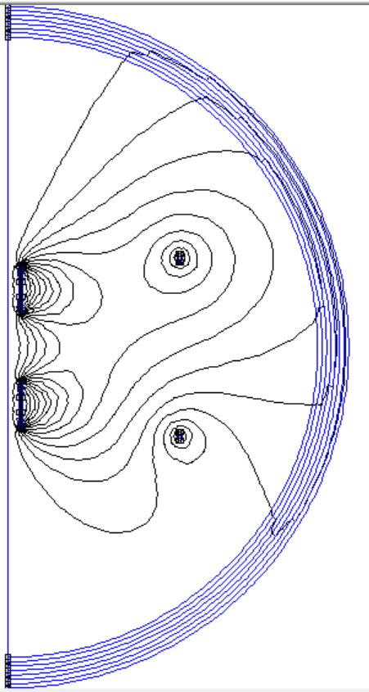
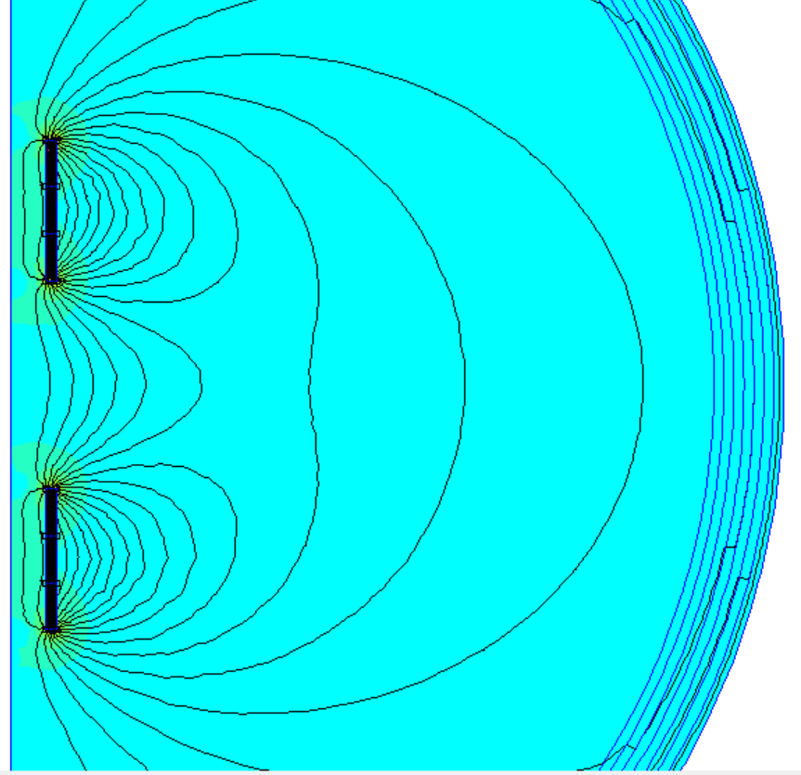
FEMM Analysis

Slide 12
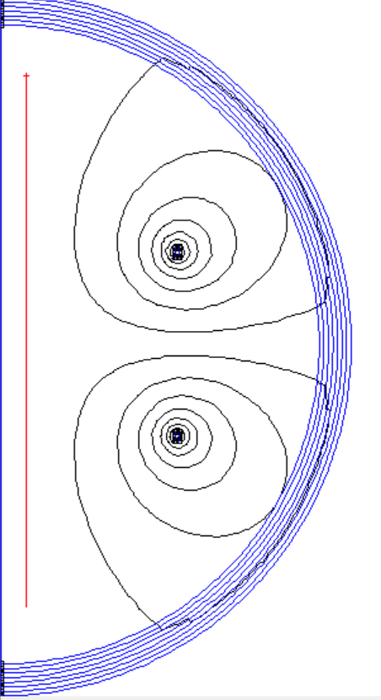
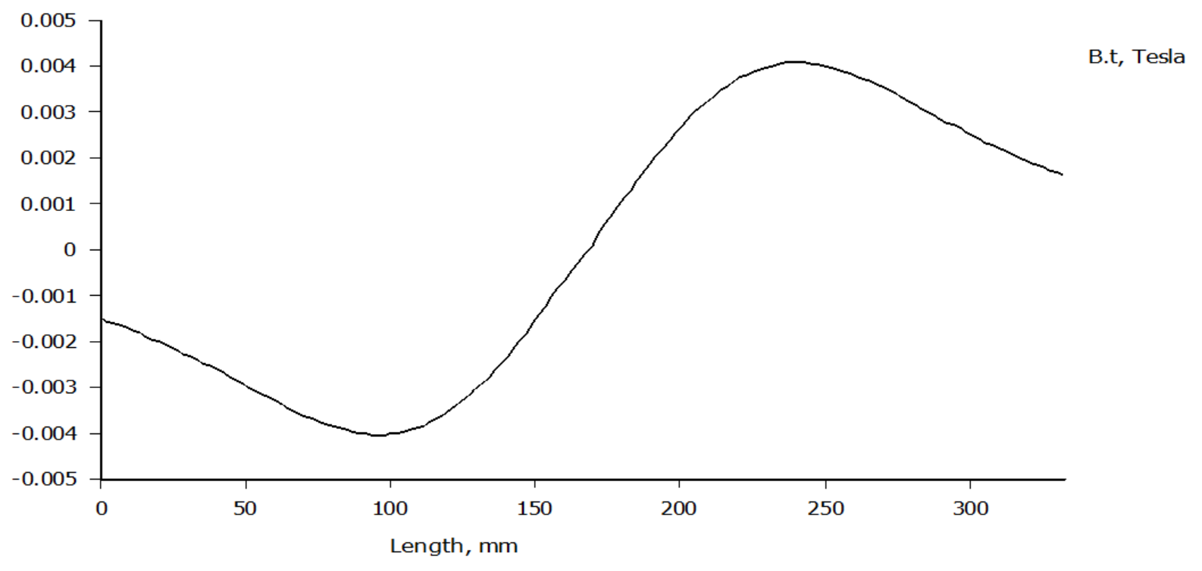
FEMM Analysis

Slide 13
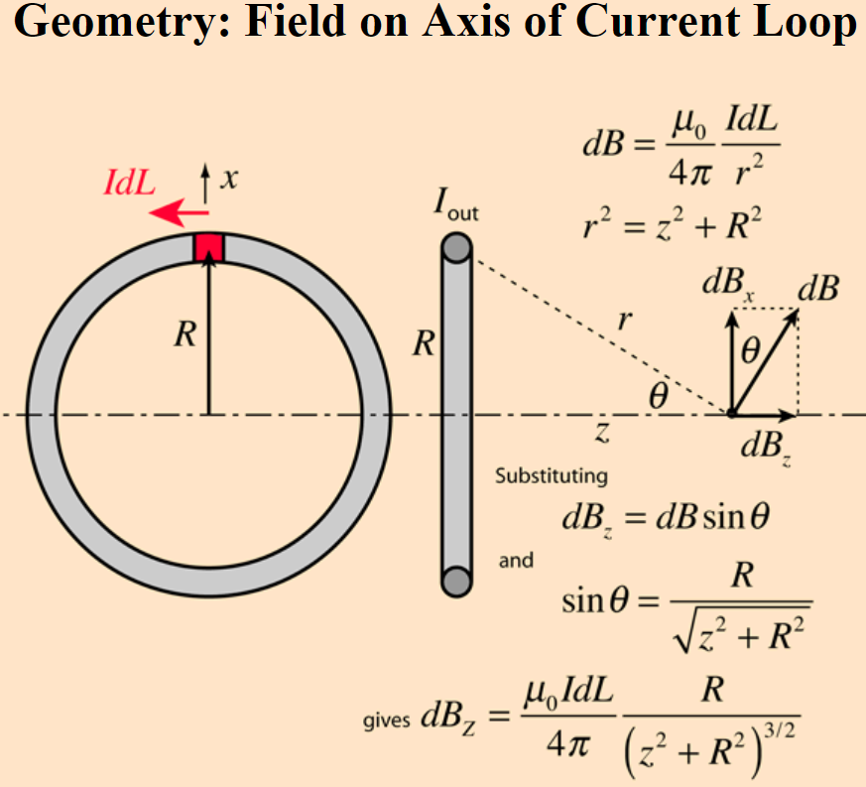
FEMM Analysis
Force acting on magnets in model magnetic field: 0.139545±0.000001N
Magnetic field strength: 87±1mT
Magnetic field strength from
Boit-Savart law: 9mT
Magnetic moment of magnets: 20.3±0.2mNmT^-1
Credit: hyperphysics

Slide 14
Summary

Slide 15
Bibliography

