Slide 1
Modelling a Cold Atom using a Driven Gyroscope
Project by Edward Taylor and Charlotte Dodd
22/02/2018

Slide 2
Aims
Drive a gyroscope using a motor
Produce a torque with electromagnetism causing the gyroscope to process
Measure the angular velocity of the rotation and procession
Analyse the accuracy of the gyroscope as a model for the cold atom with the Bloch sphere model.
Measure the strength of an external magnetic field

Slide 3
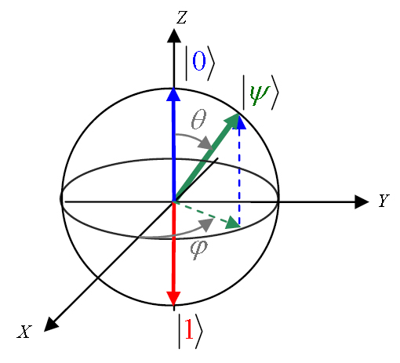
Theory – Bloch Sphere as a Cold Atom
A cold atom is a quantum system
It can be represented with the Bloch Sphere model
Gyroscope is a good model of a cold atom
Credit: Wikimedia commons
Project suggestion, Birmingham University School of Physics and Astronomy.
Nuclear induction, Bloch and Felix, Oct 1946, Phys. Rev. 70 (7-8): 460–474.

Slide 4
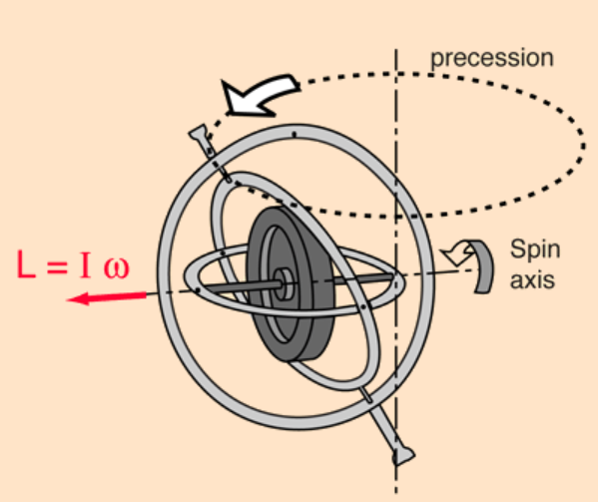

Theory – Gyroscopic Motion
$L=Iω$
$τ=r∧F$
$Ω=\frac{τ}{L}=\frac{τ}{Iω}$
$τ=B_{ext}∧μ$
Credit: hyperphysics
University Physics with modern physics, Young, Freedman and Ford, pages 328-330.

Slide 5
Progress
Research and design of Faraday Disk
Feasibility study
Redesign and proposal
Motor design
Writing code
Magnet analysis

Slide 6
Feasibility studies
Faraday Disk
Faraday disk with small conducting magnets
Tachometer and motor arrangement
Applying a processional torque with magnets

Slide 7
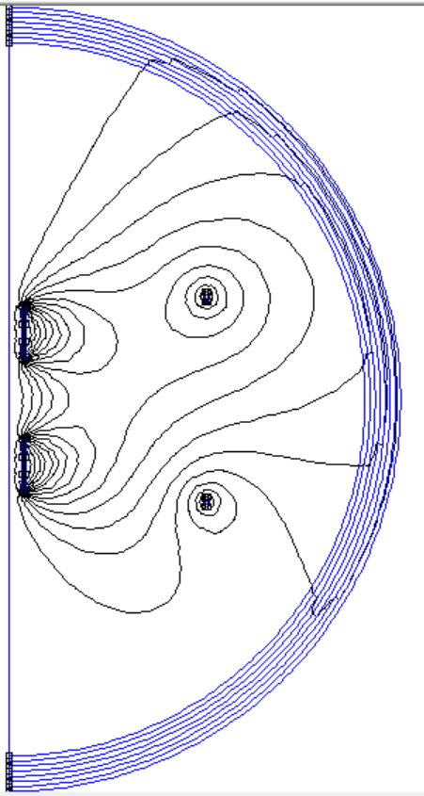
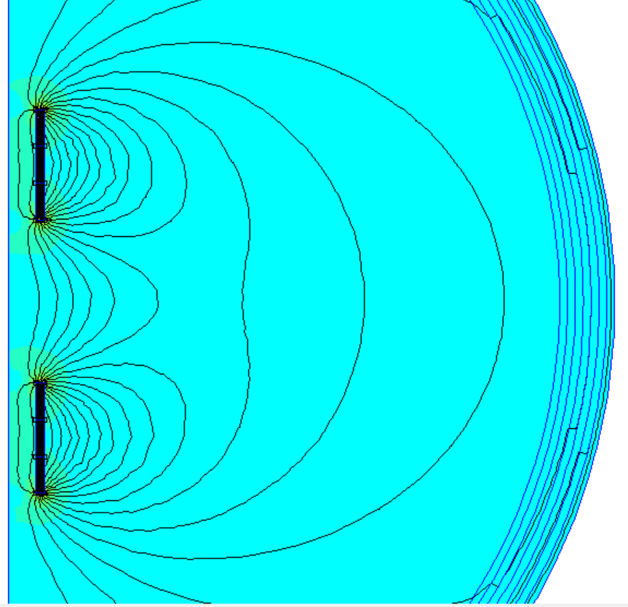
FEMM Analysis

Slide 8
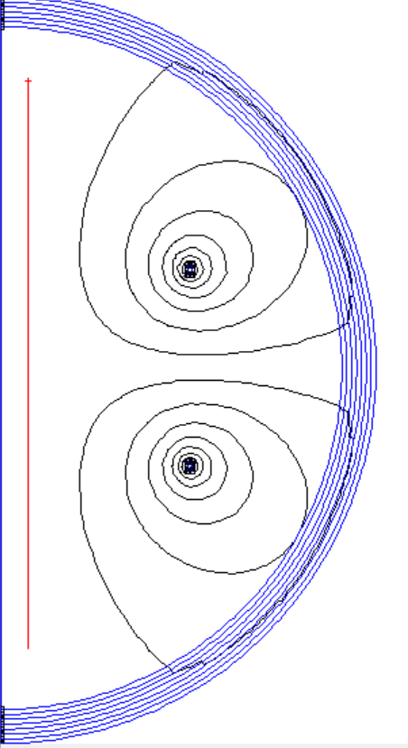
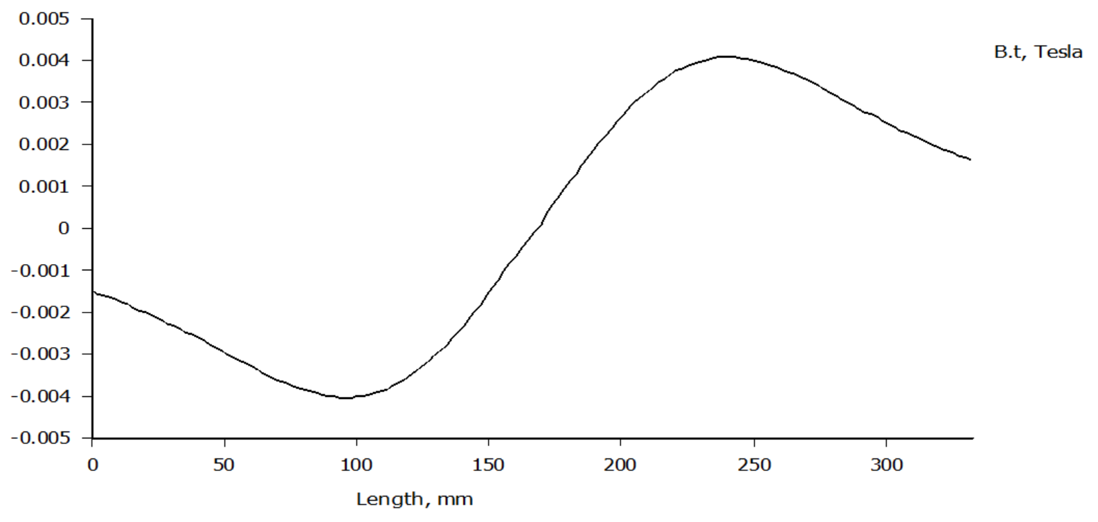
FEMM Analysis

Slide 9
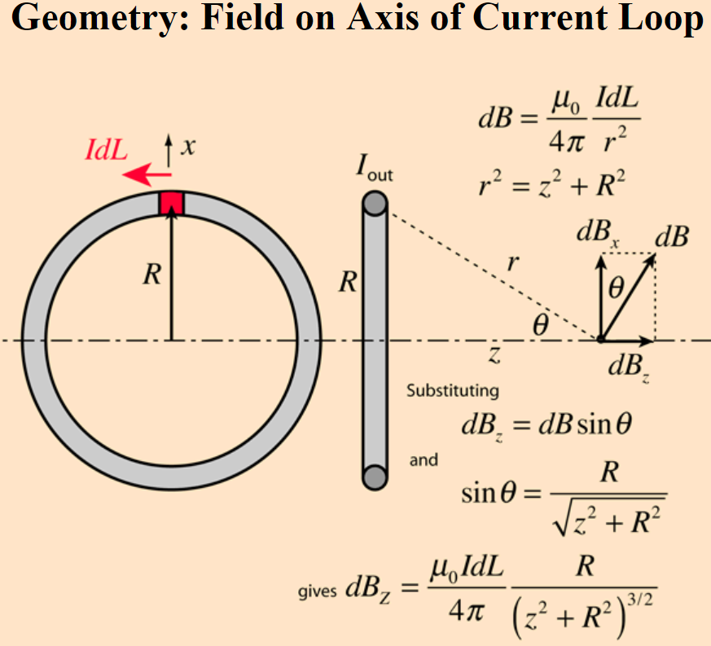
FEMM Analysis
Force acting on magnets in model magnetic field: 0.14N (0.139545±0.000001N)
Magnetic field strength: 87±1mT
Magnetic field strength from Boit-Savart law: 9mT
Magnetic moment of magnets: 20.3±0.2mNmT^-1
Credit: hyperphysics

Slide 10
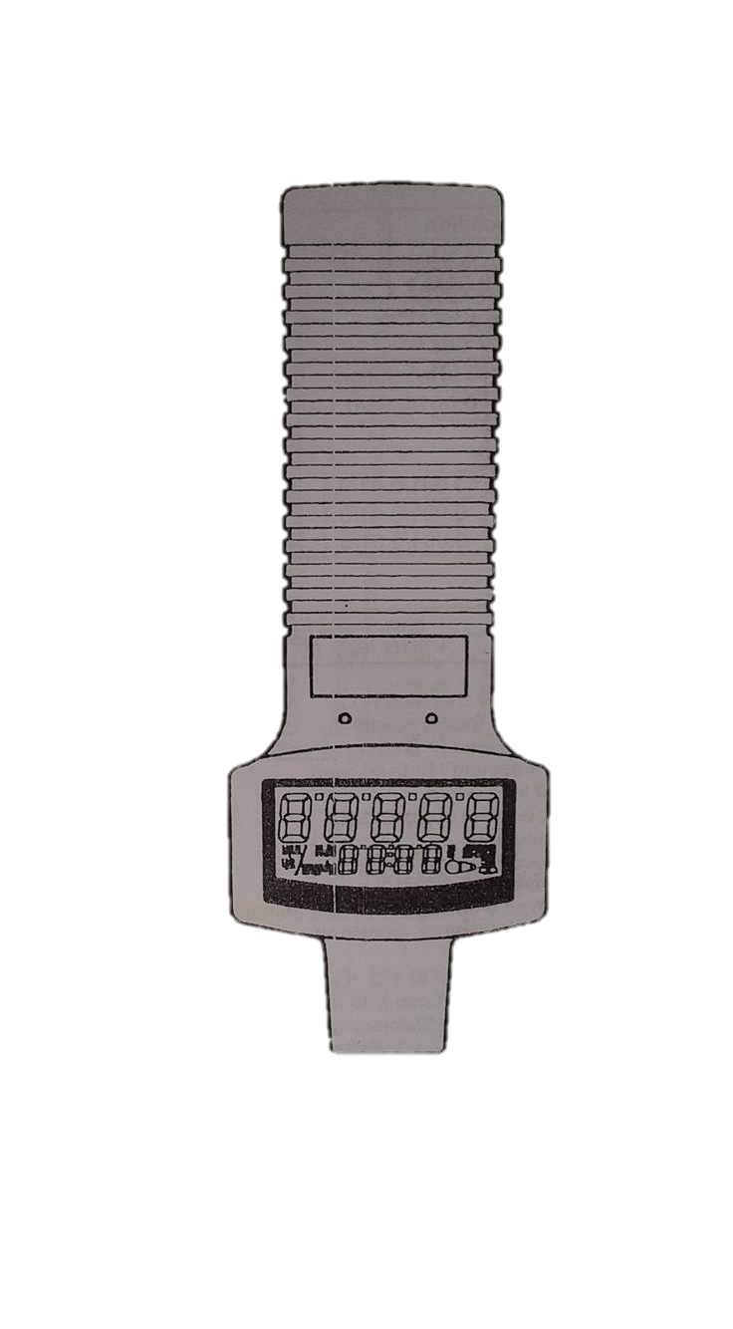
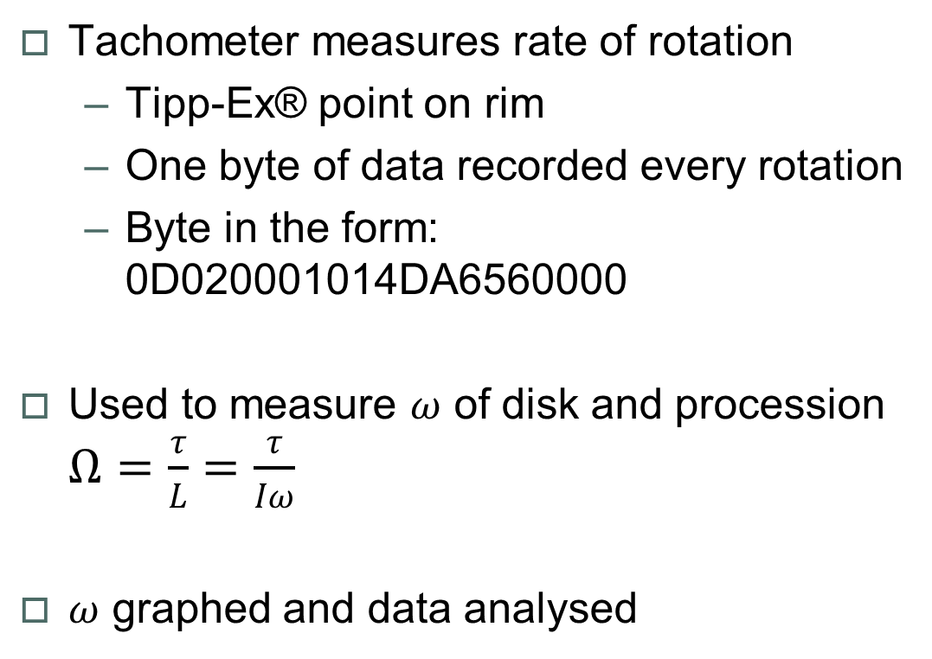
Method - Tachometer
Tachometer measures rate of rotation
Tipp-Ex® point on rim
One byte of data recorded every rotation
Byte in the form: 0D020001014DA6560000
Used to measure $ω$ of disk and procession $Ω=\frac{τ}{L}=\frac{τ}{Iω}$
$ω$ graphed and data analysed
Credit: Tachometer instruction manual.

Slide 11
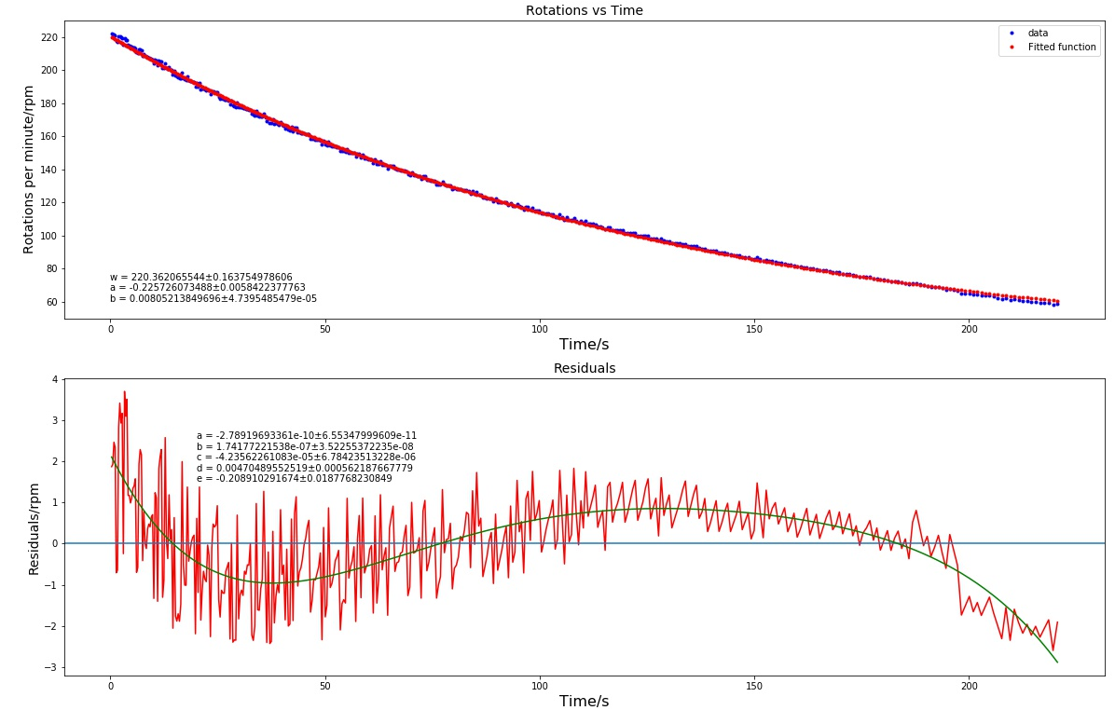

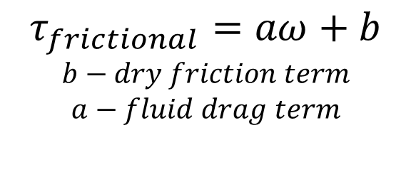
Programming
$$τ_{frictional}=aω+b$$
$$b−dry friction term$$
$$a−fluid drag term$$

Slide 12
Data manipulation
Data input: 0D020001014DA6560000
Put data in pairs: ['0D', '02', '00', '01', '01', ’4D', 'A6', ’56’, ’00’, '00']
Keep pairs needed: ['02' '01' 'A6' '56' '00']
Converted to decimal (from hex): [02, 01, 166, 86, 0]
Find rpm (without unit): float(k[2]) + 256*float (k[3]) + 65536*float(k[4]) = 221.82
Create rpm + decimal place: readings.append((value/(10**(int(k[0])/2 +1),int(k[1])))
Get rpm with unit: [(221.82, 1),…] → 221.82 rpm

Slide 13
Graphing the data
Finding time when reading taken: [(221.82, 1),…]
Loop over pairs creating list of times cumulatively adding previous time of measurement
readings.append((float(60/k[0]))) → returns a time → list(accumulate(readings) → summing them up
E.g readings.append(float(60/221.82)) → [0.27, a, b, c] → [0.27, 0.27+a, 0.27+a+b, 0.27+a+b+c, …]
Find fit parameters: params, pcov = optimize.curve_fit(func, time, velocity)
Plot velocity vs time
Error on fit parameters: standard_deviation = np.sqrt(np.diag(pcov))

Slide 14
Future Developments
Motor currently being fitted in workshop
Magnet analysis and attachment
Weeks 9-10: testing
Finishing and report writing

Slide 15
Summary
Gyroscope as a model of the cold atom
Design and feasibility
Data capture
Future developments

Slide 16
Bibliography
Digital photo tachometer, model: RM-1501, instruction manual , 2000, RS Components UK.
A gyroscope as a way of modelling atomic transitions, project suggestion, 2015, Birmingham University School of Physics and Astronomy.
Nuclear induction, Bloch and Felix, Oct 1946, Phys. Rev. 70 (7-8): 460–474.
Modelling the motion of a gyroscope and designing and magnetic propulsion system, George Gibbons, 2017, University of Birmingham, School of Physics and Astronomy.
University Physics with modern physics, 13th international edition, Young, Freedman and Ford, 2016, Pearson, pages 328-330.
Michael Orgill

