Slide 1
Modelling a Cold Atom using a Driven Gyroscope
Project by Edward Taylor and Charlotte Dodd
22/02/2018

Slide 2
Aims
Drive a gyroscope using a motor
Produce a torque with electromagnetism causing the gyroscope to process
Measure the angular velocity of the rotation and procession
Analyse the accuracy of the gyroscope as a model for the cold atom with the Bloch sphere model.

Slide 3
Theory – Blotch Sphere as a Cold Atom
Equations of cold atom? (in Gibbons)
A cold atom is a quantum system
A cold atom can be represented by the Blotch Sphere model
A Blotch Sphere is a geometrical representation of a two state quantum mechanical system.
Gyroscope is a good model of a cold atom
Inner disk spin represents the intrinsic spin of the cold atom
The procession is equivalent to the procession of the cold atom when it’s magnetic moment interacts with an external field.

Slide 4
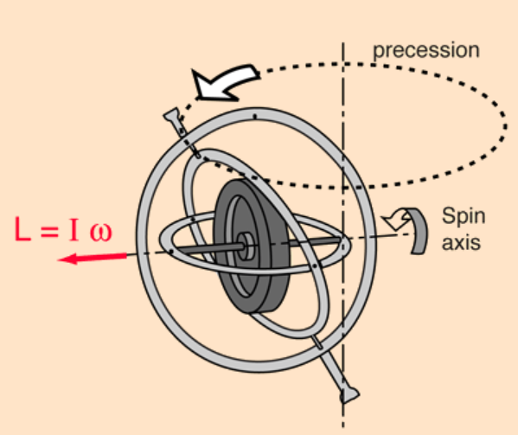

Theory – Gyroscopic Motion
$L=Iω$
$τ=r∧F$
$Ω=\frac{τ}{Iω}$
$τ=B_{ext}∧μ$
Credit: hyperphysics

Slide 5
So far
Better title
Research and design of Faraday Disk
Redesign and proposal
Motor design
Code being written to interpret results from the tachometer
Magnet analysis

Slide 6
Plans
Better title
Currently in workshop having motor fitted
Magnet analysis and attachment
Weeks 9-10: testing
Finishing and report writing
Here or at end?

Slide 7
Feasibility studies
Faraday Disk
Driving with electromagnetism and small conducting magnets
Tachometer and motor arrangement
Applying a processional torque with magnets

Slide 8
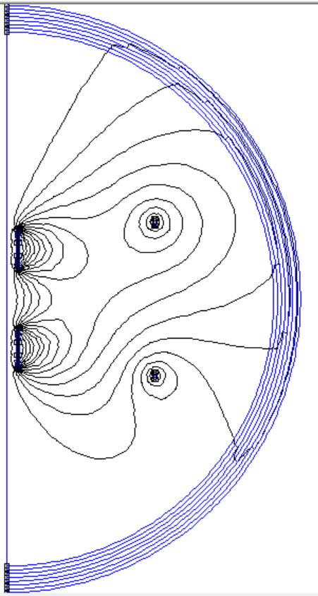
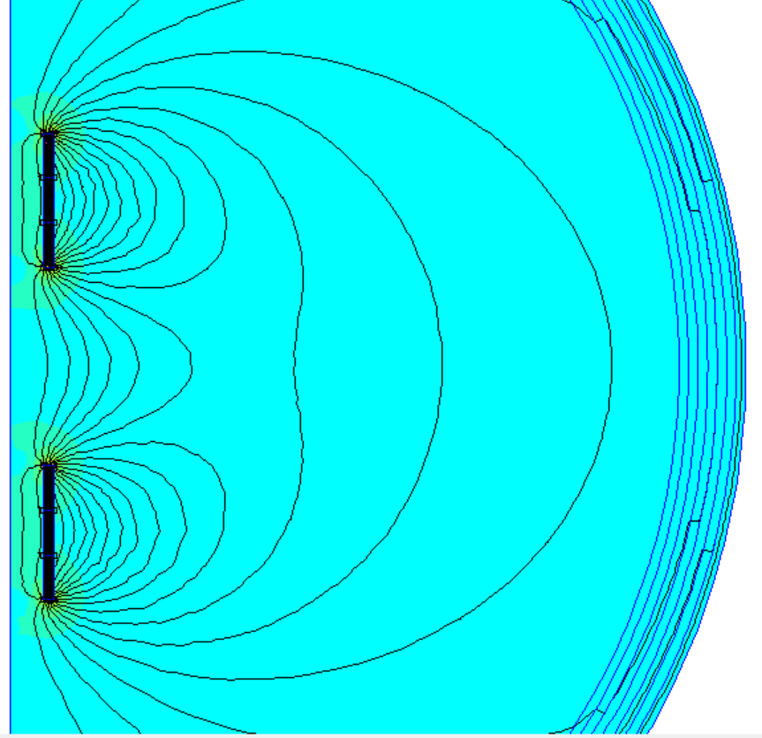
FEMM Analysis

Slide 9
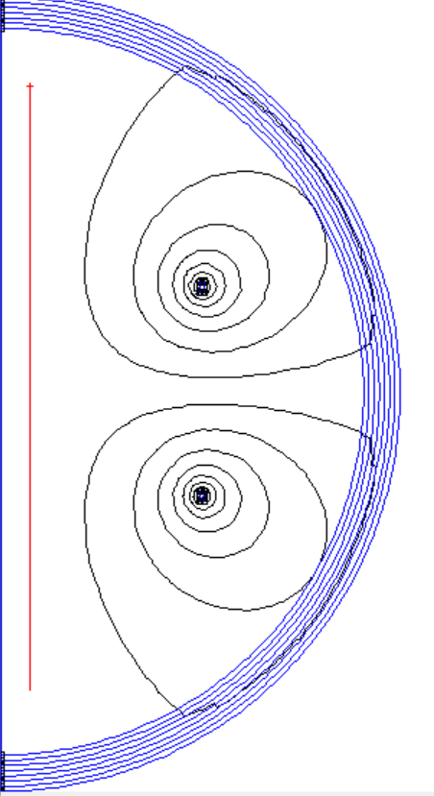
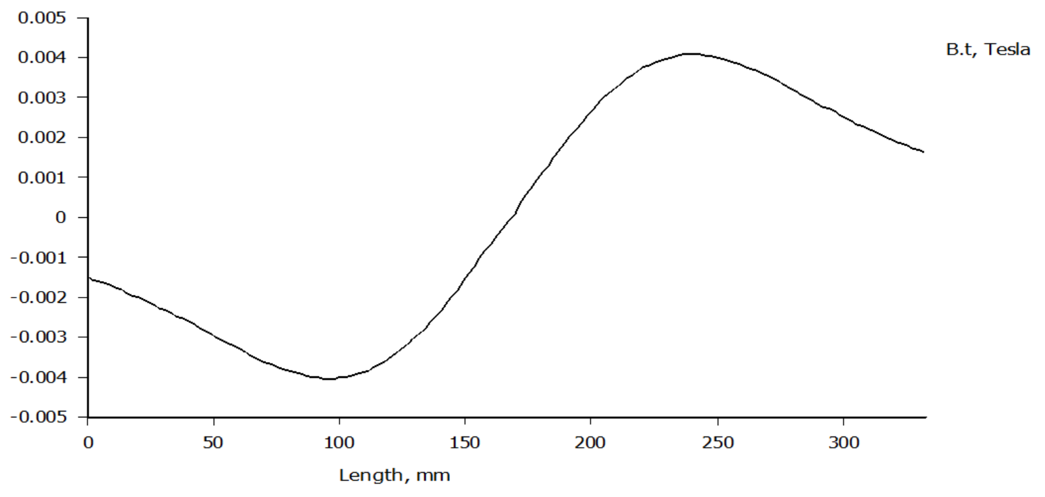
FEMM Analysis

Slide 10
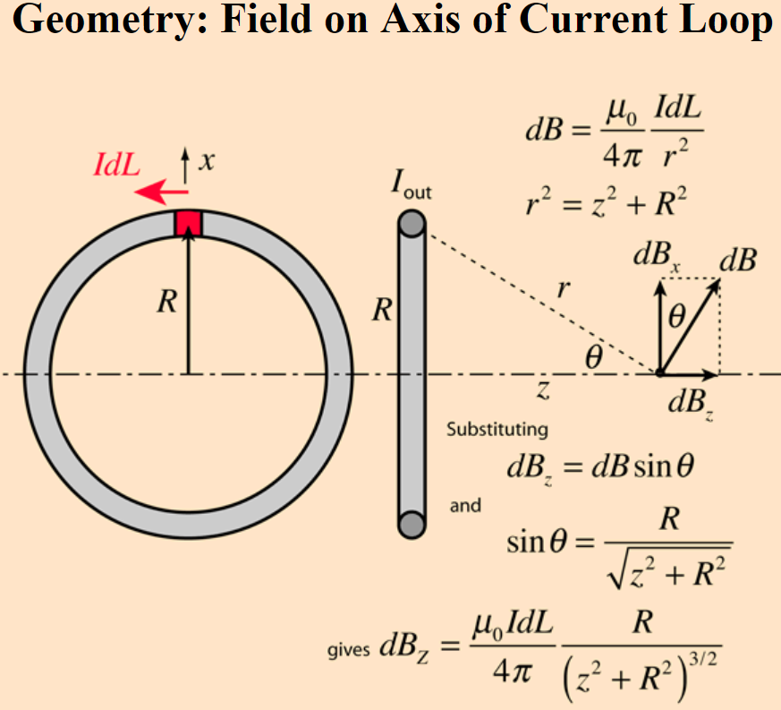
FEMM Analysis
Force acting on magnets in model magnetic field: 0.139545±0.000001N
Magnetic field strength: 87±1mT
Magnetic field strength from Boit-Savart law: 9mT
Magnetic moment of magnets: 20.3±0.2mNmT^-1
Credit: hyperphysics

Slide 11
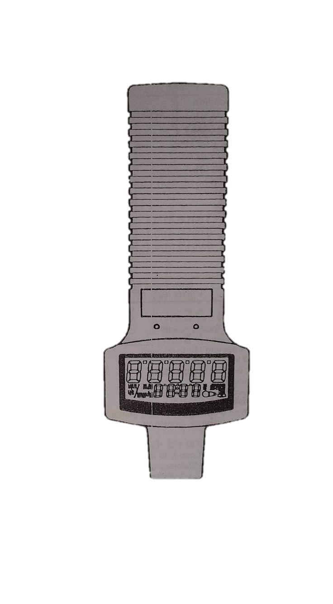
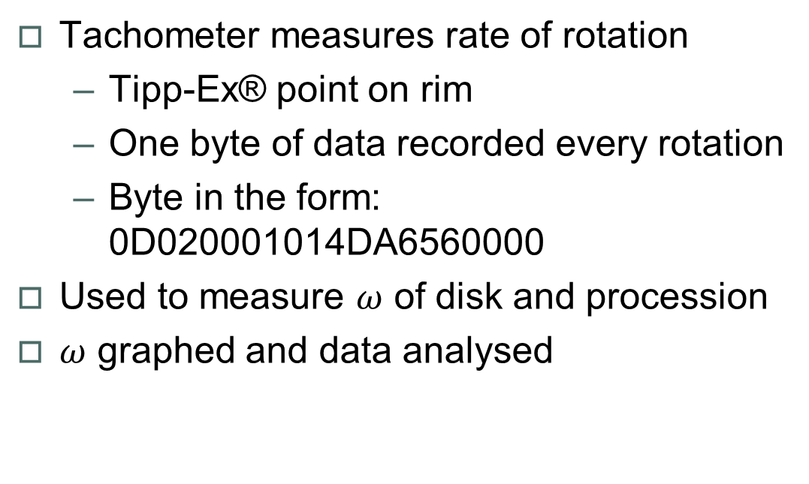
Method - Tachometer
Tachometer measures rate of rotation
Tipp-Ex® point on rim
One byte of data recorded every rotation
Byte in the form: 0D020001014DA6560000
Used to measure $ω$ of disk and procession
$ω$ graphed and data analysed

Slide 12
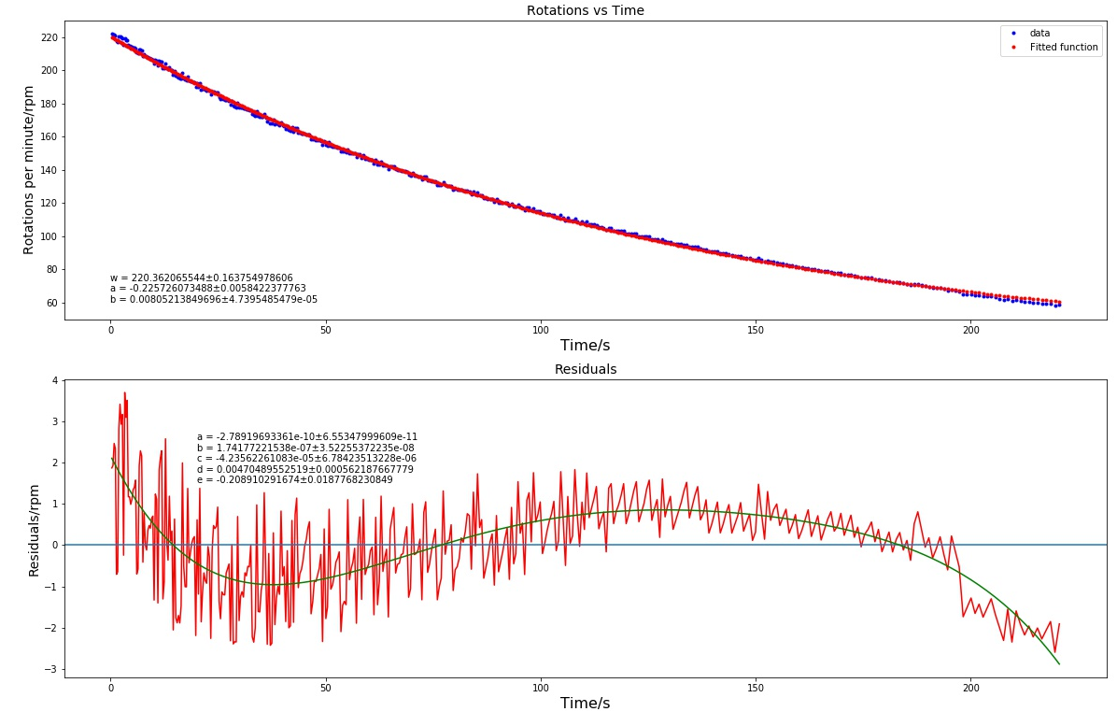

Programming

Slide 13
Data manipulation
Data input: 0D020001014DA6560000
Put data in pairs: ['0D', '02', '00', '01', '01', ’4D', 'A6', ’56’, ’00’, '00']
Keep pairs needed: ['02' '01' 'A6' '56' '00']
Converted to decimal (from hex): [02, 01, 166, 86, 0]
Find rpm (without unit): float(k[2]) + 256*float (k[3]) + 65536*float(k[4]) = 221.82
Create rpm + decimal place: readings.append((value/(10**(int(k[0])/2 +1),int(k[1])))
Get rpm with unit: [(221.82, 1),…] → 221.82 rpm

Slide 14
Graphing the data
Finding time when reading taken: [(221.82, 1),…]
Loop over pairs creating list of times cumulatively adding previous time of measurement
readings.append((float(60/k[0]))) → returns a time → list(accumulate(readings) → summing them up
E.g readings.append(float(60/221.82)) → [0.27, a, b, c] → [0.27, 0.27+a, 0.27+a+b, 0.27+a+b+c, …]
Use an arbitrary fit function: params, pcov = optimize.curve_fit(func, time, velocity)
Plot velocity vs time
Extract fit parameters: standard_deviation = np.sqrt(np.diag(pcov))

Slide 15
Summary
Gyroscope as a model of the cold atom
Plans
Magnet attachment
Results to be taken then analysis

Slide 16
Bibliography
Digital photo tachometer, model: RM-1501, instruction manual, RS Components UK, 2000.
A gyroscope as a way of modelling atomic transitions, project suggestion, Birmingham University School of Physics and Astronomy, 2015.
Bloch, Felix (Oct 1946). "Nuclear induction". Phys. Rev. 70 (7-8): 460–474.
Modelling the motion of a gyroscope and designing and magnetic propulsion system, George Gibbons, 2017, University of Birmingham, School of Physics and Astronomy.
University Physics with modern physics, 13th international edition, Young, Freedman and Ford, 2016, Pearson, pages 328-330.

