Slide 1
R Workshop – Tech
Charlotte Looby, RTI International
June 27, 2023

Slide 2
Topics
Tidyverse (briefly)
Importing CSVs
Formatting data
De-identifying data
Creating summary statistics
Creating graphs using ggplot
Creating tables using kable

Slide 3

What packages will I need?
tidyverse (this contains the readr, stringr, and ggplot2 packages we’ll use)
campfin
kableExtra
Install them like this:
Load them for use like this:

Slide 4

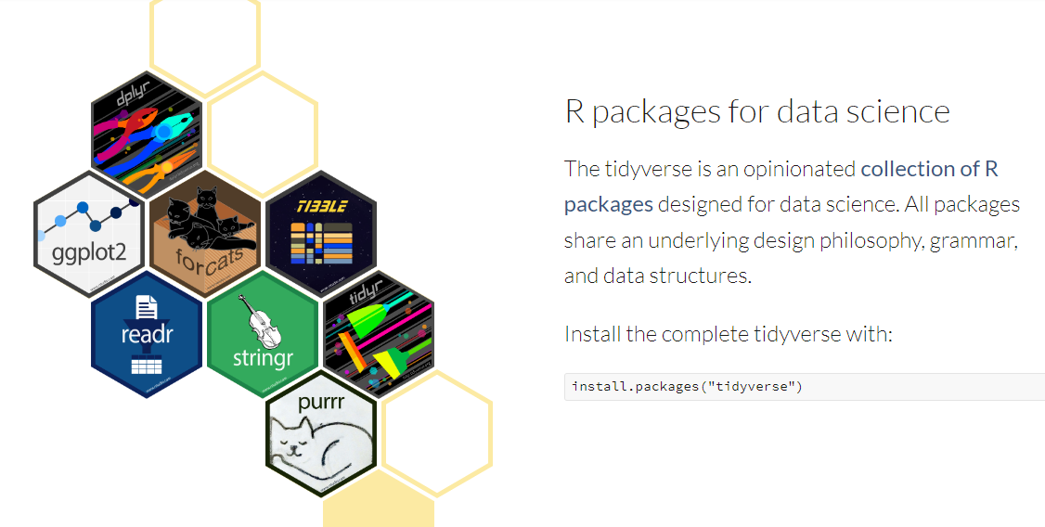
Tidyverse

Slide 5
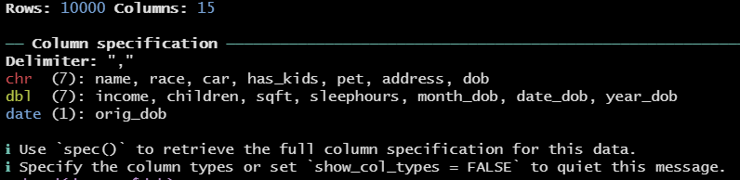
Importing CSVs
Use the read_csv function from the readr package (in tidyverse).
The console will display information about the CSV.

Slide 6
Exercise 0: Install packages and import CSV
Import CSV of dataset we’ll use for exercises from this page:
https://raw.githubusercontent.com/CharlotteLoobyRTI/IFDTC_Materials/main/PII_toydata2.csv

Slide 7

Formatting Data - Dates
Depending on the format, some dates will be read from CSV files as character. These should be converted to classification “Date”.
First, check which format it’s currently in:
Next, use the function as.Date to convert dob to Date classification in new variable dob_new
Check for correct classification.

Slide 8


Formatting Data – Dates cont’d
Now parts of the date can be extracted for use

Slide 9
Formatting Data - Addresses
Standardize format of inconsistent address formats

Slide 10

Formatting Data – Addresses Cont’d
How can we check if all addresses have a valid state?
First, extract state from the address string using the word function
Next, use the %in% function to check if the state is in the state.abb vector
Check if there are any state_valid=FALSE

Slide 11


Formatting Data – Addresses Cont’d
Uh oh, there are invalid states! What are they?
What should “PE” actually be? Check out first few observations where this happens.
“PE” should actually be “PA”. Use ifelse statement to fix.

Slide 12

Formatting Data – Addresses Cont’d
Check that the fixes were done correctly.

Slide 13
Exercise #1: Formatting Data
Format the variable “dob” to be a Date-type variable.
Extract the year from that new date of birth variable. Name it “dob_year”.
Format the variable “address” to be a clearly formatted, “pretty” address.
Extract the state from that formatted address. Name the variable “state”.
Check for valid addresses. Fix any incorrect addresses using an ifelse statement. Check for valid addresses again to make sure it was done properly.

Slide 14
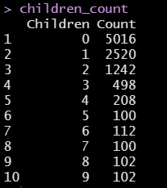
Creating Summary Statistics – Frequency Table
Create frequency table of number of children, including percentage
First, create a data.frame using the table function

Slide 15
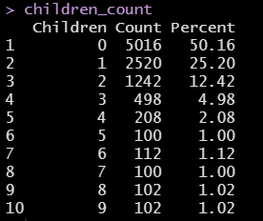
Creating Summary Statistics – Frequency Table cont’d
To add percentage, divide count by number of observations in the dataset, multiply by 100

Slide 16
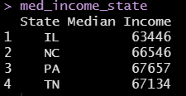
Creating Summary Statistics – Grouped Data
Use aggregate function to get the median income by state, assign names

Slide 17
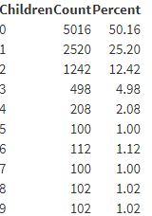
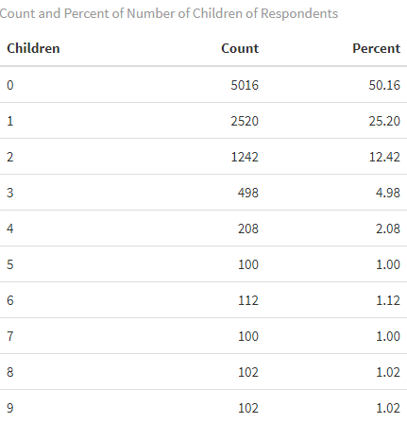
Creating Tables using kable
Create pretty version of children_count

Slide 18
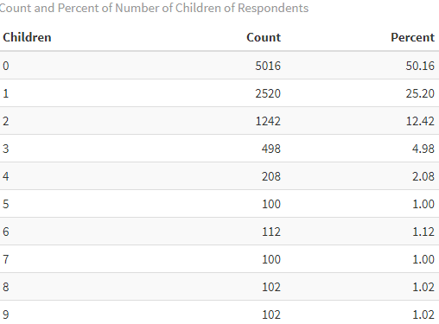
Creating Tables using kable cont’d

Slide 19
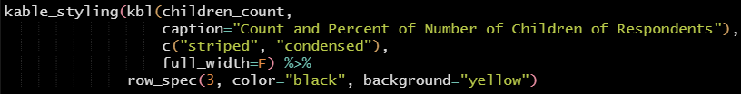
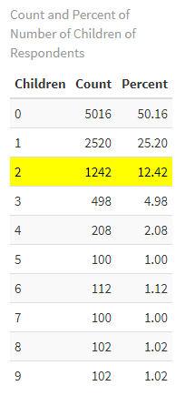
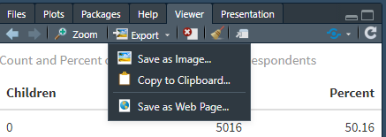
Creating Tables using kable cont’d
Save off your table in the viewer by going to “Export”:

Slide 20
Exercise #2: Summary statistics and kable
Create a frequency table of how many respondents have each type of pet (pet). Include percentage.
Create a table of grouped data that shows the maximum square footage of the respondents’ homes (sqft) within groups of whether the respondents have children (has_kids).
Use kable to create a paper-ready table of either of these tables.

Slide 21
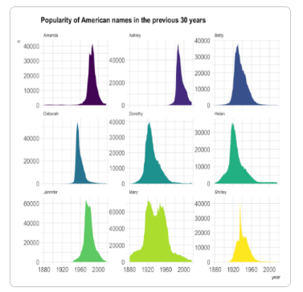
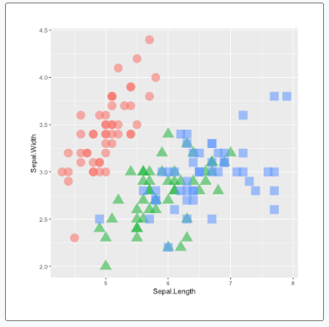
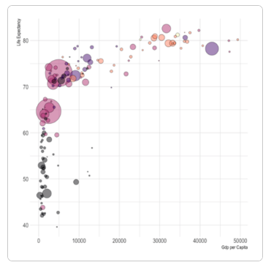
Creating Graphs using ggplot

Slide 22


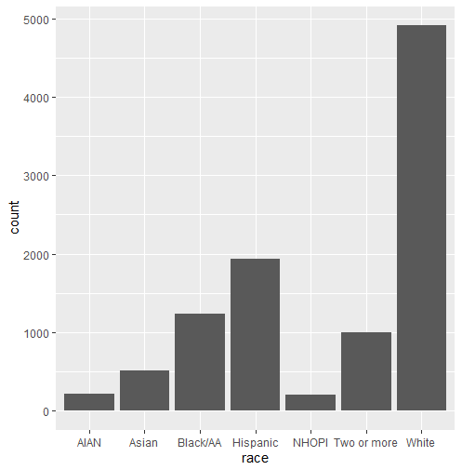
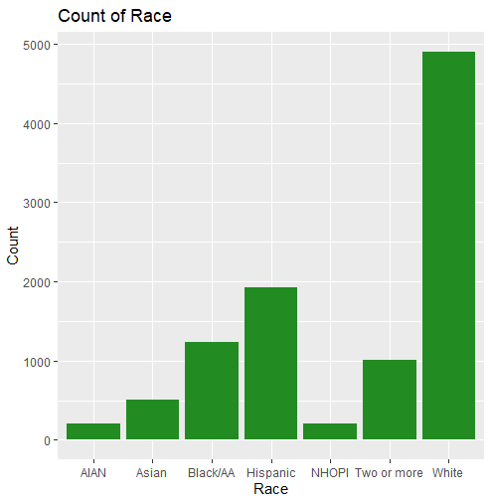
Creating Graphs using ggplot2 cont’d
Bar chart

Slide 23
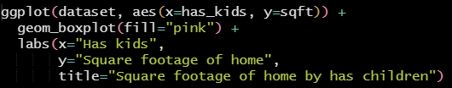
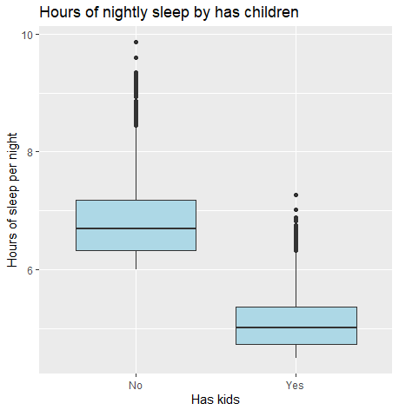
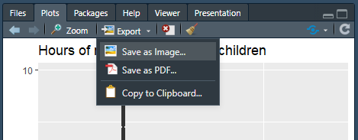
Creating Graphs using ggplot2 cont’d
Box plot with groups
Save off your graph in the viewer by going to “Export” (same as table):

Slide 24
Exercise #3: Create graphs using ggplot2
Create a bar chart of how many respondents have each type of pet (pet).
Create a box plot that groups the square footage of the respondent’s home (sqft) by whether they have children (has_kids).

Slide 25
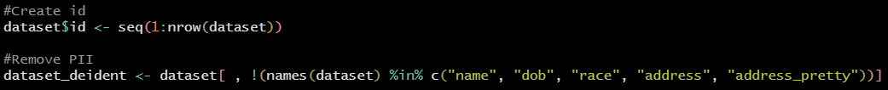
De-identifying Data
Remove any personal identifiable information (PII) using base R:
Check that the variables left are not PII

Slide 26
Exercise #4: De-identify data
De-identify the dataset by removing variables containing PII.

Slide 27
Resources
tidyverse:
kableExtra:
ggplot2:
rmarkdown:

