Slide 1
R 102: Practical Applications of R
R Workshop – Tech
Charlotte Looby, RTI International
June 27, 2023

Slide 2
Topics
Tidyverse (briefly)
Importing CSVs
Formatting data
De-identifying data
Creating summary statistics
Creating graphs using ggplot2
Creating tables using kable

Slide 3

What packages will I need?
tidyverse (this contains the readr, stringr, dplyr, and ggplot2 packages we’ll use)
campfin
kableExtra
Install them like this:
Load them for use like this:

Slide 4

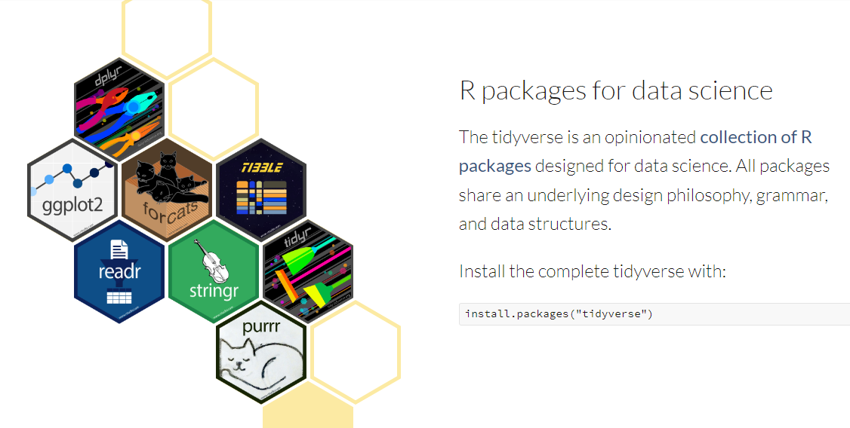
Tidyverse

Slide 5
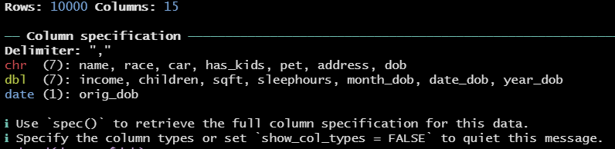
Importing CSVs
Use the read_csv function from the readr package (in tidyverse).
The console will display information about the CSV.

Slide 6
Exercise 0: Install packages and import CSV
Install needed packages (if you haven’t already): tidyverse, campfin, kableExtra
Import CSV of dataset we’ll use for exercises and name the dataset “dataset”.
The filepath can be found on the IFDTC program. Do CTRL+F for “7D”.
The link for “testing data to use during session” will be the input for the read_csv function.

Slide 7

Formatting Data - Dates
Depending on the format, some dates will be read from CSV files as character. These should be converted to classification “Date”. An R “Date” variable will be in the format YYYY-MM-DD.
First, check which format it’s currently in:
Next, use the function as.Date to convert dob to Date classification in new variable dob_new
Check for correct classification.

Slide 8


Formatting Data – Dates cont’d
Now parts of the date can be extracted for use

Slide 9
Formatting Data - Addresses
Standardize format of inconsistent address formats

Slide 10

Formatting Data – Addresses Cont’d
How can we check if all addresses have a valid state?
First, extract state from the address string using the word function
Next, use the %in% function to check if the state is in the state.abb vector
Check if there are any state_valid=FALSE

Slide 11


Formatting Data – Addresses Cont’d
Uh oh, there are invalid states! What are they?
What should “PE” actually be? Check out first few observations where this happens.
“PE” should actually be “PA”. Use ifelse statement to fix.

Slide 12

Formatting Data – Addresses Cont’d
Check that the fixes were done correctly.

Slide 13



Yeah, but how would I do these things the tidyverse way?
Most fundamentally, tidyverse coding uses pipes from the dplyr package (which actually comes from the magrittr package. Get it?)
A pipe looks like this: %>%
Coding happens left-to-right instead of inside-to-out
Inside-to-out coding is akin to: “I arrived at the mall after driving there in my car, in which I fastened my seatbelt.”
Left-to-right coding is more like: “I fastened my seatbelt, then drove my car to the mall.”

Slide 14

Coding the tidyverse way – formatting data using pipes

Slide 15
Exercise #1: Formatting Data
Format the variable “dob” to be a Date-type variable.
Extract the year from that new date of birth variable. Name it “dob_year”.
Format the variable “address” to be a clearly formatted, “pretty” address.
Extract the state from that formatted address. Name the variable “state”.
Check for valid addresses. Fix any incorrect addresses using an ifelse statement. Check for valid addresses again to make sure it was done properly.

Slide 16
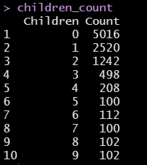
Creating Summary Statistics – Frequency Table
Create frequency table of number of children, including percentage
First, create a data.frame using the table function

Slide 17
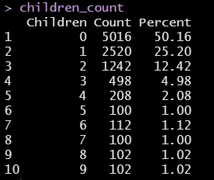

Creating Summary Statistics – Frequency Table cont’d
To add percentage, divide count by number of observations in the dataset, multiply by 100
Or do the whole thing in tidyverse:

Slide 18
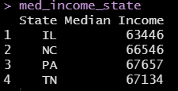

Creating Summary Statistics – Other summary data
Use aggregate function to get the median income by state, assign names
Tidyverse way:

Slide 19
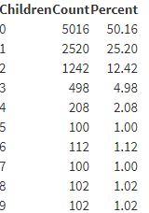
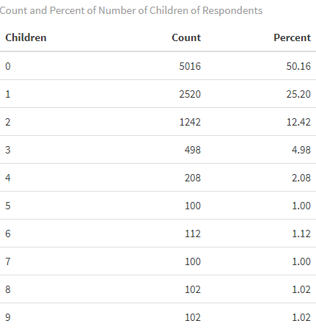
Creating Tables using kable
Create pretty version of children_count

Slide 20
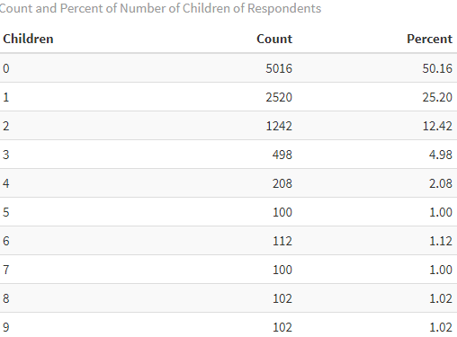
Creating Tables using kable cont’d

Slide 21
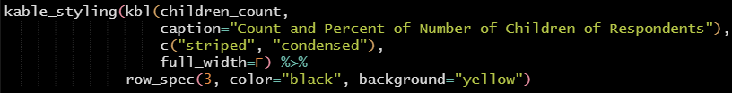
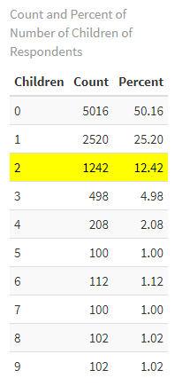
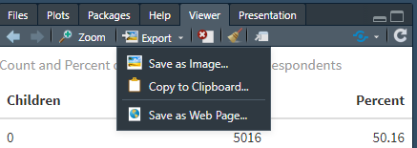
Creating Tables using kable cont’d
Save off your table in the viewer by going to “Export”:

Slide 22
Exercise #2: Summary statistics and kable
Create a frequency table of how many respondents have each type of pet (pet). Include percentage.
Create a table of grouped data that shows the maximum square footage of the respondents’ homes (sqft) within groups of whether the respondents have children (has_kids).
Use kable to create a presentation-ready table of either of these tables.

Slide 23
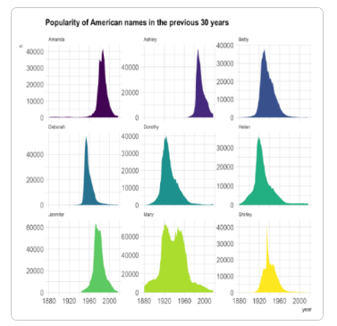
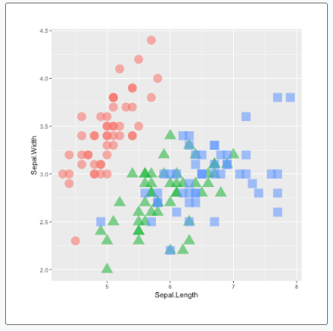
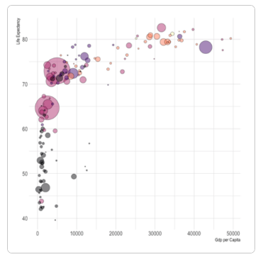
Creating Graphs using ggplot2

Slide 24


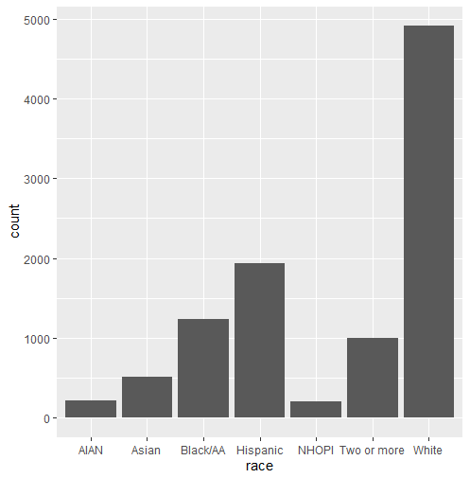
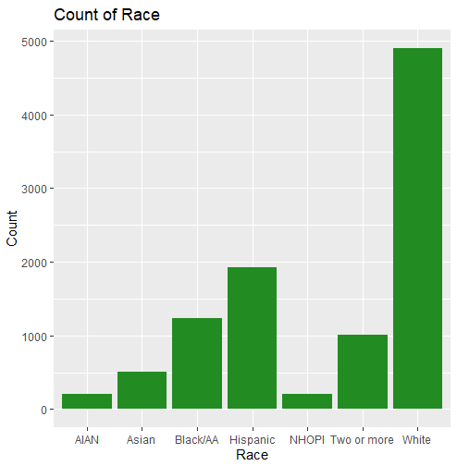
Creating Graphs using ggplot2 cont’d
Bar chart

Slide 25
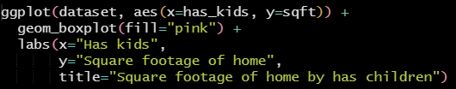
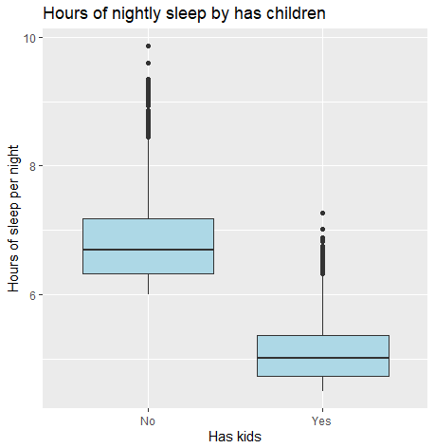
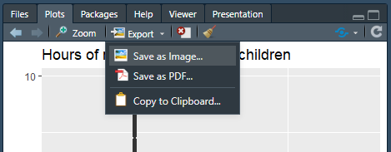
Creating Graphs using ggplot2 cont’d
Box plot with groups
Save off your graph in the viewer by going to “Export” (same as table):

Slide 26
Exercise #3: Create graphs using ggplot2
Create a bar chart of how many respondents have each type of pet (pet).
Create a box plot that groups the square footage of the respondent’s home (sqft) by whether they have children (has_kids).

Slide 27
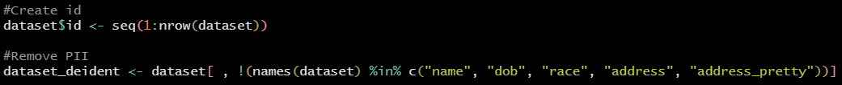

De-identifying Data
Remove any personal identifiable information (PII) using base R:
Check that the variables left are not PII
Tidyverse way!

Slide 28
Exercise #4: De-identify data
De-identify the dataset by removing variables containing PII.

Slide 29
Resources
tidyverse: https://www.tidyverse.org/packages/
This includes information on the other packages that we’ve used within tidyverse (ggplot2, stringr, readr, and dplyr)
kableExtra: https://cran.r-project.org/web/packages/kableExtra/vignettes/awesome_table_in_html.html
Beautiful graphs for inspiration: https://r-graph-gallery.com/
All the R colors neatly displayed: http://www.stat.columbia.edu/~tzheng/files/Rcolor.pdf

