Slide 1
R Workshop – April 23, 2024
Introductions to rmarkdown, tidycensus, and leaflet
Charlotte Looby, clooby@rti.org
Notes:
https://posit.cloud/content/8036479
Charlotte Looby, live in Wilmington NC
Been at RTI over 5 years
Work a lot with ABS, using API, making maps

Slide 2
Do I need to have R downloaded? Where can I find files for this presentation?
It’s recommended to have RStudio downloaded for this workshop, but it’s not necessary.
RStudio is the user-friendly interface for running R, saving programs, and much more
Alternatively, you can use RStudio online in posit’s cloud
Go to https://posit.cloud
Click “get started”
Choose a plan (I like “free”), click “learn more”
Sign up!
In the upper right, click the drop down for “New Project” → “New RStudio Project”.
It would be helpful to have the files pulled up from my GitHub page: https://github.com/CharlotteLoobyRTI/IFDTC24
There’s also a link to this in this morning’s email from Kevin

Slide 3
Who is this workshop for, anyway?
People who…
…don’t know any R
…know some R
…create documents
…use Census or American Community Survey data
…like playing with maps
Topics
Using rmarkdown to knit publish-ready documents
Using tidycensus to access ACS and Census data and corresponding shape files
Using leaflet to create maps

Slide 4
Some notes about R
Open source statistical programming language
Case-sensitive
Reads in packages
Use install.packages(“packagename”) prior to loading with library()

Slide 5
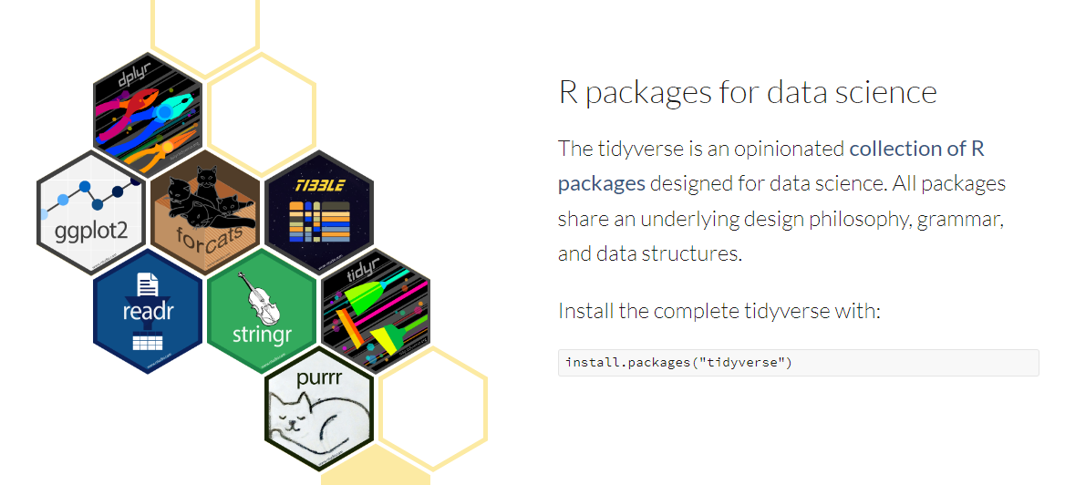
A quick note about tidyverse
tidycensus uses tidyverse packages
Notes:
https://www.tidyverse.org/
Now you go through the R Markdown example. INSTALLING PACKAGES.

Slide 6
Why use rmarkdown?
See your code and its results side-by-side in the .Rmd program
Knit your code chunks together—including text, tables, plots, etc.—to render PDF, MS Word, HTML, or MS PowerPoint files.
Create interactive documents that contain htmlwidgets or Shiny components.
Create dashboards, websites, and more
Examples: https://rmarkdown.rstudio.com/gallery.html
Notes:
Jump into example. This is when you run the R_script_example program and walk through a Markdown document
If you’re using posit cloud, new project upper right hand corner → RStudio project
What the different windows mean

Slide 7
Let’s get started!
Once you’re looking at a fresh RStudio session, go to File → New File → R Markdown
You may be prompted to install packages

Slide 8
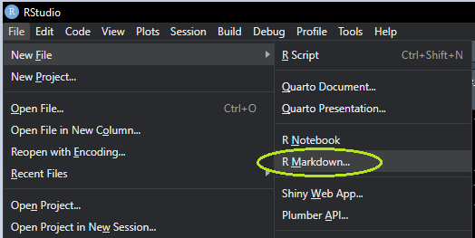

Slide 9
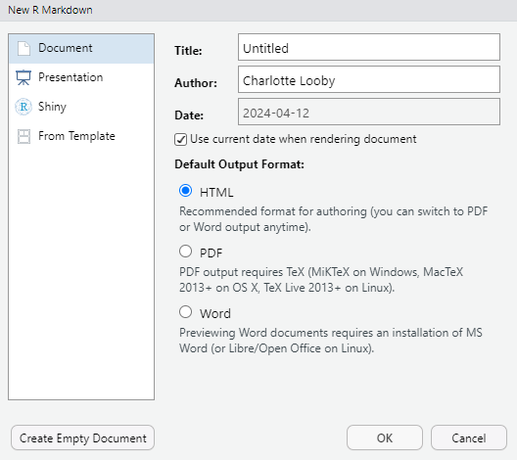
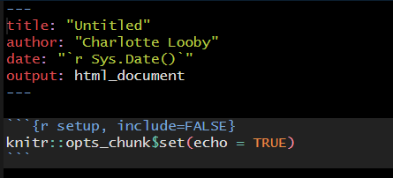

Slide 10
tidycensus
Accesses a few of the Census Bureau’s data APIs
American Community Survey
Decennial Census
Variables able to be used found using load_variables()
Geography available, useful for mapping
Request a Census API key: https://api.census.gov/data/key_signup.html
Notes:
***DON’T GO TO NEXT SLIDE WITHOUT DISCUSSING TIDYVERSE***
Kyle Walker
Application Programming Interface
The Census Data API is a data service that enables developers, data scientists, and others to access and use statistical data from the American Community Survey (ACS), decennial census, Population Estimates.
500 calls to the API before you need a key.

Slide 11
Exercise 1
Knit an HTML document that produces a table of median income of each Ohio county, by ascending median income
In the lookup_ACS dataset, look for “median income” (hint: variables with “PR” in the name only apply to Puerto Rico)

Slide 12
Making interactive maps with leaflet
Use shape files and lat/longs to make maps
Add layers like tiles, markers, popups, etc.
Interactive features zooming, clusters, and the like

Slide 13
Exercise 2
Create a map of Ohio counties, with color indicating median income (use program started for Exercise 1, add on to it)
Recommend pulling from ACS API again to include geometry just for the graph. Kable doesn’t like creating tables with geometries in them.
If using RStudio on PC, knit
If using RStudio in the posit cloud, don’t knit

Slide 14
References
rmarkdown
Website: https://rmarkdown.rstudio.com/
Cheat sheet: https://posit.co/blog/the-r-markdown-cheat-sheet/
tidycensus
Website: https://walker-data.com/tidycensus/
Basic usage: https://walker-data.com/tidycensus/articles/basic-usage.html
leaflet: https://rstudio.github.io/leaflet/
RColorBrewer
Color palettes: https://r-graph-gallery.com/38-rcolorbrewers-palettes.html
Different types of custom palettes: https://rstudio.github.io/leaflet/articles/colors.html
R Graph Gallery book (intro to data visualization in R): https://bookdown.org/content/b298e479-b1ab-49fa-b83d-a57c2b034d49/

Slide 15

Thank you
Contact: Name| email: person@rti.org

