Slide 1

Twitter Sentiment Analysis

Slide 2
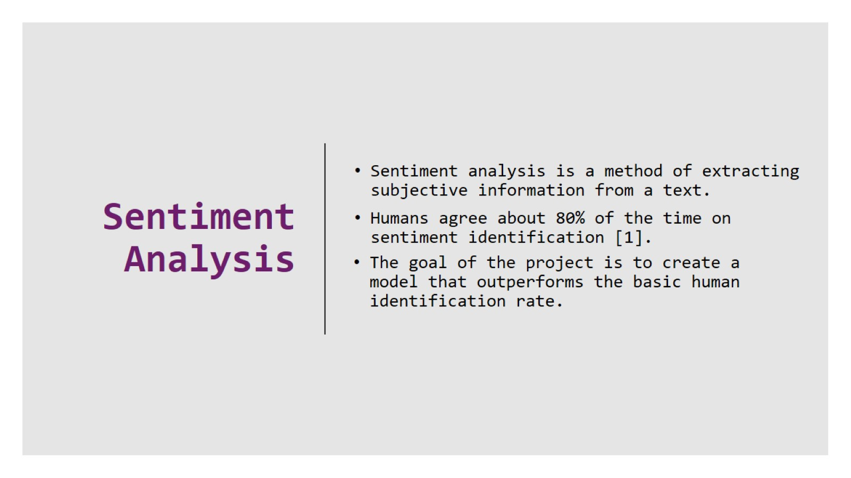
Sentiment Analysis

Slide 3

Project Design

Slide 4
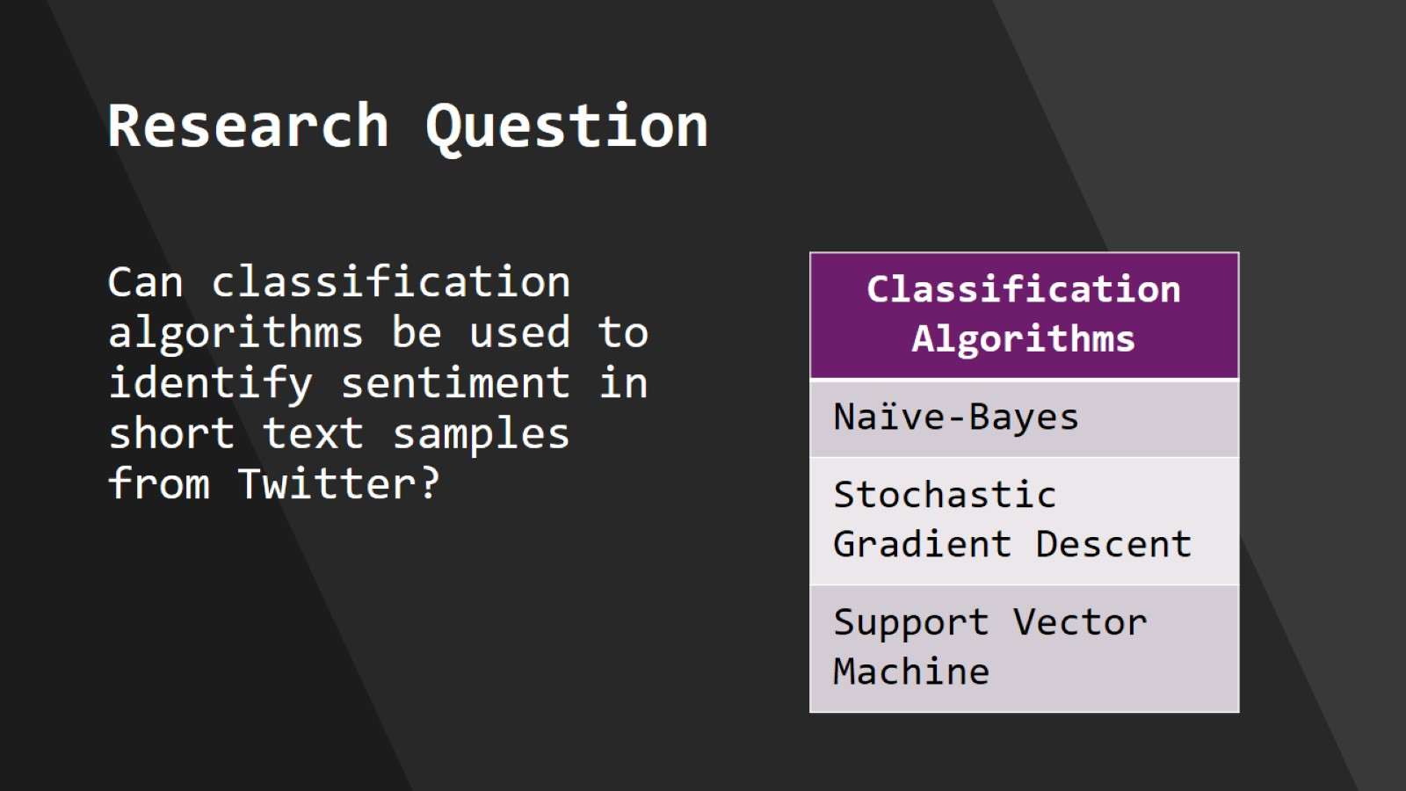
Research Question

Slide 5
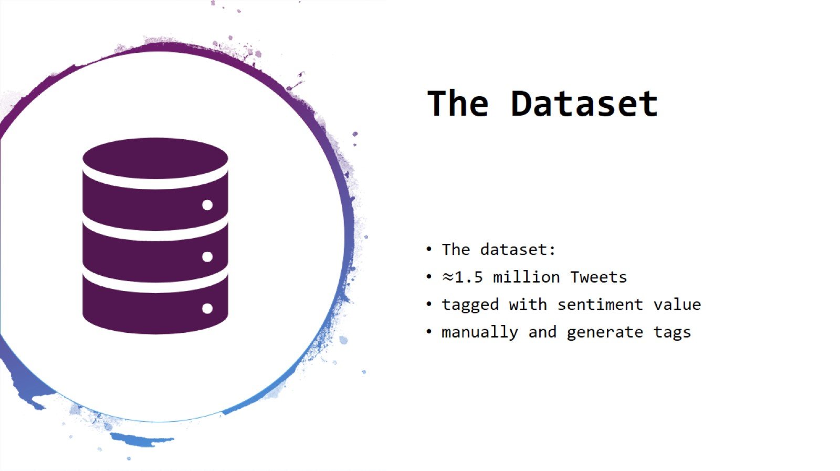
The Dataset

Slide 6
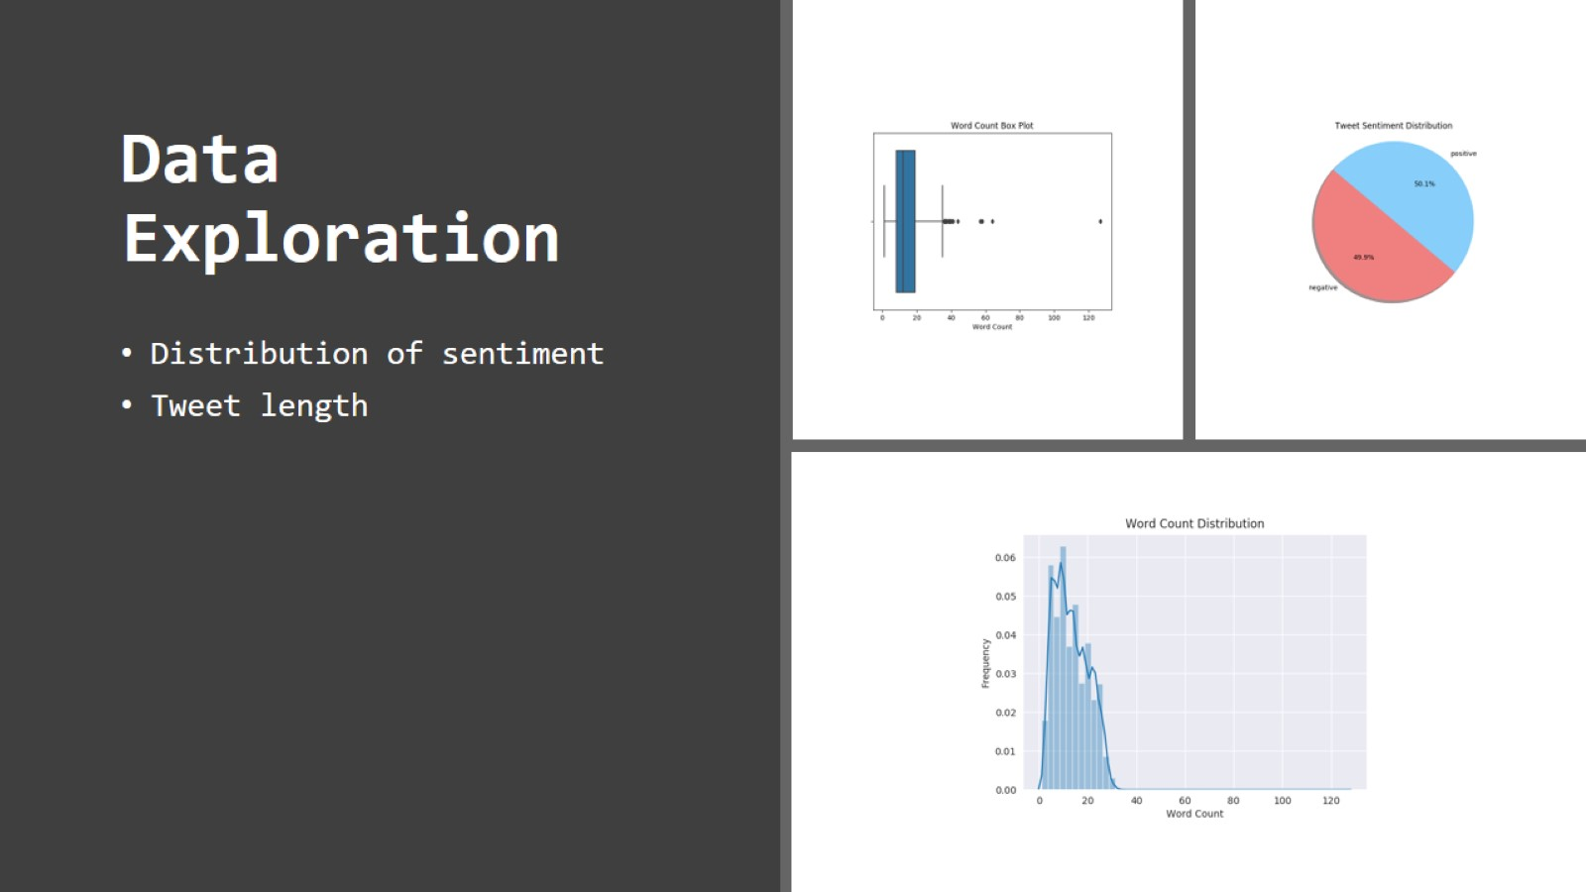
Data Exploration

Slide 7
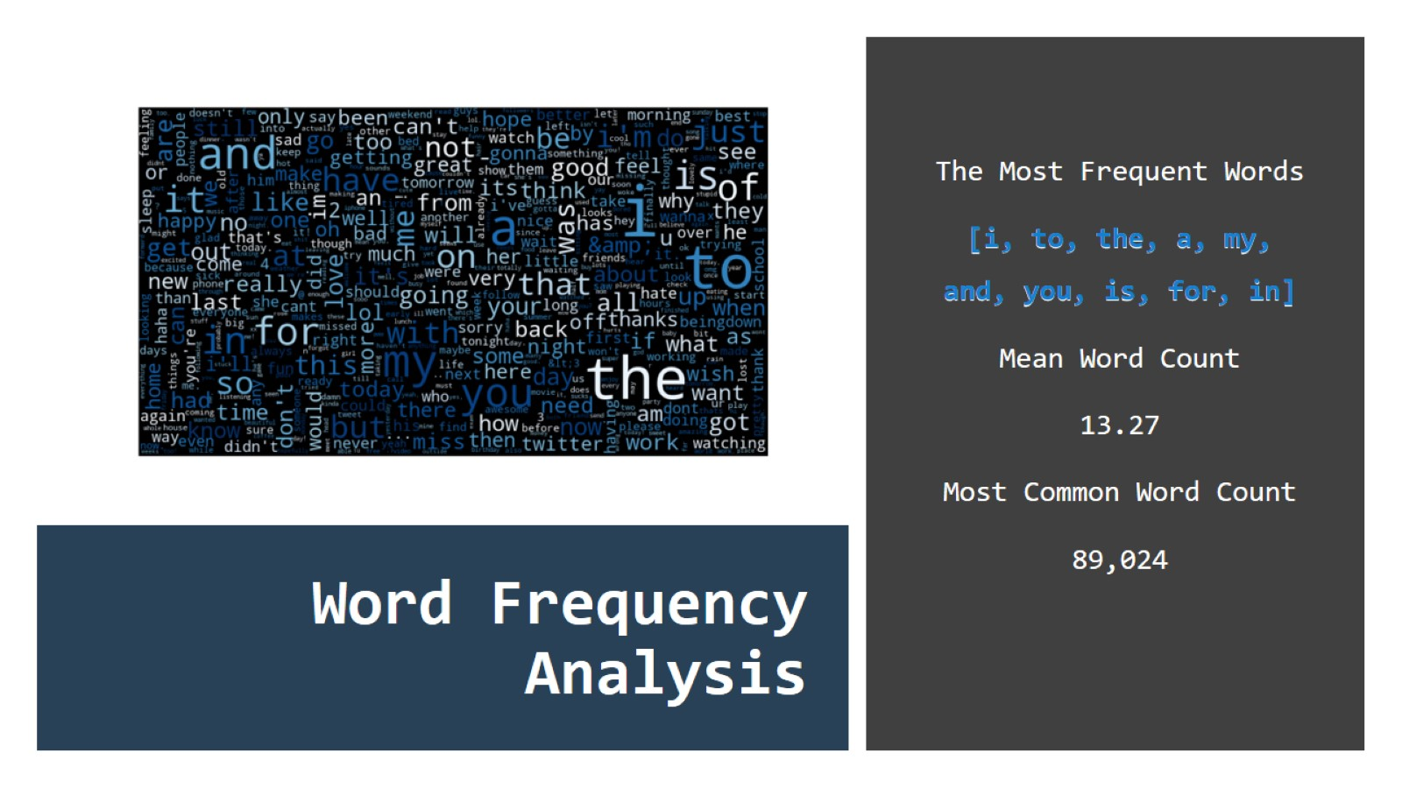
Word Frequency Analysis

Slide 8
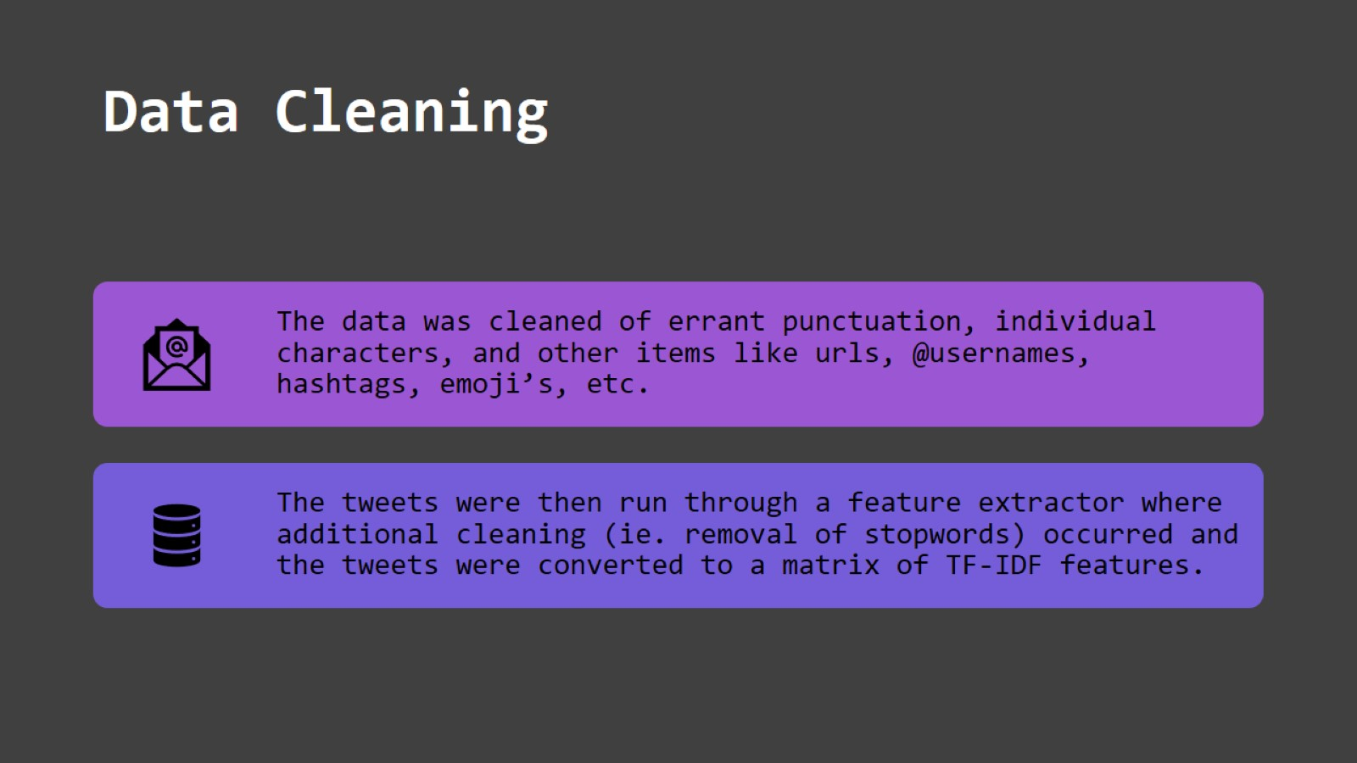
Data Cleaning

Slide 9
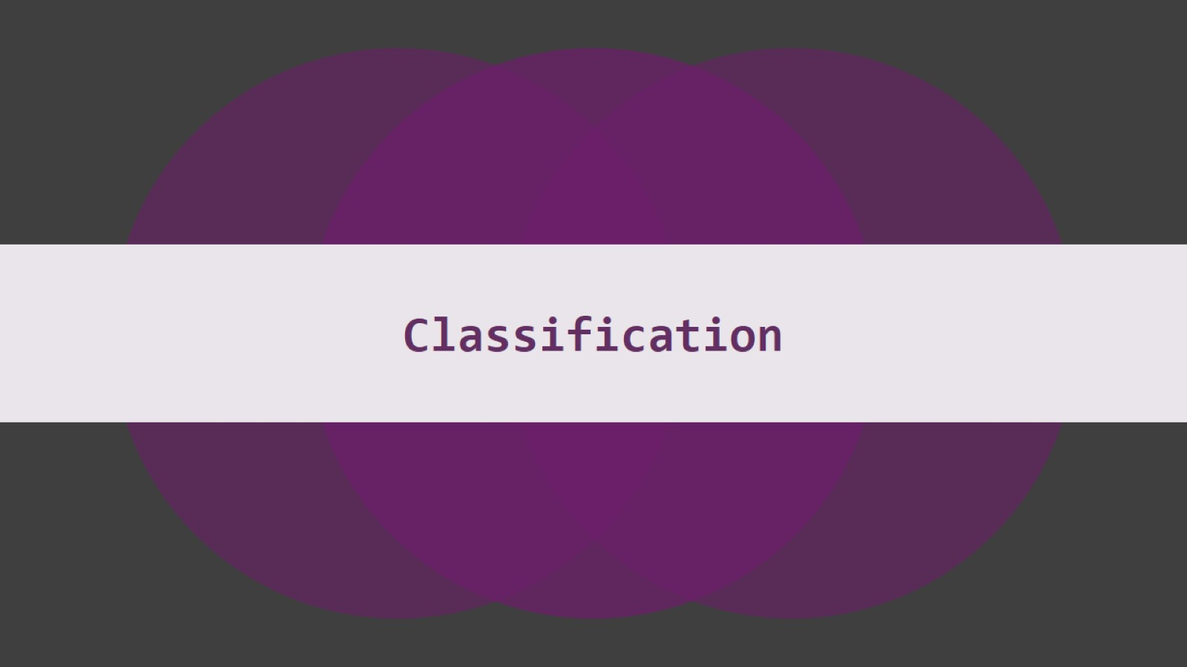
Classification

Slide 10
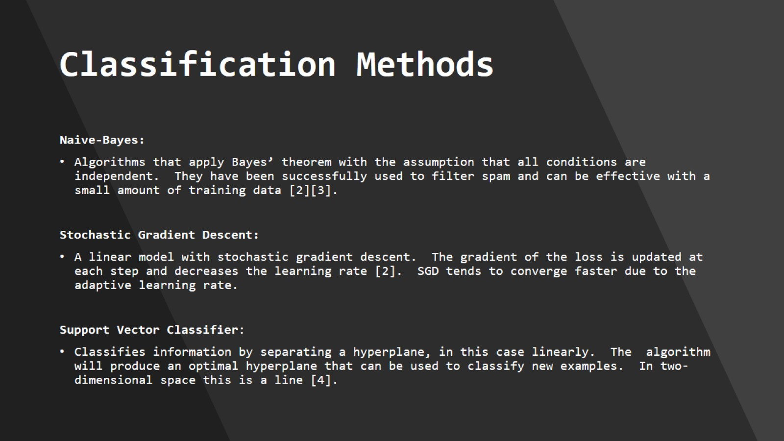
Classification Methods

Slide 11

Tools

Slide 12

Results

Slide 13
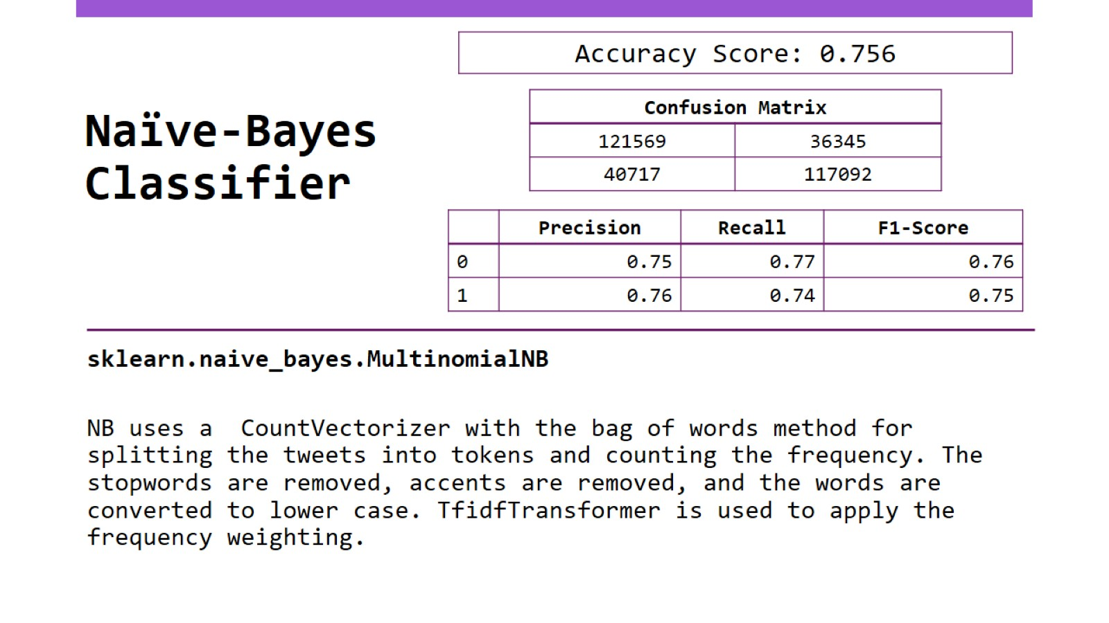
Naïve-Bayes Classifier

Slide 14
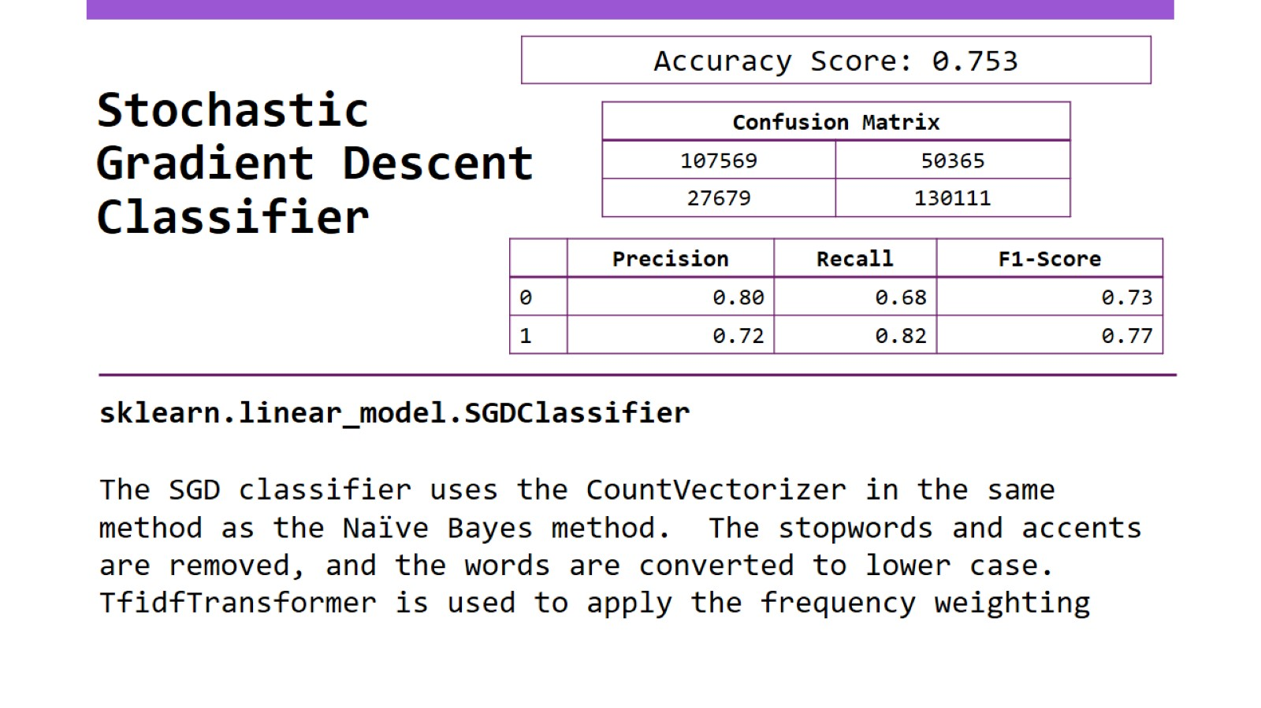
Stochastic Gradient Descent Classifier

Slide 15
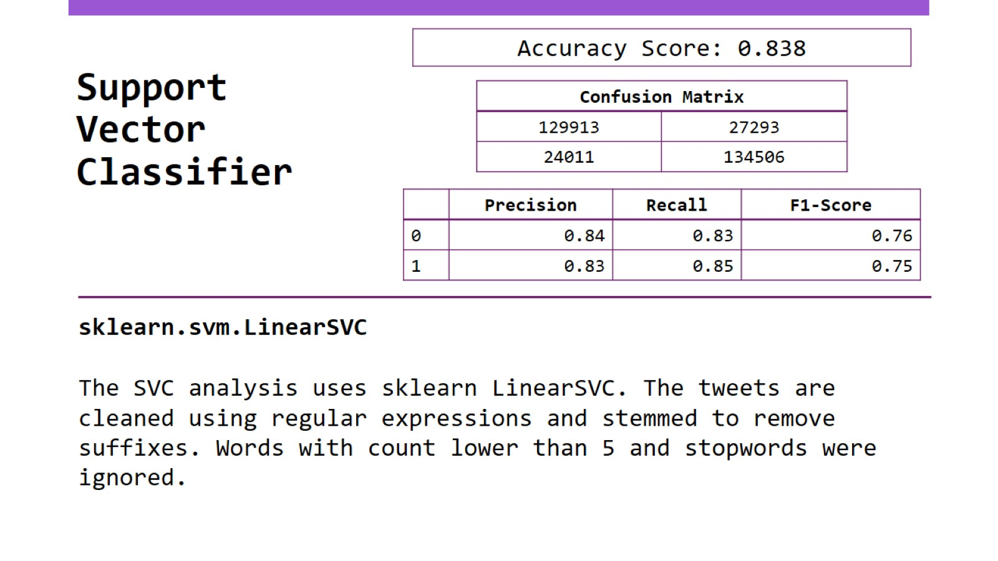
Support Vector Classifier

Slide 16
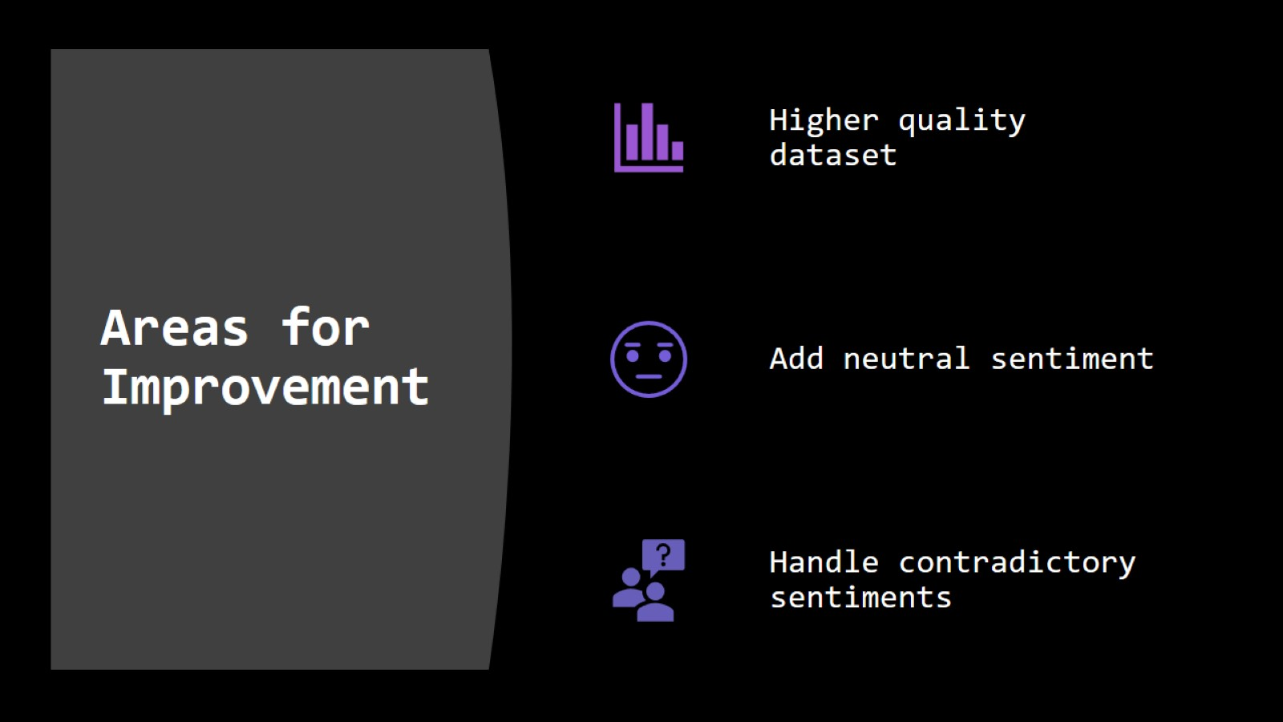
Areas for Improvement

Slide 17
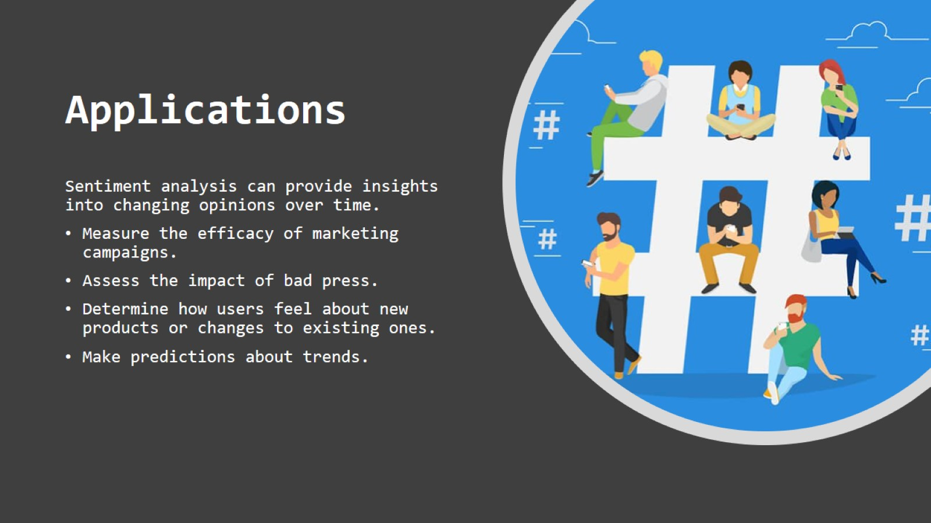
Applications

Slide 18

Thank you for listening.

Slide 19
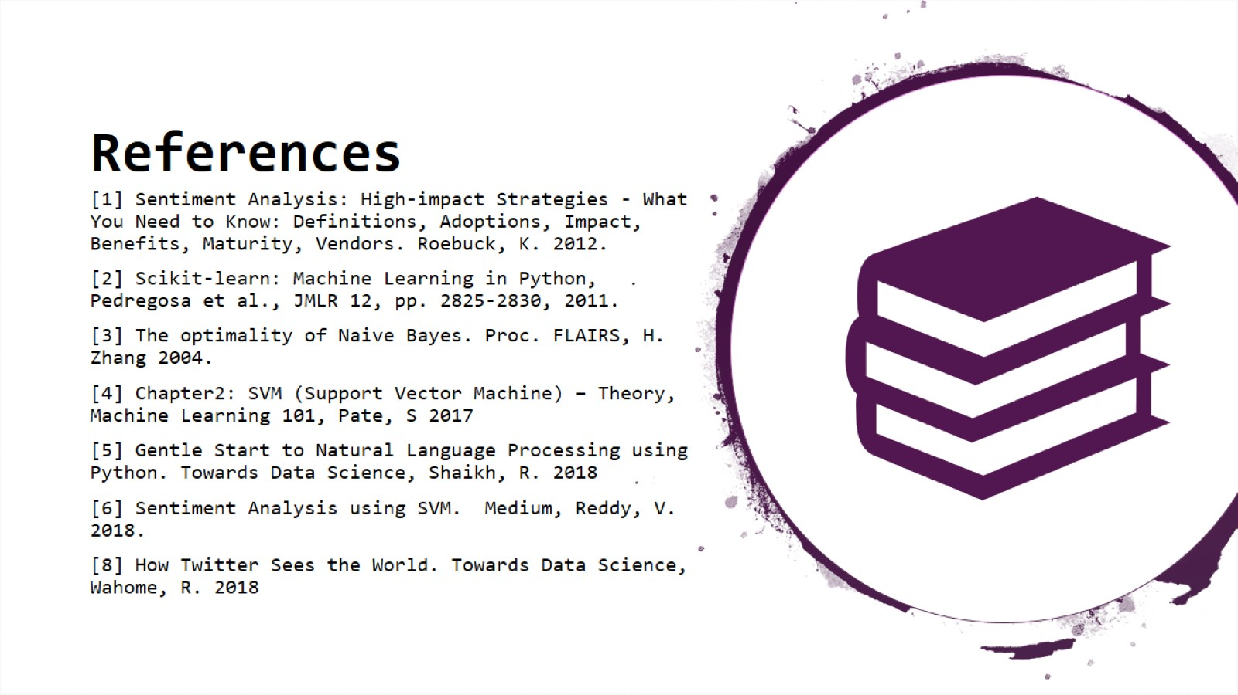
References

