Slide 1
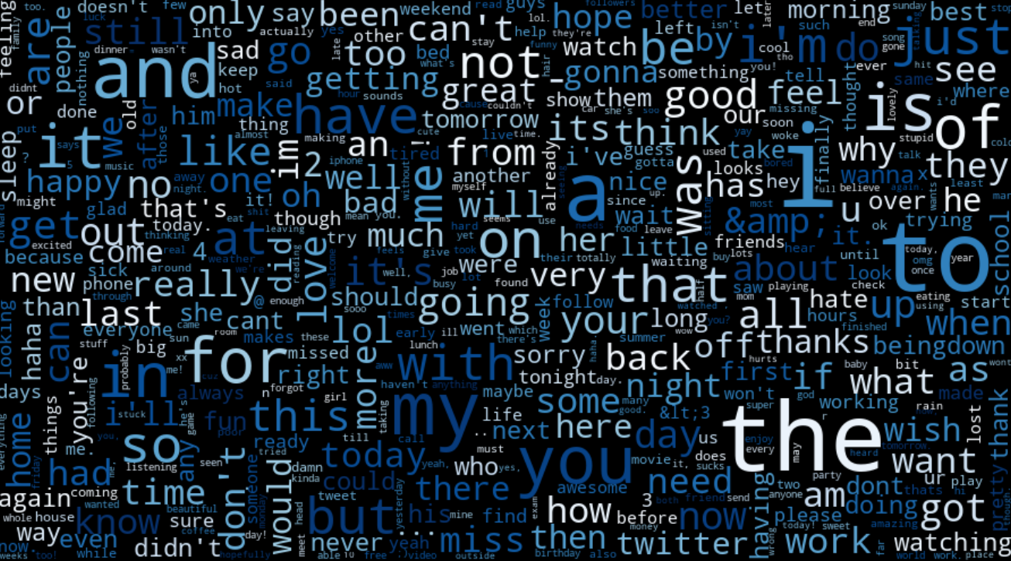
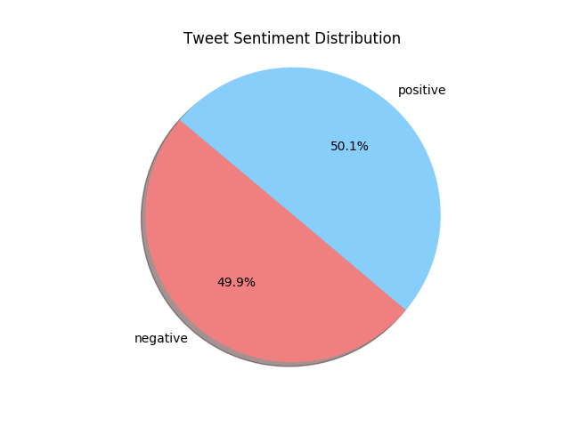
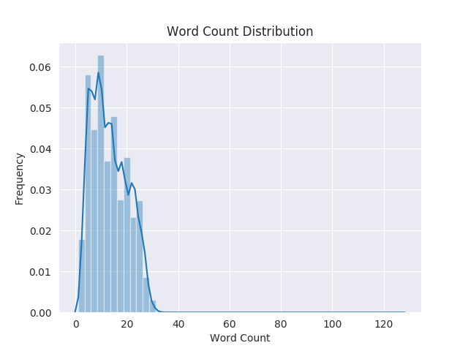
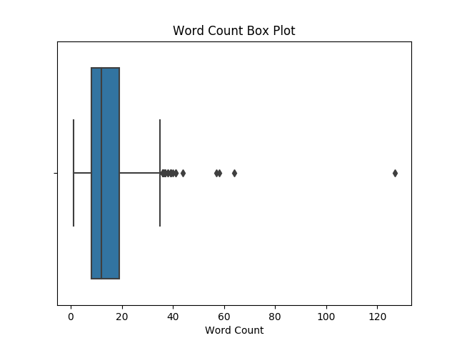
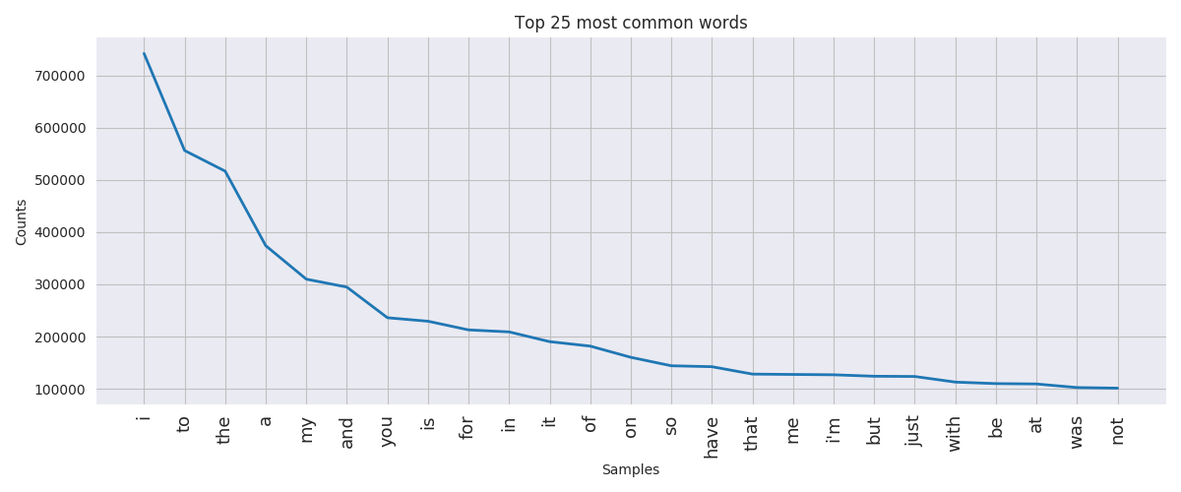
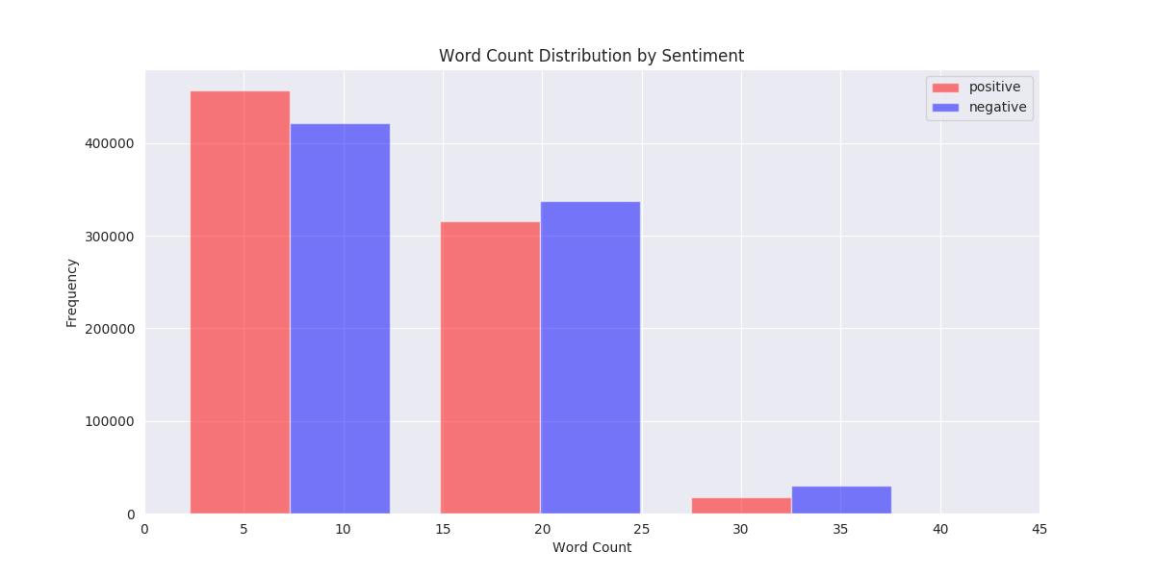
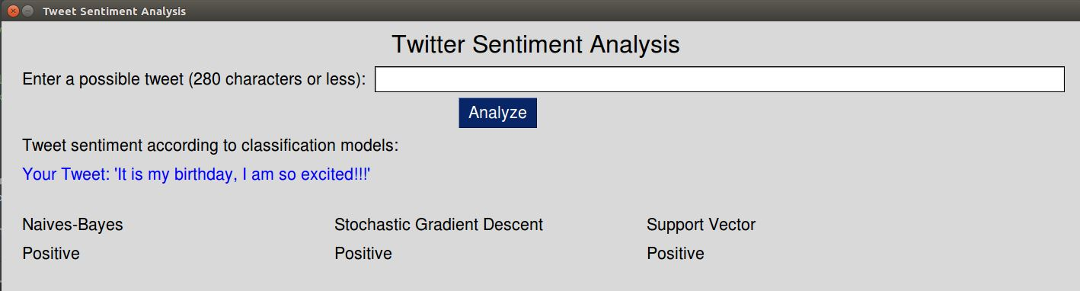
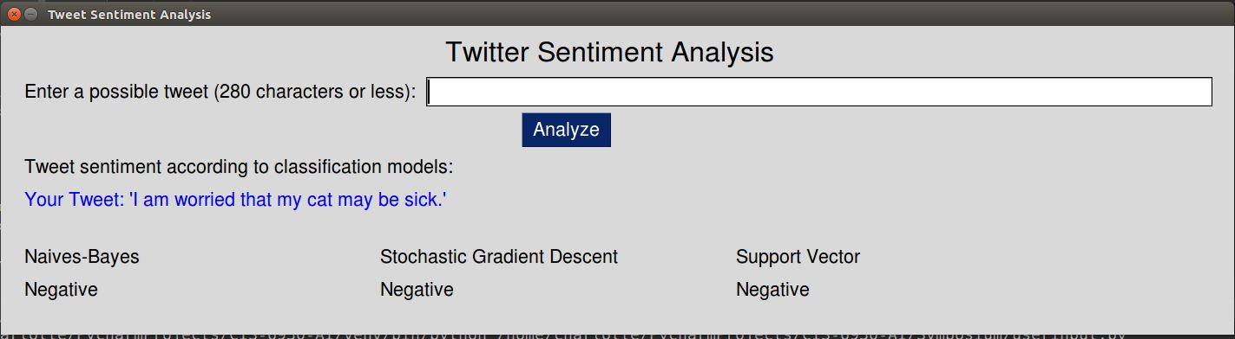





Twitter Sentiment Analysis
Charlotte Morrison
University of North Florida, College Jacksonville, FL USA 32224
INTRODUCTION
Data Exploration
DATA PREPROCESSING
Sentiment analysis is a method of extracting subjective information from a text. In this project, the goal is to determine if the text of a tweet is either positive or negative in nature. Humans agree about 80% of the time on a sentiment identification [1], so the goal is to create a model that can identify sentiment at or above the human recognition rate.
This project implements several Python libraries including the Natural Language Toolkit for text processing, Scikit-Learn for classification, PySimpleGUI for user interfaces, and Matplotlib for data visualizations.
The dataset consists of over 1.5 million tweets including manually and generated tags.
Word cloud of the most frequent words.
The data contained errant punctuation, individual characters, and other items like urls, @usernames, hashtags, emoji’s, etc. These were removed using regular expression checks prior to the sklearn preprocessing.
The tweets were then run through a feature extractor where additional cleaning (ie. removal of stopwords) occurred and the tweets were converted to a matrix of TF-IDF features.
The data is approximately evenly split by sentiment.
The most frequent words in the dataset are:
[i, to, the, a, my, and, you, is, for, in]
These common words are not particularly useful in classifying a tweet and will be removed using NLTK stopwords list in preprocessing.
The mean number of words per tweet is 13.27 with the most common 7 words appearing 89024 times.
Most tweets contained below 30 words. The right skew suggests some outlier values.
The box plot showed there were 14 values that could be considered outliers. These values were investigated further and contained single characters spaced such that they registered as words. These will be removed during preprocessing as they provide little valuable content.
CONCLUSIONS
The project was able to correctly classify short text phrases but could benefit from an additional category for ‘neutral’ tweets. Sentiment analysis could provide insights into changing opinions over time or be used as a tool for writing communications. Below is a small implementation of the models where a user can test the sentiment of their tweet.
Classification Methods
Naive-Bayes:
Algorithms that apply Bayes’ theorem with the assumption that all conditions are independent. They have been successfully used to filter spam and can be effective with a small amount of training data [2][3].
Stochastic Gradient Descent:
A linear model with stochastic gradient descent. The gradient of the loss is updated at each step and decreases the learning rate [2]. SGD tends to converge faster due to the adaptive learning rate.
Support Vector Classifier:
Classifies information by separating a hyperplane, in this case linearly. The algorithm will produce an optimal hyperplane that can be used to classify new examples. In two-dimensional space this is a line [4].
CLASSIFICATION MODELS / RESULTS
Naive-Bayes
Classifier
Stochastic Gradient Descent
Support Vector Classifier
sklearn.naive_bayes.MultinomialNB
NB uses a CountVectorizer with the bag of words method for splitting the tweets into tokens and counting the frequency. The stopwords are removed, accents are removed, and the words are converted to lower case. TfidfTransformer is used to apply the frequency weighting.
sklearn.linear_model.SGDClassifier
The SGD classifier uses the CountVectorizer in the same method as the Naïve Bayes method. The stopwords and accents are removed, and the words are converted to lower case. TfidfTransformer is used to apply the frequency weighting
sklearn.svm.LinearSVC
The SVC analysis uses sklearn LinearSVC. The tweets are cleaned using regular expressions and stemmed to remove suffixes. Words with count lower than 5 and stopwords were ignored.
REFERENCES
[1] Sentiment Analysis: High-impact Strategies - What You Need to Know: Definitions, Adoptions, Impact, Benefits, Maturity, Vendors. Roebuck, K. 2012.
[2] Scikit-learn: Machine Learning in Python, Pedregosa et al., JMLR 12, pp. 2825-2830, 2011.
[3] The optimality of Naive Bayes. Proc. FLAIRS, H. Zhang 2004.
[4] Chapter2: SVM (Support Vector Machine) – Theory, Machine Learning 101, Pate, S 2017
[5] Gentle Start to Natural Language Processing using Python. Towards Data Science, Shaikh, R. 2018
[6] Sentiment Analysis using SVM. Medium, Reddy, V. 2018.
[8] How Twitter Sees the World. Towards Data Science, Wahome, R. 2018
Accuracy Score: 0.756
Accuracy Score: 0.753
Accuracy Score: 0.838
Confusion Matrix
121569 | 36345
40717 | 117092
Confusion Matrix
107569 | 50365
27679 | 130111
Confusion Matrix
129913 | 27293
24011 | 134506
 | Precision | Recall | F1-Score
0 | 0.75 | 0.77 | 0.76
1 | 0.76 | 0.74 | 0.75
 | Precision | Recall | F1-Score
0 | 0.80 | 0.68 | 0.73
1 | 0.72 | 0.82 | 0.77
 | Precision | Recall | F1-Score
0 | 0.84 | 0.83 | 0.76
1 | 0.83 | 0.85 | 0.75

