Slide 1


HAND POSE PREDICTION DRIVEN BY
MOTONEURON SYNERGIES
Charlotte Ludovica Primiceri
A.A. 25/26
Thesis Supervisor
Prof.ssa Marilena Vendittelli
Co-Advisors
Prof.ssa Jlenia Toppi
Dott.ssa Emma Colamarino
Dr. Emanuele De Santis
Tutti i diritti relativi al presente materiale didattico ed al suo contenuto sono riservati a Sapienza e ai suoi autori (o docenti che lo hanno prodotto). È consentito l'uso personale dello stesso da parte dello studente a fini di studio. Ne è vietata nel modo più assoluto la diffusione, duplicazione, cessione, trasmissione, distribuzione a terzi o al pubblico pena le sanzioni applicabili per legge
Notes:
‹#›

Slide 2
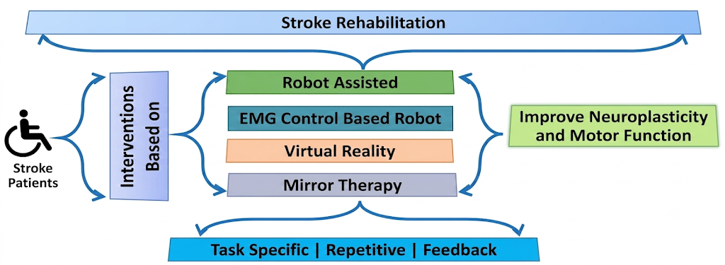
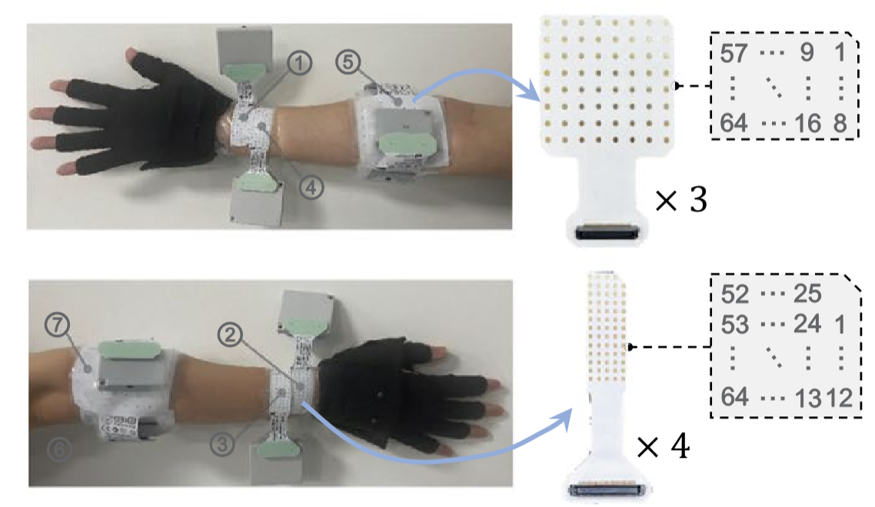
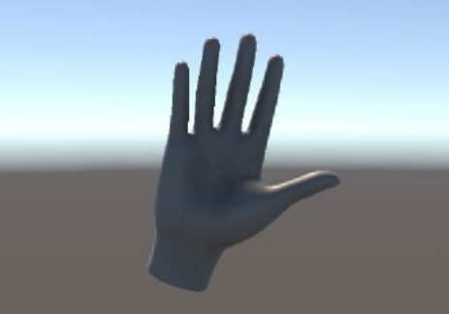
Transradial Post Stroke Rehabilitation Solutions
sEMG Features
Deep Regression Model
Continuous Joint Angles
Fig.1 “Maximizing stroke recovery with advanced technologies: A comprehensive assessment of robot-assisted, emg-controlled robotics, virtual reality, and mirror therapy interventions” Amin et al., 2024
sEMG ENABLES INTENTION DRIVEN CONTROL
⇒ Real Time Responsiveness < 300 ms
HAND POSE PREDICTION DRIVEN BY MOTONEURON SYNERGIES

Slide 3
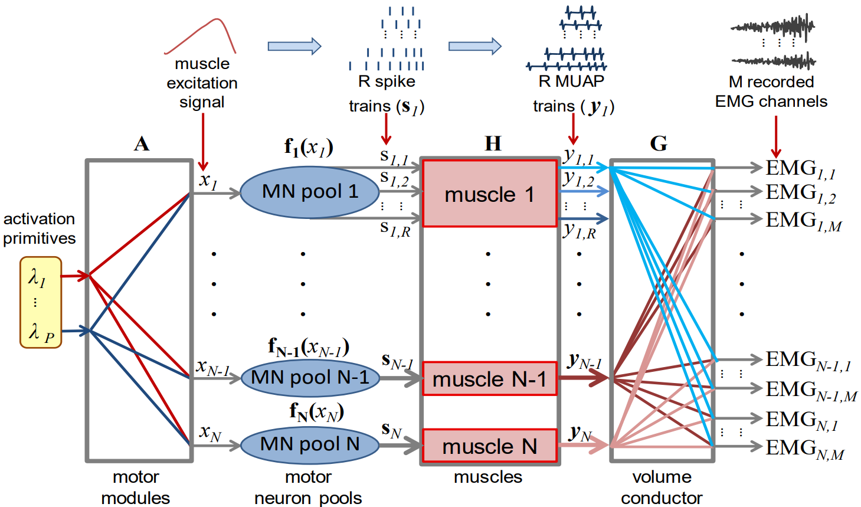

From Traditional Pattern Recognition to HD-sEMG
Sparse sEMG Pattern Recognition
- Time/Frequency Features Extraction
- Macroscopic Averaged Representation
of Muscle Activity
- Steady Contractions
High Density sEMG Convolutive Mixing Model
Fig.2 “Blind source identification from the multichannel surface electromyogram” Holobar and Farina (2014)
MUST : Motor Unit Spike Train
MUAP : Motor Unit Action Potential
HAND POSE PREDICTION DRIVEN BY MOTONEURON SYNERGIES

Slide 4
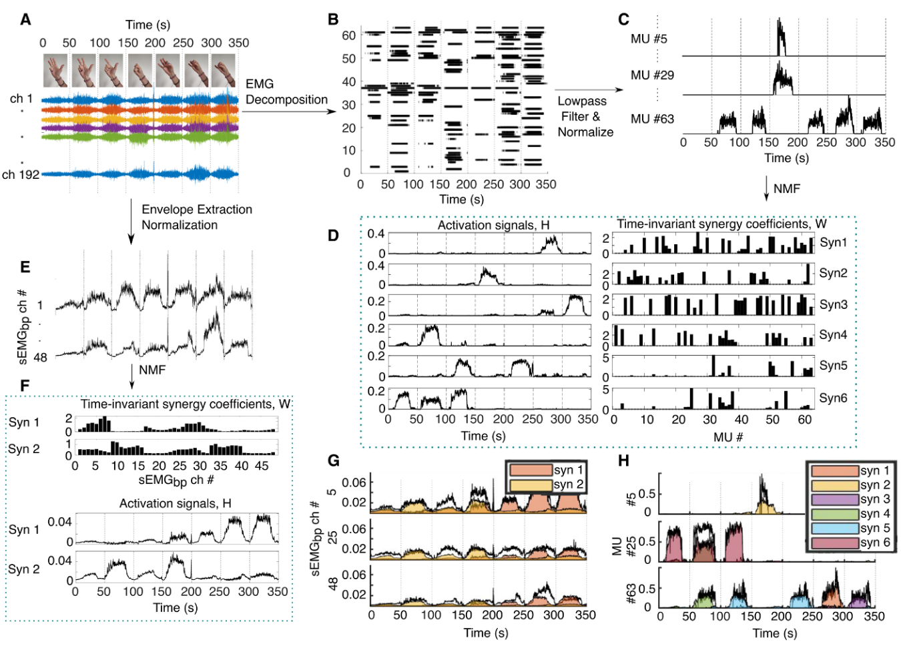


Motor Redundancy and Synergy Hypothesis
The CNS simplifies hand control by grouping Degrees of Freedom into functional synergies.
Muscle Synergies
Extracted via Non-Negative Matrix Factorization (NNMF) from sEMG envelopes:
Motoneuron Synergies
Extracted via NNMF from Motor Unit Smoothed Discharge Rates (SDRs):
Superior Orthogonality
Higher Expressive Power
Fig.3 “Merging motoneuron and postural synergies in prosthetic hand design for natural bionic interfacing” Capsi-Morales et. al (2025)
HAND POSE PREDICTION DRIVEN BY MOTONEURON SYNERGIES

Slide 5
Map Motoneuron Synergies to Hand Pose
Pipeline and Contributions:
Preliminary Experimental Setup
Open Source Dataset Preprocessing
Motor Unit Decomposition and MUs Postprocessing
Motoneuron Synergies
Synchronization
Model Architecture/Kinematic Prediction
Unity Validation/Results
HAND POSE PREDICTION DRIVEN BY MOTONEURON SYNERGIES

Slide 6
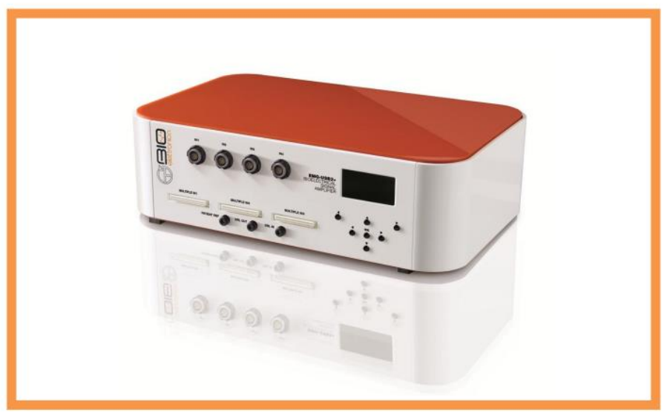
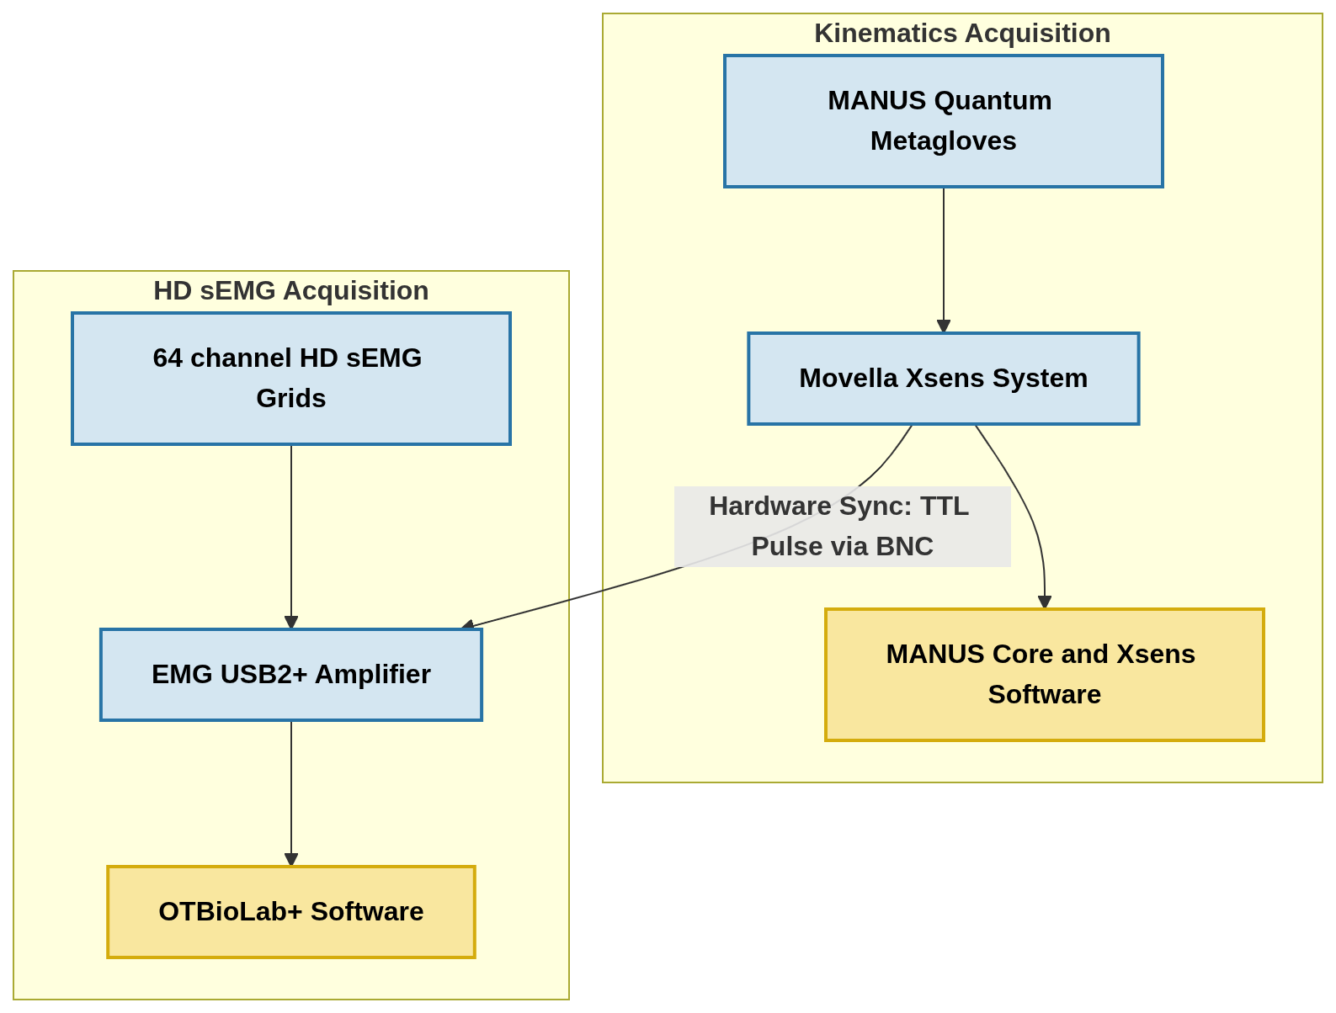
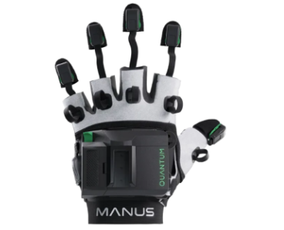
Dataset: Preliminary Experimental Setup
HAND POSE PREDICTION DRIVEN BY MOTONEURON SYNERGIES

Slide 7
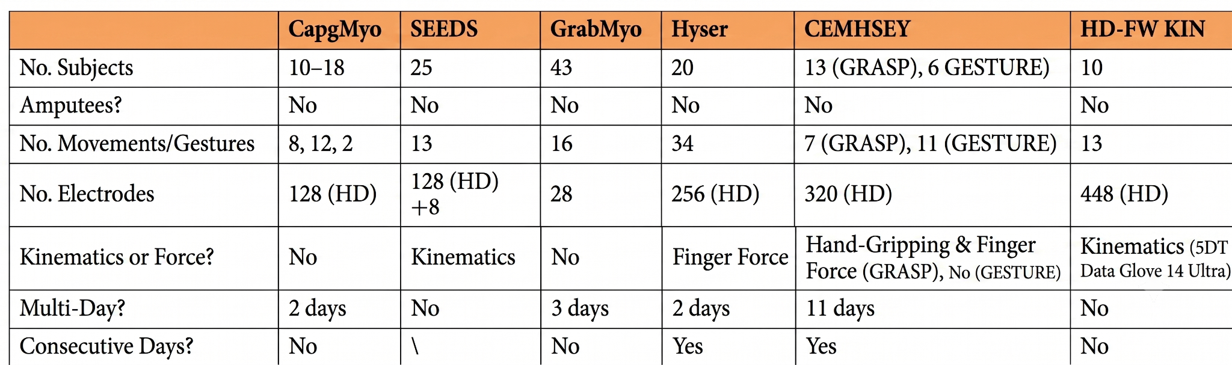
Open Source Dataset
Analyzed Dataset
  SEEDS
  HD FW KIN
- Clearer Isometric Phases
- Easier Segmentation
- Higher Inter-Trial Consistency
Fig. 4 “A consecutive multi-day high-density surface electromyography dataset comprising 7 grasps and 11 gestures,” Yang et al., 2025
HAND POSE PREDICTION DRIVEN BY MOTONEURON SYNERGIES

Slide 8
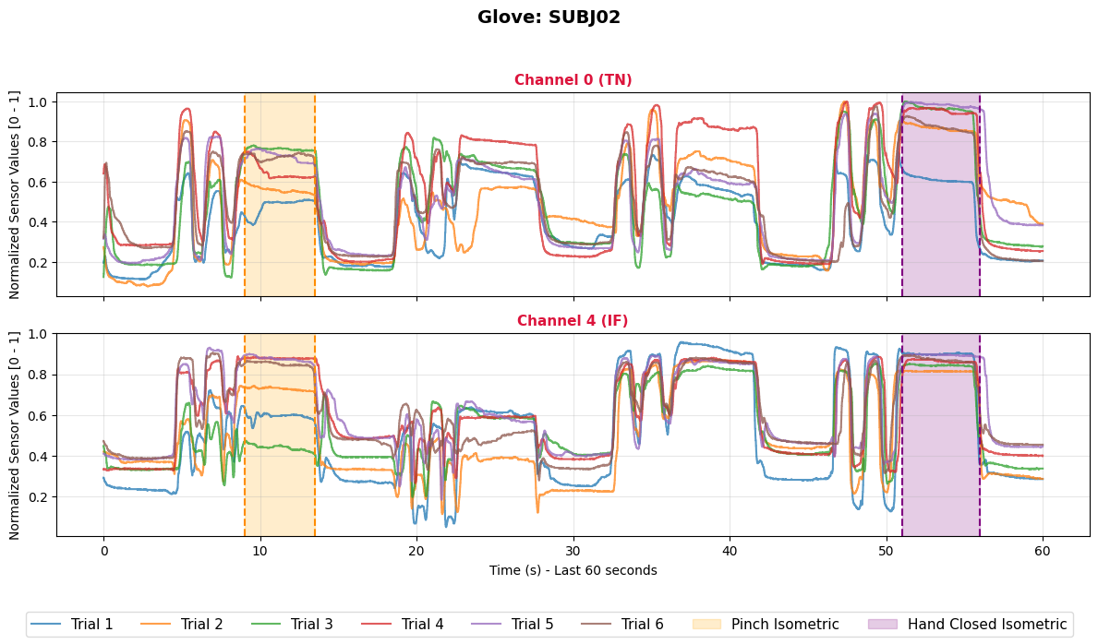
Dataset
HD FW KIN dataset
  sEMG Signal, 3 8x8 grids
  Fs: 2000 Hz
  14 Channels Glove Signals
  Fs: 200Hz
  Each represents fingers’ flexion, extension, abduction.
Target Movements
  Isometric Hand Closed
  Concatenated Isometric Pinch-Hand Closed
HAND POSE PREDICTION DRIVEN BY MOTONEURON SYNERGIES

Slide 9
Dataset
Far Fields Grids
Three 8 × 8 HD sEMG electrode arrays
10 mm inter-electrode distance attached on the flexors/extensor muscles around forearm
Fig. 5 “Hand kinematics, high-density semg comprising forearm and far-field potentials for motion intent recognition” Guo et al., 2025.
HAND POSE PREDICTION DRIVEN BY MOTONEURON SYNERGIES

Slide 10
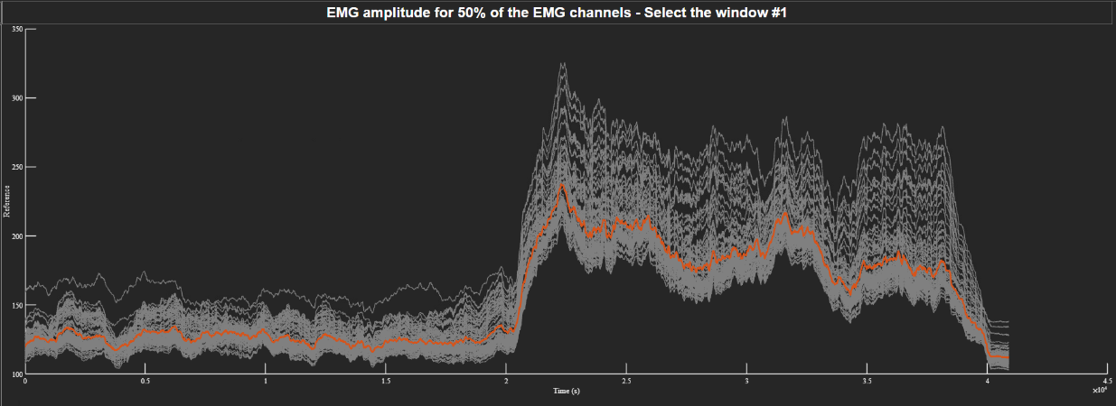
Preprocessing
Band Pass Filtering
  4th Order Butterworth 20-500 Hz
Upsampling
  sEMG Signal Upsampled up to 4000 Hz and Reconstructed at Original Fs for Time Dilation
HAND POSE PREDICTION DRIVEN BY MOTONEURON SYNERGIES

Slide 11
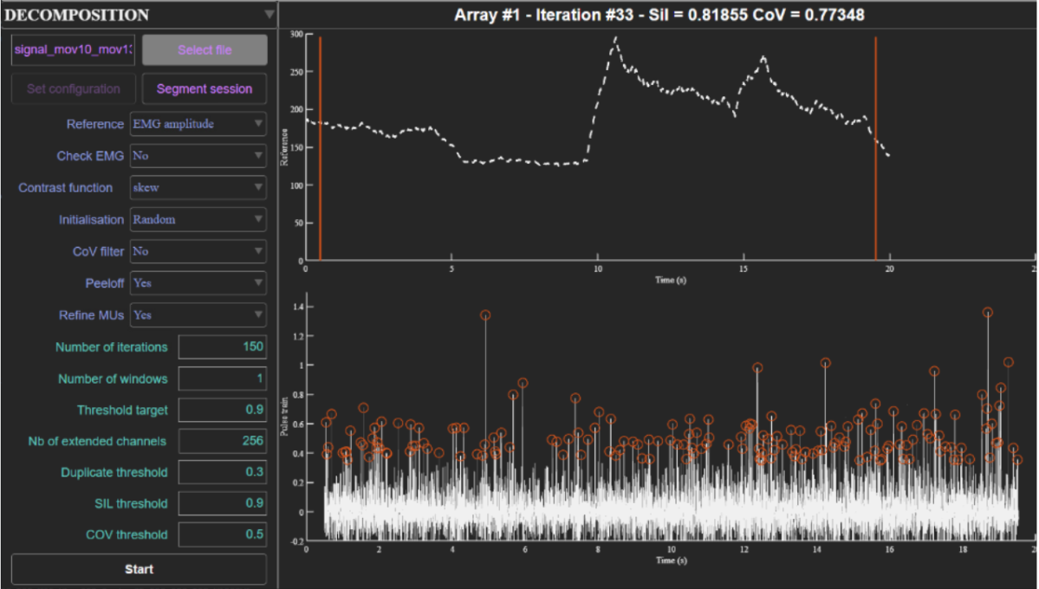
MUedit: Motor Unit Decomposition
FastICA Algorithm
For each subject, the most isometric trial has been chosen as reference.
MUfilters for each reference trial are saved and applied to the other trials relative to their subjects.
HAND POSE PREDICTION DRIVEN BY MOTONEURON SYNERGIES

Slide 12
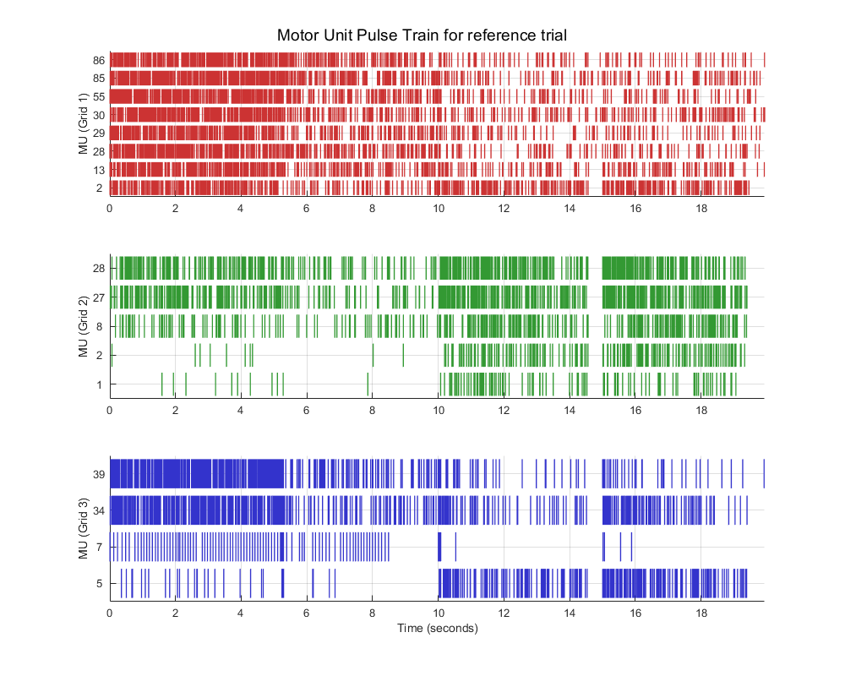
Postprocessing MUFilters
Spike Trains Discharge Rate Frequency
  Each MU must have 25 spikes per task.
2D normalized Cross-Correlation
  For each MU, its MUAP is computed with Spike Triggered Average formulation.
  MU consistency
  Cross-correlation Threshold:
    for MUAPs of same MU
    different tasks.
  Avoid Duplicates
  Cross-correlation Threshold:
    for MUAPs of different MU
    same tasks.
Pinch
Hand Closed
HAND POSE PREDICTION DRIVEN BY MOTONEURON SYNERGIES

Slide 13
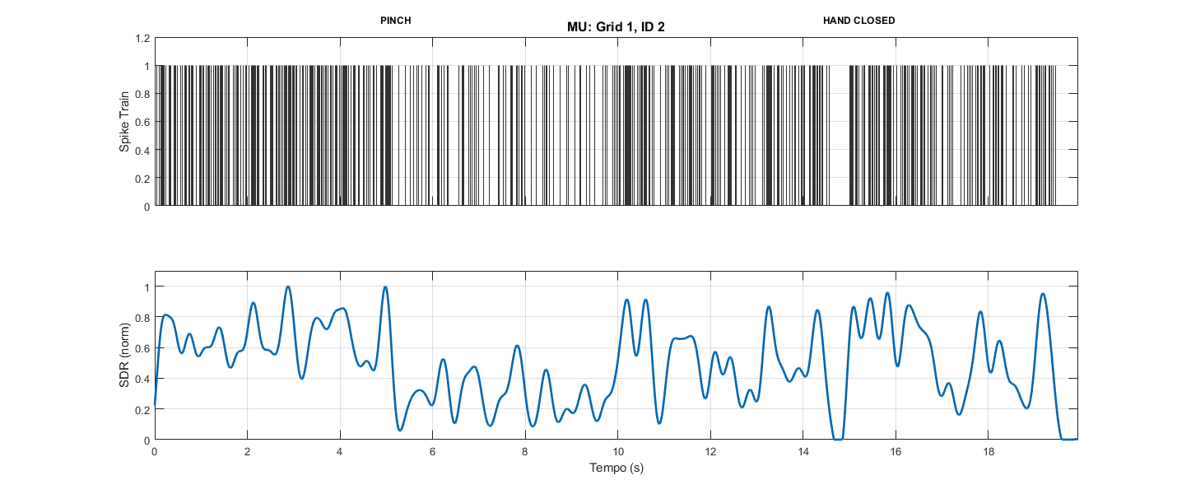
NNMF Input: SDRs Estimation
SDRs Estimation
Low pass 4° Order Butterworth, 2.5 Hz
  Equivalent to convolution with 400 ms Hanning window.
  Normalization between 0 and 1
Clipped at zero
  to avoid negative values due to filtfilt Matlab Function
HAND POSE PREDICTION DRIVEN BY MOTONEURON SYNERGIES

Slide 14
NNMF: Motoneuron Synergies
NNMF Algorithm
Applied only on the reference trial for each subject.
10 Repetitions of 100 Algorithm Iterations, with K up to 9 synergies.
W and H randomly initialized at each repetition.
Number of Synergies for final Reconstruction:
  Hand Closed only: 1 synergy
  Pinch-Hand Closed: 2 synergies
  Pinch-Hand Closed: 4 synergies, based on modal distribution of the Reconstruction Error (R2) across subjects.
HAND POSE PREDICTION DRIVEN BY MOTONEURON SYNERGIES

Slide 15
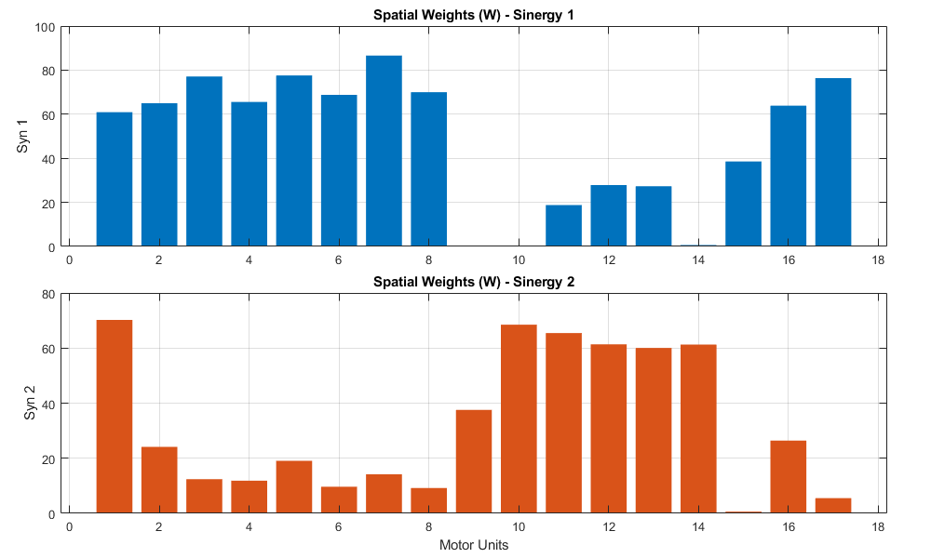
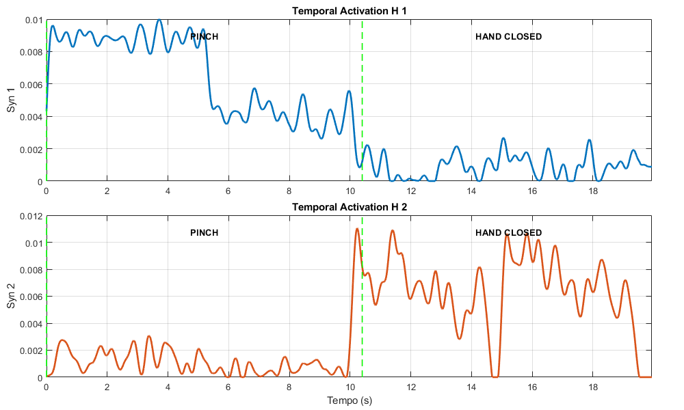
NNMF: 2 Motoneuron Synergies Reconstruction
For each subject, its reference trial’s Spatial Weights are used to reconstruct the other trial’s SDRs.
HAND POSE PREDICTION DRIVEN BY MOTONEURON SYNERGIES

Slide 16
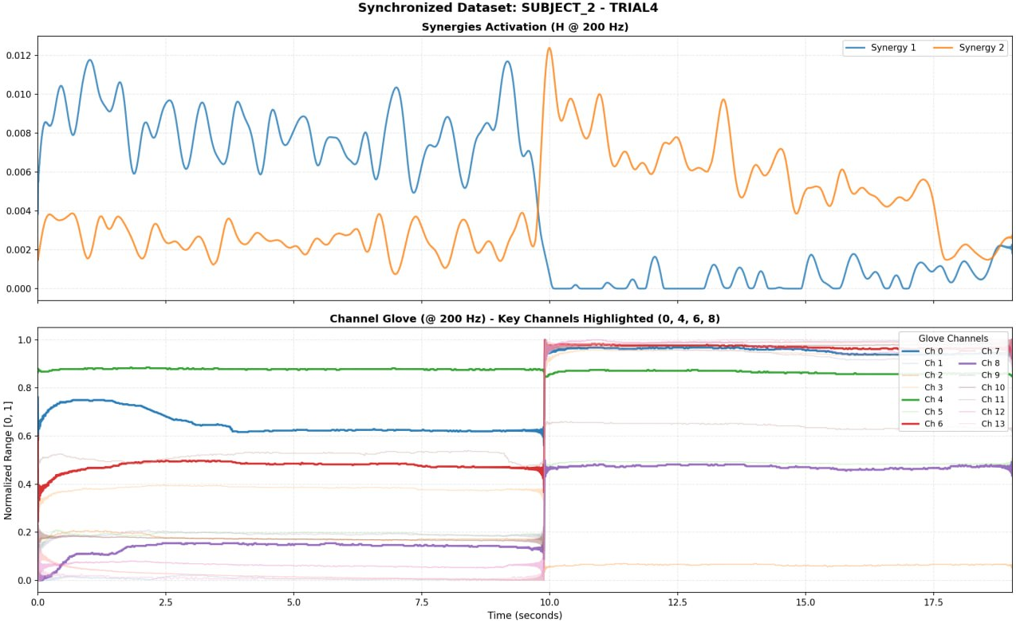
Synchronization
Channels Glove Upsampled up to 400 Hz and Reconstructed at its original Fs for Time Dilation.
Downsampling of Synergies Activation, to match 200 Hz Glove sampling Frequency.
Manual Inspection and Reordering for Consistent Synergies across subjects.
Pinch
Hand Closed
HAND POSE PREDICTION DRIVEN BY MOTONEURON SYNERGIES

Slide 17
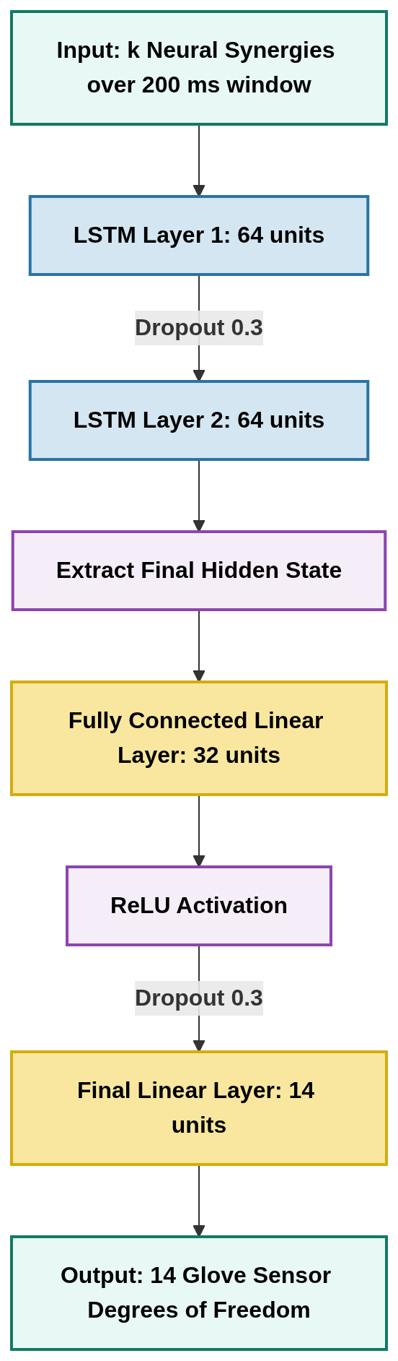

Kinematic Prediction
Training
50 Epochs
200 ms Input Window (40 samples)
Adam Optimizer:
  LR: 1e-3
  Weight Decay: 1e-4
Loss Criterion:
Target Prediction:
  Intra Subject Hand Closed.
  Intra Subject Concatenated Tasks (2 syn).
  Cross Subject Concatenated Tasks (2 syn).
    Training: One Subject
    Training: Multi Subjects
  Intra Subject Concatenated Tasks (4 syn).
HAND POSE PREDICTION DRIVEN BY MOTONEURON SYNERGIES

Slide 18
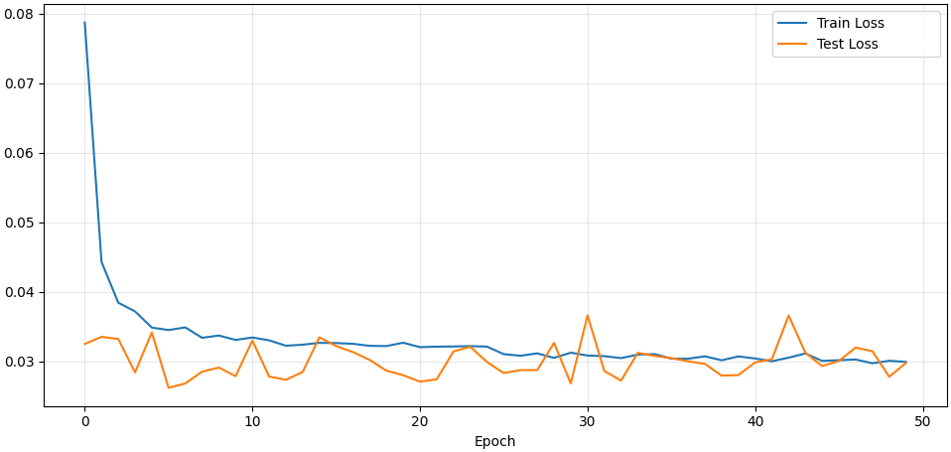
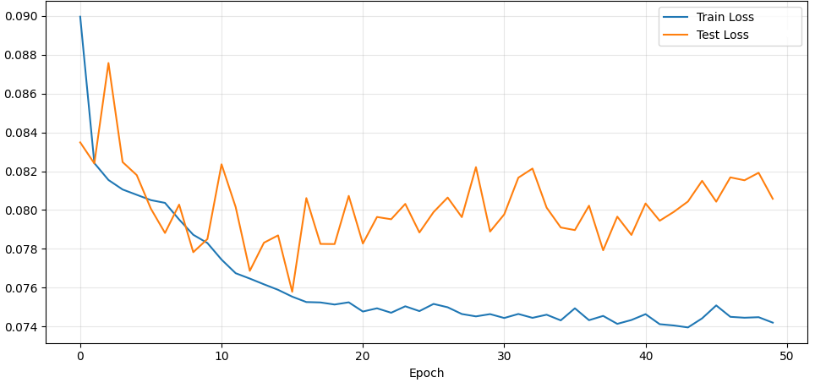
Training: 2 Motoneuron Synergies Reconstruction
Intra Subject
Cross Subject - Multi Subject Training
Loss
Loss
loss target 0.030
loss target 0.074
HAND POSE PREDICTION DRIVEN BY MOTONEURON SYNERGIES

Slide 19
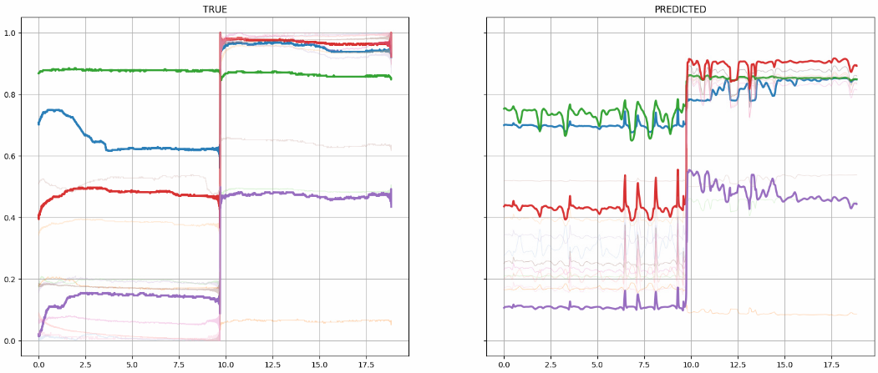
Prediction: 2 Motoneuron Synergies Reconstruction
Intra Subject, prediction on unseen trial.
HAND POSE PREDICTION DRIVEN BY MOTONEURON SYNERGIES

Slide 20
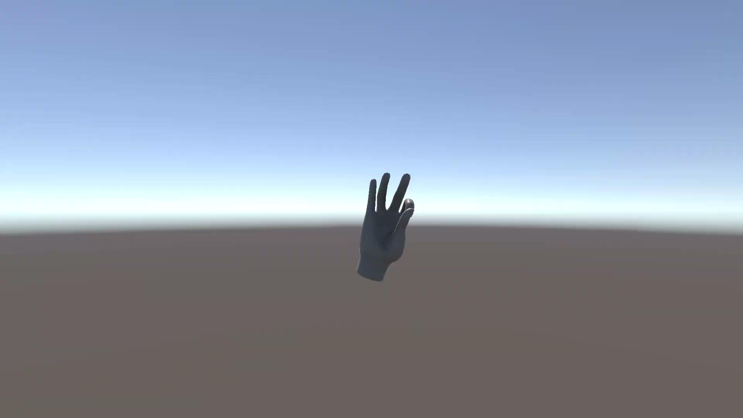
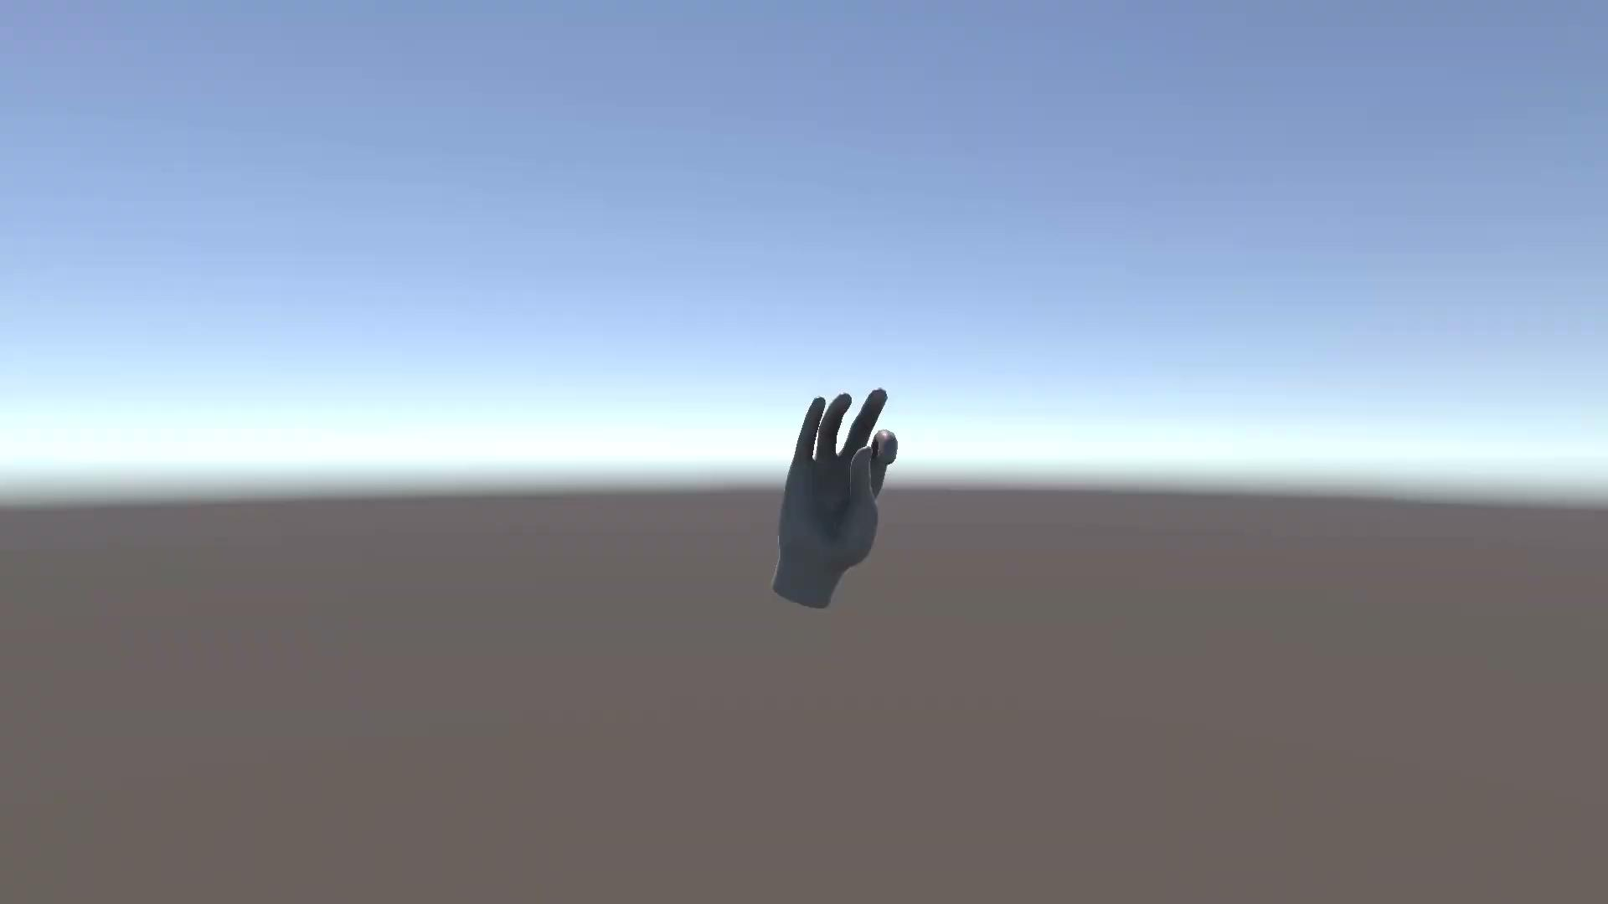
Prediction Results: Intra Subject - Hand Closed
1 Synergy
Ground Truth
Prediction - Training with possible unstable trials
HAND POSE PREDICTION DRIVEN BY MOTONEURON SYNERGIES

Slide 21
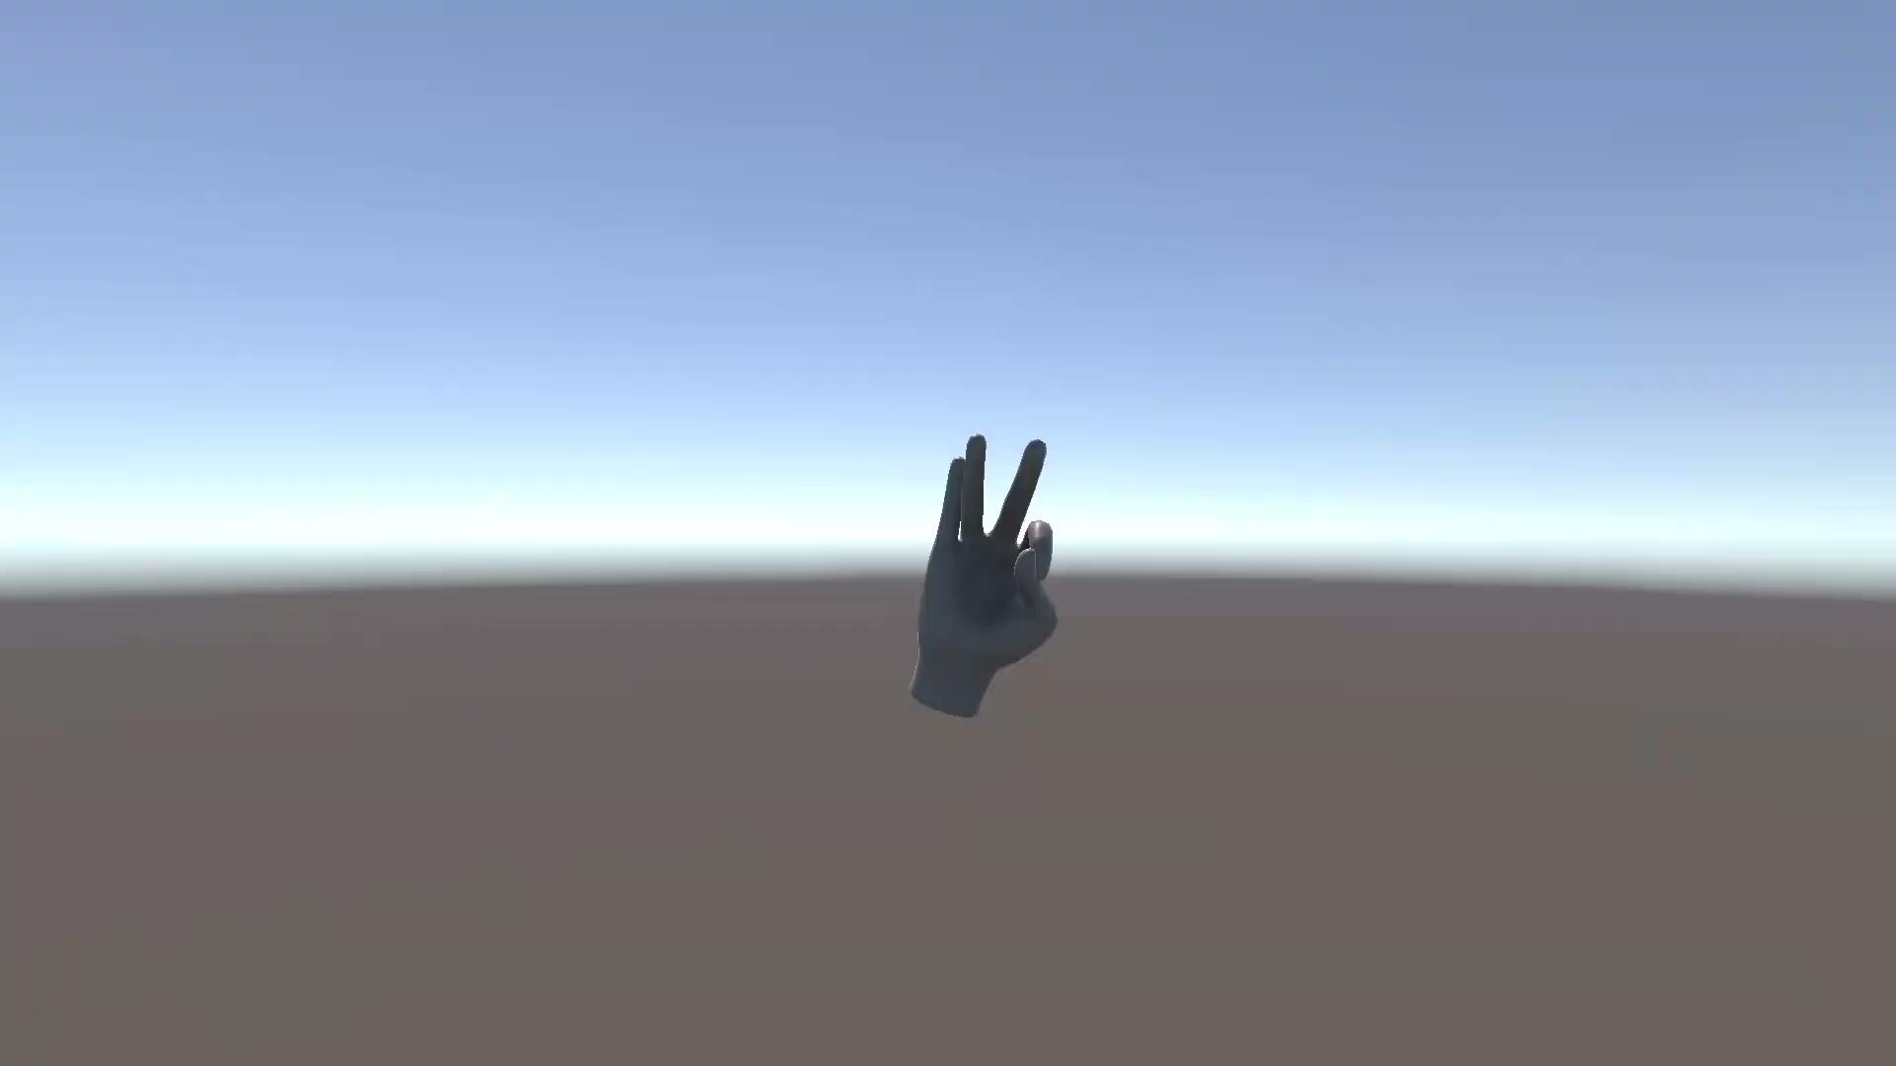
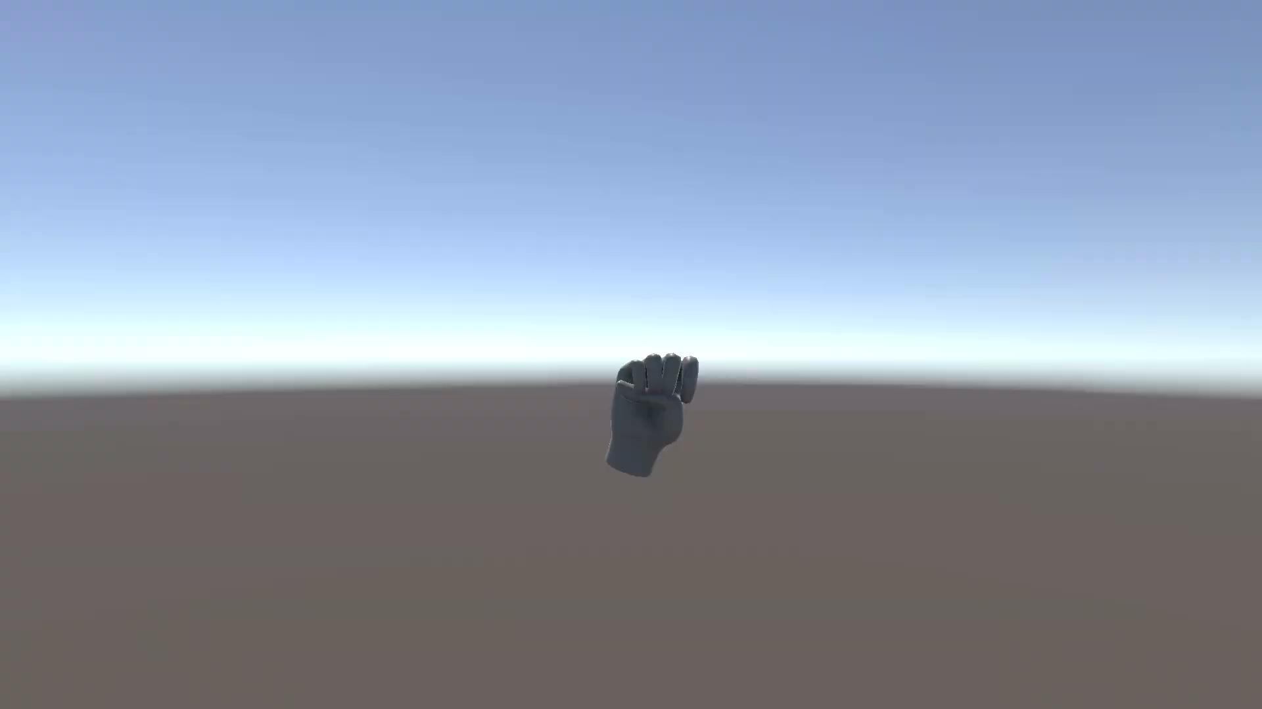
Prediction Results: Intra Subject - Hand Closed
1 Synergy
Ground Truth
Prediction - Training on only stable trials
HAND POSE PREDICTION DRIVEN BY MOTONEURON SYNERGIES

Slide 22
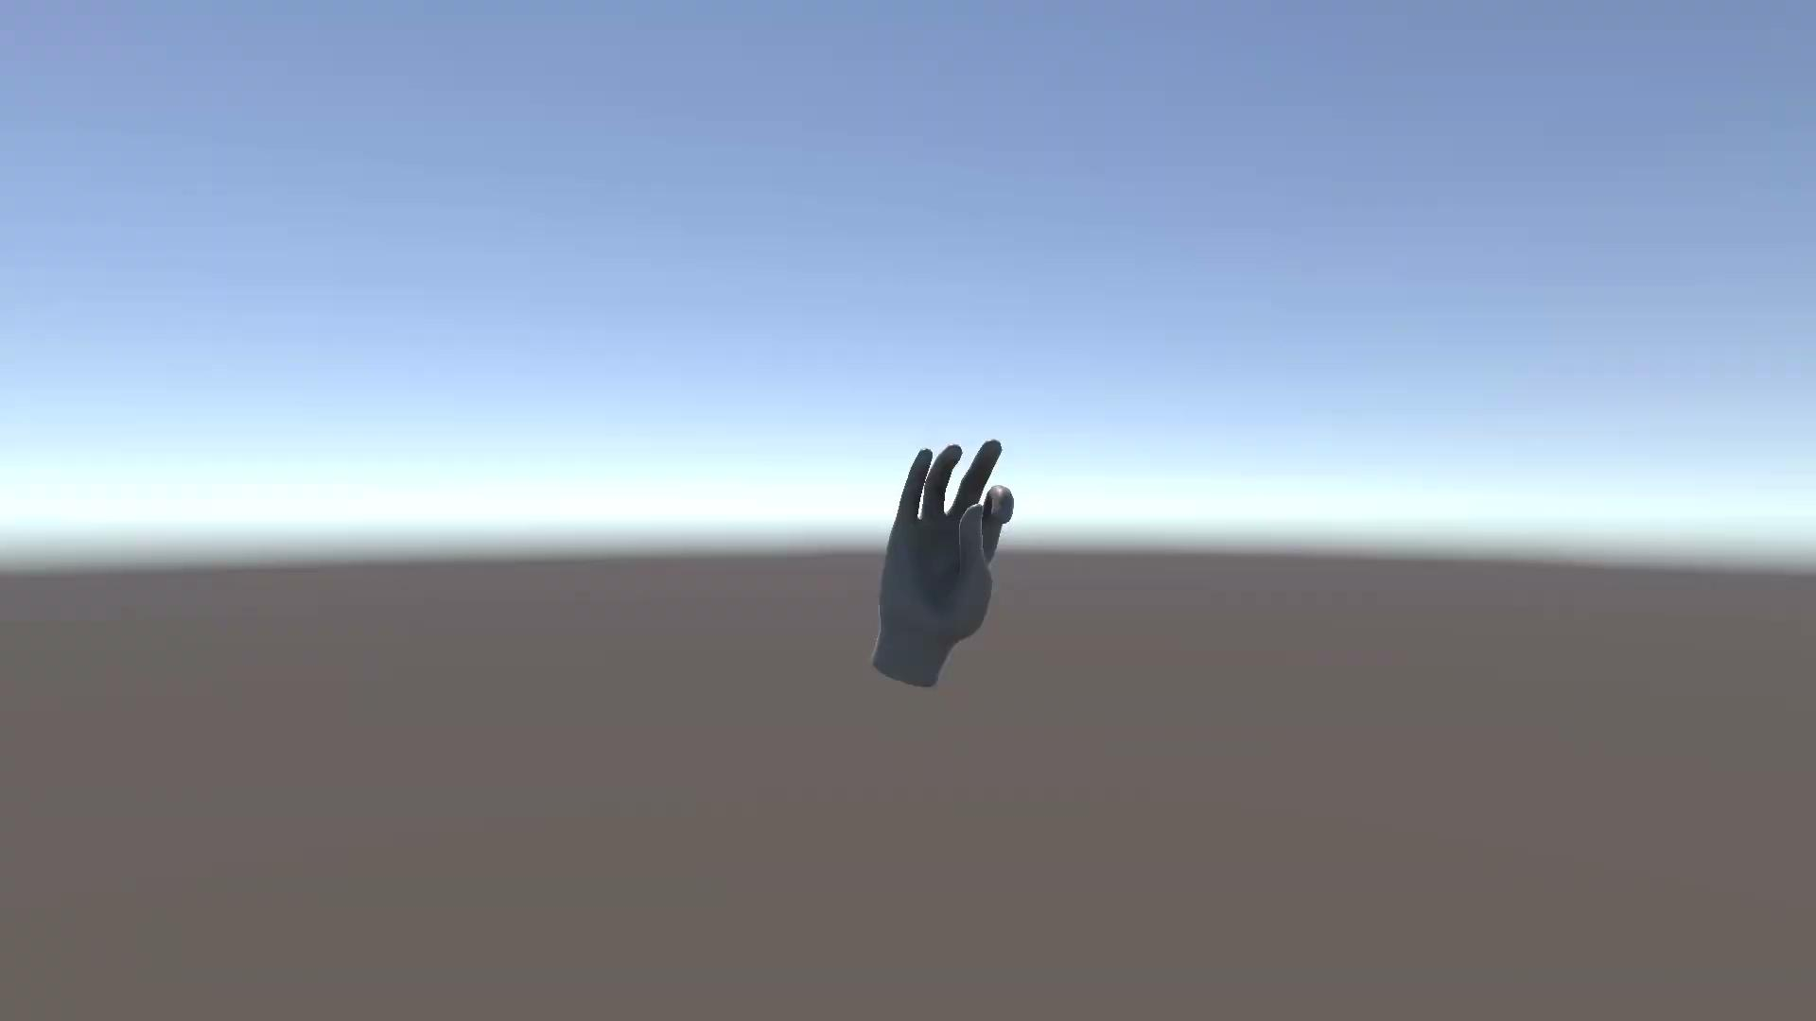
Prediction Results: Intra Subject - Concatenated Task
2 Synergies
Ground Truth
Prediction
HAND POSE PREDICTION DRIVEN BY MOTONEURON SYNERGIES

Slide 23
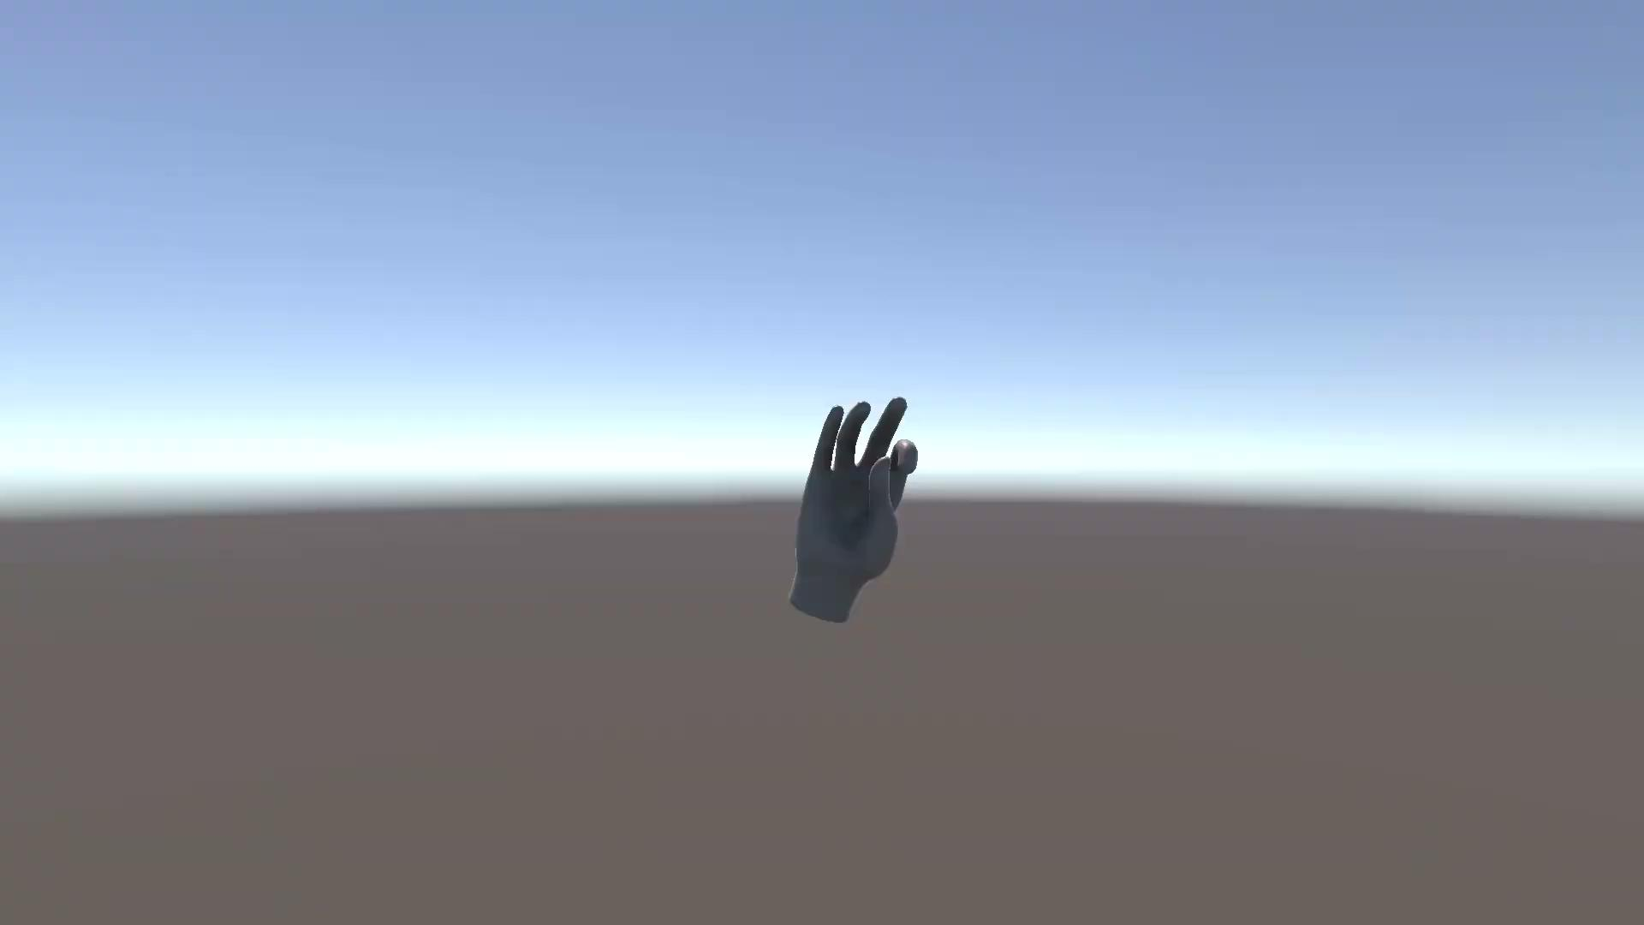
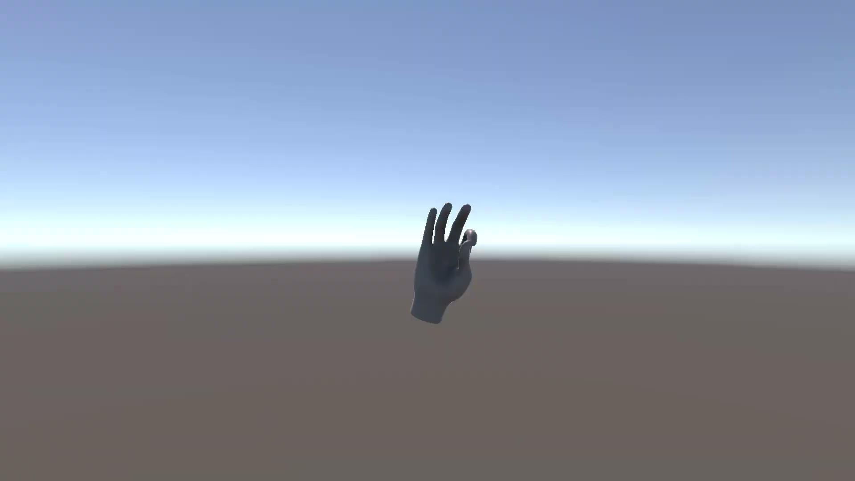
Prediction Results: Cross Subject - Concatenated Task
Prediction - Training: One Subject
Ground Truth - 2 Synergies
Prediction - Training: Multi Subjects
HAND POSE PREDICTION DRIVEN BY MOTONEURON SYNERGIES

Slide 24
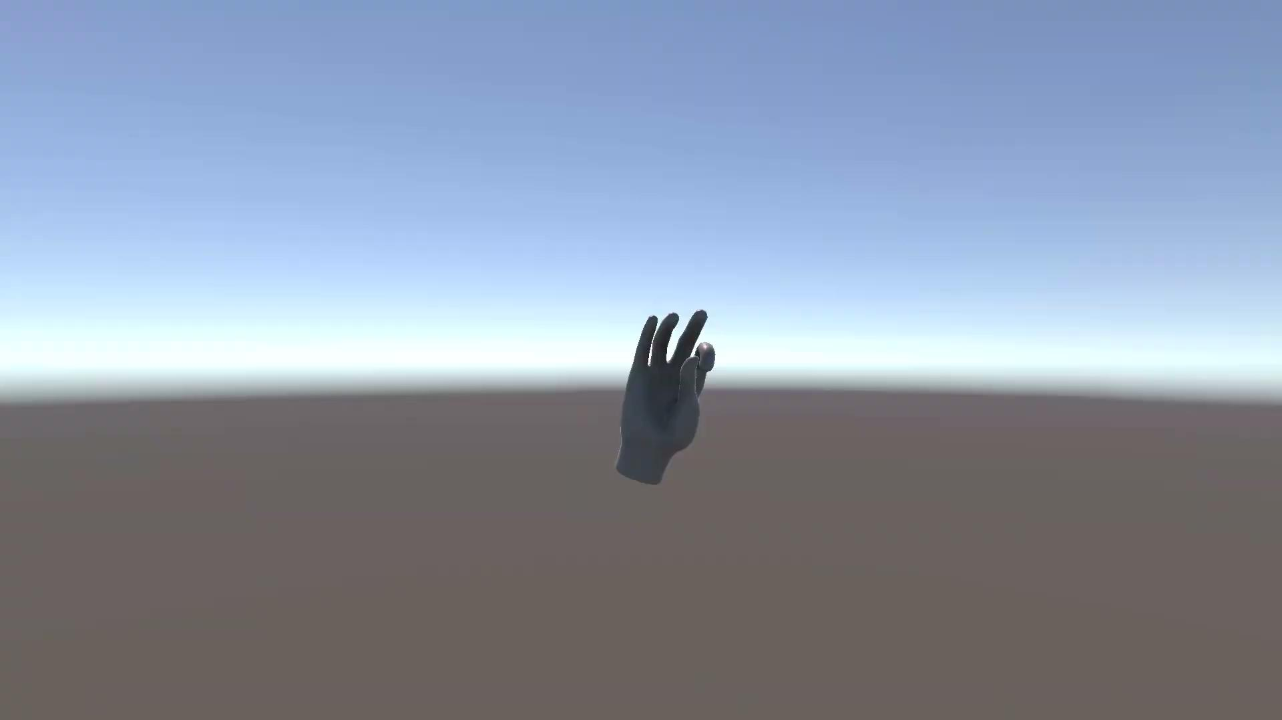
Prediction Results: Intra Subject - Concatenated Task
4 Synergies
Ground Truth
Prediction
HAND POSE PREDICTION DRIVEN BY MOTONEURON SYNERGIES

Slide 25
Future Works
Refinement of Motor Unit Decomposition and Validation
Dataset Expansion and Synergies Correlation
Dynamic Decomposition and Mapping
Prediction based on Postural Synergies
HAND POSE PREDICTION DRIVEN BY MOTONEURON SYNERGIES

Slide 26
Thank you for your attention!
Tutti i diritti relativi al presente materiale didattico ed al suo contenuto sono riservati a Sapienza e ai suoi autori (o docenti che lo hanno prodotto). È consentito l'uso personale dello stesso da parte dello studente a fini di studio. Ne è vietata nel modo più assoluto la diffusione, duplicazione, cessione, trasmissione, distribuzione a terzi o al pubblico pena le sanzioni applicabili per legge

Slide 27
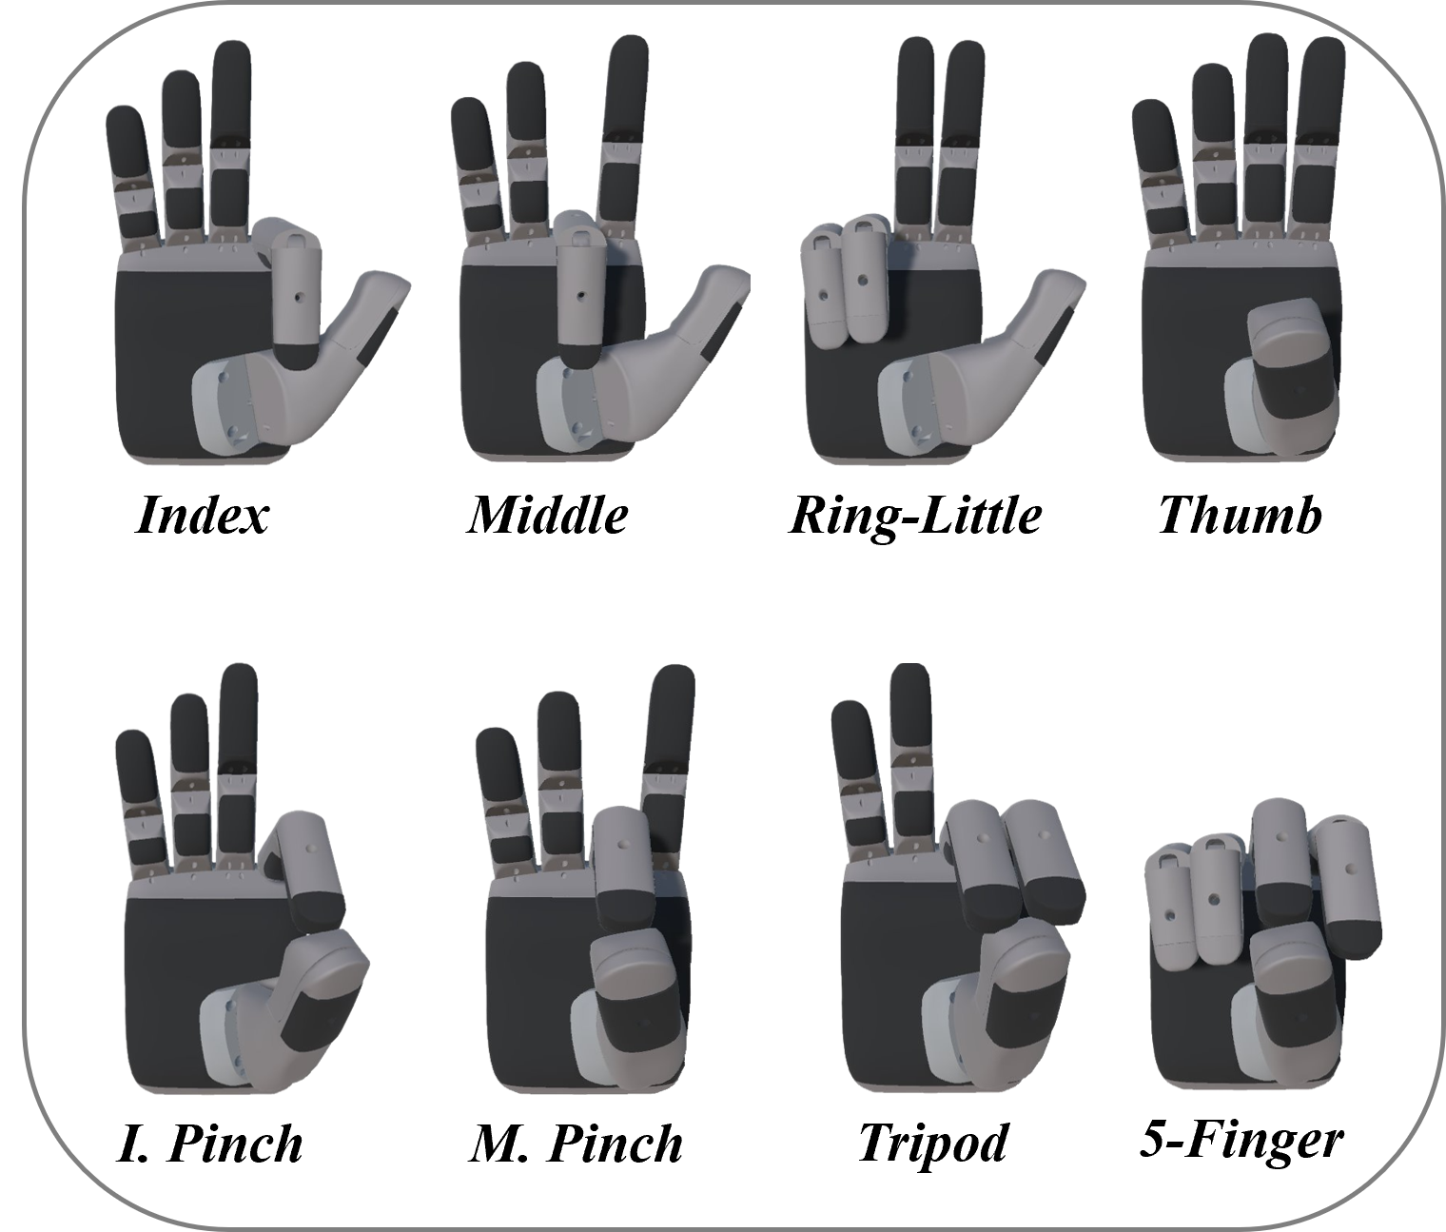
Dataset Online
HD sEMG of Forearm Muscles and 3D Hand Kinematics During Sinusoidally-Modulated Finger Movements and Grasping Tasks.
PARTECIPANTI: 21 partecipanti sani.
TASK MOTORI: 8 primati (dita singole, pinze, 5 dita) + start position e rest.
PARAMETRI DI ESECUZIONE: 2 frequenze (0.50 Hz e 0.75 Hz) con pattern sinusoidale ripetute 3 volte.
DURATA TRIAL: ~45 secondi per singola registrazione/prova.
PREPROCESSING CONSIGLIATO: Taglio dei primi e ultimi 5 secondi del segnale, per eliminare i transitori.
Task sequences were randomized, and approximately 30 s of rest were provided between recordings. Participants were seated comfortably; the elbow of the dominant hand was supported on an adjustable-height table at approximately 45° of flexion, and the hand was maintained in a neutral position, with the palm aligned parallel to the sagittal axis. The gesture sequences were displayed on a virtual interface that participants were required to observe and imitate during each task, all of which began from an open hand position.
Cit. https://figshare.com/articles/dataset/HD_sEMG_of_Forearm_Muscles_and_3D_Hand_Kinematics_During_Sinusoidally-Modulated_Finger_Movements_and_Grasping_Tasks/31032934

Slide 28
Dataset Online
HD sEMG of Forearm Muscles and 3D Hand Kinematics During Sinusoidally-Modulated Finger Movements and Grasping Tasks.
HD-sEMG
CANALI: 2 array 8x8 posizionali sui muscoli EDC (Extensor) e FDS (Flexor) rispettivamente.
CAMPIONAMENTO: HDsEMG con frequenza 2.052.52 Hz, 92160 campioni.
CINEMATICA DELLA MANO
ANGOLI
DIMENSIONI: 17 colonne x 45000 righe (100 Hz campionamento)
CONTENUTO: Indici temporali (Frame, Sub Frame) + 15 angoli articolari (3 per dito: pollice, indice, medio, anulare, mignolo)
TRAJECTORIES (POSIZIONI 3D DEI MARKER):
DIMENSIONI: 38 colonne x 4500 righe.
CONTENUTO: Indici temporali + 36 coordinate spaziali (x,y,z in mm) per 12 marker totali ( 2 sul polso e 10 sulle dita: prossimale e distale per ciascun dito).

Slide 29
Deep Learning for Robust Decomposition of High-Density Surface EMG Signals
the number of identified motor units and the accuracy of the detection of their discharge timing strongly depend on the decomposition algorithm used, but there is no consensus on the optimal algorithm.
Avrillon nel 2021: We demonstrate the feasibility and the validity of using deep CNN to accurately identify MU activity from HD-EMG with a latency lower than 80 ms, which falls within the lower bound of the human electromechanical delay.
Il paper più importante è recente è “A Deep Learning Framework for Efficient Online Decomposition of High-Density Surface Electromyogram into Motor Unit Spike Trains” Liu et al. 2026,
Hanno preso i dati scomposati dal CKC, li hanno usati come "ground truth" (verità di base) e hanno addestrato una rete neurale convoluzionale a predire gli spike dei motoneuroni direttamente dal segnale grezzo. Hanno dimostrato che il Deep Learning non solo riesce a estrarre gli spike, ma è più robusto del CKC rispetto al rumore o ai piccoli spostamenti degli elettrodi.
Cit. Clarke, A. K., et al. (2020). "Deep Learning for Robust Decomposition of High-Density Surface EMG Signals."

Slide 30
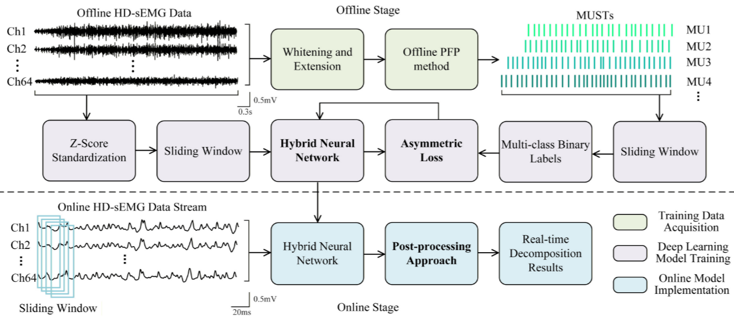
Deep Learning for Robust Decomposition of High-Density Surface EMG Signals
Tempo Totale inclusa predizione e post processing per determinare i MUSTs: 7.5 ms
“A Deep Learning Framework for Efficient Online Decomposition of High-Density Surface Electromyogram into Motor Unit Spike Trains” Liu et al. 2026

Slide 31
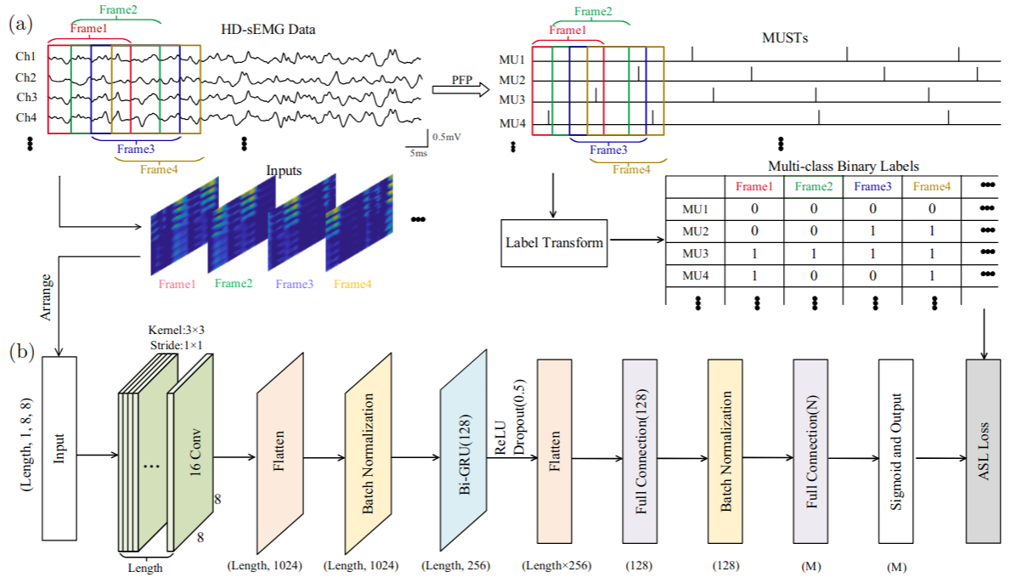
Deep Learning for Robust Decomposition of High-Density Surface EMG Signals
Solution for low online latency in HDsEMG decomposition. 7.5 ms to find MUSTs from raw signal.
“A Deep Learning Framework for Efficient Online Decomposition of High-Density Surface Electromyogram into Motor Unit Spike Trains” Liu et al. 2026

Slide 32
Deep Learning for Robust Decomposition of High-Density Surface EMG Signals
SUBJECTS: 10 patients
DATA: MVC from thumb force abduction detected with an electrode 64 array on the thumb directly.
“A Deep Learning Framework for Efficient Online Decomposition of High-Density Surface Electromyogram into Motor Unit Spike Trains” Liu et al. 2026

Slide 33
From HD-sEMG to Motoneural Synergies
A causa della cancellazione di ampiezza: nel segnale si sommano i potenziali d azione di segno opposto, questo rende più complessa la separazione dei singoli potenziali di azioni, per cui mappare il segnale grezzo direttamente alle sinergie, non garantirebbe un mapping sensato. MA se considerassimo il segnale come un video allora possiamo estrarre informazioni spazio temporali.

Slide 34
Contesto
Mi immagino un sistema fatto di 3 modelli in cascata, la cui somma temporale rientri nei limiti di efficienza responsiva: il primo modello predice real time gli spike train, poi vi è il calcolo dei MUAP (da valutare), poi un modello che predice dagli spike train alle sinergie motoneurali per evitare di passare attraverso la NNMF (per questo compariamo le tempistiche tra usare un modello o l’algoritmo), e poi il modello che dalle sinergie predice il la cinematica della mano.

Slide 35
Surface EMG Signal
Forearm muscles that control hand and wrist motion (flexors and extensors) are still partially intact and accessible under the skin. Studies have shown that residual muscles continuously receives neural information even after 10 years.
Surface EMG (sEMG) electrodes placed on the residual limb can easily detect their activity.
Therefore, non-invasive sEMG is effective and convenient — it provides enough information for control of prosthetic hand and wrist.
The sEMG signal is a multi-channel biomedical signal, its datarecording is easily affected by the external environment, biological tissue interference, muscle fatigue, electrode displacement, so there is a lot of noise and non-stationarity, which may obscure important information about muscle electrical activity.
For higher-level amputations (transhumeral or shoulder), sEMG alone is often insufficient, but Targeted Muscle Reinnervation TMR, Implanted EMG (iEMG) or Nerve or cortical interfaces (ENG, ECoG) can make it usable again by creating new EMG control sites.
EMG-DRIVEN HAND GRASP PREDICTION

Slide 36
Map Motoneuron Synergies to Hand Pose
sEMG (BioGAP)
Pre-Processing (filtering, rectification, segmentation)
Feature Extraction (RMS, M synergies, MN synergies)
Patient
Hand-Wrist Kinematic (MANUS Core)
BioGUI synchro data
Model (Transformer, LSTM)
Hand
Wrist
Force
Grasped Object (Weart, tactors)
Force
Synergy reconstruction?
Haptic Feedback α Force
Virtual Hand
MOTONEURON SYNERGIES DRIVEN HAND POSE PREDICTION

Slide 37
Non-Negative Matrix Factorization (NMF)
Input Matrix (V): The matrix containing the neural drivers (MUSTs) or muscular envelopes across all time points and all Motoneurons (or channels).
Factorization Goal: NMF decomposes the input matrix (V) into two lower-rank matrices:
Minimization Target: NMF is an iterative process that minimizes the Euclidean distance (or other metrics like Kullback-Leibler divergence) between the Original Signal (V) and the Reconstruction.
The process is run for 100 iterations and repeated 10 times. The solution with the greatest Coefficient of Determination among 10 repetitions is retained for each number of synergies.
MOTONEURON SYNERGIES DRIVEN HAND POSE PREDICTION

Slide 38
First Generation
Direct Control (60’)
Proportional Control:
Force output ∝ EMG amplitude
EMG amplitude of flexor/extensor muscle
No distinctions between more complex gestures
Pattern Recognition
Extract Features from EMG window
Classification of gestures (pinch, open hand, grasp)
EMG-DRIVEN HAND GRASP PREDICTION

Slide 39
EMG Features
Handcrafted Features
Time: Mean Absolute Value, Mean Absolute Value Slope, Zero Crossings, Slope Sign Changes, Waveform Length, Root Mean Square, Histogram, etc.
Frequency: mean frequency, median frequency, peak frequency, mean power, total power, the 1st, 2nd, and 3rd spectral moments, frequency ratio, power spectrum ratio, the variance of central frequency, etc.
Time-Frequency: short-time Fourier Transform, wavelet transform, and wavelet packet transform
From Handcrafted Features to Learned Representations
Feature Extraction + Classifier substituted by a Supervised (CNN or RNN/LSTM), Self-Supervised (Unsupervised pre-training + supervised fine-tuning), Unsupervised (AE, VAE) Learning Models which can learn spatial, spectral patterns or temporal information and directly extract the hand pose.
Self-Supervised Learning allow to mitigate Data Distribution Mutation thanks to Transfer Learning and Domain Adaptation.
EMG-DRIVEN HAND GRASP PREDICTION

Slide 40
Spatial Resolution: Sparse vs Dense EMG Acquisition
Sparse EMG (2-16 channels)
Less data to transfer and low cost of but sensitive to the domain change of sEMG signal.
Gesture Recognition and lightweight prosthesis.
Dense / High-Density EMG (32-256 channels)
captures the spatial and temporal distribution of motor unit action potentials in muscles through a two-dimensional array of electrodes. This technique increases the amount of data collected and has high recognition efficiency and control quality
Motoneuronal synergies.
Dry or textile electrodes for everyday tasks.
Wet electrodes for research.
For DL, the final prediction results are immediately affected by the quality and quantity of inputs, so the application of HD-sEMG seems to be an effective method to solve myoelectric control problems.
EMG-DRIVEN HAND GRASP PREDICTION

Slide 41
Temporal Phases: Steady-State vs Transient EMG
Transient (Onset/Offset)
The transient state is the short time interval in which the muscle changes from rest to active contraction, Onset (or vice versa, Offset)
The rapid recruitment of new motor units and the changes in firing rates introduce rich temporal dynamics that are highly discriminative of specific movements.
It enables low-latency, anticipatory control in prosthetics and VR.
Transient Detection: Onset Detection Algorithm (ODA)
Steady-state
The steady-state is the period when the contraction is sustained at a relatively constant level.
The EMG signal exhibits very little temporal structure, since the recruitment and firing patterns are actively adjusted to sustain the contraction, resulting in quasi-stationary activity.
It is useful for continuous control / force estimation because of proportional relation between EMG amplitude and force.
EMG-DRIVEN HAND GRASP PREDICTION

Slide 42
Temporal Phases: Steady-State vs Transient EMG
Transient Detection (ODA)
Steady-state Detection
Once the onset has been detected we can find when the EMG signal stabilizes with several methods: derivative-based, statistical window stability, plateau detection with energy metrics, model-based segmentation.
Take a baseline window when the muscle is known to be relaxed;
Compute the root mean square (RMS), mean absolute value (MAV), or even raw amplitude over that period;
Compute the mean and the standard deviation of the EMG amplitude during the rest period.
EMG-DRIVEN HAND GRASP PREDICTION

Slide 43
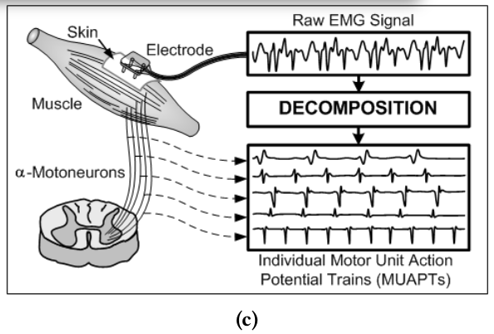
Motor Unit & EMG
Motor unit (MU): 1 alpha motor neuron + all innervated muscle fibers
Controlled by CNS (brain & spinal cord)
MU generates motor unit action potentials (MUAPs) which contains the spatial information (amplitude and shape) across the electrode grid. This signature indicates which specific muscle was activated and its location, which is crucial for subsequent analysis.
MUAPs summate → surface EMG signal
The Motor Unit Spike Train (MUST) is the temporal sequence (the when) of the MN's firing events.
1 MU innervates only part of a muscle, not the whole muscle
Alpha motor neurons originate in spinal cord
Fine movement muscles (e.g., hand) → small MUs, <10 fibers per neuron
Gross force muscles → large MUs, hundreds–>1000 fibers per neuron
EMG-DRIVEN HAND GRASP PREDICTION

Slide 44
Motor Unit & EMG
CNS sends common input to groups of MNs (MN synergies)
Each synergy = switch activating specific MN pattern
Activation primitive: turns synergy on/off, modulates intensity
Premotor interneurons integrate and distribute this common input to the appropriate MN groups.
Each MU generates a motor unit action potential (MUAP), and the superposition of all MUAPs forms the surface EMG signal.
Non-negative Matrix Factorization (NMF) extract synergy weights for each MU, identifying common activation patterns.
MUs with a high signal-to-noise ratio (SNR) or distinct firing patterns can be isolated for more detailed analysis.
EMG-DRIVEN HAND GRASP PREDICTION

Slide 45
Non-Negative Matrix Factorization (NMF)
Input Matrix (V): The matrix containing the neural drivers (MUSTs) or muscular envelopes across all time points and all Motoneurons (or channels).
Factorization Goal: NMF decomposes the input matrix (V) into two lower-rank matrices:
Minimization Target: NMF is an iterative process that minimizes the Euclidean distance (or other metrics like Kullback-Leibler divergence) between the Original Signal (V) and the Reconstruction.
The process is run for 100 iterations and repeated 10 times. The solution with the greatest Coefficient of Determination among 10 repetitions is retained for each number of synergies.
EMG-DRIVEN HAND GRASP PREDICTION

Slide 46
Signal Processing
Pre-Processing: Cleaning Raw Signal
Band-Pass Filtering: Removes low-frequency motion artifacts (electrode movement) and high-frequency instrumentation noise, isolating the main EMG power band. e.g, 20 Hz - 500 Hz
Notch Filtering:50/60 Hz Removes AC power line interference (the standard frequency of electrical grids) without significantly distorting the EMG signal band.
Rectification: Converts the oscillating signal into a positive signal (full-wave or half-wave).
Segmentation: Divides the continuous signal into small, overlapping time windows (100 - 250 ms). The time difference between the start of two consecutive windows (e.g. 50 ms) is the system’s update rate. Creates the discrete data blocks necessary for extracting features or for time-series modeling.
EMG-DRIVEN HAND GRASP PREDICTION

Slide 47
EMG signal evolution
Sparse EMG: measures muscle-level signals, few channels, no MN resolution.
Feature-Based Classification: Features are fed to Simple Classifiers like LDA (Linear Discriminant Analysis) and QDA (Quadratic Discriminant Analysis).
HD-EMG: high spatial resolution, mostly independent signals. Transition to Deep Learning (DL to exploit the spatial patterns of the HD-EMG grid.
HD- EMG + Muscular Synergies/MN synergies: extract Muscular weights/ structured patterns of MU activity → improves regression & prosthetic control.
EMG-DRIVEN HAND GRASP PREDICTION

Slide 48
Post Processing: Muscular Synergy Extraction
Envelope Extraction: The amplitude envelope (e.g., RMS or MAV) is extracted from the raw EMG signal of each channel. This process loses the temporal resolution of the individual Motoneuron activity.
Synergy Extraction: NMF is applied to the normalized amplitude envelopes.
W: The Muscular Weights shows how much each EMG channel (i.e., surface area of the muscle) contributes to a synergy.
H: The Activation, the temporal activation signal of the muscle synergy.
The Muscular Synergy is a pattern of muscle activation, not neural command. Underperforms relative to the MN synergy model because it includes biomechanical noise and is an indirect reflection of the CNS command.
EMG-DRIVEN HAND GRASP PREDICTION

Slide 49
Post Processing: Neural Synergy Extraction
EMG Decomposition: Uses algorithms (e.g., Convolution Kernel Compensation (CKC) or Blind Source Separation (BSS)) (Decomposition Framework on Matlab) to transform the electrical signal into the Motor Unit Spike Trains (MUSTs). Separates the sum of MUAPs into the temporal firing sequence of each individual motoneuron.
Data Processing: MUSTs are typically low-pass filtered and normalized. Prepares the neural firing rate for matrix factorization.
Synergy Extraction: Converts the oscillating signal into a positive signal (full-wave or half-wave). NMF is applied to the processed MUSTs .
W: The Synergy Weights, a static pattern showing which MNs are involved in each synergy.
H: The Activation Primitive, the temporal command (voluntary input) that modulates the intensity of that synergy.
EMG-DRIVEN HAND GRASP PREDICTION

Slide 50
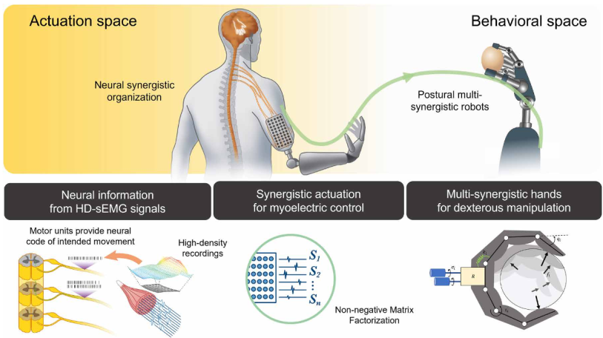
Merging motoneuron and postural synergies in prosthetic hand design for natural bionic interfacing
Soft Robotic Hands (like the SoftHand Pro-2) are intentionally designed with only a few motors to match the human Postural Synergies.
The work successfully identified MN synergies that robustly predict continuous grasping actions.
63 decomposed MUs found.
They found MNs capture more synergies and computing the degree of orthogonality among pairs of synergies, the MN synergies have a higher degree of orthonormality than muscle synergies which means that the synergies they can control are very specific, this allows for particular movement.
EMG-DRIVEN HAND GRASP PREDICTION

Slide 51
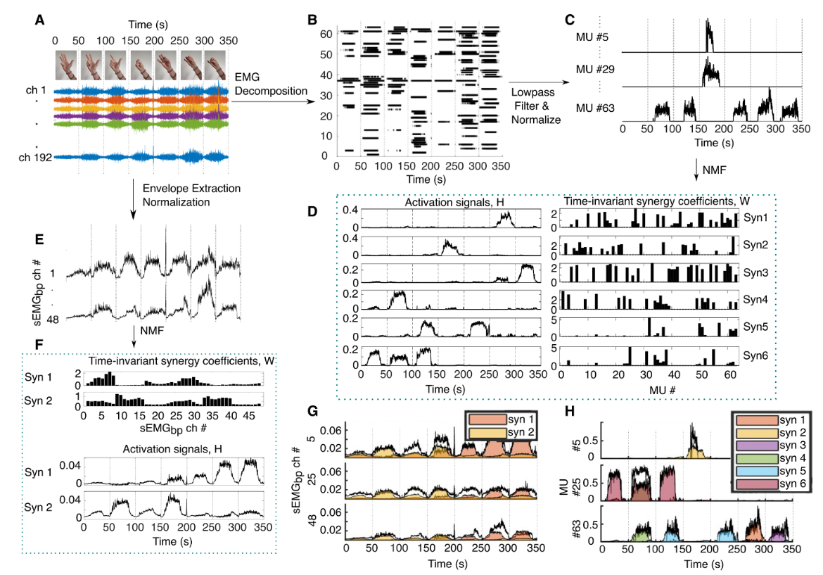
EMG-DRIVEN HAND GRASP PREDICTION

Slide 52
Dataset
Offline Acquisition
Neural/Muscular Input (EMG)
Kinematic Ground Truth: High-Fidelity Motion Capture System (MANUS), capturing the continuous movement of all finger joints (for Cinematic Synergies) and wrist angles (Flexion/Extension, Ulnar/Radial Deviation). Paper (Wearable…)
Dynamic Ground Truth (Force): Integrated Force Sensors (e.g., FSRs or Load Cells) placed directly on or within the grasped object.
Calibration Phase: Collecting the 5-10 minutes of movements (e.g., standard grasps) from the new user (the Target Subject, like an amputee). Transfer Learning.
Online Operation: Real-Time Control
Feature Extraction): EMG signal is acquired. Low latency is crucial (using an overlapping window increment of 50 ms).
Model Execution: provides the continuous, proportional prediction of the output variables.
Control Output: The fine tuned model outputs three continuous, synchronized signals: 1. Kinematic Synergy Coefficients (Hand Posture), 2. Wrist Angles, and 3. Predicted Grip Force. The outputs are reconstructed and directly injected into the VR Environment or the Soft Robotic Exoskeleton/Prosthesis to drive movement.
EMG-DRIVEN HAND GRASP PREDICTION

Slide 53
Dataset
Subjects: 9-15 participants. Healthy Subjects (for initial ground truth modeling) and, ideally, TMR or long-term amputee patients.
Movement Category:
Continuous Proportionality: Slow, gradual opening/closing of the hand (0 to 100) and slow modulation of grip force.
Smooth Transitions: Fluid, uninterrupted transitions between different static grasps (e.g., Cylindrical →Pinch →Sphere).
Wrist Movements: Continuous Flexion/Extension and Ulnar/Radial Deviation of the wrist. Provides separate ground truth data for the wrist regression head, allowing for simultaneous control (Hand Posture + Wrist Angle).
Static Grasps: Holding 3-5 distinct object types with variable force levels.
EMG-DRIVEN HAND GRASP PREDICTION

Slide 54
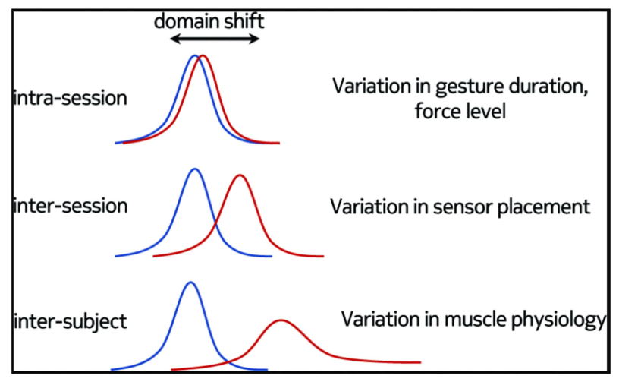
Inter- & Intra-Variability
Intra-Session: Signal changes within the same recording session (e.g., muscle fatigue, sweat, electrode heating). Movements are recorded in multiple repeated blocks (e.g., 5 blocks per task). Robustness is assessed by training on early blocks and testing on the final, fatigued blocks.
Inter-Session: Signal changes between different days (e.g., electrode repositioning, baseline shift, skin changes). The model is trained on data from Session 1 and tested on data from Session 2, 3, etc.
Inter-Subject: Signal variations between different individuals (differences in anatomy, muscle mass, and neural recruitment).
Force Robustness: The ability of the control signal to remain stable even when the muscle contraction level changes significantly. Tasks are performed at varying MVC levels (e.g., low, medium, high force).
EMG-DRIVEN HAND GRASP PREDICTION

Slide 55
OBJECTIVE
sEMG (BioGAP)
Pre-Processing (filtering, rectification, segmentation)
Feature Extraction (RMS, M synergies, MN synergies)
Patient
Hand-Wrist Kinematic (MANUS Core)
BioGUI synchro data
Model (Transformer, LSTM)
Hand
Wrist
Force
Grasped Object (Weart, tactors)
Force
Synergy reconstruction?
Haptic Feedback α Force
Virtual Hand
EMG-DRIVEN HAND GRASP PREDICTION

Slide 56
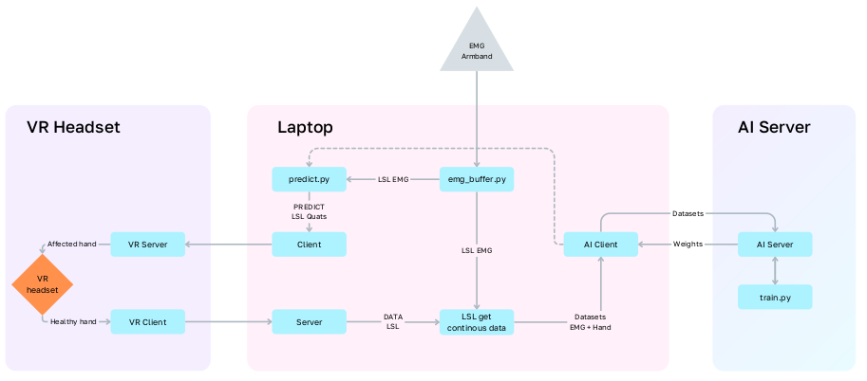
Mirrored hand motion decoding: ALVI PIPELINE
Adaptive Air Density Estimation

Slide 57
Model: Input Independent
Input Feature: Sequential F vector (where F is either MN Synergies {H), M Synergies, or RMS Features). The model must accept a flexible sequential input of size [Time x Features]
Encoder Blocks: Transformer Encoder Blocks, featuring Multi-Head Self-Attention and a Feed-Forward Network (FFN). Paper (ALVI…)
Residual Blocks: Ensures that the compressed representation maintains its high information content, preventing information loss during downsampling. Shared across all prediction tasks
Decoder Branches: Two or Three separate Decoder Branches. Multitask Learning. Separates the output prediction into distinct, manageable tasks:
Hand Posture: Predicts kinematic Synergy Coefficients.
Wrist Angles: Predicts direct angles (Flex/Ext, Ulnar/Radial Dev).
Grip Force: Predicts 1 continuous force value.
Output Layer: Continuous Prediction Layer
EMG-DRIVEN HAND GRASP PREDICTION

Slide 58
Reference Models
Wrist + Hand Prediction Deep end-to-end (raw sEMG):
Wearable and Ultra-Low-Power Fusion of EMG and A-Mode US for Hand-Wrist Kinematic Tracking
Hand Prediction + force feedback:
ALVI
EMG-DRIVEN HAND GRASP PREDICTION

Slide 59
Target Reaching Task
Completion Rate (CR): Percentage of successfully reached targets (within tolerance and time limit) out of total attempts.
Completion Time (CT): Average time required to move the hand from the previous target's center to the center of the current target.
Index of Effectiveness (IE): Composite metric combining speed and accuracy (often based on Fitts' Law).
An IE close to 1.0 indicates minimal delay introduced by the model.
Jerk (J): Measures the rate of change of acceleration.
EMG-DRIVEN HAND GRASP PREDICTION

Slide 60
Imitation Learning Approach
IL: Different branches: Behavior Cloning, Hybrid Approaches (Combination of RL and IL) ad Inverse RL, hierarchical IL and adversarial imitation learning (GAIL), Continual Imitation Learning. .
Why? Traditional control methods, such as surface electromyography (sEMG) and vision-based semi-autonomous approaches, usually require users to repeatedly generate myoelectric signals for each operation, which could be physically and mentally demanding. But because the focus of the thesis is also Rehabilitation we do need a Semi-Autonomous system with the muscular user input, unlike fully autonomous IL approaches.
How to fuse IL with sEMG information to improve rehabilitation? Fine tuning with IL?
EMG-DRIVEN HAND GRASP PREDICTION

Slide 61
Bibliography:
“Neural bases of hand synergies” Marco Santello, Gabriel Baud-Bovy and Henrik Jörntell, Frontiers in Computational Neuroscience, April 2013
“Gesture Recognition Using Surface Electromyography and Deep Learning for Prostheses Hand: State-of-the-Art, Challenges, and Future” Li
“NeuroPose: 3D Hand Pose Tracking using EMG Wearables” Yilin Liu, Shijia Zhang, Haipeng Zhou, Ruidong Zhang, Yuanchun Li, Yanzhe Liu, Chris Harrison, and Shwetak N. Patel. 2021.
“ALVI Interface: Towards Full Hand Motion Decoding for Amputees Using SEMG”Aleksandr Kovalev, Anna Makarova, Petr Chizhov, Matvey Antonov, Gleb Duplin, Vladislav Lomtev, Viacheslav Gostevskii, Vladimir Bessonov, Andrey Tsurkan, Mikhail Korobok, and Aleksejs Timčenko. 2025.
“emg2pose: A Large and Diverse Benchmark for Surface Electromyographic Hand Pose Estimation”, Salter, S., Warren, R., Schlager, C., Spurr, A., Han, S., Bhasin, R., Cai, Y., Walkington, P., Bolarinwa, A., Wang, R., Danielson, N., Merel, J., Pnevmatikakis, E., & Marshall, J. (2024).
"Online Classification of Transient EMG Patterns for the Control of the Wrist and Hand in a Transradial Prosthesis" D. D'Accolti et al., IEEE Trans. Neural Syst. Rehabil. Eng., vol. 31, pp. 642–651, 2023.
“Wearable and Ultra-Low-Power Fusion of EMG and A-Mode US for Hand-Wrist Kinematic Tracking”. Spacone, G., Frey, S., Orlandi, M., Rapa, P. M., Kartsch, V., Benatti, S., Benini, L., & Cossettini, A. (2025). IEEE Transactions on Biomedical Circuits and Systems.
“Merging motoneuron and postural synergies in prosthetic hand design for natural bionic interfacing” Patricia Capsi-Morales, Deren Y Barsakcioglu, Manuel G Catalano, Giorgio Grioli, Antonio Bicchi, Dario Farina. Sci Robot. 2025 Jan 15
EMG-DRIVEN HAND GRASP PREDICTION

Slide 62
Bibliography:
“Decoding of Multiple Wrist and Hand Movements Using a Transient EMG Classifier”, Daniele D’Accolti , Member, IEEE, Katarina Dejanovic , Leonardo Cappello, Enzo Mastinu , Max Ortiz-Catalan and Christian Cipriani, 2023
“Recent trends and challenges of surface electromyography in prosthetic applications” Drishti Yadav, Karan Veer, Biomedical Engineering Letters, 22 April 2023
“Exploring the EMG transient: the muscular activation sequences used as novel time-domain features for hand gestures classification.” Mereu, F., Morosato, F., Cordella, F., Zollo, L., and Gruppioni, E. Frontiers in Neurorobotics (2023)
“Recent trends and challenges of surface electromyography in prosthetic applications.” Yadav, D., & Veer, K. , Biomedical Engineering Letters (2023)
“Hand gesture recognition based on motor unit spike trains decoded from high-density electromyography:” Chen Chen, Yang Yu, Shihan Ma, Xinjun Sheng, Chuang Lin, Dario Farina, Xiangyang Zhu. Biomedical Signal Processing and Control (2020)
“Real-Time EMG Based Pattern Recognition Control for Hand Prostheses: A Review on Existing Methods, Challenges and Future Implementation” Parajuli, N., Sreenivasan, N., Bifulco, P., Cesarelli, M., Savino, S., Niola, V., Esposito, D., Hamilton, T. J., Naik, G. R., Gunawardana, U., & Gargiulo, G. D., Sensors (2019)
“Multiday EMG-Based Classification of Hand Motions with Deep Learning Techniques” Zia ur Rehman, M., Waris, A., Gilani, S. O., Jochumsen, M., Niazi, I. K., Jamil, M., Farina, D., & Kamavuako, E. N., Sensors (2018)
“Distance and mutual information methods for EMG feature and channel subset selection for classiﬁcation of hand movements” Al-Angari, H. M., Kanitz, G., Tarantino, S., & Cipriani, C., Biomedical Signal Processing and Control (2016)
“Deep Learning with Convolutional Neural Networks Applied to Electromyography Data)”, Atzori, M., Cognolato, M., & Müller, H., Frontiers in Neurorobotics (2016)
EMG-DRIVEN HAND GRASP PREDICTION

Slide 63
Bibliography:
“Kinematic and Dynamic Synergies of Human Precision-Grip Movements” Grinyagin, I. V., Biryukova, E. V., & Maier, M. A., Journal of Neurophysiology (2005)
“A synergy-based hand control is encoded in human motor cortical areas” Leo, A., Handjaras, G., Bianchi, M., Marino, H., Gabiccini, M., Guidi, A., Scilingo, E. P., Pietrini, P., Bicchi, A., Santello, M., & Ricciardi, E., eLife (2016)
“Regression of Hand Movements from sEMG Data with Recurrent Neural Networks” , Philipp Koch, Mark Dreier, Anna Larsen, Tim J. Parbs, Marco Maass, Huy Phan, and Alfred Mertins (2025)
“Toward Biosignals-Free Autonomous Prosthetic Hand Control via Imitation Learning” Kaijie Shi , Wanglong Lu , Hanli Zhao , Vinicius Prado da Fonseca , Member, IEEE, Ting Zou , Senior Member, IEEE, and Xianta Jiang , Senior Member, IEEE TRANSACTIONS ON NEURAL SYSTEMS AND REHABILITATION ENGINEERING (2025)
“Dexterous Manipulation through Imitation Learning: A Survey“ Shan An, Senior Member, IEEE, Ziyu Meng, Chao Tang, Yuning Zhou, Tengyu Liu, Fangqiang Ding, Shufang Zhang, Yao Mu, Ran Song, Senior Member, IEEE, Wei Zhang, Senior Member, IEEE,
Zeng-Guang Hou, Fellow, IEEE, and Hong Zhang
EMG-DRIVEN HAND GRASP PREDICTION

Slide 64
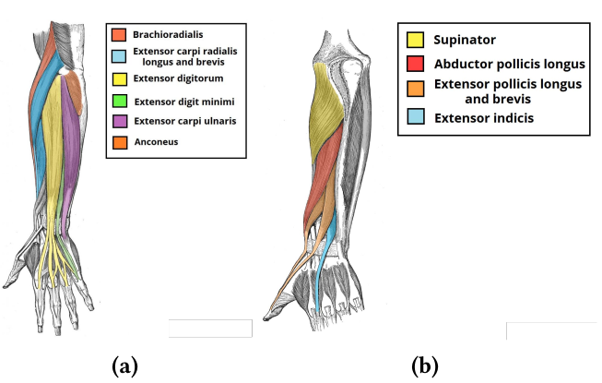
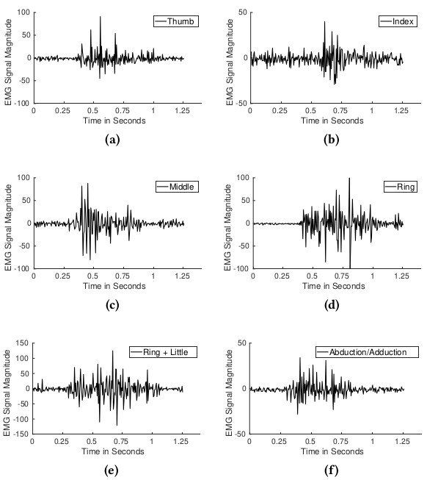
Hand
EMG-DRIVEN HAND GRASP PREDICTION

Slide 65
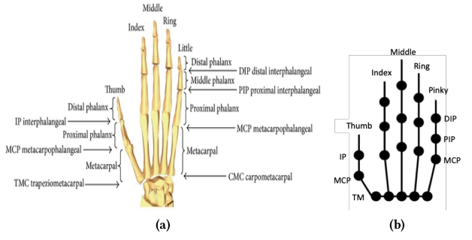
Hand
EMG-DRIVEN HAND GRASP PREDICTION

Slide 66
NN: NeuroPose3D
Input: 8 channel EMG armband (Myoband);
Output: 21 finger joint angles (4 DOF for finger);
Median accuracy of 6.24°;
Transfer Learning (this framework adapts the existing pretrained model. It fine-tunes the model to understand the specific nuances of the new user, making the tracking more accurate for them) based on Adaptive batch normalization;
NeuroPose only needs 90s of training samples from a new user to customize a pretrained model to the user.
ED NN: The network accepts 5s of sensor data and outputs the corresponding 3D hand pose sequence.
The output of network is 16 instead of 21 finger joints, because 5 of them can be computed with equations;
Input: 1000 x 8, 200 Hz so a total of 5 s;
Encoder: ResNet between layers;
Ground truth of joint position from a depth camera. Syncronization with Coordinated Universal Time (UTC) timestamps.;
Loss: sum of loss of mcp,f/e + loss of mcp,aa+losspip+lossthumb+loss smoothness. loss smoothness to enforce constant velocity smoothness, we use the derivative of the vector of all joint angles across all fingers at time step t.
12 users (8 males, 4 females)between 20-30, and weigh between 47-96kgs.
EMG-DRIVEN HAND GRASP PREDICTION

Slide 67
NN: NeuroPose3D
LSTM variant of RNN: The generated EMG sensor data is not only dependent on muscle contractions to maintain the current finger pose but also dependent on the force exerted in the muscles to move the fingers to a new position.
RNN: the transformer need 5 second of data input because of its attention layer, instead the RNN relies on its hidden state in which it moemorize the past states, and now it has only to process the current frame.
Backpropagation Through Time (BPTT) to solve the problem of explosion of gradients because of long dataset so long training.
Normalization for joint limits and bRELU;
Finetuning the BN layers help with domain adaptation because of their ability to contain wide oscillations in the distributions of input fed from one layer to the next.
User just performs random finger motions ad we did.
Each user participates in 12 separate sessions with each session lasting for 3 minutes with sufficient rest between sessions. For the first 5 sessions, both the sensor position and the wrist position are not changed. For the each of the last 6 sessions, we remove and remount the sensor. Users perform up, down, bend, down, up for sessions 11 respectively. For the last session, the users perform the mobile configuration.
EMG-DRIVEN HAND GRASP PREDICTION

Slide 68
NN: NeuroPose3D
Test: over test cases that include the last 6 sessions where (i) The sensor has been removed and remounted on the user’s arm (ii) The wrist position is completely different from the one used to train the models.
In the end the consumption and the higher accuracy of the encoder decoder rnn based network trade off is preferred to the LSTM.
Future Works: Unsupervised Domain Adaptation. Also When a user is holding an object, the muscles responsible for grip strength interfere with the signals from the muscles controlling fine finger motion. This interference corrupts the Electromyography (EMG) data, potentially reducing the accuracy of hand pose decoding. To refine the NeuroPose algorithms to minimize this interference caused by the additional muscle signals activated by force, thereby ensuring that pose tracking accuracy is maintained even when the user is physically interacting with an object.
EMG-DRIVEN HAND GRASP PREDICTION

Slide 69

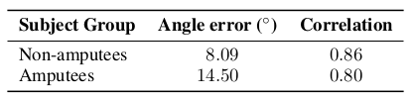
Mirrored hand motion decoding
25 Hz Reconstruction of 20 DOF Hand Pose for upper limb amputees;
0.8 correlation between prediction and ground truth;
Transformer-based method (HANDFORMER)
Limits: electrode placement, muscle fatigue, day-to-day fluctuations → regular calibration. Also it needs more amputees for the dataset.
Final achievements: participants reported growing sense of intuitive control.
Future Works: position-invariant sEMG decoding: long term stability of the interface; reduce calibration frequency (now 10 minutes). Apply to Physical prostheses.
EMG-DRIVEN HAND GRASP PREDICTION

Slide 70
Mirrored hand motion decoding: strumentation
Oculus Quest to track the intact hand;
Wireless Myo Armband by Thalmic Labs;
Lab Streaming Layer (LSL) OS
input: 200 Hz EMG activity normalized with minmax with 1.28 time window, total 256 temporal points;
output: 25 Hz in 1.28 s time window, so 32 temporal future poses.
Participants: 20 non-amputees, 2 amputees;
Gestures: 45 dynamic and 27 static;
Sessions: 3 on different days (1 for testing), 1 minute each movement.
Input [8, 256]. patch [1,8] → 256 tokens, 32 tokens per channel.
Encoder: transforms tokens in the latent space;
Decoder: ask 32 queries to extract 20 variables.
EMG-DRIVEN HAND GRASP PREDICTION

Slide 71
Mirrored hand motion decoding: TRANSFORMER
The Encoder is optimized to handle the long sEMG input sequence (8 channels x 256 time points). Instead of costly Self-Attention (O(N2)), it uses Cross-Attention to compress the input into only 32 Latent Vectors (the bottleneck). This ensures processing is fast and real-time;
The Non autoregressive Decoder generates all 32 movement frames (the 1.28 seconds of hand pose) simultaneously in a single pass. It uses 32 Learnable Queries that query the Latent Vectors in parallel. This eliminates cascading errors (common in sequential models) and ensures extremely smooth and stable hand tracking;
The model is trained in two phases: 1. MAE Pretraining (70% masking): The Encoder learns the underlying patterns and muscle relationships hidden within the EMG signal. 2. L1 Fine-tuning: The pretrained Encoder weights are used to optimize the prediction of the joint angles (the 20 movement variables), achieving maximum final pose accuracy.
FINE TUNING: updates weights every 10 seconds
EMG-DRIVEN HAND GRASP PREDICTION

Slide 72
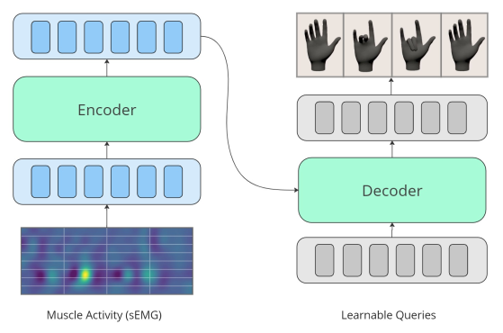
Mirrored hand motion decoding: TRANSFORMER
Each query ask for one of the 32 frame of the total movement to predict
EMG-DRIVEN HAND GRASP PREDICTION

Slide 73
emg2Pose Dataset and Vemg2pose Model
16 channel bipolar sEMG-RD wrist band at 2kHz (no HD sEMG)
velocity based emg2pose: model proposed by this paper, it predicts angular velocities. Architecture: Time-Depth Separable Convolution (TDS) featurizer which reduce 2khz to 50 Hz and a LSTM decoder. the features at each time step are concatenated to the joint angle predictions at the previous time step and fed to the decoder which produces the next velocity prediction. vemg2pose is therefore auto-regressive with respect to its own predictions. then predictions are linearly up-sampled to match the sample rate of the joint angles targets.
Limitations: more errors for new stage and new stage and user. no wrist movements. also the wrist band is not public available. Also this is Autoregresive instead of non euro regressive as ALVI model.
EMG-DRIVEN HAND GRASP PREDICTION

Slide 74
decoding of multiple wrist and hand movement using a transient emg classifier
It is the same research of before and it’s the proof that the calssificator is robust and precise, high accuracy and generalization. found that the transient EMG phase can be indeed used for predicting/classifying the intended grasp type (power, lateral, bi-digital grasps, open movement) and for controlling multi-grasp prosthetic hands with remarkable real-time performance proved that the onset of contraction includes relevant information predictive of the pre-planned grip force extracted in real-time using a regression algorithm classification on eight classes, including both wrist (flexion, extension, pronation, supination) and hand movements (open hand and power, lateral and bi-digital grasps). 14 non amputee and 5 transradial amputee.
results in classification accuracy: intra-subject classification 96,2% non amputees and 89.2% with amputees. In the preliminary online assessment, the amputee participant was able to successfully control the eight wrist and hand movements, completing 81.2% TAC test trials. cross-subject classifier, the results for the eight class problem proved promising (∼65% accuracy) for non-amputees, albeit rather poor for amputees (∼30% accuracy)
They assessed for the first time whether the informative content of the transient EMG could be used to train a cross-subject classifier. i.e., whether the data collected from multiple users could be used to train a classifier able to decode the movements of a new user
They say this kind of investigation for steady state was already made but there was such a variability in the acucuracies, that bc it proved acceptable for gross movements like wrist or power grasps but for finer movements no.
until this paper cross-subject classification using signals collected from participants with amputations was never reported.
EMG-DRIVEN HAND GRASP PREDICTION

Slide 75
decoding of multiple wrist and hand movement using a transient emg classifier
TAC test for amputees measures (in this paper you can find cit to tac test): :
Velocità (Completion Time): Quanto velocemente l'utente può passare da una presa all'altra.
Affidabilità (Success Rate): Quante volte la transizione avviene correttamente (senza errori di classificazione).
participants were instructed to perform one repetition for each movement at the maximum voluntary contraction level (MVC).tehn perform 20 repetitions of each movement, at a moderate, non-fatiguing force level (about 40% of the MVC), and were allowed to pause between each movement. the average mean absolute value (aMAV) from all EMG channels was displayed in real time to the participant as a bar with variable length (0% representing rest, 100% representing MVC). This biofeedback signal helped the participants contracting their muscles in a repeatable fashion. two different feature sets were extracted. The first (FS1) exploited widely used time domain features (i.e., MAV, zero crossing (ZC), waveform length (WL), slope sign changes (SSC) and root mean squared (RMS)) [16], the second (FS2) exploited the MAV extracted for three consecutive windows (i.e., MAV(t=50) , MAV(t=100) , MAV(t=150) ), FS1 was included to compare our method with the state-of-the-art steady-state EMG control techniques. while for inter subject both FS1 and FS2. Not surprisingly, the classification accuracy increased with the training repetitions (in a statistically significant manner for non-amputees) (Fig. 3) and the best median accuracies were achieved with 15 repetitions per movement. In their previous studies. they try only to use FS2 because dry electrode which are more commercial doesn’t have the power to compute also all the other features, but oc fs1 outperform it.
EMG-DRIVEN HAND GRASP PREDICTION

Slide 76
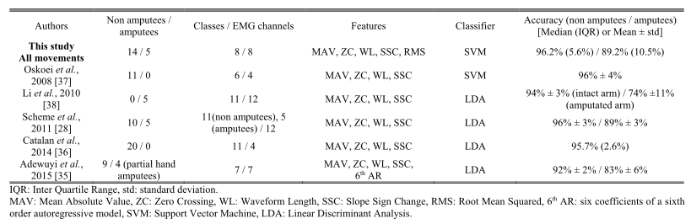
decoding of multiple wrist and hand movement using a transient emg classifier
EMG-DRIVEN HAND GRASP PREDICTION

Slide 77
transient EMG controller for the control of both wrist and hand
assumption that repeatable muscular contractions produce repeatable patterns of steady-state EMGs. processing the signals associated with the onset of contraction (transient EMG
We demonstrated that the muscle contraction associated with the initial enclosing phase of the grasp, contains indeed predictive information about the intended (and preplanned) grasp, which can be used in real-time to control a multi-grasp hand
EMG signals were acquired via the embedded system over Bluetooth wireless link with a 500 Hz sampling rate, and filtered via a 20 Hz second order Butterworth high-pass filter, a 250 Hz third order Butterworth low-pass filter, and a 50 Hz notch filter. Then, the embedded system extracted the mean absolute value (MAV) from windows of data of 100 ms with 50 ms overlap, and lastly executed the proposed classification scheme
EMG-DRIVEN HAND GRASP PREDICTION

Slide 78
transient EMG controller for the control of both wrist and hand
BioPatRec toolbox: è una piattaforma di ricerca modulare open source implementata principalmente in MATLAB. Mentre LibEMG è più in python. LibEMG non è un modello di regressione; è l'impalcatura che garantisce che il tuo modello di regressione riceva i dati EMG pre-elaborati, finestrati (windowed) e featurizzati in modo corretto e in tempo reale. Ti permette di concentrarti sulla qualità del modello di regressione senza dover riscrivere tutta la logica di gestione del segnale e della latenza.
macchina a stati per l onset detection
this is the reality aplication of the paper before.
WRIST
This classification logic allows to recognize the wrist movement, but you cannot perform wrist and closure at the same time.
I muscoli che controllano la pronazione e la supinazione sono:
Pronazione (Rotazione Palmo in Basso): Pronatore Rotondo Pronatore Quadrato
Supinazione (Rotazione Palmo in Alto): Bicipite Brachiale (Biceps Brachii - Se il gomito è flesso), Supinatore (Supinator)
EMG-DRIVEN HAND GRASP PREDICTION

Slide 79
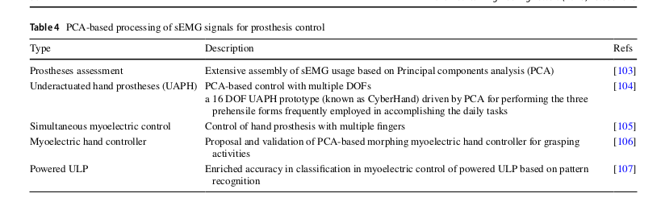
Recent trends and challenges of sEMG(2023)
the PCA recognizes a typical temporal pattern across large datasets of sEMG signals, and describes a low-dimensional space wherein the original signals can be expressed as vectors and then classified.
what about emg plus IMU?
EMG-DRIVEN HAND GRASP PREDICTION

Slide 80
Gesture Recognition Using EMG and DL for prostheses
The hand grasping is divided into 33 categories according to four parameters, including thumb position, power type, opposition type, and virtual finger assignments.
According to the way of interaction with external objects, Averta et al. (2020) divided upper limb movements into three categories: intransitive, i.e., gestures, transitive, i.e., motion interacting with an object, toolmediated, i.e., motion of interaction between objects.
sEMG pattern recognition is to extract multi-dimension features from sEMG signals, rather than relying entirely on EMG amplitude, which is usually used in non-pattern recognition.
The sEMG pattern recognition techniques can be achieved with two primary processing methods: machine learning (ML) and deep learning. For conventional machine learning algorithms, there are limitations in processing raw data, because they could not effectively train on inconsistent, noisy, abstract, and highdimensional data. It found that almost all the data used by traditional ML methods come from steady-state signals, but the sEMG signals generated by gestures in daily life are transient. Transient-state analysis is a very challenging task suitable for DL processing.
EMG-DRIVEN HAND GRASP PREDICTION

Slide 81
Gesture Recognition Using EMG and DL for prostheses
The sEMG signals are collected from sEMG sensors, which could adopt two different acquisition criteria, sparse multi-channel sEMG and high-density sEMG (HD-sEMG), in the density of the employed electrodes of view.
Pre processing:
smoothing: This means that the probability distribution of the sEMG changes with time. let s do rectification and filtering (Low-Pass Filtering (Filtro Passa-Bass oor Moving Average Method (Media Mobile)).
normalization;
segmentation: gesture detection and sliding windowing. 150-250 ms windows is best. decline is <100 ms. better overlapping windows.
Feature Extraction: increase the information density implicit in sEMG signals and improve the difference between gestures.
Traditional The existing sEMG features can be dividedinto four types: time domain features (TD), frequency domainfeatures (FD), time-frequency domain features (TFD), and parameter mode.
sEMG Image: he time-series EMG data into a two-dimensional matrix, a "pseudo-image," which CNNs can effectively analyze.The signal is re-structured into a M×N matrix. Typically, the matrix rows represent time samples within the window, and the columns represent the different EMG channels (electrodes).
EMG-DRIVEN HAND GRASP PREDICTION

Slide 82
Gesture Recognition Using EMG and DL for prostheses
the performance of AE slightly outperformed the state-of-the-art factorization algorithms, i.e., non-negative matrix factorization. The results showed that AE outperformed CNN in intra-session analysis, but CNN had stronger robustness and higher computational efficiency. it still can ave data distribution mutation problem, so better integrate transfer learning and domain adaptation.
Post-Processing:
multiwindow joint decision-making:
confidence score:
tolerate some error classification.
Performance Evaluation:
MSE or R can be biased to methods like TAC and MEasures based on FItt’s law are better for evaluating real time model of prosthesis.
Mukti session Evaluation
Intra-session:
Inter session:
Intra-subject:
EMG-DRIVEN HAND GRASP PREDICTION

Slide 83
Gesture Recognition Using EMG and DL for prostheses
Signal Acquisition and Processing Devices: problems with type of electrodes.
Offline vs Online Processing Perfomance Evaluation: system with good offline training performance does not always have excellent real-time performance.
Individual-Specific and Variability of sEMG signals: multi-user and multi-session training protocol has been adopted.g, the robustness with daily variation and potential user adaptability in a new recording session over time remains unexplored.
Simultaneous and Proportional Information: Non-Negative Matrix Factorization (NMF) with muscular synergies or Blind Source Separation, BSS with motoneuron
They suggest Ensemble Learning.
EMG-DRIVEN HAND GRASP PREDICTION

Slide 84
Muscular activation sequences used as time-domain feature
to evaluate the robustness of these features extracted from the EMG signal in transient state, on the forearm, for classifying common hand tasks.
signal associated to four hand gestures and the rest condition were acquired from ten healthy people and two persons with transradial amputation..
The highest performance were obtained with the NLR classiﬁer.
Due to the high computational cost of using features extracted from the signal spectrum, time domain features are usually preferred for real-time applications
maximum acceptable time delay between intention and classification that allows the patient not to perceive the latency of the prosthesis response is conventionally set to 300 ms
The transient state is identified by the time instant when the signal exceeds the rest state, this is the ONSET. Onset detection algorithms differ depending on how the muscular activation thresholds are computed;
A muscular activation sequence was obtained by evaluating the time instant when each EMG signal exceeded the correspondent TH_High value.
only muscular activations within 300 ms from the SoA were considered eligible for the classification.
it resulted that muscular activation occurred for three EMG signals per activation sequence, on average among the four tasks. so they reduced the matrix.
EMG-DRIVEN HAND GRASP PREDICTION

Slide 85
Muscular activation sequences used as time-domain feature
Tradition Pattern Recognition is based on what append so MAV/RMS while this new feature is based on how and when wrt the activation order. SO because there where 4 task and the emg are 3 mean then they flatten the output of the classificator of 1x12.
The study presents some limitations. Due to the nature of the EMG transient, the activation bursts are unique for each hand motion and acquisition. Also the limb orientation effect is a problem.
EMG-DRIVEN HAND GRASP PREDICTION

Slide 86
Hand gesture recognition based on motor unit spike trains decoded from high-density electromyography
It cites other paper which demonstrated that among the TD, TF and TDF features, those last ones are the most effective. the features extracted from EMG signals only indirectly reﬂect the neural drive sent to muscles from motor neurons in the spinal cord.As opposed to these classic approaches, direct neural features have also been proposed. These consist in the series of discharge timings of the motor neurons innervating the muscle where EMG is recorded]. The identiﬁcation of these features has been referred to as surface EMG decomposition. myoelectric control based on motor unit activities has been demonstrated for the wrist and ﬁngers.
192 channels: gain of 500 and sampling frequency at 2048 Hz.
EMG signals were decomposed into MUSTs following preprocessing. Then the MUAP waveforms were extracted for hand gesture recognition. The high-density EMG signals were decomposed ofﬂine into MUSTs with the convolution kernel compensation (CKC) algorithm.
Motion recognition: The ﬁrst approach utilized the MUSTs and MUAPs from the EMG decomposition. The second approach was based on the RMS feature, as a classic TD feature extracted from EMG signals used in gesture recognition.
EMG-DRIVEN HAND GRASP PREDICTION

Slide 87
Hand gesture recognition based on motor unit spike trains decoded from high-density electromyography
The MUAP waveforms were classiﬁed into 11 groups corresponding to the motions. The rest task was not taken into consideration since few motor unit discharges were identiﬁed during this task.
This approach decodes hand gestures by first using Blind Source Separation (BSS) on High-Density EMG to extract the Motor Unit Spike Trains (MUSTs) (the actual neural commands). An SVM is then trained offline to associate the cleaned neural signatures (MUAP waveforms) with 11 specific movements. Online, a voting machine classifies the gesture by identifying which group of motoneurons exhibits the highest discharge rate within a 200 ms sliding window.
Kolgomorov tells us if the data are normally distributed so that we can evaluate with ANOVA.
Il Motor Unit Spike Train (MUST) fornisce solo la sequenza temporale (quando) il neurone ha sparato. Non dice quale muscolo è stato attivato né dove si trova il neurone. Per sapere se un MUST appartiene al gesto di Flessione o Estensione, i ricercatori hanno dovuto usare le MUAP (Motor Unit Action Potential) multicanale. La MUAP contiene l'informazione spaziale—la sua forma e ampiezza mostrano dove il segnale è più forte sulla griglia di elettrodi, indicando così il muscolo specifico attivato.
EMG-DRIVEN HAND GRASP PREDICTION

Slide 88
Hand gesture recognition based on motor unit spike trains decoded from high-density electromyography
Questo metodo può essere applicato anche per non TMR amputees, invece per TMR funziona ovviamente meglio.
EMG-DRIVEN HAND GRASP PREDICTION

Slide 89
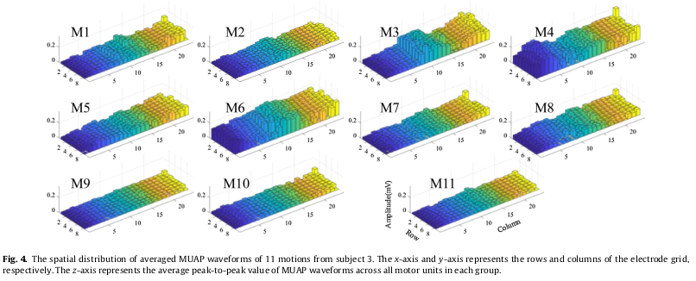
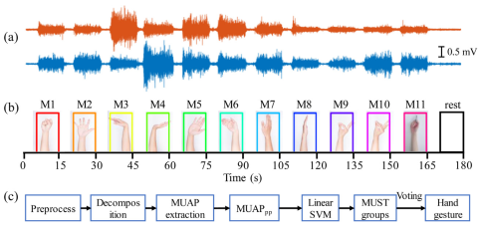
Hand gesture recognition based on motor unit spike trains decoded from high-density electromyography
EMG-DRIVEN HAND GRASP PREDICTION

Slide 90
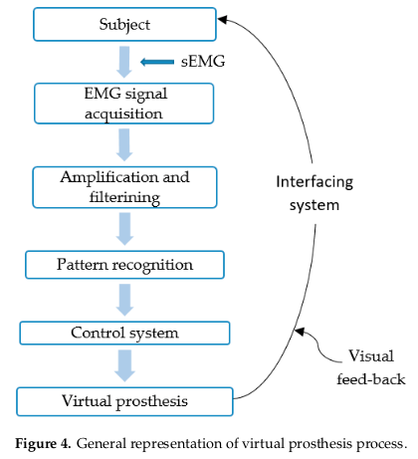
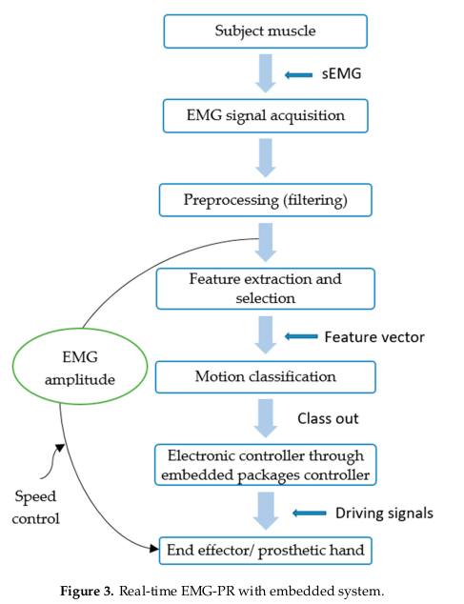
EMG Based Pattern Recognition Control: Review(2019)
EMG-DRIVEN HAND GRASP PREDICTION

Slide 91
A synergy-based hand control is encoded in human motor cortical areas
suggerisce che il comando corticale (il "pensiero" del movimento) è più fedelmente rappresentato dalle sinergie cinematiche (come le dita dovrebbero muoversi) che dalle sinergie muscolari (come i muscoli si attivano).
Grasp Aperture Synergies, Fingertip Orientation Synergies, Force Control Synergies
EMG-DRIVEN HAND GRASP PREDICTION

Slide 92
Neural bases of hand synergies
Differences between kinematic synergies and muscle synergies during two-digit grasping
The main goal of our study was to examine how combined kinematic and kinetic grip constraints are reflected in kinematic synergies and in muscle synergies. synergies of muscular activation are at least in part at the origin of kinematic synergies during upper limb reach-and-grasp movements.
EMG-DRIVEN HAND GRASP PREDICTION

Slide 93
Kinematic and Dynamic Synergies of Human Precision-Grip Movements
For fast precision grip they demonstrate that synergies are dynamic, they use PCA to track how the influence of each synergy changes in each ms of the movement. They divided cinematic synergies and dynamic synergies, the latter dominates the final phase of contact and manipulation. Fase Iniziale: I coefficienti delle sinergie cinematiche (legate all'apertura e alla forma della mano) mostrano un aumento rapido e poi un rallentamento. Questa sinergia è "accesa" per impostare la geometria della mano. Fase Intermedia (Transizione): Man mano che la mano si avvicina all'oggetto, il controllo si sposta. L'influenza dei coefficienti cinematici diminuisce, mentre i coefficienti delle sinergie dinamiche (legate alle forze esercitate) iniziano ad aumentare. Fase Finale: La sinergia dinamica domina. I coefficienti di forza e coppia (torque) raggiungono il loro picco e si stabilizzano, riflettendo la fase di controllo della forza sull'oggetto.

Slide 94
Wearable and Ultra-Low-Power Fusion of EMG and
A-Mode US for Hand-Wrist Kinematic Tracking
1 soggetto, 3 sessioni (re-positioning dei sensori a ogni sessione).
11 gesture (6 mano, 5 polso):
Mano: open, fist, fine pinch, middle pinch, thumb up/down.
Polso: flexion, extension, radial dev., ulnar dev., supination.
Ogni gesto tenuto per 4 s × 6 ripetizioni per set × 5 set/sessione.
Totale ≈ 5.5 min per set, ≈ 16.5 mis/sessione
ultra-low- power (sub-50 mW) system for concurrent acquisition of 8 channel EMG and 4-channel A-mode US signals, integrating two state-of-the-art platforms into fully wearable, dry-contact armbands. We propose a framework for continuous tracking of 23 degrees of freedom (DoFs), 20 for the hand and 3 for the wrist, using a kinematic glove for ground-truth labeling.
EMG and US have independently been explored for regression, to the best of our knowledge, no studies have combined them for wearable HGR regression.
MANUS Quantum Metaglove
compared to the original Neuropose that predicted only hand joint angles, we support simultaneous prediction of both hand and wrist angles through multitask learning
EMG-DRIVEN HAND GRASP PREDICTION

Slide 95
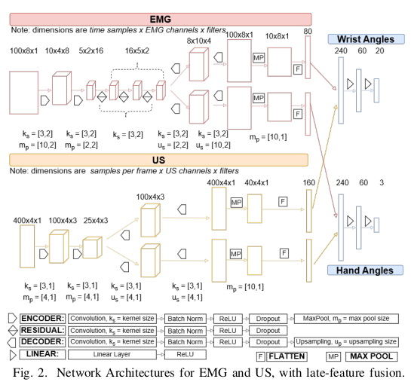
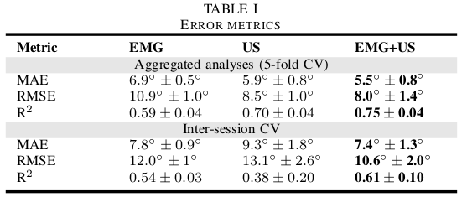

Wearable and Ultra-Low-Power Fusion of EMG and
A-Mode US for Hand-Wrist Kinematic Tracking
EMG-DRIVEN HAND GRASP PREDICTION

Slide 96
Wearable and Ultra-Low-Power Fusion of EMG and
A-Mode US for Hand-Wrist Kinematic Tracking
EMG-DRIVEN HAND GRASP PREDICTION

Slide 97

L is the total length of the original dataset collected.
S number of synergies extracted. T number of tasks or hand postures for which the algorithm is trained. A dof of robot.
Map activation signals H (SxL) to commands fo the hand X (AxL).
The trained hand postures were defined as P=KH (TxL) so that ks are the weights of K and are initialized with the average activation of each corresponding active synergy per task. These weights are normalized per pi (hand task) by setting the sum of weights equal to 1. la divisione per P assicura che il modello sia robusto all'intensità: non importa quanto forte il soggetto pensi di muoversi; la mano assume sempre la postura corretta, determinata solo dal bilanciamento delle sinergie.
EMG-DRIVEN HAND GRASP PREDICTION

Slide 98
La Relazione R funge da traduttore meccanico:
X = RP
il sistema utilizza i 192 elettrodi per isolare le scariche delle singole Unità Motorie (MU). La decomposizione (separazione) avviene in tempo reale dopo una breve sessione di calibrazione iniziale (training phase).
Online Training Version of NMF for Synergies: Una volta che il segnale neurale (le scariche delle MU) è pronto, l'algoritmo NMF (Non-negative Matrix Factorization) viene applicato continuamente (online). Questo algoritmo estrae in modo dinamico i segnali di attivazione H (le Sinergie di Motoneuroni o MNS) che rappresentano il comando neurale intenzionale dell'utente.
testano il controllo su un cursore in uno spazio 2D (il Target Reaching Task)
EMG-DRIVEN HAND GRASP PREDICTION

Slide 99

Five point Likert scale, participants preferred MN synergies.
On amputhees the number of synergies recorded for both MN and Ms are the same. date for them were recorded by analyzing first the intact arm and then the residual limb, 36 of 40 targets and 33 of 40 target hit for MNs, vs 16 out of 40 for Ms. also MN in shorter time.
They believe that the continuous and proportional control of multiple DOFs with various synergies is better for in hand manipulation that the pattern classification which sequentially swittchs between DOFs or grasps.
Also a generic map between MU spike trains and hand activation commands would need to be retrained for each use, whereas the identification of the latent small dimensionality in MU control can be done from any MU because the latent low-dimensional modules are invariant across the subset of units used for their determination
EMG-DRIVEN HAND GRASP PREDICTION

Slide 100
Merging motoneuron and postural synergies in prosthetic hand design for natural bionic interfacing
seven grip types
particular attention for participants with smaller forearm circumference
Monopolar HD-sEMG recorded, amplified with a gain of 150, bandpass filtered between 10 and 500 H, sampled at 2028 Hz, A/D converted to 16 bits. then a 20 to 500 Hz digital bandpass filter applied.
MVC of each grip is measured though estimated emg amplitude from each emg window (128 samples, 62.5 ms) by first computing the root-mean-square value of each emg channel and then selecting the median value. this signal is lowpass filtered with fourth order butterworth filter with cutoff frequency of 2.5 Hz. participants can see the percentage of force on the screen. 63 recordings.
raw emg signals are digitally band pass filtered concatenated across all grip types and decomposed to extract the piking activity of individual Mu.
during decomposition they compute SDR of the spikes with Filtro Lowpass Butterworth del Quarto Ordine (2.5 Hz): it focuses on the density of the spikes during time.
EMG-DRIVEN HAND GRASP PREDICTION

Slide 101
Merging motoneuron and postural synergies in prosthetic hand design for natural bionic interfacing
NMF is the iterative process that minimizes the euclidean distance between the original signals V and the reconstruction obtained by the multiplicazion of W and H. 100 iterations repeated 10 times for each number of synergies. the greatest r2 among the 10 repetitions was retained for each number of synergies.
EMG-DRIVEN HAND GRASP PREDICTION

Slide 102
Regression of Hand Movements from sEMG Data
with Recurrent Neural Networks
for medical applications requiring a reliable hand gesture recognition like upper limb prostheses [3] or exoskeletons [4], [5] both optical tracking systems as well as data gloves are not suitable.it is worth investigating whether the classification can be replaced by a movement regression of all the different movable hand parts.
Usano Correctness Score per l error measurement
EMG-DRIVEN HAND GRASP PREDICTION

Slide 103
MANUS
A proprietary algorithm calculates 20 finger
joint angles: for each finger, the spread of the carpometacarpal
joint (CMC), the flexion of the CMC, the flexion of the
proximal interphalangeal joint (PIP) and the flexion of the
distal interphalangeal joint (DIP). To represent the 3-axis wrist
rotation, the algorithm computes quaternions, acceleration, and
absolute heading from the 9-axis IMU data. In addition, the
Core provides timestamps. The MANUS SDK [31], developed
in C++, provides an interface to access MANUS Core data.
EMG-DRIVEN HAND GRASP PREDICTION

Slide 104
HAPTICS
Analisi percettiva: quale canale aptico aiuta di più il recupero motorio?
Confronta vibrazione vs forza vs termico (TouchDiver supporta più modalità) per capire quale aiuta più nel migliorare accuratezza o velocità di apprendimento. Ottimo contributo scientifico e pratico.
EMG-DRIVEN HAND GRASP PREDICTION

Slide 105
long term session
Temporal stability: come l’errore cambia nel tempo durante sessioni lunghe, eventuale drift. Spesso il confronto è solo “within-session breve”; se fai cross-session o monitoraggio lungo, potrebbe essere nuovo.
EMG-DRIVEN HAND GRASP PREDICTION

Slide 106
Sparse sEMG or HD-sEMG?
Sparse multi-channel sEMG: less data to transfer and low cost of but sensitive to the domain change of sEMG signal.
HD-sEMG captures the spatial and temporal distribution of motor unit action potentials in muscles through a two-dimensional array of electrodes. This technique increases the amount of data collected and has high recognition efficiency and control quality. For DL, the final prediction results are immediately affected by the quality and quantity of inputs, so the application of HD-sEMG seems to be an effective method to solve myoelectric control problems.
cit. Gesture Recognition Using Surface Electromyography and Deep Learning for Prostheses Hand: State-of-the-Art, Challenges, and Future
EMG-DRIVEN HAND GRASP PREDICTION

Slide 107
general considerations
use of EMG signals recorded from the skin surface remains today the most clinically viable approach for controlling transradial hand prostheses
The sEMG signal is a multi-channel biomedical signal, its datarecording is easily affected by the external environment, biological tissue interference, muscle fatigue, electrode displacement, so there is a lot of noise and non-stationarity, which may obscure important information about muscle electrical activity.
EMG-DRIVEN HAND GRASP PREDICTION

Slide 108
sEMG Tracking
Filter
Segmentation
Muscolare Features
MANUS
Synchronization and Mapping
EMG-DRIVEN HAND GRASP PREDICTION

Slide 109
skeletal muscle contraction: STEADY AND TRANSIENT
STEADY STATE: very little temporal structure due to the active modification of recruitment
and of the firing patterns needed to sustain the contraction. No ODA
TRANSIENT STATE: shows a more deterministic structure, likely due to the orderly recruitment of the Motor Units. ODA algorithm
In general they can be both used for pattern recognition, by extracting the time and frequency features with ML, or through CNN. Transient is better then steady, and CNN methods are better than machine learning ones as LDA or ECOC classifiers.
EMG-DRIVEN HAND GRASP PREDICTION

Slide 110
Recent trends and challenges of sEMG(2023)
sEMG signals offer reasonably high signal-to-noise ratio in comparison of other biosignals. This documentation give a comparison with visual-based control, EEG-based control and controlling action via movements of the eye, and voice control. When compared to voice control, sEMG control has just a minor delay. Furthermore, sEMG control is robust to and insensitive to changes in ambient sound.
In general, sEMG feature extraction can be categorized into three methods: (1) time domain, (2) frequency domain, and (2) time–frequency domain. Common time domain features include Mean Absolute Value, Mean Absolute Value Slope, Zero Crossings, Slope Sign Changes, Waveform Length, Root Mean Square, Histogram, etc.
most of the frequency domain features are normally based on the signal's power spectral density (PSD). Frequency domain features include mean frequency, median frequency, peak frequency, mean power, total power, the 1st, 2nd, and 3rd spectral moments, frequency ratio, power spectrum ratio, the variance of central frequency, etc.
Time frequency domain features are more advantageous than time and frequency domain features alone. the drawback is that these features require more resources and time for their computation. The features from the time–frequency domain include, but are not limited to, short-time Fourier Transform, wavelet transform, and wavelet packet transform.
EMG-DRIVEN HAND GRASP PREDICTION

Slide 111
Merging motoneuron and postural synergies in prosthetic hand design for natural bionic interfacing
different from the traditional designs, multisynergistic soft robotic hands would permit the continuous mapping of different grasp patterns and their transitions. the adaptive implementation of kinematic templates in the interaction with objects, through the softness property, is key to providing versatile grasping patterns. It is simpler to do continuous proportional control strategies than for fully actuated systems. But in order to do this the modular organization of neural variables should be matched with the postural synergistic structure of the robotic limb.
The number of spinal MNs is orders of magnitude greater than the number of muscles involved in a motor task.
prosthetic hand with two inputs than can change two kinematic synergies. their combo span a similar linear space of postures as those generated by the two first postural synergies observed in human hands. this design allows for the grasp and in hand manipulation of objects of different shapes with almost full hans mobility. Grasping actions can be described by two or three postural synergies which justify the implementation of only two independent actuation signals.
EMG-DRIVEN HAND GRASP PREDICTION

Slide 112
They identified MN synergies in several hand-grasping activities.
SoftHand Pro-2: 15 joints with flection/extension. One tendon. one revolute joiny at the thumb. fingers are connected through two motors wich are the dof.
9 participants
They identified MN synergies in several hand-grasping activities.
EMG-DRIVEN HAND GRASP PREDICTION

Slide 113
They used HD electrodes 192 channels to decompose the signal.
- NMF( Non negative matrix factorization) extracts the synergies weights (this is a static pattern of connection between a synergy and specific neuromotors, a higher weight on a MN means that that synergy activates it a lot) for each MU.
- Activation Primitive: temporal signal that decided how much a synergy must be activated in a certain moment, it’s the voluntary command of the user.
EMG-DRIVEN HAND GRASP PREDICTION

Slide 114
ABCD: Extraction of motoneuron synergies
Multiple channels allow for signal decomposition.
B… EMG decomposition: transform electrical signal in neural signal, so in temporal strikes of the singol MUs.
C.. Lowpass Filter and Normalize
D…NMF decompose the signal strikes in two matrices M=WH, W is the synergy weights (shows which MU is involved in each synergy. H is represents the activation Primitive (how much a synergy is activated).
EMG-DRIVEN HAND GRASP PREDICTION

Slide 115
AEF: Extraction of Muscolar Synergy
E..Envelope Extraction and Normalizatiom: extract amplitude of sEMG for each channel
F.. Apply NMF to those amplitude. W represents muscular weights so how much each EMG channel influences a certain synergy.
63 MU synergies are the maximum number of mu decomposed in their pipeline and they are sufficient to extract neural synergies.
EMG-DRIVEN HAND GRASP PREDICTION

Slide 116
G and H shows how good is the reconstruction. in particular for the muscular analysis they use 48 bipolar electrodes.
EMG-DRIVEN HAND GRASP PREDICTION

Slide 117

R2 tell us the minimum number of synergies necessary to capture the majority of the variance.
The histogram tell us that MNS capture more synergies. Also, computing the degree of orthogonality among pairs of synergies, the MN synergies have a higher degree of ortho than muscle synergies which means that the synergies that they can control are very specific, this allows for particular movement.
D shows not all MN synergies could be matched with corresponding muscle synergies.
EMG-DRIVEN HAND GRASP PREDICTION

Slide 118
Multiday EMG-Based Classification of Hand Motions
with Deep Learning Techniques
Deep Learning with Convolutional Neural Networks Applied to Electromyography Data
This study demonstrated that deep learning techniques outperformed the classical machine learning algorithm using both handcrafted features and raw EMG signals as inputs. The results of intra/intersessions and between-days analyses imply that CNN has the potential to recognize EMG patterns even from raw bipolar EMG data for long-term classification notwithstanding the stochastic nature of the EMG signals.
l paper di Al-Angari dimostra che, nell'era del Pattern Recognition classico (LDA, SVM), i ricercatori erano costretti a dedicare sforzi enormi per trovare il sottinsieme di dati ottimale (feature e canali) da dare in pasto al classificatore. Questo processo era lento, manuale e basato su calcoli statistici espliciti.
The paper demonstrated that CNNs are highly effective at learning relevant features directly from the complex, high-dimensional EMG data (often treating the signal as a time-channel structure). This automatically learned representation proved superior to traditional methods like LDA or SVM using hand-crafted features. achieved high accuracy, particularly on large-scale datasets such as the NinaPro series.
EMG-DRIVEN HAND GRASP PREDICTION

Slide 119
Gesture Recognition Using EMG and DL for prostheses
EMG-DRIVEN HAND GRASP PREDICTION

