Slide 1

MATLAB Tutorial

Slide 2
Variables and Assignments
To store a value, use a variable
One way to put a value(s) in a variable is with an assignment statement
General form:
The order is important
Variable name on the left
Assignment operator “=” (Note: this does NOT mean equality)
Expression on the right
variable = expression
% variable = expression a1 = 3 a2 = 5
Name | Value
a1 | 3
a2 | 5
Module 1: Introduction

Slide 3
Variable names
Names must begin with a letter of the alphabet
After that names can contain letters, digits, and the underscore character(_)
You cannot use other character except for ‘_'
MATLAB is case-sensitive
Names should be mnemonic (they should make sense!)
Use a workspace browser rather than type these command
clear clears out variables and also functions
Module 1: Introduction

Slide 4
Example: Variable names
8val = 10; % error: must begin with a letter of the alphabet _col = 0 ; % error: must begin with a letter of the alphabet row_3_ = 1; % no error row@3 = 10; % error: cannot contain characters other than underscore col-03 = 10; % error: cannot contain characters other than underscore % Following scripts have no error but the names should be mnemonic asdf1 = 100; % no error love = 10; % no error aaaa3 = 10; % no error
% define a variable of ‘ga1’ ga1 = 100
Q: What value is in ‘Ga1’ ?
Module 1: Introduction

Slide 5



Data Types
Every expression and variable has an associated type, or class
Real numbers: single, double
Integer types: numbers in the names are the number of bits used to store a value of that type
Signed integers: int8, int16, int32, int64
Unsigned integers: uint8, uint16, uint32, uint64
Single characters and character vectors: char
Strings of characters: string
True/false: logical
The default type for numbers in MATLAB is double
Container
Example
2.145, 0.15893, 3.0, 2.45
10, 11, 24, 30, 400
‘a’, ‘b’, ‘A’, ‘c’
0, 1
char
double
logical
int
Module 1: Introduction

Slide 6
Constants
In programming, variables are used for values that could change, or are not known in advance
Constants are used when the value is known and is not updated in the program.
Examples in MATLAB (these are actually functions that return constant values)
pi 3.14159….
i, j imaginary number
inf infinity
NaN stands for “not a number”; e.g. the result of 0/0
Module 1: Introduction

Slide 7
Example: Arithmetic Operation in MATLAB
If the car has a mass of 300kg and you push the car with an acceleration of 5 , compute the force that is generated from the car in newton
% MATLAB as a calculator 300*5*0.0254
Name | Value
ans | 38.1
% MATLAB as programming tool inch2m = 0.0254; % inch to m mass = 300; % kg accel = 5; % inch/s/s % force = mass(kg) * acceleration (m/s/s) force = mass * accel * inch2m;
Name | Value
inch2m | 0.0254
mass | 300
accel | 5
force | 38.1
Module 1: Introduction

Slide 8
Operator Precedence
A symbol that perform specific mathematical or logical manipulations.
Precedence list (highest to lowest) so far:
( ) parentheses
^ exponentiation
- negation
*, /, \ all multiplication and division
+, - addition and subtraction
Nested parentheses: expressions in inner parentheses are evaluated first
val1 = (5 + 1)*2; val2 = 10^2*3; val3 = 10^(2+3); val4 = 4-3*2; val5 = 3*((4+3)*2);
Name | Value
val1 | 12
val2 | 300
val3 | 100000
val4 | -2
val5 | 42
Module 1: Introduction

Slide 9

Relational Operator
The relational operators in MATLAB are:
> greater than
< less than
>= greater than or equals
<= less than or equals
== equality
~= inequality
The resulting type is logical 1 for true or 0 for false
% relation operator ro1 = 3 < 4; ro2 = 3 > 5; ro3 = 3 == 5; ro4 = 3 ~= 7; ro5 = 3 <= 3; ro6 = 3 >= 3;
Name | Value
ro1 | 1
ro2 | 0
ro3 | 0
ro4 | 1
ro5 | 1
ro6 | 1
Module 1: Introduction

Slide 10

Logical Operator
The logical operators are:
|| or for scalars
&& and for scalars
~ not
Also, xor function which returns true if only one of the arguments is true
Note that the logical operators are commutative
(e.g., x|| y is equivalent to y || x)
The resulting type is logical 1 for true or 0 for false
x | y
true | true
true | false
false | false
~x | x || y | x && y | xor(x,y)
false | true | true | false
false | true | false | true
true | false | false | false
Module 1: Introduction

Slide 11
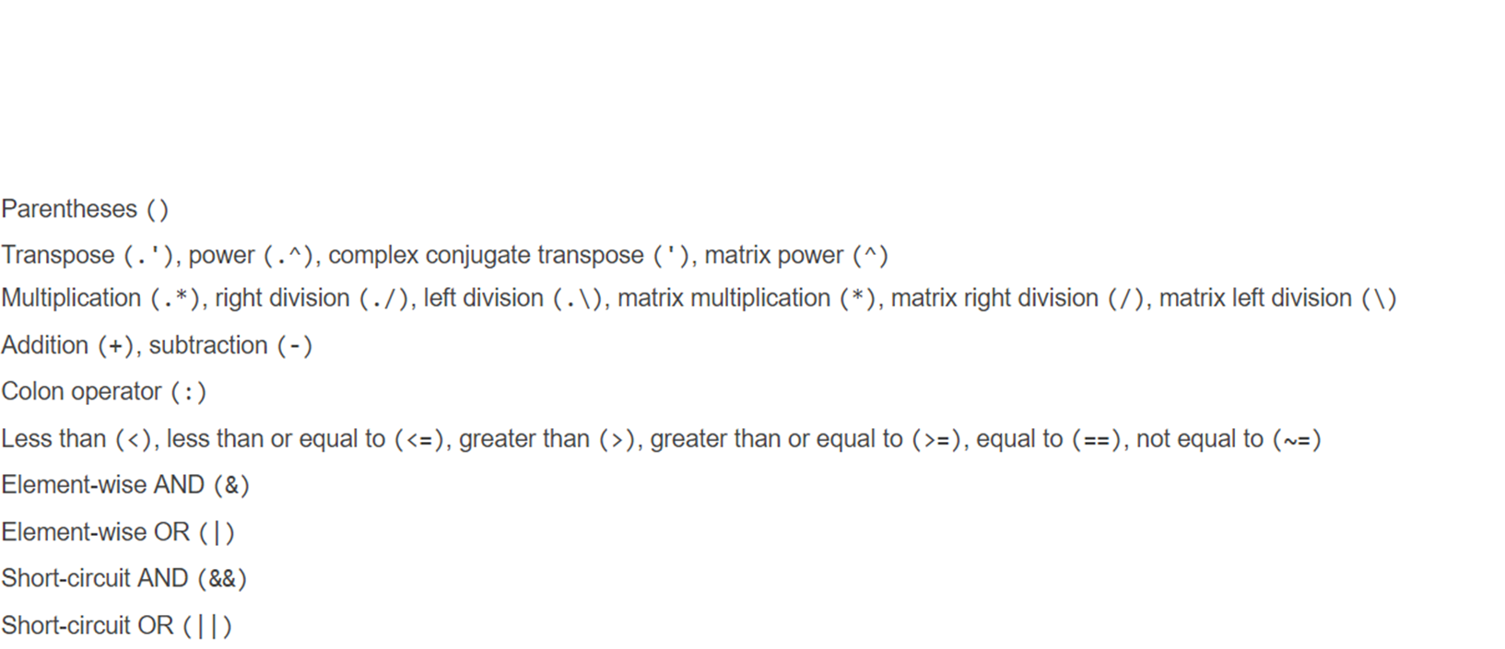
Operator Precedence
Name | Value
lg1 | 1
lg2 | 0
lg3 | 3
lg4 | 1
lg5 | 0
lg6 | 1
lg7 | 1
lg1 = (3 < 4) < 4; lg2 = 3 < (4 < 5); lg3 = (3 > 5) + 3; lg4 = (10 > 4) && (4 > 1); lg5 = (10 < 4) && (4 < 1); lg6 = ~((10 < 4) && (4 < 1)); lg7 = 2 < 3 + 4;
Module 1: Introduction

Slide 12
Example2: Operator Precedence
How to write a code to check if x lies in between 5 and 10. If yes, 1 and otherwise 0.
x1 = 6; x2 = 11; lg1 = (5>=x1) && (x1<=10) lg2 = 5 <= x1 <=10; lg3 = (5 <= x1) <=10; lg4 = (5>=x2) && (x2<=10) lg5 = 5<= x2 <=10; lg6 = (5 <= x2) <=10;
Name | Value
x1 | 6
x2 | 11
lg1 | 0
lg2 | 1
lg3 | 1
lg4 | 0
lg5 | 1
lg6 | 1
Module 1: Introduction

Slide 13
Array Operations
Array operations on two matrices A and B:
These are applied term-by-term, or element-by-element
The matrices must have the same dimensions (no! after R2016)
In MATLAB:
addition/subtraction: A + B, A – B
array multiplication: A .* B
array division: A ./ B, A .\ B
array exponentiation A .^ 2
Matrix multiplication: NOT an array operation
A = [2 2 2; 4 4 4; 6 6 6]; B = [1 1 1; 2 2 2; 3 3 3]; AmB = A.*B; AdB = A./B;
2 | 2 | 2
4 | 4 | 4
6 | 6 | 6
1 | 1 | 1
2 | 2 | 2
3 | 3 | 3
A
B
2 | 2 | 2
8 | 8 | 8
18 | 18 | 18
2 | 2 | 2
2 | 2 | 2
2 | 2 | 2
AmB
AdB
Module 1: Introduction

Slide 14
Matrix Multiplication: Dimensions
Matrix multiplication is not an array operation
It does not mean multiplying term by term
In MATLAB, the multiplication operator * performs matrix multiplication
In order to be able to multiply a matrix A by a matrix B, the number of columns of A must be the same as the number of rows of B
If the matrix A has dimensions m x n, that means that matrix B must have dimensions n x something; we will call it p
In mathematical notation, [A]m x n [B]n x p
We say that the inner dimensions must be the same
The resulting matrix C has the same number of rows as A and the same number of columns as B
in other words, the outer dimensions m x p
In mathematical notation, [A]m x n [B]n x p = [C]m x p.
This only defines the size of C
Module 1: Introduction

Slide 15
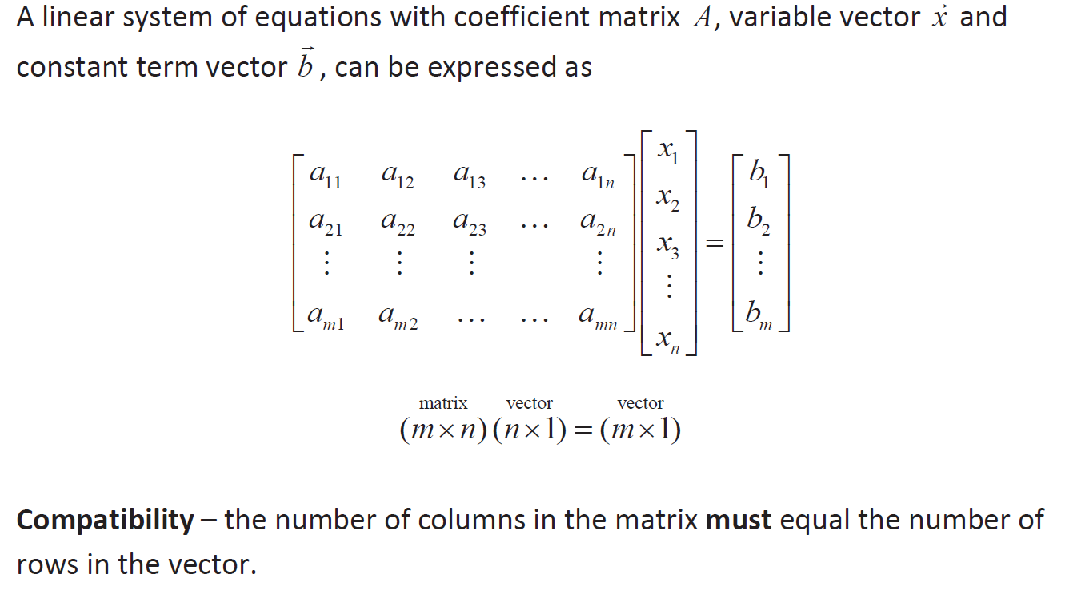
Matrix Times a Vector
Module 1: Introduction

Slide 16
Example: Matrix Times a Vector
m1 = [1 1 1; 2 2 2; 3 3 3]; v1 = [2 2 2]’; c1 = m1*v1; c21 = m1(1,:)*v1; c22 = m1(2,:)*v1; c23 = m1(3,:)*v1; c2 = [c21;c22;c23];
1 | 1 | 1
2 | 2 | 2
3 | 3 | 3
2
2
2
6
12
18
*
=
m1
*
v1
=
c1
2
2
2
1 | 1 | 1
*
=
6
m1(1,:)
*
v1
=
c21
2
2
2
2
2
2
2 | 2 | 2
*
=
12
3 | 3 | 3
*
=
18
m1(2,:)
*
v1
=
c22
m1(3,:)
*
v1
=
c23
Module 1: Introduction

Slide 17
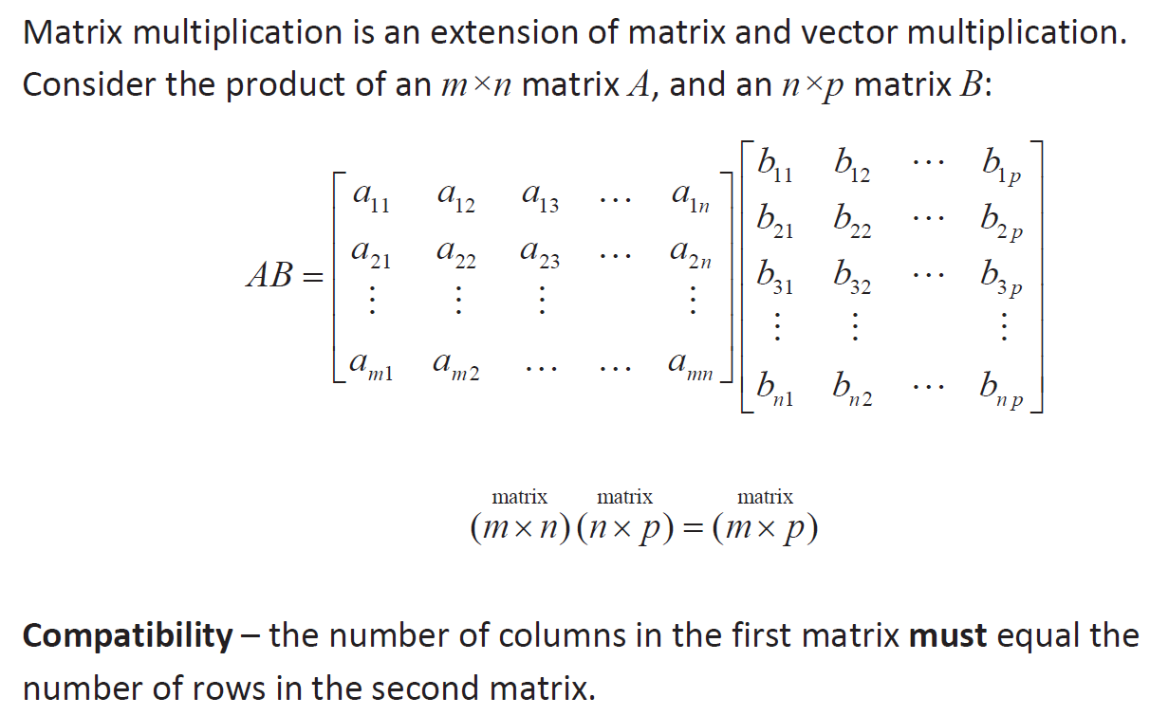
Matrix Times a Matrix
Module 1: Introduction

Slide 18
Example: Matrix Times a Matrix
m1 = [1 2;3 4]; m2 = [1 2;2 1]; m3 = m1*m2; m411 = m1(1,:)*m2(:,1); m421 = m1(2,:)*m2(:,1); m412 = m1(1,:)*m2(:,2); m422 = m1(2,:)*m2(:,2); m4 = [m411 m412;m421 m422];
1 | 2
3 | 4
1 | 2
2 | 1
5 | 4
11 | 10
*
=
m1
*
m2
=
m3
1
2
1 | 2
*
=
5
m1(1,:)
*
m2(:,1)
=
m411
2
1
1 | 2
*
=
4
2
1
m1(1,:)
*
m2(:,2)
=
m412
3 | 4
*
=
11
2
1
m1(1,:)
*
m2(:,2)
=
m421
3 | 4
*
=
10
m1(2,:)
*
m2(:,2)
=
m422
Module 1: Introduction

Slide 19
Example: Swapping Columns
Swap the 2nd and 3rd columns in mat1
1 | 2 | 3
4 | 5 | 6
7 | 8 | 9
1 | 3 | 2
4 | 6 | 5
7 | 9 | 8
mat1 = [1 2 3; 4 5 6; 7 8 9];
mat1(:, [3 2]) = ...
mat1(:, [2 3]);
Module 1: Introduction

Slide 20
If-Statement
The if statement is used to determine whether or not a statement or group of statements is to be executed
General form:
if condition
action
end
the condition is any relational expression (True or False)
the action is any number of valid statements (including, possibly, just one)
If the condition is true, the action is executed – otherwise, it is skipped entirely
Module 2: Selection statement

Slide 21
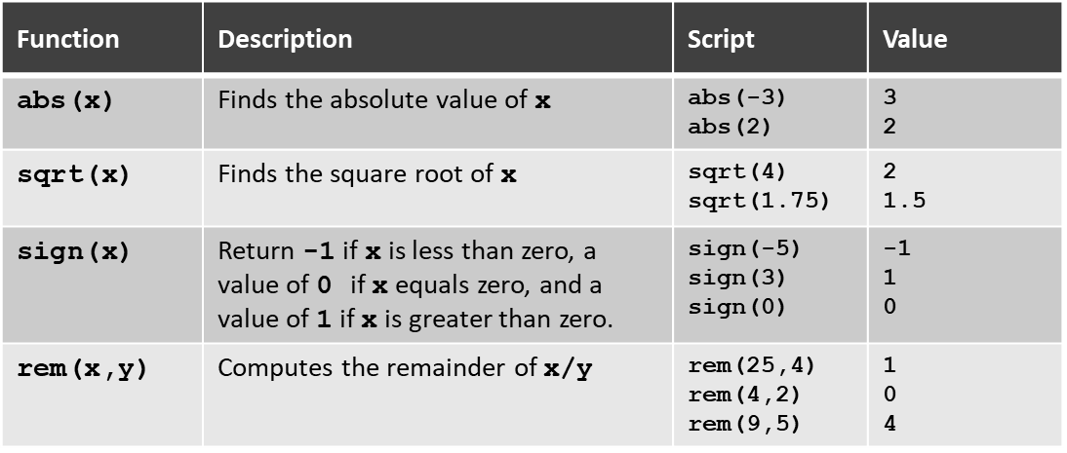
Example 1: If-Statement
x1 = -3 xsign = 1; if x1<0 xsign = -1; end x1_abs = xsign*x1;
x1 = 3 xsign = 1; if x1<0 xsign = -1; end x1_abs = xsign*x1;
Name | Value
x1 | -3
x1_abs | 3
xsign | -1
Name | Value
x1 | 3
x1_abs | 3
xsign | 1
Module 2: Selection statement

Slide 22
Example 2: If-Statement
x1 = -3 xsign = 0; if x1<0 xsign = -1; end if x1>0 xsign = 1; end
x1 = 3 xsign = 0; if x1<0 xsign = -1; end if x1>0 xsign = 1; end
Name | Value
x1 | -3
xsign | -1
Name | Value
x1 | 3
x1_abs | 1
Module 2: Selection statement

Slide 23
If-else Statement
The if-else statement chooses between two actions
General form:
if condition
action1
else
action2
end
Only one action is executed; which one depends on the value of the condition (action1 if it is logical true or action2 if it is false)
Module 2: Selection statement

Slide 24
Example 1: If-else Statement
x1 = -3; xsign = 1; if x1<0 xsign = -1; end x1_abs = xsign*x1;
x1=-3; if x1 < 3 x1_abs = -1*x1; else x1_abs = x1; end
Name | Value
x1 | -3
x1_abs | 3
xsign | -1
Name | Value
x1 | -3
x1_abs | 3
Module 2: Selection statement

Slide 25
Nested if-else Statements
To choose from more than two actions, nested if-else statements can be used (an if or if-else statement as the action of another)
General form:
if condition1
action1
else
if condition2
action2
else
action3
end
end
Module 2: Selection statement

Slide 26
Example: Nested if-else Statements
Q: If ‘scalar1’ is larger than 0 and less than 50, assign 10 to ‘out1’. Otherwise, assign 5 to ‘out1’.
scalar1 = 20; if scalar1 > 0 if scalar1<50 out1 = 10; else out1 = 5; end end
scalar1 = 20; if (scalar1 > 0) && (scalar1 < 50) out1 = 10; else out1 = 5; end
Module 2: Selection statement

Slide 27
if, if-else, if-elseif, if-elseif-else
if condition1
action1
end
if condition1
action1
else
action2
end
if condition1
action1
elseif condition2
action2
end
if condition1
action1
elseif condition2
action2
else
action3
end
Module 2: Selection statement

Slide 28
For-Loop Statement
Used as a counted loop (We know how many times are repeated)
Repeats an action a specified number of times
An iterator or loop variable specifies how many times to repeat the action
General form:
for loopvar = range
action
end
The range is specified by a vector.
The action is repeated for every value of loopvar in the specified vector
If it is desired to repeat the process of prompting the user and reading input a specified number of times (N), a for loop is used:
for ii = 1:N
% do something with it!
end
Module 3: Loop statement

Slide 29
Example1: How For-Loop Works
1 2 3 4 5 | sumv = 0; for ii=1:3 sumv = sumv + ii; end
Step | Operation | Workspace
1 | line1: assign 0 to sumv | sumv → 0
2 | line2: ii becomes 1 | sumv → 0, ii → 1
3 | line3: add sumv and ii, and assign the value to sumv | sumv → 1, ii → 1
4 | line4: end | sumv → 1, ii → 1
5 | go to line2 and ii becomes 2 | sumv → 1, ii → 2
6 | line3: add sum and ii, and assign the value to sumv | sumv → 3, ii → 2
7 | line4: end | sumv → 3, ii → 2
8 | go to line2 and ii becomes 3 | sumv → 3, ii → 3
9 | line3: add sum and ii, and assign the value to sumv | sumv → 6, ii → 3
10 | line4: end | sumv → 6, ii → 3
11 | no more value in range, and go to line5 | sumv → 6, ii → 3
Module 3: Loop statement

Slide 30
Example2: Summation Using For-Loop (continue)
Sum all values in a vector named ‘vec’ and assign the value to ‘sumv’
1 2 3 4 5 | vec = [1 3 7 11]; sumv = 0; for ii=1:4 sumv = sumv + vec(ii); end
1 2 3 4 5 | vec = [1 3 7 11]; sumv = 0; for ii=vec sumv = sumv + ii; end
for ii = 1:N
% do something!
end
for loopvar = range
action
end
Module 3: Loop statement

Slide 31
Nested For-Loop Statement
A nested for loop is one inside of ( as the action of) another for loop
General form of a nested for loop:
for loopvar1 = range1
action1
for loopvar2 = range2
action2
end
end
The inner loop action is executed in its entirety for every value of the outer loop variable
Module 3: Loop statement

Slide 32
Example1: How Nested For-Loop Works
1 2 3 4 5 6 7 | mat1 = [1 2 3;4 5 6]; sumv = 0; for ii=1:2 for jj=1:3 sumv = sumv + mat1(ii,jj); end end
1 | 2 | 3
4 | 5 | 6
mat1
Step | Operation | Workspace
1 | line1: assign values to mat1 | mat1 → [1 2 3;4 5 6]
2 | line2: assign 0 to sumv | mat1 → [1 2 3;4 5 6], sumv → 0
3 | line3: ii becomes 1 | ii → 1, mat1 → [1 2 3;4 5 6], sumv → 0
4 | line4: jj becomes 1 | ii → 1, jj → 1, mat1 → [1 2 3;4 5 6], sumv → 0
5 | line5: read a value at 1 row and 1 column in mat1, and add the value to sumv | ii → 1, jj → 1, mat1 → [1 2 3;4 5 6], sumv → 1
6 | line6: end | ii → 1, jj → 1, mat1 → [1 2 3;4 5 6], sumv → 1
7 | line4: jj becomes 2 | ii → 1, jj → 2, mat1 → [1 2 3;4 5 6], sumv → 1
Module 3: Loop statement

Slide 33
Example1: How Nested For-Loop Works
1 2 3 4 5 6 7 | mat1 = [1 2 3;4 5 6]; sumv = 0; for ii=1:2 for jj=1:3 sumv = sumv + mat1(ii,jj); end end
1 | 2 | 3
4 | 5 | 6
mat1
Step | Operation | Workspace
7 | line5: read a value at 1 row and 2 column in mat1, and add the value to sumv | ii → 1, jj → 2, mat1 → [1 2 3;4 5 6], sumv → 3
8 | line6: end | ii → 1, jj → 2, mat1 → [1 2 3;4 5 6], sumv → 3
9 | line4: jj becomes 3 | ii → 1, jj → 3, mat1 → [1 2 3;4 5 6], sumv → 3
10 | line5: read a value at 1 row and 3 column in mat1, and add the value to sumv | ii → 1, jj → 3, mat1 → [1 2 3;4 5 6], sumv → 6
11 | line6: end and line7: end | ii → 1, jj → 3, mat1 → [1 2 3;4 5 6], sumv → 6
12 | line3: ii becomes 2 | ii → 2, jj → 3, mat1 → [1 2 3;4 5 6], sumv → 6
13 | line4: jj becomes 1 | ii → 2, jj → 1, mat1 → [1 2 3;4 5 6], sumv → 6
Module 3: Loop statement

Slide 34
Example1: How Nested For-Loop Works
1 2 3 4 5 6 7 | mat1 = [1 2 3;4 5 6]; sumv = 0; for ii=1:2 for jj=1:3 sumv = sumv + mat1(ii,jj); end end
1 | 2 | 3
4 | 5 | 6
mat1
Step | Operation | Workspace
14 | line5: read a value at 1 row and 2 column in mat1, and add the value to sumv | ii → 2, jj → 1, mat1 → [1 2 3;4 5 6], sumv → 10
15 | line6: end | ii → 2, jj → 1, mat1 → [1 2 3;4 5 6], sumv → 10
16 | line4: jj becomes 2 | ii → 2, jj → 2, mat1 → [1 2 3;4 5 6], sumv → 10
17 | line5: read a value at 1 row and 3 column in mat1, and add the value to sumv | ii → 2, jj → 2, mat1 → [1 2 3;4 5 6], sumv → 15
18 | line6: end | ii → 2, jj → 2, mat1 → [1 2 3;4 5 6], sumv → 15
19 | line4: jj becomes 3 | ii → 2, jj → 3, mat1 → [1 2 3;4 5 6], sumv → 15
Module 3: Loop statement

Slide 35
MATLAB Operator
Symbol | Role
== | Equal to
~= | Not equal to
> | Greater than
>= | Greater than or equal to
< | Less than
<= | Less than or equal to
&& | Logical AND (scalar logical)
|| | Logical OR (scalar logical)
~ | Logical NOT
& | Logical AND (array)
| | Logical OR (array)
Symbol | Role
+ | Addition
- | Subtraction
* | Multiplication
/ | Division
^ | Matrix power
./ | Element-wise right division
.* | Element-wise multiplication
.^ | Element-wise power
‘ | Transpose
Module 4: Operator

Slide 36
Assign Value(s) to a Variable
val2 = 2; % scalar value vec1 = [1 2 3 4]; % vector vec3 = vec1-val2
variable = expression
Conduct a ‘minus’ operation between a vector of ‘vec1’ and a scalar value ‘val2’. This operation subtract 2 from each element in [1 2 3 4]. A resulting vector is [-1 0 1 2].
Assign a resulting vector to ‘vec3’. ‘vec3’ contains [-1 0 1 2].
Module 4: Operator

Slide 37
MATLAB Operator
1 | 2
3 | 4
5 | 6
7 | 8
1 | 2 | 3 | 4
val1 = 10; % scalar value val2 = 2; % scalar value vec1 = [1 2 3 4]; % vector mat1 = [1 2; 3 4]; % matrix mat2 = [5 6; 7 8]; % matrix
mat1
mat2
vec1
val1 + val2 val1 * val2 val1 / val2 val1^val2 vec1*val1 vec1/val2 vec1 + val2 vec1 - val2 mat1*val2 mat1/val2 mat1 + val2 mat1 - val2 mat1 + mat2 mat1 - mat2 | 12 20 5 100 [10 20 30 40] [0.5 1 1.5 2] [3 4 5 6] [-1 0 1 2] [2 4; 6 8] [0.5 1; 1.5 2] [3 4; 5 6] [-1 0;1 2] [6 8; 10 12] [-4 -4;-4 -4]
Operator
+
-
*
/
^
./
Scalar ★ Scalar
Vector ★ Scalar
Matrix ★ Scalar
Vector ★ Vector
Matrix ★ Matrix
★: Operator
Module 4: Operator

Slide 38
MATLAB Operator
1 | 2
3 | 4
1 | 0
0 | 1
1
0
1 | 2
vec1 = [1 2]; % vector vec2 = [1; 0]; % vector mat1 = [1 2; 3 4]; % matrix mat2 = [1 0; 0 1]; % matrix
mat1
mat2
vec1
vec2
mat1*vec1 mat1*vec2 vec1*mat1 vec2*mat1 mat1*mat2 mat1*mat1 mat1^2 vec1.* vec2’ mat1.*mat2 mat2./mat1 mat1.^2 mat1.*vec2 mat1.*vec1 | error [1; 3] [7 10] error [1 2;3 4] [7 10;15 22] [7 10;15 22] [1 0] [1 0;0 4] [1 0;0 0.25] [1 4;9 16] [1 2;0 0] [1 4;3 8]
Operator
+
-
*
/
^
./
.*
.^
‘
Scalar ★ Scalar
Vector ★ Scalar
Matrix ★ Scalar
Vector ★ Vector
Matrix ★ Matrix
★: Operator
Module 4: Operator

Slide 39
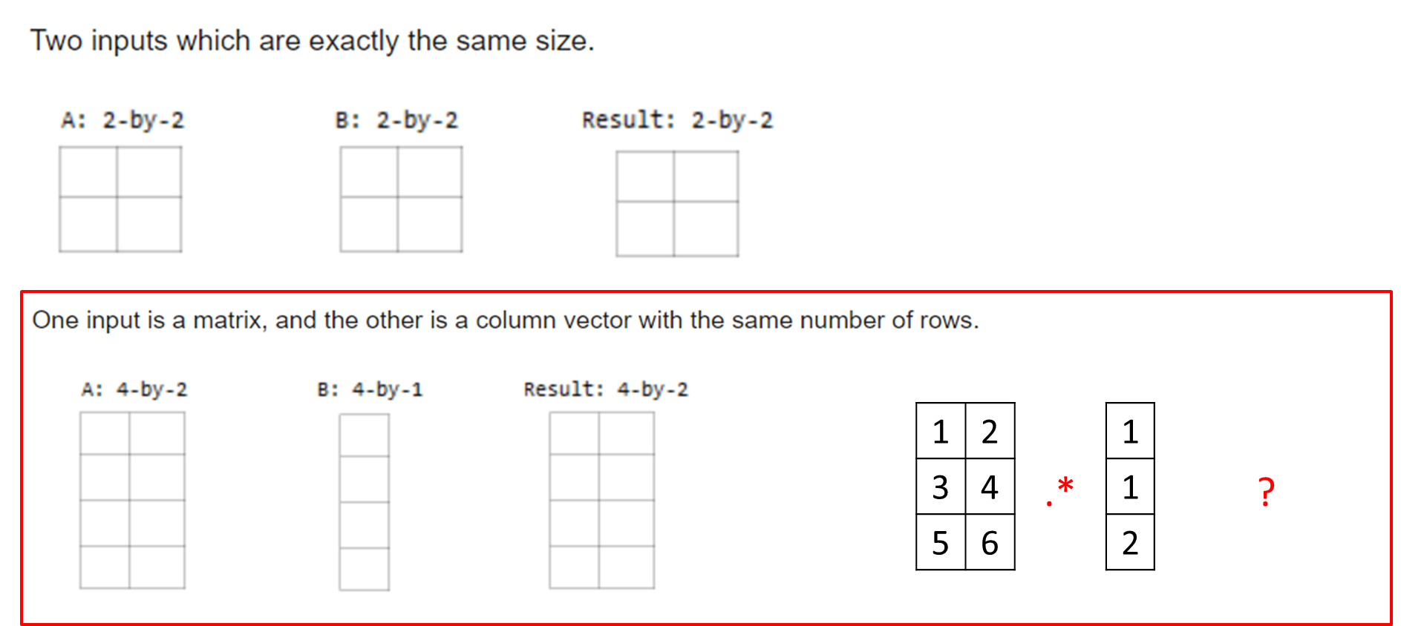
MATLAB Implicitly Expands Element-wise Operations (Changed After R2016b)
Module 4: Operator

Slide 40
MATLAB Operator
1 | 2
3 | 4
1 | 0
0 | 1
1 | 2 | 3 | 4
vec1
val1 = 1; % scalar value val2 = 2; % scalar value vec1 = [1 2 3 4]; % vector vec2 = [1 0 1 4]; % vector mat1 = [1 2; 3 4]; % matrix mat2 = [1 0; 5 4]; % matrix
1 | 0 | 1 | 4
vec2
mat1
mat2
vec1== val1 vec1<=val2 vec1 ~= val2 vec1 == vec2 vec1 >= vec2 vec1 < vec2 mat1 == val1 mat1 ~= val2 mat1 == mat2 mat1 ~= mat2 mat1 >= mat2 mat1 == [1 2] mat1 == [1;2] mat1 > [1 2] | [1 0 0 0] [1 1 0 0] [1 0 1 1] [1 0 0 1] [1 1 1 1] [0 0 0 0] [1 0;0 0] [1 0;1 1] [1 0;0 1] [0 1;1 0] [1 1;0 1] [1 1;0 0] [1 0;0 0] [0 0;1 1]
Symbol | Role
== | Equal to
~= | Not equal to
> | Greater than
>= | Greater than or equal to
< | Less than
<= | Less than or equal to
Module 4: Operator

Slide 41
MATLAB Operator
val1 = 1; val2 = 0; vec1 = [1 0]; vec2 = [0 0]; mat1 = [1 1; 0 0]; mat2 = [1 0; 0 1];
val1 && val1 val2 && val2 val1 || val2 val2 || val2 ~ val1 ~ val2 vec1 && val1 vec1 & val1 vec1 & val2 vec1 | val2 vec2 | val1 vec2 | vec1 vec2 & vec1 mat1 | mat2 mat1 & mat2 mat1 & vec1 mat1 | vec2 | 1 0 1 0 0 1 error [1 0] [0 0] [1 0] [1 1] [1 0] [0 0] [1 1;0 1] [1 0;0 0] [1 0;0 0] [1 1;0 0]
Symbol | Role
&& | Logical AND (scalar logical)
|| | Logical OR (scalar logical)
~ | Logical NOT
& | Logical AND (array)
| | Logical OR (array)
1 | 1
0 | 0
1 | 0
0 | 1
1 | 0
vec1
0 | 0
vec2
mat1
mat2

Slide 42
Value Replacement
If values in ‘vec1' are larger than 0 and less than 50, replace the values to 10. Otherwise, replace them to 5.
vec1 = [1 10 70 80 2]
vec1 = [1 10 70 80 2]; for ii=1:numel(vec1) testv = vec1(ii); if testv > 0 if testv < 50 replv = 10; else replv = 5; end else replv = 5; end vec1(ii) = replv; end
vec1 = [1 10 70 80 2]; logi10 = and(vec1>0, vec1<50); vec1(logi10) = 10; vec1(~logi10) = 5;
‘vec1’ becomes
vec1 = [10 10 5 5 10]
Module 4: Operator

Slide 43
Rounding Functions
Function | Description | Note
round(x) | Rounds x to the nearest integer
fix (x) | Truncates x to the nearest integer toward zero.
floor(x) | Rounds x to the nearest integer toward negative infinity.
ceil(x) | Rounds x to the nearest integer toward positive infinity.
0
0
0
Module 4: Operator

Slide 44
Rounding Functions (Example 1)
-0.6
-0.3
0.3
0.6
-1
0
1
 | round | ceil | fix | floor
0.3 | 0 | 1 | 0 | 0
0.6 | 1 | 1 | 0 | 0
-0.3 | 0 | 0 | 0 | -1
-0.6 | -1 | 0 | 0 | -1
Module 4: Operator

Slide 45
Rounding Functions (Example 2)
x1 = -0.6; x2 = -0.3; x3 = 0.3; x4 = 0.6; x = [x1 x2 x3 x4]; x_ce = ceil(x); x_fi = fix(x); x_fl = floor(x); x_ro = round(x);
Name | Value
x1 | -0.6
x2 | -0.3
x3 | 0.3
x4 | 0.3
x | [-0.6 -0.3 0.3 0.6]
x_ce | [0 0 1 1]
x_fi | [0 0 0 0]
x_fl | [-1 -1 0 0]
x_ro | [-1 0 0 1]
Module 4: Operator
Notes:
x1 = 10.3
x2 = 12.7
x3 = -1.3
x1_ce = 11
x1_fi = 10
x1_fl = 10
x2_ce =13
x2_fi = 12
x2_fl = 12
x3_ce = -1
x3_fi = -1
x3_fl = -2
x3_ro = -1

Slide 46
Array Operations
reshape changes dimensions of a matrix to any matrix with the same number of elements
diag create diagonal matrix or get diagonal elements of matrix
rot90 rotates a matrix 90 degrees counter-clockwise
fliplr flips columns of a matrix from left to right
flipud flips rows of a matrix up to down
flip flips a row vector left to right, column vector or matrix up to down
repmat replicates an entire matrix; it creates m x n copies of the matrix
repelem replicates each element from a matrix in the dimensions specified
Module 4: Operator

Slide 47
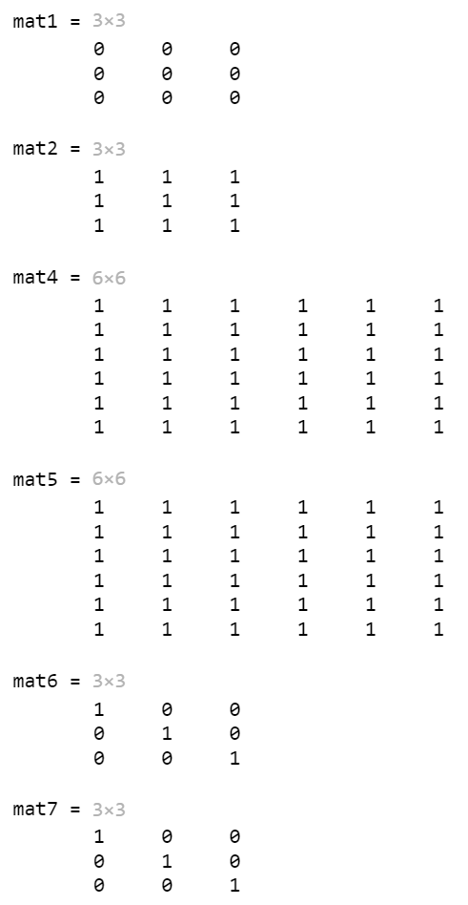
Example: Create and Index Arrays
mat1 = zeros(3,3) mat2 = ones(3,3) mat4 = ones(6,6); mat5 = repmat(mat2, 2, 2); mat6 = eye(3,3); mat7 = diag(ones(3,1));
Module 4: Operator

Slide 48
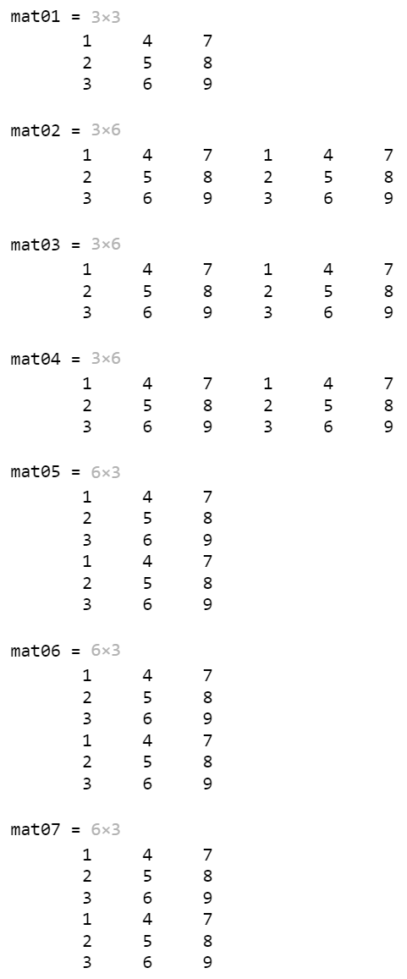
Example: Combine and Transform Array (horcat, vertcat, cat)
mat01 = reshape(1:9, 3, 3); mat02 = horzcat(mat01, mat01); mat03 = cat(2, mat01, mat01); mat05 = vertcat(mat01, mat01); mat06 = cat(1, mat01, mat01);
Module 4: Operator

Slide 49
Example: Combine and Transform Array (repelem)
mat08 = cat(2, ones(2,2), ones(2,2)+1); mat09 = cat(1, mat08, mat08+2); mat10 = repelem([1 2;3 4], 2, 2);
1 | 2
3 | 4
1 | 1
1 | 1
2 | 2
2 | 2
1 | 1
1 | 1
2 | 2
2 | 2
mat08
1 | 1
1 | 1
2 | 2
2 | 2
1 | 1
1 | 1
2 | 2
2 | 2
1 | 1
1 | 1
2 | 2
2 | 2
3 | 3
3 | 3
4 | 4
4 | 4
3 | 3
3 | 3
4 | 4
4 | 4
3 | 3
3 | 3
4 | 4
4 | 4
mat09
mat10
Module 4: Operator

Slide 50
Example: Combine and Transform Array
mat1 = reshape(1:9, 3, 3) mat2 = flip(mat1, 1) mat3 = flipud(mat1) mat4 = flip(mat1, 2) mat5 = fliplr(mat1) mat6 = transpose(mat1) mat7 = mat1’ mat8 = flipud(rot90(mat1))
1 | 4 | 7
2 | 5 | 8
3 | 6 | 9
3 | 6 | 9
2 | 5 | 8
1 | 4 | 7
3 | 6 | 9
2 | 5 | 8
1 | 4 | 7
mat1
mat2
mat3
7 | 4 | 1
8 | 5 | 2
9 | 6 | 3
7 | 4 | 1
8 | 5 | 2
9 | 6 | 3
1 | 2 | 3
4 | 5 | 6
7 | 8 | 9
1 | 2 | 3
4 | 5 | 6
7 | 8 | 9
1 | 2 | 3
4 | 5 | 6
7 | 8 | 9
mat4
mat5
mat6
mat7
mat8
Module 4: Operator

Slide 51
Cell Array
A cell array is a type of data structure that can store different types of values in its elements
A cell array could be a vector (row or column) or a matrix
It is an array, so indices are used to refer to the elements
e.g., Store multiple values in different types or matrix in a single variable
Module 5: Data type

Slide 52
Cell Array
The syntax used to create a cell array is curly braces { } instead of [ ]
The direct method is to put values in the row(s) separated by commas or spaces, and to separate the rows with semicolons (so, same as other arrays) – the difference is using { } instead of [ ]
The cell function can also be used to preallocate by passing the dimensions of the cell array, e.g.
cell(4,2)
Module 5: Data type

Slide 53
Example: Containing Multiple Data Types
temp_st1 = [10 11; 12 15; 9 7]; temp_st2 = [12 13]; temp_st3 = [8 9; 11 12]; num_st1 = 3; num_st2 = 1; num_st3 = 2; name_st1 = ‘Kitchener’; name_st2 = ‘Waterloo’; name_st3 = ‘Guelph’;
data_st{1,1} = [10 11; 12 15; 9 7]; data_st{2,1} = [12 13]; data_st{3,1} = [8 9; 11 12]; data_st{1,2} = 3; data_st{2,2} = 1; data_st{3,2} = 2; data_st{1,3} = ‘Kitchener’; data_st{2,3} = ‘Waterloo’; data_st{3,3} = ‘Guelph’;
find([data_st{:,2}] == 2) find(strcmp(data_st(:,3), 'Waterloo')) | 3 2
Other benefit?
Module 5: Data type

Slide 54
Structure Variables
Structures store values of different types, in fields
Fields are given names; they are referred to as
structurename.fieldname using the dot operator
Structure variables can be initialized using the struct function, which takes pairs of arguments (field name as a string followed by the value for that field)
To print, disp will display all fields; fprintf can only print individual fields
Module 5: Data type

Slide 55
Example: Containing Multiple Data Types
temp_st1 = [10 11; 12 15; 9 7]; temp_st2 = [12 13]; temp_st3 = [8 9; 11 12]; num_st1 = 3; num_st2 = 1; num_st3 = 2; name_st1 = ‘Kitchener’; name_st2 = ‘Waterloo’; name_st3 = ‘Guelph’;
temp_st{1} = [10 11; 12 15; 9 7]; temp_st{2} = [12 13]; temp_st{3} = [8 9; 11 12]; num_st = [3 1 2]; name_st{1} = ‘Kitchener’; name_st{2} = ‘Waterloo’; name_st{3} = ‘Guelph’; data_st.temp_st = temp_st; data_st.num_st = num_st; data_st.name_st = name_st;
Module 5: Data type

Slide 56
Cell Arrays vs Structures
Cell arrays are arrays, so they are indexed
That means that you can loop though the elements in a cell array – or have MATLAB do that for you by using a vectorized code
Structs are not indexed, so you cannot loop
However, the field names are mnemonic so it is more clear what is being stored in a struct
For example:
variable{1} vs. variable.weight: which is more mnemonic?
Module 5: Data type

Slide 57
Cell Arrays vs Structures
Cell arrays are arrays, so they are indexed
That means that you can loop though the elements in a cell array – or have MATLAB do that for you by using vectorized code
Structs are not indexed, so you cannot loop
However, the field names are mnemonic so it is more clear what is being stored in a struct
For example:
variable{1} vs. variable.weight: which is more mnemonic?
Module 5: Data type

Slide 58




Numerical Technique
Algorithms that are used to obtain numerical solutions of a mathematical problem
It is useful when no analytical solution exists or analytical solution is difficult to obtain.
$$f(x) = 2x + 3$$
$$f\left(x\right)=\log\left(x\right)∗2x+{e^{3x}∗x}^{2/3}$$
$$f′\left(3\right)$$
$$f′\left(3\right)$$
Module 6: Numerical technique

Slide 59
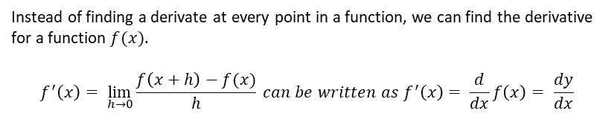
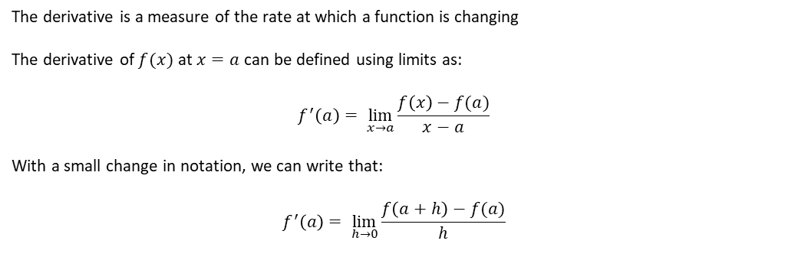
Theory: Differentiation
The derivative is a measure of the rate at which a function is changing
The derivative of $f(x)$ at $x=a$ can be defined using limits as:
$$f^{′}\left(a\right)= \lim_{x→a}{\frac{f\left(x\right)−f(a)}{x−a}}$$
With a small change in notation, we can write that:
$$f^{′}\left(a\right)= \lim_{h→0}{\frac{f\left(a+h\right)−f(a)}{h}}$$
For one point
Instead of finding a derivate at every point in a function, we can find the derivative for a function $f(x)$.
$$f^{′}\left(x\right)= \lim_{h→0}{\frac{f\left(x+h\right)−f(x)}{h}} can be written as f^{′}\left(x\right)= \frac{d}{dx}f\left(x\right)= \frac{dy}{dx}$$
For a function
Module 6: Numerical technique

Slide 60
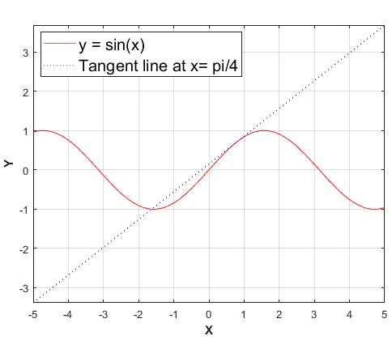
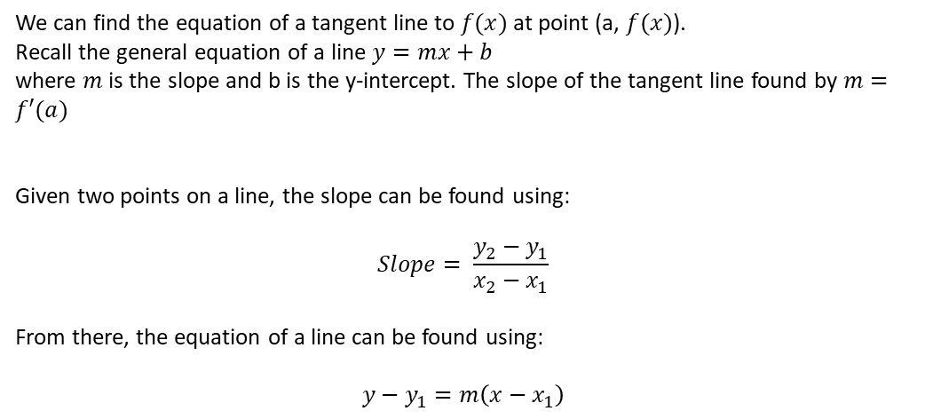
Theory: Tangent Lines
We can find the equation of a tangent line to $f(x)$ at point (a, $f(x)$).
Recall the general equation of a line $y=mx+b$
where $m$ is the slope and b is the y-intercept. The slope of the tangent line found by $m=f′(a)$
Given two points on a line, the slope can be found using:
$$Slope= \frac{y_{2}−y_{1}}{x_{2}−x_{1}}$$
From there, the equation of a line can be found using:
$$y−y_{1}=m\left(x−x_{1}\right)$$
Module 6: Numerical technique

Slide 61
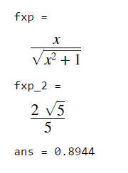
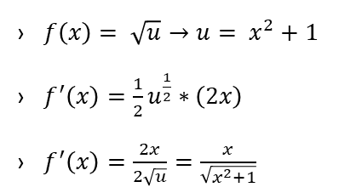
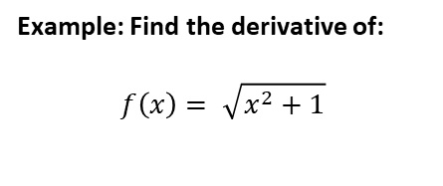
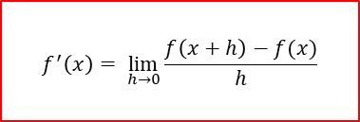
Theory: Differentiation 1 – Symbolic Way
Example: Find the derivative of:
$$f\left(x\right)= \sqrt{x^{2}+1}$$
syms x fx = sqrt(x^2 + 1); fxp = diff(fx); fxp fxp_2 = subs(fxp, x, 2) double(fxp_2)
$f\left(x\right)= \sqrt{u}→u= x^{2}+1$
$f^{′}\left(x\right)=\frac{1}{2}u^{\frac{1}{2}}∗\left(2x\right)$
$f^{′}\left(x\right)=\frac{2x}{2\sqrt{u}}=\frac{x}{\sqrt{x^{2}+1}}$
$$f^{′}\left(x\right)= \lim_{h→0}{\frac{f\left(x+h\right)−f(x)}{h}}$$
Module 6: Numerical technique

Slide 62
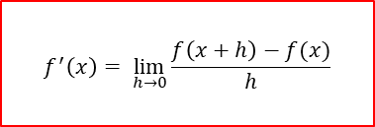
Theory: Differentiation 1 – Numerical Way
Example: Find the derivative of:
$$f\left(x\right)= \sqrt{x^{2}+1}$$
h = 0.000000001; x = 2; (diff_ex1(x+h) - diff_ex1(x))/h
$f\left(x\right)= \sqrt{u}→u= x^{2}+1$
$f^{′}\left(x\right)=\frac{1}{2}u^{\frac{1}{2}}∗\left(2x\right)$
$f^{′}\left(x\right)=\frac{2x}{2\sqrt{u}}=\frac{x}{\sqrt{x^{2}+1}}$
function fx = diff_ex1(x) fx = sqrt(x^2 + 1); end
$$f^{′}\left(x\right)= \lim_{h→0}{\frac{f\left(x+h\right)−f(x)}{h}}$$
Module 6: Numerical technique

Slide 63
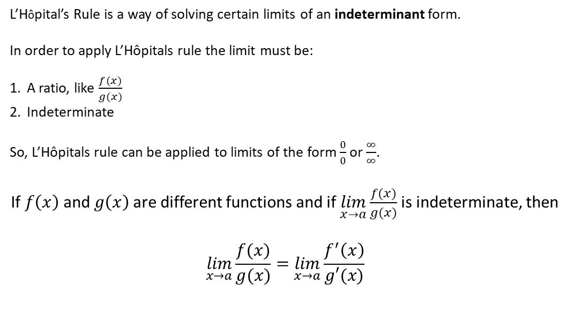
Theory: L’Hôpital’s Rule
L’Hôpital’s Rule is a way of solving certain limits of an indeterminant form.
In order to apply L’Hôpitals rule the limit must be:
A ratio, like $\frac{f(x)}{g(x)}$
Indeterminate
So, L’Hôpitals rule can be applied to limits of the form $\frac{0}{0}$ or $\frac{∞}{∞}$.
If $f\left(x\right)$ and $g\left(x\right)$ are different functions and if $\lim_{x→a}{\frac{f(x)}{g(x)}}$is indeterminate, then
$$\lim_{x→a}{\frac{f(x)}{g(x)}}=\lim_{x→a}{\frac{f^{′}\left(x\right)}{g′(x)}}$$
Module 6: Numerical technique

Slide 64

Example: L’Hôpital’s Rule
Example: Find the following using L’Hôpital’s rule
1. $\lim_{x→1}{\frac{ln(x)}{x−1}⇒\frac{0}{0}}$
Using L’Hôpital’s rule $=\lim_{x→1}{\frac{\frac{1}{x}}{1}}=1$
2. $\lim_{x→∞}{\frac{e^{x}}{x^{2}}⇒\frac{0}{0}}$
Using L’Hôpitlals rule $=\lim_{x→∞}{\frac{e^{x}}{2x}=\lim_{x→∞}\frac{e^{x}}{2}}= ∞$
Module 6: Numerical technique

Slide 65
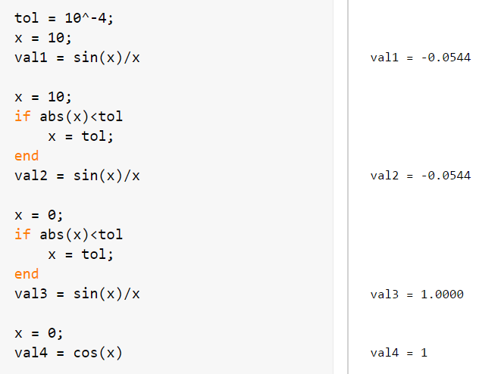
Example: L’Hopitals Rule (Script)
Module 6: Numerical technique

Slide 66

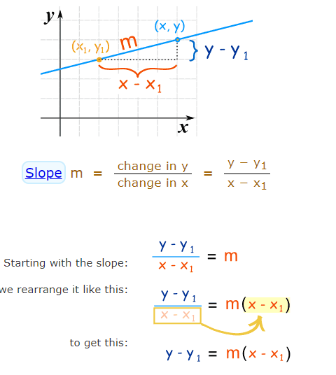
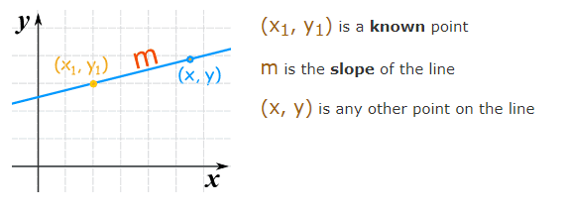
Theory: Point-Slope Equation of a Line
https://www.mathsisfun.com/algebra/line-equation-point-slope.html
Module 6: Numerical technique

Slide 67
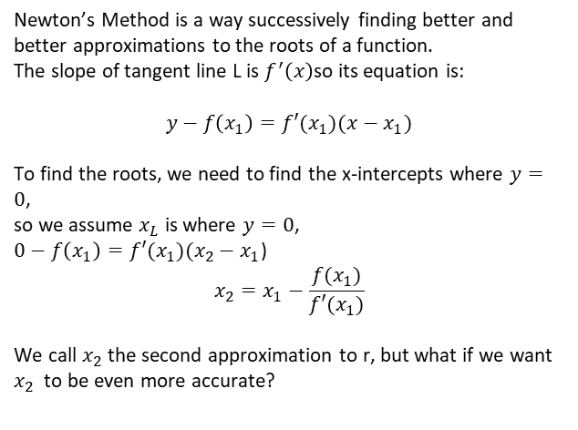
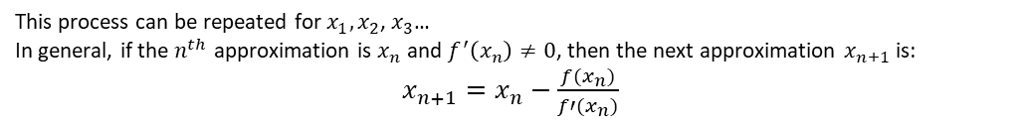
Theory: Newton’s Method
Newton’s Method is a way successively finding better and better approximations to the roots of a function.
The slope of tangent line L is $f^{′}\left(x\right)$so its equation is:
$$y−f\left(x_{1}\right)=f′(x_{1})(x−x_{1})$$
To find the roots, we need to find the x-intercepts where $y=0$,
so we assume $x_{L}$ is where $y=0$,
$0−f\left(x_{1}\right)=f′(x_{1})(x_{2}−x_{1}$)
$$x_{2}=x_{1}−\frac{f(x_{1})}{f′(x_{1})}$$
We call $x_{2}$ the second approximation to r, but what if we want $x_{2}$ to be even more accurate?
Initial Estimation: x = 5
This process can be repeated for $x_{1},x_{2}$, $x_{3}$…
In general, if the $n^{th}$ approximation is $x_{n}$ and $f^{′}\left(x_{n}\right)≠0$, then the next approximation $x_{n+1}$is:
$x_{n+1}=x_{n}−\frac{f(x_{n})}{f′(x_{n})}$
Module 6: Numerical technique

Slide 68
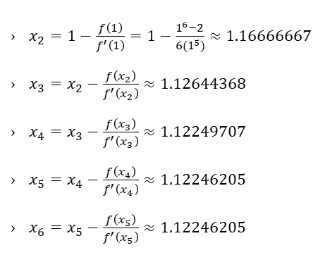
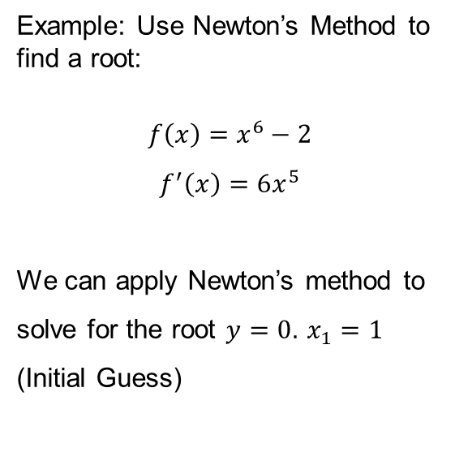

Example: Newton’s Method 1
Example: Use Newton’s Method to find a root:
$$f\left(x\right)=x^{6}−2$$
$$f^{′}\left(x\right)=6x^{5}$$
We can apply Newton’s method to solve for the root $y=0$. $x_{1}=1$ (Initial Guess)
$x_{2}=1−\frac{f\left(1\right)}{f^{′}\left(1\right)}=1−\frac{1^{6}−2}{6(1^{5})}≈1.16666667$
$x_{3}=x_{2}−\frac{f\left(x_{2}\right)}{f^{′}\left(x_{2}\right)}≈1.12644368$
$x_{4}=x_{3}−\frac{f\left(x_{3}\right)}{f^{′}\left(x_{3}\right)}≈1.12249707$
$x_{5}=x_{4}−\frac{f\left(x_{4}\right)}{f^{′}\left(x_{4}\right)}≈1.12246205$
$x_{6}=x_{5}−\frac{f\left(x_{5}\right)}{f^{′}\left(x_{5}\right)}≈1.12246205$
$x_{n+1}=x_{n}−\frac{f(x_{n})}{f′(x_{n})}$
Module 6: Numerical technique

Slide 69
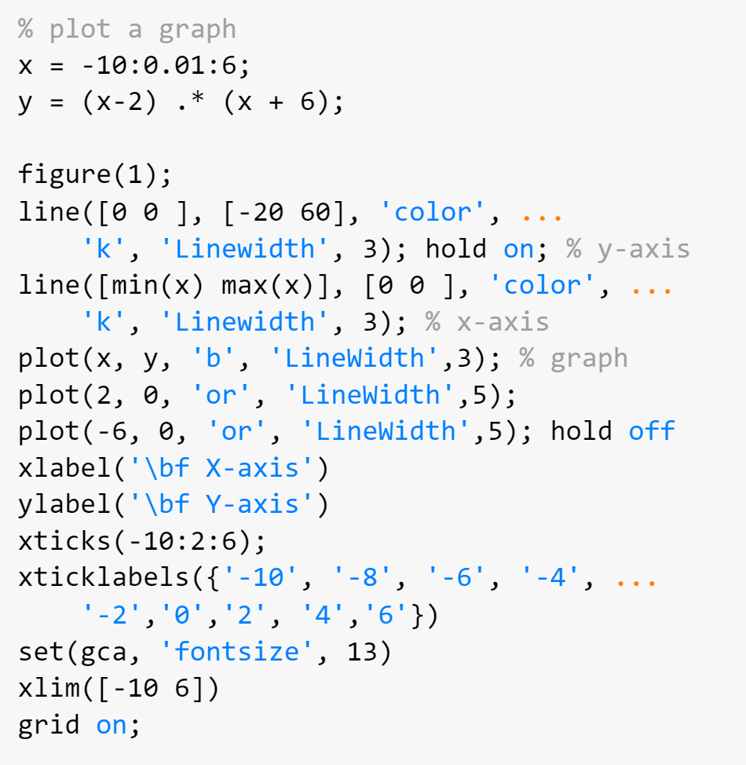
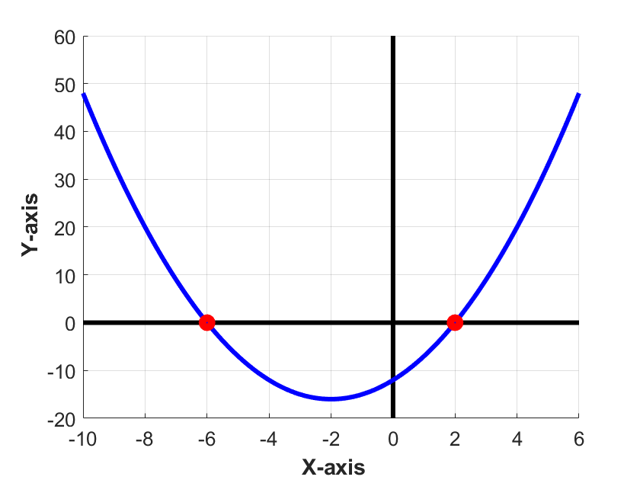

Example: Root Finding 1
$$f\left(x\right)=\left(x−2\right)\left(x−6\right)$$
$$=x^{2}−4x−12$$
Module 6: Numerical technique

Slide 70
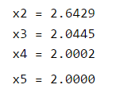
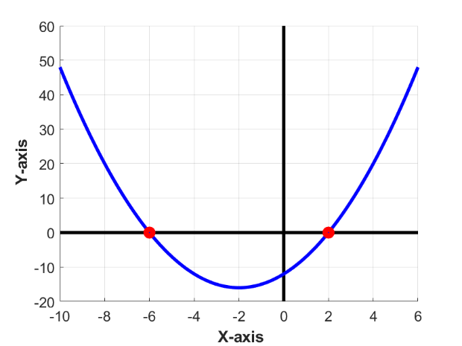



Example: Root Finding 1 (Simulation)
$x_{n+1}=x_{n}−\frac{f(x_{n})}{f′(x_{n})}$
x1 = 5; x2 = x1 - myfun(x1)/myfunp(x1) x3 = x2 - myfun(x2)/myfunp(x2) x4 = x3 - myfun(x3)/myfunp(x3) x5 = x4 - myfun(x4)/myfunp(x4)
function fx = myfun(x) fx = (x-2) .* (x + 6); end function fxp = myfunp(x) fxp = 2*x + 4; end
$$f\left(x\right)=x^{2}−4x−12$$
$$f′\left(x\right)=2x−4$$
Module 6: Numerical technique

Slide 71
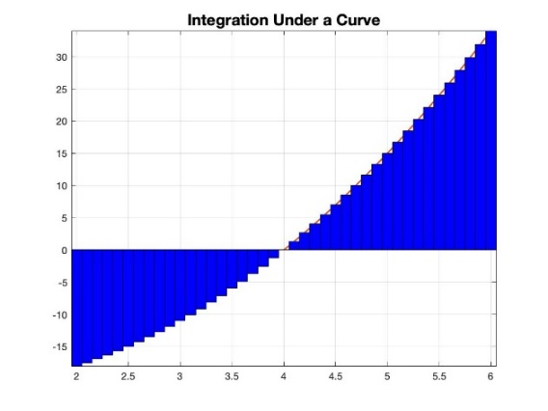
Theory: Integral
Integration is the technique of determining the area under a curve. This process is opposite the process of differentiation.
To find the area under a curve, we divide the curve into many equal segments of equal width. Each rectangle is multiplied by it’s corresponding y-value to get the area of that rectangle. The rectangle’s areas are summed for the total area under that curve segment:
Left endpoints can be used so that the rectangular segments give an underestimation
Right endpoints can be used so that the rectangular segments give an overestimation
Center endpoints can be used to try and balance the error from overestimations and underestimations
How can you make your estimation even more accurate?
Take smaller segments!
Module 6: Numerical technique

Slide 72
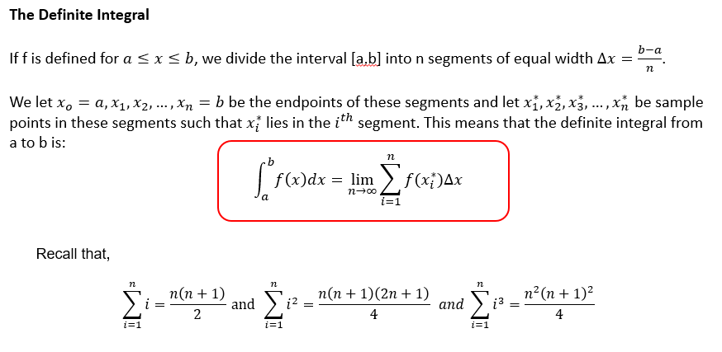
Theory: Integral
Module 6: Numerical technique

Slide 73
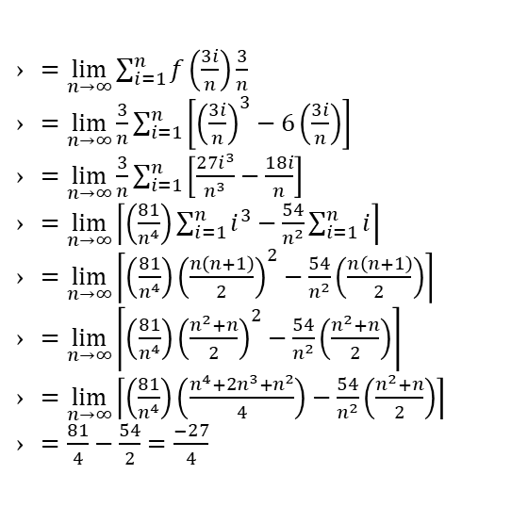
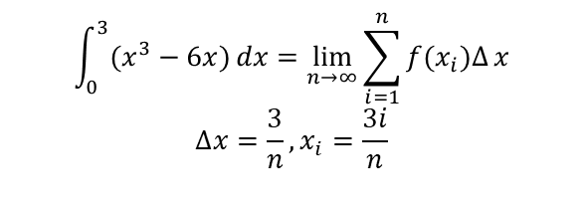
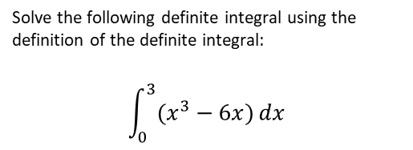
Example: Definite Integral
Solve the following definite integral using the definition of the definite integral:
$$\int_{0}^{3}{(x^{3}−6x)}dx$$
$=\lim_{n→∞}{\sum_{i=1}^{n}{f\left(\frac{3i}{n}\right)\frac{3}{n}}}$
$=\lim_{n→∞}{\frac{3}{n}\sum_{i=1}^{n}{\left[{\left(\frac{3i}{n}\right)}^{3}−6\left(\frac{3i}{n}\right)\right]}}$
$=\lim_{n→∞}{\frac{3}{n}\sum_{i=1}^{n}{\left[\frac{27i^{3}}{n^{3}}−\frac{18i}{n}\right]}}$
$=\lim_{n→∞}\left\lceil \left(\frac{81}{n^{4}}\right)\sum_{i=1}^{n}{i^{3}−\frac{54}{n^{2}}}\sum_{i=1}^{n}{i}\right\rceil$
$=\lim_{n→∞}\left\lceil \left(\frac{81}{n^{4}}\right){\left(\frac{n\left(n+1\right)}{2}\right)}^{2}−\frac{54}{n^{2}}\left(\frac{n\left(n+1\right)}{2}\right)\right\rceil$
$=\lim_{n→∞}\left\lceil \left(\frac{81}{n^{4}}\right){\left(\frac{n^{2}+n}{2}\right)}^{2}−\frac{54}{n^{2}}\left(\frac{n^{2}+n}{2}\right)\right\rceil$
$=\lim_{n→∞}\left\lceil \left(\frac{81}{n^{4}}\right)\left(\frac{n^{4}+2n^{3}+n^{2}}{4}\right)−\frac{54}{n^{2}}\left(\frac{n^{2}+n}{2}\right)\right\rceil$
$=\frac{81}{4}−\frac{54}{2}=\frac{−27}{4}$
$$\int_{0}^{3}{(x^{3}−6x)}dx=\lim_{n→∞}\sum_{i=1}^{n}{f(x_{i})∆}{x}$$
$$∆x=\frac{3}{n}, x_{i}=\frac{3i}{n}$$
Module 6: Numerical technique

Slide 74
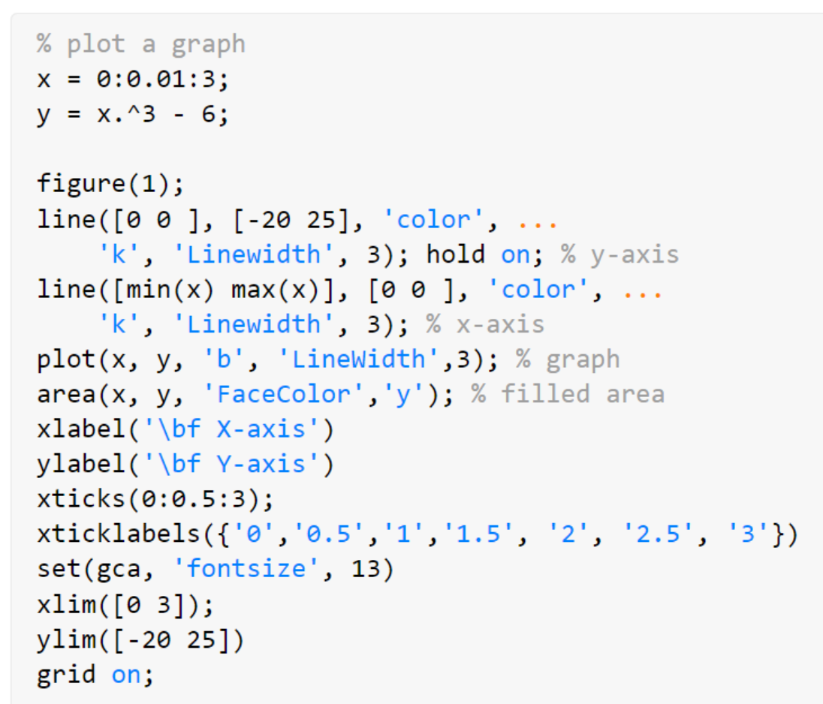
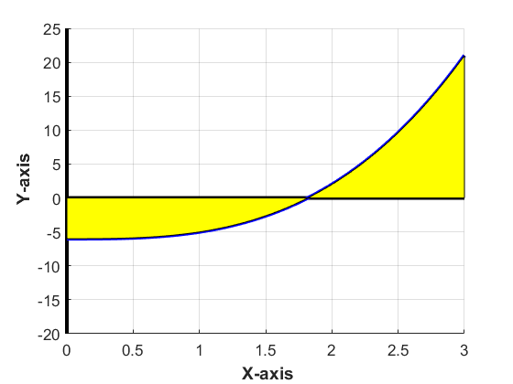

Example: Integral (graph)
$$f\left(x\right)=x^{3}−6x$$
Module 6: Numerical technique

Slide 75
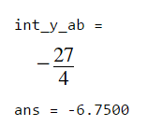
Example: Integral (Symbolic)
syms x y = x^3 -6*x; int_y_ab = int(y, 0, 3) double(int_y_ab)
Module 6: Numerical technique

Slide 76
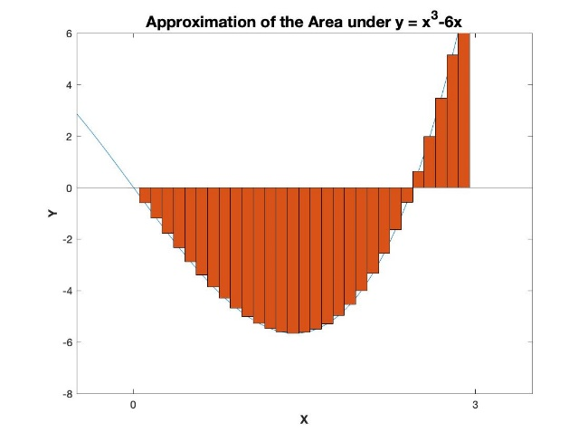
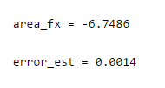

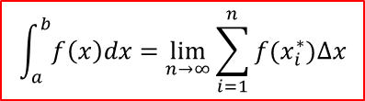
Example: Integral (Numeric 1)
1 2 3 4 5 6 7 8 9 10 11 12 13 | n = 10000; a = 0; b = 3; del_x = (b-a)/n; area_fx = 0; for ii=1:n x_star = a + del_x*ii; area_fx = area_fx + myfun(x_star)*del_x; end area_fx error_est = area_fx - (-27/4)
function fx = myfun(x) fx = x^3 – 6*x; end
$$f\left(x\right)=x^{3}−6x$$
$$\int_{a}^{b}{f\left(x\right)dx}=\lim_{n→∞}{\sum_{i=1}^{n}{f(x_{i}^{∗})∆x}}$$
Module 6: Numerical technique

Slide 77
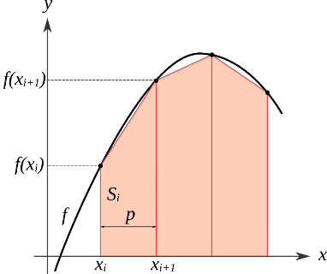
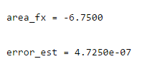
Example: Integral (Numeric 2)
1 2 3 4 5 6 7 8 9 10 11 12 13 14 | n = 10000; a = 0; b = 3; del_x = (b-a)/n; area_fx = 0; for ii=1:n-1 x_star1 = a + del_x*ii; x_star2 = a + del_x*(ii+1); area_fx = area_fx + (myfun(x_star2)+myfun(x_star1))/2*del_x; end area_fx error_est = area_fx - (-27/4)
function fx = myfun(x) fx = x^3 – 6*x; end
Module 6: Numerical technique

Slide 78
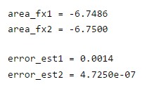
Example: Integral (Numeric 1 vs Numeric 2)
1 2 3 4 5 6 7 8 9 10 11 12 13 14 15 16 17 18 19 20 21 22 23 24 | n = 10000; a = 0; b = 3; del_x = (b-a)/n; area_fx1 = 0; for ii=1:n x_star = a + del_x*ii; area_fx1 = area_fx1 + myfun(x_star)*del_x; end area_fx2 = 0; for ii=1:n-1 x_star1 = a + del_x*ii; x_star2 = a + del_x*(ii+1); area_fx2 = area_fx2 + (myfun(x_star2)+myfun(x_star1))/2*del_x; end area_fx1 area_fx2 error_est1 = area_fx1 - (-27/4) error_est2 = area_fx2 - (-27/4)
function fx = myfun(x) fx = x^3 – 6*x; end
Module 6: Numerical technique

