Slide 1
Signal Processing I
Chul Min Yeum
Assistant Professor
Civil and Environmental Engineering
University of Waterloo, Canada
CIVE 497 – CIVE 700: Smart Structure Technology
Last updated: 2019-12-24

Slide 2
Reference
We will cover some key topics in Chapters 3 ~ 6 of the following reference:
Shin, K., & Hammond, J. K. (2008). Fundamentals of Signal Processing: for Sound and Vibration Engineers, John Wiley & Sons.
Chapter 3: Fourier Series
Chapter 4: Fourier Integrals (Fourier Transform) and Continuous-Time Linear Systems
Chapter 5: Time Sampling and Aliasing
Chapter 6: The Discrete Fourier Transform

Slide 3
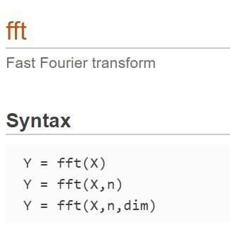
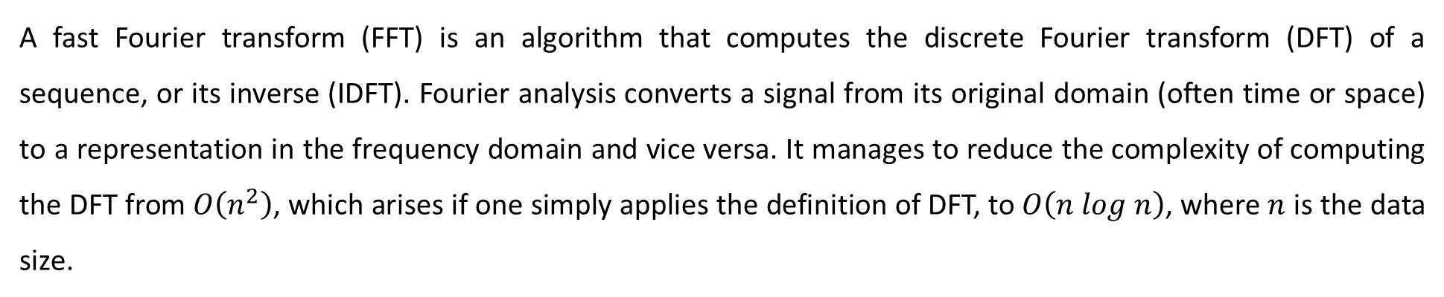
Fast Fourier Transform
A fast Fourier transform (FFT) is an algorithm that computes the discrete Fourier transform (DFT) of a sequence, or its inverse (IDFT). Fourier analysis converts a signal from its original domain (often time or space) to a representation in the frequency domain and vice versa. It manages to reduce the complexity of computing the DFT from $O\left(n^{2}\right)$, which arises if one simply applies the definition of DFT, to $O\left(n log n\right)$, where $n$ is the data size.
FFT in Matlab
Y = fft(X) computes the discrete Fourier transform (DFT) of X using a fast Fourier transform (FFT) algorithm
Y = fft(X,n) returns the n-point DFT. If no value is specified, Y is the same size as X.
Notes:
We are going to use this function at the end.
We need to learn fundamentals of the

Slide 4
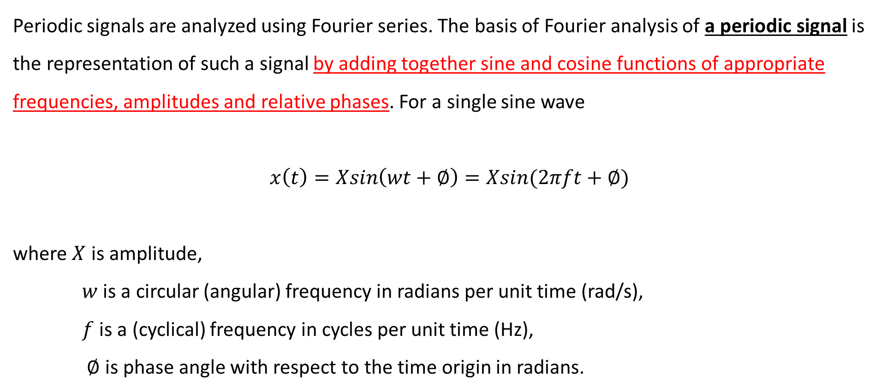
Periodic Signals and Fourier Series
Periodic signals are analyzed using Fourier series. The basis of Fourier analysis of a periodic signal is the representation of such a signal by adding together sine and cosine functions of appropriate frequencies, amplitudes and relative phases. For a single sine wave
$$x\left(t\right)=Xsin\left(wt+∅\right)=Xsin(2πft+∅)$$
where $X$ is amplitude,
$w$ is a circular (angular) frequency in radians per unit time (rad/s),
$f$ is a (cyclical) frequency in cycles per unit time (Hz),
$∅$ is phase angle with respect to the time origin in radians.

Slide 5
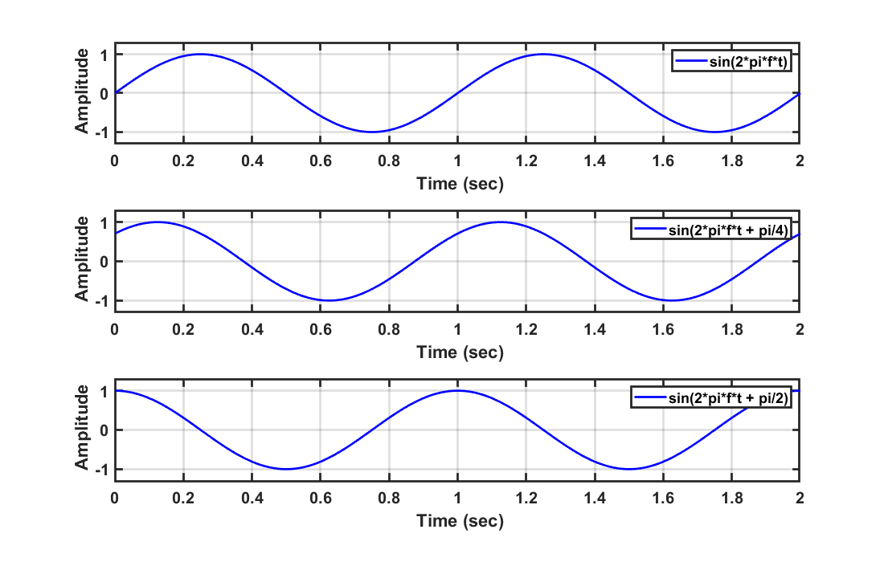
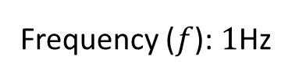



Example: Periodic Signals and Fourier Series
$$sin(2πft)$$
$$sin(2πft+π/4)$$
$$sin(2πft+π/2)$$
Frequency ($f$): $1$Hz

Slide 6

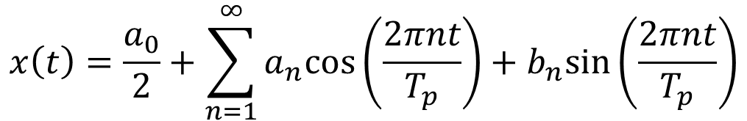




Fourier Series
A Fourier series is an expansion of a periodic function f(x) in terms of an infinite sum of sines and cosines. Fourier series make use of the orthogonality relationships of the sine and cosine functions. It decomposes any periodic function or periodic signal into the weighted sum of a (possibly infinite) set of simple oscillating functions, namely sines and cosines.
$$x\left(t\right)$$
Periodic
$$x\left(t\right)=x(t+nT_{p})$$
$$t$$
$$0$$
$$T_{p}$$
$$x\left(t\right)=\frac{a_{0}}{2}+\sum_{n=1}^{∞}{a_{n}cos⁡\left(\frac{2πnt}{T_{p}}\right)+b_{n}sin⁡\left(\frac{2πnt}{T_{p}}\right)}$$
Notes:
* What’s the orthogonality?

Slide 7
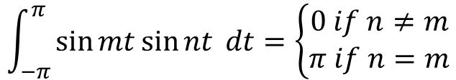
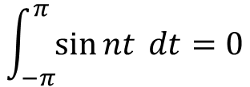
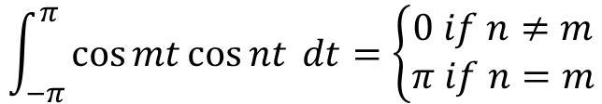
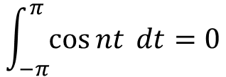



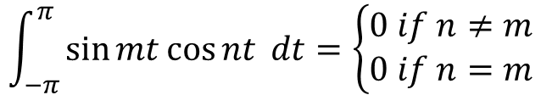
Basic Trigonometric Equations
$$\int_{−π}^{π}{\cos{nt} dt=0}$$
$$\int_{−π}^{π}{\sin{nt} dt=0}$$
Orthogonality of trigonometric functions
$$\int_{−π}^{π}{\cos{mt\cos{nt}} dt=\left\{\begin{matrix}0 if n≠m \\ π if n=m\end{matrix}\right.}$$
$$\cos{mt\cos{nt=\frac{1}{2}\left[\cos\left(m+n\right)t+\cos\left(m−n\right)t\right]}}$$
$$\int_{−π}^{π}{\sin{mt\sin{nt}} dt=\left\{\begin{matrix}0 if n≠m \\ π if n=m\end{matrix}\right.}$$
$$\sin{mt\sin{nt=\frac{1}{2}\left[\cos\left(m−n\right)t−\cos\left(m+n\right)t\right]}}$$
$$\int_{−π}^{π}{\sin{mt\cos{nt}} dt=\left\{\begin{matrix}0 if n≠m \\ 0 if n=m\end{matrix}\right.}$$
$$\sin{mt\cos{nt=\frac{1}{2}\left[\sin\left(m+n\right)t+\sin\left(m−n\right)t\right]}}$$

Slide 8
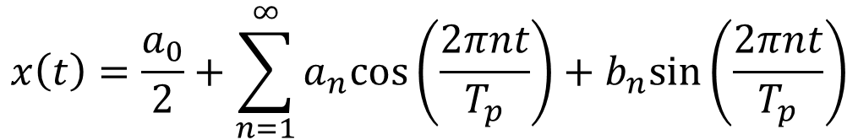
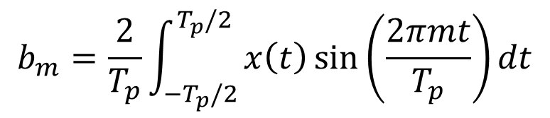
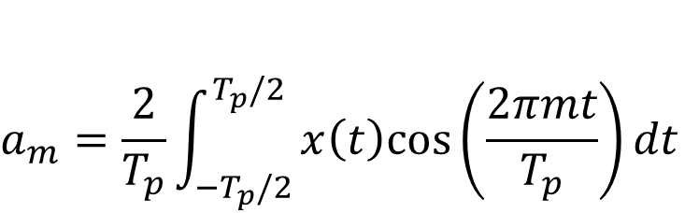
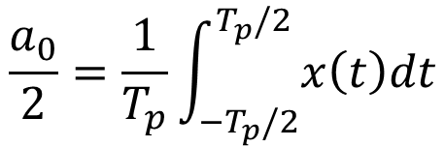
Fourier Coefficients
$$x\left(t\right)=\frac{a_{0}}{2}+\sum_{n=1}^{∞}{a_{n}cos⁡\left(\frac{2πnt}{T_{p}}\right)+b_{n}sin⁡\left(\frac{2πnt}{T_{p}}\right)}$$
$$\frac{a_{0}}{2}=\frac{1}{T_{p}}\int_{−T_{p}/2}^{T_{p}/2}{x\left(t\right)dt}$$
$$a_{m}=\frac{2}{T_{p}}\int_{−T_{p}/2}^{T_{p}/2}{x\left(t\right)cos⁡\left(\frac{2πmt}{T_{p}}\right)dt}$$
$$b_{m}=\frac{2}{T_{p}}\int_{−T_{p}/2}^{T_{p}/2}{x\left(t\right)\sin{⁡\left(\frac{2πmt}{T_{p}}\right)}dt}$$
Notes:
We have x (t). If we know the period (Tp), then, we can get all coefficient.

Slide 9
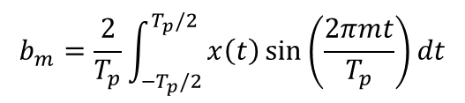
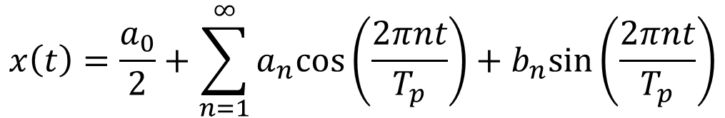

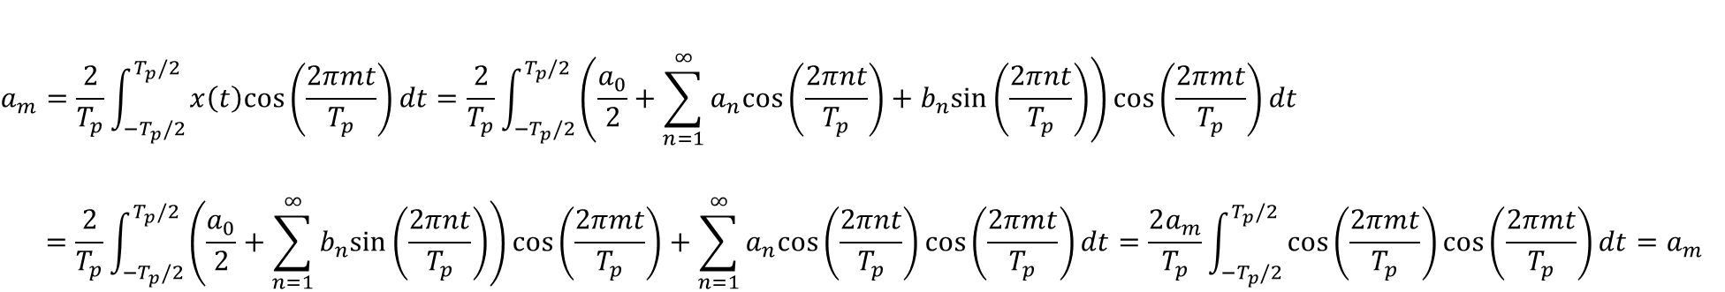

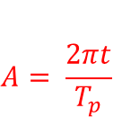
Derivation of the Fourier Coefficients
$$x\left(t\right)=\frac{a_{0}}{2}+\sum_{n=1}^{∞}{a_{n}cos⁡\left(\frac{2πnt}{T_{p}}\right)+b_{n}sin⁡\left(\frac{2πnt}{T_{p}}\right)}$$
$$\frac{a_{0}}{2}=\frac{1}{T_{p}}\int_{0}^{T_{p}}{x\left(t\right)dt}=\frac{1}{T_{p}}\int_{−T_{p}/2}^{T_{p}/2}{x\left(t\right)dt}=\frac{a_{0}}{2}+\frac{1}{T_{p}}\int_{{−T}_{p}/2}^{T_{p}/2}{\sum_{n=1}^{∞}{a_{n}cos⁡\left(\frac{2πnt}{T_{p}}\right)+b_{n}sin⁡\left(\frac{2πnt}{T_{p}}\right)}dt}$$
$$0$$
$$a_{m}=\frac{2}{T_{p}}\int_{−T_{p}/2}^{T_{p}/2}{x\left(t\right)cos⁡\left(\frac{2πmt}{T_{p}}\right)dt}=\frac{2}{T_{p}}\int_{−T_{p}/2}^{T_{p}/2}{\left(\frac{a_{0}}{2}+\sum_{n=1}^{∞}{a_{n}cos⁡\left(\frac{2πnt}{T_{p}}\right)+b_{n}sin⁡\left(\frac{2πnt}{T_{p}}\right)}\right)cos⁡\left(\frac{2πmt}{T_{p}}\right)dt}$$
$$=\frac{2}{T_{p}}\int_{−T_{p}/2}^{T_{p}/2}{\left(\frac{a_{0}}{2}+\sum_{n=1}^{∞}{b_{n}sin⁡\left(\frac{2πnt}{T_{p}}\right)}\right)\cos\left(\frac{2πmt}{T_{p}}\right)+\sum_{n=1}^{∞}{a_{n}cos⁡\left(\frac{2πnt}{T_{p}}\right)}\cos\left(\frac{2πmt}{T_{p}}\right)dt}=\frac{2a_{m}}{T_{p}}\int_{−T_{p}/2}^{T_{p}/2}{\cos\left(\frac{2πmt}{T_{p}}\right)cos\left(\frac{2πmt}{T_{p}}\right)dt}=a_{m}$$
$$0$$
$$b_{m}=\frac{2}{T_{p}}\int_{−T_{p}/2}^{T_{p}/2}{x\left(t\right)\sin{⁡\left(\frac{2πmt}{T_{p}}\right)}dt}$$
$$A= \frac{2πt}{T_{p}}$$
Notes:
Derivation on the board

Slide 10


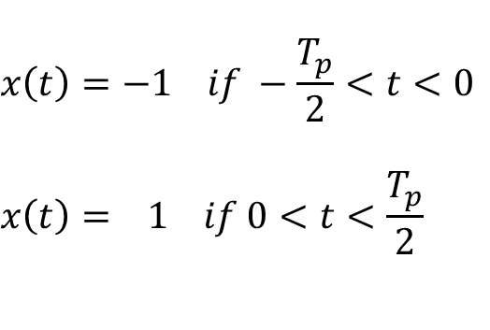


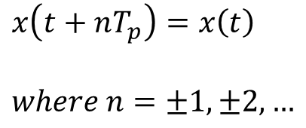

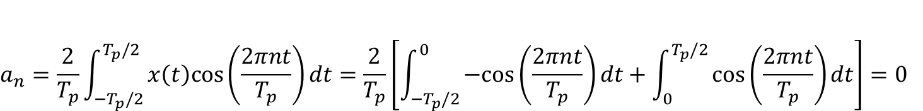
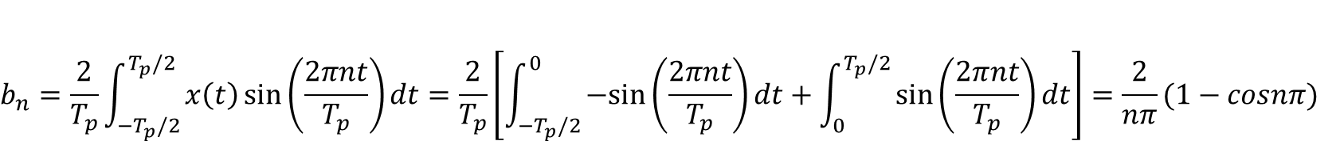
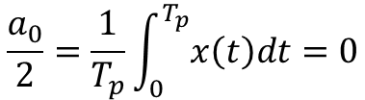


Example: Square Wave
$$x\left(t\right)=−1 if −\frac{T_{p}}{2}<t<0$$
$$x\left(t\right)= 1 if 0<t<\frac{T_{p}}{2}$$
$$x\left(t\right)$$
$$x\left(t+nT_{p}\right)=x\left(t\right)$$
$$where n=±1,±2, …$$
$$1$$
$$0$$
$$t$$
$$−\frac{T_{p}}{2}$$
$$\frac{T_{p}}{2}$$
$$−1$$
$$\frac{a_{0}}{2}=\frac{1}{T_{p}}\int_{0}^{T_{p}}{x\left(t\right)dt}=0$$
$$a_{n}=\frac{2}{T_{p}}\int_{−T_{p}/2}^{T_{p}/2}{x\left(t\right)cos⁡\left(\frac{2πnt}{T_{p}}\right)dt}=\frac{2}{T_{p}}\left[\int_{−T_{p}/2}^{0}{−cos⁡\left(\frac{2πnt}{T_{p}}\right)dt}+\int_{0}^{T_{p}/2}{cos⁡\left(\frac{2πnt}{T_{p}}\right)dt}\right]=0$$
$$b_{n}=\frac{2}{T_{p}}\int_{−T_{p}/2}^{T_{p}/2}{x\left(t\right)\sin{⁡\left(\frac{2πnt}{T_{p}}\right)}dt}=\frac{2}{T_{p}}\left[\int_{−T_{p}/2}^{0}{−sin⁡\left(\frac{2πnt}{T_{p}}\right)dt}+\int_{0}^{T_{p}/2}{sin⁡\left(\frac{2πnt}{T_{p}}\right)dt}\right]=\frac{2}{nπ}(1−cosnπ)$$
Notes:
Derivation on the board

Slide 11
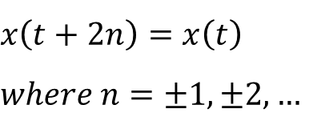
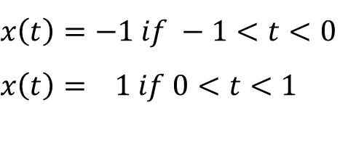
Example: Square Wave (Continue)
$$x\left(t\right)=−1 if −1<t<0$$
$$x\left(t\right)= 1 if 0<t<1$$
$$x\left(t+2n\right)=x\left(t\right)$$
$$where n=±1,±2, …$$

Slide 12
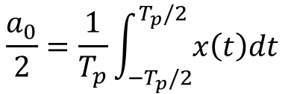
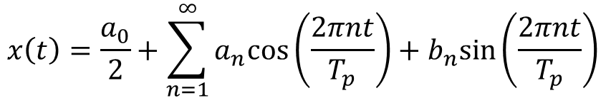
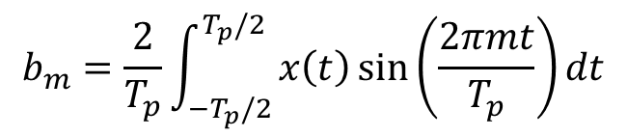
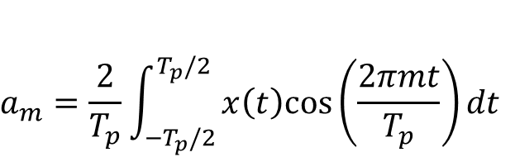
Example: Square Wave – MATLAB Script
1 2 3 4 5 6 7 8 | % the signal is assumed to be analog. ncyle = 3; Fsa = 1000; % # of samples per a second Tp = 2; t = -ncyle*Tp:1/Fsa:ncyle*Tp; x = @(t) square(t*(2*pi)/Tp); a0 = integral(x, -Tp/2, Tp/2);
9 10 11 12 13 14 15 16 17 18 | nCoeff = 5; a = zeros(nCoeff,1); b = zeros(nCoeff,1); for ii=1:nCoeff fun_a = @(t) x(t).*cos(2*pi*ii*t/Tp); a(ii) = integral(fun_a, -Tp/2, Tp/2); fun_b = @(t) x(t).*sin(2*pi*ii*t/Tp); b(ii) = integral(fun_b, -Tp/2, Tp/2); end
$$x\left(t\right)=\frac{a_{0}}{2}+\sum_{n=1}^{∞}{a_{n}cos⁡\left(\frac{2πnt}{T_{p}}\right)+b_{n}sin⁡\left(\frac{2πnt}{T_{p}}\right)}$$
$$a_{m}=\frac{2}{T_{p}}\int_{−T_{p}/2}^{T_{p}/2}{x\left(t\right)cos⁡\left(\frac{2πmt}{T_{p}}\right)dt}$$
$$\frac{a_{0}}{2}=\frac{1}{T_{p}}\int_{−T_{p}/2}^{T_{p}/2}{x\left(t\right)dt}$$
$$b_{m}=\frac{2}{T_{p}}\int_{−T_{p}/2}^{T_{p}/2}{x\left(t\right)\sin{⁡\left(\frac{2πmt}{T_{p}}\right)}dt}$$

Slide 13
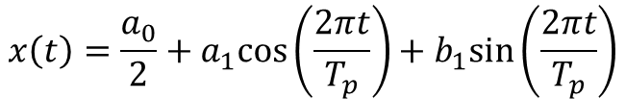
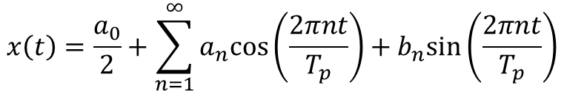
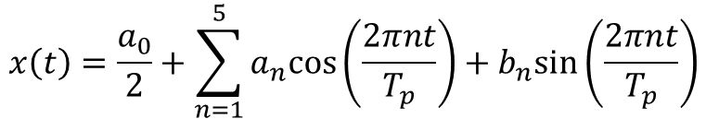
Example: Square Wave – MATLAB Script (Continue)
19 20 21 22 23 24 25 26 27 28 | % numerical integration sig_y_numeric = zeros(nCoeff, numel(t)); for ii=1:nCoeff if ii==1 sig_y_numeric(ii,:) = a0/2 + a(ii)*cos(2*pi*ii*t/Tp) + b(ii)*sin(2*pi*ii*t/Tp); else sig_y_numeric(ii,:) = ... sig_y_numeric(ii-1,:) + a(ii)*cos(2*pi*ii*t/Tp) + b(ii)*sin(2*pi*ii*t/Tp); end end
$$x\left(t\right)=\frac{a_{0}}{2}+a_{1}cos⁡\left(\frac{2πt}{T_{p}}\right)+b_{1}sin⁡\left(\frac{2πt}{T_{p}}\right)$$
$$x\left(t\right)=\frac{a_{0}}{2}+\sum_{n=1}^{∞}{a_{n}cos⁡\left(\frac{2πnt}{T_{p}}\right)+b_{n}sin⁡\left(\frac{2πnt}{T_{p}}\right)}$$
$$x\left(t\right)=\frac{a_{0}}{2}+\sum_{n=1}^{5}{a_{n}cos⁡\left(\frac{2πnt}{T_{p}}\right)+b_{n}sin⁡\left(\frac{2πnt}{T_{p}}\right)}$$

Slide 14

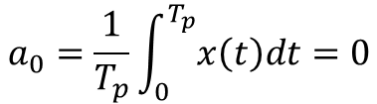
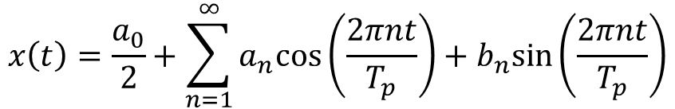
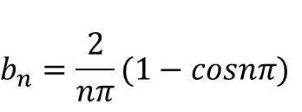
Example: Square Wave – MATLAB Script (Continue)
$$x\left(t\right)=\frac{a_{0}}{2}+\sum_{n=1}^{∞}{a_{n}cos⁡\left(\frac{2πnt}{T_{p}}\right)+b_{n}sin⁡\left(\frac{2πnt}{T_{p}}\right)}$$
$$b_{n}=\frac{2}{nπ}(1−cosnπ)$$
$$a_{n}=0$$
$$a_{0}=\frac{1}{T_{p}}\int_{0}^{T_{p}}{x\left(t\right)dt}=0$$
1 2 3 4 5 6 | nCoeff = 5; Tp = 2; t = -ncyle*Tp:1/Fsa:ncyle*Tp; sig_y_analytic = zeros(nCoeff, numel(t)); for ii=1:nCoeff sig_y_analytic(ii,:) = x_analytic(t, Tp, ii); end
1 2 3 4 5 6 | function x = x_analytic (t, Tp, n) x = zeros(1, numel(t)); for ii=1:n x = x + 2/(ii*pi)*(1-cos(ii*pi))*sin(2*pi*ii*t/Tp); end end

Slide 15


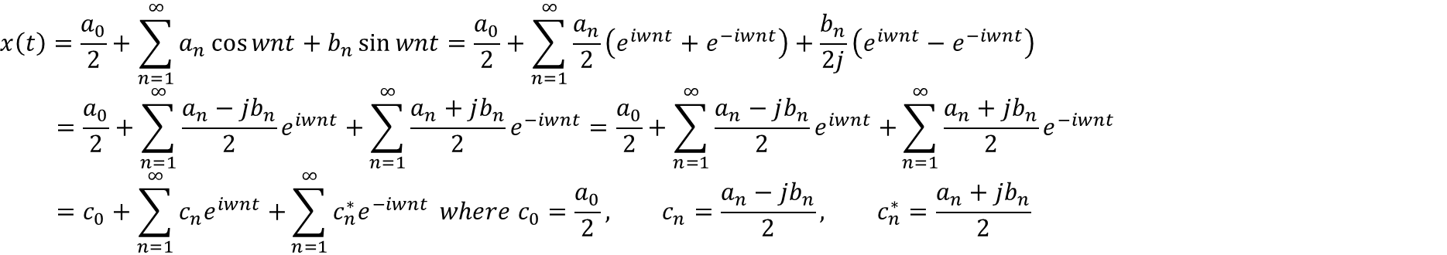

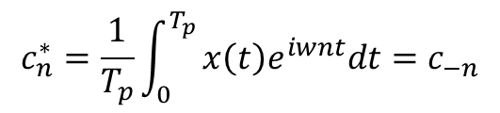


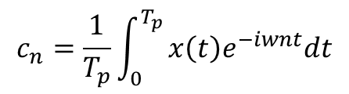

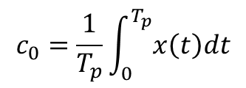
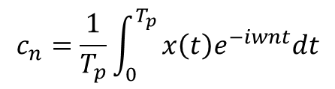
Complex Form of the Fourier Series
Euler Formula
$$coswt=\frac{1}{2}(e^{iwt}+e^{−iwt})$$
$$sinwt=\frac{1}{2}(e^{iwt}−e^{−iwt})$$
$$e^{iwt}=coswt+i sinwt$$
$$e^{−iwt}=coswt−i sinwt$$
$$x\left(t\right)=\frac{a_{0}}{2}+\sum_{n=1}^{∞}{a_{n}\cos{wnt}+b_{n}\sin{wnt}=\frac{a_{0}}{2}+\sum_{n=1}^{∞}{\frac{a_{n}}{2}\left(e^{iwnt}+e^{−iwnt}\right)+\frac{b_{n}}{2j}\left(e^{iwnt}−e^{−iwnt}\right)}}$$
$$=\frac{a_{0}}{2}+\sum_{n=1}^{∞}{\frac{a_{n}−jb_{n}}{2}e^{iwnt}+}\sum_{n=1}^{∞}{\frac{a_{n}+jb_{n}}{2}e^{−iwnt}}=\frac{a_{0}}{2}+\sum_{n=1}^{∞}{\frac{a_{n}−jb_{n}}{2}e^{iwnt}+}\sum_{n=1}^{∞}{\frac{a_{n}+jb_{n}}{2}e^{−iwnt}}$$
$$=c_{0}+\sum_{n=1}^{∞}{c_{n}e^{iwnt}+}\sum_{n=1}^{∞}{c_{n}^{∗}e^{−iwnt}} where c_{0}=\frac{a_{0}}{2}, c_{n}=\frac{a_{n}−jb_{n}}{2}, c_{n}^{∗}=\frac{a_{n}+jb_{n}}{2}$$
$$w=\frac{2π}{T_{p}}$$
$$c_{0}=\frac{1}{T_{p}}\int_{0}^{T_{p}}{x\left(t\right)dt}$$
$$c_{n}=\frac{1}{T_{p}}\int_{0}^{T_{p}}{x\left(t\right)e^{−iwnt}dt}$$
$$c_{n}^{∗}=\frac{1}{T_{p}}\int_{0}^{T_{p}}{x\left(t\right)e^{iwnt}dt}=c_{−n}$$
Negative frequency term ($c_{−n}$)
$$c_{n}=\frac{1}{T_{p}}\int_{0}^{T_{p}}{x\left(t\right)e^{−iwnt}dt}$$
$$w=\frac{2π}{T_{p}}$$
$$x\left(t\right)=\sum_{n=−∞}^{∞}{c_{n}e^{iwnt}}$$
Notes:
Derivation on the board

Slide 16
Example: Square Wave (Comparison of General and Complex Forms)
$$x\left(t\right)=−1 if −1<t<0$$
$$x\left(t\right)= 1 if 0<t<1$$
$$x\left(t+2n\right)=x\left(t\right)$$
$$where n=±1,±2, …$$

Slide 17
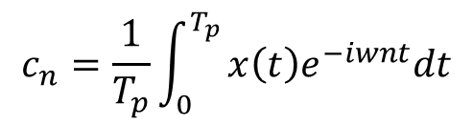

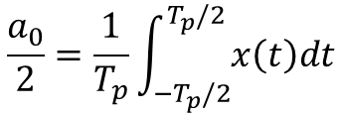
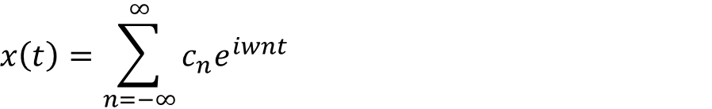

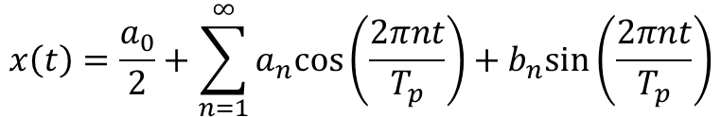


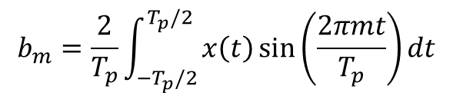

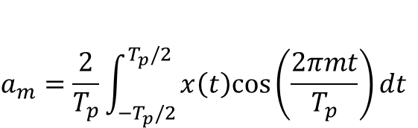

Summary
General form
$$x\left(t\right)=\frac{a_{0}}{2}+\sum_{n=1}^{∞}{a_{n}cos⁡\left(\frac{2πnt}{T_{p}}\right)+b_{n}sin⁡\left(\frac{2πnt}{T_{p}}\right)}$$
$$a_{m}=\frac{2}{T_{p}}\int_{−T_{p}/2}^{T_{p}/2}{x\left(t\right)cos⁡\left(\frac{2πmt}{T_{p}}\right)dt}$$
$$\frac{a_{0}}{2}=\frac{1}{T_{p}}\int_{−T_{p}/2}^{T_{p}/2}{x\left(t\right)dt}$$
$$b_{m}=\frac{2}{T_{p}}\int_{−T_{p}/2}^{T_{p}/2}{x\left(t\right)\sin{⁡\left(\frac{2πmt}{T_{p}}\right)}dt}$$
Complex form
$$x\left(t\right)$$
$$x\left(t\right)=x(t+nT_{p})$$
$$x\left(t\right)=\sum_{n=−∞}^{∞}{c_{n}e^{iwnt}}$$
$$t$$
$$0$$
$$c_{n}=\frac{1}{T_{p}}\int_{0}^{T_{p}}{x\left(t\right)e^{−iwnt}dt}$$
$$w=\frac{2πn}{T_{p}}$$
$$T_{p}$$
Periodic signal

