Slide 1
Signal Processing II
Chul Min Yeum
Assistant Professor
Civil and Environmental Engineering
University of Waterloo, Canada
CIVE 497 – CIVE 700: Smart Structure Technology
Last updated: 2019-12-24

Slide 2
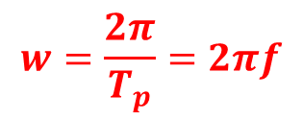
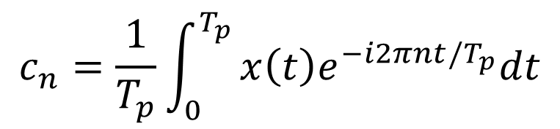
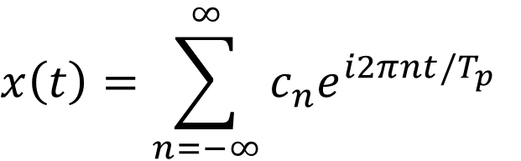
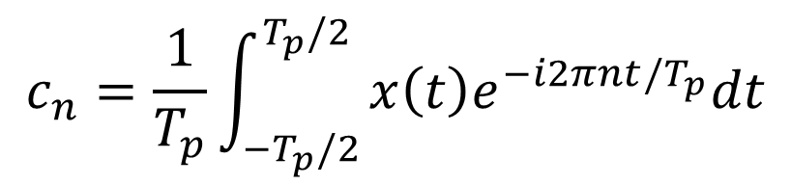
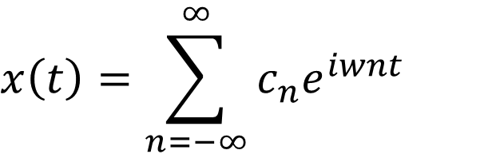
Fourier Series of a Periodic Signal
$$x\left(t\right)=\sum_{n=−∞}^{∞}{c_{n}e^{iwnt}}$$
$$c_{n}=\frac{1}{T_{p}}\int_{0}^{T_{p}}{x\left(t\right)e^{−i2πnt/T_{p}}dt}$$
Let’s represent the Fourier series of a periodic signal, where the interval of integration is defined from $−T_{p}/2$ to $T_{p}/2$ for convenience:
$$x\left(t\right)=\sum_{n=−∞}^{∞}{c_{n}e^{i2πnt/T_{p}}}$$
$$c_{n}=\frac{1}{T_{p}}\int_{{−T}_{p}/2}^{T_{p}/2}{x\left(t\right)e^{−i2πnt/T_{p}}dt}$$
$$w=\frac{2π}{T_{p}}=2πf$$

Slide 3



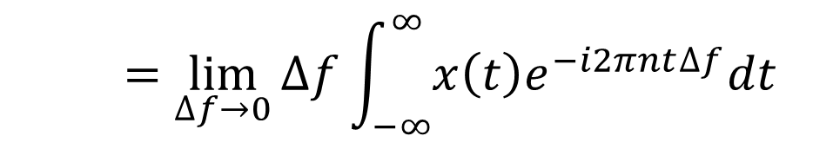

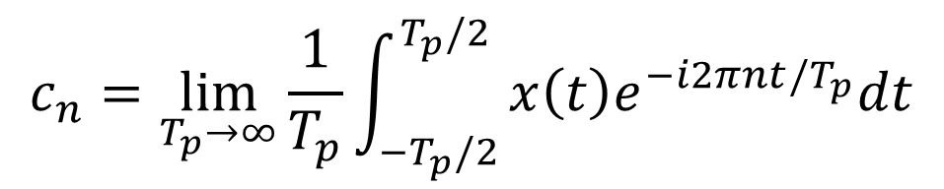
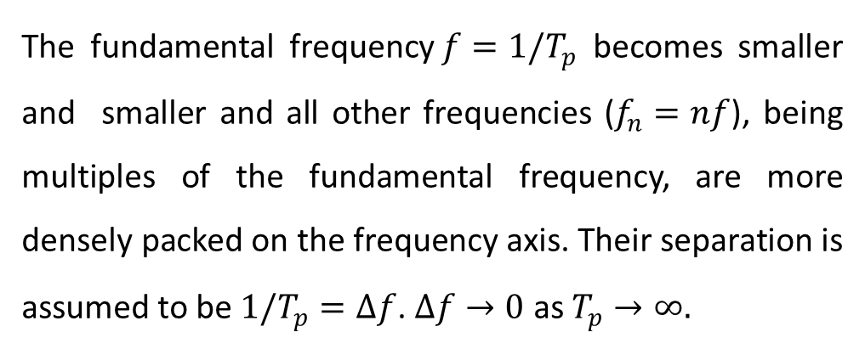



Fourier Integral for Non-periodic Functions
The fundamental frequency$f=1/T_{p}$ becomes smaller and smaller and all other frequencies ($f_{n}=nf$), being multiples of the fundamental frequency, are more densely packed on the frequency axis. Their separation is assumed to be$1/T_{p}=∆f$. $∆f→0$ as $T_{p}→∞.$
$$x\left(t\right)$$
$$t$$
$$T_{p}$$
$$x\left(t\right)$$
$$t$$
$$T_{p}$$
$$c_{n}=\lim_{T_{p}→∞}{\frac{1}{T_{p}}\int_{{−T}_{p}/2}^{T_{p}/2}{x\left(t\right)e^{−i2πnt/T_{p}}dt}}$$
$$x\left(t\right)$$
$$t$$
$$T_{p}$$
$$=\lim_{∆f→0}{∆f\int_{−∞}^{∞}{x\left(t\right)e^{−i2πnt∆f}dt}}$$

Slide 4
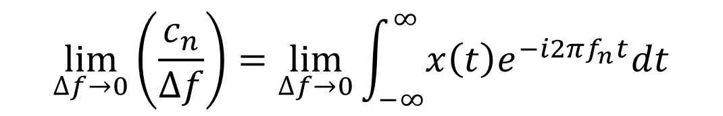
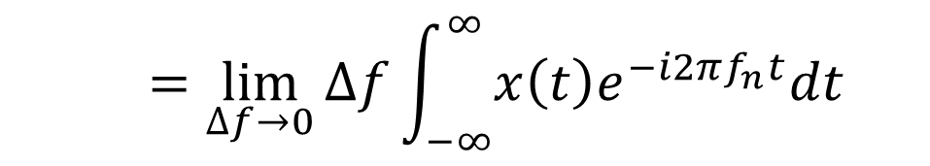
Fourier Integral for Non-periodic Functions (Continue)
$$c_{n}=\lim_{∆f→0}{∆f\int_{−∞}^{∞}{x\left(t\right)e^{−i2πnt/T_{p}}dt}=\lim_{∆f→0}{∆f\int_{−∞}^{∞}{x\left(t\right)e^{−i2πn∆ft}dt}}}$$
$$=\lim_{∆f→0}{∆f\int_{−∞}^{∞}{x\left(t\right)e^{−i2πf_{n}t}dt}}$$
$$\lim_{∆f→0}\left(\frac{c_{n}}{∆f}\right)=\lim_{∆f→0}{\int_{−∞}^{∞}{x\left(t\right)e^{−i2πf_{n}t}dt}}$$

Slide 5
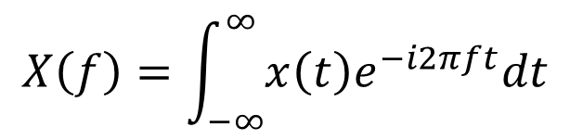
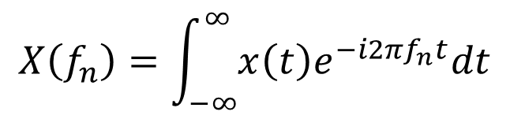
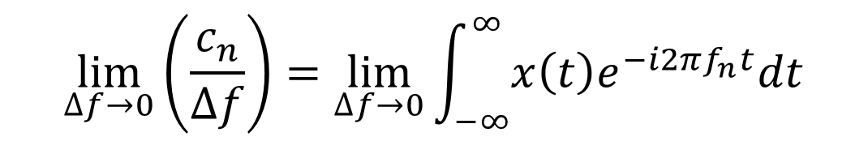
Fourier Integral for Non-periodic Functions (Continue)
$$\lim_{∆f→0}\left(\frac{c_{n}}{∆f}\right)=\lim_{∆f→0}{\int_{−∞}^{∞}{x\left(t\right)e^{−i2πf_{n}t}dt}}$$
Assuming the limits exist, we write this as
$$X\left(f_{n}\right)=\int_{−∞}^{∞}{x\left(t\right)e^{−i2πf_{n}t}dt}$$
Since $∆f→0$, the frequencies $f_{n}$become a continuum, so we write $f$ instead of $f_{n}$.
$$X\left(f\right)=\int_{−∞}^{∞}{x\left(t\right)e^{−i2πft}dt}$$
Fourier integral or Fourier transform of $x\left(t\right)$

Slide 6
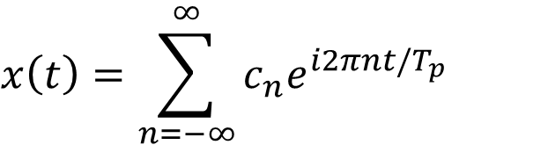
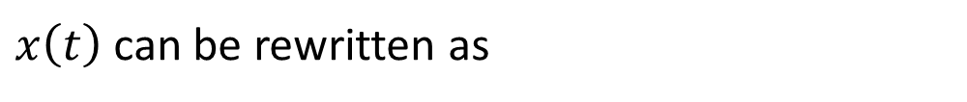
Fourier Integral for Non-periodic Functions (Continue)
$$x\left(t\right)=\sum_{n=−∞}^{∞}{c_{n}e^{i2πnt/T_{p}}}$$
$$\lim_{∆f→0}\left(\frac{c_{n}}{∆f}\right)=\lim_{∆f→0}{\int_{−∞}^{∞}{x\left(t\right)e^{−i2πf_{n}t}dt}}=\lim_{∆f→0}X\left(f_{n}\right)$$
$x\left(t\right)$ can be rewritten as
$$x\left(t\right)=\sum_{n=−∞}^{∞}{c_{n}e^{i2πnt/T_{p}}}=\lim_{∆f→0}{\sum_{n=−∞}^{∞}{∆fX\left(f_{n}\right)e^{i{2πf}_{n}t}}}$$
This can be represented in a continuous form as
$$x\left(t\right)=\int_{−∞}^{∞}{X\left(f\right)e^{i2πft}df}$$

Slide 7
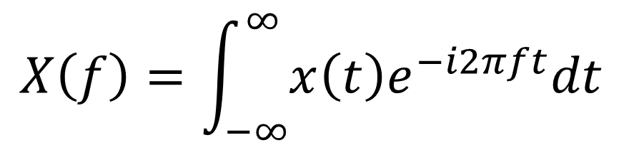
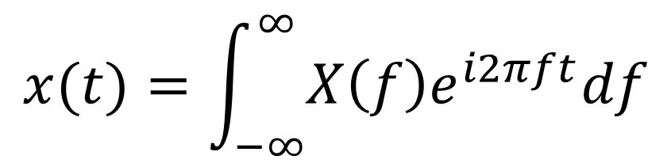
Fourier Integral Pair (Fourier Transform)
$$x(t)=\int_{−∞}^{∞}{X\left(f\right)e^{i2πft}df}$$
$$X\left(f\right)=\int_{−∞}^{∞}{x\left(t\right)e^{−i2πft}dt}$$
The Fourier transform (FT) decomposes a function of time (a signal) into its constituent frequencies. This is similar to the way a musical chord can be expressed in terms of the volumes and frequencies of its constituent notes. The term Fourier transform refers to both the frequency domain representation and the mathematical operation that associates the frequency domain representation to a function of time.
https://en.wikipedia.org/wiki/Fourier_transform

Slide 8

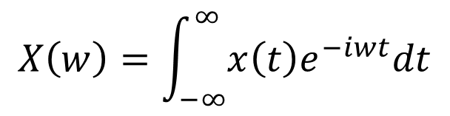

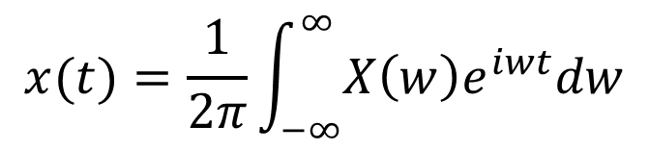
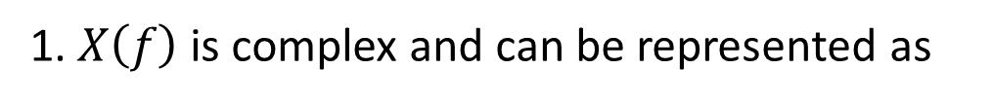

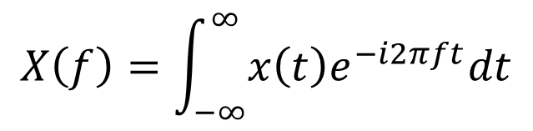

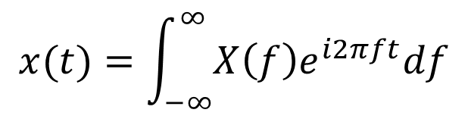


Comments on the Fourier Integral
1. $X\left(f\right)$ is complex and can be represented as
$$Im$$
$$X\left(f\right)$$
$$\left|X\left(f\right)\right|$$
$$X\left(f\right)=X_{Re}\left(f\right)+{i X}_{Im}\left(f\right)=\left|X\left(f\right)\right|e^{i∅(f)}$$
$$∅$$
$$Re$$
2. Fourier transformation using $f$and $w$
$$x(t)=\int_{−∞}^{∞}{X\left(f\right)e^{i2πft}df}$$
$$x(t)=\frac{1}{2π}\int_{−∞}^{∞}{X\left(w\right)e^{iwt}dw}$$
$$X\left(f\right)=\int_{−∞}^{∞}{x\left(t\right)e^{−i2πft}dt}$$
$$X\left(w\right)=\int_{−∞}^{∞}{x\left(t\right)e^{−iwt}dt}$$

Slide 9



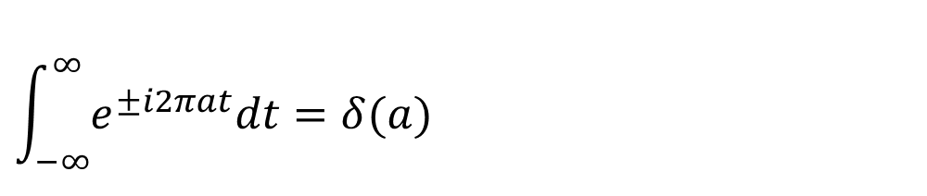

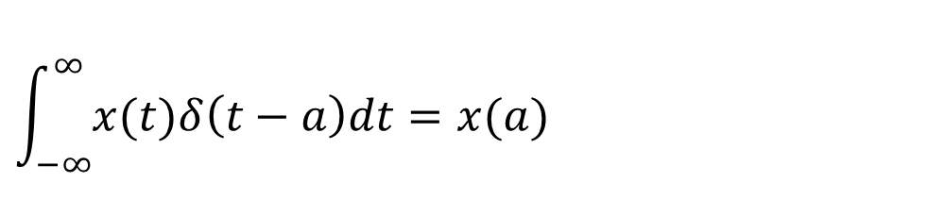
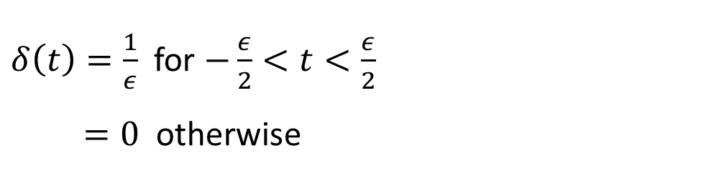
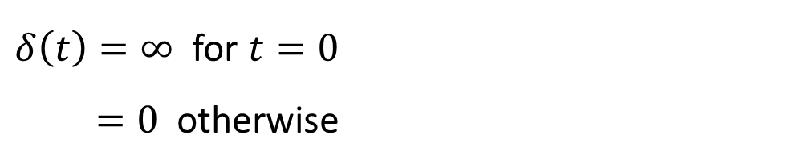
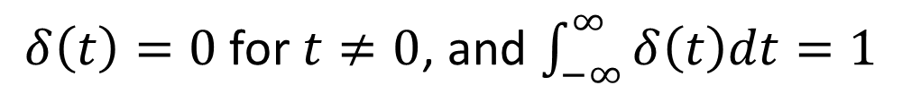

Dirac Delta Function
The Dirac delta function is denoted by $δ(t)$
$$\frac{1}{ε}$$
$δ\left(t\right)=0$ for $t≠0$, and $\int_{−∞}^{∞}{δ\left(t\right)dt}=1$
$δ\left(t\right)=\frac{1}{ε}$ for $−\frac{ε}{2}<t<\frac{ε}{2}$
$=0$ otherwise
$δ\left(t\right)=∞$ for $t=0$
$=0$ otherwise
$$−\frac{ε}{2}$$
$$\frac{ε}{2}$$
$$t$$
Properties
$$\int_{−∞}^{∞}{x(t)δ\left(t−a\right)dt}=x(a)$$
$$\int_{−∞}^{∞}{e^{±i2πat}dt}=δ(a)$$
Notes:
integral( x(A+a)del(A)dA) =

Slide 10


Proof: Dirac Delta Function
$$\int_{−∞}^{∞}{e^{±i2πat}dt}=\lim_{M→∞}\left(\int_{−M}^{M}{\left(cos2πat±i sin2πat\right)dt}\right)$$
$$=\lim_{M→∞}\left(\int_{−M}^{M}{\left(cos2πat\right)dt}\right)=\lim_{M→∞}{\left.2\frac{sin2πat}{2πa}\right|}_{0}^{M}$$
$$=\lim_{M→∞}2M\frac{sin2πaM}{2πaM}=δ(a)$$
L’Hôpitals rule can be applied to limits of the form $\frac{0}{0}$ or $\frac{∞}{∞}$.
If $f\left(x\right)$ and $g\left(x\right)$ are different functions and if $\lim_{x→a}{\frac{f(x)}{g(x)}}$is indeterminate, then
$$\lim_{x→a}{\frac{f(x)}{g(x)}}=\lim_{x→a}{\frac{f^{′}\left(x\right)}{g′(x)}}$$
Sinc function

Slide 11
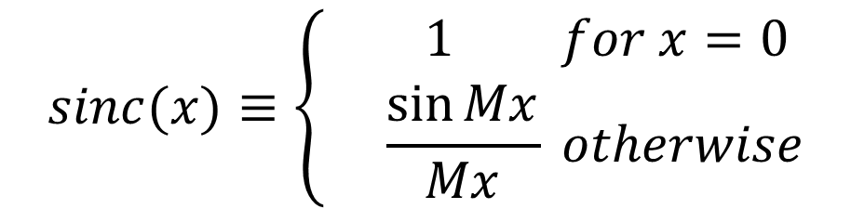
Sinc Function
$$sinc(x)≡\left\{\begin{matrix} 1 for x=0 \\ \frac{\sin{Mx}}{Mx} otherwise\end{matrix}\right.$$

Slide 12
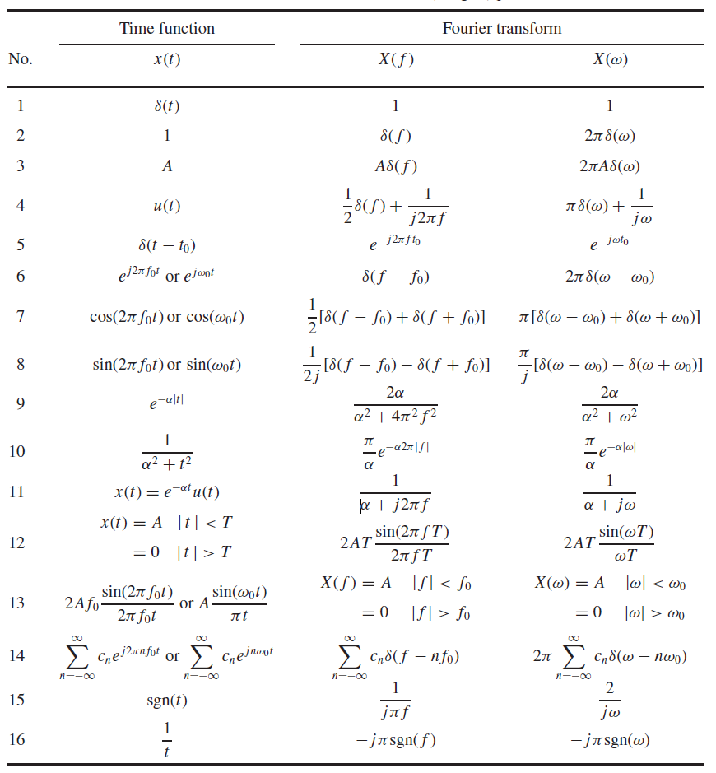
Table of Fourier Transform Pairs

Slide 13
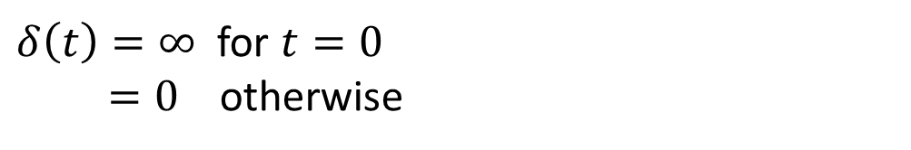


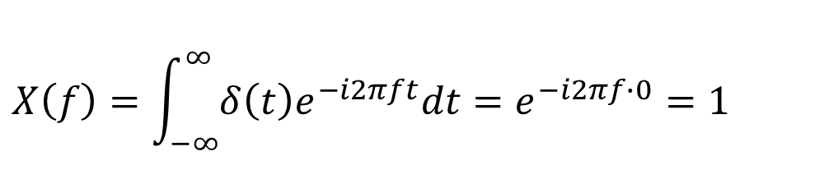



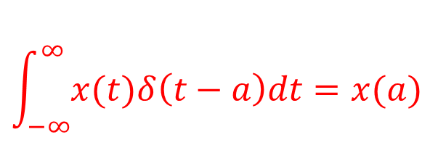
Example: Dirac Delta Function
$δ\left(t\right)=∞$ for $t=0$
$=0$ otherwise
$$X\left(f\right)=\int_{−∞}^{∞}{δ\left(t\right)e^{−i2πft}dt}=e^{−i2πf∙0}=1$$
$$\int_{−∞}^{∞}{x(t)δ\left(t−a\right)dt}=x(a)$$
$$δ(t)$$
$$X(f)$$
$$1.0$$
$$t$$
$$f$$

Slide 14
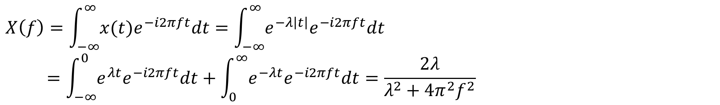
Example: Exponentially Decaying Symmetric Function
$$x\left(t\right)=e^{−λ\left|t\right|}, λ>0$$
$$X\left(f\right)=\int_{−∞}^{∞}{x(t)e^{−i2πft}dt}=\int_{−∞}^{∞}{e^{−λ\left|t\right|}e^{−i2πft}dt}$$
$$=\int_{−∞}^{0}{e^{λt}e^{−i2πft}dt}+\int_{0}^{∞}{e^{−λt}e^{−i2πft}dt}=\frac{2λ}{λ^{2}+4π^{2}f^{2}}$$

Slide 15
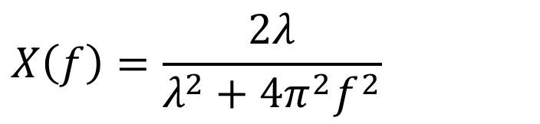

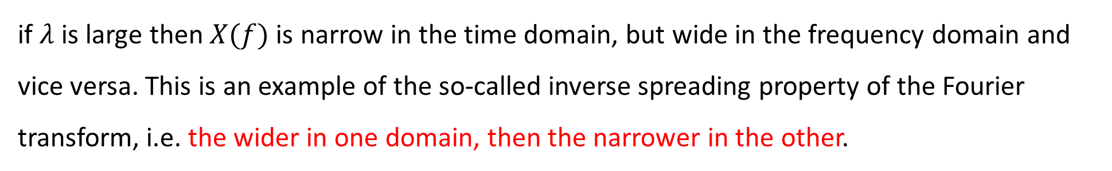
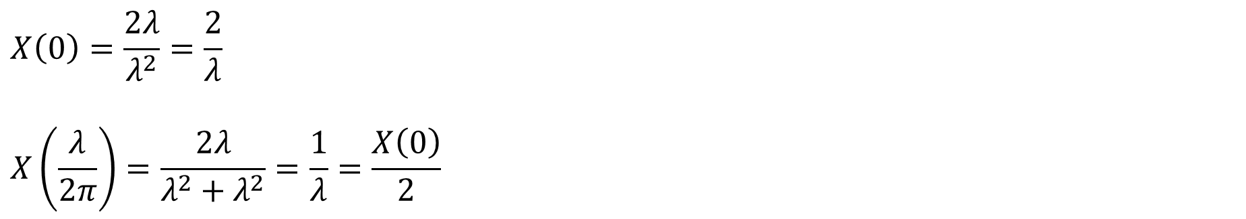
Example: Exponentially Decaying Symmetric Function (Continue)
$$X\left(f\right)=\frac{2λ}{λ^{2}+4π^{2}f^{2}}$$
$$x\left(t\right)=e^{−λ\left|t\right|}, λ>0$$
$$X\left(0\right)=\frac{2λ}{λ^{2}}=\frac{2}{λ}$$
$$X\left(\frac{λ}{2π}\right)=\frac{2λ}{λ^{2}+λ^{2}}=\frac{1}{λ}=\frac{X\left(0\right)}{2}$$
if $λ$ is large then $X(f)$ is narrow in the time domain, but wide in the frequency domain and vice versa. This is an example of the so-called inverse spreading property of the Fourier transform, i.e. the wider in one domain, then the narrower in the other.

Slide 16

Exponentially Decaying Symmetric Function with Different Lambda Values
if $λ$ is large then $X(f)$ is narrow in the time domain, but wide in the frequency domain and vice versa. This is an example of the so-called inverse spreading property of the Fourier transform, i.e. the wider in one domain, then the narrower in the other.

Slide 17


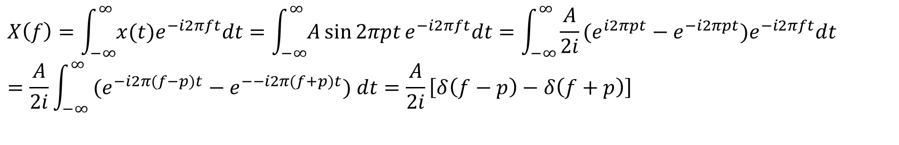








Example: Sine Function
$$x\left(t\right)=A\sin{2πpt}$$
$$X\left(f\right)=\int_{−∞}^{∞}{x(t)e^{−i2πft}dt}=\int_{−∞}^{∞}{A\sin{2πpt}e^{−i2πft}dt}=\int_{−∞}^{∞}{\frac{A}{2i}(e^{i2πpt}−e^{−i2πpt})e^{−i2πft}dt}=\frac{A}{2i}\int_{−∞}^{∞}{ (e^{−i2π(f−p)t}−e^{−−i2π(f+p)t}) dt}=\frac{A}{2i}\left[δ\left(f−p\right)−δ\left(f+p\right)\right]$$
$$\left|X(f) \right|$$
$$x(t)$$
$$A$$
$$A/2$$
$$A/2$$
$$t$$
$$−p$$
$$p$$
$$f$$
$$1/p$$

Slide 18
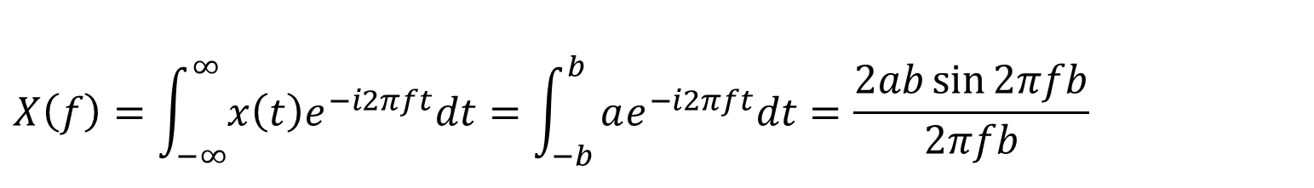
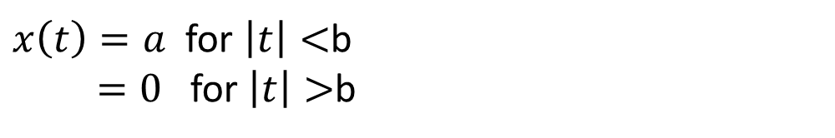
Example: Rectangular Function
$x\left(t\right)=a$ for $\left|t\right|<$b
$=0$ for $\left|t\right|>$b
$$X\left(f\right)=\int_{−∞}^{∞}{x\left(t\right)e^{−i2πft}dt}=\int_{−b}^{b}{ae^{−i2πft}dt=\frac{2ab\sin{2πfb}}{2πfb}}$$
See Sinc function

Slide 19
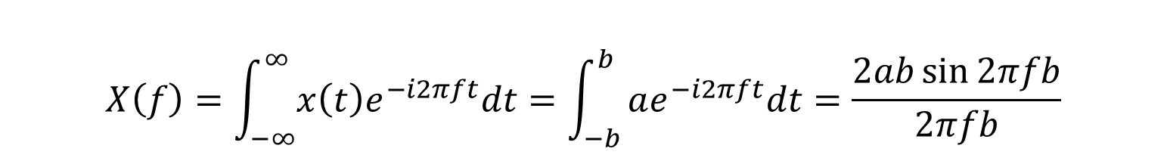
Rectangular Function with Different Ranges
$$X\left(f\right)=\int_{−∞}^{∞}{x\left(t\right)e^{−i2πft}dt}=\int_{−b}^{b}{ae^{−i2πft}dt=\frac{2ab\sin{2πfb}}{2πfb}}$$

Slide 20
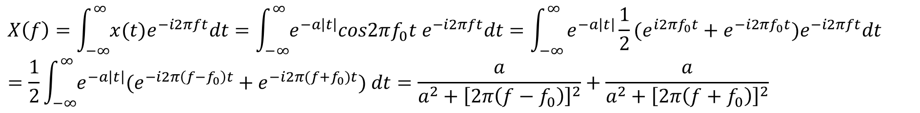
Example: Damped Symmetrically Oscillating Function
$$x\left(t\right)=e^{−a\left|t\right|}cos2πf_{0}t$$
$$X\left(f\right)=\int_{−∞}^{∞}{x(t)e^{−i2πft}dt}=\int_{−∞}^{∞}{e^{−a\left|t\right|}cos2πf_{0}t e^{−i2πft}dt}=\int_{−∞}^{∞}{e^{−a\left|t\right|}\frac{1}{2}(e^{i2πf_{0}t}+e^{−i2πf_{0}t})e^{−i2πft}dt}$$
$$=\frac{1}{2}\int_{−∞}^{∞}{e^{−a\left|t\right|}(e^{−i2π\left(f−f_{0}\right)t}+e^{−i2π(f+f_{0})t}) dt}=\frac{a}{a^{2}+{\left[2π\left(f−f_{0}\right)\right]}^{2}}+\frac{a}{a^{2}+{\left[2π\left(f+f_{0}\right)\right]}^{2}}$$
convolution

Slide 21
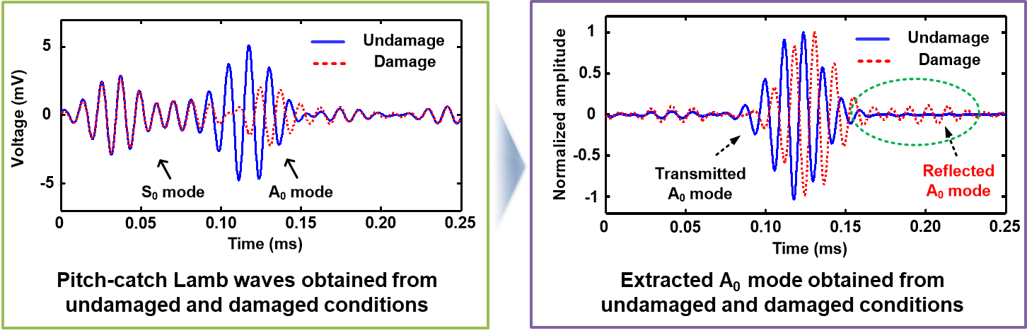
Example: Ultrasonic-based Damage Detection
https://www.sciencedirect.com/science/article/pii/S0165212511000102
https://www.sciencedirect.com/science/article/pii/S0886779809001266

Slide 22
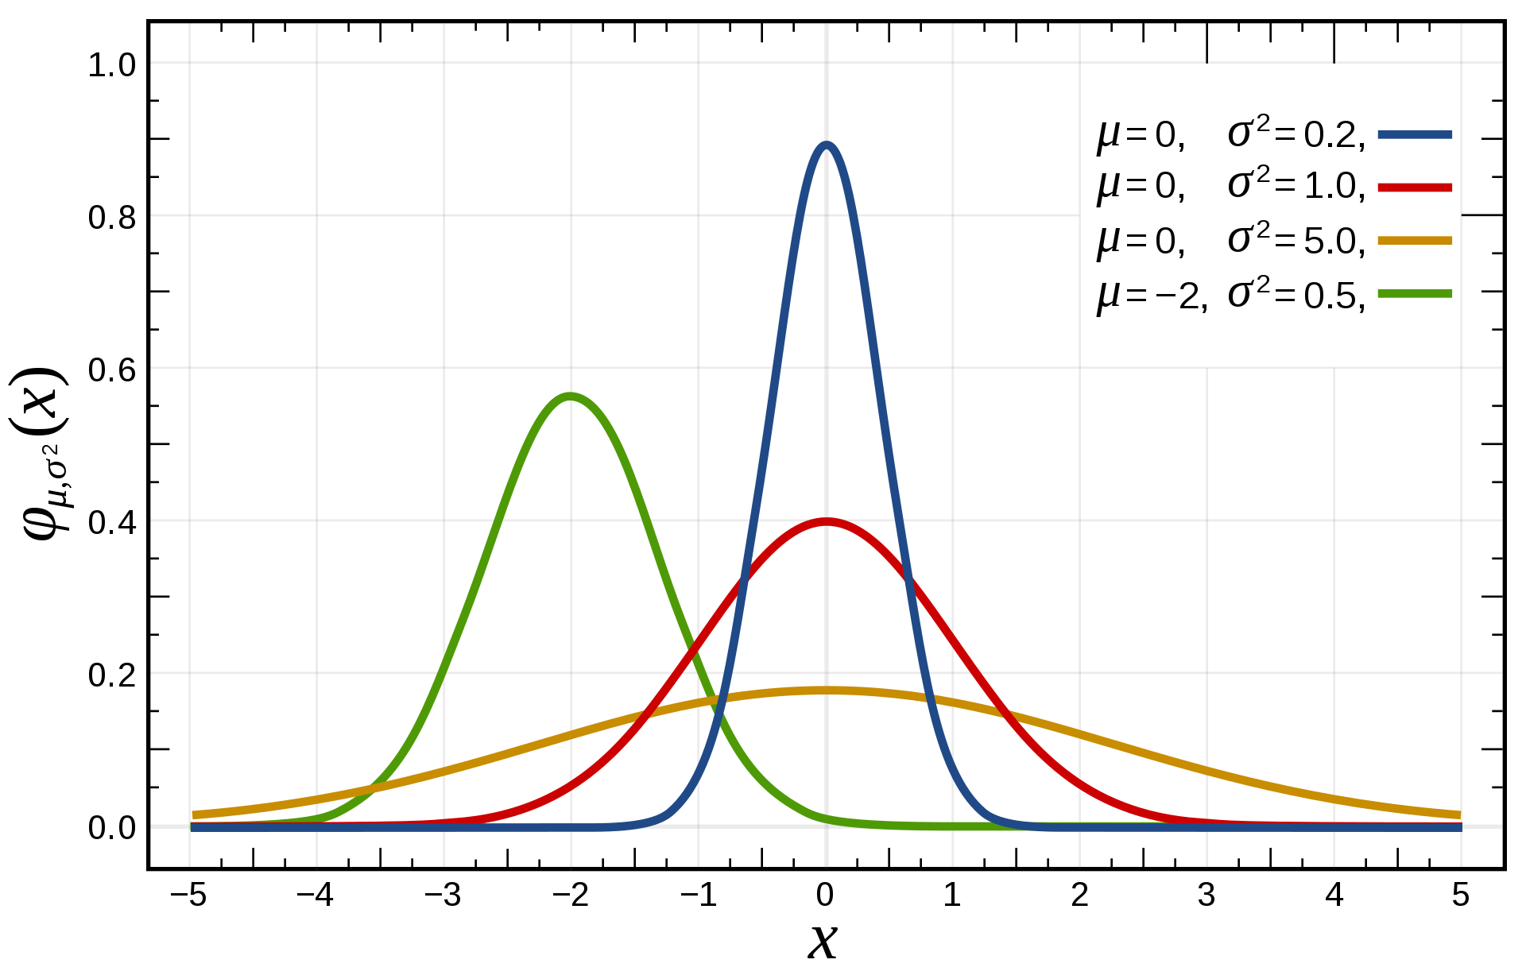

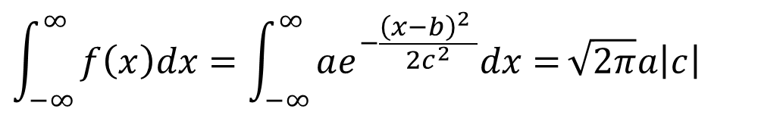

Gaussian Function
$$f\left(x\right)=ae^{−\frac{{\left(x−b\right)}^{2} }{2c^{2}}}$$
$$g\left(x\right)=\frac{1}{σ\sqrt{2π}}e^{−\frac{1}{2}{\left(\frac{x−u}{σ}\right)}^{2}}$$
$$\int_{−∞}^{∞}{f\left(x\right)dx=\int_{−∞}^{∞}{ae^{−\frac{{\left(x−b\right)}^{2} }{2c^{2}}}dx=}}\sqrt{2π}a\left|c\right|$$

Slide 23
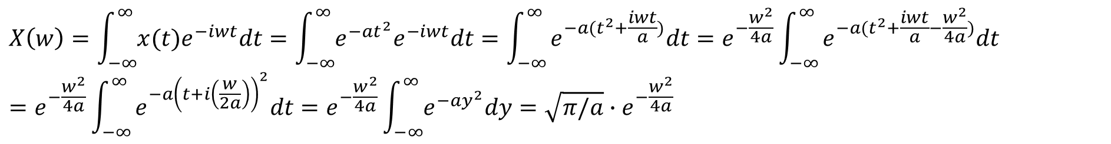
Example: Gaussian Function
$$x\left(t\right)=e^{−at^{2}}$$
$$X\left(w\right)=\int_{−∞}^{∞}{x(t)e^{−iwt}dt}=\int_{−∞}^{∞}{e^{−at^{2}}e^{−iwt}dt}=\int_{−∞}^{∞}{e^{−a(t^{2}+\frac{iwt}{a})}dt}=e^{−\frac{w^{2}}{4a}}\int_{−∞}^{∞}{e^{−a(t^{2}+\frac{iwt}{a}−\frac{w^{2}}{4a})}dt}$$
$$=e^{−\frac{w^{2}}{4a}}\int_{−∞}^{∞}{e^{−a{\left(t+i\left(\frac{w}{2a}\right)\right)}^{2}}dt}=e^{−\frac{w^{2}}{4a}}\int_{−∞}^{∞}{e^{−ay^{2}}dy}=\sqrt{π/a}{∙e}^{−\frac{w^{2}}{4a}}$$
Notes:
As a is larger in time, the enveloped in frequency become more narrower and the one in time become wider.

Slide 24

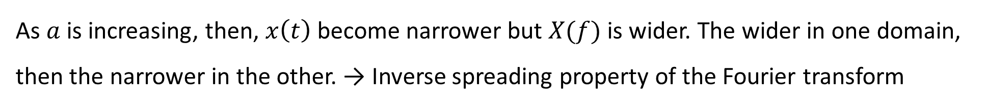
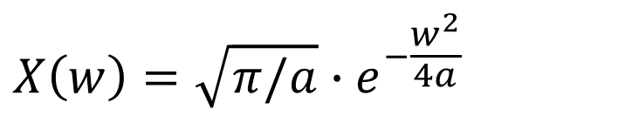
Gaussian Function with Different Variances
$$X\left(w\right)=\sqrt{π/a}{∙e}^{−\frac{w^{2}}{4a}}$$
$$x\left(t\right)=e^{−at^{2}}$$
As $a$ is increasing, then, $x\left(t\right)$ become narrower but $X(f)$ is wider. The wider in one domain, then the narrower in the other. → Inverse spreading property of the Fourier transform

Slide 25


Example: Fourier Transform of a Periodic Function
$$x\left(t\right)=\sum_{n=−∞}^{∞}{c_{n}e^{i2πnt/T_{p}}}$$
$$X\left(f\right)=\int_{−∞}^{∞}{\sum_{n=−∞}^{∞}{c_{n}e^{i2πnt/T_{p}}}e^{−i2πft}dt}=\sum_{n=−∞}^{∞}{\int_{−∞}^{∞}{c_{n}e^{i2π\left(f−\frac{n}{T_{p}}\right)t}dt=\sum_{n=−∞}^{∞}{\int_{−∞}^{∞}{c_{n}δ(f−\frac{n}{T_{p}})dt}}}}$$
Fourier transform of a periodic function is a series of delta functions scaled by $c_{n}$, and located at multiples of the fundamental frequency, $1/T_{p}$.
Notes:
See the slide for “Example: Sine Function”

