Slide 1
Signal Processing III
Chul Min Yeum
Assistant Professor
Civil and Environmental Engineering
University of Waterloo, Canada
CIVE 497 – CIVE 700: Smart Structure Technology
Last updated: 2019-12-26

Slide 2
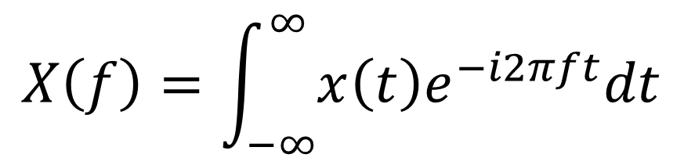
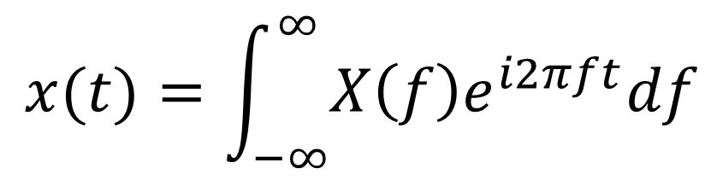
Fourier Integral Pair (Fourier Transform)
$$x(t)=\int_{−∞}^{∞}{X\left(f\right)e^{i2πft}df}$$
$$X\left(f\right)=\int_{−∞}^{∞}{x\left(t\right)e^{−i2πft}dt}$$
The Fourier transform (FT) decomposes a function of time (a signal) into its constituent frequencies. This is similar to the way a musical chord can be expressed in terms of the volumes and frequencies of its constituent notes. The term Fourier transform refers to both the frequency domain representation and the mathematical operation that associates the frequency domain representation to a function of time.
https://en.wikipedia.org/wiki/Fourier_transform

Slide 3



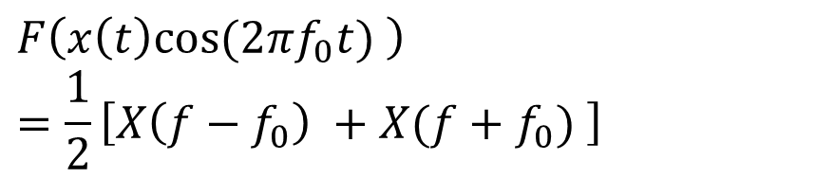


Properties of Fourier Transforms
1. Time scaling
2. Time reversal
$$F\left(x\left(at\right)\right)=\frac{1}{\left|a\right|}X(\frac{f}{a})$$
$$F\left(x\left(−t\right)\right)=X(−f)$$
3. Differentiation
Inverse spreading relationship
5. Modulation
$$F\left(\dot{x}\left(t\right)\right)=i2πfX(f)$$
$$F\left(x\left(t\right)e^{i2πf_{0}t}\right)=X(f−f_{0})$$
4. Time shifting
$$F\left(x\left(t\right)cos⁡(2πf_{0}t) \right)=\frac{1}{2}\left[X\left(f−f_{0}\right) +X(f+f_{0}) \right]$$
$$F\left(x\left(t−t_{0}\right)\right)=e^{−i2πft_{0}}X(f)$$
Only phase shift !
Sine wave

Slide 4
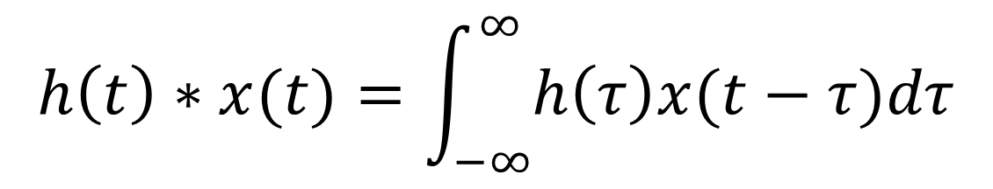

Properties of Fourier Transforms (Convolution)
$$F\left(h\left(t\right)∗x(t)\right)=H\left(f\right)X(f)$$
Where the convolution of the two functions $h\left(t\right)$ and $x(t)$ is defined as
$$h\left(t\right)∗x(t)=\int_{−∞}^{∞}{h\left(τ\right)x(t−τ)dτ}$$
Notes:
Signal processing
Image processing
Machine learning

Slide 5
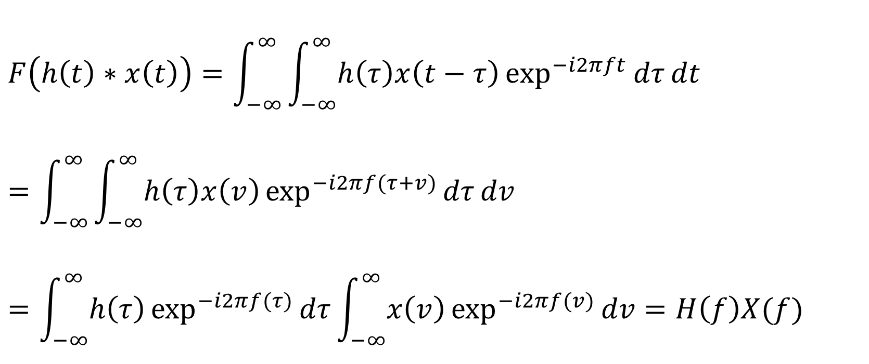
Proof of Convolution Relationship
$$F\left(h\left(t\right)∗x\left(t\right)\right)=\int_{−∞}^{∞}{\int_{−∞}^{∞}{h\left(τ\right)x\left(t−τ\right)\exp^{−i2πft}{dτ}}dt}=\int_{−∞}^{∞}{\int_{−∞}^{∞}{h\left(τ\right)x\left(v\right)\exp^{−i2πf(τ+v)}{dτ}}dv}=\int_{−∞}^{∞}{h\left(τ\right)\exp^{−i2πf(τ)}{dτ}}\int_{−∞}^{∞}{x\left(v\right)\exp^{−i2πf(v)}{dv}}=H\left(f\right)X(f)$$

Slide 6
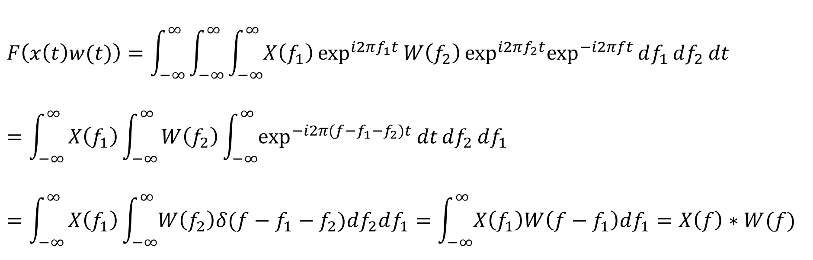
Properties of Fourier Transforms (Convolution) (Continue)
$$F\left(x\left(t\right)w(t)\right)=\int_{−∞}^{∞}{X\left(g\right)W\left(f−g\right)dg}=X\left(f\right)∗W(f)$$
$$F\left(x\left(t\right)w(t)\right)=\int_{−∞}^{∞}{\int_{−∞}^{∞}{\int_{−∞}^{∞}{X\left(f_{1}\right)\exp^{i2πf_{1}t}{W\left(f_{2}\right)\exp^{i2πf_{2}t}\exp^{−i2πft}{df_{1}}}}df_{2}}dt}=\int_{−∞}^{∞}{X\left(f_{1}\right)\int_{−∞}^{∞}{W\left(f_{2}\right)\int_{−∞}^{∞}{\exp^{−i2π(f−f_{1}−f_{2})t}{\operatorname{dt}{df_{2}}}}df_{1}}}$$
$$=\int_{−∞}^{∞}{X\left(f_{1}\right)\int_{−∞}^{∞}{W\left(f_{2}\right)δ(f−f_{1}−f_{2})df_{2}df_{1}}=\int_{−∞}^{∞}{X\left(f_{1}\right)W\left(f−f_{1}\right)df_{1}}=X\left(f\right)∗W(f) }$$

Slide 7

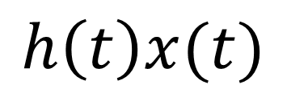
Example: Convolution 1 (Square Wave)
$h\left(t\right)=3 if −3<t<3$. Otherwise, $h\left(t\right)=0$
$x\left(t\right)=2 if −1<t<1$. Otherwise, $x\left(t\right)=0$
$$h\left(t\right)x(t)$$

Slide 8
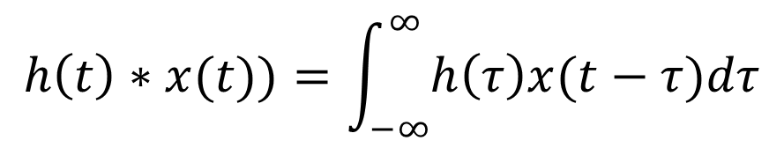
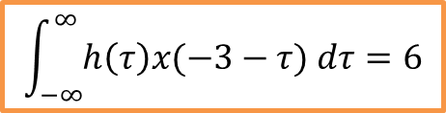

Example: Convolution 1 (Square Wave) (Continue)
$$h\left(t\right)∗x(t))=\int_{−∞}^{∞}{h\left(τ\right)x(t−τ)dτ}$$
$$\int_{−∞}^{∞}{h\left(τ\right)x(−5−τ) dτ}=0$$
$$\int_{−∞}^{∞}{h\left(τ\right)x(−3−τ) dτ}=6$$

Slide 9

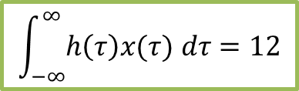
Example: Convolution 1 (Square Wave) (Continue)
$$h\left(t\right)∗x(t))=\int_{−∞}^{∞}{h\left(τ\right)x(t−τ)dτ}$$
$$\int_{−∞}^{∞}{h\left(τ\right)x(τ) dτ}=12$$
$$\int_{−∞}^{∞}{h\left(τ\right)x(3−τ) dτ}=6$$

Slide 10
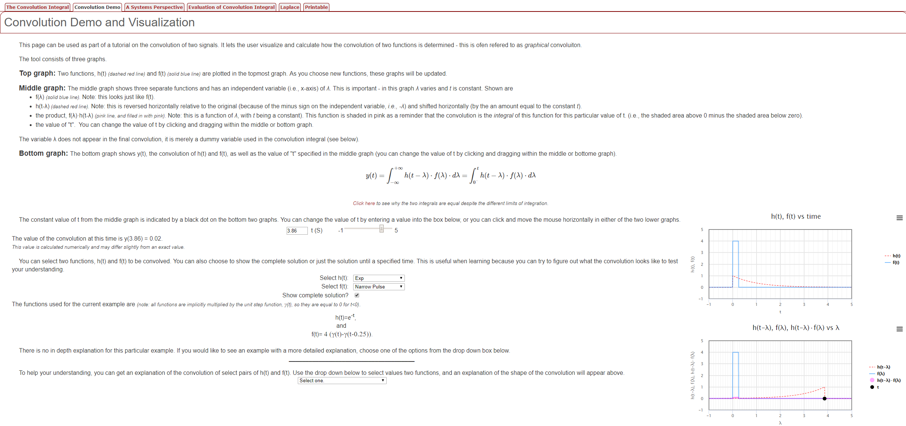
Convolution (Visualization)
http://lpsa.swarthmore.edu/Convolution/CI.html

Slide 11



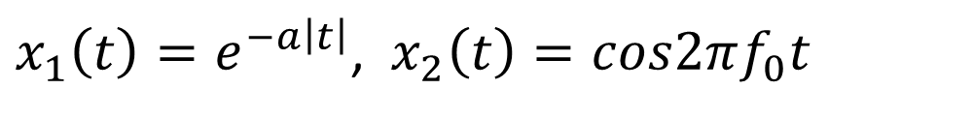





Example: Convolution 2 (Damped Symmetrically Oscillating Function)
$x_{1}\left(t\right)=e^{−a\left|t\right|}$, $x_{2}\left(t\right)=cos2πf_{0}t$
$$x\left(t\right)=x_{1}\left(t\right)x_{2}\left(t\right)=e^{−a\left|t\right|}cos2πf_{0}t$$
$$\left|X_{2} (f) \right|$$
$$A/2$$
$$A/2$$
$$−f_{0}$$
$$f_{0}$$
$$f$$
$$\left|X_{1} (f) \right|$$
$$f$$

Slide 12

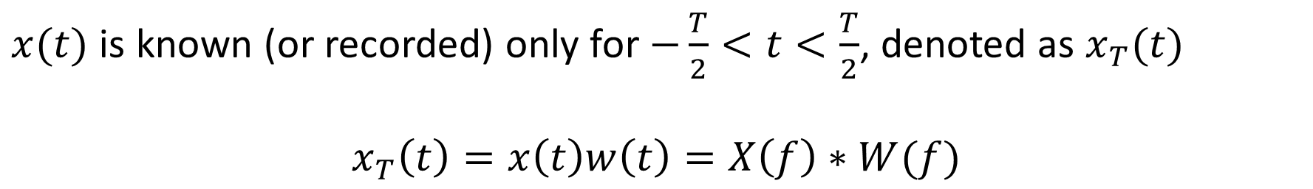

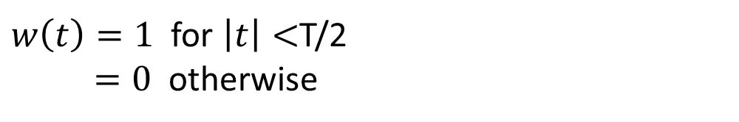

Effect of Data Truncation (Windowing)
$$x(t)$$
$$w(t)$$
$w\left(t\right)=1$ for $\left|t\right|<$T/2
$=0$ otherwise
$$t$$
$x(t)$ is known (or recorded) only for $−\frac{T}{2}<t<\frac{T}{2}$, denoted as $x_{T}(t)$
$$x_{T}\left(t\right)=x\left(t\right)w\left(t\right)=X\left(f\right)∗W(f)$$
Fourier transform of the product of two time signals is the convolution of their Fourier transforms.

Slide 13

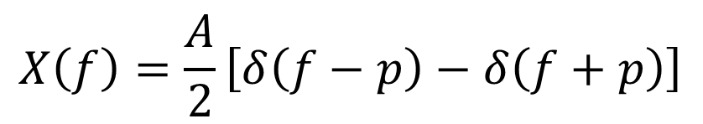









Effect of Data Truncation (Windowing) (Continue)
$$x\left(t\right)=A\cos{2πpt}$$
$$w\left(t\right)=1$$
$$X\left(f\right)=\frac{A}{2}\left[δ\left(f−p\right)−δ\left(f+p\right)\right]$$
$$W\left(f\right)=δ\left(f\right)$$
$$X(f)$$
$$W(f)$$
$$A/2$$
$$A/2$$
$$−p$$
$$p$$
$$f$$
Notes:
https://stackoverflow.com/questions/31131672/difference-between-mean-and-gaussian-filter-in-result
https://community.plm.automation.siemens.com/t5/Testing-Knowledge-Base/Introduction-to-Filters-FIR-versus-IIR/ta-p/520959
https://electronics.stackexchange.com/questions/109820/why-should-i-use-digital-filters-for-bandpassing-rather-than-simply-manipulate-s
https://dsp.stackexchange.com/questions/6220/why-is-it-a-bad-idea-to-filter-by-zeroing-out-fft-bins

Slide 14
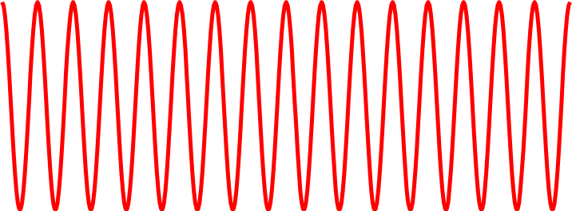



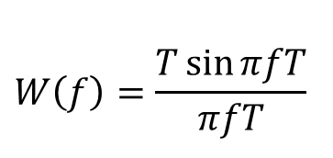




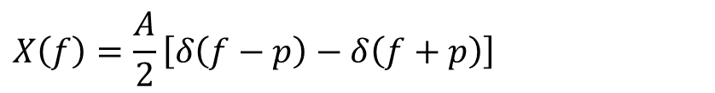








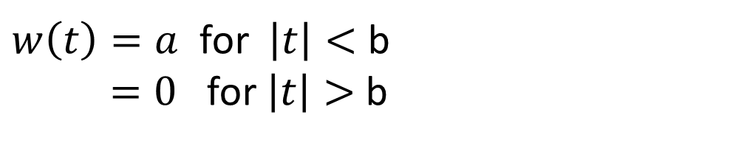

Truncated Sine Wave
$$x(t)$$
$$W(f)$$
$$w(t)$$
$$W\left(f\right)=\frac{T\sin{πfT}}{πfT}$$
$$T$$
$$1/T$$
$$\left|X_{1} (f) \right|$$
$$A/2$$
$$A/2$$
$$X\left(f\right)=\frac{A}{2}\left[δ\left(f−p\right)−δ\left(f+p\right)\right]$$
$$x\left(t\right)=A\cos{2πpt}$$
$$−p$$
$$p$$
$$f$$
$$X_{T}(f)$$
$w\left(t\right)=a$ for $\left|t\right|<$ b
$=0$ for $\left|t\right|>$b
Smearing: Distortion due to the main lobe
Leakage: Distortion due to the side lobe
$$x_{T}\left(t\right)=x\left(t\right)w(t)$$
$$−p$$
$$p$$

Slide 15
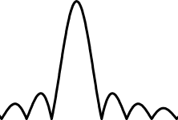














Effect of Data Truncation: Frequency Separation
$$\left|X(f) \right|$$
$x(t)$ is the sum of three sine (or cosine) waves
$$f_{0}$$
$$f_{1}$$
$$f_{2}$$
$$\left|X(f) \right|$$
$T_{p}$ Increase
Considerable smearing due to the spectral window
$$f_{0}$$
$$f_{1}$$
$$f_{2}$$
$$\left|X(f) \right|$$
Three components are resolved but with considerable leakage at other frequencies
$$f_{0}$$
$$f_{1}$$
$$f_{2}$$

Slide 16
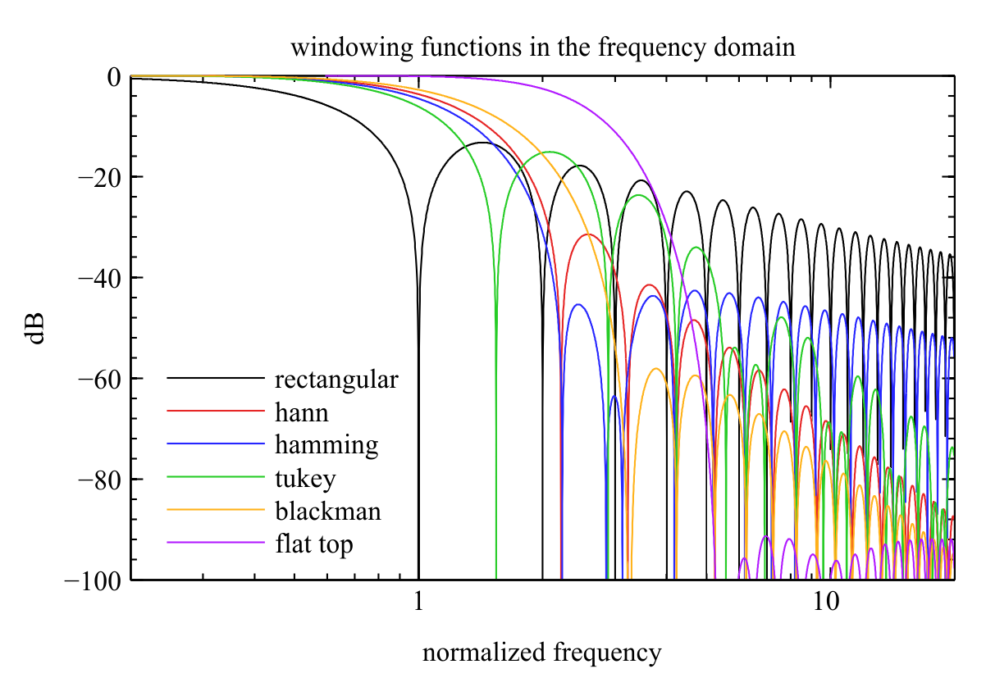
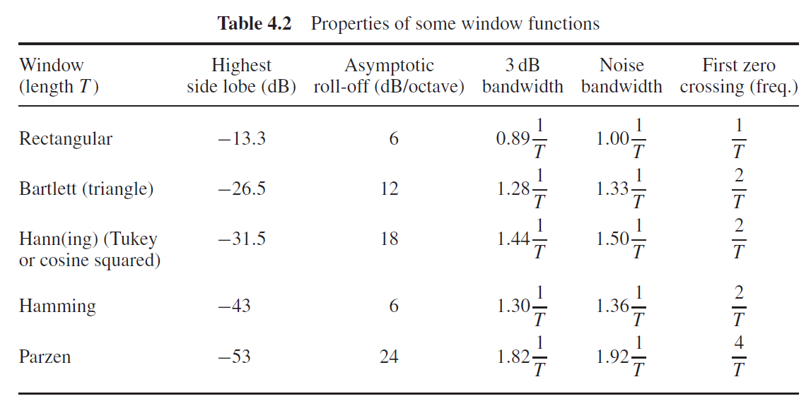
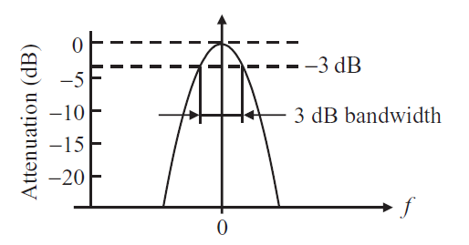
Window Function
Notes:
https://en.wikipedia.org/wiki/Window_function
https://www.bksv.com/media/doc/bo0436.pdf

Slide 17
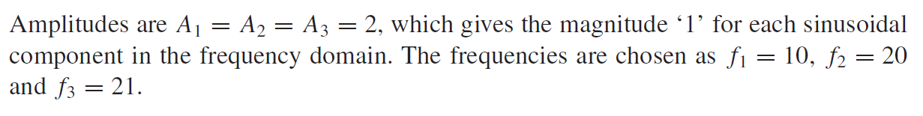
Example: Hanning Window vs Rectangular Window
$$x\left(t\right)=A_{1}\sin{2πf_{1}t+A_{2}sin2{πf}_{2}t}+A_{3}sin2πf_{3}t$$

Slide 18


Example: Hanning Window vs Rectangular Window (Continue)
Original signal
Rectangular
Hanning
$$T_{p}=0.6$$
$$T_{p}=1$$

Slide 19


Example: Hanning Window vs Rectangular Window (Continue)
Original signal
Rectangular
Hanning
$$T_{p}=2$$
$$T_{p}=4$$

Slide 20



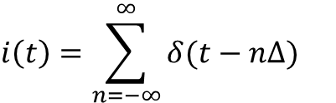










Impluse Train Modulation (Discretization)
A ‘train’ of delta functions $i\left(t\right)$is expressed as
$$i(t)$$
$$i\left(t\right)=\sum_{n=−∞}^{∞}{δ(t−n∆)}$$
$$Δ$$
$$t$$
The sampling procedure can be illustrated as
$$x_{s}\left(t\right)=x\left(t\right)i\left(t\right)$$
$$x(t)$$
$$i(t)$$
$$x_{s}(t)$$
$$×$$
$$=$$
$$t$$
$$t$$
$$t$$
$$X_{s}\left(f\right)=\int_{−∞ }^{∞ }{\left[x(t)\sum_{n=−∞}^{∞}{δ(t−n∆)}\right]e^{−i2πft}dt}=\sum_{n=−∞}^{∞}{\left[\int_{−∞ }^{∞ }{{x(t)e}^{−i2πft}δ(t−n∆)dt}\right]=\sum_{n=−∞}^{∞}{x(n∆)e^{−i2πfn∆}}}$$
Notes:
https://dsp.stackexchange.com/questions/45821/what-is-the-product-of-dirac-delta-function-and-t

Slide 21
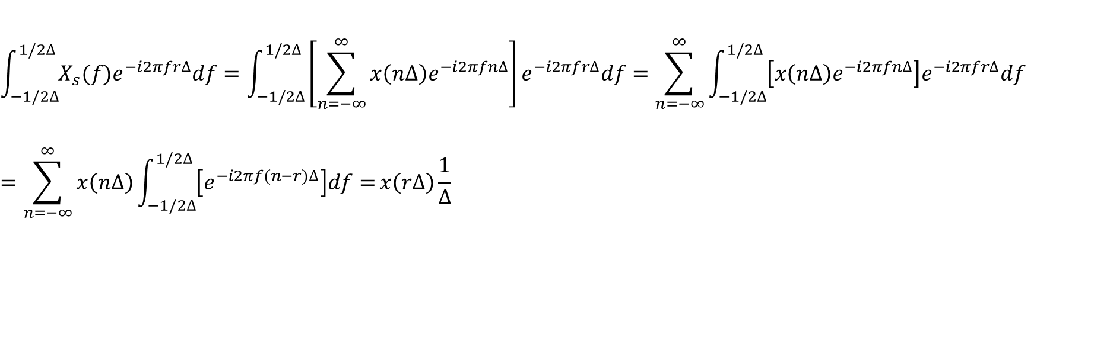


Impluse Train Modulation (Continue)
$$X_{s}\left(f+r/∆\right)=\sum_{n=−∞}^{∞}{x(n∆)e^{−i2π(f+r/∆)n∆}}=\sum_{n=−∞}^{∞}{x(n∆)e^{−i2πfn∆−i2πrn}}=\sum_{n=−∞}^{∞}{x\left(n∆\right)e^{−i2πfn∆}=X_{s}(f)}$$
$$X_{s}\left(f\right)=\sum_{n=−∞}^{∞}{x(n∆)e^{−i2πfn∆}}$$
Multiplying both sides of equation by $e^{−i2πfr∆}$ and integrating w.r.t $f$
$$\int_{−1/2∆}^{1/2∆}{X_{s}(f)e^{−i2πfr∆}df}=\int_{−1/2∆}^{1/2∆}{\left[\sum_{n=−∞}^{∞}{x\left(n∆\right)e^{−i2πfn∆}}\right]e^{−i2πfr∆}df}=\sum_{n=−∞}^{∞}{\int_{−1/2∆}^{1/2∆}{\left[x\left(n∆\right)e^{−i2πfn∆}\right]e^{−i2πfr∆}df}}=\sum_{n=−∞}^{∞}{x\left(n∆\right)\int_{−1/2∆}^{1/2∆}{\left[e^{−i2πf(n−r)∆}\right]df}=}x\left(r∆\right)\frac{1}{∆}$$
Use L'Hôpital's rule
$$X_{s}(f)=\sum_{n=−∞}^{∞}{x(n∆)e^{−i2πfn∆}}$$
$$x\left(n∆\right)=∆ \int_{−1/2∆}^{1/2∆}{X_{s}(f)e^{i2πfn∆}df}$$

Slide 22
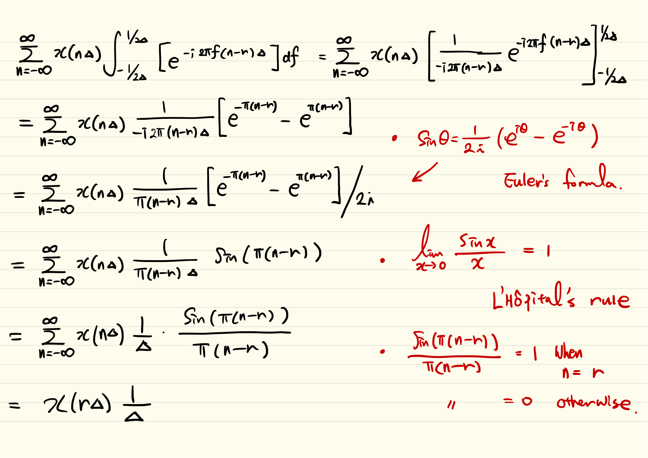
Impluse Train Modulation (Continue) - Proof

Slide 23
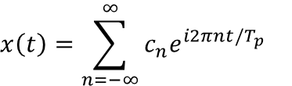
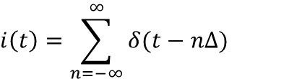
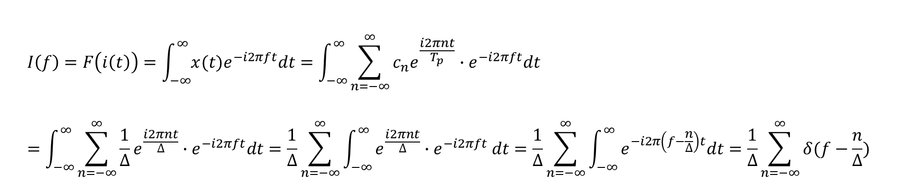
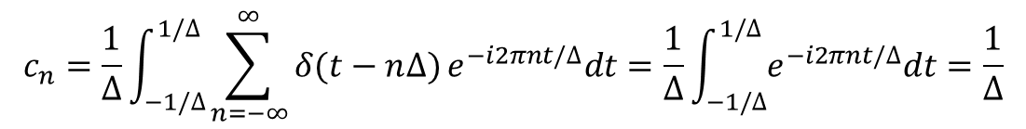
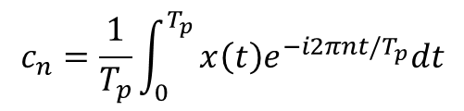
Link Between Fourier Transform of a Discrete Sequence and Continuous Signal
Fourier coefficients
$$x\left(t\right)=\sum_{n=−∞}^{∞}{c_{n}e^{i2πnt/T_{p}}}$$
$$c_{n}=\frac{1}{T_{p}}\int_{0}^{T_{p}}{x\left(t\right)e^{−i2πnt/T_{p}}dt}$$
Impluse train
$$i\left(t\right)=\sum_{n=−∞}^{∞}{δ(t−n∆)}$$
$$c_{n}=\frac{1}{∆}\int_{−1/∆}^{1/∆}{\sum_{n=−∞}^{∞}{δ(t−n∆)}e^{−i2πnt/∆}dt}=\frac{1}{∆}\int_{−1/∆}^{1/∆}{e^{−i2πnt/∆}dt}=\frac{1}{∆}$$
Fourier Transform of the impulse train
$$I\left(f\right)=F\left(i\left(t\right)\right)=\int_{−∞}^{∞}{x(t)e^{−i2πft}dt}=\int_{−∞}^{∞}{\sum_{n=−∞}^{∞}{c_{n}e^{\frac{i2πnt}{T_{p}}}}∙e^{−i2πft}dt}=\int_{−∞}^{∞}{\sum_{n=−∞}^{∞}{\frac{1}{∆}e^{\frac{i2πnt}{∆}}}∙e^{−i2πft}dt=\frac{1}{∆}\sum_{n=−∞}^{∞}{\int_{−∞}^{∞}{e^{\frac{i2πnt}{∆}}{∙e}^{−i2πft}dt=\frac{1}{∆}\sum_{n=−∞}^{∞}{\int_{−∞}^{∞}{e^{−i2π\left(f−\frac{n}{∆}\right)t}dt}}}}}=\frac{1}{∆}\sum_{n=−∞}^{∞}{δ(f−\frac{n}{∆})}$$

Slide 24
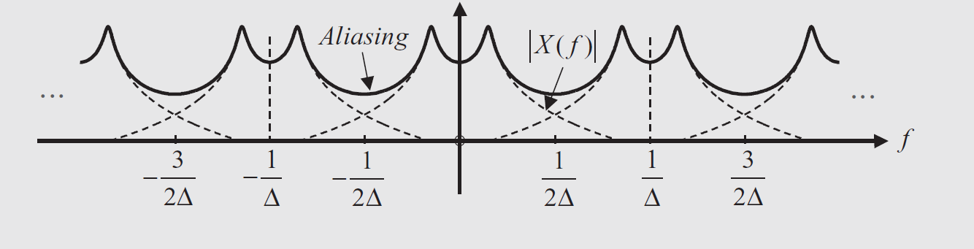
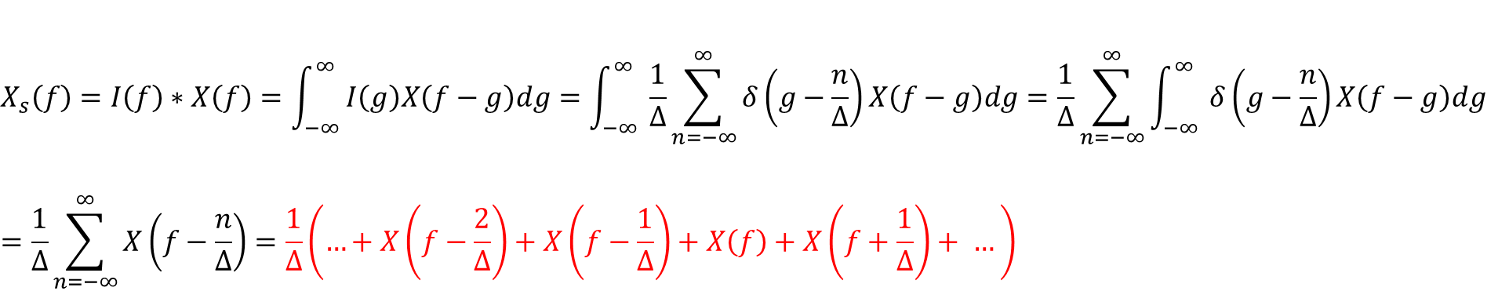




Link Between Fourier Transform of a Discrete Sequence and Continuous Signal (Continue)
Fourier Transform of a discrete sequence, $x_{s}(t)$
$$X_{s}\left(f\right)=I\left(f\right)∗X\left(f\right)=\int_{−∞ }^{∞ }{I\left(g\right)X\left(f−g\right)dg}=\int_{−∞ }^{∞ }{\frac{1}{∆}\sum_{n=−∞}^{∞}{δ\left(g−\frac{n}{∆}\right)}X\left(f−g\right)dg}=\frac{1}{∆}\sum_{n=−∞}^{∞}{\int_{−∞ }^{∞ }{δ\left(g−\frac{n}{∆}\right)}X\left(f−g\right)dg }=\frac{1}{∆}\sum_{n=−∞}^{∞}{X\left(f−\frac{n}{∆}\right)}=\frac{1}{∆}\left(…+X\left(f−\frac{2}{∆}\right)+X\left(f−\frac{1}{∆}\right)+X\left(f\right)+X\left(f+\frac{1}{∆}\right)+ …\right)$$
$$X_{s}\left(f\right)$$
$$X(f)$$
$$−\frac{1}{∆}$$
$$\frac{1}{∆}$$

Slide 25


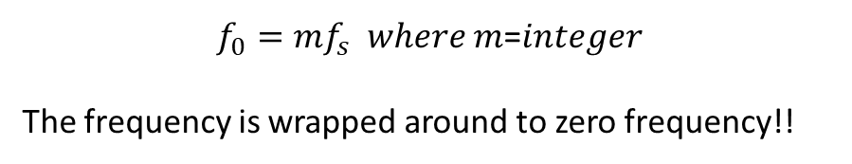










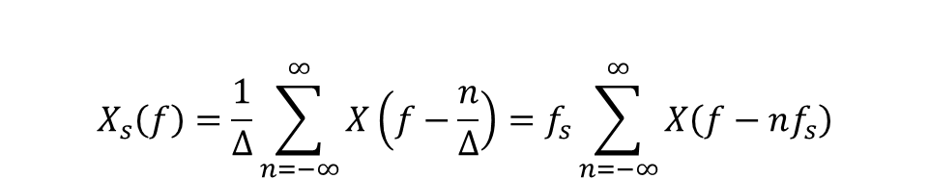


Revisit: Spaceship Helicopter
$$X(f)$$
Props frequency
roughly = 500 RPM
$$X_{s}\left(f\right)=\frac{1}{∆}\sum_{n=−∞}^{∞}{X\left(f−\frac{n}{∆}\right)}=f_{s}\sum_{n=−∞}^{∞}{X\left(f−nf_{s}\right)}$$
…
$$f_{s}=60Hz$$
$${2f}_{s}$$
$${3f}_{s}$$
$${4f}_{s}$$
$$f_{0}$$
$$X(f)$$
$$X_{S}(f)$$
$$−\frac{1}{2∆}$$
…
$$\frac{1}{2∆}$$
$$f_{s}$$
$$f_{0}−{2f}_{s}$$
$$f_{0}−f_{s}$$
$$f_{0}$$
$f_{0}=mf_{s}$ 𝑤ℎ𝑒𝑟𝑒 𝑚=𝑖𝑛𝑡𝑒𝑔𝑒𝑟
The frequency is wrapped around to zero frequency!!

Slide 26





Discrete Fourier Transform
So far we have considered sequences that run over the range −∞ < n < ∞(n integer). For the special case where the sequence is of finite length (i.e. non-zero for a finite number of values) an alternative Fourier representation is possible called the discrete Fourier transform (DFT).
It turns out that the DFT is a Fourier representation of a finite length sequence and is itself a sequence rather than a continuous function of frequency, and it corresponds to samples, equally spaced in frequency, of the Fourier transform of the signal. The DFT is fundamental to many digital signal processing algorithms.
$$X_{s}(f)=\sum_{n=−∞}^{∞}{x(n∆)e^{−i2πfn∆}}$$
Continuous in frequency
Repeated every 1/ $∆$
$$X(k)=\sum_{n=0}^{N−1}{x(n)e^{−i\frac{2π}{N}nk}}$$
$$f=\frac{k}{N∆}$$
DFT of a finite (sampled) sequence $x(n∆)$
$X\left(k\right)$ is $X_{s}(f)$ evaluated at $f=\frac{k}{N∆}$ Hz ($k$ integer)
$$x(n)=\frac{1}{N}\sum_{n=0}^{N−1}{X(k)e^{i\frac{2π}{N}nk}}$$
Inverse DFT
Notes:
https://dsp.stackexchange.com/questions/10293/zero-padding-in-fft
https://www.mathworks.com/matlabcentral/answers/364256-in-the-fft-example-on-matlab-help-why-do-we-multiply-by-2

Slide 27



Discrete Fourier Transform (Derivation)
$$X_{s}(f)=\sum_{n=−∞}^{∞}{x(n∆)e^{−i2πfn∆}}$$
Here is a Fourier transform of a discrete sequence $x(n∆)$
Let’s drop the subscript s.
$$X(f)=\sum_{n=0}^{N−1}{x(n)e^{−i2πfn∆}}$$
Let’s consider only first N points and assume zero elsewhere.
Note that this is still continuous in frequency
$$X(k)=\sum_{n=0}^{N−1}{x(n)e^{−i\frac{2π}{N}kn}}$$
Let’s evaluate this at frequencies $f=\frac{k}{N∆}$ where k is integer
This is the DFT of a finite (sampled) sequence $x\left(n∆\right).$
The relationship between the Fourier transform of a sequence and the DFT of a finite length sequence can be expressed as
$X\left(k\right)=$ $X_{s}(f)$ evaluated at $f=\frac{k}{N∆}$ Hz (k is integer)

Slide 28
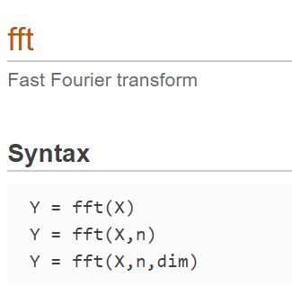
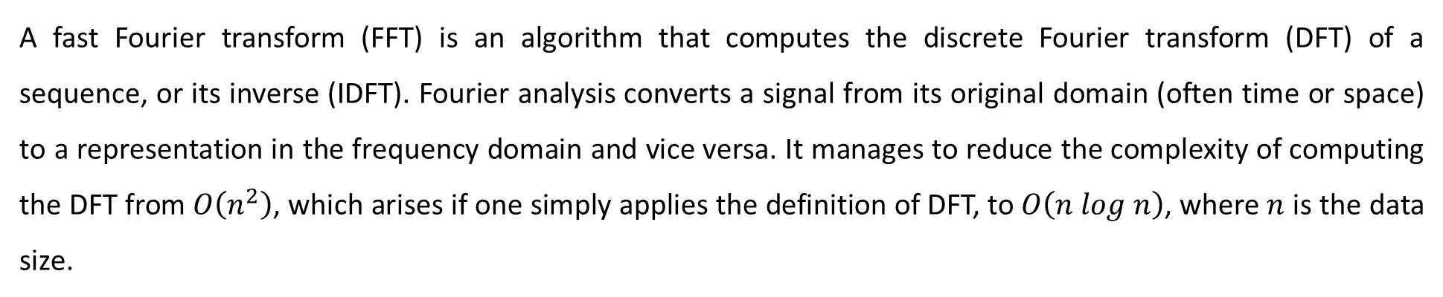
Fast Fourier Transform
A fast Fourier transform (FFT) is an algorithm that computes the discrete Fourier transform (DFT) of a sequence, or its inverse (IDFT). Fourier analysis converts a signal from its original domain (often time or space) to a representation in the frequency domain and vice versa. It manages to reduce the complexity of computing the DFT from $O\left(n^{2}\right)$, which arises if one simply applies the definition of DFT, to $O\left(n log n\right)$, where $n$ is the data size.
FFT in Matlab
Y = fft(X) computes the discrete Fourier transform (DFT) of X using a fast Fourier transform (FFT) algorithm
Y = fft(X,n) returns the n-point DFT. If no value is specified, Y is the same size as X.

Slide 29
Discrete Fourier Transform (See a Tutorial)

Slide 30
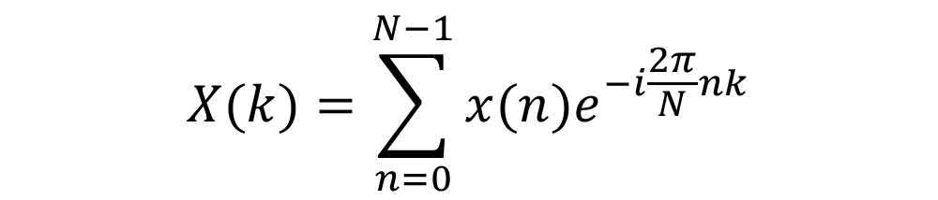
Zero-Padding
Y = fft(X, n) returns the n-point DFT. If no value is specified, Y is the same size as X.
If X is a vector and the length of X is less than n, then X is padded with trailing zeros to length n.
If X is a vector and the length of X is greater than n, then X is truncated to length n.
$$X(k)=\sum_{n=0}^{N−1}{x(n)e^{−i\frac{2π}{N}nk}}$$
$X\left(k\right)$ is $X_{s}(f)$ evaluated at $f=\frac{k}{N∆}$ Hz
frequency spacing $\frac{1}{N∆}$ Hz

Slide 31

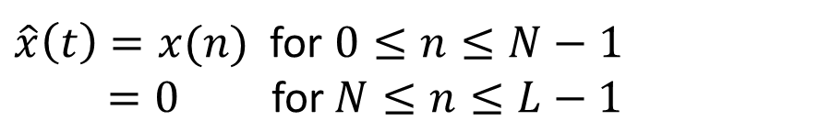
Zero-Padding (Continue)
$\hat{x}\left(t\right)=x(n)$ for $0≤n≤N−1$
$=0 \text{for} N≤n≤L−1$
$$\hat{X}(k)=\sum_{n=0}^{L−1}{\hat{x}\left(n\right)e^{−i\frac{2π}{L}nk}=}\sum_{n=0}^{N−1}{x\left(n\right)e^{−i\frac{2π}{L}nk}}$$
“Finer” spacing in the frequency domain. However, the zero padding does not increase the “true” resolution.
Vibration problems, this can be used to obtain the fine detail near resonances
See the slide of “effect of data truncation”
Notes:
Original frequency interval is still k/Ndel but add more points on the frequency graph.

Slide 32
Example: Zero-Padding

