Slide 1
Multi-view Geometry (Two View Geometry)
Chul Min Yeum
Assistant Professor
Civil and Environmental Engineering
University of Waterloo, Canada
CIVE 497 – CIVE 700: Smart Structure Technology
Last updated: 2019-03-08

Slide 2
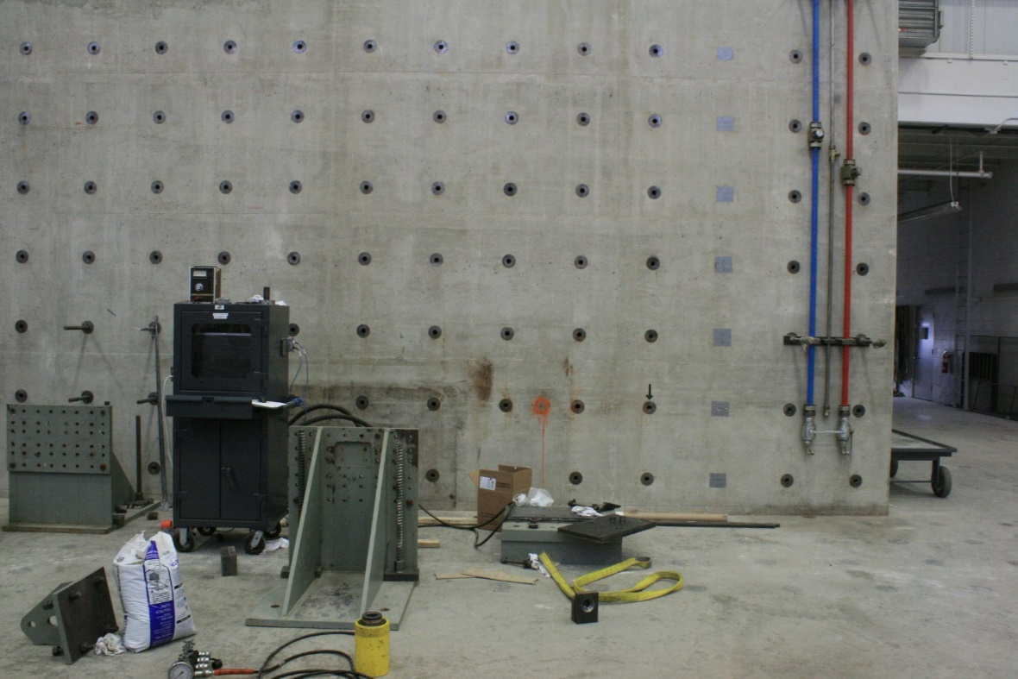
How do We Find 3D locations from Images?
(X,Y,Z)
(x₁,y₁)
(x₂,y₂)
Y₁
Y₂
X₁
X₂

Slide 3
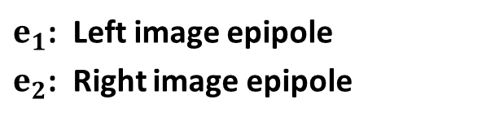








Two View Geometry
Epipolar line in the left image
$$\text{X}$$
Epipolar plane
$$x_{1}$$
$$x_{2}$$
$$e_{1}$$
$$e_{2}$$
$$C_{1}$$
baseline
$$C_{2}$$
Left camera image plane
Right camera image plane
$e_{1}$: Left image epipole
$e_{2}$: Right image epipole

Slide 4


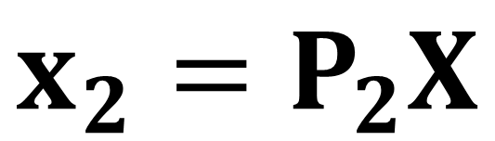
Two View Geometry
Cameras $P_{1}$ and $P_{2}$ such that
Baseline between the cameras is non-zero
$$x_{1}=P_{1}X$$
$$x_{2}=P_{2}X$$
Given an image point in the first view, where is the corresponding point in the second view?
What is the relative position of the cameras?
What is the 3D geometry of the scene?

Slide 5
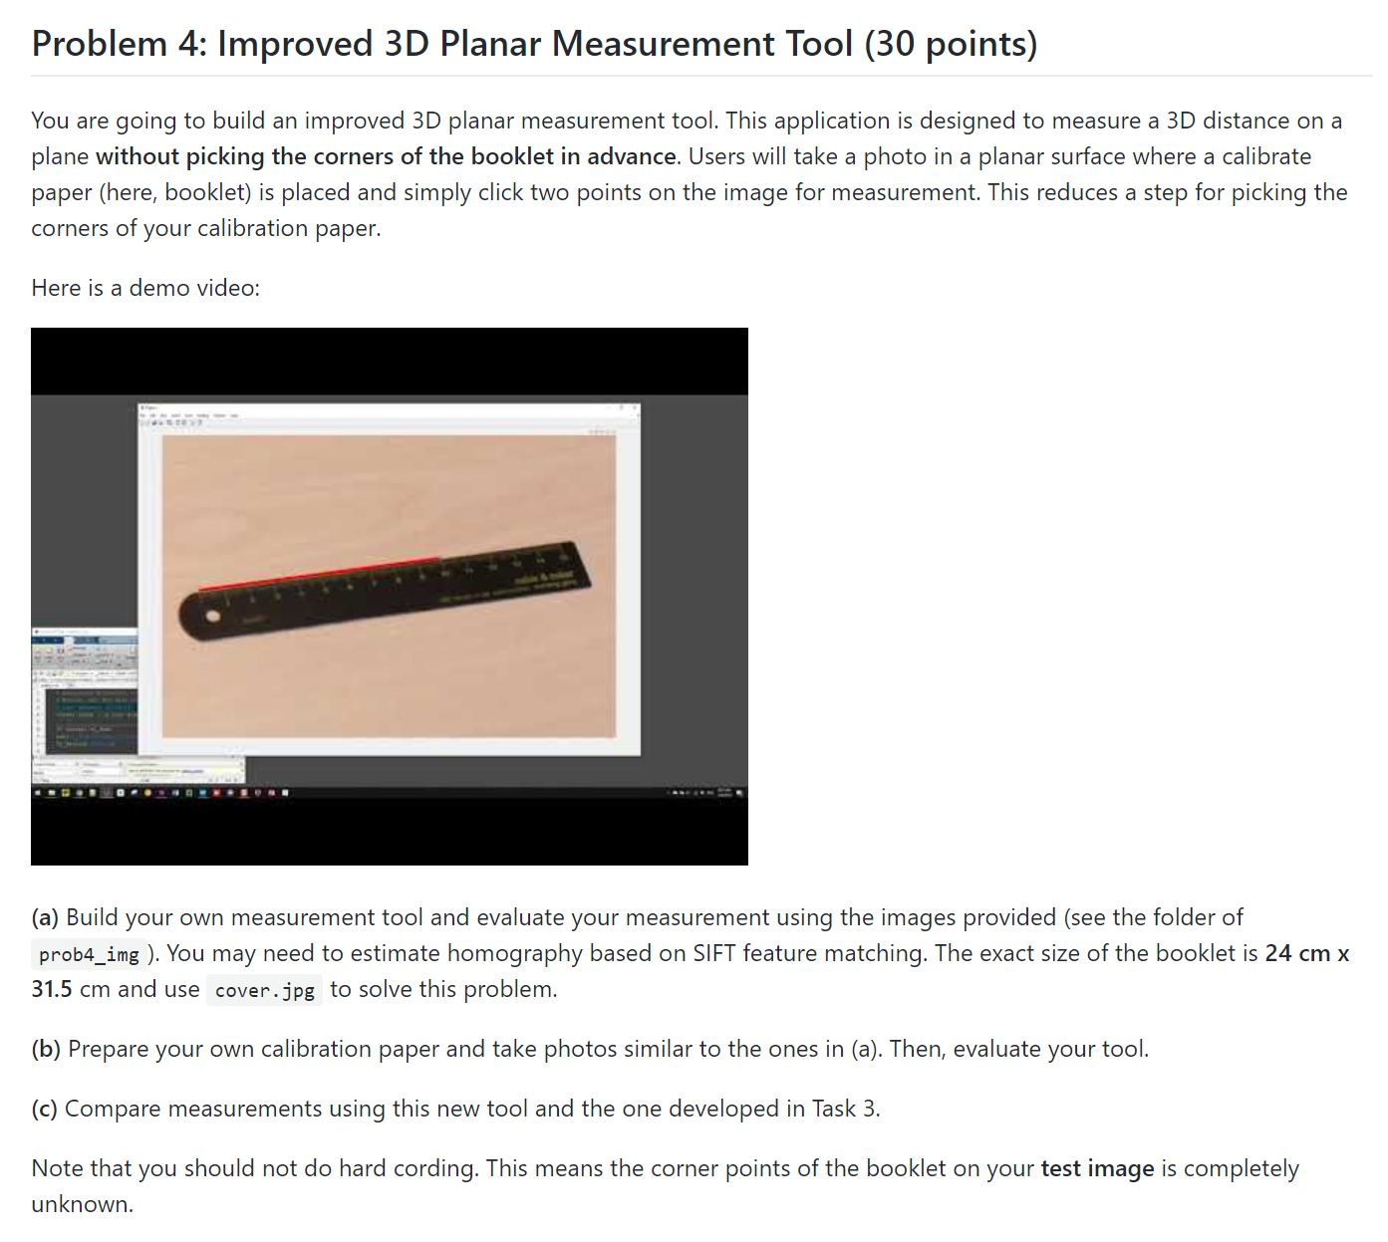
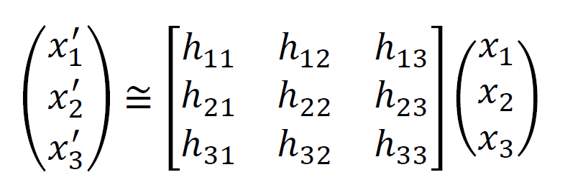
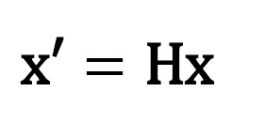
Example: Improved 3D Planar Measurement Tool

Slide 6
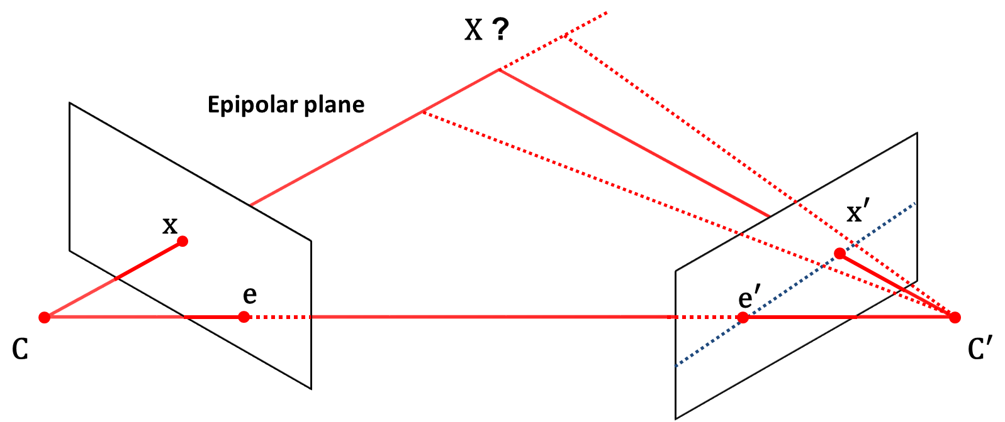






Correspondence Geometry
Given the image of a point in one view, what can we say about its position in another?
$$x_{1}$$
$$x_{2}$$
$$e_{1}$$
$$e_{2}$$
$$C_{1}$$
$$C_{2}$$
A point in one image “generates” a line in the other image. This line is known as an epipolar line, and the geometry which gives rise to it is known as epipolar geometry.

Slide 7
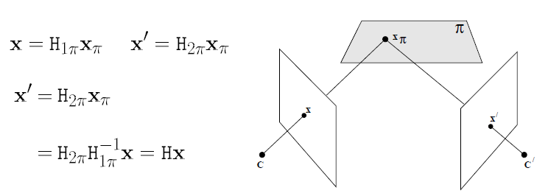
Images of Planes
Projective transformation between images induced by a plane
H can be computed from the correspondence of four points on the plane

Slide 8
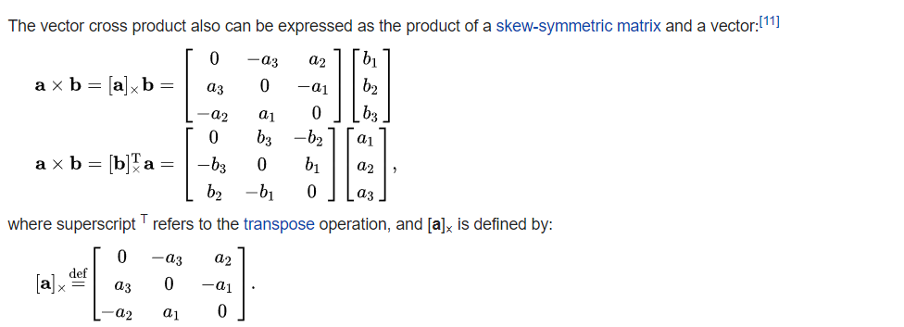
Matrix Multiplication of Cross Product
[a]_{x} is a 3x3 skew-symmetric matrix of rank 2. a is the null-vector of [a]_{x.}
https://en.wikipedia.org/wiki/Cross_product

Slide 9
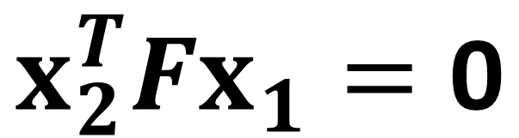
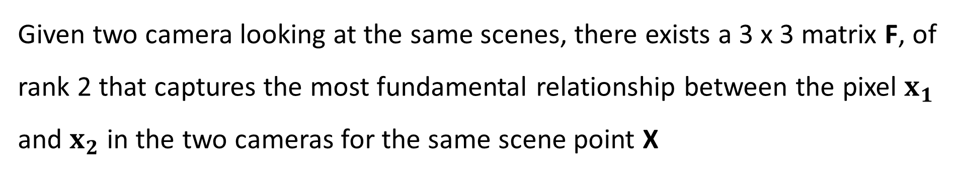
Fundamental Matrix
Given two camera looking at the same scenes, there exists a 3 x 3 matrix F, of rank 2 that captures the most fundamental relationship between the pixel $x_{1}$ and $x_{2}$ in the two cameras for the same scene point X
$$x_{2}^{T}Fx_{1}=\text{0}$$
We call F the fundamental matrix.

Slide 10
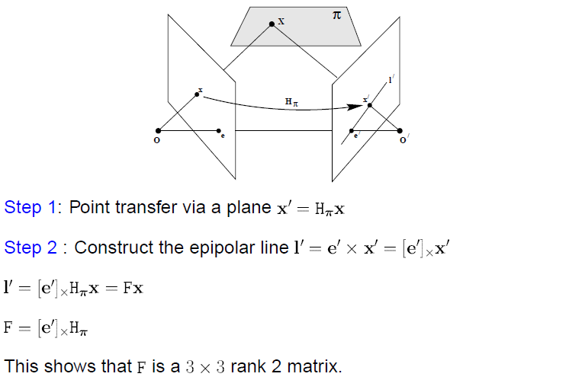
Fundamental Matrix (Derivation)
rank(AB)≤min(rank(A),rank(B)).
Notes:
https://math.stackexchange.com/questions/192164/rank-product-of-matrix-compared-to-individual-matrices

Slide 11
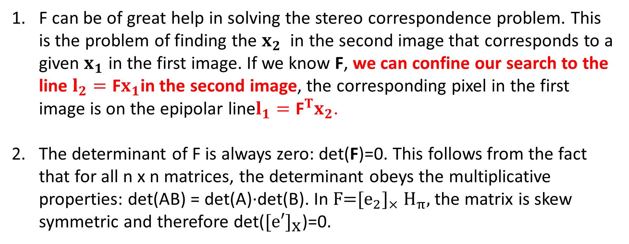
Properties of F
F can be of great help in solving the stereo correspondence problem. This is the problem of finding the $x_{2}$ in the second image that corresponds to a given $x_{1}$ in the first image. If we know F, we can confine our search to the line $l_{2}=\text{F}x_{1}$in the second image, the corresponding pixel in the first image is on the epipolar line$l_{1}={\text{F}}^{T}x_{2}$.
The determinant of F is always zero: det(F)=0. This follows from the fact that for all n x n matrices, the determinant obeys the multiplicative properties: det(AB) = det(A)·det(B). In $\text{F}\text{=}{\text{[}e_{2}\text{]}}_{×} {\text{H}}_{π},$the matrix is skew symmetric and therefore det(${\text{[}\text{e}\text{′]}}_{\text{x}}$)=0.

Slide 12
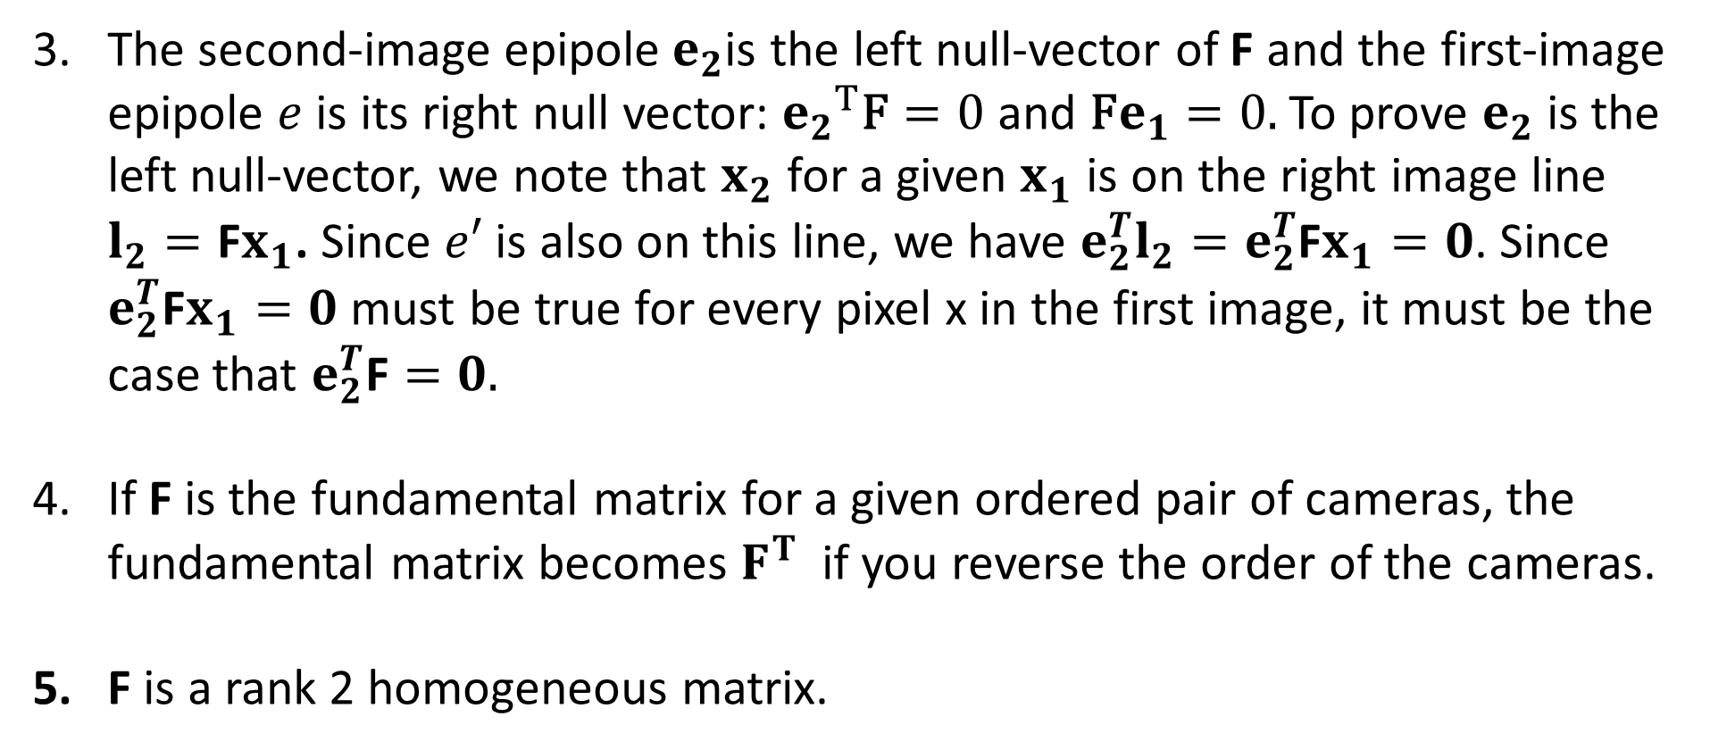
Properties of F (Continue)
The second-image epipole$e_{2}$is the left null-vector of F and the first-image epipole $e$ is its right null vector: ${e_{2}}^{T}\text{F}=0$ and $\text{F}e_{1}=0.$To prove $e_{2}$ is the left null-vector, we note that $x_{2}$ for a given $x_{1}$ is on the right image line $l_{2}=\text{F}x_{1}\text{. }$Since $e′$ is also on this line, we have ${e_{2}^{T}l}_{2}=e_{2}^{T}\text{F}x_{1}=0$. Since $e_{2}^{T}\text{F}x_{1}=0$ must be true for every pixel x in the first image, it must be the case that $e_{2}^{T}\text{F}=0.$
If F is the fundamental matrix for a given ordered pair of cameras, the fundamental matrix becomes $F^{T}$ if you reverse the order of the cameras.
F is a rank 2 homogeneous matrix.

Slide 13
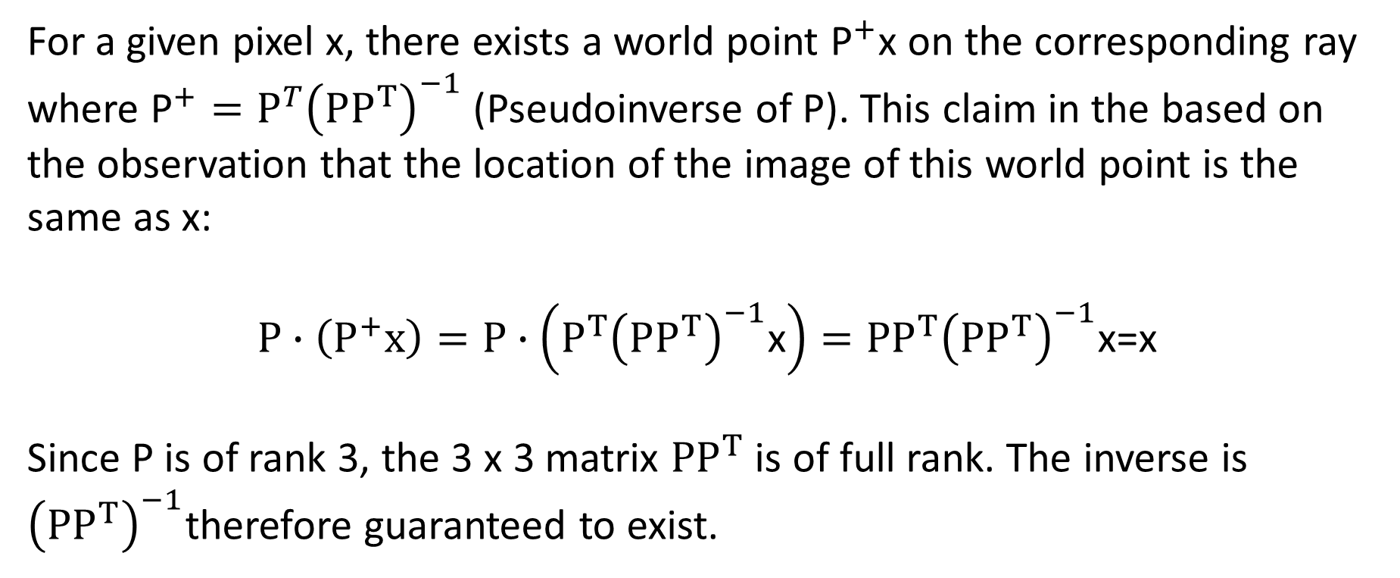
Back-projecting an Image Pixel into World Frame
For a given pixel x, there exists a world point ${\text{P}}^{+}\text{x}$ on the corresponding ray where ${\text{P}}^{+}=P^{T}{\left(PP^{T}\right)}^{−1}$ (Pseudoinverse of P). This claim in the based on the observation that the location of the image of this world point is the same as x:
$$P∙\left(P^{+}x\right)=P∙\left({P^{T}\left(PP^{T}\right)}^{−1}\text{x}\right)={PP^{T}\left(PP^{T}\right)}^{−1}\text{x}\text{=}\text{x}$$
Since P is of rank 3, the 3 x 3 matrix $PP^{T}$ is of full rank. The inverse is ${\left(PP^{T}\right)}^{−1}$therefore guaranteed to exist.

Slide 14
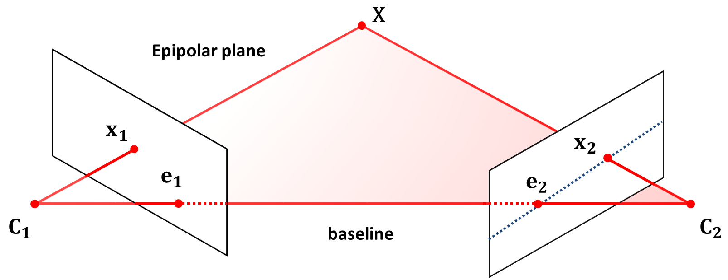
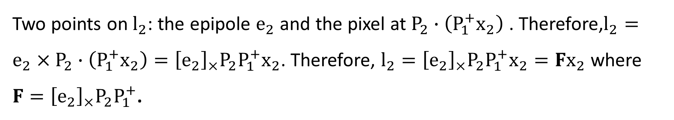

Relationship Between Fundamental Matrix and Projection Matrix
By construction, $e_{2}=P_{2}C_{1}$and $e_{1}=P_{1}C_{2}$
Two points on $l_{2}$: the epipole $e_{2}$ and the pixel at $P_{2}∙\left(P_{1}^{+}x_{2}\right)$ . Therefore,$l_{2}=e_{2}×P_{2}∙\left(P_{1}^{+}x_{2}\right)={\left[e_{2}\right]}_{×}P_{2}P_{1}^{+}x_{2}$. Therefore, $l_{2}={\left[e_{2}\right]}_{×}P_{2}P_{1}^{+}x_{2}=Fx_{2}$ where $F={\left[e_{2}\right]}_{×}P_{2}P_{1}^{+}$.
$$F={\left[e_{2}\right]}_{×}P_{2}P_{1}^{+}$$

Slide 15
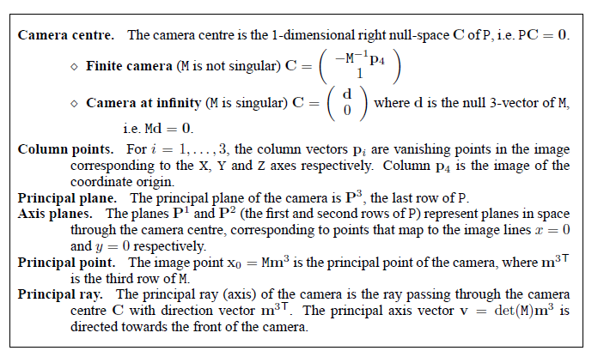
How to Compute Epipoles?

Slide 16
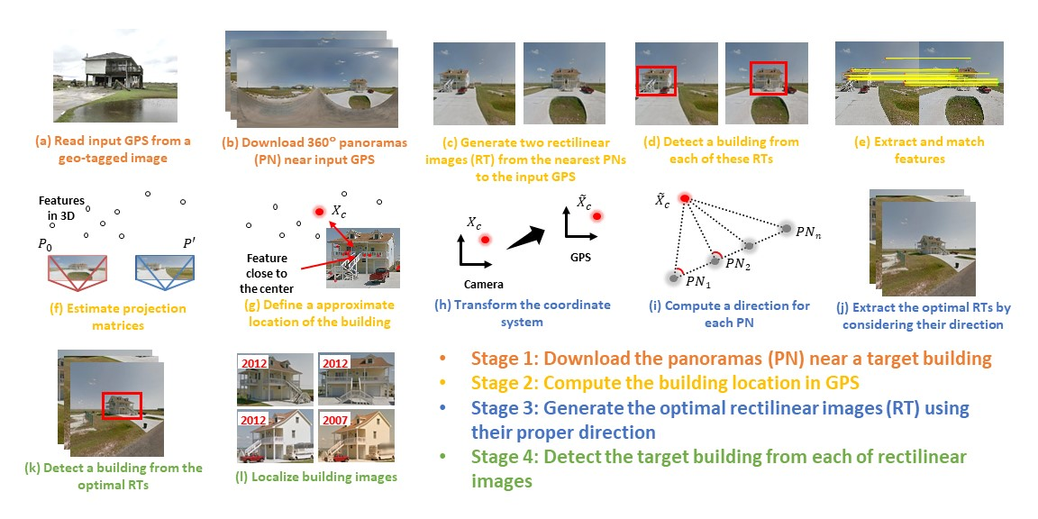
Example: House Localization

Slide 17


Estimating F
If we don’t know K₁, K₂, R, or t, can we estimate F for two images?
Yes, given enough correspondences

Slide 18
Estimating F: 8 Point Algorithm
The fundamental matrix F is defined by
for any pair of matches x and x’ in two images.
Let x=(u,v,1)^{T} and x’=(u’,v’,1)^{T},
each match gives a linear equation

Slide 19
8 Point Algorithm
In reality, instead of solving , we seek f to minimize , least eigenvector of .

Slide 20
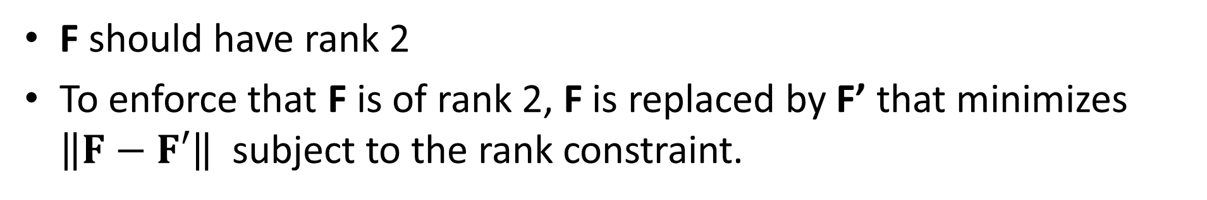

8-point Algorithm (Continue)
F should have rank 2
To enforce that F is of rank 2, F is replaced by F’ that minimizes $\left\|F−F′\right\|$ subject to the rank constraint.
This is achieved by SVD. Let $F=UΣV^{T}$, where
then $F=UΣ′V^{T}$ is the solution.

Slide 21
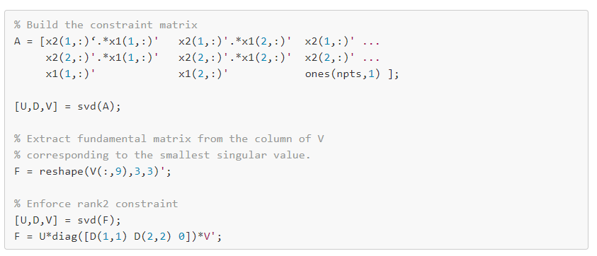
8 Point Algorithm (MATLAB)

Slide 22
Problem with 8-point algorithm
~10000
~10000
~100
~10000
~10000
~100
~100
~100
1
Orders of magnitude difference
between column of data matrix
→ least-squares yields poor results
!

Slide 23
Normalized 8-point Algorithm
normalized least squares yields good results
Transform image to become [-1,1] x [-1,1]
(0,500)
(700,500)
(-1,1)
(1,1)
(0,0)
(0,0)
(700,0)
(-1,-1)
(1,-1)

Slide 24
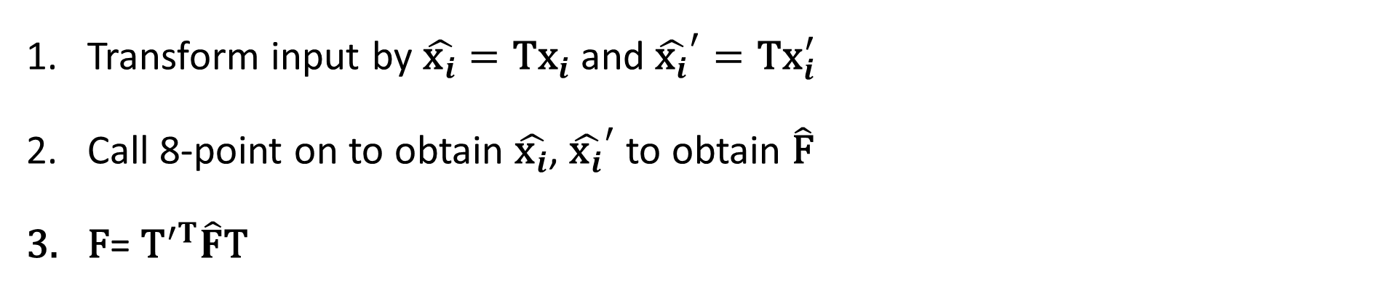
Normalized 8-point Algorithm
Transform input by $\hat{{\text{x}}_{i}}=\text{T}{\text{x}}_{i}$ and ${\hat{{\text{x}}_{i}}}^{′}=\text{T}{\text{x}}_{i}^{′}$
Call 8-point on to obtain $\hat{{\text{x}}_{i}}$, ${\hat{{\text{x}}_{i}}}^{′}$ to obtain $\hat{\text{F}}$
$\text{F}$= ${\text{T}}^{′T}\hat{F}\text{T}$

Slide 25
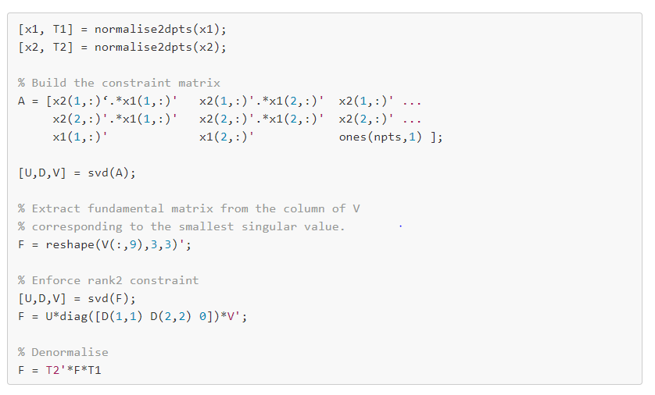
Normalized 8-point Algorithm (MATLAB)

Slide 26
Example: 8-Point Algorithm (Unnormalized vs Normalized)
See tutorials:
fundamental_matrix_8points_V1.m
fundamental_matrix_norm_8points_V1.m

Slide 27

Fundamental Matrix Song

Slide 28
Slide Credits and References
Lecture notes: Robert Collins
Lecture notes: Avinash Kak
Lecture notes: Noah Snavely
Lecture notes: Richard Hartely and Andrew Zisserman
Hartley, Richard, and Andrew Zisserman. Multiple view geometry in computer vision. Cambridge university press, 2003.

