Slide 1
Clustering Model Mockup
Through a unsupervised clustering model, we’ll be associating the dead probability or illness seriousness with several health and vaccination features.

Slide 2
Clustering Roadmap & Mockup
Load Data
Process it
Define Clusters
Understand
COVID-19 case’s dataset with 6K rows and 116 features.
+ Encoding & Scaling
PCA &
Elbow Curve
3D plotting
+Data Analytics
+Visualization
Data cleaning:
Non COVID scenarios.
Nearly empty rows.
Non relevant features.
Filling null values, etc.
Decreasing features and defining clusters.

Slide 3
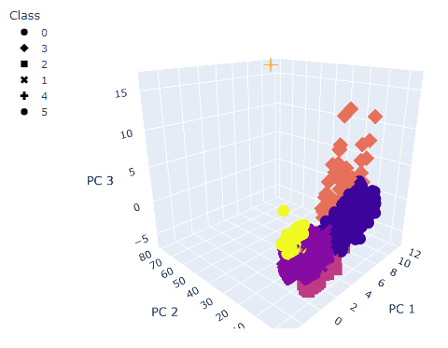
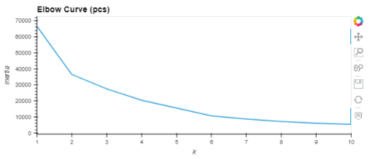
Clustering Roadmap & Mockup
COVID patients clustering
Processed dataset: (5.3K data points and 81 features)
Six clusters selected (Elbow Curve)
3D Plotting to visualize each cluster

