Slide 1
ML Model Mockup
Through an unsupervised clustering model, we’ll be associating the dead probability or illness seriousness with several health and vaccination features.
With a supervised machine model, Logistic Regression, we’ll try to predict the outcome of a COVID patient.

Slide 2
Clustering Roadmap & Mockup
Load Data
Process it
Define Clusters
Understand
COVID-19 case’s dataset with 6K rows and 116 features.
+ Encoding & Scaling
PCA &
Elbow Curve
3D plotting
+Data Analytics
+Visualization
Data cleaning:
Non COVID scenarios.
Nearly empty rows.
Non relevant features.
Filling null values, etc.
Decreasing features and defining clusters.

Slide 3
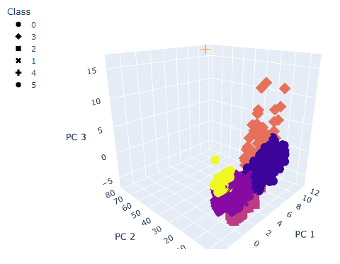
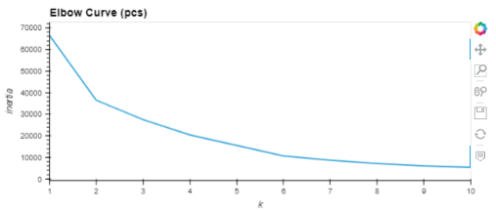
Clustering Roadmap & Mockup
COVID patients clustering
Processed dataset: (5.3K data points and 81 features)
Six clusters selected (Elbow Curve)
3D Plotting to visualize each cluster

Slide 4
Classification Roadmap & Mockup
Load Data
Process it
Output
COVID-19 case’s dataset with 6K rows and 116 features.
Split Data, transform the y array into interger
DataFrame with predicted vs actual values, and a card report
Additional Data cleaning:
Fill NA Values in where possible.
Delete columns where we can’t get any information.
Transform binary columns to numeric.

Slide 5
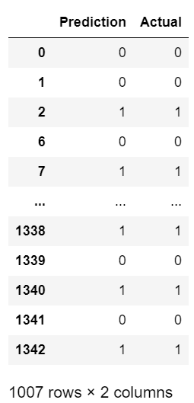
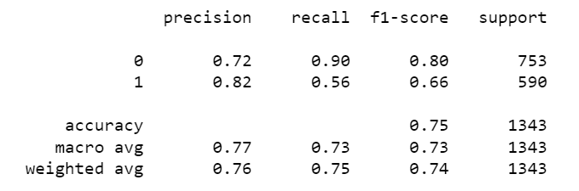
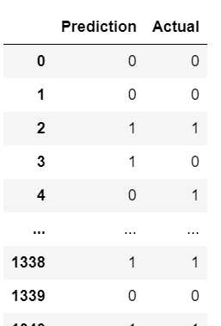
Classification Roadmap & Mockup
Processed dataset: (4K data points and 56 features)
ML Model: (Logistic Regression)
Actual Predicted Values and Card Report
Predicted Values for the X_test Shape: (1343, 56)

