Slide 1
Hardware Software Platforms Project Presentation
LED Matrix Control Tutorial
Carlos Ivan Torres Quero
charly_tq@outlook.com
Islam Hammad
Islam.HAMMAD@student.umons.ac.be

Slide 2
Contents
Context
Software
Quartus Prime
Model Sim Altera
Hardware
LED Matrix
Max7219 IC
Implementation
Driver
Application
Testbench
Results
Useful Links

Slide 3
Context
LED Matrix requires 3 signals to be driven:
DIN
CS
CLK
The FPGA must be able to create the control signals of the MAX7419
Final Challenge: Drive the Matrix using the FPGA having the MAX7219 as an intermediate component

Slide 4
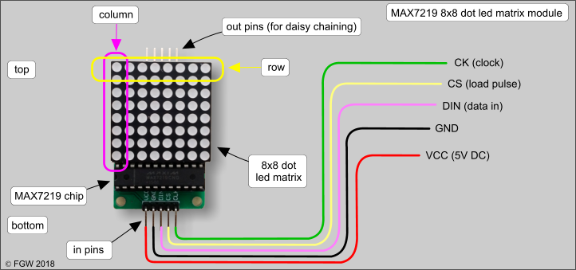
LED Matrix MAX7219
Power Supply: 4.0V ~ 5.5V
Supply Current: 330mA
Segment drive source current -40mA
Scan rate 500-1300Hz (800Hz Typ.)
CLK max 10MHz
Voltage Specs.
Vih (input high) min 3.5V
Vil (input low) max 0.8V
Voh (output high) min V+-1
Vol (output low) max 0.4V

Slide 5
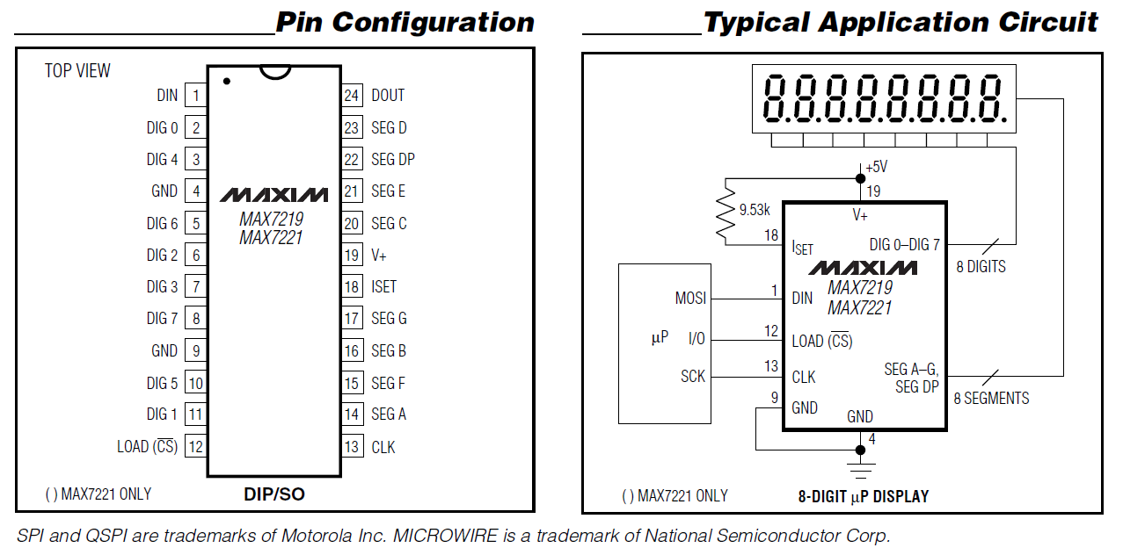
MAX7219 IC

Slide 6
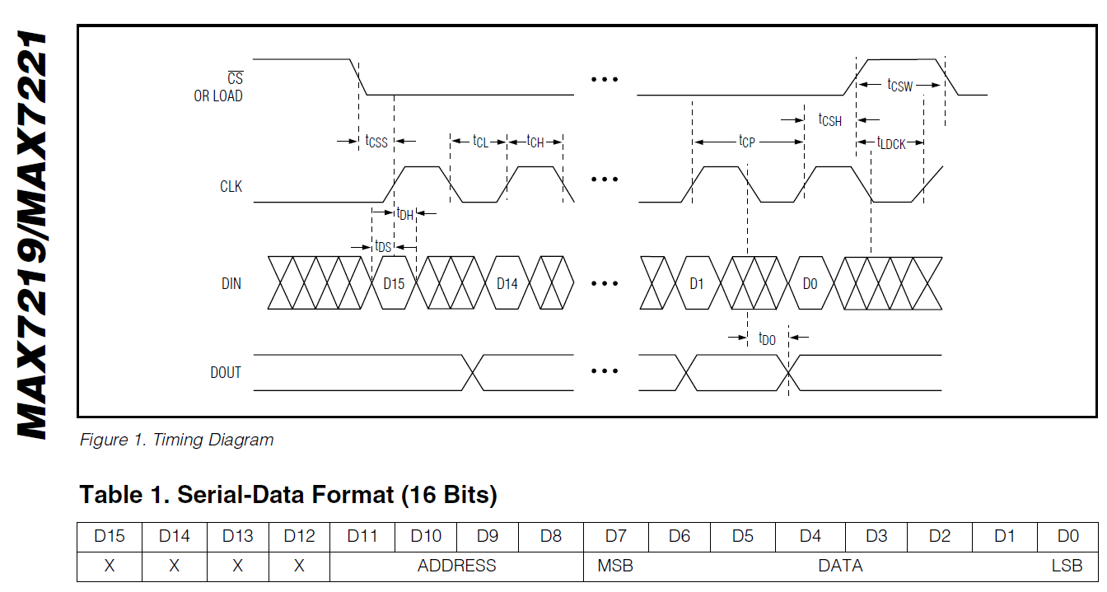
Signal
8 bits for the data and 4 for the address to know which LED or line of LED and so on that we want to switch or not.

Slide 7
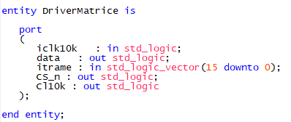
Driver
Designing a driver to make the FPGA and the MAX7219 able to communicate each other.
Entity:
Inputs: Clk (frequency for the IC)
16 bits signal
Outputs: CLK (Frequency for the matrix)
CS signal
Data Array signal for matrix
16 States ->
State 1: Recept (Receive the Data Array)
15 States: Counters

Slide 8
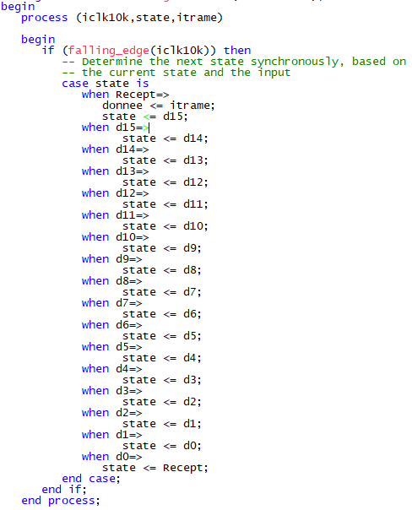
Driver
Variable “Donnee” receive the data
16 States:
State 1: Recept (Receive the Data Array)
15 States: Counters

Slide 9
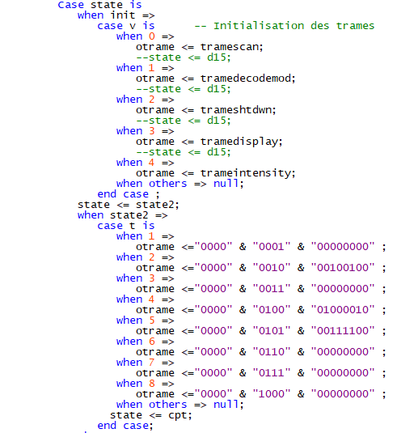
Application
The first 4 bits are never used for this device.
The last 8 bits each monitor one led in the line.
If the bits are equal to 1, the corresponding LEDs will be lit and in the same way, they will be off if the bits are equal to 0.

Slide 10
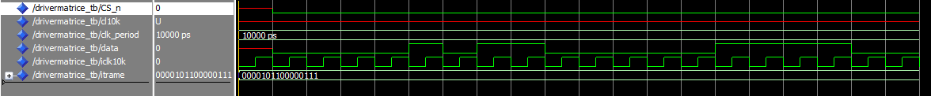
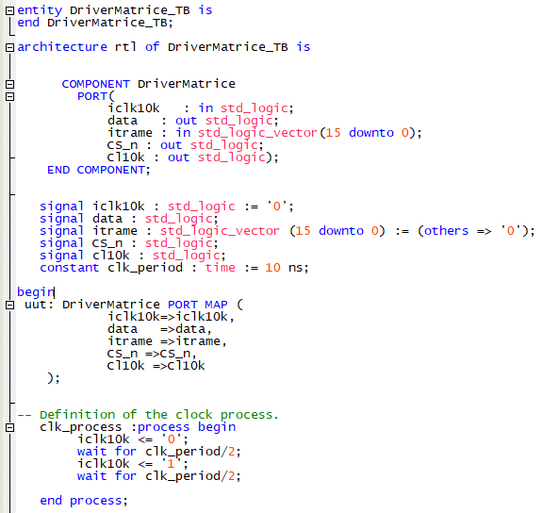
Testbench
The frame chosen contains 16 bits and represent one initialization frame of data frame for the matrix.
CS comes to zero -> Data starts its duty cycle
We can see that the data waveform is the same as the data frame

Slide 11
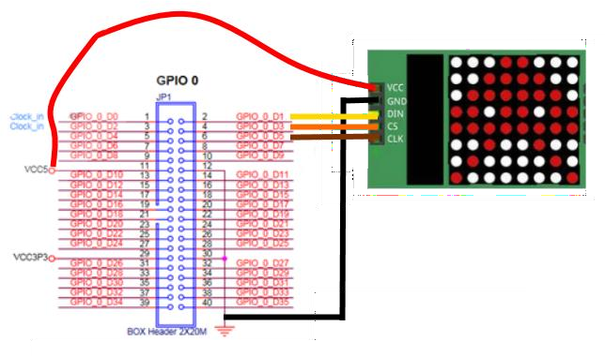
NON done job
VCC and the GND respectively connected on the VCC5 and GND pins of GPIO 0.
Three signals to the MAX7219:
data => mapped on GPO_0_D1
CS => mapped on GPO_0_D3
CLK => mapped on GPO_0_D5

Slide 12
Conclusion
The project consists of software and hardware parts.
The Software section has the objective to explain how to program the driver, show the application (what we want to output on the led matrix) and stablish the communication between the board and the led matrix.
The Hardware section includes the wiring proposed by us just by looking at the characteristics of the board and the LED Matrix online.
The application code is changeable. We can display whatever we want changing the data frame that is declared in the code in the application and keeping the rest of program without any changing.
The code is a continuous program that keep displaying the same figure once the CS signal change. This can be corrected by adding a new state that detect once the data frame is received.

Slide 13
Useful Links
GitHub Link
https://github.com/CharlyTQ/Max7219_Tutorial_FPGA
Altera Quartus Software Link
https://fpgasoftware.intel.com/?edition=lite

