Slide 1





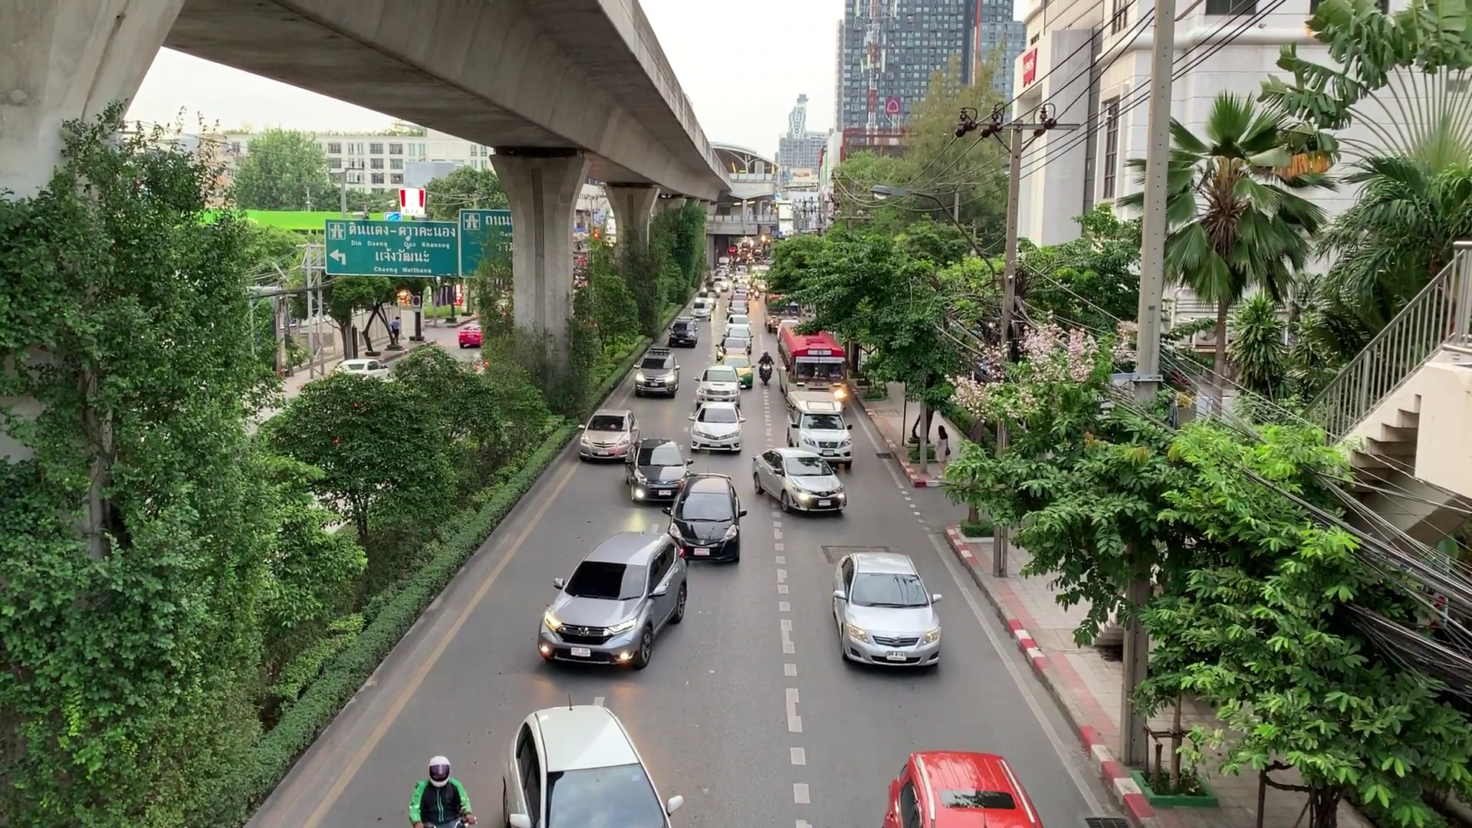



Existing Solutions
Cross-Modal Retrieval Models, such as CLIP
DNN-based Frame-by-frame Processing, such as Mask R-CNN
Wrong
and Slow Query Results
Query video clips of at least 10 seconds, with at least 5 vehicles in each frame
Natural Language Query
Video Repositories
Ground Truth
Relevant Clip Query
Approximate Query Processing
High-Quality and Low-Cost Query Results
Flexibility
Efficiency
ARC System

Slide 2






Relevant Clip Query
Pruning Phase
SELECT relevant_clips
FROM road_video
WHERE duration >= 10
AND count_vehicles >= 5
CONFIDENCE LEVEL 0.9
BUDGET 5000
Video Repositories
Inference
Cluster
Input
Proxy
Probability Distribution
Clustering
Initialize
Enhance
Non-Candidate Frames
Candidate Relevant Clips
Sample Progressively
Update
Propagate Labels
Approximate Relevant Clips
CONFIDENCE 0.95
OVERHEAD 3500
Output
Estimate Confidence
As Input
Inference
Quality and Cost
Frame
Oracle
Reliable Probability Distribution
Query Result
Refinement Phase

