Slide 1
On GET Writing
Excerpt from MP4 introduction

Slide 2
GET Writing
Direction: Write a two-paragraph report based on the figure. Ensure that
Paragraph 1 outlines the trend or pattern and summarizes the information shown in the figure. Highlight the key points.
Paragraph 2 provides possible explanations or personal comments in response to the trend or pattern revealed in the figure, i.e., Why do these patterns occur or what do you think about them?
About 200 words in total.（220-250）

Slide 3
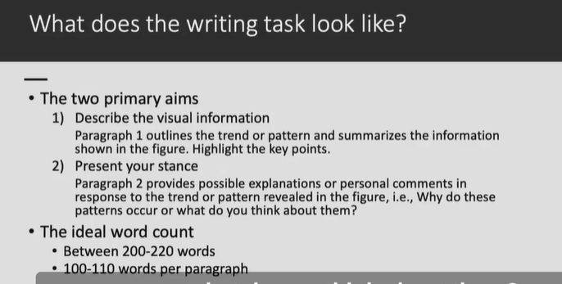

Slide 4
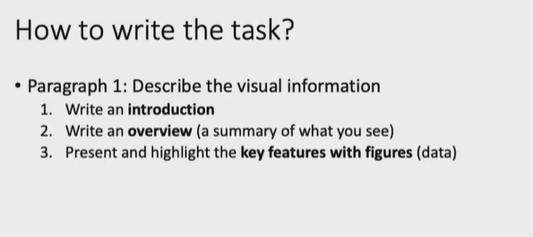

Slide 5
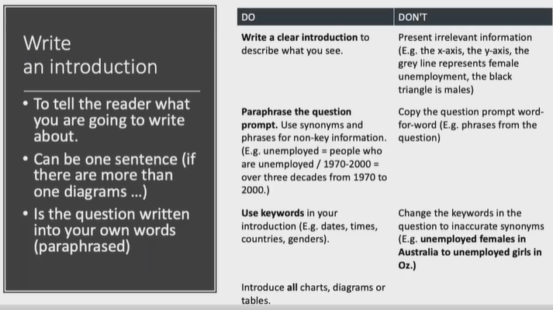

Slide 6
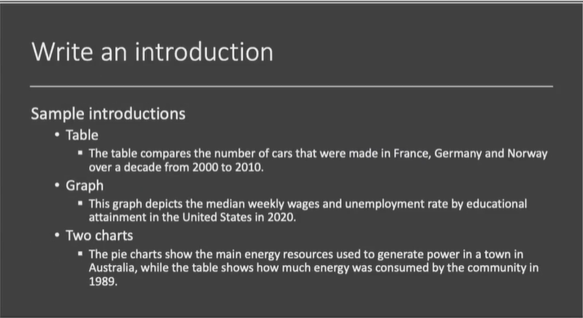

Slide 7
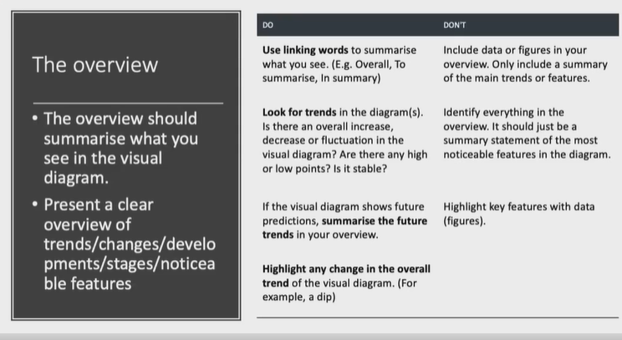

Slide 8
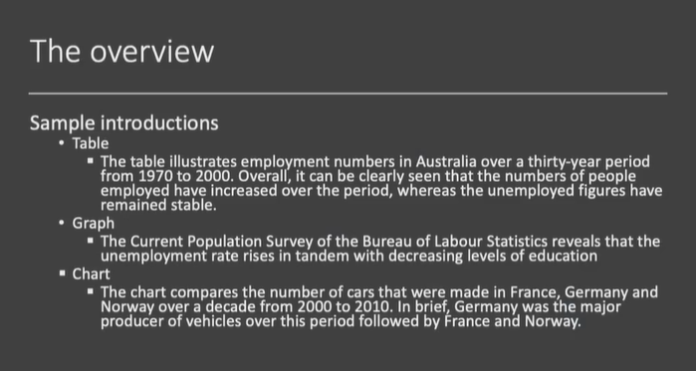

Slide 9
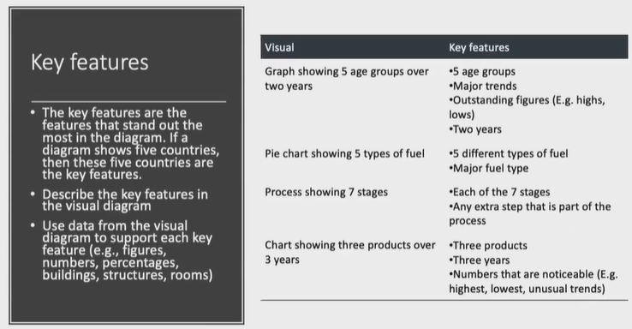

Slide 10
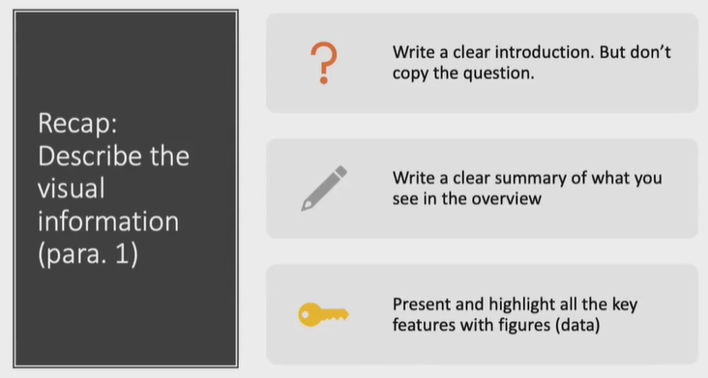

Slide 11
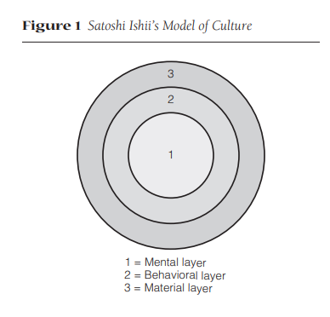

Slide 12
Model of culture (P28, B2)
Ishii (1997) proposes a three-layer-structure model of culture (see Figure 1). According to him, culture consists of three layers—material, behavioral, and mental. The most external, overt, and visible layer of culture is the material one, which is represented by various artifacts (e.g., food and clothing) produced, operated, and controlled by the behavioral layer. The semi-overt layer of culture is the behavioral one, which is composed of verbal and nonverbal behaviors as symbols (e.g., words and gestures) and reflects the mental layer. The most internal, covert, and invisible layer of culture is the mental one, which functions in the form of values, beliefs, and attitudes.

Slide 13
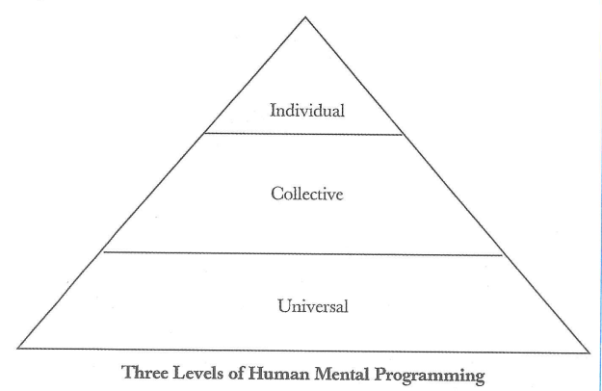
Mental Programming(On P54, B1)

Slide 14
As is pictured below, the human mental programming can be divided into three layers. The bottom is universal level, which is shared by all human beings meaning the biological system of the human body(e.g., laughing, weeping). The interlayer is collective level, which is shared with some in a certain group, including aspects of culture (e.g., language, ceremonials). The top is individual level with the feature of unique individual personality. Of course, the dividing line among the three levels is vague. （81）

Slide 15
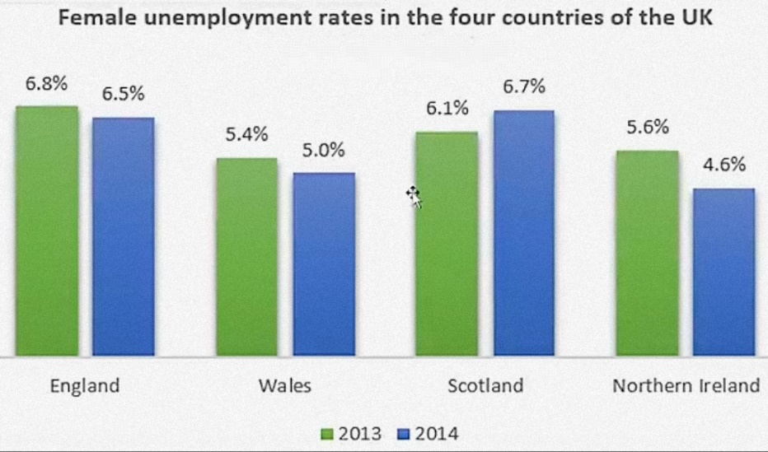

Slide 16
3.General-Comparison
The bar chart shows female unemployment rates in four countries of the United Kingdom in the years 2013 and 2014. We can see that the lowest female unemployment rate was in Northern Ireland in 2014 with 4.6%, while the highest female unemployment rate was in England in 2013 with 6.8%.
We can also see that unemployment for women dropped very slightly in England, Wales, and Northern Ireland. In contrast, female unemployment in Scotland rose from 6.1% to 6.7%. Finally, we can see that Northern Ireland had the largest single-year drop when female unemployment went down from 5.6% to 4.6%.

Slide 17
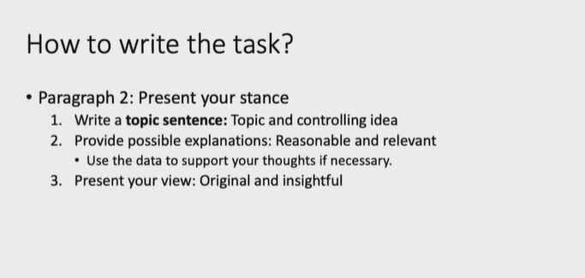

Slide 18
language use
Coherence: conjunctions
Proficiency: more complex sentence types
Reasoning：topic sentence- analysis-conclusion. example; comparison; gradual abduction; from general to specific; negative and positive, problem-solution…
Format: tidy handwriting

Slide 19
logic chain
What the picture conveys goes far beyond a new fashion trend. Instead, it carries cultural meanings as well. The fact that people from different countries are attracted to mysterious Chinese culture indicates that to some extent a culture can be accepted, respected, appreciated and shared internationally. In other words, a nation’s unique culture can become international through worldwide economic and cultural exchanges. Since the trend of globalization become irresistible, the increasing cultural exchanges can effectively improve mutual understanding and friendship.

Slide 20
Variety of sentence types
山羊在农场静静地吃草(graze)，没有发现猎人在悄然临近(approach)。
The goats grazed peacefully in the farm and were unaware of the approaching hunter.（两个并列分句）
Grazing peacefully, the goats in the farm were unaware of the approaching hunter.（现在分词短语+简单句）
In the farm, the goats grazed peacefully and were unaware of the approaching hunter.介词短语+并列分句）
There were goats grazing peacefully in the farm, unaware of the approaching hunter.（简单句+形容词短语）
As the goats grazed peacefully in the farm, they were unaware of the approaching hunter.(原因从句+主句）
（选择句型的要点：重要的在句首）

Slide 21
Which is better?
The Arctic(北极) is the northernmost region on Earth. It is centred on the North Pole. It comprises all of the area located north of the latitude 66° North.
The Arctic, which is the northernmost region on Earth, is centred on the North Pole. The latitude 66° North, which is the southern limit of the area, marks the Arctic Circle.
The Arctic is the northernmost region on Earth. Centred on the North Pole, it comprises all of the area located north of the latitude 66° North, which marks the Arctic Circle.
simple
Heavy head
proper

Slide 22
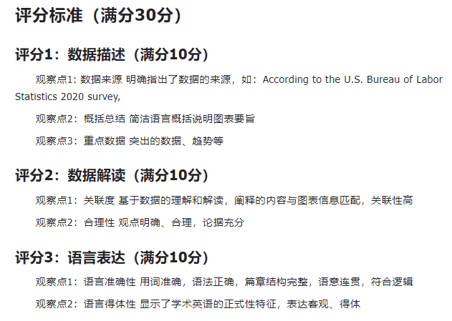

Slide 23
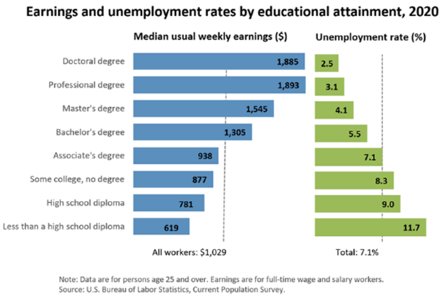
Sample

Slide 24
图表写作样本
Earnings and Unemployment Rate
This graph depicts the median weekly wages and unemployment rate by educational attainment in the United States in 2020. （introduction: what is the diagram about）The Current Population Survey of the Bureau of Labor Statistics reveals that the unemployment rate rises in tandem with decreasing levels of education. (overview: trend, rule)Those with the highest levels of education in the United States in 2020 can expect weekly earnings that are nearly three times as high as those with the lowest levels of education who are also working full time. (key figures, features)The graph exemplifies the central role of education in preparing one for the job market and demonstrates the inability of those without a degree to support themselves financially.(concluding remarks from the author.)

Slide 25
Personal but it should be clear and logical
Higher education is typically required in the current American job market to earn one's desired salary. Potential causes for this trend include the increased visibility of employers' educational requirements and the cutthroat nature of today's job market. Young people are becoming increasingly aware that they cannot avoid becoming economically inactive if they do not pursue higher education. Many people believe that education plays a significant role in their lives because it not only increases their level of knowledge but also gives them access to better job opportunities. One of the responsibilities of a Chinese college student is, arguably, to recognize the value of a degree.(background, analysis, explanation, solution…It should be logical and coherent.)

Slide 26
Terms: PICTURE?
Figure
Graph
Chart
Diagram
Table
Pie chart饼图
Line graph线形图
Bar graph 柱状图
…

Slide 27
Useful expressions:
(1)According to the figure, we know/it can be known...
(2)The writer states that...
(3)The graph above is about..
(4)The chart mainly tells us that...
(5) As is shown/described/illustrated/depicted in the diagram...

Slide 28
Useful expressions
According to the figures given in the bar graph( or line graph, table, pie chart), we know that …
The bar graph(or line graph, table, pie chart)shows ( or indicates, makes it clear)that…
It can be seen from( or it is clear from; it is evident from the bar graph(or line graph, table, pie chart) that…

Slide 29
Useful expressions
1. Here we can see a figure which shows you the relationship between A and B. / This figure shows how A varies with B.
2. In this figure, the horizontal axis is A and the vertical axis is B. This figure is quite complex, but the only thing the author wants to focus on is...
3. The heavy (or thin) solid (or dotted) line means (or represent, or is for).../ The last column of the table indicates close agreement between theoretical predications and experimental results.
4. Basically what is highlighted in this table is ...

Slide 30
VOCABULARY
Level off
趋平
Grow/rise// on the rise
上升
Go up/down
上升、下降
Fall/decline/dip
下降
Drop to the lowest point
降至最低点
Reach the bottom/peak
降至最低点、上升到最高点
Range from… to…
在…和…之间发生变化

Slide 31
Grow an average of
平均增加
Reach
达到
Stay the same
保持不变
Halve
减半
Fluctuate
波动
Since the beginning of
从…起
Increase to /by
上升到/上升了
Decrease to/by
下降到/下降了

Slide 32
Triple
增加两倍, 增至三倍
For a … period ， over
历时
Over the 1st / 2nd half of …
在前/后半期
Over the period from …to…
从…至…时期
Increase year by year
逐年上升
Double
增加一倍，两倍，翻一番
During the same period
同期
Start with
从…开始

Slide 33
By the middle of
到中期时
In mid-…
在中期
By the end of …
到…末期
Steadily
稳定地
Moderately
适度地
Unequally
不相等地
Slightly
轻微地
Rapidly
迅速地

Slide 34
Gradually
逐渐地
Dramatically
大幅度地
Subsequently
随后
Respectively
分别
Significantly
显著地
Sharply
急剧地
Steady/stable
稳定的
Substantially
相当大地

Slide 35
Exercise
Direction: Write a two-paragraph report based on the figure. Ensure that
Paragraph 1 outlines the trend or pattern and summarizes the information shown in the figure. Highlight the key points.
Paragraph 2 provides possible explanations or personal comments in response to the trend or pattern revealed in the figure, i.e., Why do these patterns occur or what do you think about them?
About 250 words in total.

Slide 36
Other samples on graph writing
As Reference

Slide 37
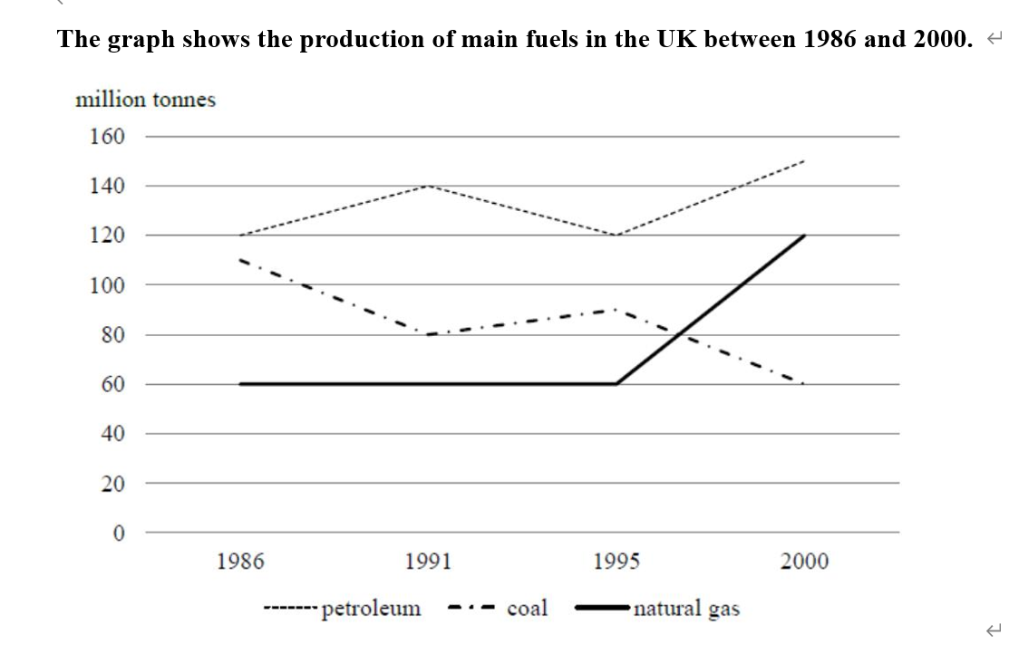
1.折线图
a curve graph

Slide 38
The line graph illustrates changes in the quantity of non-renewable fuels produced in Britain during the 14-year period from 1986 to 2000.
In 1986, petroleum was the most popular fuel, with 120 million tonnes (MTs) produced. Less coal was produced (110 MTs), while the production of natural gas stood at only 60 MTs.
During this 14-year period, the production of petroleum and natural gas fluctuated. The quantity of petroleum produced rose to 140 MTs in 1991 before falling to the 1986 figure in 1995. In the following 5 years, this figure reached 150 MTs. By contrast, the trend for the production of coal reversed. There was a downward trend in its production, decreasing to 80 MTs in 1991. After a slight increase in 1995, this figure continued to decline to just only 60 MTs in the end.
On the other hand, the amount of natural gas produced remained stable at 60 MTs between 1986 and 1995. This figure doubled in the next 5 years, overtaking the production of coal in around 1997.
Overall, the graph shows how the production of the three types of fossil fuels grew, with coal the notable exception. It is also noticeable that petroleum was the dominant fuel produced over the period given.

Slide 39
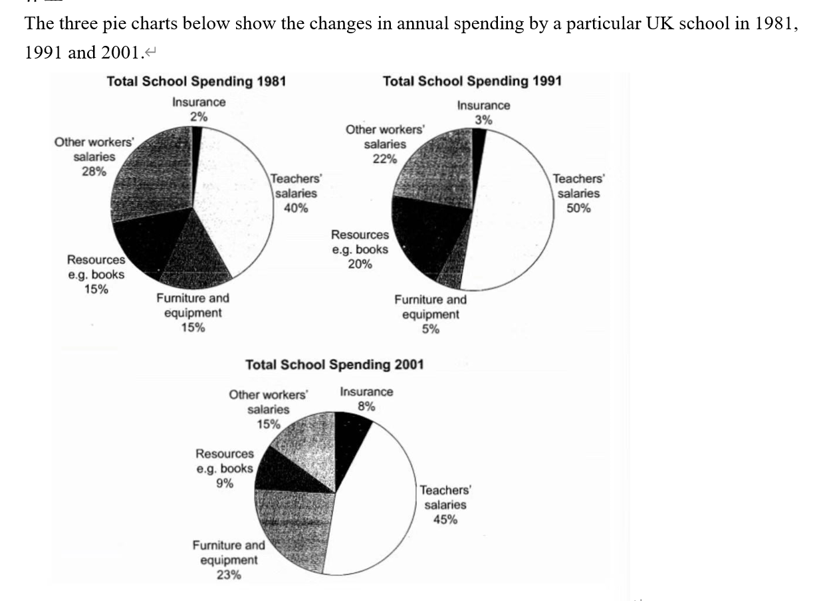
2.饼图
pie graph

Slide 40
The pie charts give information about changes in the spending pattern of a UK school in 1981, 1991 and 2001.
In all three years, teachers’ salaries always had the largest proportion, rising to 50% in 1991 and ending at 45% in 2001. In contrast, insurance constantly occupied the smallest percentage, although it increased from 2% to 8%. In addition, other workers’ salaries kept decreasing from 28% in 1981 to only 15% in 2001.
Spending on resources had increased to 20% in 1991 before dropping to only 9% by the end of the period. By contrast, the cost of furniture and equipment experienced an opposite trend, decreasing to only 5% in 1991, but rising sharply to 23% of total school budget in 2001.
All in all, it is clear to see that most of the school expenditure is spent on teachers’ salaries, and the proportion of insurance could be seen an upward trend. However, less and less cost is spent on other workers’ salaries.

Slide 41
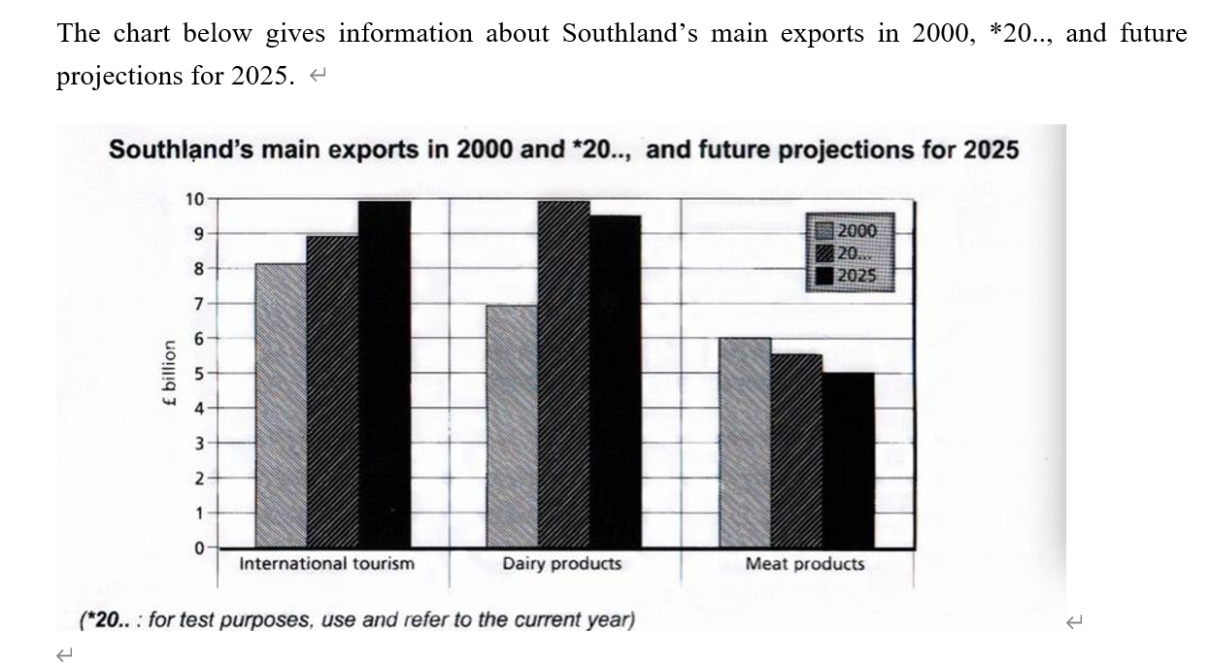
3.柱状图
bar chart

Slide 42
The bar chart illustrates changes in the performance of Southland’s primary exports in 2000 and 2019 with future projections for 2025. It indicates that international tourism will become the dominant industry, while dairy products exports will remain strong.
In 2000, international tourism was the greatest exports earner of the three industries, with over￡8 billion revenues. This figure has increased slightly, so that by now, it has reached around￡9 billion. It is estimated that international tourism will continue to grow, earning around￡10 billion for the country in 2025.
The revenue of dairy exports stood at around￡7 billion in 2000, after which time there has been a dramatic increase by 2019, when it is reaching approximately￡10 billion (the highest figure in the chart). It is expected that sales in this area will fall slightly to a figure of￡9.5 billion in 2025. (figure for + 对象；figure of + 数据)
Meat products are the third key industry in Southland land in all years, but sales have dropped since 2000 and now stand at ￡5.5 billion. It is projected that sales will continue to decrease in the future.
All in all, it is estimated that there will be a growth in international tourism while decreases in dairy products and meat products.

Slide 43
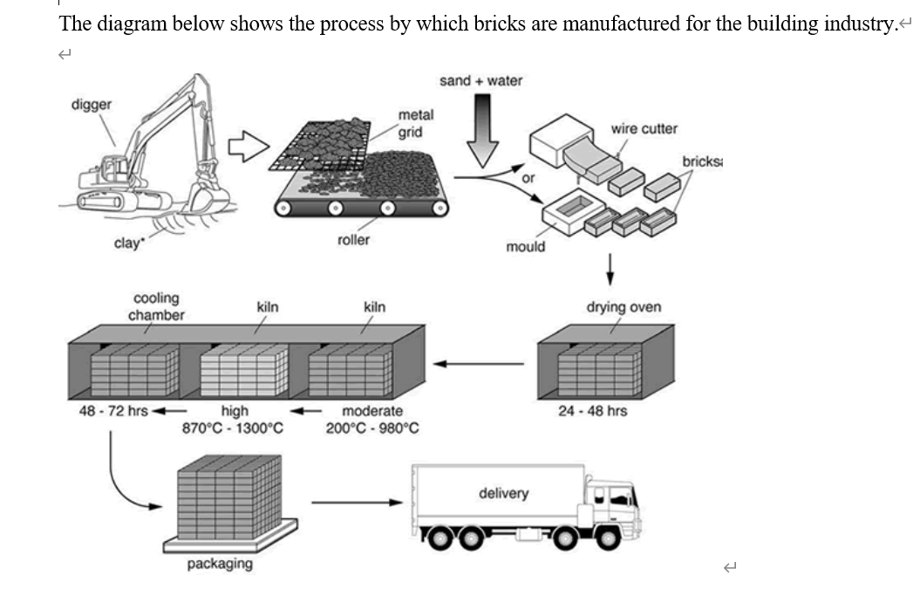
4.流程图
flow chart

Slide 44
The diagram shows different stages of brick manufacturing for the building industries.
The process starts with digging clay with the help of a digger and then the clay is passed through a metal grid to break them. After that, the smashed clay is transported to a roller and then mixed with sand and water. Once mixed, the mixture either moves through a brick cutter, where it is cut into a brick shape, or is placed into a mould, where the shape of a brick is formed.
In the fourth step, the shaped raw bricks are dried for 24 to 48 hours in a drying oven, after which they are transferred to the first kiln for heating, where the temperature is moderate, 200 to 980 C. In the following step, they are heated in the second kiln under the high temperature from 870-1300C. Subsequently, in a cooling chamber, they are cooled for two to three days before they are packaged and delivered to the construction sites.
Overall, brick production involves 7 steps, starting from the digging stage and ending at the delivery stage.

Slide 45
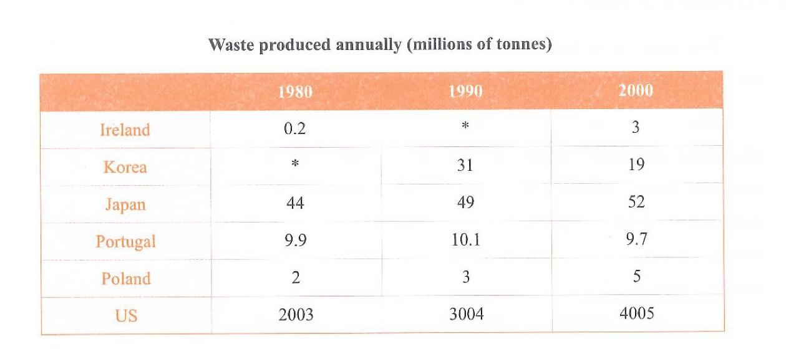
5.表格table

Slide 46
The chart compares six different countries in terms of waste production in year 1980, 1990 and 2000.
The US produced significantly more waste than other countries did, and the amount of waste produced by this country nearly doubled from 2003 millions of tonnes to 4005 during this period. The rising trend was also seen in Japan, where the waste rose from 44 to 52 millions of tonnes.
The waste production was noticeably lower in Ireland, Portugal and Poland. While the figures for Ireland and Poland increased slightly to 3 and 5 million tonnes respectively, the waste produced in Portugal remained roughly unchanged at around 10 millions throughout 20 years.
To be mentioned, Korea was the only country which witnessed a marked decline in waste production, from 31 million in 1990 to 19 million in 2000, with no figure provided in 1980.
Overall, the US and Japan saw an increase in waste production and these two countries also produced much more waste than other countries did.

Slide 47
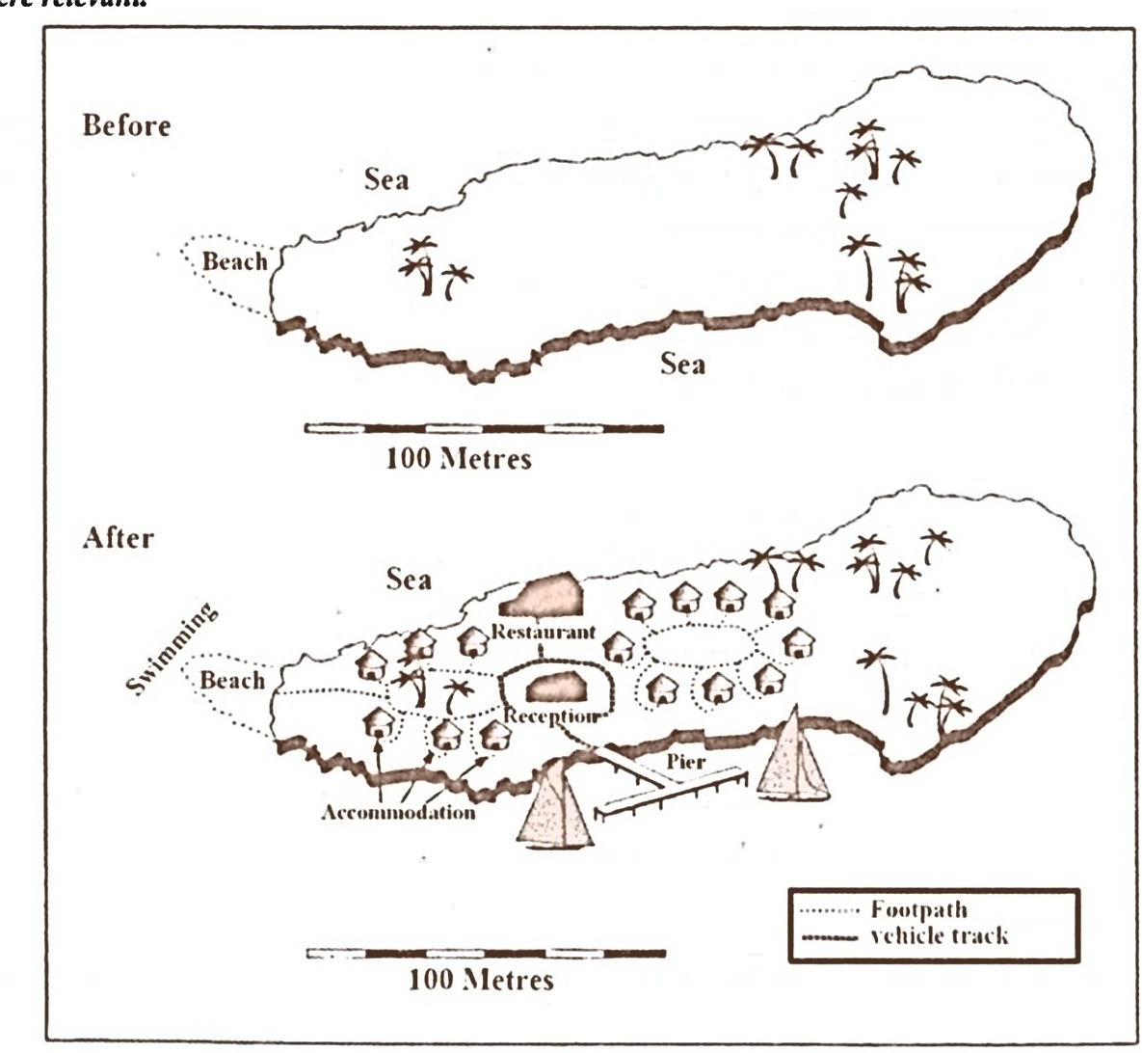
6.地图
map

Slide 48
The map shows the changes in an island, which is now a tourist attraction. The coastal line of the island is about 600 metres in length.
The island is surrounded by sea. While a beach is located on the western end of the island, some trees are scattered in the western and eastern sides.
Tourism has led to some significant changes. A number of accommodation units are built surrounding those trees in the western part of the island. These facilities are connected with the beach, a site now open to swimmers, by a circular footpath. Another cluster of accommodation facilities is sited in the middle of the island next to trees, also linked by a footpath.
Between these two groups of accommodation units is a reception with a restaurant lying to the north. There is a vehicle track linking the restaurant and the reception with a T-shaped pier constructed on the southern end of the island, which is used for yachting.
In summary, the island has changed to cater for the needs of tourists, after the construction of these facilities, while the trees have been well preserved.

Slide 49
必备句型及词汇

Slide 50
一、开头句
A．表明，比较 compare = show = illustrate = give information about
B．时间：
(1）一段时间
in 1980 and 2000 = from 1980 to 2000 = between 1980 and 2000 =over a period of 20 years = during a span of 20 years
(2）具体到某年
In the years 1980 and 2000 = over two separate years

Slide 51
二、正文常用词汇及句式
上升：rise = increase = grow = climb = jump = skyrocket
(1）轻微上升：a slight increase = increase slightly
(2）迅速上升：rapid growth = increase more rapidly
(3）显著上升：a dramatic increase = increase dramatically
(4）匀速上升：increase uniformly = increase constantly
(5）持续上升：increase continuously
(6）小增长：see a small rise to
(7）涨到峰值：climb to its peak at = reach its peak at
Eg: go through /experience a rise
增长了……：increase by ……
增长至……：increase to……

Slide 52
下降：decrease = decline = fall = drop = slide = plummet
(1）轻微下降：a slight decrease = decrease slightly
(2）显著下降：a significant decline = decline noticeably
(3）持续下降：fall consistently
(4）骤降：plummet to
(5）呈现下降趋势：witness a downward trend
无变化：remain
(1）保持：remain stable = steady = constant = uncharged
(2）相对而言保持稳定：... remained relatively stable = remain uncharged at around.
There is relatively little change in the figure for...
(3)相同：be the same as/be similar to/have sth in common
Eg: suffer from/witness a fall
Eg: reach a plateau

Slide 53
波动：fluctuate=up and down
(1）从某年开始波动：the number of （主体）fluctuated after （年份）
(2）先升后降：the figure rose to （数值） in 2000 but fell again by（数值）in 2005
超过：overtake
(1)A超过 B: A overtook B as the primary...
(2) 相交后超过：The year 2008 marks the point at which A overtook that for B
Eg: display/demonstrate fluctuation
排位：
rank the second
come the second
at the second place
X is the second largest

Slide 54
三、常用程度副词
轻微：slightly = slowly = steadily =moderately
显著：noticeably = considerably = significantly = markedly
非常显著： dramatically = sharply =radically
连续不断地：continuously = all the way
表示大约（在具体数值前加）:close to = around = about = almost = nearly = approximately

Slide 55
最高值的表达方式：
(1)The amount / number / percentage of （主体） was the highest, with / at / standing at+具体数值
(2) The highest amount /number / percentage of( ± )was found in, where the figure was＋具体数值
(3) （主体） accounted for the highest proportion of..
(4) figure for （主体）peaking at around＋具体数值 in...
(5)See the peak/reach to a peak of
最小值的表达方式
(1) The figures for……were much lower, ranging between... no more than
(2) .. around 145000 , is the lowest figure shown on the chart
(3) By contrast, （主体） recorded by far the lowest figures
(4）微不足道，不值一提的数值 a negligible amount..
(5)……reach the bottom/drop to an all-time low

Slide 56
中间值的表达方式
(1）紧随其后：., which was followed closely by...
e.g. Turkey spent the greatest proportion of income on food among the five countries ,at 32. 14% which was followed closely by Ireland (28. 91%).
(2）接下来是：Next came...which represented / averaged / ranged+ 数字
e.g Turkey spent the greatest proportion of income on food/drink/tobacco among the five countries, at 32. 14%. Next came Ireland, which represented 28. 91%.
(3）离得不远：... was/were not far behind ＋数字
e.g Turkey spent the greatest proportion of income on food/drink/tobacco among the five countries ,at 32. 14%. Ireland was not far behind (28. 91%).

Slide 57
四、数值之间的关系
大于：the number of A almost doubled/tripled to B
the figure ..was twice as high as..
A is far higher among..
等于：the figure for...are the same,at about..
with roughly the same figures for .
The number of A equaled the figure recorded for B
小于：主体 A...The figures for （主体B)stood at around one fifth of that amount.
主体 A had risen to just under half that amount...
倍数：
（1）是……的几倍A + be +half /twice/...times/ + as原形(adj) as+ B
Eg:在日本，老人的数量是成人数量的两倍
The number of the elderly in Japan is twice as much as that of the adults.
(2) .....double /triple/quadruple 变成 2/3/4倍（动词）eg: sth doubles 翻了一翻
(3) is three/four times more than……

Slide 58
五、各类趋势的表达方式
相同趋势
(1) The upward/rising trend was also seen in(主体）+趋势
(2) The similar pattern can be seen …
(3) the same proportion of （主体） is in..
相反趋势
(1 ) The opposite trend can be seen when we look at (主体)...
(2) However, There was a different trend for (主体)
唯一与其他相反的趋势
(1)（主体） way the only figure which + 趋势
(2) The trend for （主体） was noticeably different from those described above
预测的表达方式（题中带预测或图中有未来年份的数据）
Looking into the future...is predicted to / is likely to / is expected to
By+未来年份，it is thought that

