Slide 1
NODE.JS

Slide 2

what is node.js?
v8 JavaScript runtime
Event driven
Non-blocking standard libraries
Most APIs speak streams
Provides a package manager and module system

Slide 3

javascript everywhere
Code reuse
Same programming culture on client and server
Lots of JavaScript programmers

Slide 4
node.js features
Node.js = Runtime Environment + JavaScript Library
Asynchronous and Event Driven
Very Fast
Single Threaded but Highly Scalable
Where to Use Node.js? Where Not to Use Node.js?
I/O bound Applications
Data Streaming Applications
Data Intensive Real-time Applications (DIRT)
JSON APIs based Applications
Single Page Applications
CPU intensive applications

Slide 5
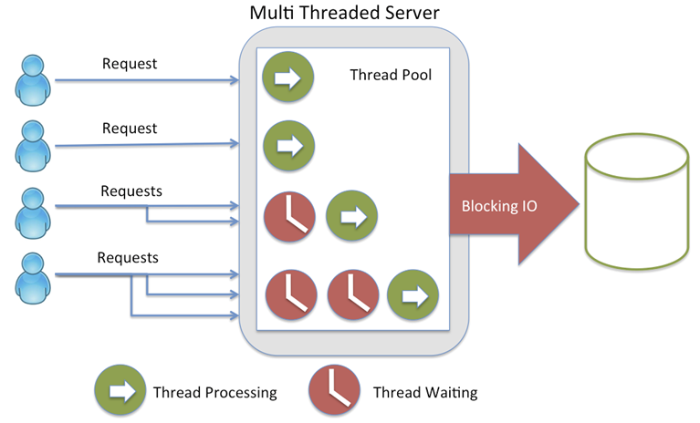
multithreaded server request processing

Slide 6
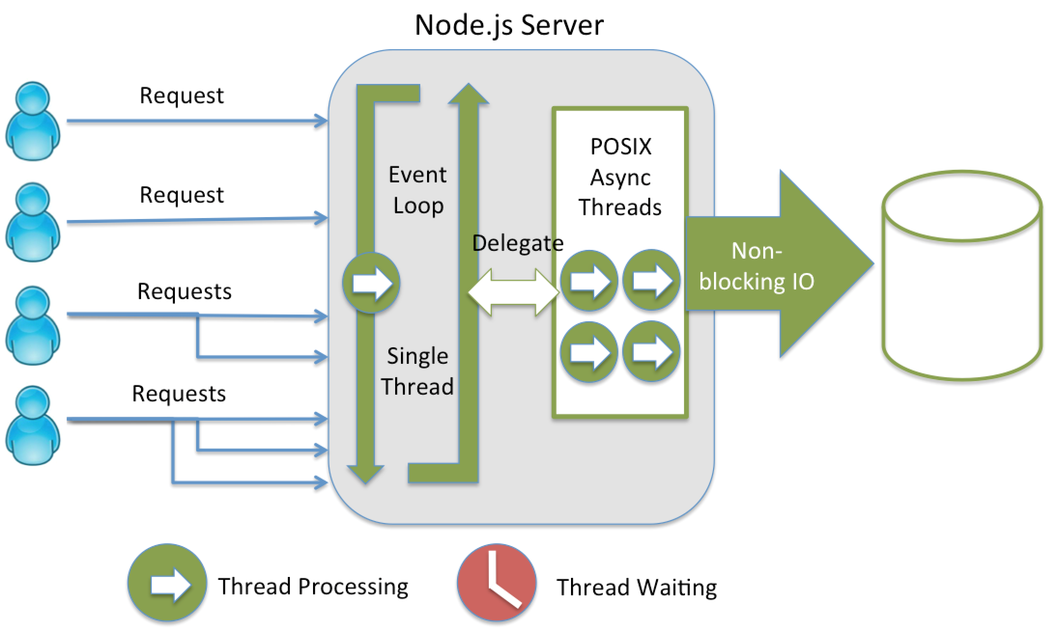
node.js request processing with event loop

Slide 7
NPM

Slide 8
NPM
Node Package Manager (NPM) provides two main functionalities:
Online repositories for node.js packages/modules
Command line utility to install Node.js packages, do version management and dependency management

Slide 9
package.json
{
"name": "async-lib",
"version": "1.1.2",
"description": ”Async library",
"main": "index.js",
"scripts": {
"test": "mocha test.js"
},
"author": "Vladimir Sonkin",
"license": "ISC",
“keywords": “async",
"dependencies": {
"bluebird": "^3.5.0"
},
"devDependencies": {
"mocha": "~2.1.0"
}
}
Commands:
npm init
npm install express
npm uninstall express
npm install express@3.2.1
npm search express
npm update express
npm install webpack -g
npm adduser
npm publish
Notes:
name − name of the package
version − version of the package
description − description of the package
homepage − homepage of the package
author − author of the package
contributors − name of the contributors to the package
dependencies − list of dependencies. NPM automatically installs all the dependencies mentioned here in the node_module folder of the package.
repository − repository type and URL of the package
main − entry point of the package
keywords − keywords

Slide 10
npm folders
Local install (default): puts stuff in ./node_modules of the current package root.
Global install (with -g): puts stuff in /usr/local or wherever node is installed.
Install it locally if you're going to require() it.
Install it globally if you're going to run it on the command line.
If you need both, then install it in both places, or use npm link.

Slide 11
package-lock.json
package-lock.json is automatically generated for any operations where npm modifies either the node_modules tree, or package.json
This file is intended to be committed into source repositories, and serves various purposes:
Describe a single representation of a dependency tree
Provide a facility for users to "time-travel" to previous states of node_modules without having to commit the directory itself.
To facilitate greater visibility of tree changes through readable source control diffs.

Slide 12
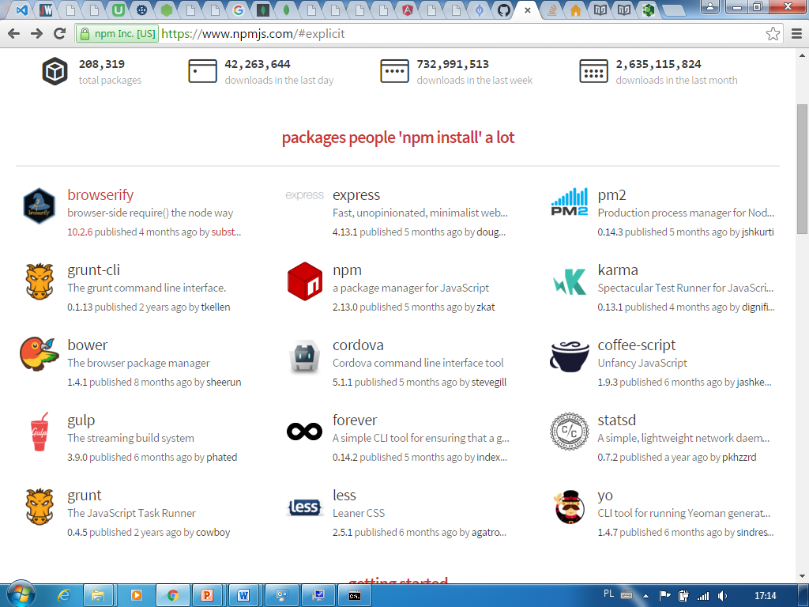
popular npm modules

Slide 13
forever module
Installation:
sudo npm install -g forever
Use forever -w, instead of node to start your app:
$ forever -w app.js
Alternates:
nodemon
supervisor

Slide 14
Common.JS module system

Slide 15
CommonJS module
function myModule() { this.hello = function() { return 'hello!'; } this.goodbye = function() { return 'goodbye!'; } } module.exports = myModule;

Slide 16
CommonJS client
var myModule = require('myModule'); var myModuleInstance = new myModule(); myModuleInstance.hello(); // 'hello!' myModuleInstance.goodbye(); // 'goodbye!'

Slide 17
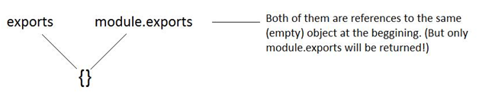
exports and module.exports
// module.js
exports.name = function() { console.log('My name is John'); };
var module= require('./module.js'); module.name(); //

Slide 18
express framework

Slide 19
Minimal express app
var express = require('express'); var app = express(); app.get('/', function(req, res){ res.send("Hello world!"); }); app.listen(3000);
npm init
npm install express
npm install -g nodemon
> nodemon index.js

Slide 20
express routing

Slide 21
get and post request
HTTP methods:
GET
POST
PUT
DELETE
var express = require('express'); var app = express(); app.get('/hello', function(req, res){ res.send("Hello World!"); }); app.post('/hello', function(req, res){ res.send("You just called the post method at '/hello'!\n"); }); app.all('/test', function(req, res){ res.send("HTTP method doesn't have any effect on this route!"); });
app.listen(3000);

Slide 22
parameters in request url
var express = require('express'); var app = express(); app.get('/:id', function(req, res){ res.send('The id you specified is ' + req.params.id); }); app.listen(3000);
http://localhost:3000/123
The id you specified is 123

Slide 23
request query
// GET /search?q=paul+mccartney req.query.q // => "paul mccartney" // GET /shoes?order=desc&shoe[color]=blue&shoe[type]=converse req.query.order // => "desc" req.query.shoe.color // => "blue" req.query.shoe.type // => "converse"

Slide 24
pattern matched route
var express = require('express'); var app = express(); app.get('/things/:id([0-9]{5})', function(req, res){ res.send('id: ' + req.params.id); }); // Other routes here app.get('*', function(req, res){ res.send('Sorry, this is an invalid URL.'); });
app.listen(3000);
this will only match the requests that have a 5-digit long id
http://localhost:3000/things/12345
id:12345
http://localhost:3000/things/123
Sorry, this is an invalid URL

Slide 25
app.route()
app.route('/book') .get(function (req, res) { res.send('Get a random book') }) .post(function (req, res) { res.send('Add a book') }) .put(function (req, res) { res.send('Update the book') })

Slide 26
put router to separate module
To separate the routes from our main index.js file, we will use Express.Router
things.js:
var express = require('express');
var router = express.Router();
router.get('/', function(req, res){
res.send('GET route on things.');
});
router.post('/', function(req, res){
res.send('POST route on things.');
});
//export this router to use in our index.js
module.exports = router;
index.js:
var things = require(
'./things.js'); // index.js and things.js // should be
// in same directory app.use('/things', things); app.listen(3000);

Slide 27
response methods
Method | Description
res.download() | Prompt a file to be downloaded: res.download('/report-12345.pdf');
res.end() | End the response process.
res.json() | Send a JSON response.
res.jsonp() | Send a JSON response with JSONP support.
res.redirect() | Redirect a request.
res.render() | Render a view template: res.render('user', { name: 'Tobi' }, function(err, html) { … } );
res.send() | Send a response of various types.
res.sendFile() | Send a file as an octet stream.
res.sendStatus() | Set the response status code and send its string representation as the response body.

Slide 28
pug template engine

Slide 29
pug template engine
var express = require('express'); var app = express(); app.get('/', function(req, res){ res.render("template.pug",
{title: "Experimental", name:"John"}); }); app.listen(3000);
views/template.pug
html head body h2= title p hello, #{name}

Slide 30
loops in pug
views/template.pug
h2 Beatles for item in list div= item div #{item} #{item.length}
var express = require('express'); var app = express(); let list = ['John','George','Paul','Ringo']; app.get('/list', function(req, res){ res.render("list.pug", {list}); }); app.listen(3000);
Beatles
John
John 4
George
George 6
Paul
Paul 4
Ringo
Ringo 5

Slide 31
conditions and variables in pug
- var user = { description: 'foo bar baz' } - var authorised = false #user if user.description h2.green Description p.description= user.description else if authorised h2.blue Description p.description. User has no description, why not add one... else h2.red Description p.description User has no description
Description
foo bar baz

Slide 32
pug each
ul each val, index in ['zero', 'one', 'two'] li= index + ': ' + val
<ul>
<li>0: zero</li>
<li>1: one</li>
<li>2: two</li>
</ul>

Slide 33
pug template inheritance
//- layout.pug html head title My Site - #{title} block scripts script(src='/jquery.js') body block content block foot #footer p some footer content
//- page-a.pug extends layout.pug block scripts script(src='/jquery.js') script(src='/pets.js') block content h1= title - var pets = ['cat', 'dog'] each petName in pets include pet.pug
//- pet.pug p= petName

Slide 34
pug block append/prepend
//- page.pug extends layout append head script(src='/vendor/three.js') script(src='/game.js')
//- layout.pug html head block head script(src='/vendor/jquery.js') script(src='/vendor/caustic.js') body block content

Slide 35
pug: mixins
<ul>
<li>foo</li>
<li>bar</li>
<li>baz</li>
</ul>
<ul>
<li>foo</li>
<li>bar</li>
<li>baz</li>
</ul>
mixin list ul li foo li bar li baz +list +list
mixin list(id, ...items) ul(id=id) each item in items li= item +list('my-list', 1, 2, 3, 4)
<ul id="my-list">
<li>1</li>
<li>2</li>
<li>3</li>
<li>4</li>
</ul>

Slide 36
middleware

Slide 37
middleware
var express = require('express'); var app = express(); var timeLogger = function (req, res, next) { console.log("A new request received at " + Date.now()); next(); }; app.use(timeLogger); app.get('/', function (req, res) { res.send('Hello World!') }); app.listen(3000);

Slide 38
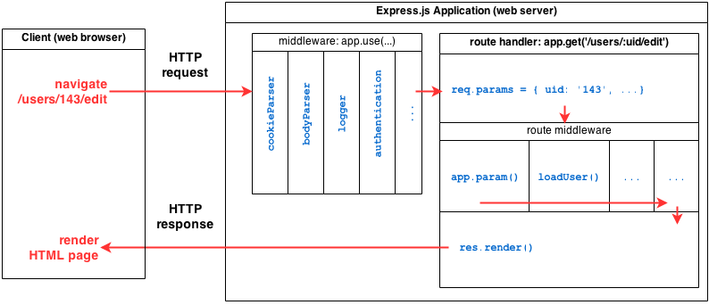
express structure

Slide 39
restricting middleware to route
var express = require('express'); var app = express(); //Middleware function to log request protocol app.use('/things', function(req, res, next){ console.log("A request for things received at " + Date.now()); next(); }); // Route handler that sends the response app.get('/things', function(req, res){ res.send('Things'); }); app.listen(3000);

Slide 40
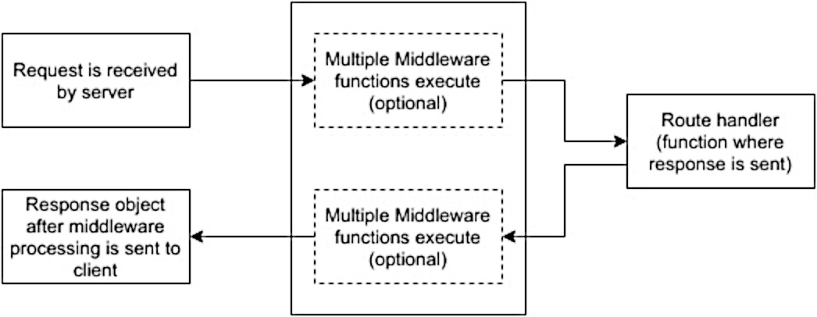
Order of Middleware Calls
var express = require('express'); var app = express(); // First middleware before response is sent app.use(function(req, res, next){ console.log("Start"); next(); }); // Route handler app.get('/', function(req, res, next){ res.send("Middle"); next(); }); app.use('/', function(req, res){ console.log('End'); }); app.listen(3000);

Slide 41
body-parser middleware
var bodyParser = require('body-parser'); //To parse URL encoded data app.use(bodyParser.urlencoded({ extended: false })) //To parse json data app.use(bodyParser.json())
app.post("/", function (req, res) { console.log(req.body.name); console.log(req.body.email); });
<form method="post" action="/"> <input type="text" name="name"> <input type="text" name="email"> <input type="submit" value="Submit"> </form>

Slide 42
session middleware
var session = require('express-session');
app.use(session({secret: "Shh, its a secret!"}));
app.get('/', function(req, res){
if(req.session.page_views){
req.session.page_views++;
res.send("You visited this page " +
req.session.page_views + " times");
} else {
req.session.page_views = 1;
res.send("Welcome to this page for the first time!");
}
});

Slide 43
examples

Slide 44
example: notes
var express = require('express'); var app = express(); var session = require('express-session'); app.use(session({ secret: "notes app", resave:true, saveUninitialized:true})); app.get('/', function(req, res){ if (!req.session.notes) req.session.notes = []; res.render("notes.pug", {notes:req.session.notes}); });
views/notes.pug
html head body form(method="post" action="/") textarea(name="note") input(type="submit") h2 list of notes: ul for note in notes li= note

Slide 45
example: post note
var bodyParser = require('body-parser'); app.use(bodyParser.urlencoded({ extended: false })); app.use(bodyParser.json()); app.post('/', function(req, res){ let note = req.body.note; if (!req.session.notes) req.session.notes = []; req.session.notes.push(note); res.render("notes.pug", {notes:req.session.notes}); });

Slide 46
use express to create rest service

Slide 47
Serving static files
app.use(express.static('public'))
Now, you can load the files that are in the public directory:
http://localhost:3000/images/kitten.jpg
http://localhost:3000/css/style.css
http://localhost:3000/js/app.js
http://localhost:3000/images/bg.png
http://localhost:3000/hello.html
http://localhost:3000/hello - not static, will be processed by the server
The path that you provide to the express.static function is relative to the directory from where you launch your node process. If you run the express app from another directory, it’s safer to use the absolute path:
app.use(express.static(path.join(__dirname, 'public')))

Slide 48
example: rest service - get
var express = require('express'); var app = express(); app.use(express.static('public')); var session = require('express-session'); app.use(session({secret: "notes app",resave:true,saveUninitialized:true})); app.get('/', function(req, res){ if (!req.session.notes) req.session.notes = []; res.send({notes:req.session.notes}); });

Slide 49
example: rest service - post
var bodyParser = require('body-parser'); app.use(bodyParser.urlencoded({ extended: false })); app.use(bodyParser.json()); app.post('/', function(req, res){ let note = req.body.note; if (!req.session.notes) req.session.notes = []; req.session.notes.push(note); res.send({notes:req.session.notes}); });

Slide 50
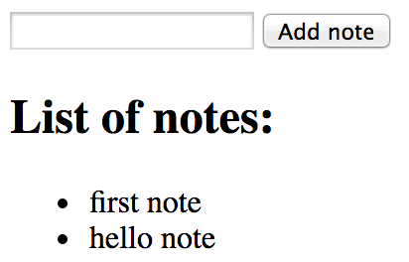
jquery client
function loadNotes() { $.get("/").then(res=>{ let notes = res.notes.map( note=>`<li>${note}</li>`).join(""); $("#placeholder").html(` <input type="textarea" id="noteText"> <button id="addNote"> Add note </button> <h2>List of notes:</h2> <ul>${notes}</ul>`); } ) } loadNotes();
<head> <meta charset="UTF-8"> <title>Notes REST app</title> <script src="http://code.jquery.com/jquery-3.2.1.js"></script> </head> <body> <div id="placeholder"></div> </body> <script src="notes-jquery.js"></script>
function addNote() { var note = $("#noteText").val(); $.post("/", {note}).then(loadNotes); } $("#placeholder").on("click", "#addNote", addNote);

Slide 51
using pug on client
notes.pug
textarea#noteText button#addNote Add note h2 list of notes: ul for note in notes li= note
// Compile a function var template = require("pug-loader!./notes.pug"); var $ = require("jquery"); function loadNotes() { $.get("/").then(res=>{ var html = template(res); $("#placeholder").html(html); } ) } loadNotes();
function addNote() { var note = $("#noteText").val(); $.post("/", {note}).then(loadNotes); } $("#placeholder").on("click", "#addNote", addNote);
notes-pug.html
<div id="placeholder"></div> <script src="notes-client-bundle.js"></script>
npm i pug-loader
webpack notes-client.js notes-client-bundle.js

Slide 52
error handling

Slide 53
default error handler
The error handling middleware are defined in the same way as other middleware functions, except that error-handling functions MUST have four arguments instead of three – err, req, res, next:
app.use(function(err, req, res, next) { console.error(err.stack); res.status(500).send('Something broke!'); // res.render('error', { error: err }) });

Slide 54
error handling
For error handling, we have the next(err) function. A call to this function skips all middleware and matches the next error handler for that route.
app.get('/', function(req, res, next){
//Create an error and pass it to the next function
var err = new Error("Something went wrong");
next(err);
});
// other route handlers and middleware here ...
//An error handling middleware
app.use(function(err, req, res, next) {
res.status(500);
res.send("Oops, something went wrong.")
});

Slide 55
custom error class
app.get('/event/:id', function(req, res, next){ if (req.params.id != 1) { next(new NotFound('Cannot find event ' +
req.params.id)); } else { req.send('event found!'); } }); app.use(function(err, req, res, next){ if (err instanceof NotFound) { res.render('404.ejs'); } else { next(err); } });
function NotFound(msg){ this.name = 'NotFound'; Error.call(this, msg); Error.captureStackTrace( this, arguments.callee); }

Slide 56
debugging logging
To see all internal logs used in Express, set the DEBUG environment variable to Express:* when starting the app
DEBUG = express:* node index.js

Slide 57
node event loop timers

Slide 58
set immediate
console.log('before immediate'); setImmediate((arg) => { console.log(`executing immediate: ${arg}`); }, 'so immediate'); console.log('after immediate');
before immediate
after immediate
executing immediate: so immediate

Slide 59
set immediate
setTimeout(() => { console.log('timeout'); }, 0); setImmediate(() => { console.log('immediate'); }); console.log('no timeout');
no timeout
timeout
immediate

Slide 60
unref
unref() tells that app may finish not waiting for the timer
var timer = setInterval(function() { console.log("A"); }, 300); var timer2 = setInterval(function() { console.log("B"); }, 100); timer.unref(); setTimeout(function() { timer2.unref(); },1000);
>node unref.js
B
B
A
B
B
B
A
B
B
B
A
B

Slide 61
node event loop
TIMERS
executes callbacks scheduled by setTimeout() and setInterval()
I/O CALLBACKS
executes almost all callbacks with the exception of close callbacks, the ones scheduled by timers, and setImmediate()
Incoming:
connections,
data, etc.
retrieve new I/O events; node will block here when appropriate
POLL
CHECK
setImmediate() callbacks are invoked here
CLOSE CALLBACKS
e.g. socket.on('close', ...)

Slide 62
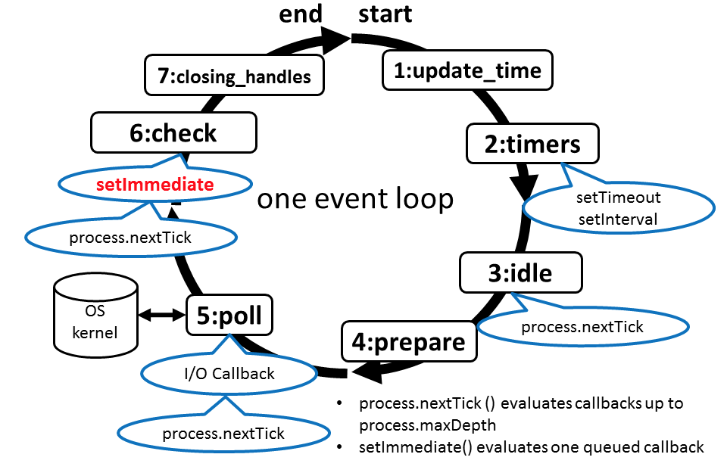
timers
var fs = require("fs"); setTimeout(() => console.log('timeout 0'), 0); setImmediate(() => console.log('immediate')); fs.readFile("file.txt",(err,res)=> { setTimeout(() => console.log('file read: timeout 0'), 0); setImmediate(() => console.log('file read: immediate')); console.log("file is read"); }); console.log('no timeout'); setTimeout(() => console.log('timeout 1'), 1); setTimeout(() => console.log('timeout 10'), 10); process.nextTick(()=>console.log('next tick'));
no timeout
next tick
timeout 0
timeout 1
immediate
file is read
file read: immediate
timeout 10
file read: timeout 0

Slide 63
node events and streams

Slide 64
Event emitter
var eventEmitter = require('events').EventEmitter; var counter = 0; var em = new eventEmitter(); setInterval(function() { em.emit('timed', counter++); }, 3000); em.on('timed', function(data) { console.log('timed ' + data); });

Slide 65
Simplest HTTP server
var http = require('http'); http.createServer(function (request, response) { response.writeHead(200, {'Content-Type': 'text/plain'}); response.end('Hello World\n'); }).listen(8124); console.log('Server running at http://127.0.0.1:8124/');

Slide 66
HTTP server
var http = require('http'); var server = http.createServer(); server.on('request', function (request, response) { console.log('request event'); response.writeHead(200, {'Content-Type': 'text/plain'}); response.end('Hello World\n'); }); server.on('connection', function() { console.log('connection event'); });
server.listen(8124, function() { console.log('listening event'); }); console.log('Server running on port 8124');

Slide 67
Standard input/output
process.stdin.setEncoding('utf8'); process.stdin.on('readable', function() { var input = process.stdin.read(); if (input !== null) { // echo the text process.stdout.write(input); var command = input.trim(); if (command == 'exit') process.exit(0); } });

Slide 68
read from file
var fs = require("fs");
//Asynchronous read
fs.readFile('input.txt', function (err, data) {
if (err) {
return console.error(err);
}
console.log("Asynchronous read: " + data.toString());
});
//Synchronous read
var data = fs.readFileSync('input.txt');
console.log("Synchronous read: " + data.toString());
console.log("Program Ended");
Notes:
68

Slide 69
Working with files
var fs = require('fs'); fs.writeFile('./some.txt', 'Writing to a file', function(err) { if (err) return console.error(err); fs.readFile('./some.txt','utf-8', function(data,err) { if (err) return console.error(err); console.log(data); }); });
Writing to a file

Slide 70
Low level work with files
fs.open('./new.txt','a+',0x666, function(err, fd) { if (err) return console.error(err); fs.write(fd, 'First line', 'utf-8', function(err,written, str) { if (err) return console.error(err); var buf = new Buffer(written); fs.read(fd, buf, 0, written, 0, function (err, bytes, buffer) { if (err) return console.error(err); console.log(buf.toString('utf8')); }); }); });

Slide 71
Exception handling: sync
var fs = require('fs'); try { var data = fs.readFileSync('./apples.txt','utf8'); console.log(data); var adjData = data.replace(/[A|a]pple/g,'orange'); fs.writeFileSync('./oranges.txt', adjData); } catch(err) { console.error(err); }

Slide 72
Exception handling: async
var fs = require('fs'); fs.readFile('./apples.txt','utf8', function(err,data) { if (err) { console.error(err); } else { var adjData = data.replace(/apple/g,'orange'); fs.writeFile('./oranges.txt', adjData, function(err) { if (err) console.error(err); }); } });

Slide 73
File streams
var readable = fs.createReadStream('./working.txt') .setEncoding('utf8'); var data = ''; readable.on('data', function(chunk) { data += chunk; }); readable.on('end', function() { console.log(data); });

Slide 74
Listing files
fs.readdir ('./',function(err, files) { for (let file of files) { let ext = path.extname(file); let base = path.basename(file, ext); console.log ('file ' + base + ' with extension of ' + ext); } });

Slide 75
async/await syntax

Slide 76
async/await syntax
async function test() { await new Promise((resolve, reject) => setTimeout(() => resolve(), 1000)); console.log('Hello, World!'); } test();
>node async-await.js
Hello, World! (in 1s)

Slide 77
async/await parallel execution
function wait(ms) { return new Promise(resolve=> setTimeout(() => resolve(), ms)); }
async function test(ms, message) {
for (let i = 0; i < 5; ++i) {
await wait(ms);
console.log(ms * (i + 1) + message); }
}
// These two function calls will actually run in parallel
test(50, "a");
test(100, "b");
>node async-check.js
50a
100b
100a
150a
200b
200a
250a
300b
400b
500b

Slide 78
exception processing with async/await
async function test() { try { await new Promise((resolve, reject) => { setTimeout(() => reject(new Error('Woops!')), 1000); }); } catch (error) { // Prints "Caught Woops!" console.log('Caught', error.message); } } test();

Slide 79
loop with async/await
function wait(ms) { return new Promise(resolve => setTimeout(() => resolve(), ms)); } async function test() { for (let i = 0; i < 5; ++i) { await wait(1000); // Prints out "Hello, World!" once per second and then exits console.log('Hello, World time '+i); } } test();
>node loop.js
Hello, World time 0
Hello, World time 1
Hello, World time 2
Hello, World time 3
Hello, World time 4

Slide 80
reading file with async/await
var util = require("util"); var fs = require("fs"); let readFileAsync = util.promisify(fs.readFile); async function readFile() { let contents = await readFileAsync('file.txt', 'utf-8'); console.log(contents); }
readFile();
hello all
I'm contents of file.txt
bye!

Slide 81
using bluebird
var Promise = require("bluebird"); let fs = Promise.promisifyAll(require('fs')); async function readFile() { let contents = await fs.readFileAsync('file.txt', 'utf-8'); console.log(contents); } readFile();

Slide 82
async/await with express
app.get('/user/:id', async (req, res, next) => { try { const user = await getUserFromDb({ id: req.params.id }) res.json(user); } catch (e) { //this will eventually be handled by your error handling middleware next(e) } })

Slide 83
no need to try…catch: async middleware
const asyncMiddleware = fn => (req, res, next) => { Promise.resolve(fn(req, res, next)).catch(next); };
app.get('/users/:id', asyncMiddleware(async (req, res, next) => { const user = await getUserFromDb({ id: req.params.id }) res.json(user); })); app.post('/users', asyncMiddleware(async (req, res, next) => { const user = await makeNewUser(req.body); res.json(user) }));

Slide 84
node streams

Slide 85
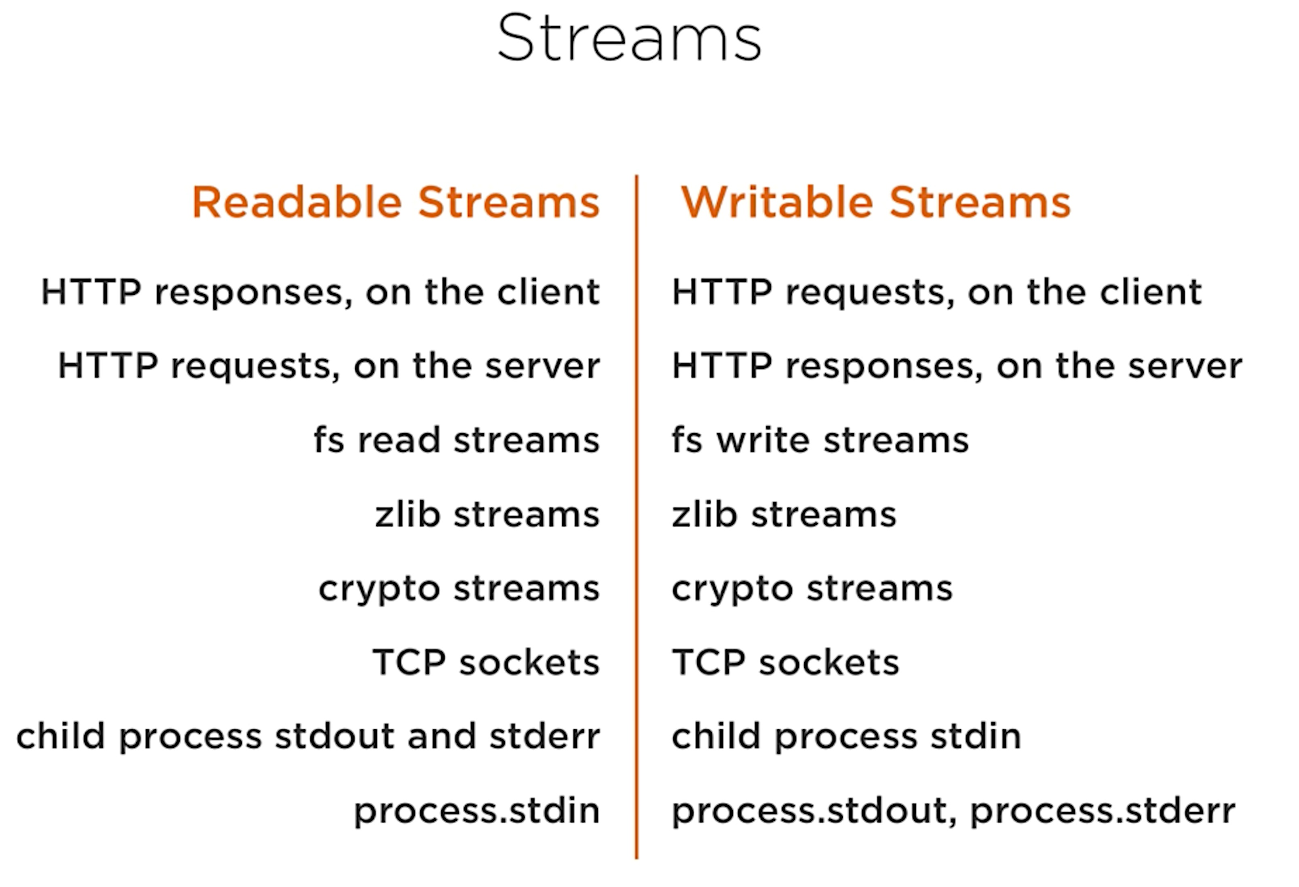

Slide 86
creating big file with streams
const fs = require('fs'); const file = fs.createWriteStream('./big.file'); for(let i=0; i<= 100000; i++) { file.write(i+'\n'); } file.end();

Slide 87
create writable stream to count occurences of 13
const { Writable } = require('stream'); const outStream = new Writable({ write(chunk, encoding, callback) { let s = chunk.toString(); var count = (s.match(/13/g) || []).length; console.log(count); callback(); } }); //process.stdin.pipe(outStream); const fs = require('fs'); const file = fs.createReadStream('./big.file'); file.pipe(outStream);
>node writable.js
458
1319
320
319
319
319
319
320
307

Slide 88
create server with file contents
const fs = require('fs'); const server = require('http').createServer(); server.on('request', (req, res) => { fs.readFile('./big.file', (err, data) => { if (err) throw err; res.end(data); }); }); server.listen(8000);

Slide 89
create server with stream api
const fs = require('fs'); const server = require('http').createServer(); server.on('request', (req, res) => { const src = fs.createReadStream('./big.file'); src.pipe(res); }); server.listen(8000);

Slide 90
stream types in node.js
Readable stream
Example: fs.createReadStream()
Writable stream
Example: fs.createWriteStream()
A duplex streams is both Readable and Writable. An example of that is a TCP socket.
A transform stream is basically a duplex stream that can be used to modify or transform the data as it is written and read. An example of that is the zlib.createGzip stream to compress the data using gzip.
All streams are instances of EventEmitter.

Slide 91
stream events
Streams can also be consumed with events directly.
Here’s the simplified event-equivalent code of what the pipe method mainly does to read and write data:
# readable.pipe(writable) readable.on('data', (chunk) => { writable.write(chunk); }); readable.on('end', () => { writable.end(); });

Slide 92
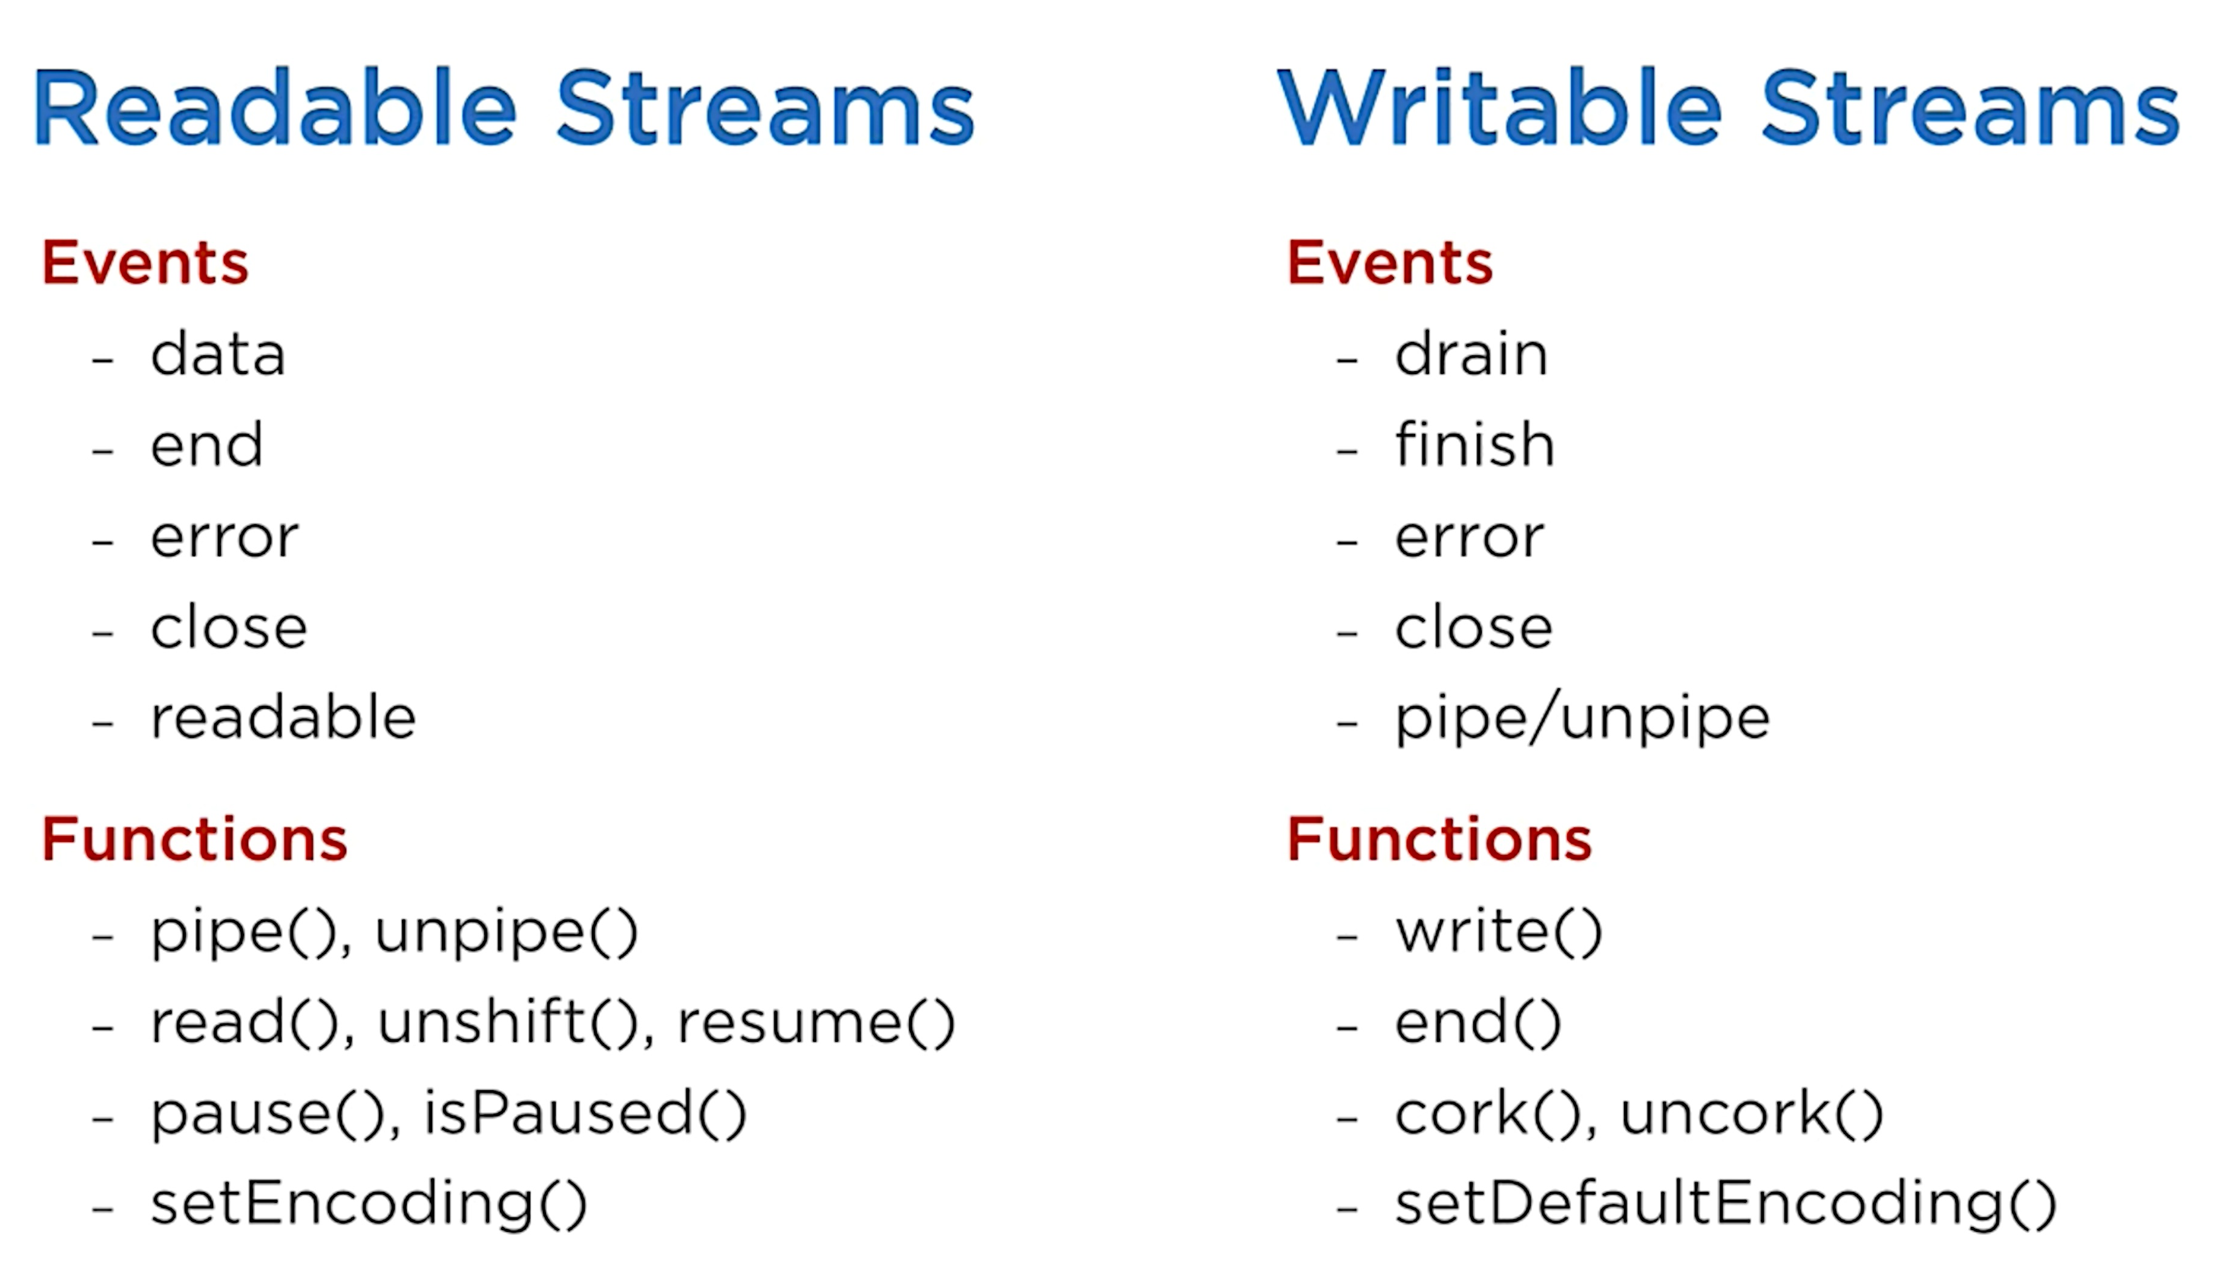

Slide 93
create readable stream
const { Readable } = require('stream'); const inStream = new Readable(); inStream.push('ABCDEFGHIJKLM'); inStream.push('NOPQRSTUVWXYZ'); inStream.push(null); // No more data inStream.pipe(process.stdout);

Slide 94
create transform stream
const { Transform } = require('stream'); const upperCaseTr = new Transform({ transform(chunk, encoding, callback) { this.push(chunk.toString().toUpperCase()); callback(); } }); process.stdin.pipe(upperCaseTr).pipe(process.stdout);

Slide 95
using pipes for data processing
const fs = require('fs'); const zlib = require('zlib'); const file = fs.createReadStream('./big.file'); file .pipe(zlib.createGzip()) .on('data', () => process.stdout.write('.')) .pipe(fs.createWriteStream('big.gzip')) .on('finish', () => console.log('Done'));

Slide 96
thank you!

