Slide 1
Implementation
Platform:
Windows 10 64 bit
Intel® Core™ i5-6200U @2.30GHz
8GB RAM
Camera:
Blackberry Classic front Camera
2MP 2.31mm fixed focal length
OpenCV:
OpenCV 3.1.0

Slide 2
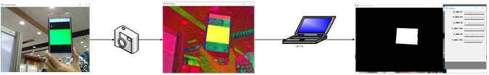
Basic OpenCV operation(Related Work)

Slide 3
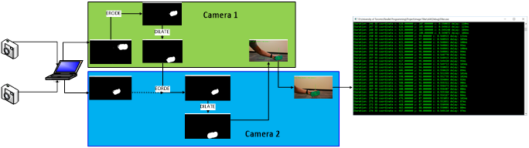
Single Thread Implementation

Slide 4
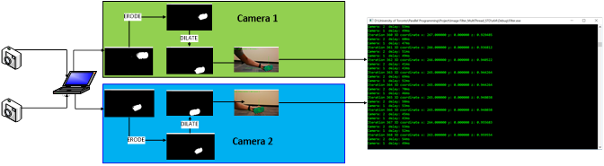
Parallel Implementation: DWORD WINAPI
Parallel both camera image processing

Slide 5
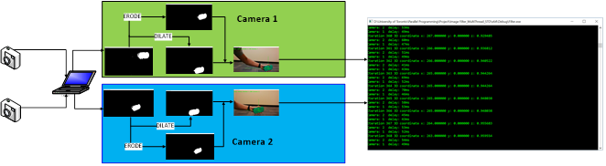
Parallel Implementation: STD:THREAD
Further parallelize Image Enhancement: Erode and Dilate

Slide 6
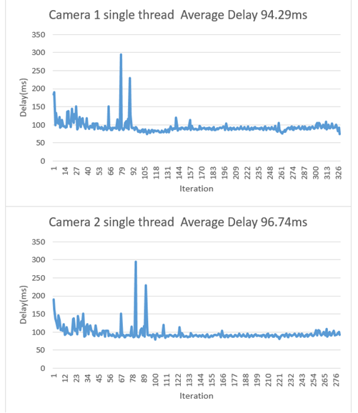
Experimental Result - Single Thread

Slide 7
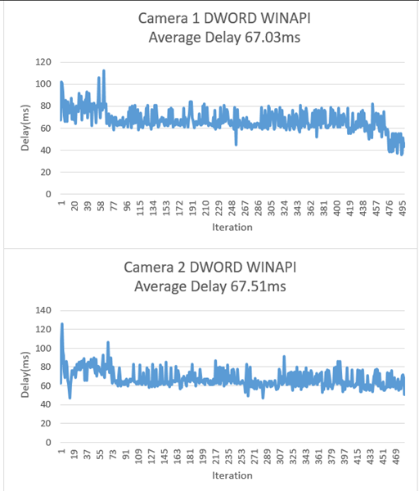
Experimental Result – DWORD WINAPI

Slide 8
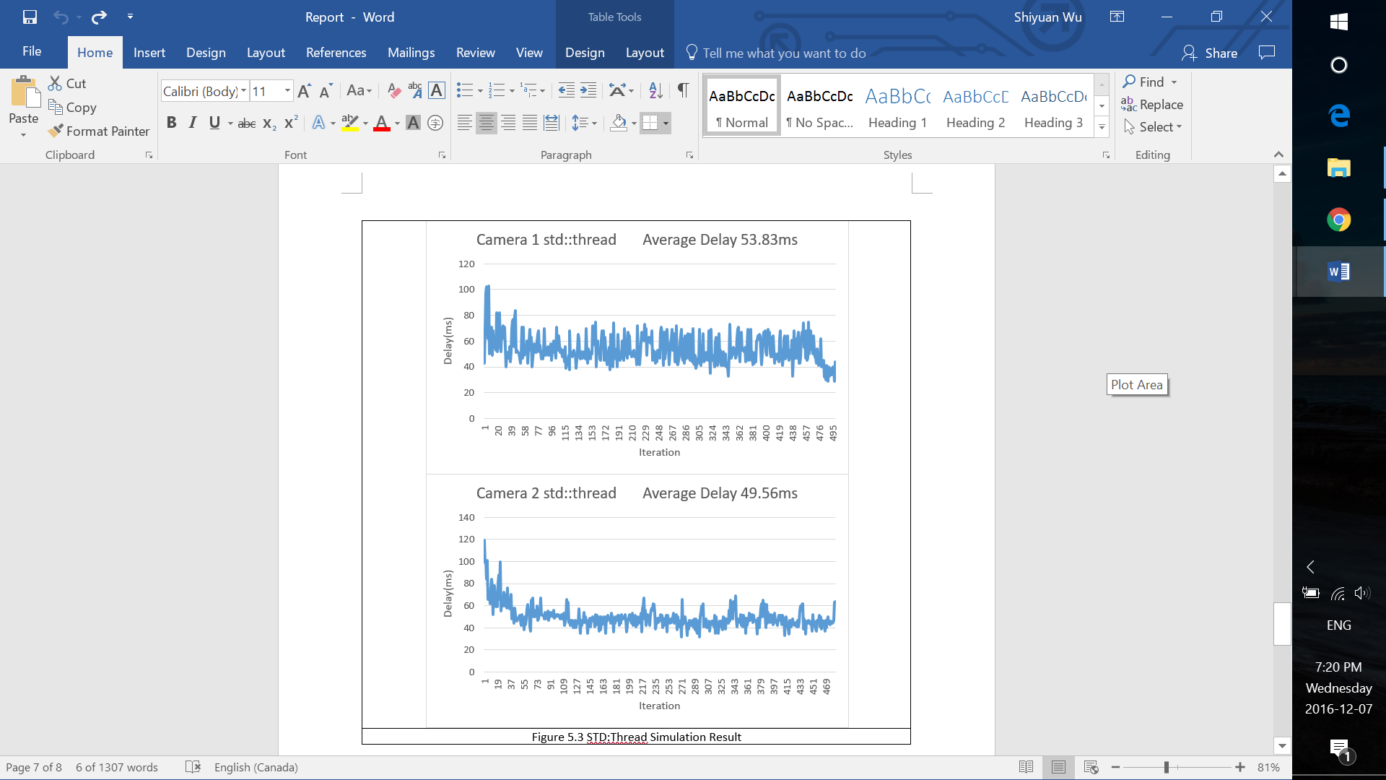
Experimental Result – STD::THREAD

