Slide 1
Face Detection
Academic Year:- 2020-21

Slide 2
Introduction
Face detection can be thought of as such a problem where we detect human faces in an image.
Face recognition is a method of identifying or verifying the identity of an individual using their face.
There are various algorithms that can do face recognition but their accuracy might vary.
In computer vision, one essential problem we are trying to figure out is to automatically detect objects in an image without human intervention.

Slide 3
Tools and Technology
Tools
VS Code
Desktop
Technology
Python with OpenCV

Slide 4
Libraries
Numpy
Provides objects for multi-dimensional arrays
Cv2
For all sorts of image and video analysis, like facial recognition and detection, license plate reading, photo editing, advanced robotic vision, optical character recognition, and a whole lot more
faceRecognition
Recognize and manipulate faces from Python or from the command line

Slide 5
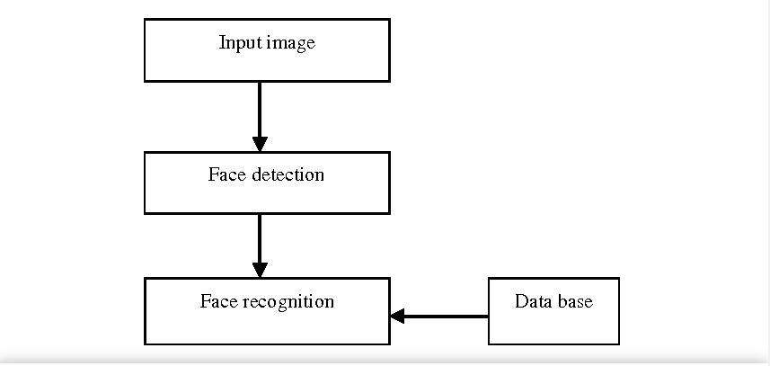
Block diagram

Slide 6
Steps followed:-
Training the dataset
Labeling for face recognition
Calculating confidence:
Confidence: The confidence interval is a range of values. In the ideal condition, it should contain the best estimate of a statistical parameter. It is expressed as a percentage

Slide 7
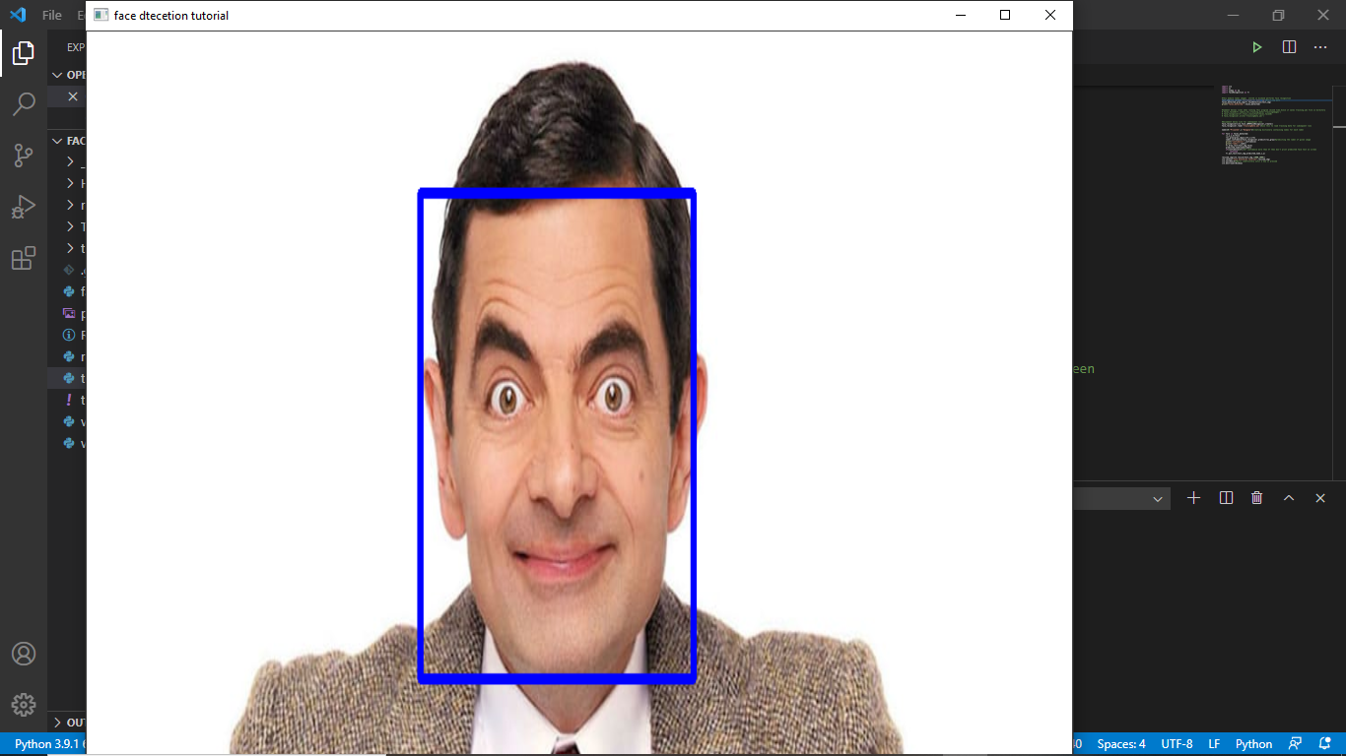

Face Detection

Slide 8
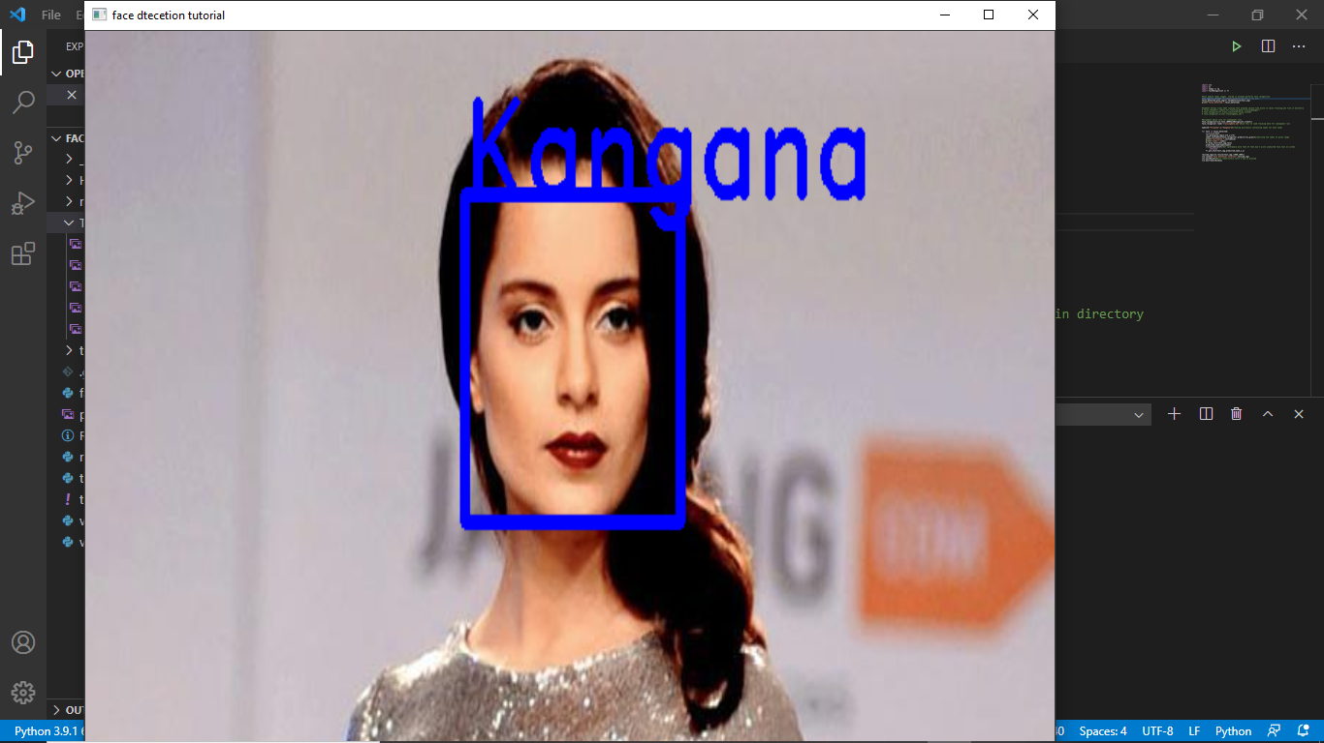

Face Reconition

Slide 9
Thank you

