Slide 1
Alberta Home Insurance Premium Pressure Monitor
SQL, Python, and Power BI Analytics Capstone

Slide 2
Business Question
Is Alberta home insurance premium growth unusual enough to warrant deeper affordability, market, or catastrophe-risk review?
Stakeholder: Provincial public policy / insurance affordability analyst
Key framing: This analysis is a review-trigger tool, not a causal proof model.

Slide 3
Data and Analytics Workflow
Data sources:
Alberta home insurance CPI
Alberta all-items CPI
Canada home insurance CPI
Residential construction-cost context
Curated catastrophe events
Alberta auto insurance CPI sensitivity check
Workflow:
Raw data → SQLite warehouse → SQL views → Python analysis → Power BI dashboard
Purpose:
Show technical process without overloading the audience.

Slide 4
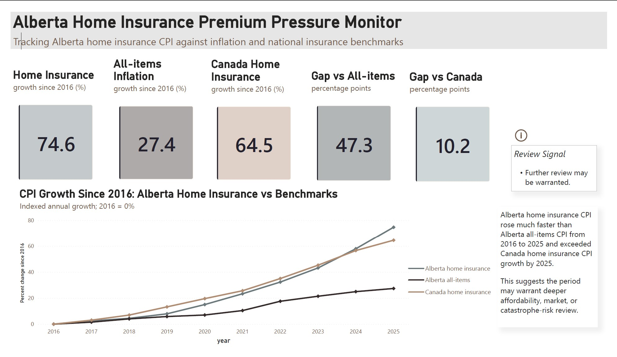
Alberta Home Insurance CPI Rose Faster Than Key Benchmarks
Alberta home insurance CPI: +74.6%
Alberta all-items CPI: +27.4%
Canada home insurance CPI: +64.5%
Alberta home insurance CPI rose much faster than general inflation and exceeded Canada home insurance growth by 2025.

Slide 5
Dashboard (Pg.1) | Executive Review
KPI cards summarize benchmark divergence.
Main line chart compares Alberta home insurance against inflation and national insurance trends.
Review signal indicates further review may be warranted.
Wording avoids causal over claiming.

Slide 6
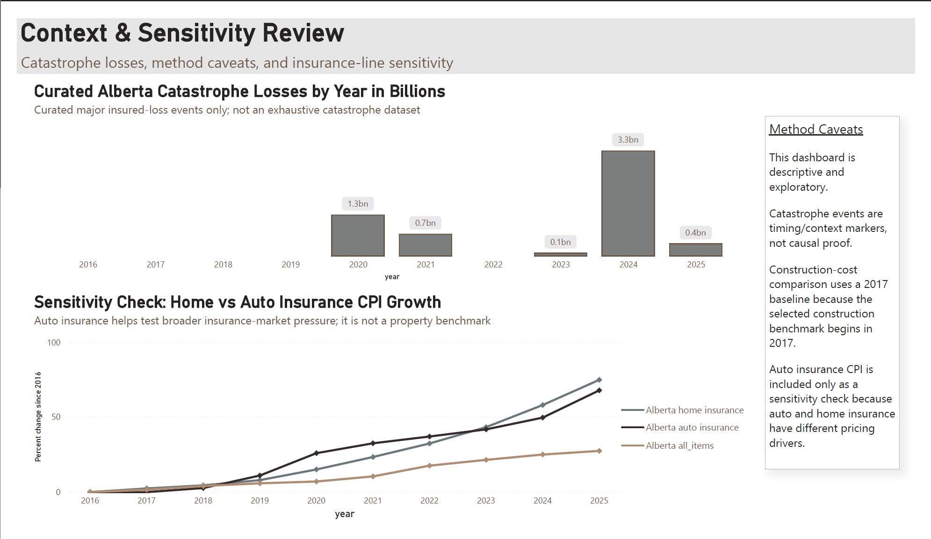
Dashboard (Pg.2) | Context & Sensitivity
Catastrophe losses cluster more heavily in later years.
Auto insurance CPI sensitivity suggests some broader insurance-market pressure.
Home insurance still exceeded auto insurance growth by 2025.
Context supports review, but does not prove causality.

Slide 7
Dashboard (Pg.2) | Limitations
Descriptive and exploratory analysis
Catastrophe events are contextual markers, not causal proof
Construction-cost benchmark uses a 2017 baseline
CPI data are aggregated and do not show individual policy-level premiums
Auto insurance CPI is a sensitivity check, not a property benchmark
Limitations define the valid use case: this dashboard supports review and follow-up investigation, not causal attribution.

Slide 8
Closing Message
Recommendation
Future Work
Use benchmark divergence as a monitoring signal for affordability, market, and catastrophe-risk review.
Compare Alberta against other provinces
Add more complete catastrophe-event data
Investigate property-specific drivers such as claims severity, reinsurance, deductibles, and regional risk territories
Explore GIS or regional exposure analysis as a separate project
The project identifies when Alberta home insurance CPI diverges from relevant benchmarks and helps stakeholders decide where deeper review is warranted

