Slide 1
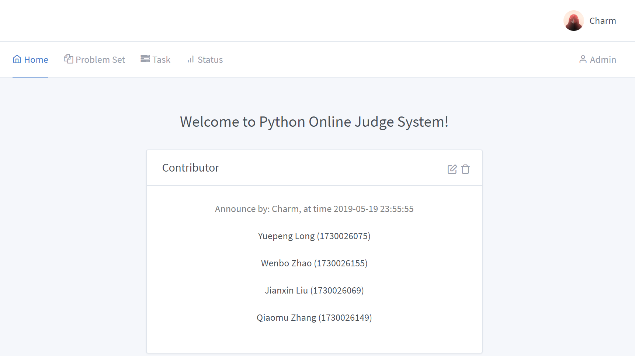


Slide 2
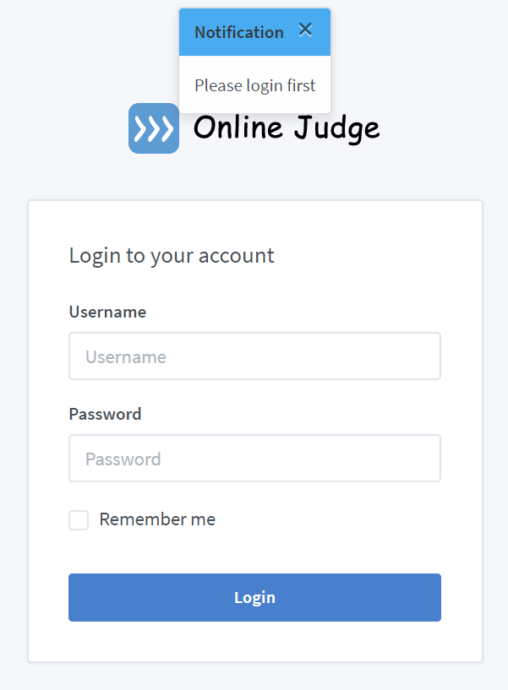
Pop-up hints
Surface Introduction
Login information

Slide 3
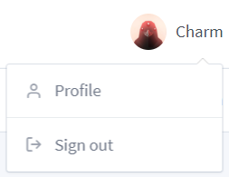

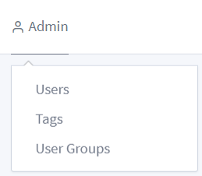
Change profile
Surface Introduction
Log out
(Only administers have)
Home page
Problem set page
Task list
Submission list
Admin users
Add/delete tags
Admin user groups

Slide 4
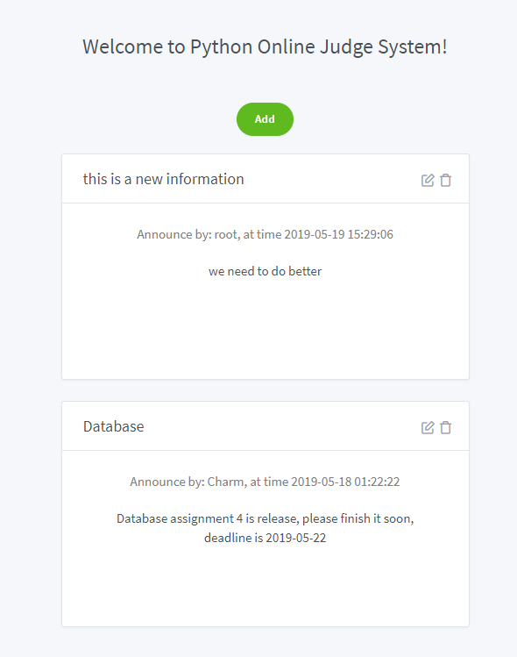


Add announcement
Function
Manage announcement
Delete announcement

Slide 5
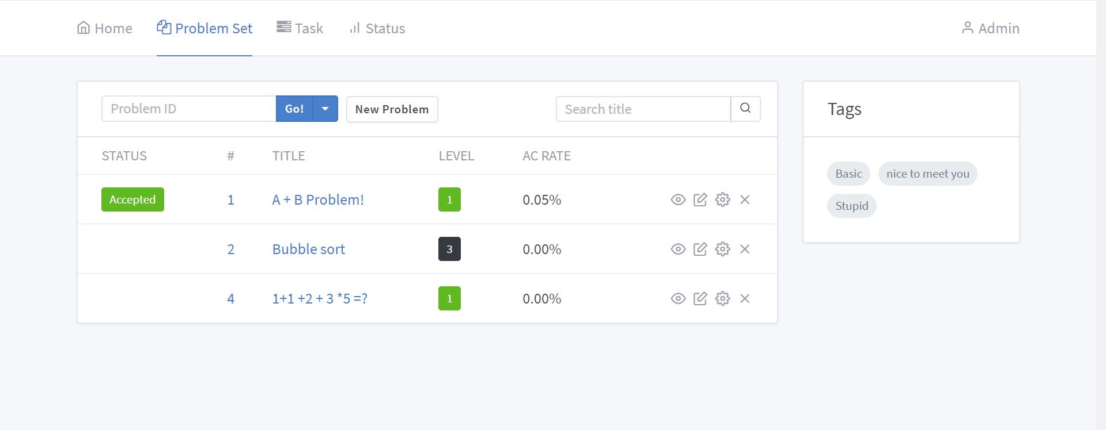
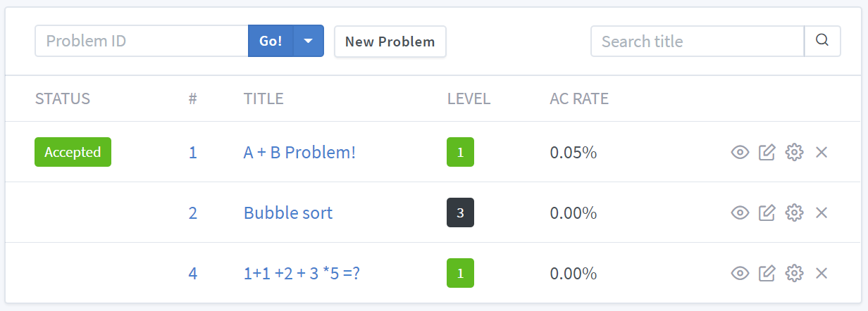
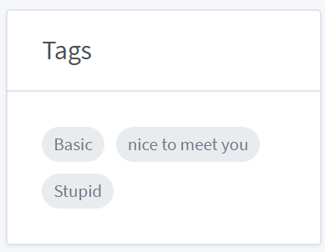
Function

Slide 6
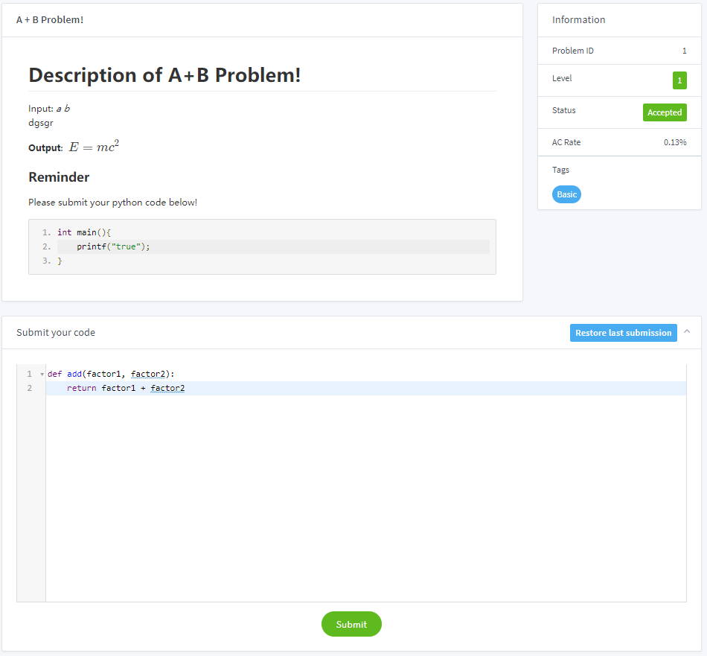
Description of problem
Information of the problem
Where users write their code

Slide 7

Function
Add new problem
Search problem by id/title/tags
Function
(Only administers have)
Hide/show
Manage the problem (title and description)
Delete problem
Manage tests code of problem

Slide 8
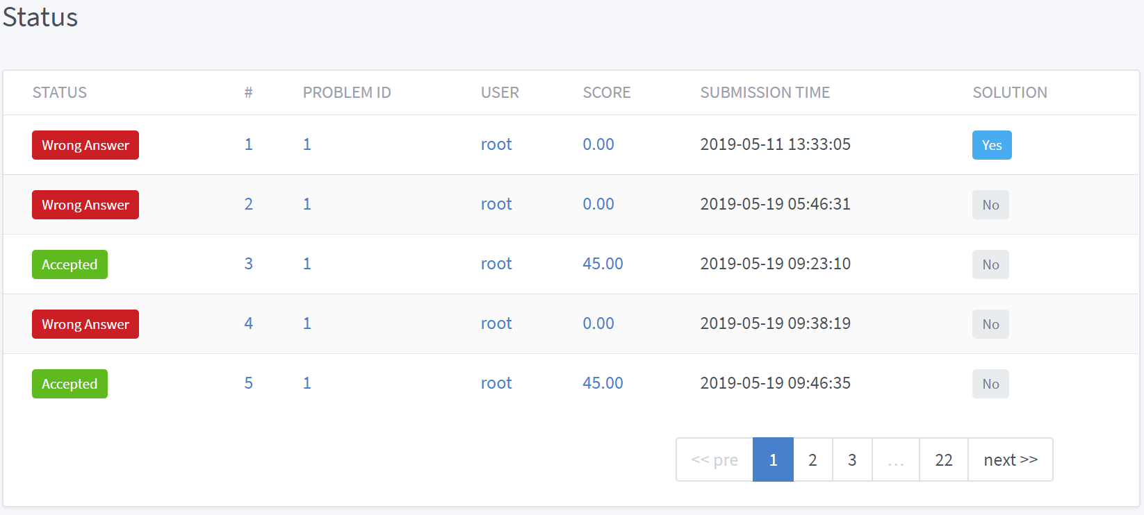

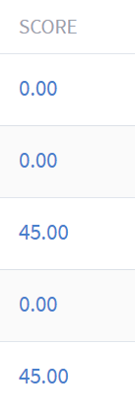


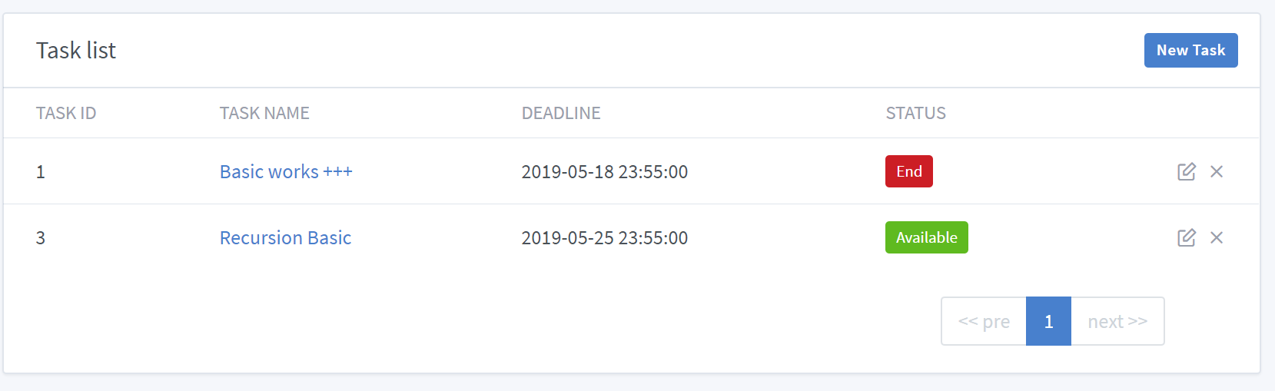


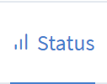
Function
Final score of a submission
Click to the submission/
the problem
Task is a group of problems for a user group
Click to go to
Add a task
Click to change the is_solution state
Manage/delete task

Slide 9
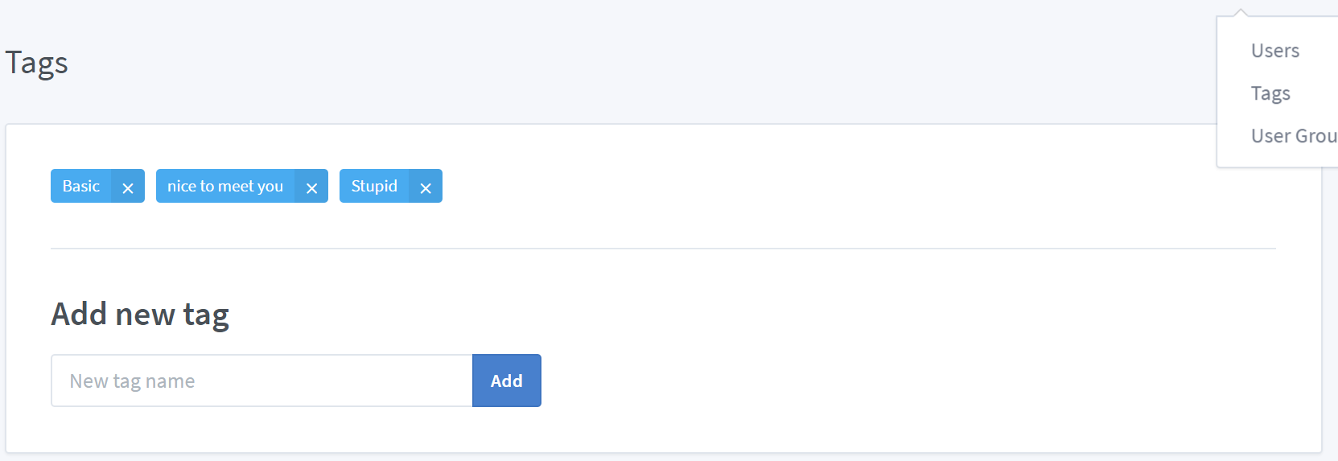
Function
Click to change tag name
Click to delete tag
Add a tag

Slide 10
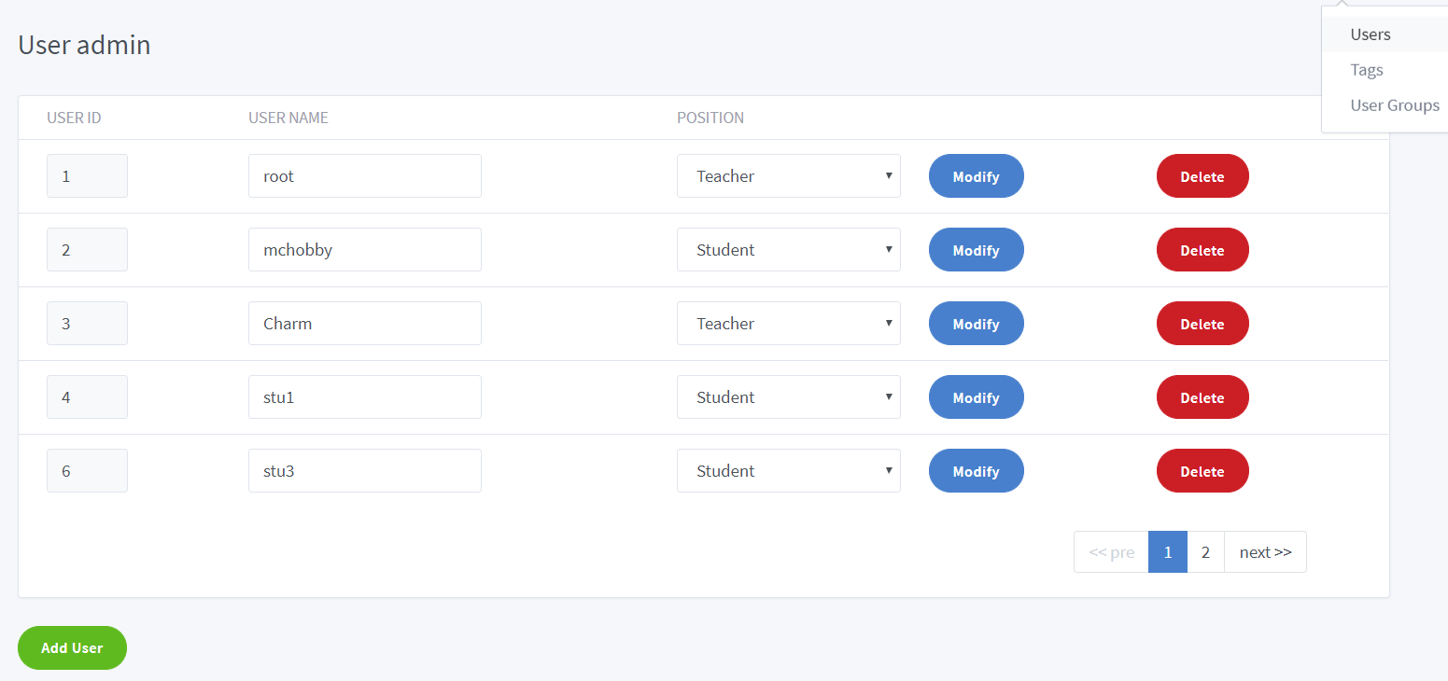
Function
Save the change
Delete user
Add a user

Slide 11
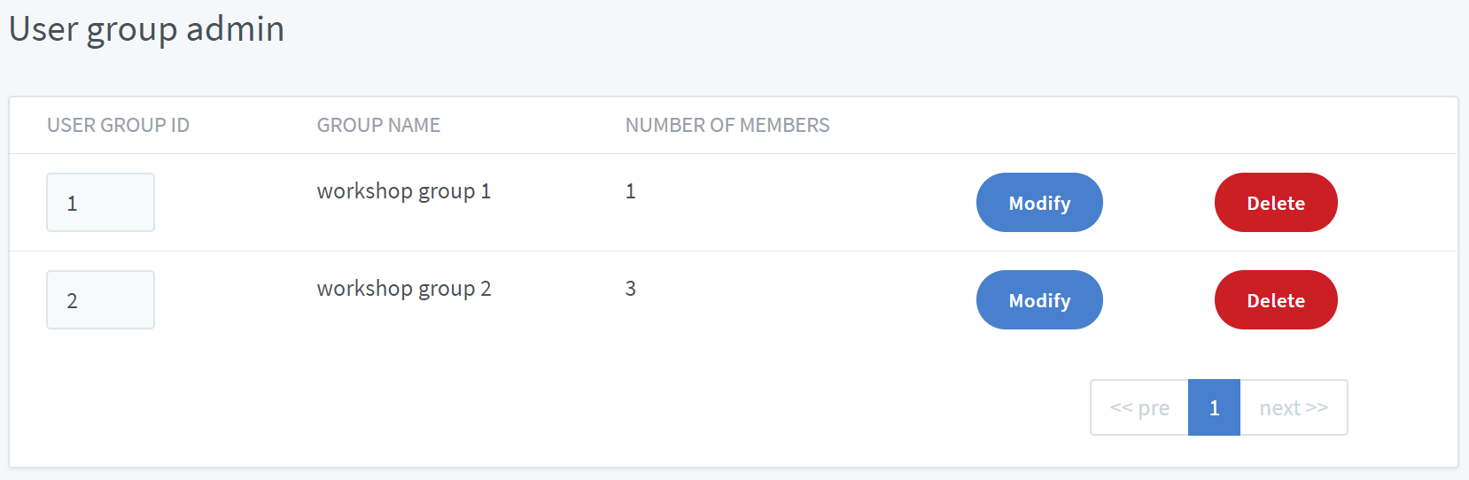
Function
Modify the group in detail
Delete the group

Slide 12
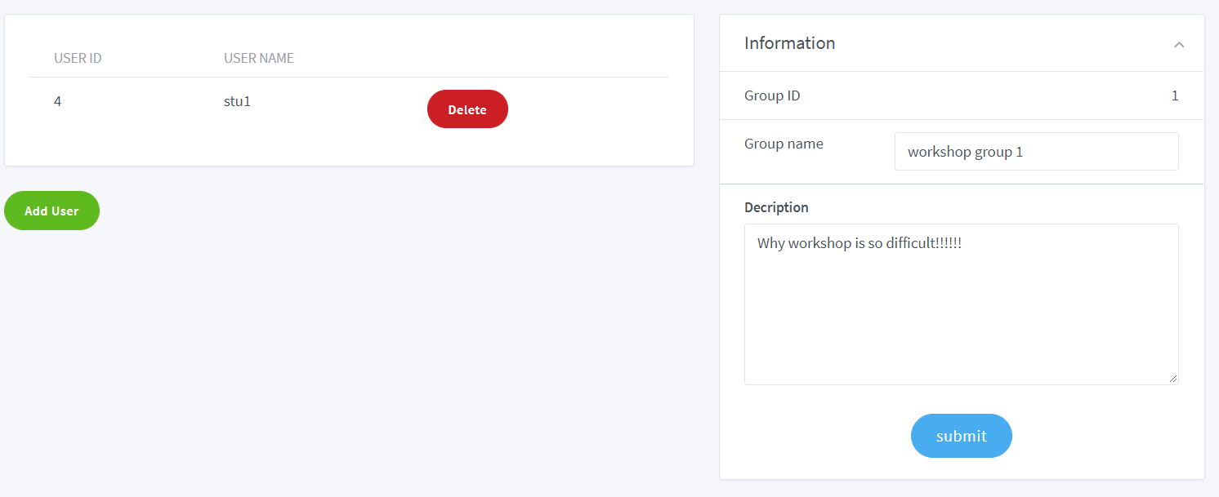
Function
Delete user
Manage information
Add user

Slide 13
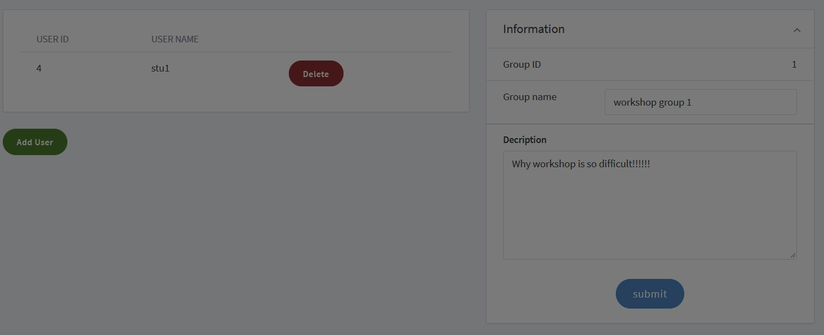
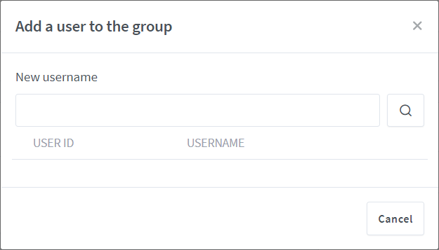
Function

Slide 14
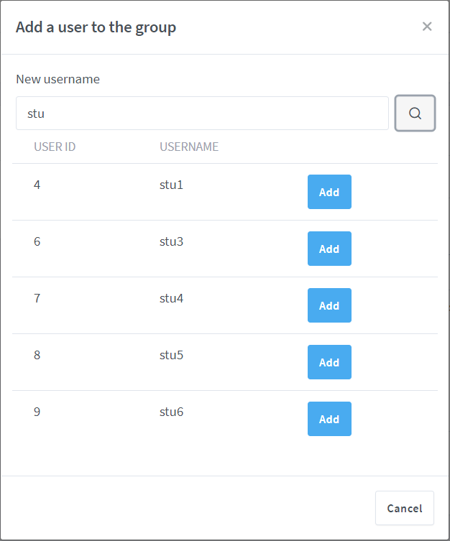
Function

Slide 15
Function
Almost all the detail managements in the project are similar (such as)
Fuzzy Search

Slide 16
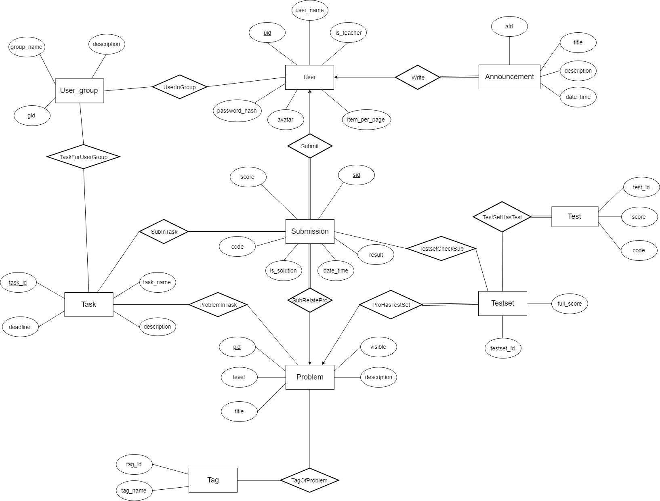
Database design

Slide 18
User (uid, user_name, password_hash, is_teacher, avatar, item_per_page
)
Announcement(aid, uid, title,
description, date_time
)

Slide 19
User (uid, user_name, password_hash, is_teacher, avatar, item_per_page
)
UserInGroup (gid, uid)
UserGroup (gid, group_name, description)
Submission (sid, uid, pid, code, is_solution, date_time, testset_id, result, score
)
TaskForUserGroup (gid, task_id)
Task (task_id, task_name, deadline, description
)

Slide 20
SubInTask (task_id, sid)
Submission (sid, uid, pid, code, is_solution, date_time, testset_id, result, score
)
ProblemInTask (task_id, pid)
Task (task_id, task_name, deadline, description
)
Problem (pid, level, title, description,
testset_id, visible
)
Tag (tag_id, tag_name)
TagOfProblem (tag_id, pid)

Slide 21
TestsetHasTest (testset_id, test_id)
Submission (sid, uid, pid, code, is_solution, date_time, testset_id, result, score
)
Test (test_id, score, code)
Testset (testset_id, full_score)
Problem (pid, level, title, description,
testset_id, visible
)

Slide 22
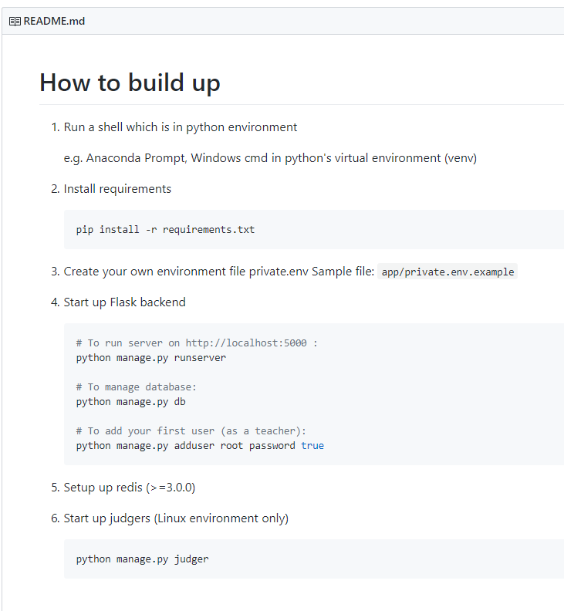
Realization
Easy to set up!

Slide 23
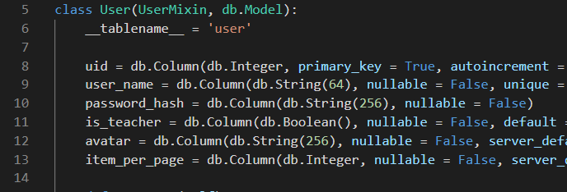
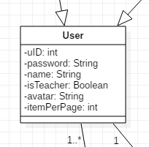

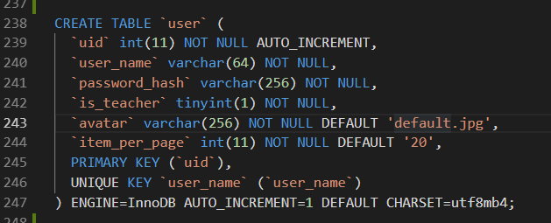
ORM
(Object Relational Mapper)

Slide 24
“Find 5 problems with the lowest scores that a user has passed”
SELECT problem.pid, problem.testset_id, problem.level, problem.title, problem.description, problem.visible
FROM problem INNER JOIN submission ON problem.pid = submission.pid INNER JOIN testset ON submission.testset_id = testset.testset_id
WHERE submission.score = submission.full_score AND submission.uid = current_user.uid
GROUP BY problem.pid
ORDER BY submission.full_score ASC
LIMIT 5
ORM
(Object Relational Mapper)
Problem.query.join(Problem.submissions)
.filter(Submission.score == Submission.full_score)
.filter_by(uid = current_user.uid)
.order_by(Submission.full_score).limit(5).all()

Slide 25
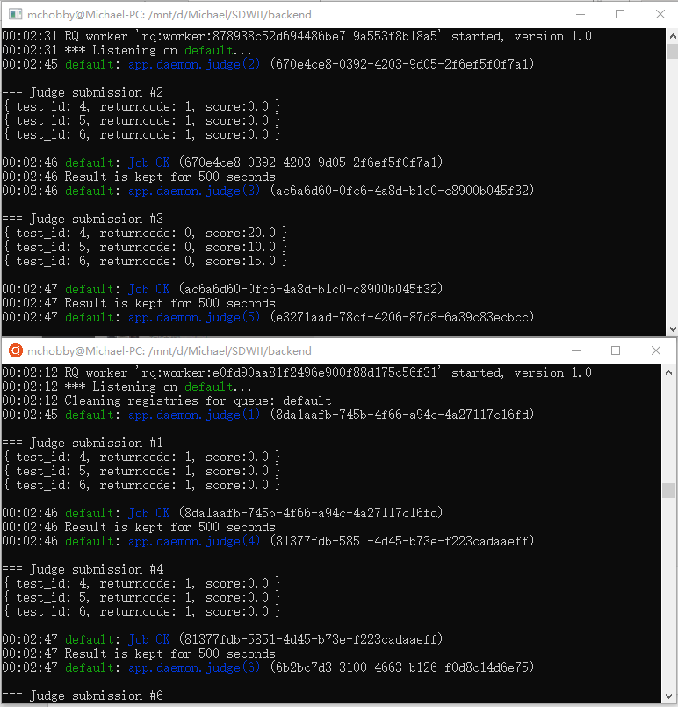


Multi-threaded asynchronous judger
Redis
(In-memory key-value database)
Flask-RQ2 (Redis Queue)
(This plugin limits judger on Windows)

