Slide 1
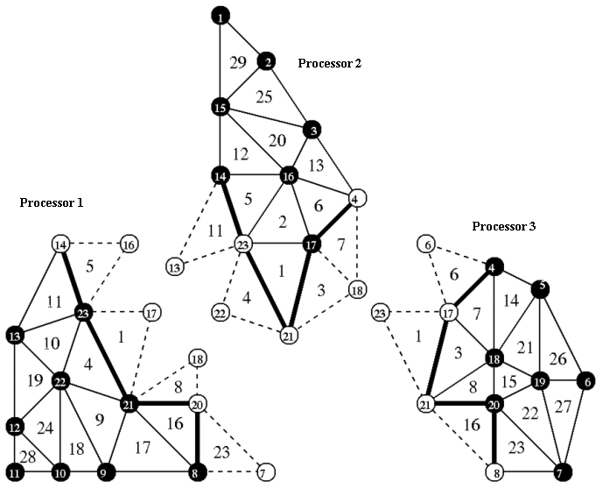
Mesh

Slide 2
Mesh

Slide 5
Mesh with vertices (ungrouped)
1
2
15
3
14
16
4
5
23
17
13
18
22
19
6
21
20
12
11
10
9
8
7

Slide 6
Mesh with cells & vertices (ungrouped)
1
29
2
25
15
20
3
12
13
14
16
5
6
4
11
2
14
5
23
17
7
13
10
1
21
4
3
18
26
19
22
8
15
19
6
21
20
22
27
12
24
9
16
28
18
17
23
11
10
9
8
7
23

Slide 7
Mesh with vertices (grouped)
1
2
15
3
14
16
4
5
23
17
13
18
22
19
6
21
20
12
11
10
9
8
7

Slide 8
Mesh with cells & vertices (ungrouped)
1
29
2
25
15
20
3
12
13
14
16
5
6
4
11
2
14
5
23
17
7
13
10
1
21
4
3
18
26
19
22
8
15
19
6
21
20
22
27
12
24
9
16
28
18
17
23
11
10
9
8
7
23

Slide 9
flecsi/execution/context.h
flecsi::initialize
process registered tasks
execute runtime driver
flecsi/execution/runtime_driver.h
process registered data clients
process registered fields
execute specialization top-level-task
execute SPMD task
flecsi/execution/runtime_driver.h
execute specialization SPMD task
execute driver

Slide 10
Application
FleCSI Specialization
FleCSI Core
Runtime
Data Structures

