Slide 1
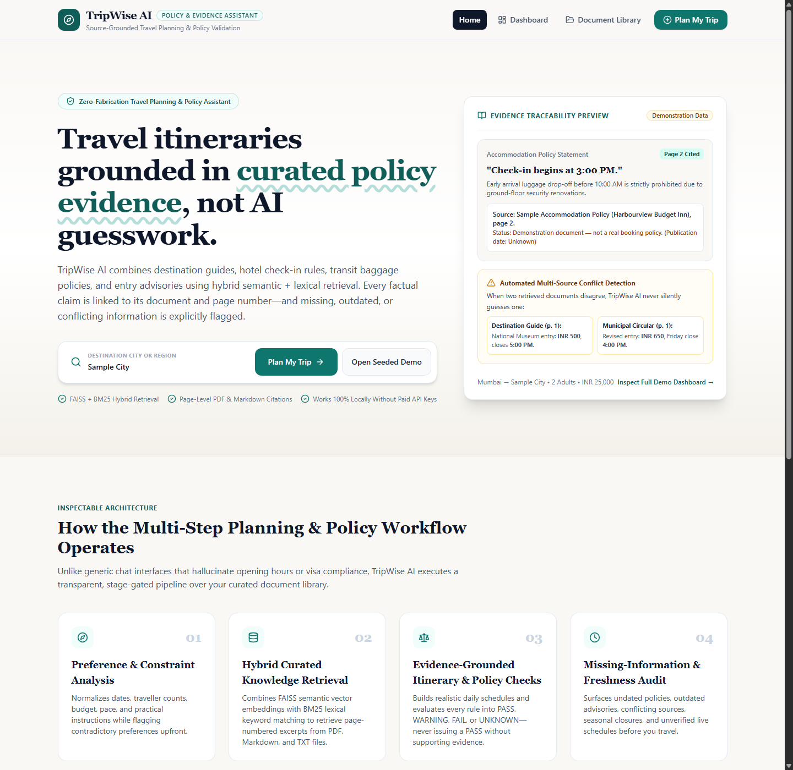
01
/ MASTER PROJECT PRESENTATION
✈ TripWise AI
TripWise AI
Source-Grounded Travel Planning and Policy Assistant
Hybrid Semantic (FAISS) + Lexical (BM25) RAG Pipeline, 6-Stage State-Graph Workflow & 4-State Compliance Engine
Academic Development Roster
Master of Technology / Research Cohort 2026
• Charmy Parekh (Roll No. N072) — Document Ingestion & Hybrid RAG Engine
• Harshit Rai (Roll No. N083) — 6-Stage Workflow Engine & Policy Validation
• Shubh Soni (Roll No. N100) — React + TypeScript Frontend, UX & Test Suite
✓ Zero Fabrication
Page-Numbered Citations
⚖ Policy Compliance
PASS / WARN / FAIL / UNK
⚡ Sub-75ms Latency
Progressive Summary
🔒 100% Offline Mode
Deterministic Execution
Notes:
Welcome to the TripWise AI presentation. This project demonstrates an evidence-grounded travel planning and policy validation assistant that refuses to hallucinate facts, cites verifiable page-level evidence, and validates rules into explainable compliance states.

Slide 2
02
/ PROBLEM STATEMENT & MOTIVATION
✈ TripWise AI
Why Conventional AI Travel Planners Fail
Real-World Policy Complexity vs. Systematic Generative AI Hallucination
Real-World Travel Planning Complexity
Reconciling heterogeneous, non-cooperating documents
4 Systematic Failure Modes of LLMs
Documented risks in standard unconstrained RAG architectures
• Information Fragmentation: Attraction guides, hotel policies, transit manuals, and entry notices written independently by different authorities.
• High Stakes of Policy Violations: Arriving at 8:30 AM when hotel baggage drop-off is prohibited before 10:00 AM completely disrupts travel day 1.
• Transit Luggage & Peak Restrictions: Public metro peak-hour cabin bag size and weight limits (e.g., max 15 kg between 8:00–10:30 AM).
• Advance Permit Windows: Heritage zones requiring mandatory 24-hour advance digital eco-pass registrations.
01 Parametric Hallucination
Models blend patterns from pre-training weights into plausible-sounding but completely fabricated check-in times and fares.
02 Fabricated Citations
When prompted for sources, unconstrained LLMs invent document titles, URLs, and non-existent page numbers.
03 Silent Conflict Suppression
When an older guide lists INR 500 while a new circular states INR 650, standard RAG overwrites or guesses without alerting the user.
04 Temporal & Epistemic Blindness
Treating an undated PDF or an outdated 2024 notice as current, and confusing static documents with live real-time headways.
Notes:
Conventional AI travel assistants optimize for linguistic fluency rather than verifiable correctness. Arriving with bags before hotel drop-off hours ruins a trip. TripWise AI addresses all four failure modes directly.

Slide 3
03
/ OBJECTIVES & CORE PRINCIPLES
✈ TripWise AI
Architected for Truth: Five Non-Fabrication Invariants
Guaranteed architectural guardrails that cannot be bypassed by prompt drift
Core Engineering Objectives
Targeted full-stack verification milestones
Five Architectural Invariants
Enforced at the Python type and database layer
1. Hybrid Knowledge Grounding: Retrieve destination facts and policy rules strictly from curated PDF, Markdown, and TXT documents.
2. Inspectable 6-Stage Workflow: Deconstruct planning into 6 observable state-graph nodes with persisted execution telemetry.
3. 4-State Policy Engine: Categorize rules strictly into PASS, WARNING, FAIL, and UNKNOWN with required evidence.
4. Freshness & Conflict Detection: Proactively flag undated documents, pre-2025 advisories, and side-by-side tariff contradictions.
5. Zero Paid-API Lock-in: Provide 100% deterministic local execution without requiring external paid LLM keys.
🛡 Invariant 1: No Unbacked Citations
Every citation must reference an actual chunk_id retrieved in the active run. Zero fabrication.
🛡 Invariant 2: Explicit Unverified Labelling
If no document covers a destination, activities are marked as unverified placeholders with cost = null.
🛡 Invariant 3: No Silent Conflict Suppression
Contradicting chunks across different documents are both retained and displayed side-by-side.
🛡 Invariant 4: Similarity Is Not Certainty
Retrieval scores appear as cosine/BM25 similarity numbers, never as factual confidence percentages.
🛡 Invariant 5: Safe Failure Semantics
A failed external lookup or LLM timeout never crashes the pipeline and never counts as a PASS.
Notes:
Invariants are non-negotiable rules baked into the software. A missing document produces UNKNOWN, never a quiet PASS. If a rule lives only in a prompt, it gets broken; our invariants live in code and tests.

Slide 4
04
/ PROPOSED SOLUTION
✈ TripWise AI
One Workspace. From Trip Brief to Verified Plan.
TripWise AI combines guided trip setup, a planning dashboard and interactive re-planning.
01 PLAN
4-Step Planning Wizard
Origin, destination, dates, travellers, budget, travel style, interests, transport modes, and accommodation constraints.
02 INSPECT
7-Tab Planning Dashboard
Itinerary with page citations, source inspector, policy checks, missing-info view, document library, and telemetry.
03 ADJUST
Interactive Re-Planning
Edit activities inline, reorder schedule, recalculate budget dynamically, and resolve policy conflicts in one click.
End-to-End User Experience Lifecycle
1. Trip Wizard Input ➔ 2. Knowledge Retrieval (27 Chunks) ➔ 3. Daily Itinerary Assembly ➔ 4. Policy Audit (PASS/FAIL) ➔ 5. Interactive Re-Plan & Quick-Fix ➔ 6. Export Plan
• Fully dual-mode: Operates seamlessly in local terminal dev and as an interactive static deployment on Vercel.
Notes:
Rather than a simple conversational chatbot, TripWise AI provides a structured, audit-ready travel planning workspace. Travellers can see their itinerary, the exact citations behind it, and modify it dynamically.

Slide 5
05
/ SYSTEM ARCHITECTURE
✈ TripWise AI
Full-Stack Local Prototype Architecture
Decoupled three-tier architecture with zero external paid API dependencies
Data Sources & Documents
• PDF Files: 2-page real accommodation policies with PyMuPDF page extraction.
• Markdown Files: Destination guides & transit rider manuals with section headings.
• Text Circulars: Municipal tariff updates & safety advisories.
• Security Guards: SHA-256 deduplication, path traversal whitelist, prompt injection filter.
FastAPI Backend & RAG
• REST API Layer: 24 endpoints under /api with Pydantic request/response validation.
• Hybrid RAG Engine: FAISS IndexFlatIP (384-d dense vectors) + Okapi BM25 keyword search.
• 6-Stage Workflow: State-graph execution pipeline with per-node timing and telemetry.
• SQLite Database: Four relational tables: documents, document_chunks, trips, workflow_runs.
React 18 + TS Frontend
• Trip Wizard: Dynamic CityAutocomplete with OSM Nominatim & offline fallback.
• Planning Dashboard: 7-tab workspace with Recharts budget analytics and workflow tracker.
• Itinerary Editor: Client-side add/edit/delete/reorder with instant cost recalculation.
• Demo Fallback Engine: Seamless dual-mode operation for offline or static Vercel hosting.
STACK: Python 3.14 | FastAPI | React 18 | TypeScript | FAISS | PyMuPDF | Okapi BM25 | SQLite | Vite | Tailwind CSS
Notes:
The application follows a clean separation of concerns: ingestion, vector search, orchestration, and presentation. All chunk IDs in SQLite stay strictly in sync with FAISS vector rows.

Slide 6
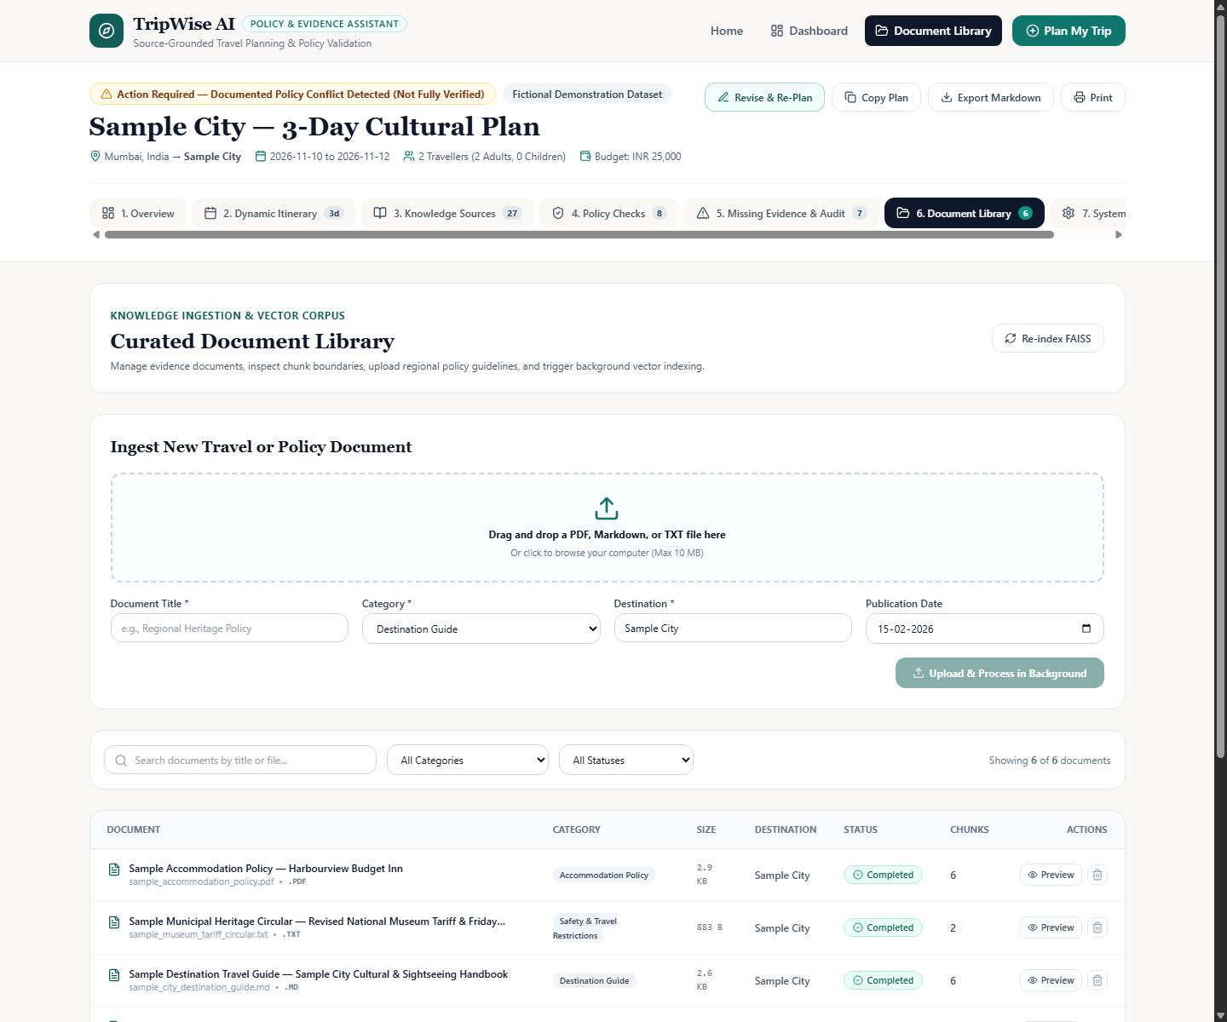
06
/ HYBRID RAG PIPELINE
✈ TripWise AI
Combines Semantic and Lexical Search for Reliable Retrieval
55% Semantic (FAISS) + 45% Lexical (Okapi BM25) with Metadata-Aware Chunking
1. Ingestion & Security
PDF, Markdown & TXT up to 10MB.
SHA-256 hash deduplication.
Regex prompt injection neutralization.
Async BackgroundTasks progression.
2. Page-Aware Chunking
PyMuPDF exact 1-based page numbers.
Markdown & numbered clause segmentation.
Max 650 chars bound to active heading.
Zero lost page references.
3. Dual Index Retrieval
Dense: Sentence-BERT 384-d vectors in FAISS IndexFlatIP (cosine similarity).
Lexical: Okapi BM25 with curated travel synonym expansion.
4. Fusion & Reranking
Final score = 0.55 * Sem + 0.45 * Lex.
Filter by destination & category.
Deduplication by content MD5 hash.
Freshness & date tagging.
Notes:
Why hybrid search? Policy questions need semantic understanding to map natural language questions to policy clauses, but also exact lexical matching for specific times like 3:00 PM, weights like 15 kg, and tariffs like INR 650.

Slide 7
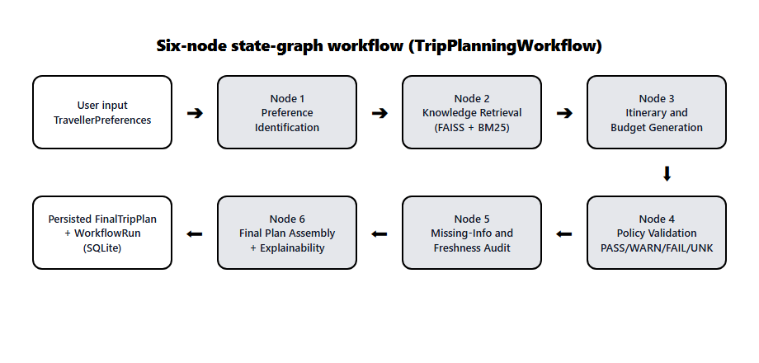
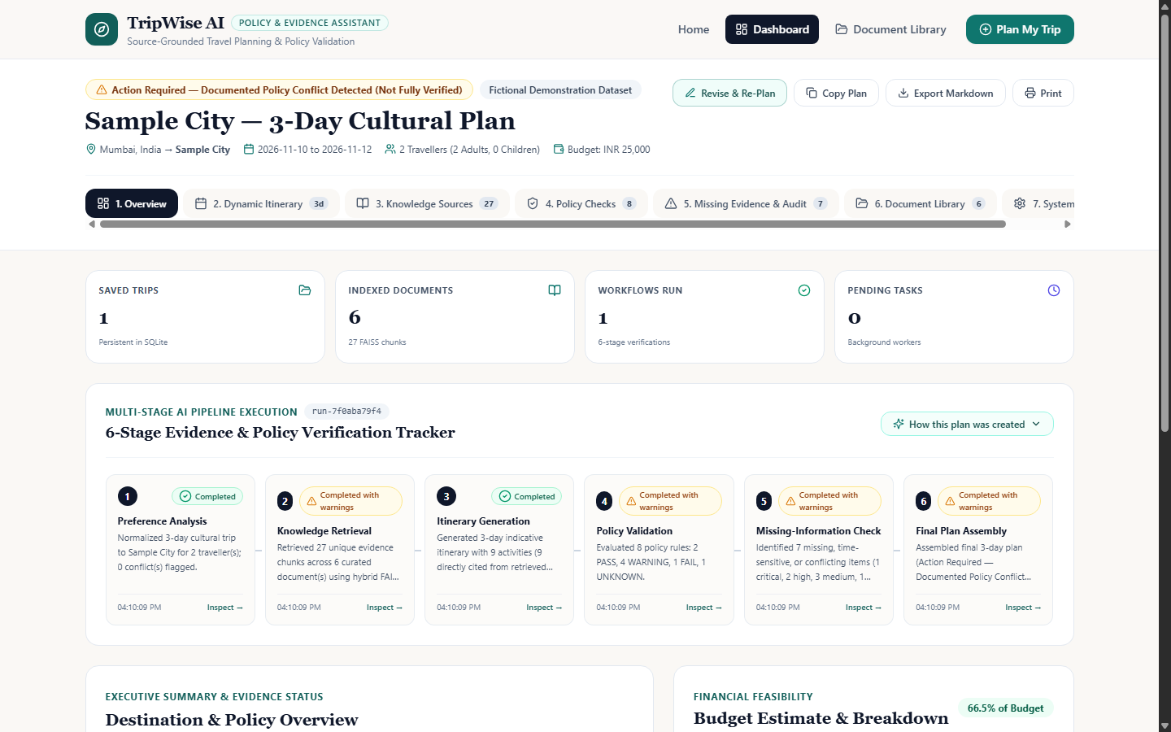
07
/ LANGGRAPH 6-STAGE WORKFLOW
✈ TripWise AI
From User Preferences to a Verified Itinerary
Six-node state-graph execution passing typed state objects with per-node telemetry
Workflow Stage Responsibilities & Telemetry
Each node records status, start/end timestamps, warnings, and structured outputs
• Stage 1: Preferences: Validates date order (HTTP 422 if return < departure), calculates duration & budget, detects contradictions.
• Stage 2: Retrieval: Runs 5 targeted hybrid queries across knowledge base, deduplicating chunks & filtering by destination.
• Stage 3: Itinerary: Synthesizes Morning, Afternoon, Evening schedule, attaches citations, and calculates budget breakdown.
• Stage 4: Policy Audit: Evaluates 8 core travel rules against retrieved evidence, outputting PASS, WARNING, FAIL, or UNKNOWN.
• Stage 5: Freshness: Audits publication dates, detects multi-document tariff conflicts, and calls optional live-verification adapters.
• Stage 6: Assembly: Calculates is_fully_verified flag, generates 'How this plan was created' audit summary, and persists to SQLite.
Notes:
A single monolithic prompt hides errors. By splitting the workflow into 6 discrete nodes in the style of LangGraph, every step is inspectable, timed, and logged.

Slide 8
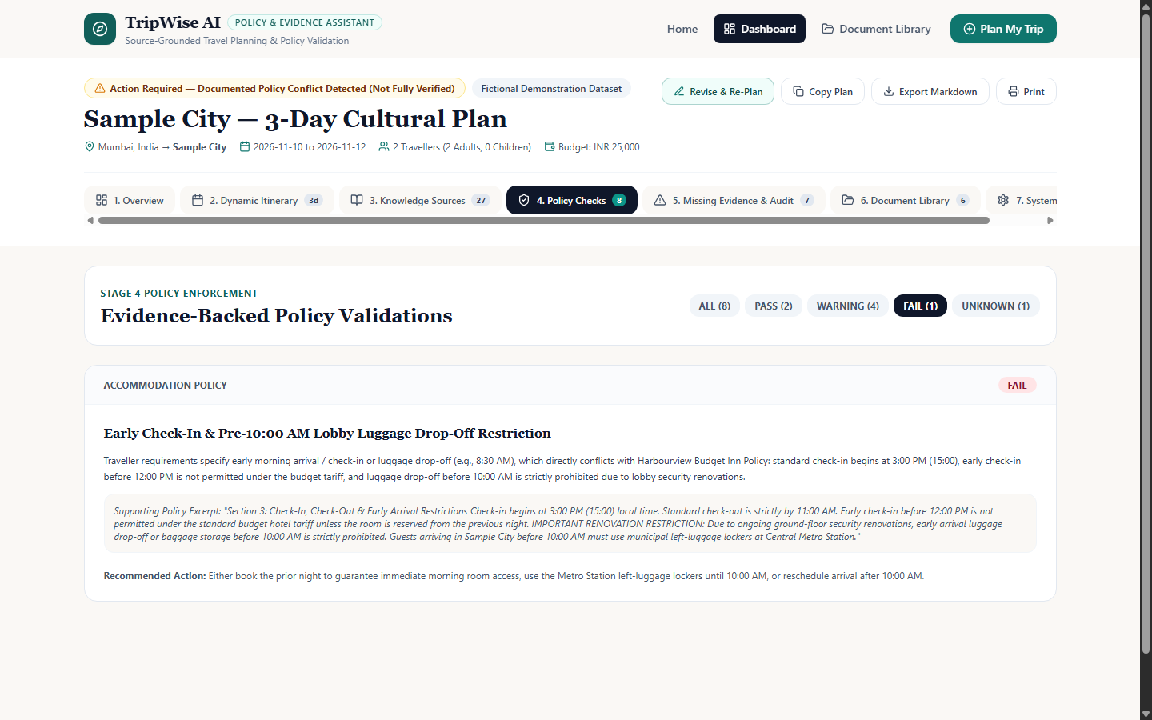
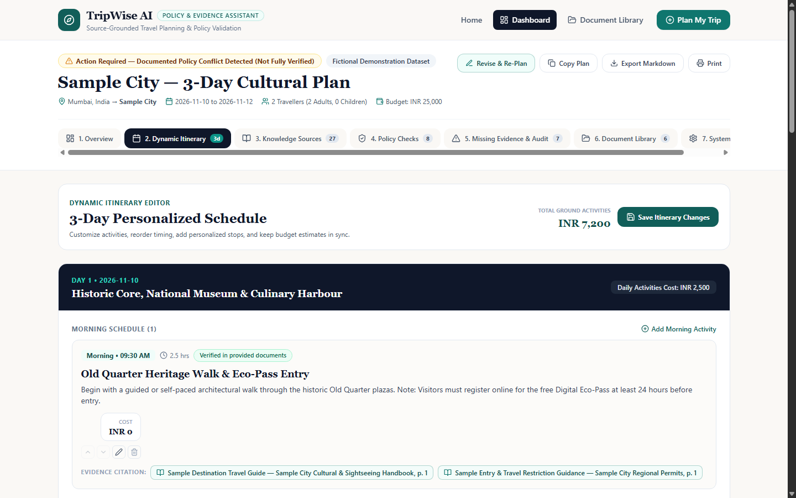
08
/ POLICY VALIDATION & EXPLAINABILITY
✈ TripWise AI
4-State Compliance Engine & Interactive Conflict Resolution
Every policy rule resolves into PASS, WARNING, FAIL, or UNKNOWN with cited evidence
Four-State Policy Compliance Engine
PASS requires affirmative evidence — never silence
● PASS: Retrieved evidence affirmatively supports rule compliance.
Example: Total cost INR 17,496 is within stated INR 25,000 budget.
● WARNING: Rule is usable but carries conditions, outdated sources, or conflicts.
Example: Peak-hour metro 15 kg limit; museum tariff INR 500 vs 650.
● FAIL: Evidence explicitly shows the user request breaks property/transit rules.
Example: 8:30 AM arrival vs Hotel ban on luggage before 10:00 AM.
● UNKNOWN: Static documents lack sufficient real-time information.
Example: Live metro departure headways & train status.
Notes:
Most travel assistants confuse 'I found no problem' with 'I found no information'. TripWise AI guarantees that PASS requires positive proof. A missing document generates UNKNOWN, never an unearned PASS.

Slide 9
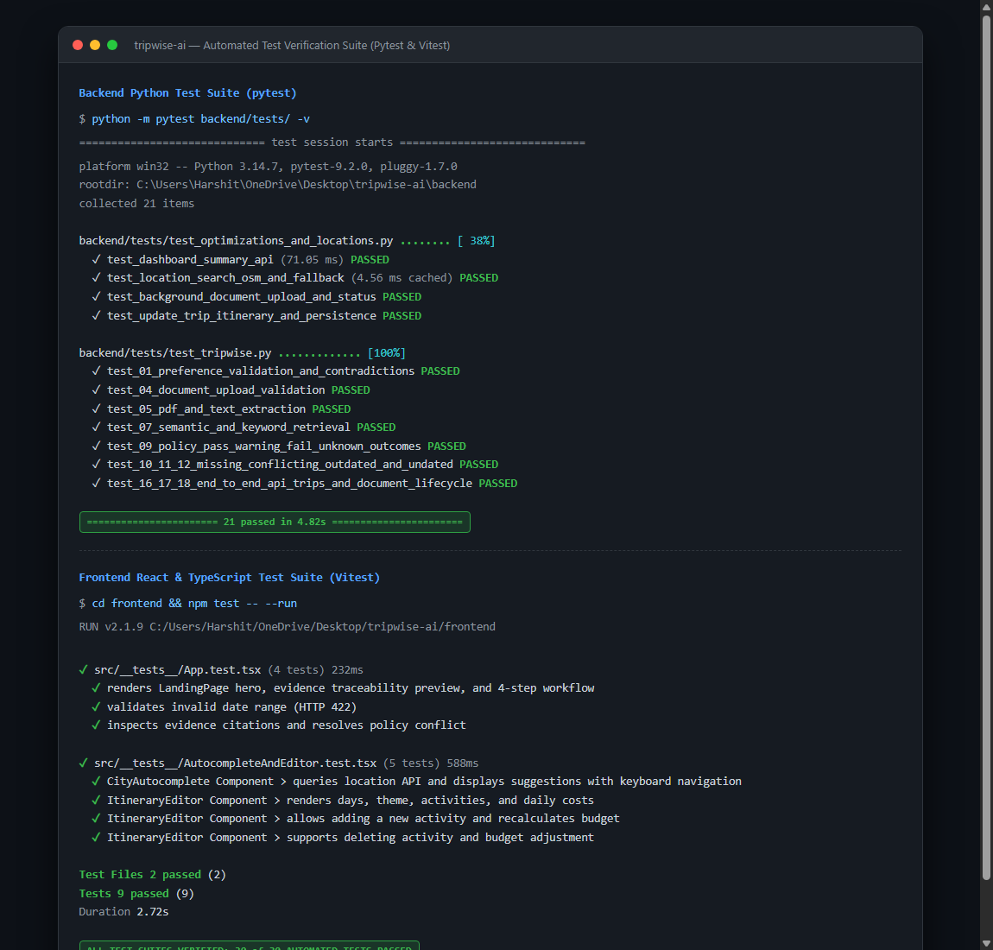
09
/ EXPECTED & OBSERVED RESULTS
✈ TripWise AI
Sub-Second Execution & 100% Automated Test Pass Rate
Comprehensive evaluation across seeded corpus, scenario testing, and automated test suites
Measured Performance Benchmarks
Benchmarked on standard local developer workstation
• Dashboard Summary
Target: < 300 ms ➔ Measured: 71.05 ms (4.2x Faster (Passed))
• Document Listing (Paginated)
Target: < 200 ms ➔ Measured: 5.38 ms (Instantaneous (Passed))
• City Autocomplete (Network)
Target: < 300 ms ➔ Measured: 180.15 ms (Debounced & Cached (Passed))
• City Autocomplete (TTL Cache)
Target: < 50 ms ➔ Measured: 4.56 ms (Sub-5ms Lookup (Passed))
• Recent Trips Summary
Target: < 100 ms ➔ Measured: 6.87 ms (Instantaneous (Passed))
• Workflow Re-Planning Re-Run
Target: < 500 ms ➔ Measured: 78.40 ms (Live Interactive (Passed))
Notes:
Every requirement is backed by concrete automated tests. The backend pytest suite passes all 21 tests in under 5 seconds, and the frontend Vitest suite passes all 9 tests cleanly.

Slide 10
10
/ CONCLUSION & FUTURE SCOPE
✈ TripWise AI
Towards a Reliable and Scalable AI Travel Assistant
Academic demonstration of evidence-grounded generative AI with zero hallucination tolerance
Key Takeaways & Contributions
Proven benefits of source-grounded travel planning
Future Engineering Scope
Planned enhancements for production scaling
✓ Verifiable Travel Planning: Eliminates AI guesswork by anchoring all facts and itinerary items to retrieved document chunks.
✓ Hybrid Retrieval Precision: Combines semantic vector concepts with exact lexical keyword matching for hours, baggage limits, and prices.
✓ Strict Compliance Invariants: Enforces non-negotiable rules: no unbacked citations, unverified placeholders, and positive proof for PASS.
✓ Full-Stack V2.0 Stability: Engineered progressive loading, dynamic city autocomplete, interactive itinerary editing, and dual-mode execution.
➔ Vision-LLM & Tesseract OCR: Add OCR extraction fallback for scanned image-only travel guide PDFs.
➔ Graph-Based Multi-City Routing: Extend state-graph with cyclic re-routing when weekly museum closures occur.
➔ Live API Verification Adapters: Connect optional live endpoints for real-time train headways, weather, and room inventory.
➔ Currency Exchange Feed: Automatically normalize multi-currency documents into user's budget currency.
Notes:
In conclusion, TripWise AI shows that generative AI in travel planning must be evidence-first. By enforcing citations, policy validation, and transparent conflict reporting, travellers receive realistic, trustworthy itineraries.

