Slide 1

GROUP 6
MODELLING FOR PANDEMIC PREPAREDNESS AND RESPONSE
MODELLING OF MPOX IN DRC
GROUP MEMBERS
Charlene N. T. Mfangnia | Nabwana, Martin
Solomon Idan | Mouhamadou Djima Baranon

Slide 2
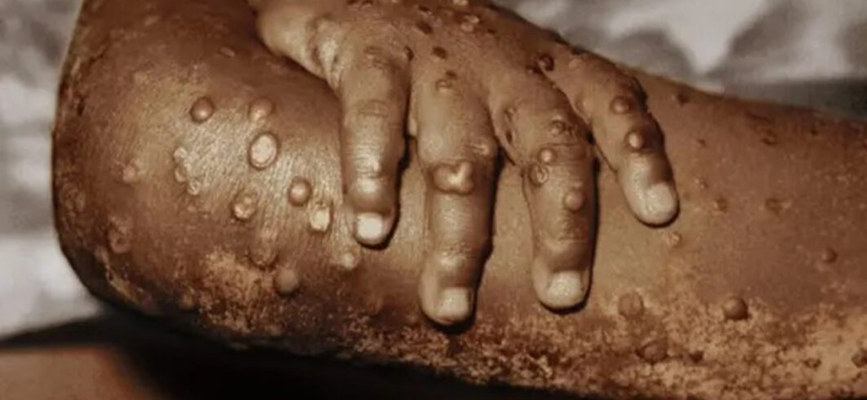
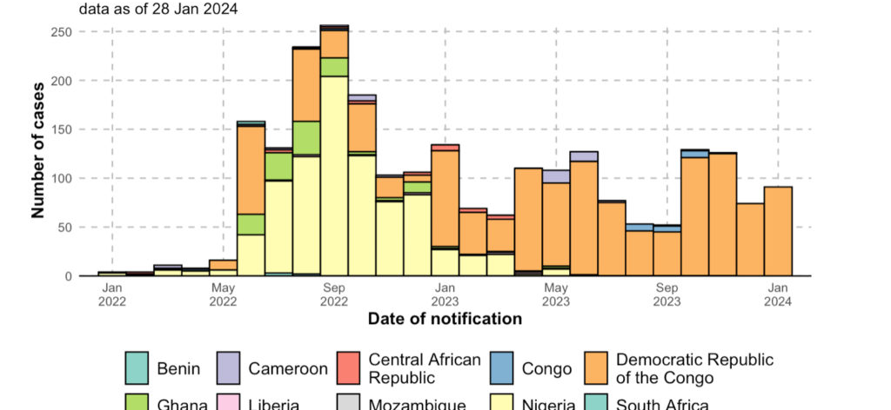
Background
Symptoms
Skin rash or mucosal lesion
Headache
Back pain
Low energy
Lymph nodes

Slide 3
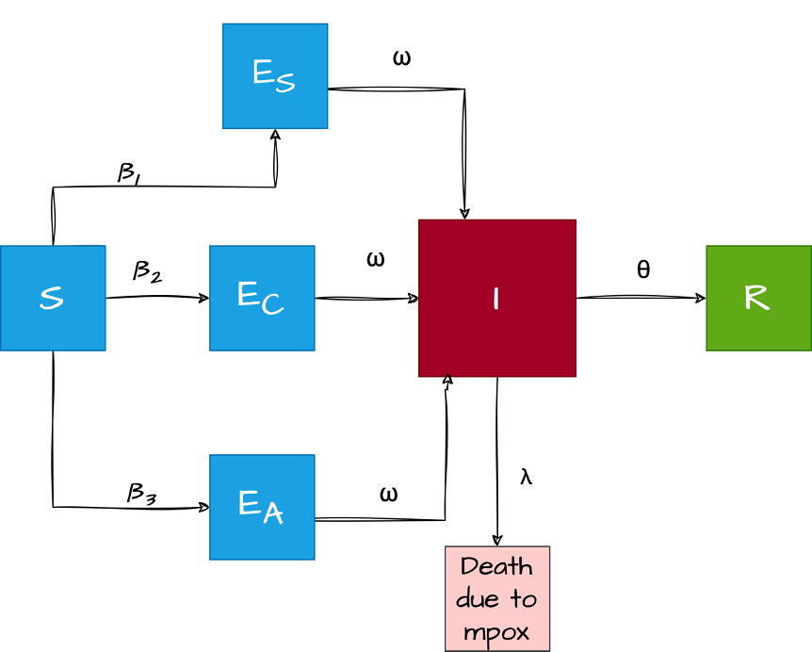
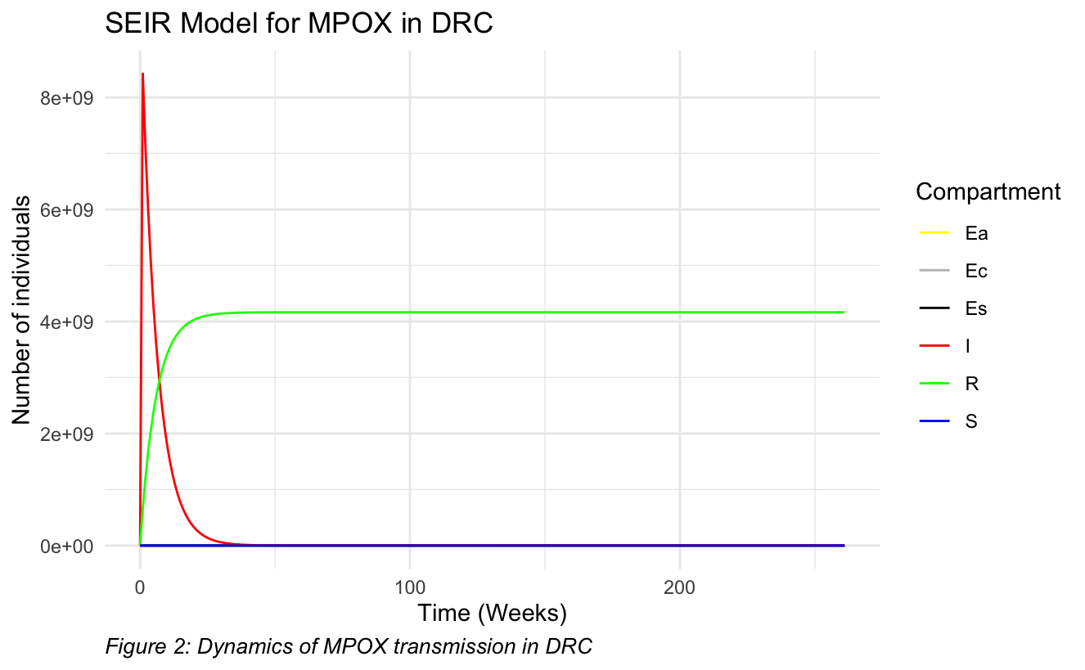
Homogeneous SEIR model for MPOX dynamics

Slide 4
Model with heterogeneous mixing
Distribution into young (< 19) and adults (>19)
Contact between chilren and parent?
Contact between parent and parent
Contact between children and children
Airborne, direct contact and sexual transmission rates
Average sexual contact rates
Incubation period
Mortality rate
λ_{Y}
β_{YC} C_{i.j}
E_{Yc}
ω
S_{Y}
I_{Y}
θ
R_{Y}
β_{YA} C_{i.j}
ω
E_{AC}
E_{AC}
β_{AC} C_{i.j}
ω
S_{A}
β_{AA} C_{i.j}
E_{AA}
ω
I_{A}
θ
R_{A}
β_{AS} C_{i.j}
ω
E_{AS}
λ_{A}

Slide 5
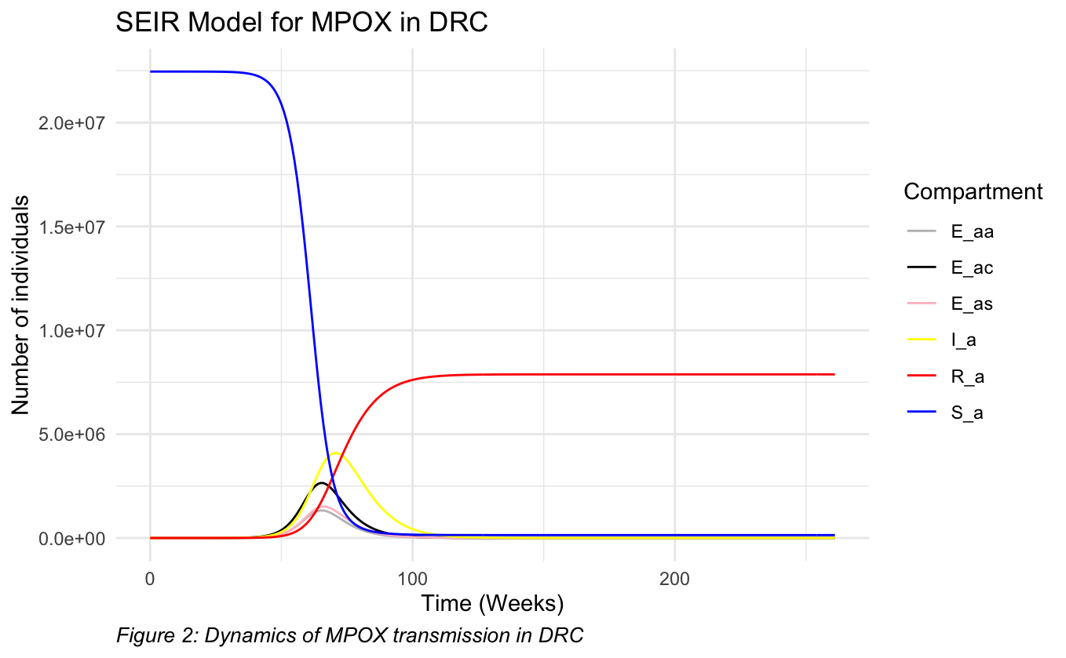
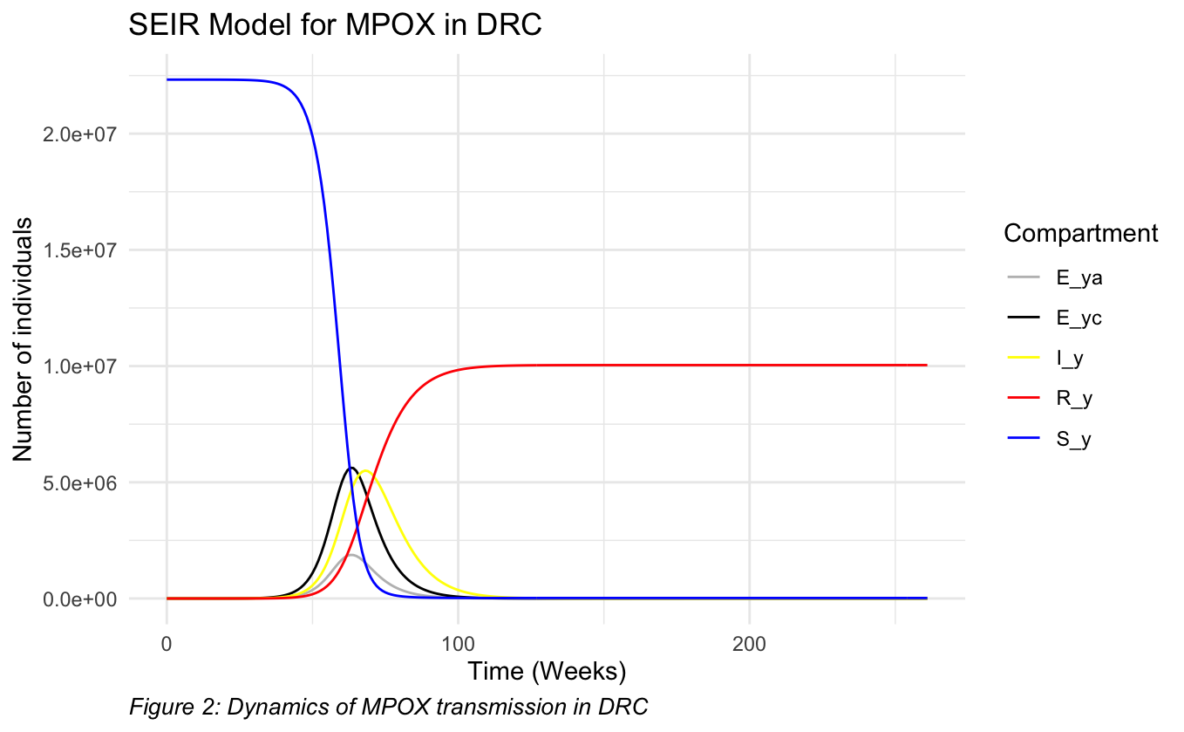
Simulation with heterogeneous mixing

Slide 6
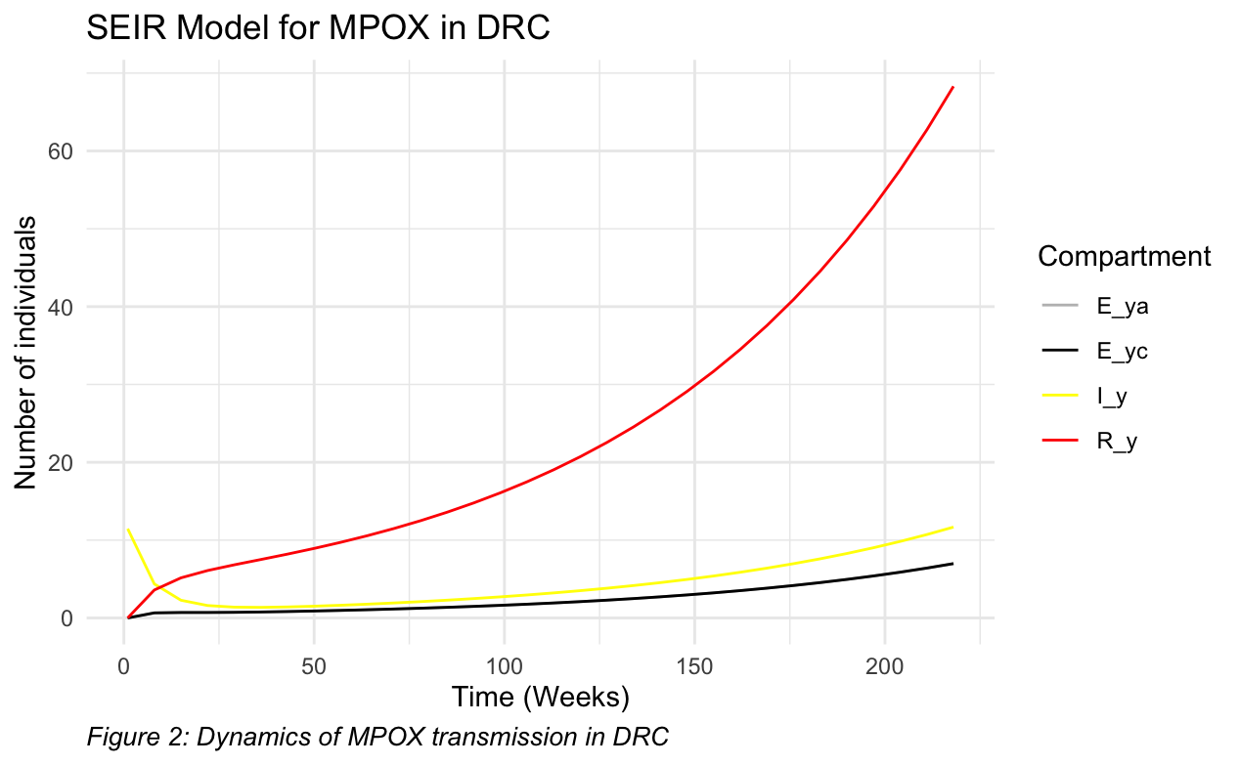
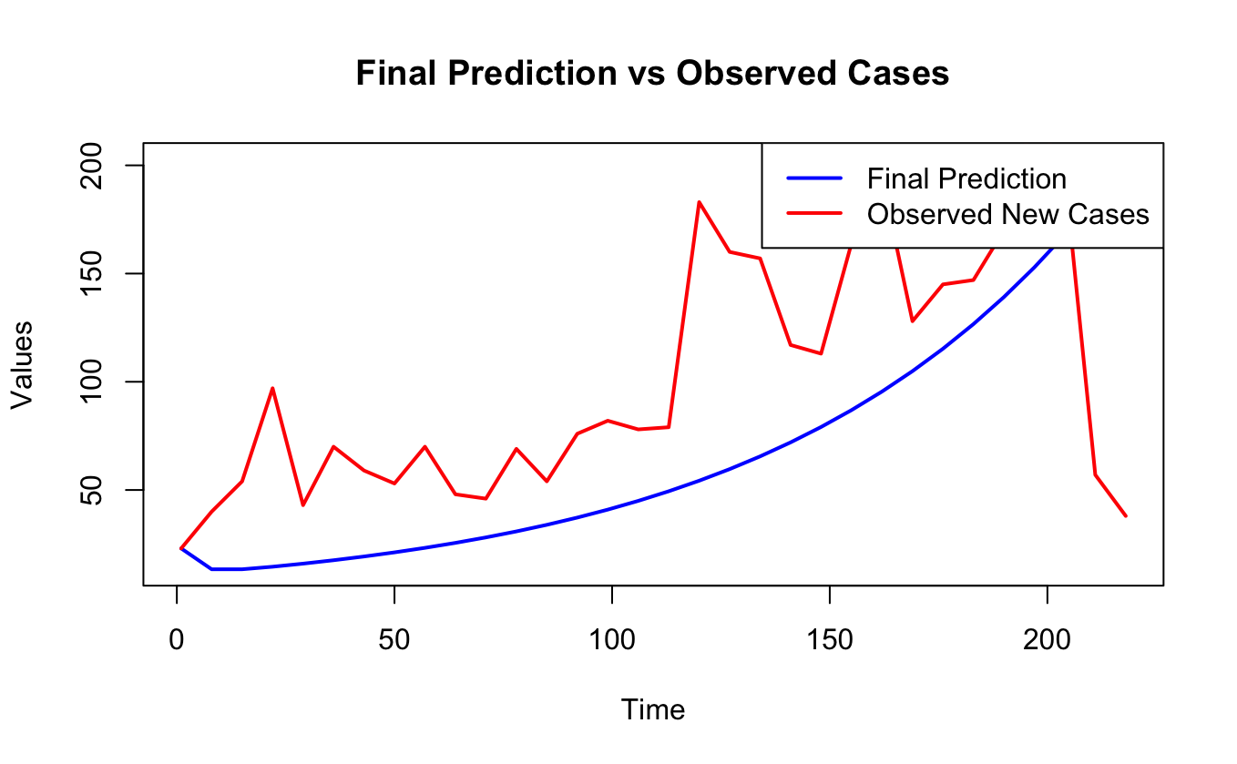
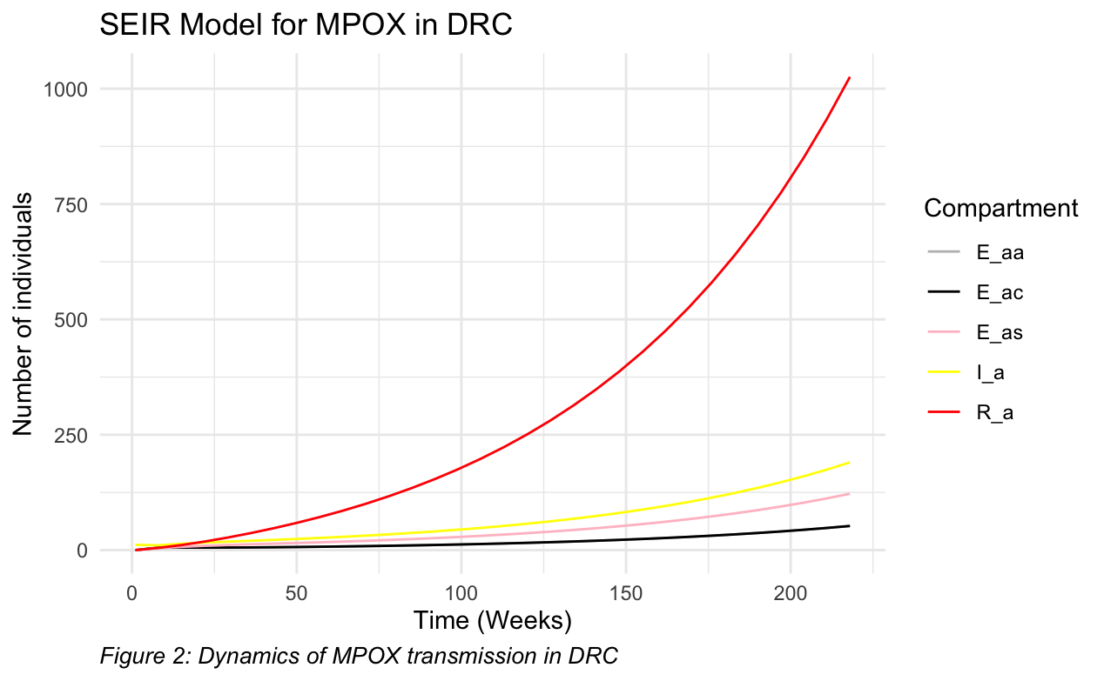
Fitting

Slide 7
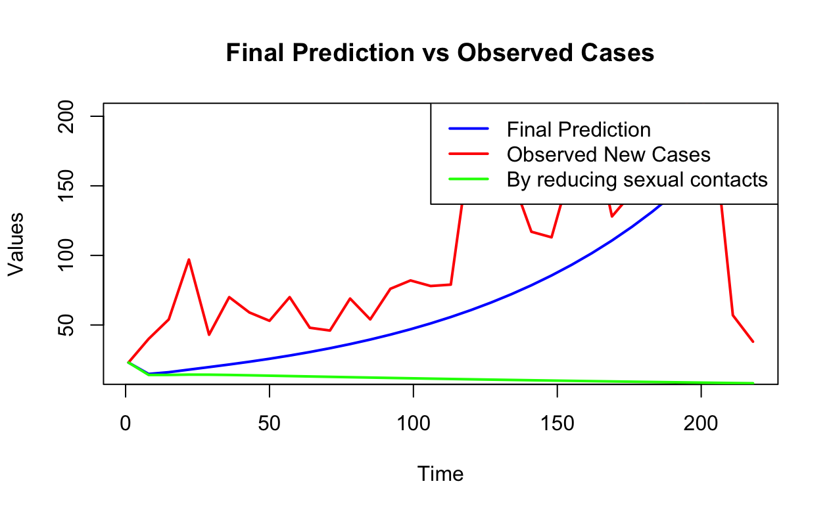
Conclusion
A simple SEIR model is designed, extended and calibrated using incidence data from the DRC
More scenario analysis would allow identifying the optimal strategy for Mpox reduction.

Slide 8
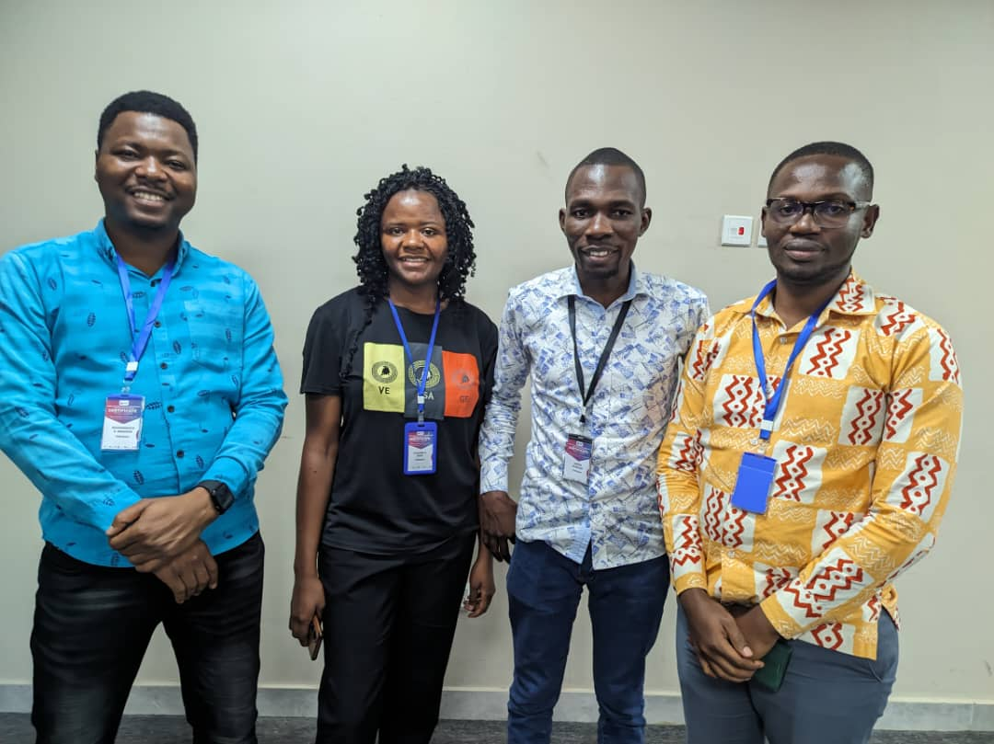
THANK YOU
https://github.com/Charnadata/Group-6.git

