Slide 1
Group 6
Modelling for pandemic preparedness and response

Slide 2
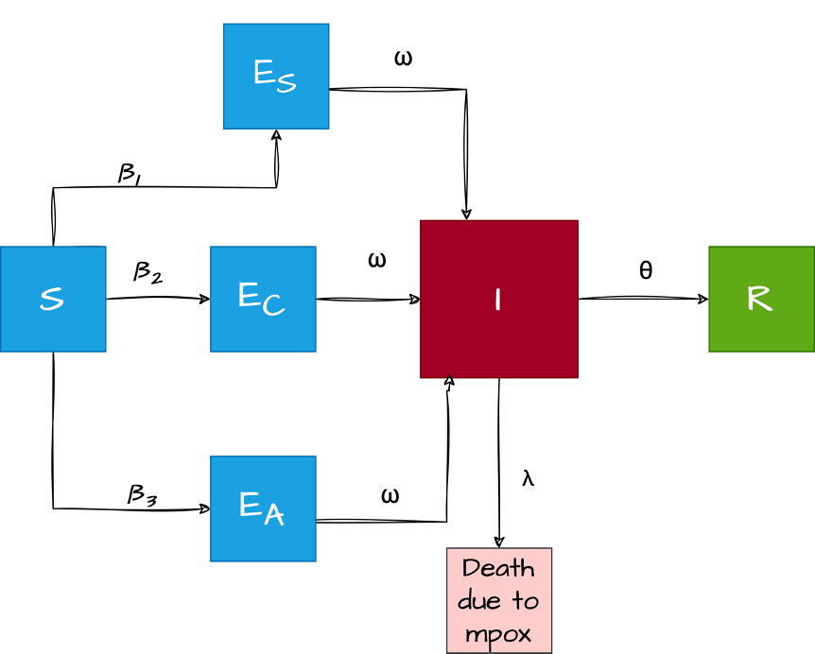
Simple SEIR model for MPOX dynamics

Slide 3
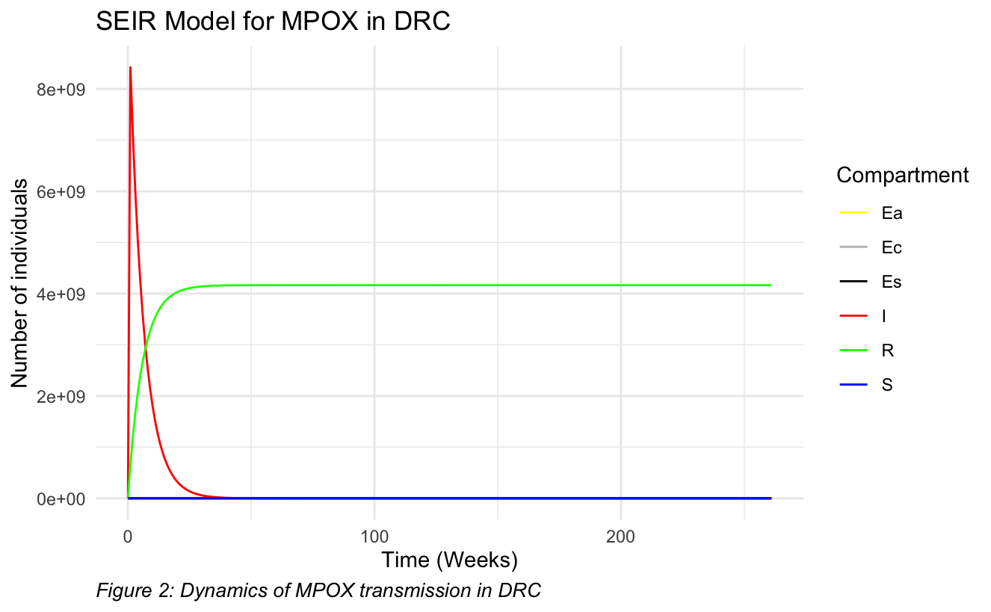
Simulation

Slide 4
Model with heterogeneous mixing
λ_{Y}
β_{YC} C_{i.j}
E_{Yc}
ω
S_{Y}
I_{Y}
θ
R_{Y}
β_{YA} C_{i.j}
ω
E_{AC}
E_{AC}
β_{AC} C_{i.j}
ω
S_{A}
β_{AA} C_{i.j}
E_{AA}
ω
I_{A}
θ
R_{A}
β_{AS} C_{i.j}
ω
E_{AS}
λ_{A}

Slide 5
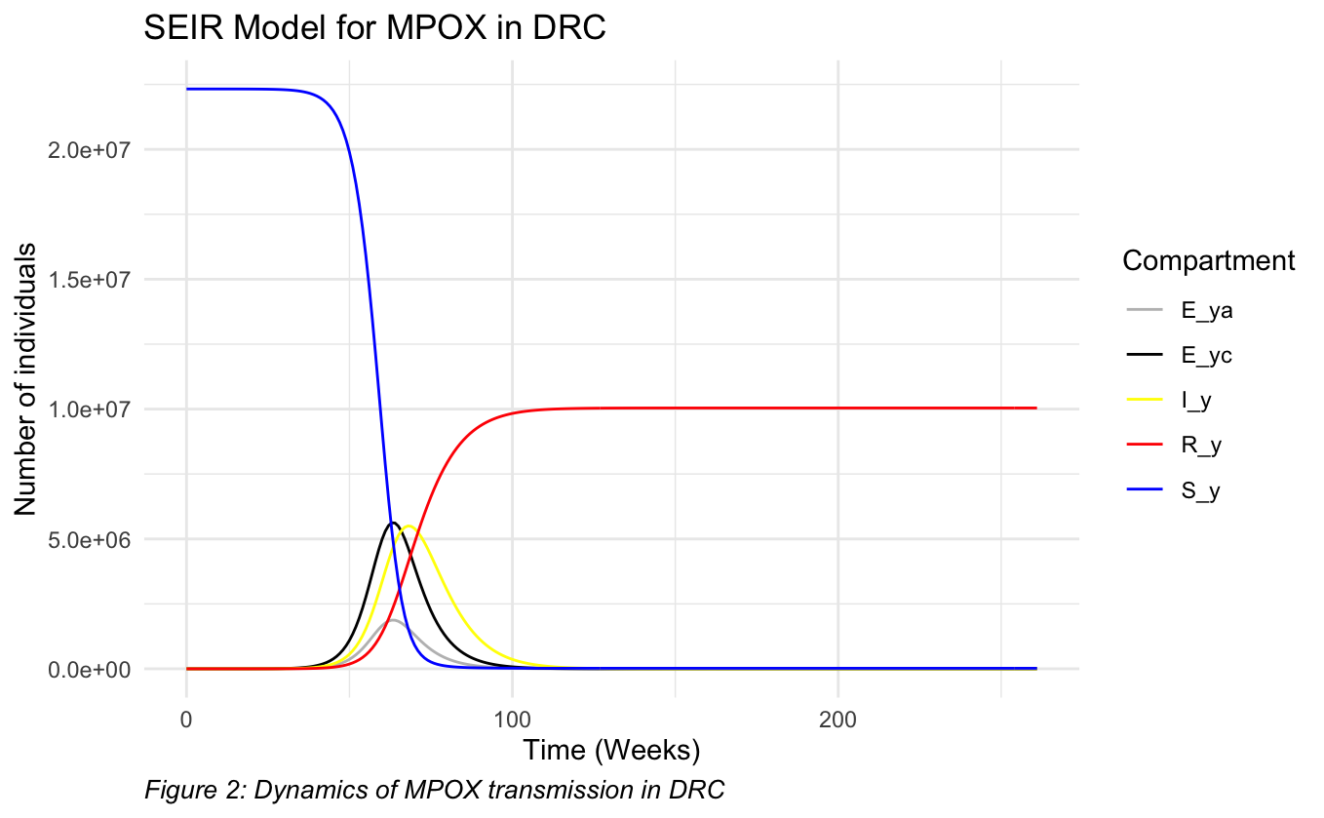
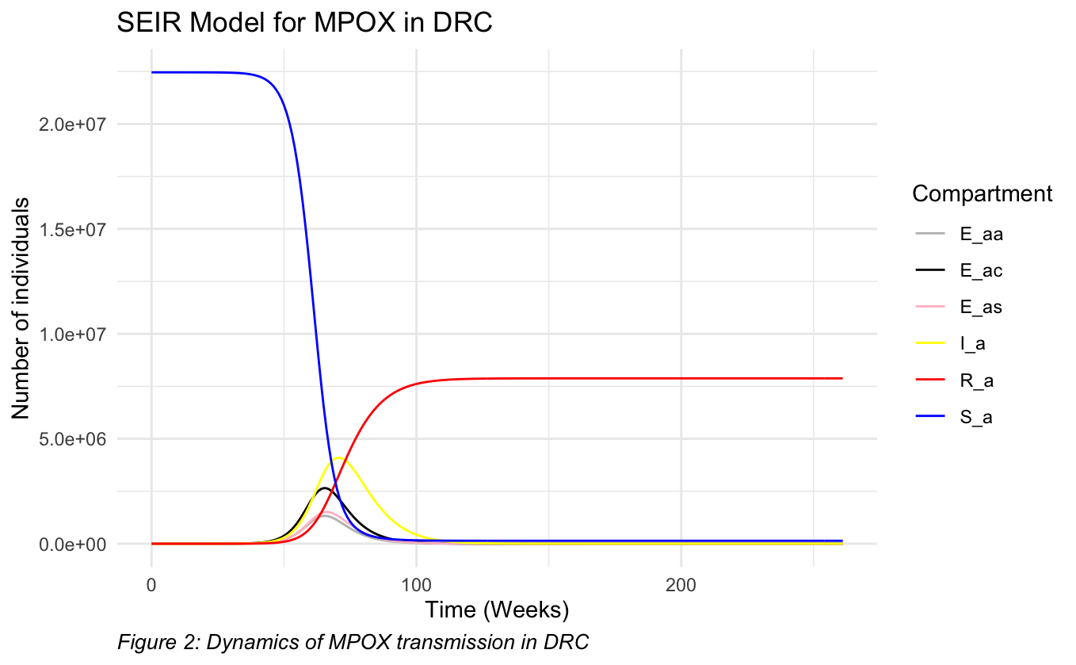
Simulation with heterogeneous mixing

Slide 6
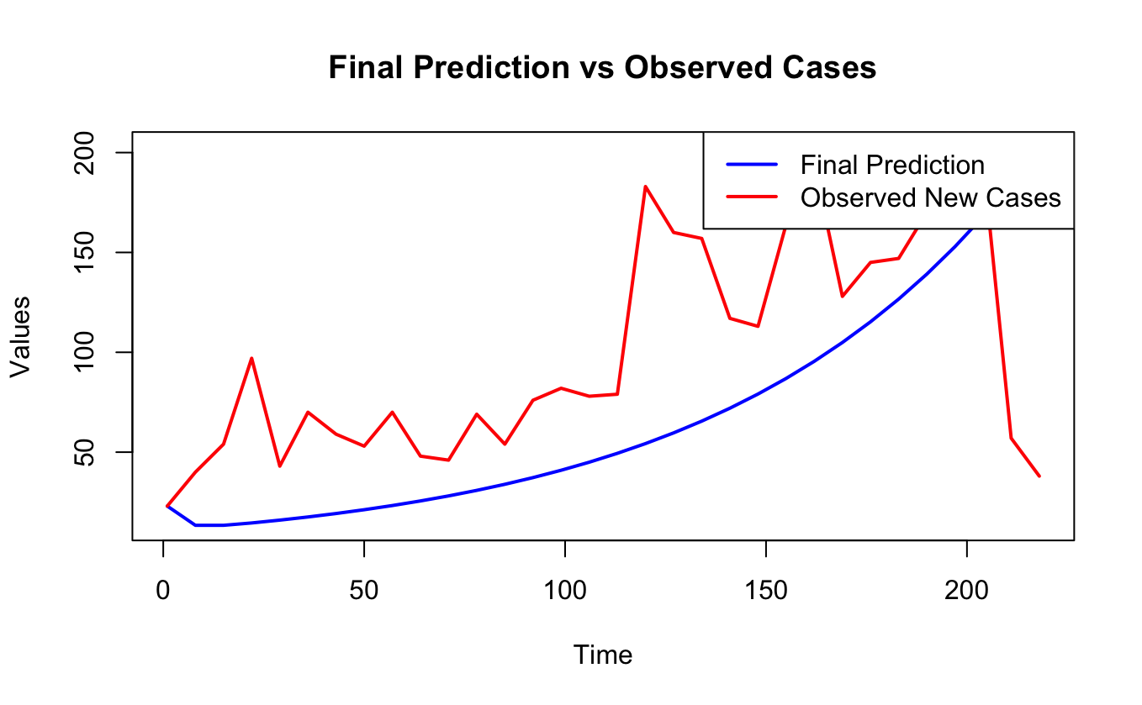
Fitting

