Slide 1
C H A R O N
MONEY
NO ONE
CAN SEE
01 / 09
Notes:
Charon. Money no one can see. Private sends, private swaps, private payroll, all on Solana.

Slide 2

CHARON
02 · 09
THE PROBLEM
Every payment on Solana
is public forever.
01
Transfers are permanent, indexed, searchable
anyone can screenshot your money
02
Salaries, payments, treasury: exposed
competitors, data brokers, anyone
03
Nobody opted into total transparency
so money stays off-chain today
Notes:
Every payment on Solana is public, permanently: salaries, trades, treasury, all searchable by anyone, forever. Nobody opted into total transparency. It's why serious money still stays off-chain.

Slide 3
CHARON
03 · 09
CHARON CASH
One shielded balance.
Three moves.
● BETA
SEND
Private transfers. Amount and recipient never appear on-chain.
● BETA
PAY
One CSV, one signature. Your whole team paid. Salaries invisible.
● BETA
SWAP
Swap on the same shielded balance, shipping now. Nothing moves in public.
1 deposit once → 2 balances become encrypted notes → 3 proofs made on your device → 4 relayer broadcasts, holds no keys
Notes:
Charon Cash is one shielded balance with three moves. Send: private transfers, nothing visible. Pay: one CSV, one signature, the whole team, salaries invisible on-chain. Swap: same balance. All three are in beta on devnet today. Deposit once, balances become encrypted notes, proofs are made on your own device, and the relayer broadcasts transactions without holding any keys.

Slide 4
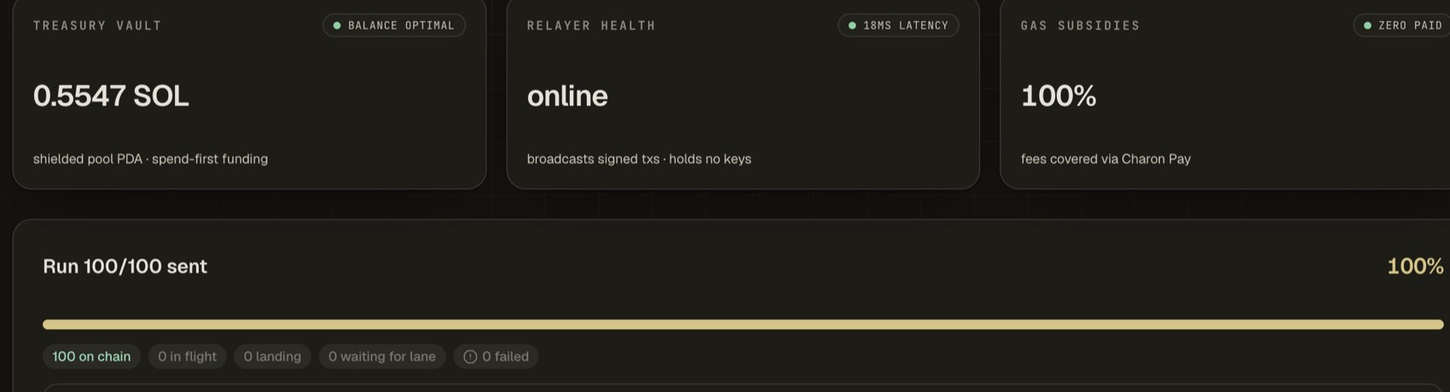
CHARON
04 · 09
IT WORKS: MEASURED, LIVE
One protocol.
Proven at scale.
≈80s
100 PAYOUTS, END TO END
0.6–1.4s
PROOF, IN YOUR BROWSER
1
SIGNATURE PER PAYROLL RUN
● 9 beta testers
● live on devnet
● built in-house: circuit · program · prover · SDK
LIVE RUN: 100/100 SENT · 100 ON CHAIN · 0 FAILED
● one protocol: send · swap · pay
Notes:
This is measured, not promised. The protocol proves itself at scale: a hundred private payouts in about eighty seconds, end to end, zero failures. Each zero-knowledge proof is made in the browser in about a second, fast by any yardstick in the field. One signature funds the whole run. Payroll is just the first use case: the same engine carries send and swap.

Slide 5
CHARON
05 · 09
WHY NOW
Money is moving on-chain.
In public.
THE WAVE
$320B stablecoins. $4.5T moved every quarter.
· Sept 2026: private money ships on Solana mainnet: payroll first, category validated
· People want money on-chain. They can't accept it in public
THE FIELD
Private money already has real flow.
· Privacy Cash: $500M+ routed, $139k in fees (DefiLlama)
· Cloak: private payroll live on Solana mainnet since Sept 2026
· Umbra: shielded pools + private vesting on Solana
· $957M+ locked across 47 privacy protocols (DefiLlama)
Notes:
Why now: stablecoins are a $320B market moving four and a half trillion a quarter, and people want that money on-chain without exposing it. The field proves demand: Privacy Cash has routed over five hundred million dollars in private volume and earns fees tracked on DefiLlama; Cloak shipped private payroll on Solana mainnet in September 2026; Umbra runs shielded pools and private vesting on Solana. Across the category, more than nine hundred and fifty million dollars is locked in private protocols today, tracked on DefiLlama.

Slide 6
CHARON
06 · 09
WHY WE WIN
Fast proofs.
Fraction of the cost.
MEASURED SPEED
0.6–1.4s in-browser. Measured, not promised.
· Aztec ≈ 6.8s · Zcash ≈ 40s · Railgun seconds
· 136k CU per transfer: 30 to 45% of what others in the space burn
· 65 KB on-chain program: proof verification at Solana cost
BUILT DIFFERENT
Everything in-house. Everything ours.
· Program, circuits, SDK, relayer: all built in-house
· Payroll already runs on it: crash-safe, one signature, can't double-pay
· Whole stack built from zero, in months
Notes:
Why we win: our Groth16 proving runs in the browser in about a second; Aztec is around seven seconds, Zcash around forty. A private transfer burns about a hundred and thirty-six thousand compute units, thirty to forty-five percent of what others in the space burn, so fees stay at Solana level. The on-chain program is 65 kilobytes, so privacy runs at Solana cost. And the whole stack, program, circuits, SDK, relayer, is built in-house, so we can move fast and fix anything ourselves. Payroll that's crash-safe and can't double-pay. All built from zero, in months.

Slide 7
CHARON
07 · 09
ROADMAP
From devnet
to the default.
NOW
Live on devnet
Send, swap, pay: all in beta, measured, 9 beta testers.
NEXT
Closed beta + audit
Real teams in closed beta. Independent security audit.
THEN
Mainnet beta
Real teams on mainnet, payroll as the flagship use case.
BEYOND
Charon SDK
Any app ships private payments on the protocol: wallets, agents, treasuries.
Notes:
Where this goes. Now: live on devnet, all three moves, measured. Next: closed beta with real teams, and an independent security audit so the privacy is verifiable, not just promised. Then: mainnet beta, payroll as the flagship use case. Beyond: the SDK, so any app can ship private payments on Charon.

Slide 8
CHARON
08 · 09
TEAM: FOUR, ALL TECHNICAL
One stack. Four builders.
Kartik
TECHNICAL CO-FOUNDER
Built SolStudio before this: 50+ users. Grad: Rektoff · Turbine · Ack3AI · Superteam · prev Aarambh Labs, Wizz.
Namay
TECHNICAL CO-FOUNDER
Accel+ builder, Turbine. Full-stack developer.
Vedansh
TECHNICAL CO-FOUNDER
Turbine accelerated-builder grad. Certified auditor, Rektoff.
Prasang
TECHNICAL CO-FOUNDER
Full-stack Solana & security, 100xDevs. Certified auditor, Rektoff · Turbine accelerated builder. Pinocchio native: like our program.
Notes:
Four of us, all technical, and the whole stack was built by the four of us. Before Charon I built SolStudio, with fifty plus users. Namay, Accel-plus builder at Turbine, full-stack. Vedansh, Turbine grad and certified auditor. Prasang, Solana security and certified auditor, the deepest Pinocchio person I know, which is exactly what our program is written in.

Slide 9
C H A R O N
THANK YOU.
MONEY NO ONE CAN SEE
charon.cash · @Charon_cash
09 / 09
Notes:
Thank you. Charon: money no one can see. Send, swap, pay: one shielded balance, fast proving, built from zero. Find us at charon.cash and @Charon_cash.

