Slide 1
Million Song Dataset Prediction
Group 3
Zhixing Yang 5524726 Contribution: 25%
Charottama O. Damara 6599126 Contribution: 25%
Christophorus Ivan Darmasaputra 5699551 Contribution: 25%
Zhiyu Tong 5429274 Contribution: 25%

Slide 2
Outline
Introduction
Overview
Task Flow
Explorative Analysis And Visualization
Spark Mllib Modeling
Tensorflow-Keras Modeling
Self-Implemented Modeling
Conclusion
Summary
Model Comparation
Lessons Learned

Slide 3

Overview
Problem Statement:
More and more music platform plan to use machine learning
methods to recommend songs to users to derive financial gain
We wants to thorough some audio features to predict the re
lease year of a song and discover their relation between them
This is a regression problem.

Slide 4
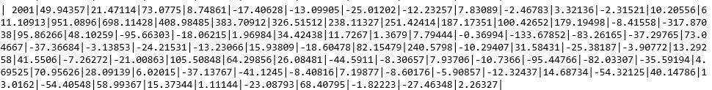
Overview
Dataset:
Derive from UC Irvine Machine Learning Repository
Totally 515345 samples in dataset, the first column is the target
(actual release year of the song) the next 12 columns are timbre average, the last 78 columns are timbre covariance
Timbre is the distinguishing characteristic that differentiates one sound
from another.
Goal:
Explore and visualize the data
Develop models to predict the release year of a song
Provide the performance evaluation of fitted models and make conclusion.

Slide 5
Outline
Introduction
Overview
Task Flow
Explorative Analysis And Visualization
Spark Mllib Modeling
Tensorflow-Keras Modeling
Self-Implemented Modeling
Conclusion
Summary
Model Comparation
Lessons Learned

Slide 6
Step1:Explorative Analysis And Visualization
Step2:Self-Implemented Modeling
Linear Regression
Random Forest Regressor
Decision Tree Regressor
Step3:Spark MLlib Modeling
Decision Tree Regressor
Random Forest Regressor
Linear Regression
Step4:Tensor Flow Keras Modeling
Linear Regression
Convolutional Neural Network
Self-Implemented Modeling
Step5:Summary
Learned Lessons
Interesting Finding
Task flow

Slide 7
Outline
Introduction
Overview
Task Flow
Explorative Analysis And Visualization
Spark Mllib Modeling
Tensorflow-Keras Modeling
Self-Implemented Modeling
Conclusion
Summary
Model Comparation
Lessons Learned

Slide 8
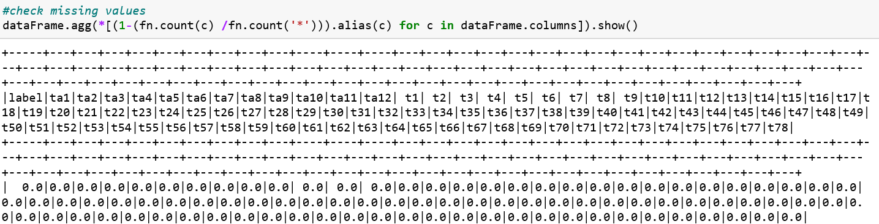
Preprocessing:
We ignore the process of preprocessing because the dataset was already preprocessed, so it should not have noise, outliers and duplicate data
Also we have a check it did not have missing values

Slide 9
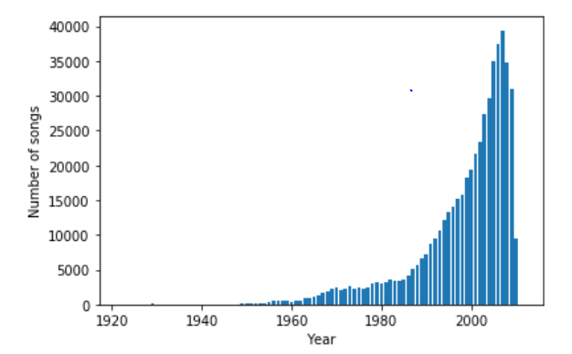
Target Variable Balance Plot
Can find it is imbalance. From 1922 to 2007, the number of songs increased by years，reach peak in 2007
Reduce from 2008 to 2011
It may be related to the trend of music industry

Slide 10
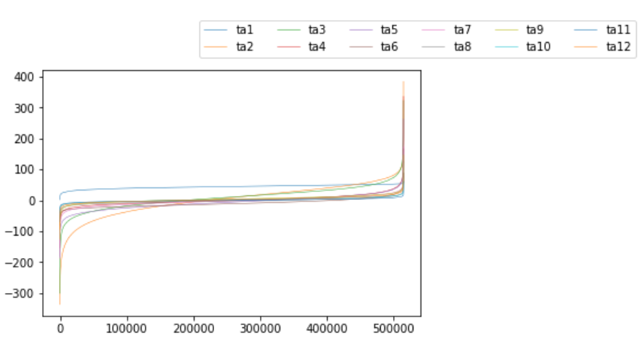
Data Values Distribution Plot
Show first 12 columns which are timbre average
Can see the range is from minus 300 to 400
Most of the data values near to 0

Slide 11
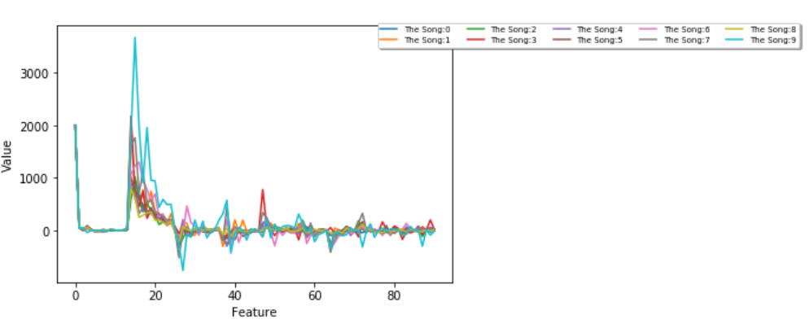
The First 10 Samples Plot
Mostly samples have high values between column 12 and 20
Have lowest values between column 22 and 28

Slide 12
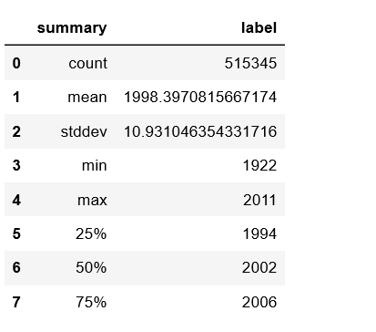

Skewness
Five number summary of the target
Distribution is left skewed

Slide 13
Outline
Introduction
Overview
Task Flow
Explorative Analysis And Visualization
Spark Mllib Modeling
Tensorflow-Keras Modeling
Self-Implemented Modeling
Conclusion
Summary
Model Comparation
Lessons Learned

Slide 14
Spark MLlib Modeling
Decision Tree Regressor
Random Forest Regressor
Decision Tree Regressor
Every model are evaluated with MSE (Mean Squared Error)

Slide 15
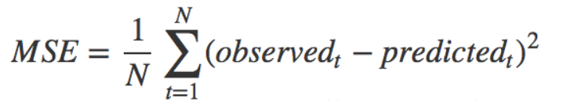
Evaluation Method
We determine which model performs best by comparing which model has the best MSE results on the validation set.
In the regression model, these two types of verification can determine the difference between the predicted data and the original data.

Slide 16
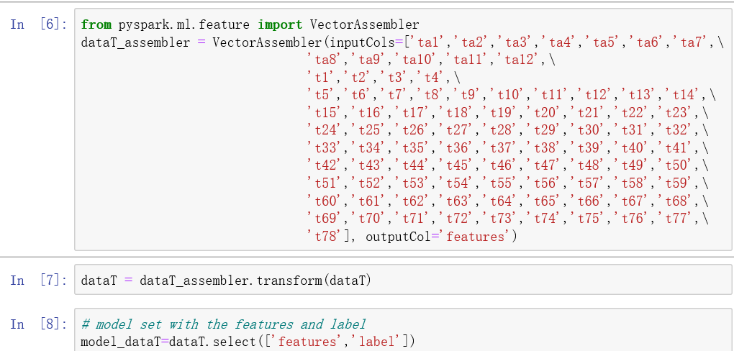
Data Preprocess For Pyspark
The dataset has one label and 90 non-label attributes
With the 90 non- lebal attributes are assembled using Vector Assembler.

Slide 17
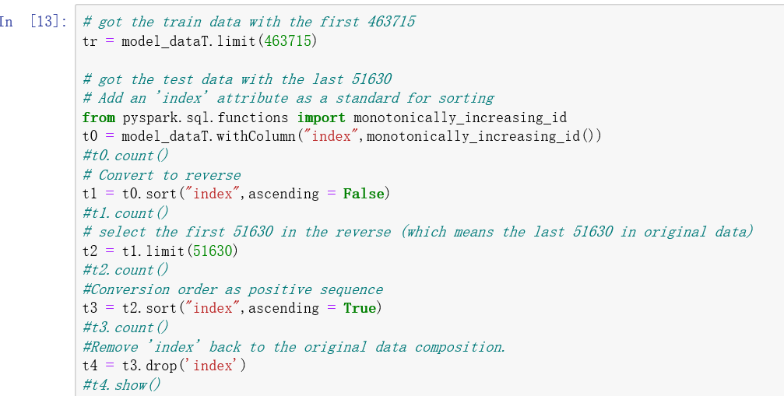
Data Split For Pyspark
By using limit() and sort(), the sample data is successfully segmented into a training set with 463,715 data volumes and a test set with 51,630 data volumes.

Slide 18
Decision Tree Regressor Model
For models of decision tree regression, most attributes are set to default values, such as impurity (information gain calculation criteria), minInfoGain (minimum information gain required to split nodes). We decided to adjust maxBins and maxDepth to get the smallest possible MSE.
When the parameter of the largest category is set to 5 in the Vector Indexer, the whole model has better results.
As a result, when maxBins is 32 and maxDepth is 10, the decision tree can get the minimum MSE when the maximum category is set to 5, and the value is 94.3053.

Slide 19
Random Forest Regressor Model
Because the results of decision tree regression are not good enough, and it is impossible to determine whether there is an impact of outliers, the choice of multiple forests such as random forests reduces the impact of single decision trees caused by outliers. Inaccurate and avoid the possibility of overfitting.
However, random forests also have core shortcomings, and the calculation of comparisons is particularly large.
As a result, when maxBins is 32 and maxDepth is 10, the decision tree can get the minimum MSE when the maximum category is set to 5, and the value is 94.3053.

Slide 20
Linear Regression Model
Use linear regression to predict this data in pyspark. Two different regularizations are used to determine the range of the approximate data.
Use elasticNetParam in linear regression functions to aid in regularization. When elasticNetParam is 1, the model uses Lasso regression. When 0, the model uses redge regression. At the same time, the maximum number of iterations is controlled to 30 times. The regularization parameter is 0.3.
The MSE range for the final result is between 90.015526 and 94.589867 (the first is L2 and the last is L1)

Slide 21
Interesting Finding For Spark MLlib
Comparing the three models, the random forest has the best results in pyspark.
For linear regression, the amount of data for this data is large, so the final prediction results are unsatisfactory. But it also shows that the data set has a certain linear relationship.
More interesting is the maximum discrete feature number of the continuous feature discretization in the tree model is 32, and this value is exactly the default parameter of the property.
On the parameter adjustment of the maximum depth, when the maximum tree depth exceeds 10, the final calculated MSE will increase. It can be seen that parameter 10 is similar to the valley of the quadratic function in the tree model of the data. Take this value and get the smallest value in different tree models

Slide 22
Outline
Introduction
Overview
Task Flow
Explorative Analysis And Visualization
Spark Mllib Modeling
Tensorflow-Keras Modeling
Self-Implemented Modeling
Conclusion
Summary
Model Comparation
Lessons Learned

Slide 23
Tensorflow-Keras Modeling
Multi-layer Perceptron
Convolutional Neural Network
Recursive Neural Network
Every model are evaluated with MSE (Mean Squared Error)

Slide 24
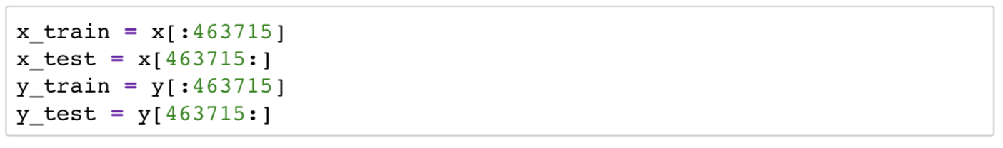
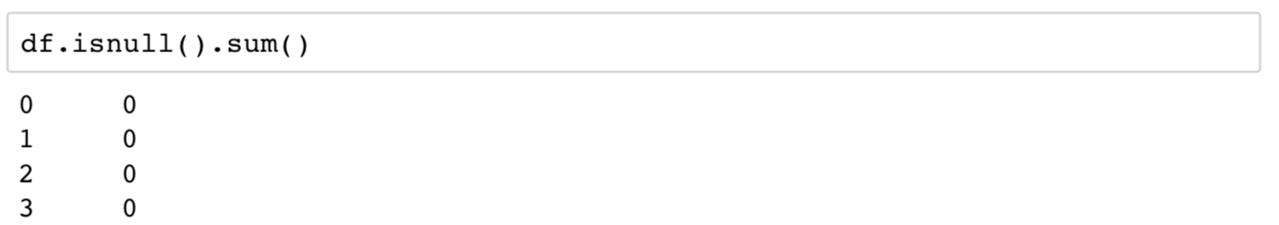
Loading Data And Preprocess

Slide 25
About Tensorflow And Keras
Open-source by Google, to implement ML particularly NN. Input as multidimensional array, aka tensor. Models are represented by flowchart to perform on the input.
Keras is high-level API, user-friendly

Slide 26
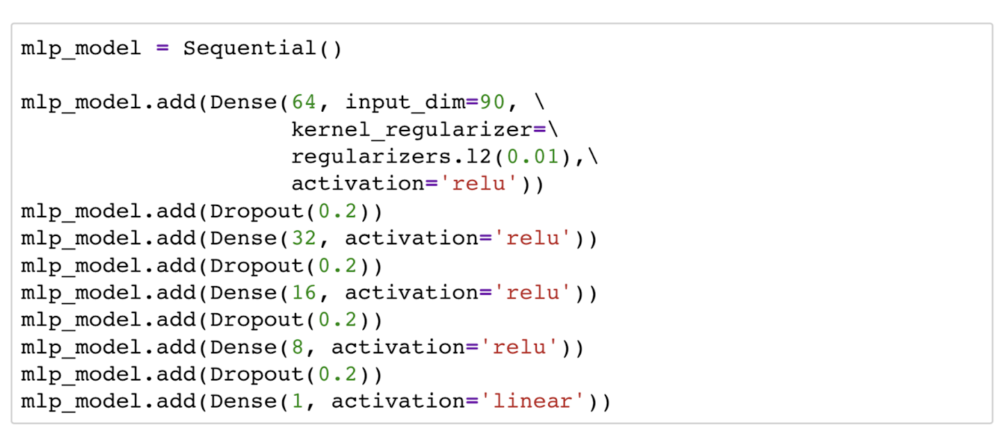
Multi-layer Perceptron Model

Slide 27
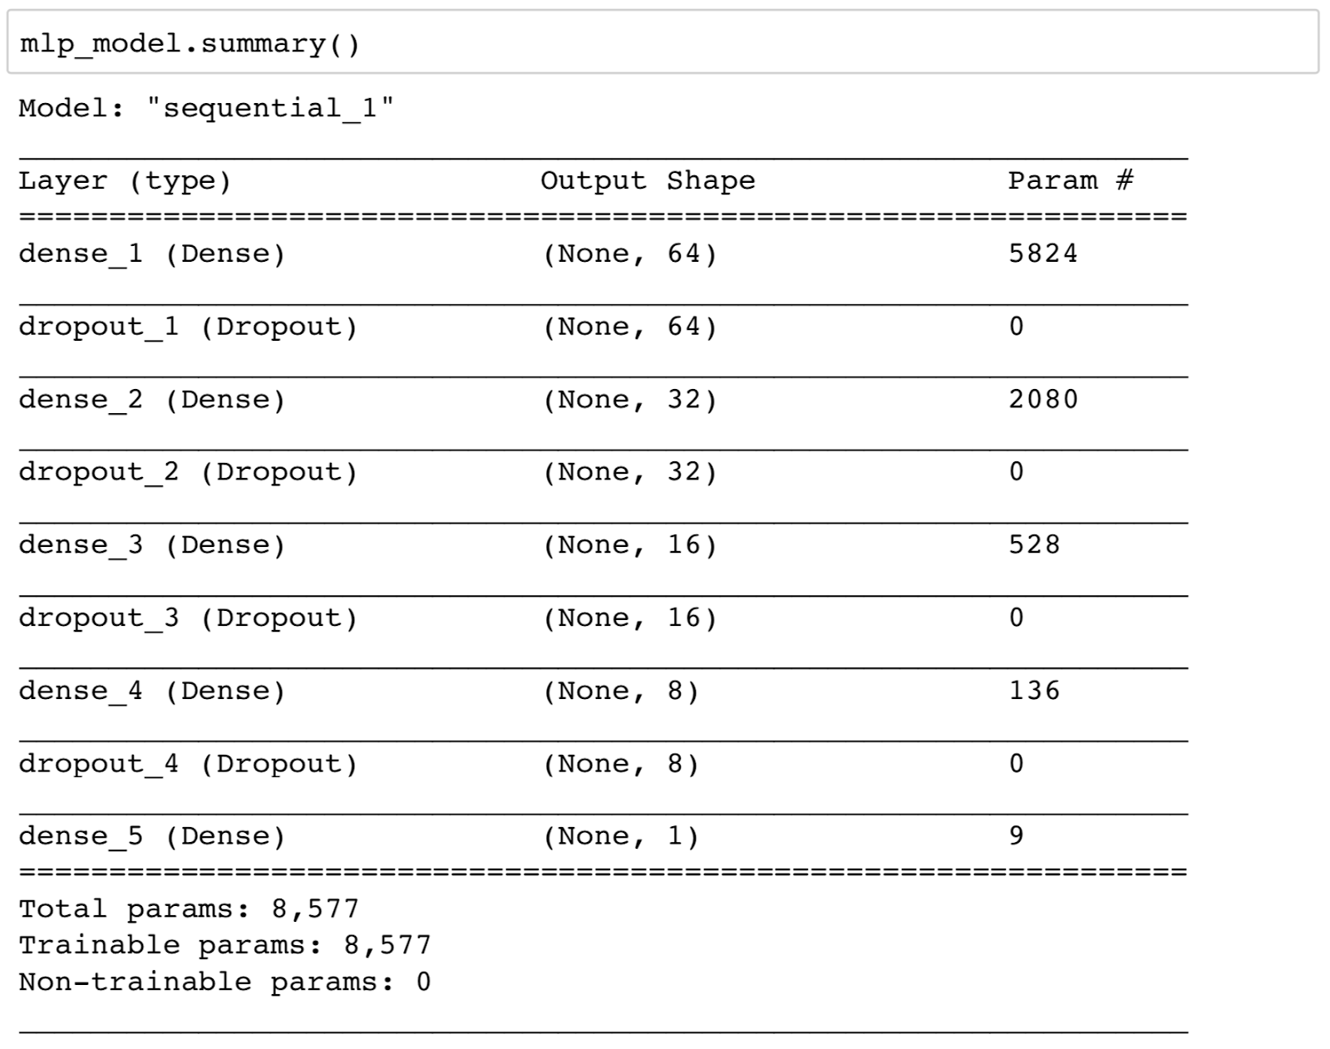
Multi-layer Perceptron Model Continue

Slide 28
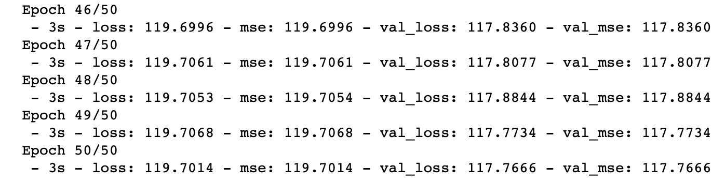
Multi-layer Perceptron Model Continue

Slide 29
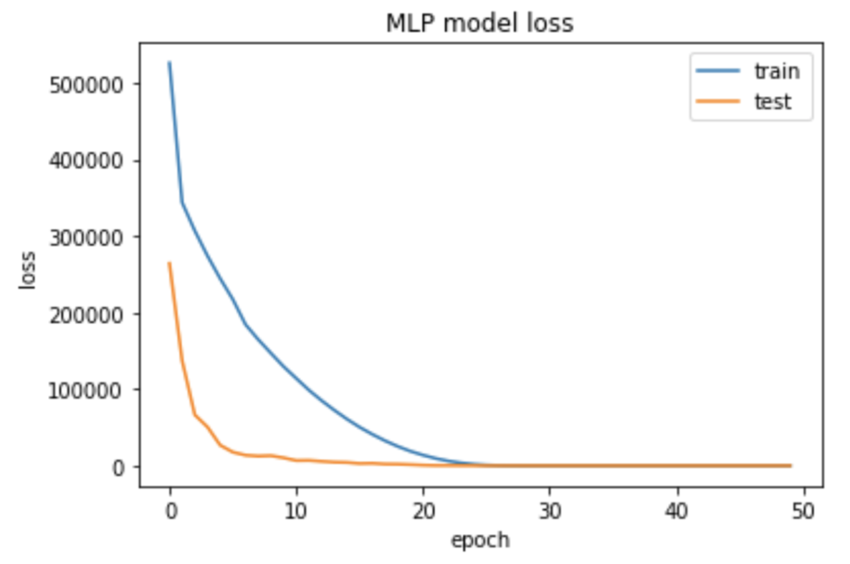
Multi-layer Perceptron Model Continue

Slide 30
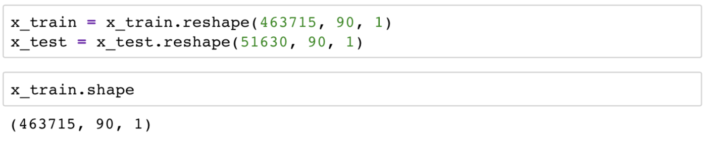
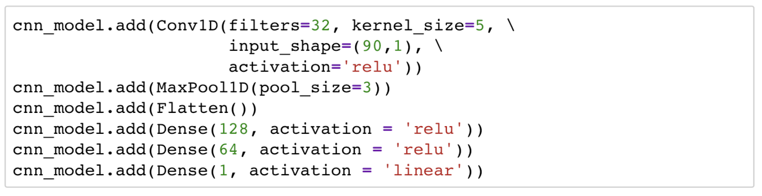
Convolutional Neural Network Model

Slide 31
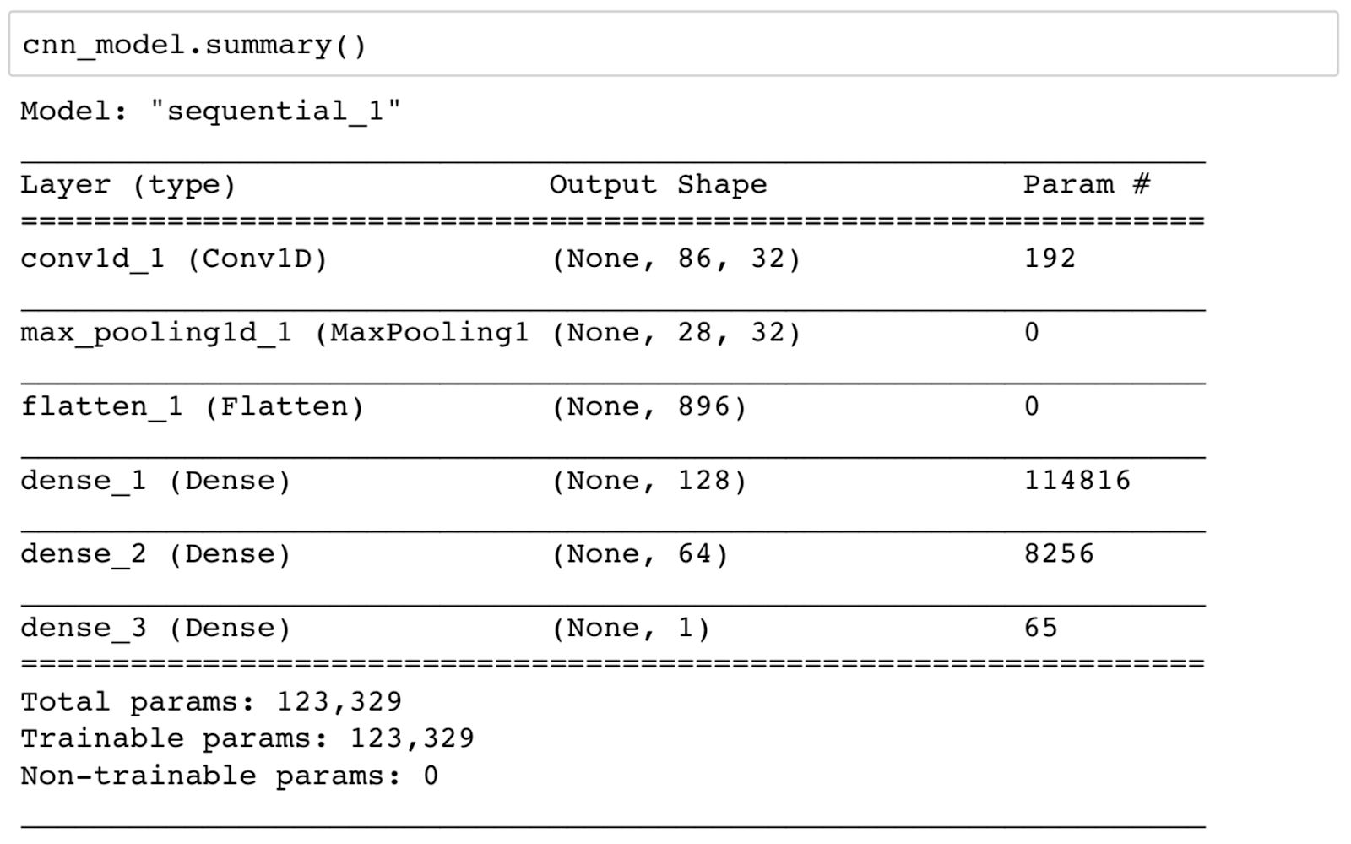
Convolutional Neural Network Model Continue

Slide 32
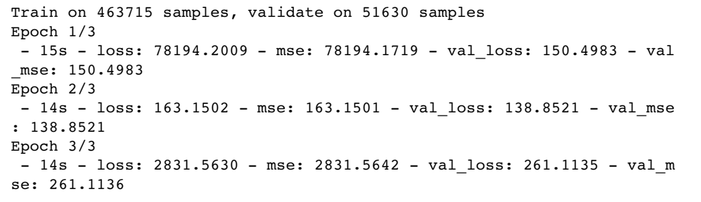
Convolutional Neural Network Model Continue

Slide 33
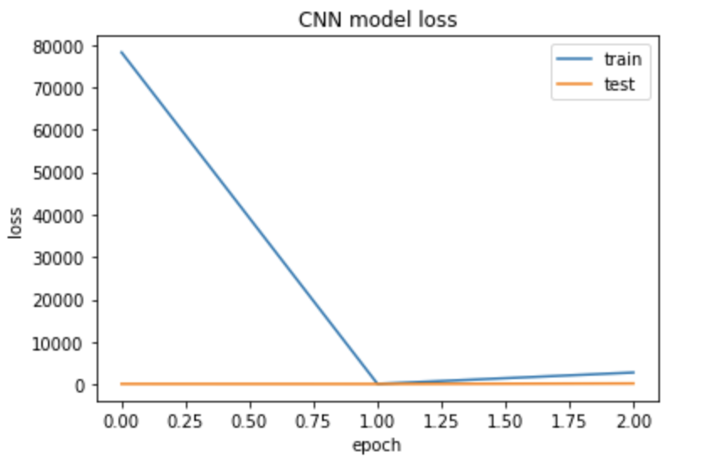
Convolutional Neural Network Model Continue

Slide 34
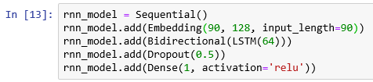
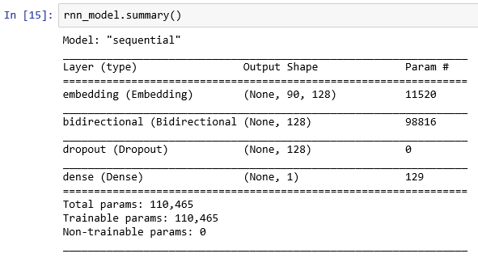
Recurrent Neural Network Model

Slide 35
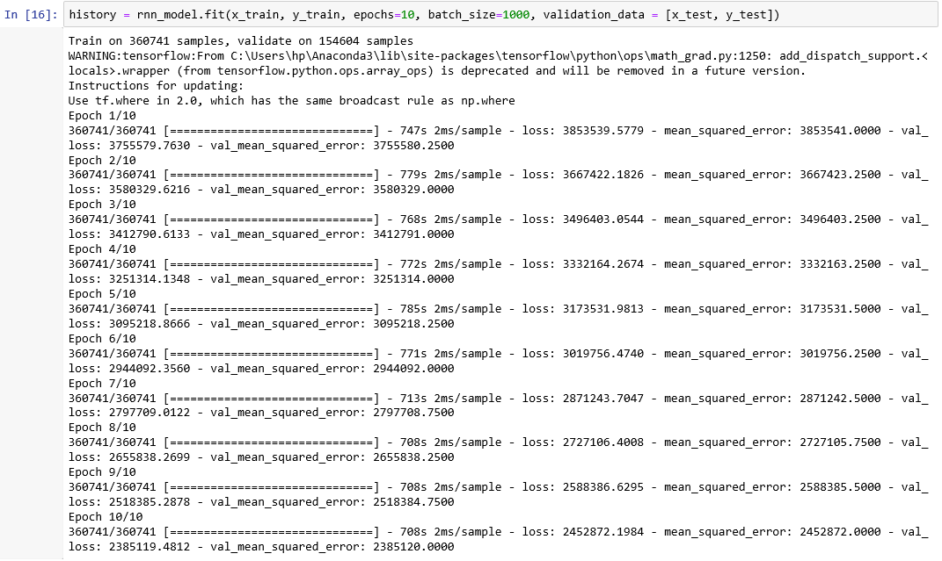
Recurrent Neural Network Model Continue

Slide 36
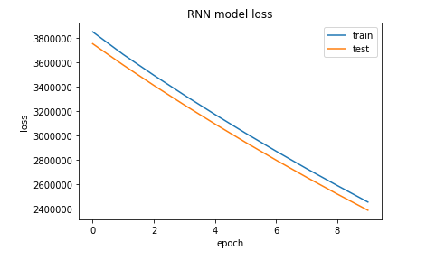
Recurrent Neural Network Model Continue

Slide 37
Interesting Finding For Tensorflow-Keras
MLP most consistent, but slower than CNN
CNN is very quick and can yield slightly better result but tends to overfit and is inconsistent
RNN takes very long to compute and is infeasible for this type of problem

Slide 38
Outline
Introduction
Overview
Task Flow
Explorative Analysis And Visualization
Spark Mllib Modeling
Tensorflow-Keras Modeling
Self-Implemented Modeling
Conclusion
Summary
Model Comparation
Lessons Learned

Slide 39
Self-Implemented Modeling
Linear Regression
Random Forest Regressor
Decision Tree Regressor
Every model are evaluated with MSE (Mean Squared Error)

Slide 40

Linear Regression Model
Numpy to do all of the vectorized numerical computations on the dataset including the implementation of the algorithm
Matplotlib to plot graphs for better understanding the problem at hand with some visual aid
Pandas to load the csv file into a dataframe format which is easier to plot.
Library we use in Linear Regression

Slide 41
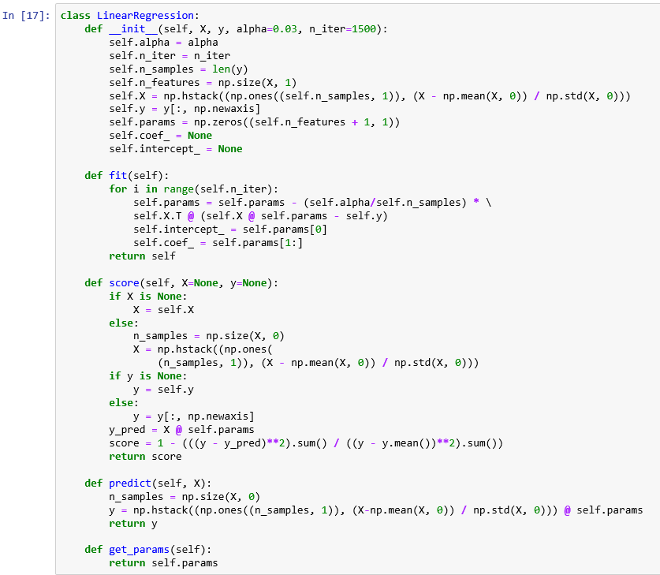



Linear Regression Model Continue

Slide 42
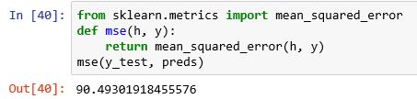
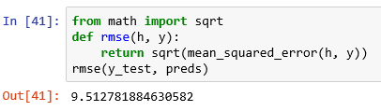
Linear Regression Model MSE And RMSE
Linear Regression Model MSE
Linear Regression Model RMSE

Slide 43
Random Forest Model
Numpy to do all of the vectorized numerical computations on the dataset including the implementation of the algorithm
Matplotlib to plot graphs for better understanding the problem at hand with some visual aid
Pandas to load the csv file into a dataframe format which is easier to plot.
Library we use in Random Forest

Slide 44
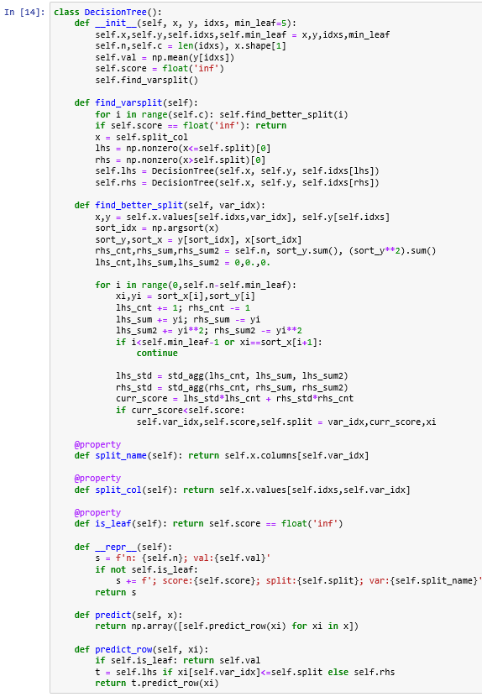


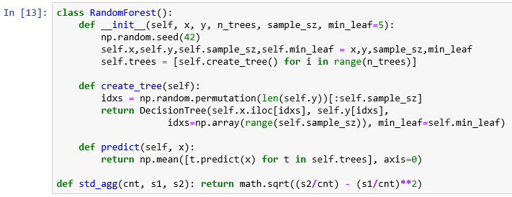
Random Forest Model Continue
Notes:
A set of features – x
A target variable – y
Number of trees in the random forest – n_trees
A variable to define the sample size – sample_sz
A variable for minimum leaf size – min_leaf
A random seed for testing
Define a function that uses a sample of data (with replacement) and creates a decision tree over the same.
Create a predict function. The mean of the predicted value from each tree for a particular row is returned as the final prediction.
We call DecisionTree in the function create_tree, so let’s define it here.
A decision tree would have a set of independent variables, a target variable, and the index values.
For every column, we use the function find_better_split to identify a split point and then return the column name, value, and score for the split.

Slide 45


Random Forest Model MSE And RMSE
Random Forest Model MSE
Random Forest Model RMSE

Slide 46
Decision Tree Model
Numpy to do all of the vectorized numerical computations on the dataset including the implementation of the algorithm
Matplotlib to plot graphs for better understanding the problem at hand with some visual aid
Pandas to load the csv file into a dataframe format which is easier to plot.
Libraries we used in Decision Tree
Notes:
Trees are recursive data structures

Slide 47
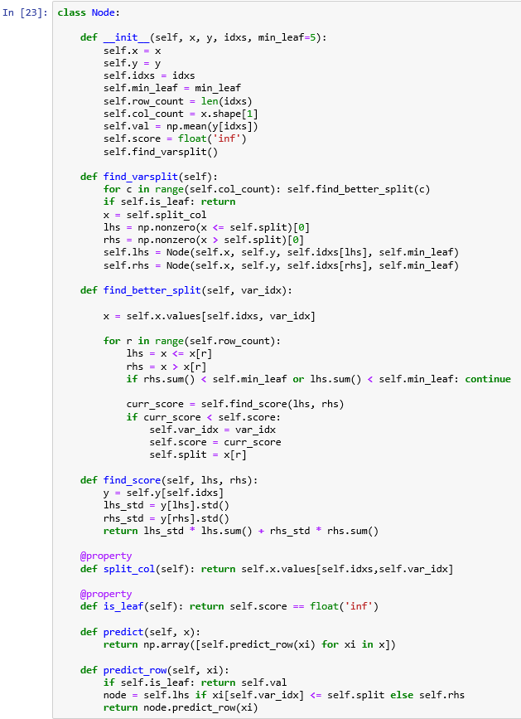
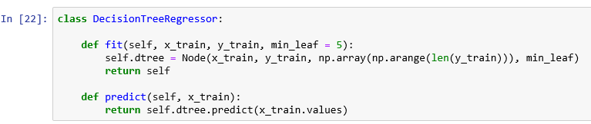

Decision Tree Model Continue
Notes:
Node class represents one decision point in our model.
Each division within the model has 2 possible outcomes for finding a solution — go to the left or go to the right.
That decision point also divides our data into two sets.
The property idxs stores indexes of the subset of the data that this Node is working with.
The decision (prediction) is based on the value that Node holds.
To make that prediction we’re just going to take the average of the data of the dependent variable for this Node.
find a better feature to split on.
If no such feature is found (we’re at a leaf node) we do nothing.
Then we use the split value found by find_better_split,create the data for the left and right nodes and create each one using a subset of the data.
Starting at the tree root, predict_row checks if we need to go left or right node based on the split value we found.
The recursion ends once we hit a leaf node.
At that point, the answer/prediction is stored in the val property.

Slide 48
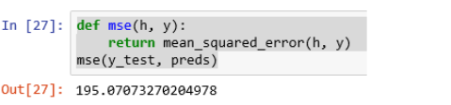
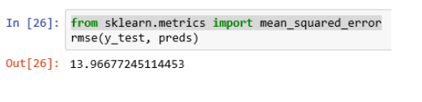
Decision Tree Model MSE And RMSE
Decision Tree Model MSE
Decision Tree Model RMSE

Slide 49
Interesting Finding For Self-Implemented Models
Linear regression are more suitable for this kind of problem if we conclude based on MSE/RMSE only.
Decision Tree used up too much memory to run and took a long time to finish.
Random Forest is suitable but the MSE/RMSE is not better than Linear Regression

Slide 50
Outline
Introduction
Overview
Task Flow
Explorative Analysis And Visualization
Spark Mllib Modeling
Tensorflow-Keras Modeling
Self-Implemented Modeling
Conclusion
Summary
Model Comparation
Lessons Learned

Slide 51
Summary
PySpark model of Random Forest have the best MSE from all 9 models.
Keras library need to be fine tuned to achieve maximum result
PySpark is a powerful machine learning library
Although we have all these powerful machine learning library, self implemented machine learning model are still a plausible choice

Slide 52
Outline
Introduction
Overview
Task Flow
Explorative Analysis And Visualization
Spark Mllib Modeling
Tensorflow-Keras Modeling
Self-Implemented Modeling
Conclusion
Summary
Model Comparation
Lessons Learned

Slide 53
Model Comparation
Spark MLlib Models
 | Linear Regression | Decision Tree Regressor | Random Forest Regressor
Mean square error | 90.0155 | 94.3053 | 89.3555
For Spark MLlib Models Random Forest Regressor get better result
For Tensorflow-Keras MLP get better result
For Self-Implemented Models Linear Regression get better result
Tensorflow-Keras Models
 | Multi-layer Perceptron | Recursive Neural Network | Convolutional Neural Network
Mean square error | 119.7014 ` | 2831.5642 | 2452872.1984
Self-Implemented Models
 | Linear Regression | Decision Tree Regressor | Random Forest Regressor
Mean square error | 90.4930 | 195.0707 | 117.8514

Slide 54
Outline
Introduction
Overview
Task Flow
Explorative Analysis And Visualization
Spark Mllib Modeling
Tensorflow-Keras Modeling
Self-Implemented Modeling
Conclusion
Summary
Model Comparation
Lessons Learned

Slide 55
Lessons Learned
From our project we learn that Pyspark mllib is the most suitable approach for this dataset. Because it is fast reliable and have good MSE
There are still possible ways to reduce MSE further by changing the hyperparameters of the models, such as the learning rate, optimizer, maxDepth
Recursive Neural Network model is more suitable for image processing, not very suitable for the regression problem

Slide 56
Thank you for listening

