Slide 1


Minor Project
PCause: PCOS detection system based on deep learning model using ultrasound images
Presented by:
R2142210244- Charu Gupta
R2142210448- Lakshay Agarwal
Mentored By:
Ms. Sugandha Sharma

Slide 2
Content
Introduction
Literature Review
Objectives
Methodology
Working Model
Results
Conclusions
References

Slide 3
Introduction
Technical Concepts (Algorithms):
The technical concepts used are:
Image processing: We implemented Generative Adversarial Networks (GANs) to generate synthetic data, adding diversity to the dataset. This enriches our data pool and sets the stage for analysis and modeling. Following this, Principal Component Analysis (PCA) is employed to streamline the dataset, selecting essential features while reducing its complexity. This sequential process of using GANs for data augmentation followed by PCA for feature selection improves the efficiency of our image processing, ultimately leading to better PCOS detection accuracy.
Deep learning: Deep learning methodologies like convolutional neural network (CNN) architectures, VGG-16, VGG-19, RESNET-50, and ALEXNET, are used for the detection of PCOS from the dataset provided to these models.

Slide 4
Introduction
Motivation:
The motivation behind this project stems from the aspiration to revolutionize PCOS diagnosis by using technologies of deep learning and image processing. By developing an automated PCOS detection system, we aim to enhance the accuracy and speed of diagnosis, and facilitating early intervention. Improved diagnostic capabilities not only empower healthcare professionals but also contribute to the overall well-being of women affected by PCOS, addressing a significant gap in current healthcare practices. Ultimately, our project seeks to make a meaningful impact on public health by advancing the early detection of PCOS, thereby improving the quality of life for affected women.
Problem Statement:
Polycystic Ovary Syndrome (PCOS) is a common hormonal disorder affecting women of reproductive age. Early detection and accurate diagnosis of PCOS are crucial for effective management and prevention of associated complications. However, existing diagnostic methods often rely on manual assessments and subjective criteria, leading to potential misdiagnosis or delayed intervention. The lack of a standardized and efficient diagnostic approach poses a significant challenge in providing timely and personalized healthcare for individuals with PCOS. Therefore, there is a pressing need for the development of an automated and accurate PCOS detection system that leverages advanced technologies, such as machine learning and image processing, to enhance early diagnosis, streamline treatment planning, and improve overall healthcare outcomes for individuals affected by PCOS.

Slide 5
Introduction
Area of application:
The PCause model can be highly beneficial in the healthcare sector for addressing PCOS which is a common endocrine disorder affecting women of reproductive age, characterized by hormonal imbalances, irregular menstrual cycles, and the presence of cysts on the ovaries.
PCause model could be applied to the field of PCOS:
Early Detection and Diagnosis: The model can analyze a wide range of patient data and by processing this information, it can assist healthcare professionals in early detection and accurate diagnosis of PCOS.
Later the model can be used for:
Personalized Treatment Plans
Research and Development
Patient Education and Support
Dataset and input format:
Dataset
The image dataset is in .jpg format

Slide 6
Literature Review
Cite Related work
In [1], Principal Component Analysis (PCA) as a pivotal tool for enhancing image classification in computer vision. PCA efficiently reduces the dimensionality of high-dimensional datasets, improving interpretability and visualization. The integration of PCA with convolutional neural networks (CNNs) demonstrates its role in optimizing computational efficiency and accuracy in classifying diverse datasets. Overall, PCA emerges as a crucial technique, simplifying complex data representations and contributing to the advancement of image classification methodologies in artificial intelligence applications.
[2] underscores the potential of advanced deep learning models, including Alexnet, Inception V3, Resnet50, and VGG16, in enhancing the accuracy of Polycystic Ovary Syndrome (PCOS) diagnosis from ultrasound images. The utilization of transfer learning techniques, particularly in the medical field, showcases the effectiveness of pre-trained models in image analysis. Additionally, feature selection, image pre-processing, and evaluation metrics like precision, recall, sensitivity, specificity, and F1 score play crucial roles in fine-tuning and evaluating the models. This research contributes significantly to advancing automated PCOS diagnosis, offering potential benefits for timely and accurate medical interventions.

Slide 7
Literature Review
[3] proposes a pioneering approach for Polycystic Ovary Syndrome (PCOS) detection using a hybrid method that combines deep learning and traditional machine learning techniques. The study utilizes transfer learning with a pre-trained VGG16 model for feature extraction from ultrasound images. Compared to existing methods, the proposed approach achieves a remarkable accuracy in PCOS detection with efficient execution. While the method shows certain limitations that include a small dataset and challenges in explaining the model's decisions. The main aim of this research is to address such health issues and explore applications in detecting other clinical disorders.
Generative Adversarial Networks (GANs) in [4] uses image processing, emphasizing their role in generating realistic images through adversarial training. One of the impactful applications of Generative Adversarial Networks (GANs) in medical imaging, specifically in enhancing ultrasound image resolution. GANs integrated with deep learning models facilitate end-to-end encoding and decoding processes, enabling the generation of high-resolution images from routinely captured prostate ultrasound scans. Moreover, GANs are useful in creating different types of abnormalities in medical images, even when there are only a few examples available for each abnormality. The incorporation of deep convolutional GANs further enables the transformation of 2D images into 3D, expediting the analysis of medical images.

Slide 8
Literature Review
Using Convolutional Neural Networks (CNN) as an image classifier, utilizing feature extraction [5] attempts to effectively detect ovarian cysts in ultrasound images. The algorithm is trained on a dataset, using input ultrasound images as training data. It classifies test data within the dataset to determine if the ovary is affected, providing critical information on parameters such as area, solidity, extent, and perimeter affected by the cysts. This approach enhances diagnostic capabilities, showcasing the potential of CNNs in medical image analysis for precise identification and characterization of ovarian abnormalities, particularly in the context of disorders like Polycystic Ovary Syndrome (PCOS).

Slide 9
Literature Review
Inference from Literature
Citation | Inference | Algorithms | Results
[1] | Principal Component Analysis (PCA) is a crucial technique in image classification, not only for dimension reduction but also for revealing significant features, leading to highly accurate results, as evidenced by recent studies across various datasets and evaluation metrics. | PCA | Authors used PCA dimension reduction and got higher accuracy for indian pines (∼ 96%), salians (∼ 99%), pavia university (∼ 58%, ∼ 99%) as compared to singular value decomposition and independent component analysis.
[2] | The paper presents a prediction method for Polycystic Ovary Syndrome (PCOS) using transfer learning techniques, including AlexNet, Inception V3, ResNet50, VGG16, and Hybrid Models, through feature extraction and performance coefficient analysis. | AlexNet, Inception V3, ResNet50, VGG16, and Hybrid Models | Accuracy for various models are AlexNet - 78% , Inception V3 - 73% , ResNet50 - 90% , VGG16 - 88% , and Hybrid Models - 95%.
[3] | The research proposes an extended machine learning approach for PCOS prediction using CNN for feature extraction from ovary ultrasound images, combined with ensemble learning techniques, with VGGNet16 and XGBoost yielding the best performance. | “VGGNet16” model with meta-learner “XGBoost” | Accuracy of 99.89%
[4] | The deep learning associated Generated Adversarial Networks (GAN) has presenting remarkable outcomes on image segmentation. In this study, the authors have presented a systematic review analysis on recent publications of GAN models and their applications. | GAN | GAN models integrated with deep learning enable high-resolution ultrasound image generation, facilitate lesion classification with minimal data, and accelerate 3D image analysis through optical clearing techniques.
[5] | The paper presents CNN-based algorithms developed in Python for classifying ovarian cysts filled with blood or fluid using ultrasound images, leveraging CNN-based image processing for feature extraction and classification, using an independent dataset related to PCOS for evaluation. | CNN | The test dataset is used for performing the feature extraction process and the results are met with 85% accuracy using performance factors

Slide 10
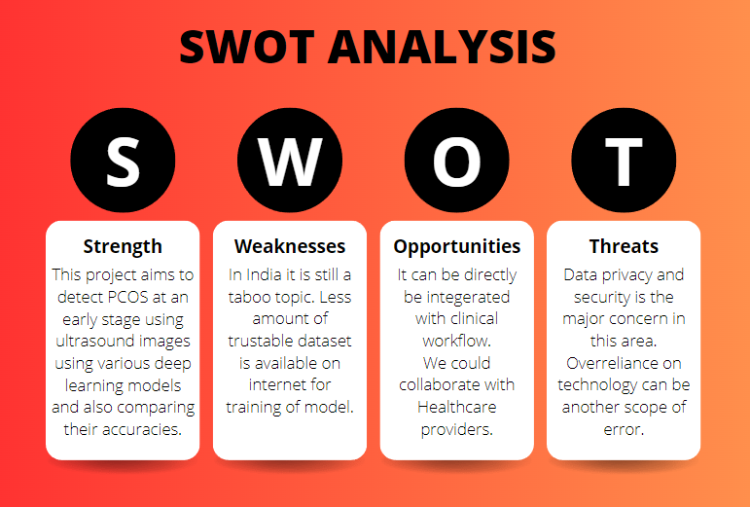
Literature Review
SWOT analysis

Slide 11
Objective
Main Objective:
The primary goal of this project is to correctly predict whether the patient is infected with PCOS or not using the ultrasound image.
Sub Objectives:
Feature Extraction from Image Dataset: Utilize image processing techniques to identify and extract relevant features from the image dataset. This aims to enhance the model's accuracy and adaptability to variations in images.
Data Augmentation for Model Training: Implement data augmentation strategies to expand the training dataset. This step is crucial for enhancing the model's generalization and performance by exposing it to a diverse set of images.
Conduct Comparative Analysis of Deep Learning Models: Perform a comprehensive comparative analysis of various deep learning models. Evaluate their performance based on the accuracy of the results they produce. This analysis will provide insights into the effectiveness of different models under specific conditions.

Slide 12
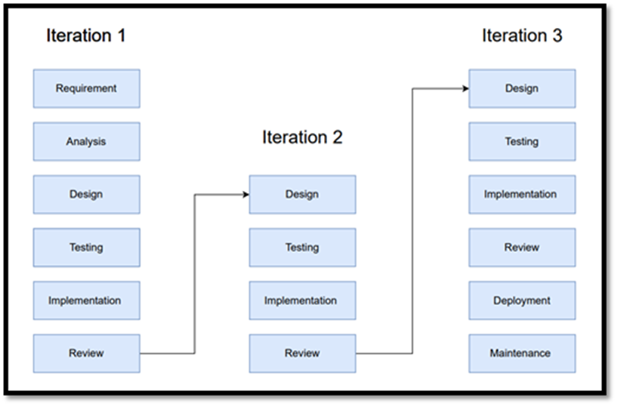
Methodology
Reference Software model
We will be using the Iterative Model to implement our project. The iterative method begins with a basic implementation of a limited set of software requirements in the iterative model, then repeatedly improves the evolving versions until the entire system is built and prepared for deployment.

Slide 13
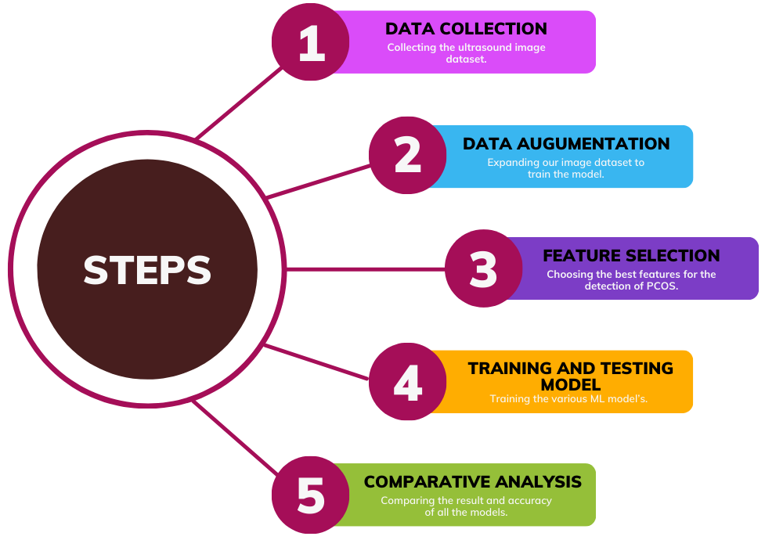
Methodology
Steps

Slide 14
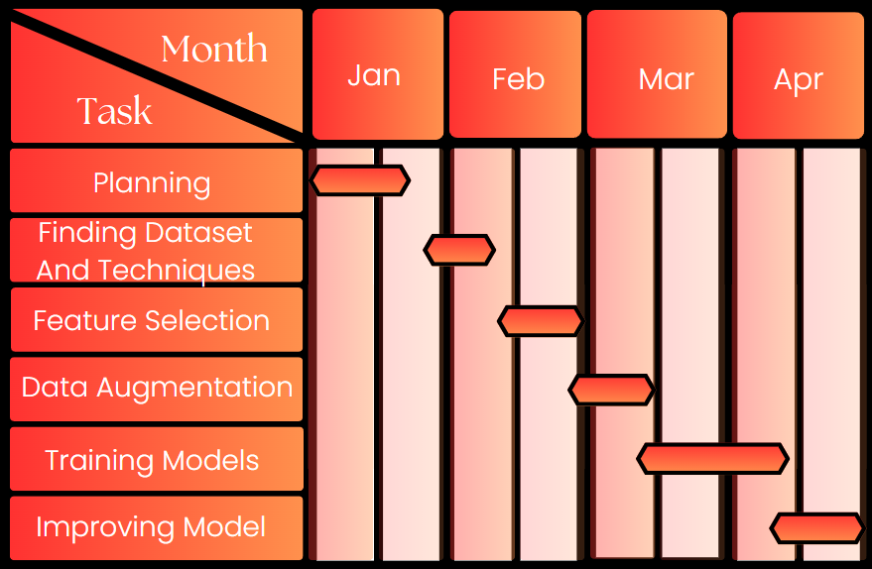
Methodology
Timeline

Slide 15
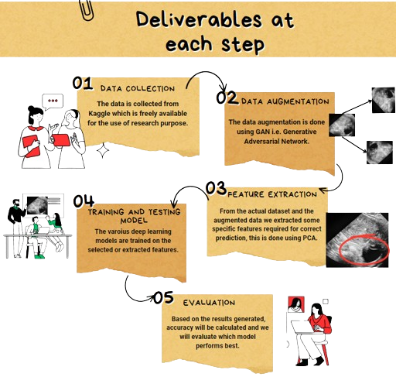
Methodology

Slide 16
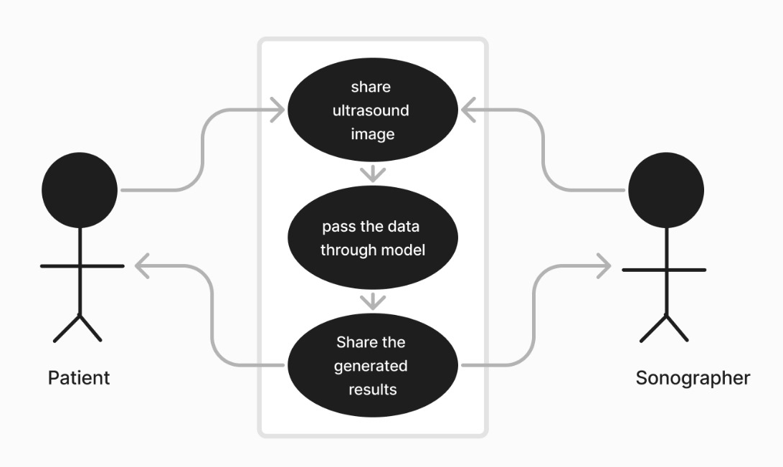
Working Model
Requirement analysis (Link of SRS):
SRS
Technical Diagram:
UML Diagram

Slide 17
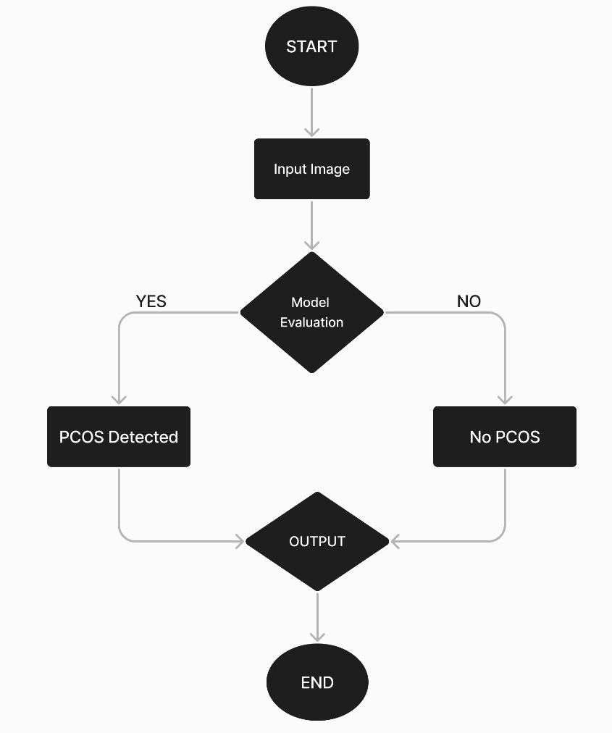
Working Model
Technical Diagram:
Flow Chart

Slide 18
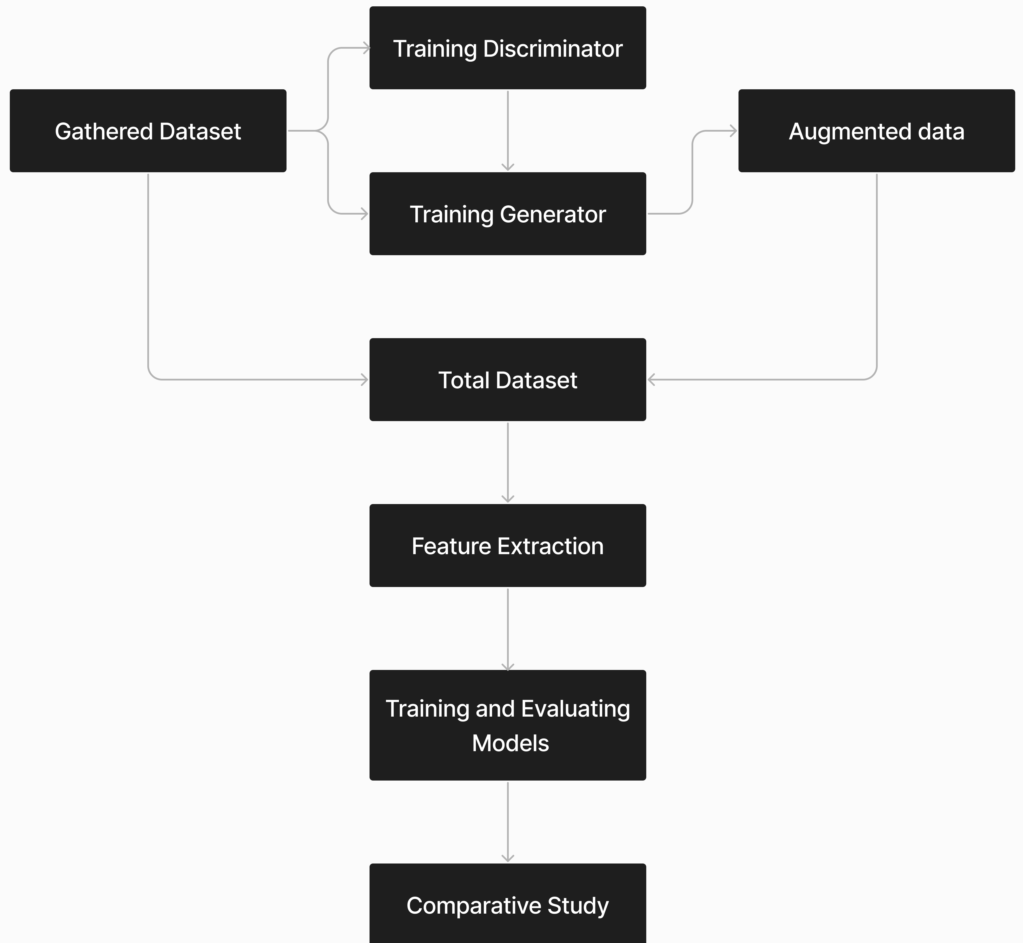
Working Model
Working Module:

Slide 19
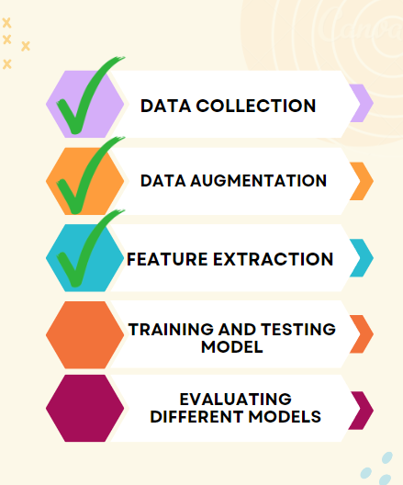
Working Model
Attained Deliverable :

Slide 20
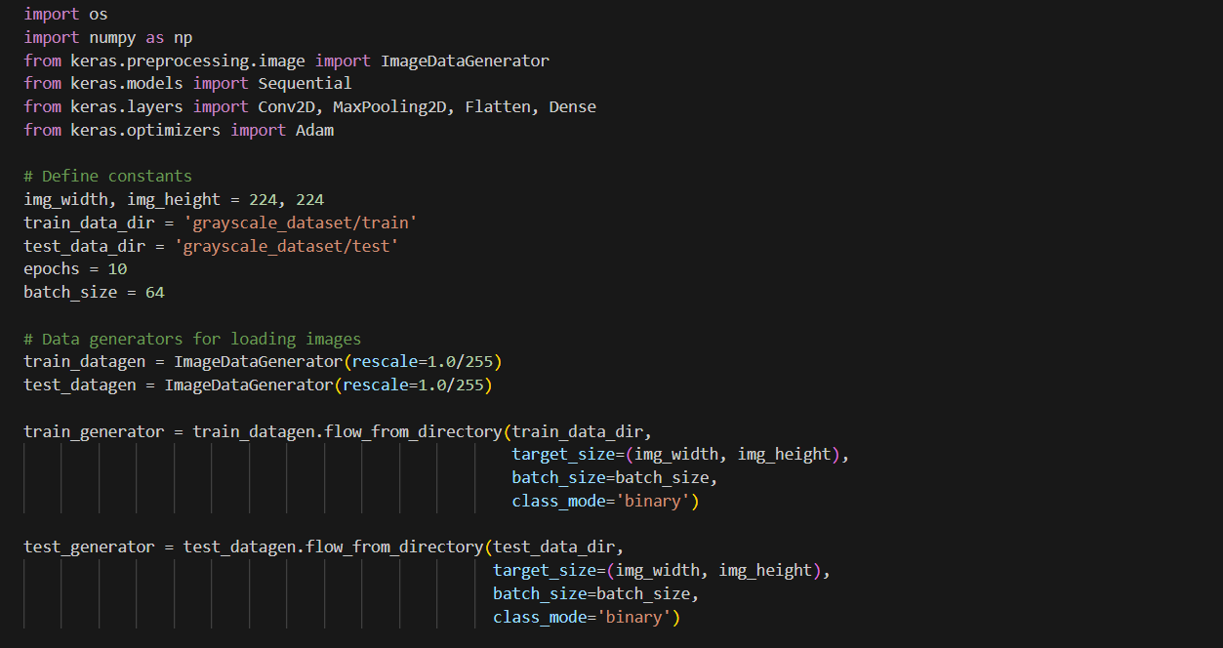
Results
VGG16:

Slide 21
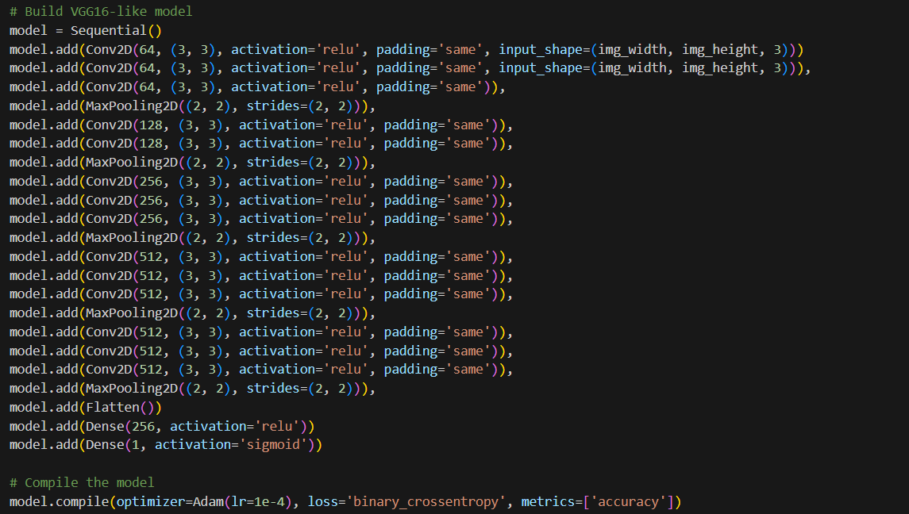

Slide 22
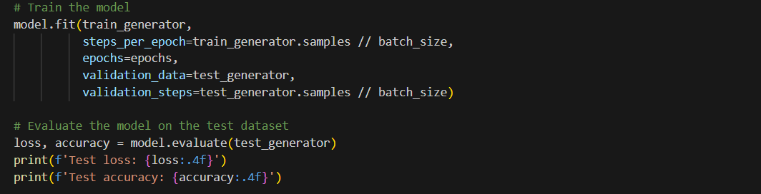


Slide 23
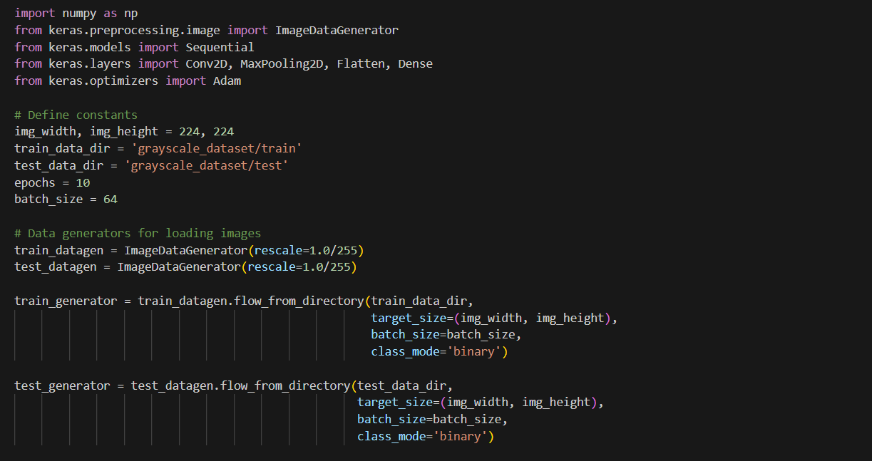
VGG19:

Slide 24
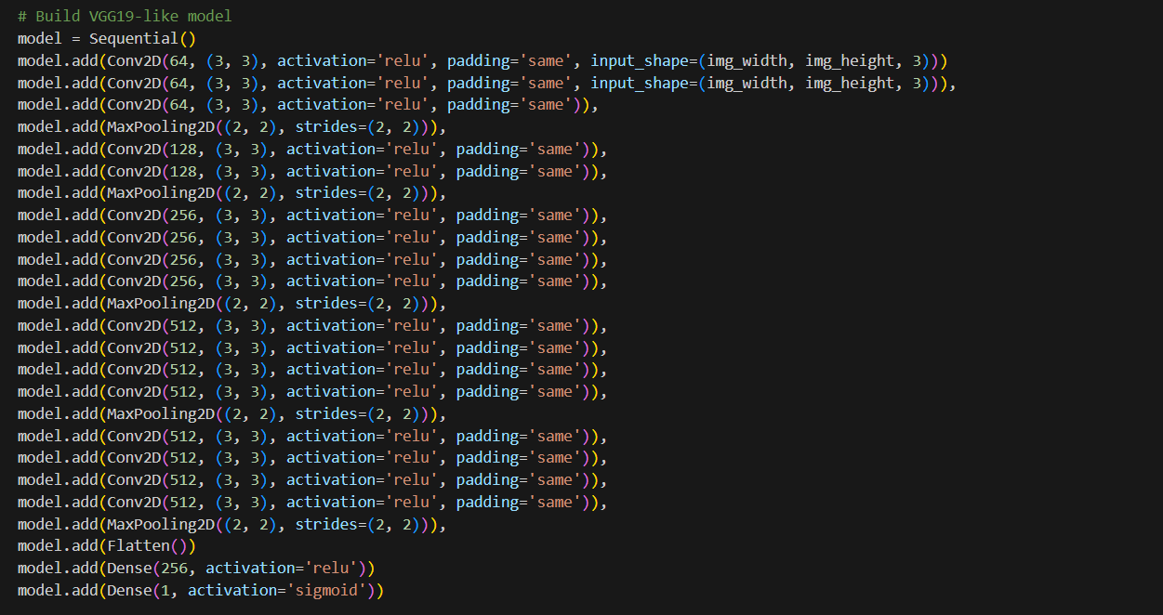

Slide 25
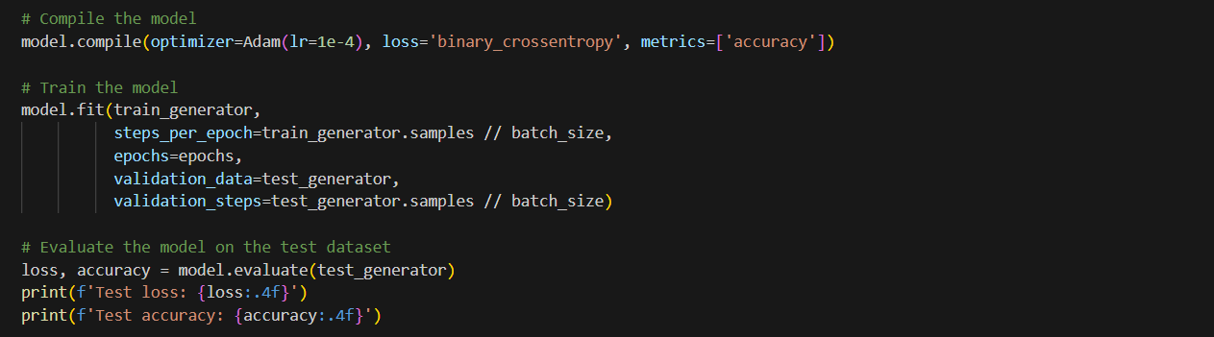

Slide 26
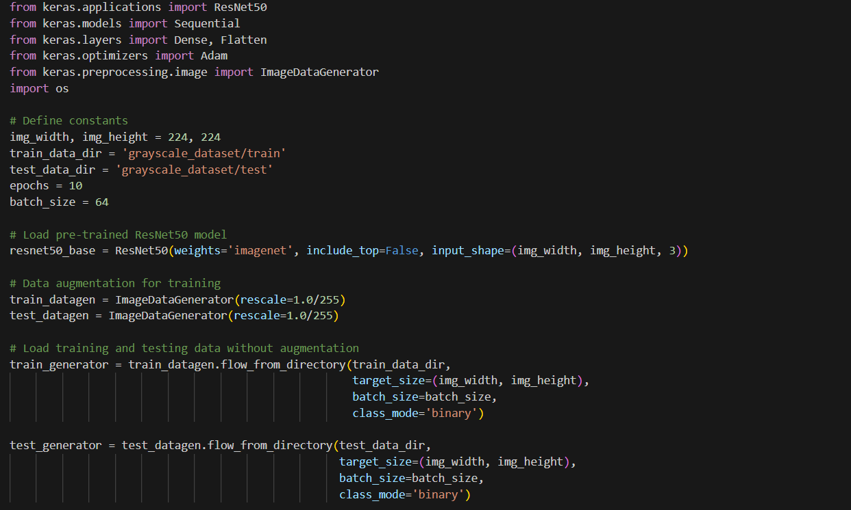
Resnet50:

Slide 27
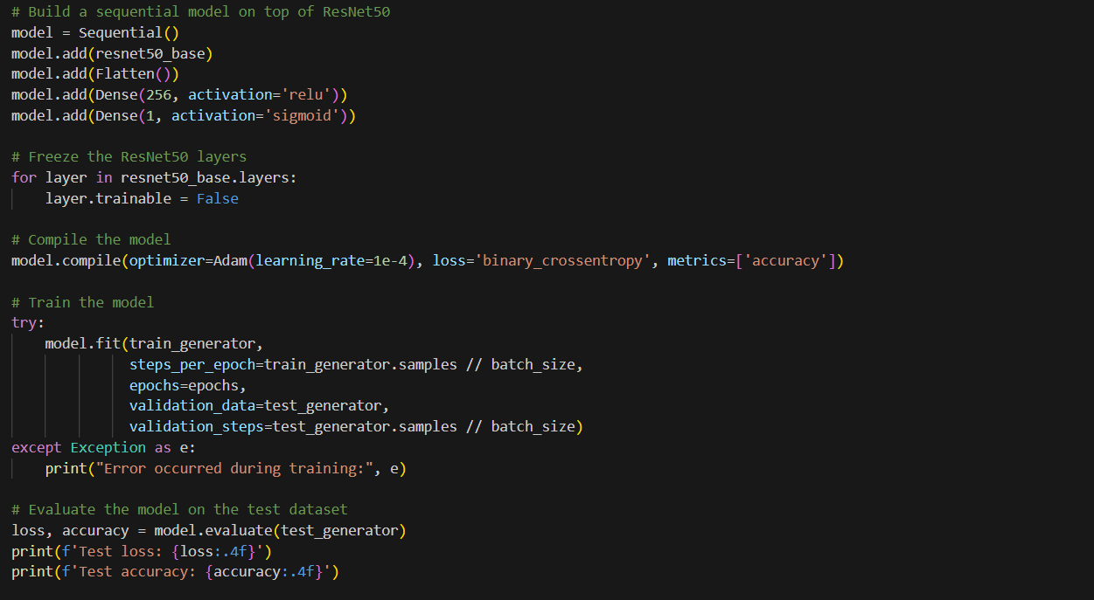

Slide 28
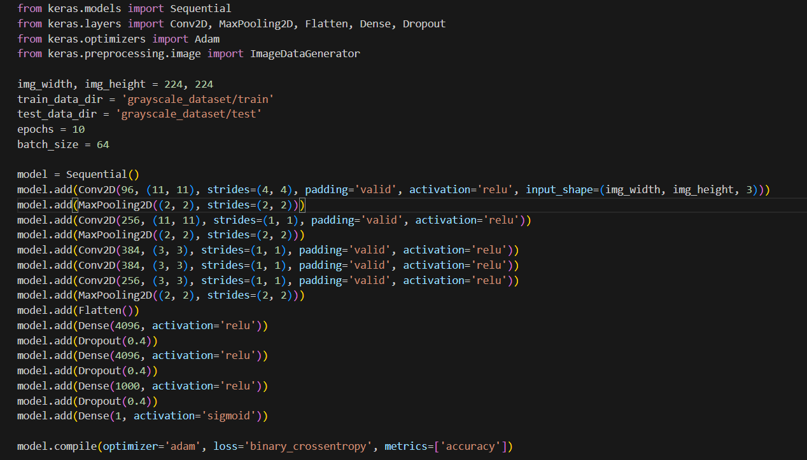
AlexNet:

Slide 29
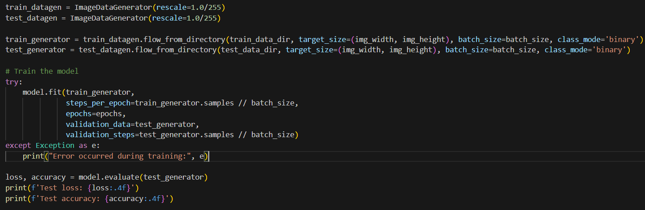

Slide 30
Conclusion
Comparative analysis
Models | Architecture | Computational Complexity | Accuracy
VGG16 | 16 layers (13 Convolutional + 3 Fully Connected) | High computational cost due to depth and parameters | 69.56%
VGG19 | 19 layers (16 Convolutional + 3 Fully Connected) | Similar to VGG16 | 87.48%
ResNet50 | 50 layers with residual connections (Residual Blocks) | More computationally efficient than VGG models | 97.43%
AlexNet | 8 layers (5 Convolutional + 3 Fully Connected) | Less computationally complex compared to VGG and ResNet | 98.33%

Slide 31
Reference
List of cited papers
[1]Aslam, S., & Rabie, T. F. (2023, February). Principal Component Analysis in Image Classification: A review. In 2023 Advances in Science and Engineering Technology International Conferences (ASET) (pp. 1-7). IEEE.
[2] Chitra, P., Srilatha, K., Sumathi, M., Jayasudha, F. V., Bernatin, T., & Jagadeesh, M. (2023, March). Classification of Ultrasound PCOS Image using Deep Learning based Hybrid Models. In 2023 Second International Conference on Electronics and Renewable Systems (ICEARS) (pp. 1389-1394). IEEE.
[3] Suha, S. A., & Islam, M. N. (2022). An extended machine learning technique for polycystic ovary syndrome detection using ovary ultrasound image. Scientific Reports, 12(1), 17123.
[4] Aggarwal, A., Mittal, M., & Battineni, G. (2021). Generative adversarial network: An overview of theory and applications. International Journal of Information Management Data Insights, 1(1), 100004.
[5] Sumathi, M., Chitra, P., Prabha, R. S., & Srilatha, K. (2021, February). Study and detection of PCOS related diseases using CNN. In IOP Conference Series: Materials Science and Engineering (Vol. 1070, No. 1, p. 012062). IOP Publishing.

Slide 32
Thank You

