Slide 1


Major Project
PCause: PCOS detection system based on deep learning model using ultrasound images
Presented by:
R2142210244- Charu Gupta
R2142210448- Lakshay Agarwal
Mentored By:
Ms. Sugandha Sharma

Slide 2
Content
Introduction
Literature Review
Objectives
Methodology
References

Slide 3
Introduction
Motivation:
Polycystic Ovary Syndrome (PCOS) is a common yet challenging condition affecting millions of women worldwide, often leading to complications like infertility and metabolic disorders. However, accurate diagnosis remains difficult due to reliance on subjective manual interpretation of ultrasound images, resulting in inconsistencies and delayed treatment. PCause is driven by the need for an automated, AI-powered solution that enhances diagnostic accuracy, reduces the burden on healthcare professionals, and enables early intervention. By integrating deep learning and advanced image processing, PCause aims to revolutionize PCOS detection, ensuring timely and personalized treatment while advancing medical research and patient awareness.
Problem Statement:
The increasing prevalence of PCOS and the challenges of accurate diagnosis highlight the need for an automated diagnostic system. Traditional methods rely on manual ultrasound interpretation, leading to inconsistencies and placing a burden on healthcare providers. Despite technological advancements, there is a lack of AI-driven tools for reliable PCOS detection. PCause addresses this gap by leveraging image processing and deep learning to ensure early, accurate diagnosis, enabling personalized treatment and improving healthcare outcomes.

Slide 4
Introduction
Area of application:
The PCause model can be highly beneficial in the healthcare sector for addressing PCOS which is a common endocrine disorder affecting women of reproductive age, characterized by hormonal imbalances, irregular menstrual cycles, and the presence of cysts on the ovaries.
PCause model could be applied to the field of PCOS:
Early Detection and Diagnosis: The model can analyze a wide range of patient data and by processing this information, it can assist healthcare professionals in early detection and accurate diagnosis of PCOS.
Later the model can be used for:
Personalized Treatment Plans
Research and Development
Patient Education and Support
Dataset and input format:
Dataset
The image dataset is in .jpg format

Slide 5
Literature Review
Cite Related work
Principal Component Analysis (PCA) as a pivotal tool for enhancing image classification in computer vision. PCA efficiently reduces the dimensionality of high-dimensional datasets, improving interpretability and visualization. The integration of PCA with convolutional neural networks (CNNs) demonstrates its role in optimizing computational efficiency and accuracy in classifying diverse datasets. Overall, PCA emerges as a crucial technique, simplifying complex data representations and contributing to the advancement of image classification methodologies in artificial intelligence applications.
The paper underscores the potential of advanced deep learning models, including Alexnet, Inception V3, Resnet50, and VGG16, in enhancing the accuracy of Polycystic Ovary Syndrome (PCOS) diagnosis from ultrasound images. The utilization of transfer learning techniques, particularly in the medical field, showcases the effectiveness of pre-trained models in image analysis. Additionally, feature selection, image pre-processing, and evaluation metrics like precision, recall, sensitivity, specificity, and F1 score play crucial roles in fine-tuning and evaluating the models. This research contributes significantly to advancing automated PCOS diagnosis, offering potential benefits for timely and accurate medical interventions.

Slide 6
Literature Review
The paper proposes a pioneering approach for Polycystic Ovary Syndrome (PCOS) detection using a hybrid method that combines deep learning and traditional machine learning techniques. The study utilizes transfer learning with a pre-trained VGG16 model for feature extraction from ultrasound images. Compared to existing methods, the proposed approach achieves a remarkable accuracy in PCOS detection with efficient execution. While the method shows certain limitations that include a small dataset and challenges in explaining the model's decisions. The main aim of this research is to address such health issues and explore applications in detecting other clinical disorders.
Generative Adversarial Networks (GANs) uses image processing, emphasizing their role in generating realistic images through adversarial training. One of the impactful applications of Generative Adversarial Networks (GANs) in medical imaging, specifically in enhancing ultrasound image resolution. GANs integrated with deep learning models facilitate end-to-end encoding and decoding processes, enabling the generation of high-resolution images from routinely captured prostate ultrasound scans. Moreover, GANs are useful in creating different types of abnormalities in medical images, even when there are only a few examples available for each abnormality. The incorporation of deep convolutional GANs further enables the transformation of 2D images into 3D, expediting the analysis of medical images.

Slide 7
Literature Review
Using Convolutional Neural Networks (CNN) as an image classifier, utilizing feature extraction attempts to effectively detect ovarian cysts in ultrasound images. The algorithm is trained on a dataset, using input ultrasound images as training data. It classifies test data within the dataset to determine if the ovary is affected, providing critical information on parameters such as area, solidity, extent, and perimeter affected by the cysts. This approach enhances diagnostic capabilities, showcasing the potential of CNNs in medical image analysis for precise identification and characterization of ovarian abnormalities, particularly in the context of disorders like Polycystic Ovary Syndrome (PCOS).
Polycystic ovary syndrome (PCOS) is a prevalent endocrine disorder in young women, characterized by ovulatory dysfunction, hyperandrogenism, and micropolycystic ovaries. Hyperandrogenism is the hallmark of PCOS, contributing to symptoms like hirsutism, acne, and anovulation. The androgen receptor (AR) gene, located in the Xq11–q12 region, has a polymorphic region in exon 1 comprising (CAG)n trinucleotide repeats. Variations in the length of these repeats affect AR activity and have been linked to androgen-related disorders. This systematic review aimed to assess the association between AR gene polymorphism and PCOS. The findings suggest that shorter CAG repeats may correlate with PCOS, indicating that AR polymorphism could serve as a potential biomarker for the disorder. However, conflicting results in the literature and limited data underscore the need for further studies to clarify this association and its implications for PCOS pathophysiology.

Slide 8
Literature Review
PCOS affects 5–10% of women, causing irregular periods, hormonal imbalances, and ovarian cysts. New diagnostic tools like AMH testing and treatments such as GLP-1 receptor agonists and SGLT2 inhibitors help manage insulin resistance, weight, and blood sugar. IVF and ICSI improve fertility, while minimally invasive options like UAE address complications like fibroids. Further research is needed to ensure long-term safety and personalized treatment.
Recent research leverages DenseNet-121 for multi-disease detection in chest X-rays, addressing limitations in single-disease diagnosis. Using the ChestX-Ray8 dataset (108,948 images, 32,717 patients), the model identifies eight diseases and fourteen pathological conditions. Compared to radiologists, DenseNet-121 improves accuracy and efficiency, demonstrating AI’s potential in healthcare. This study highlights the role of deep learning in enhancing early detection and assisting medical professionals in diagnosing multiple conditions simultaneously.

Slide 9
Literature Review
Inference from Literature
Citation | Inference | Algorithms | Results
[1] | Principal Component Analysis (PCA) is a crucial technique in image classification, not only for dimension reduction but also for revealing significant features, leading to highly accurate results, as evidenced by recent studies across various datasets and evaluation metrics. | PCA | Authors used PCA dimension reduction and got higher accuracy for indian pines (∼ 96%), salians (∼ 99%), pavia university (∼ 58%, ∼ 99%) as compared to singular value decomposition and independent component analysis.
[2] | The paper presents a prediction method for Polycystic Ovary Syndrome (PCOS) using transfer learning techniques, including AlexNet, Inception V3, ResNet50, VGG16, and Hybrid Models, through feature extraction and performance coefficient analysis. | AlexNet, Inception V3, ResNet50, VGG16, and Hybrid Models | Accuracy for various models are AlexNet - 78% , Inception V3 - 73% , ResNet50 - 90% , VGG16 - 88% , and Hybrid Models - 95%.
[3] | The research proposes an extended machine learning approach for PCOS prediction using CNN for feature extraction from ovary ultrasound images, combined with ensemble learning techniques, with VGGNet16 and XGBoost yielding the best performance. | “VGGNet16” model with meta-learner “XGBoost” | Accuracy of 99.89%
[4] | The deep learning associated Generated Adversarial Networks (GAN) has presenting remarkable outcomes on image segmentation. In this study, the authors have presented a systematic review analysis on recent publications of GAN models and their applications. | GAN | GAN models integrated with deep learning enable high-resolution ultrasound image generation, facilitate lesion classification with minimal data, and accelerate 3D image analysis through optical clearing techniques.
[5] | The paper presents CNN-based algorithms developed in Python for classifying ovarian cysts filled with blood or fluid using ultrasound images, leveraging CNN-based image processing for feature extraction and classification, using an independent dataset related to PCOS for evaluation. | CNN | The test dataset is used for performing the feature extraction process and the results are met with 85% accuracy using performance factors

Slide 10
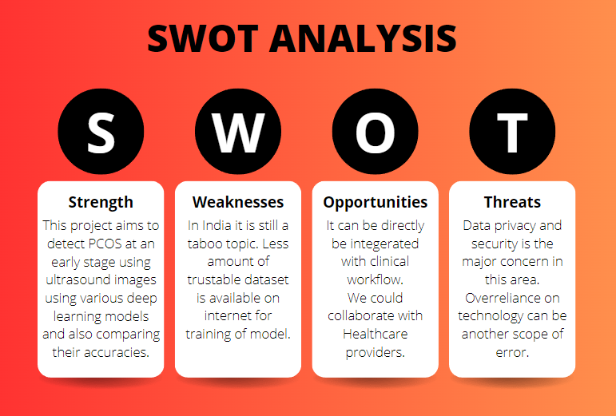
Literature Review
SWOT analysis

Slide 11
Objective
Main Objective:
The primary objective of the current project is to develop an application for deploying a deep learning model to detect PCOS using ultrasound images. Additionally, we will create interactive dashboards for visualization, enabling users to analyze and interpret the results effectively
Sub Objectives:
Creating user authentication
Creating dashboard
Uploading screen
Prediction result screen
Analytics screen
Questionnaire Screen

Slide 12
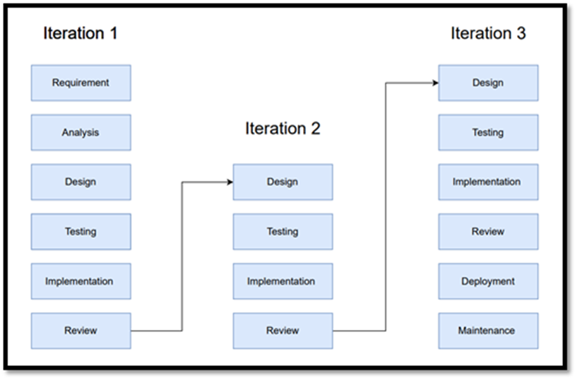
Methodology
Reference Software model
We will be using the Iterative Model to implement our project. The iterative method begins with a basic implementation of a limited set of software requirements in the iterative model, then repeatedly improves the evolving versions until the entire system is built and prepared for deployment.

Slide 13
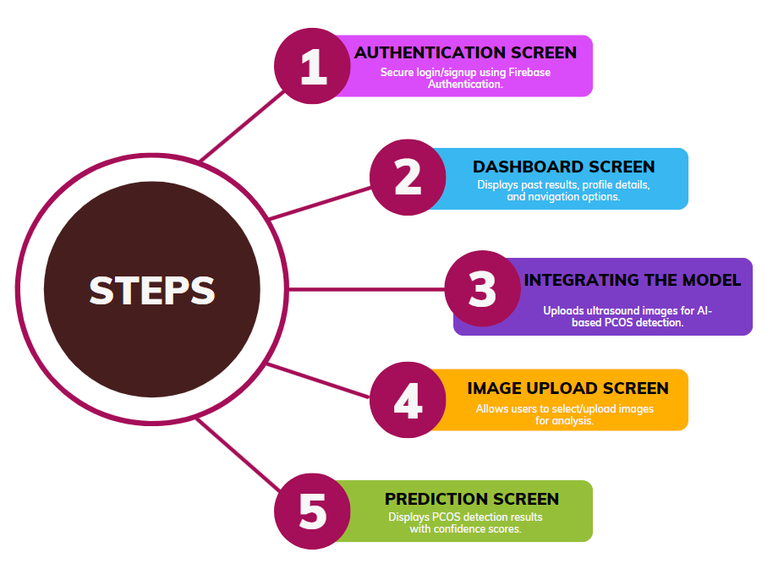
Methodology
Steps

Slide 14
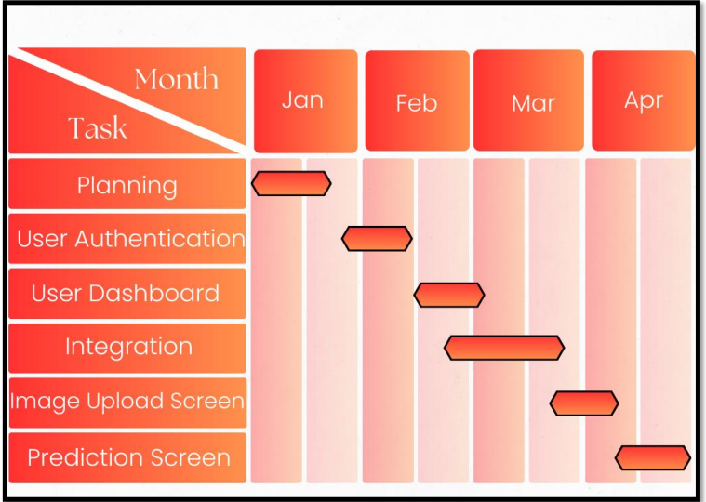
Methodology
Timeline

Slide 15
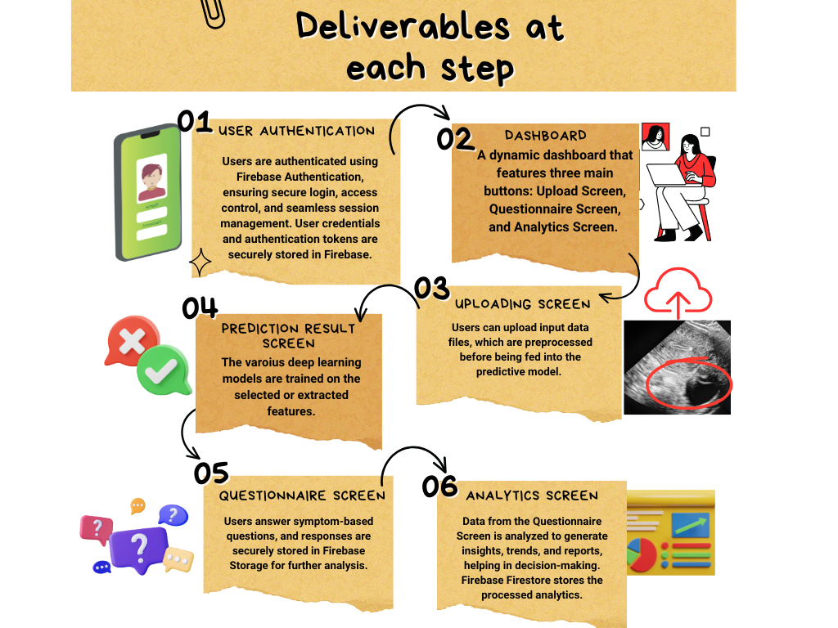
Methodology

Slide 16
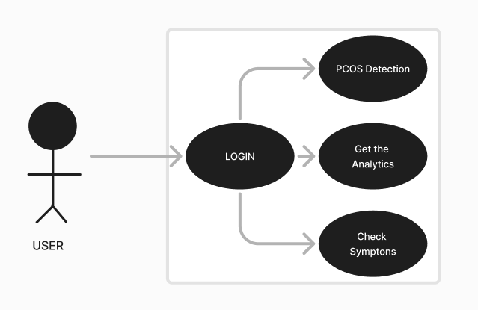
Working Model
Requirement analysis (Link of SRS):
Project Report
Technical Diagram:
UML Diagram

Slide 17
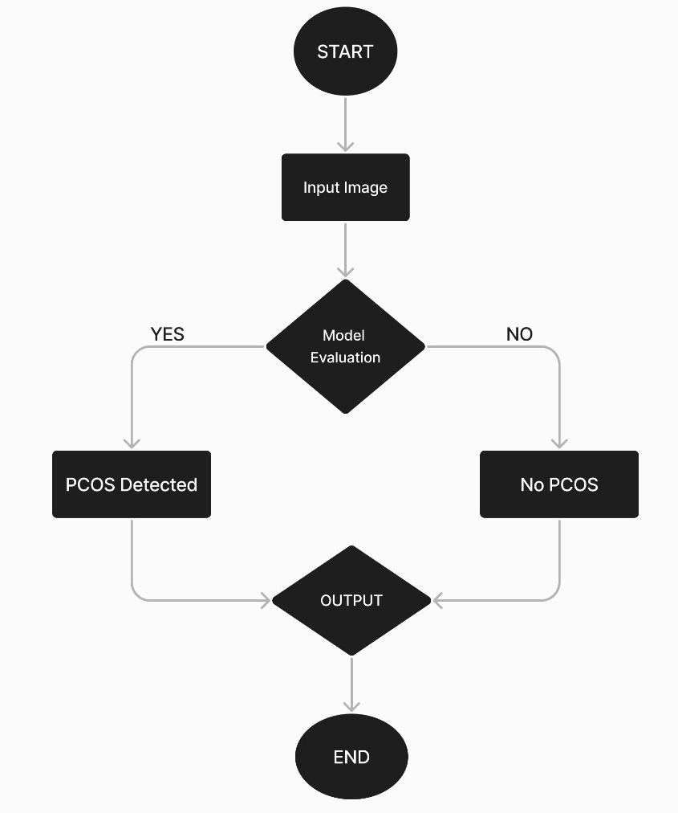
Working Model
Technical Diagram:
Flow Chart

Slide 18
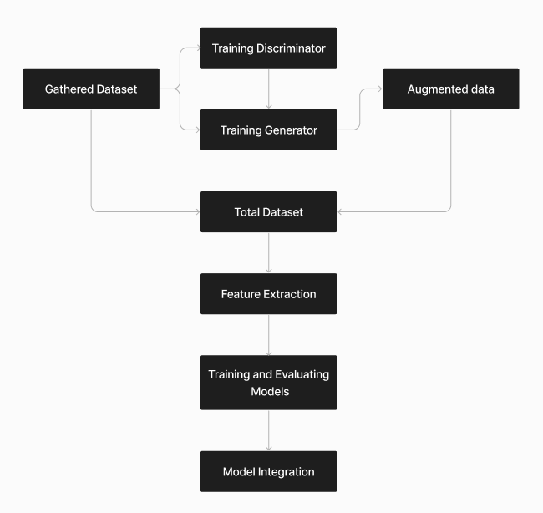
Working Model
Working Module:

Slide 19
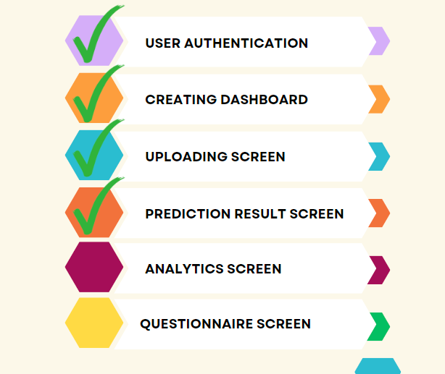
Working Model
Attained Deliverable :

Slide 20
Reference
List of cited papers
[1]Aslam, S., & Rabie, T. F. (2023, February). Principal Component Analysis in Image Classification: A review. In 2023 Advances in Science and Engineering Technology International Conferences (ASET) (pp. 1-7). IEEE.
[2] Chitra, P., Srilatha, K., Sumathi, M., Jayasudha, F. V., Bernatin, T., & Jagadeesh, M. (2023, March). Classification of Ultrasound PCOS Image using Deep Learning based Hybrid Models. In 2023 Second International Conference on Electronics and Renewable Systems (ICEARS) (pp. 1389-1394). IEEE.
[3] Suha, S. A., & Islam, M. N. (2022). An extended machine learning technique for polycystic ovary syndrome detection using ovary ultrasound image. Scientific Reports, 12(1), 17123.
[4] Aggarwal, A., Mittal, M., & Battineni, G. (2021). Generative adversarial network: An overview of theory and applications. International Journal of Information Management Data Insights, 1(1), 100004.
[5] Sumathi, M., Chitra, P., Prabha, R. S., & Srilatha, K. (2021, February). Study and detection of PCOS related diseases using CNN. In IOP Conference Series: Materials Science and Engineering (Vol. 1070, No. 1, p. 012062). IOP Publishing.

Slide 21
Thank You

