Slide 1
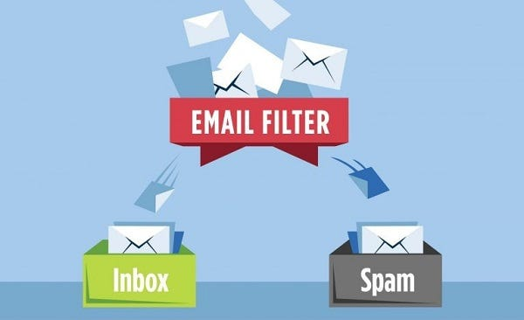
Spam Classifier Using Logistic Regression And NLP

Slide 2
What is NLP?
Natural language processing (NLP) is a machine learning technology that gives computers the ability to interpret, manipulate, and comprehend human language. NLP softwares process the data, analyze the intent or sentiment in the message, and respond in real time to human communication.
NLP implementation steps:
Typically, NLP implementation begins by gathering and preparing unstructured text or speech data from sources like cloud data warehouses, surveys, emails, or internal business process applications.
Pre-processing
The NLP software uses pre-processing techniques such as tokenization, stemming, lemmatization, and stop word removal to prepare the data for various applications.
Here's a description of these techniques:
Tokenization breaks a sentence into individual units of words or phrases.
Stemming and lemmatization simplify words into their root form. For example, these processes turn "starting" into "start."
Stop word removal ensures that words that do not add significant meaning to a sentence, such as "for" and "with," are removed.
https://aws.amazon.com/what-is/nlp/

Slide 3
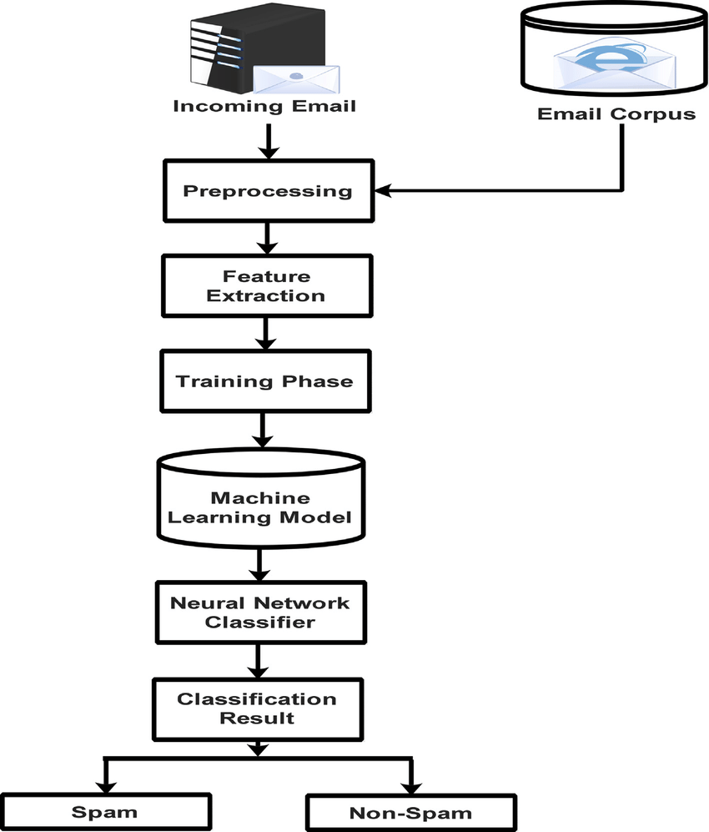
Workflow

Slide 4
1. Importing Libraries:
Pandas – This library helps to load the data frame in a 2D array format and has multiple functions to perform analysis tasks in one go.
Numpy – Numpy arrays are very fast and can perform large computations in a very short time.
NLTK – Natural Language Tool Kit provides various functions to process the raw textual data.
Scikit-learn- Python library that provides efficient implementation of various algorithms and utilities for data preprocessing, model evaluation, and model selection.

Slide 5
2. Data Loading and Preprocessing
Data Cleaning:
Drop Unnecessary Columns: Remove columns that are not needed for analysis(e.g., unnamed columns).
Column Renaming: Rename columns to improve clarity and consistency (e.g., rename 'v1' to 'target', 'v2' to 'text’).
Target Variable Encoding:
Label Encoding: Encode the target variable ('spam'/'ham') into numerical values (0 for 'ham', 1 for 'spam') using LabelEncoder.
Handling Duplicates and Missing Values:
Duplicate Removal: Check for and remove duplicate rows, keeping only the first occurrence.
Missing Value Check: Verify if there are any missing values in the dataset and handle them appropriately.

Slide 6
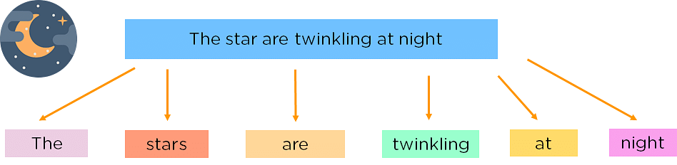
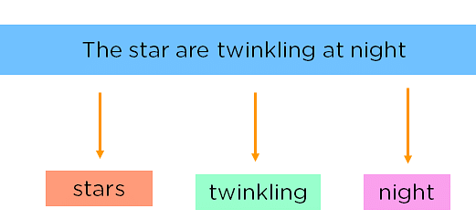
3. Text Processing
1. Tokenization:
For the algorithm to understand sentences, you need to get the words in a sentence and explain them individually to our algorithm. So, you break down your sentence into its constituent words and store them. This is called tokenizing, and each world is called a token.
2. Removing Stop Words:
The learning process can be made faster by getting rid of non-essential words, which add little meaning to our statement and are just there to make our statement sound more cohesive. Words such as was, in, is, and, the, are called stop words and can be removed.

Slide 7
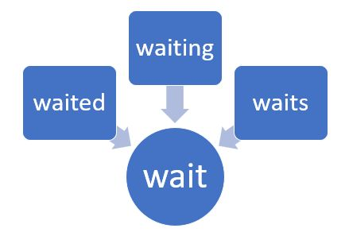
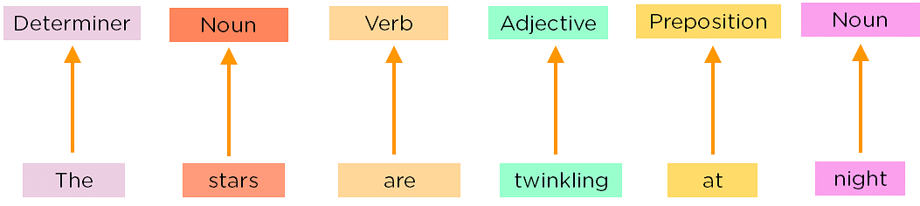
3. Stemming:
Reduce words to their root form using stemming (e.g., 'running' becomes 'run') to reduce dimensionality.
4. Part of Speech Tagging:
Explaining the concept of nouns, verbs, articles, and other parts of speech to the machine by adding these tags to our words. This is called ‘part of’.

Slide 8
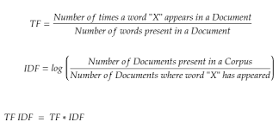
4. Feature Extraction
TF-IDF Vectorization:
Term Frequency-Inverse Document Frequency (TF-IDF): Convert text data into numerical feature vectors.
TF-IDF Vectorizer: Calculate TF-IDF scores for each term in the corpus, emphasizing words that are frequent in a document but rare across documents.

Slide 9
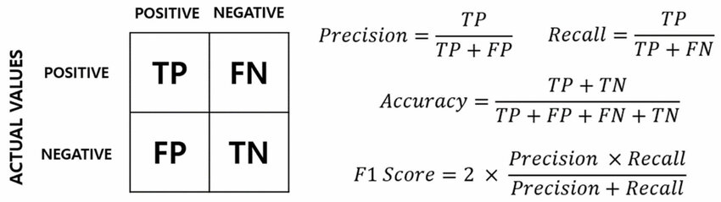
5. Model Training and Evaluation
Train-Test Split:
Split the dataset into training and testing sets to evaluate model performance.
Initialize Classifier:
Initialize a logistic regression classifier for binary classification of spam and ham messages.
Train and Evaluate Classifier:
Fit the classifier to the training data and evaluate its performance on the testing data.
Evaluation metrics such as accuracy and precision to assess the classifier's effectiveness in distinguishing between spam and ham messages.

Slide 10
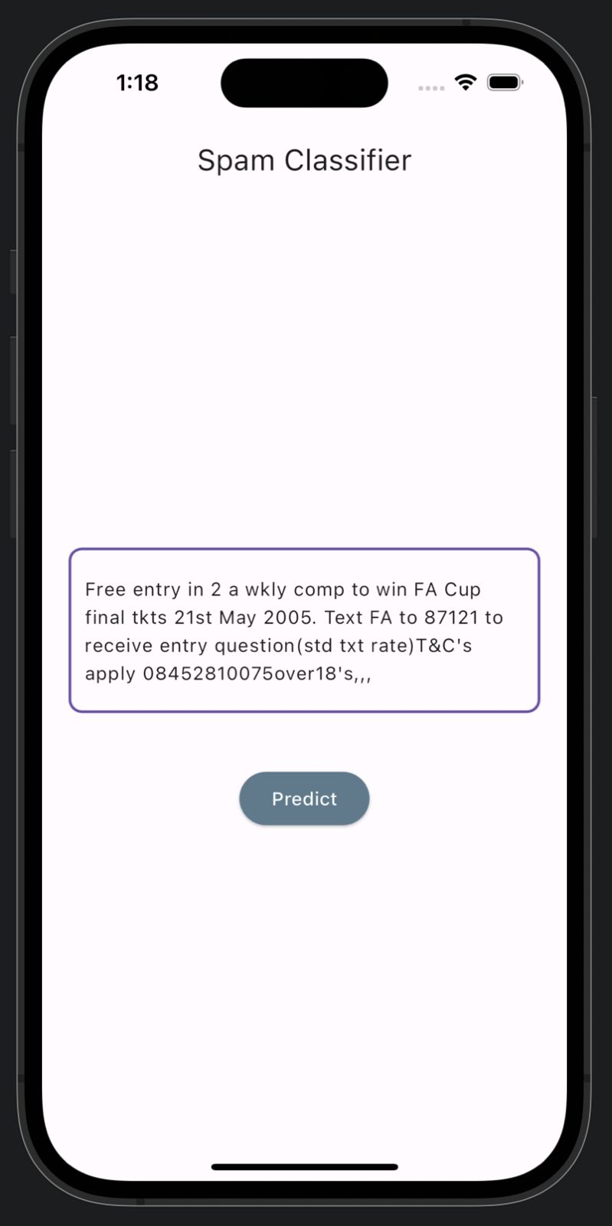
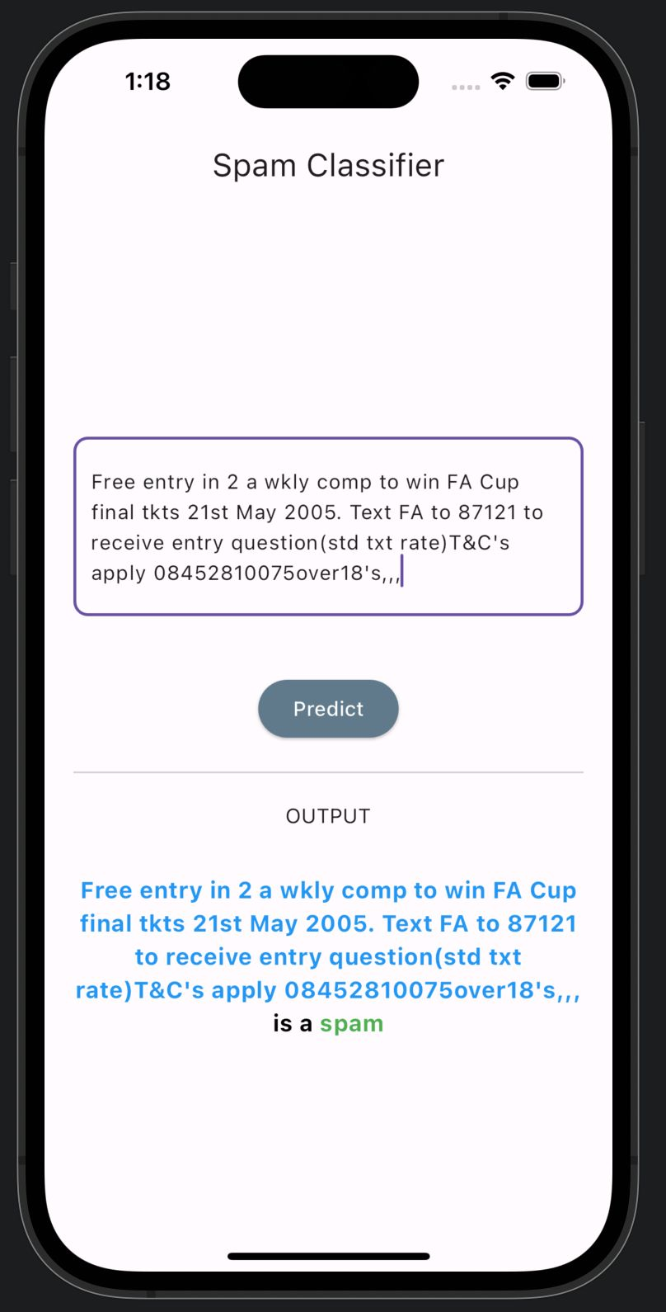
Results

Slide 11
THANK YOU
code

