Slide 1


Minor Project
TradeHelp: A helping hand for the stock market
Presented by:
R2142210244- Charu Gupta
R2142210448- Lakshay Agarwal
Mentored By-
Dr. Niharika Singh

Slide 2
Content
Introduction
Literature Review
Objectives
Methodology
Working Model
Results
Conclusion
References

Slide 3
Introduction
Technical background of project
Technical Concepts used
Linear Regression model
Motivation
TradeHelp project is inspired by the growing need for reliable stock market predictions and well-informed decision-making, which aims to have important consequences for monetary gain and risk management. In this project we will combine technical expertise with a strong interest in finance, and offer helpful instructional resources for anyone looking to grasp data analysis and machine learning in a real-world setting.

Slide 4
Introduction
Problem Statement
Developing an accurate stock market prediction system is essential due to the volatility and unpredictability of financial markets. Current methods often fall short, creating risks and missed opportunities for investors. This project aims to create a reliable predictive model to improve decision-making, managing risks, and gaining a competitive edge in the financial industry, while considering ethical and regulatory implications.
Area of application
Stock Market
Dataset and input format
Datasets
Formats: .txt and .csv

Slide 5
Literature Review
TITLE | INFERENCE
Stock Market Analysis Using Linear Regression and Decision Tree Regression [1] | In this paper, two supervised regression machine learning algorithms are taken and a statistic formula is used to predict the better accuracy of stock price and then comparing the performance based on the size of the dataset and algorithmically.
Analysis of stock market predictor variables using linear regression [2] | In this paper, there are two models having different features. One model having all the features and the other model with two features volume and adjusted close omitted. Based on these features various accuracy methods are used to analyse the performance.
Stock Price Prediction using Linear Regression in Machine Learning [3] | The paper anticipates the stock price of the organization on any day by utilizing straight relapse and polynomial relapse based on the exactness of the various models for regression.
stock market prediction using linear regression modeling | This site stated that linear regression models are gaining prominence in stock market prediction due to their potential to provide more accurate forecasts amidst the constantly changing stock prices.
Machine Learning Regression | This site gives a basic introduction of Machine Learning and knowledge about linear regression from absolute basics.
Regression Analysis and the Best Fitting Line using C++ | This article discusses the basics of linear regression and its implementation in the C++ programming language. It also helps to find the best fit line for the data.
Linear regression from scratch in c++ | This videos helped us to see the implementation of linear regression in c++ and also visualize using graph.

Slide 6
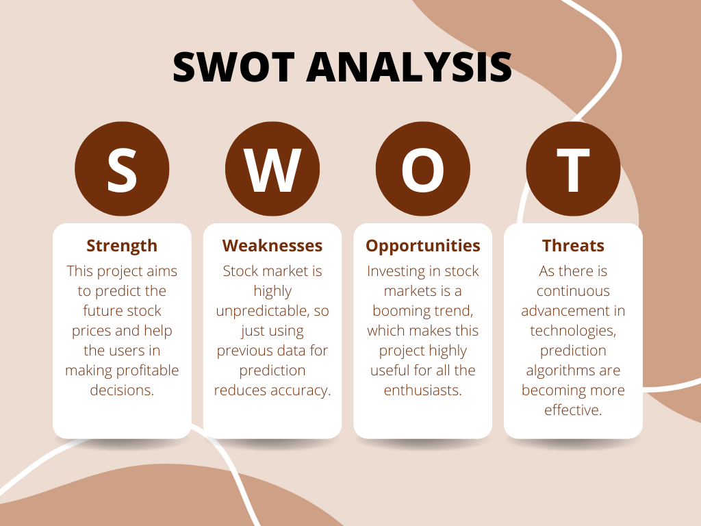
Literature Review

Slide 7
Objective
Main Objective
The core objective of this endeavour is to help the user in increasing the profits in stock market trading.
Sub Objective
Finding applicable stock pricing datasets
Preprocessing the dataset to filter out the input values
Training the model
Testing the model and checking accuracy
Improving the model accuracy based on the testing results

Slide 8
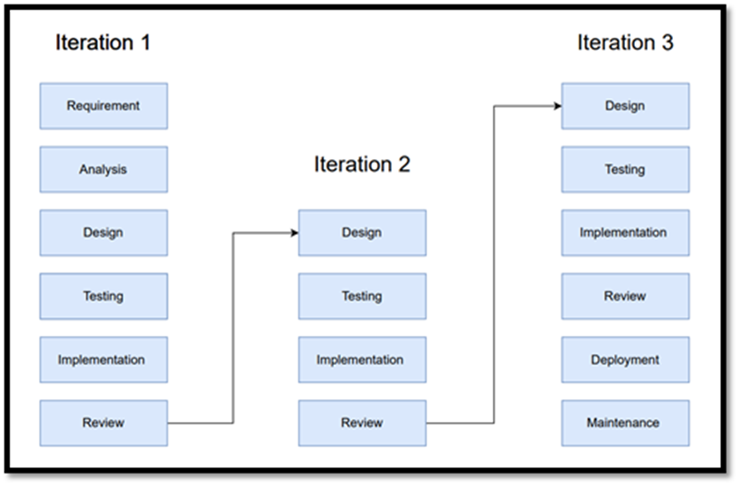
Methodology
Reference Software model
We will be using the Iterative Model to implement our project. The iterative method begins with a basic implementation of a limited set of software requirements in the iterative model, then repeatedly improves the evolving versions until the entire system is built and prepared for deployment.

Slide 9
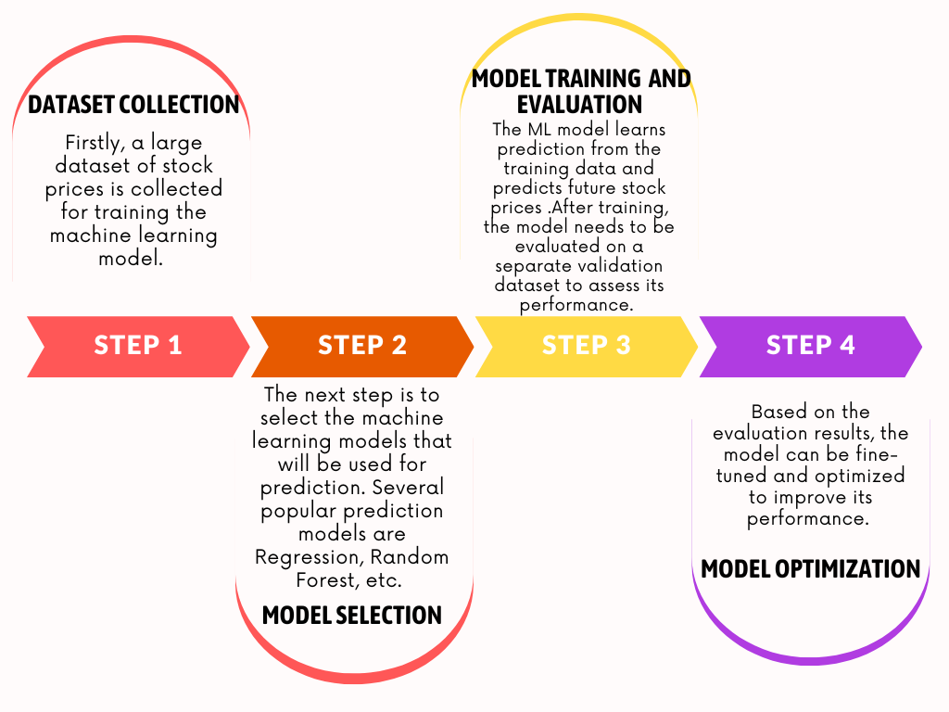
Methodology
Steps:

Slide 10
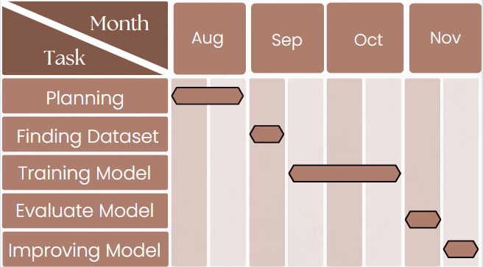
Methodology
Timeline

Slide 11
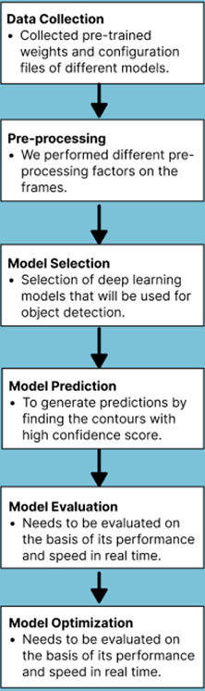
Working Model
Requirement analysis (Link of SRS)
SRS
Technical Diagram

Slide 12
Working Model
Working Module
Attained Deliverable

Slide 13
Results
Tests Cases
Outcome Graphs
Comparative Studies

Slide 14
Conclusion
Justification of Objectives
Future Scope

Slide 15
Reference
[1] Amit Gupta, T.J.Nagalakshmi. (2019). Stock Price Prediction using Linear Regression in Machine Learning.
[2]Seethalakshmi, Ramaswamy. (2018). Analysis of stock market predictor variables using linear regression. International Journal of Pure and Applied Mathematics.
[3]Karim, Rezaul & Alam, Md & Hossain, Rezaul. (2021). Stock Market Analysis Using Linear Regression and Decision Tree Regression.

Slide 16
Thank You

