Slide 1


Minor Project
TradeHelp: A helping hand for the stock market
Presented by:
R2142210244- Charu Gupta
R2142210448- Lakshay Agarwal
Mentored By-
Dr. Niharika Singh

Slide 2
Content
Introduction
Literature Review
Objectives
Methodology
Working Model
Results
Conclusion
References

Slide 3
Introduction
Technical Concepts used
Linear Regression model
Motivation
TradeHelp project is inspired by the growing need for reliable stock market predictions and well-informed decision-making, which aims to have important consequences for monetary gain and risk management. In this project we will combine technical expertise with a strong interest in finance, and offer helpful instructional resources for anyone looking to grasp data analysis and machine learning in a real-world setting.

Slide 4
Introduction
Problem Statement
Developing an accurate stock market prediction system is essential due to the volatility and unpredictability of financial markets. Current methods often fall short, creating risks and missed opportunities for investors. This project aims to create a reliable predictive model to improve decision-making, managing risks, and gaining a competitive edge in the financial industry, while considering ethical and regulatory implications.
Area of application
Stock Market
Dataset and input format
Datasets
Formats: .txt and .csv

Slide 5
Literature Review
TITLE | INFERENCE
Stock Market Analysis Using Linear Regression and Decision Tree Regression [1] | In this paper, two supervised regression machine learning algorithms are taken and a statistic formula is used to predict the better accuracy of stock price and then comparing the performance based on the size of the dataset and algorithmically.
Analysis of stock market predictor variables using linear regression [2] | In this paper, there are two models having different features. One model having all the features and the other model with two features volume and adjusted close omitted. Based on these features various accuracy methods are used to analyse the performance.
Stock Price Prediction using Linear Regression in Machine Learning [3] | The paper anticipates the stock price of the organization on any day by utilizing straight relapse and polynomial relapse based on the exactness of the various models for regression.
stock market prediction using linear regression modeling | This site stated that linear regression models are gaining prominence in stock market prediction due to their potential to provide more accurate forecasts amidst the constantly changing stock prices.
Machine Learning Regression | This site gives a basic introduction of Machine Learning and knowledge about linear regression from absolute basics.
Regression Analysis and the Best Fitting Line using C++ | This article discusses the basics of linear regression and its implementation in the C++ programming language. It also helps to find the best fit line for the data.
Linear regression from scratch in c++ | This videos helped us to see the implementation of linear regression in c++ and also visualize using graph.

Slide 6
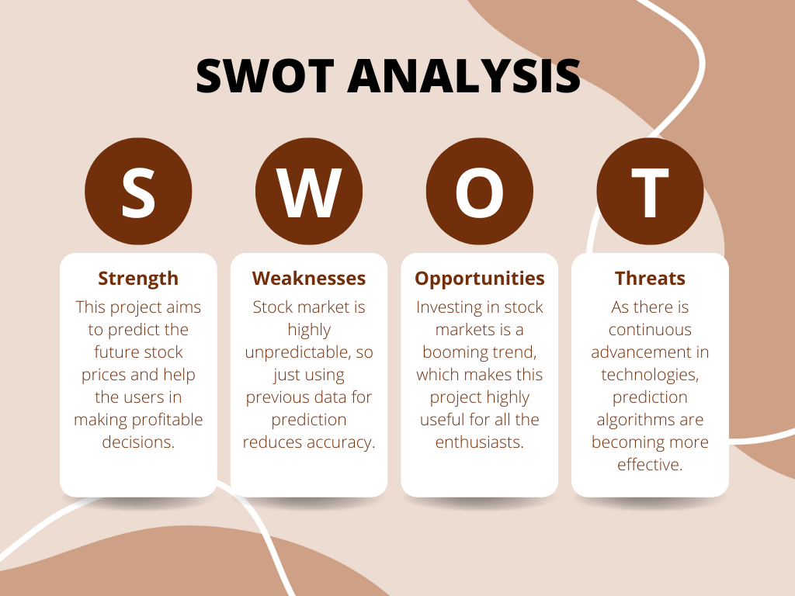
Literature Review

Slide 7
Objective
Main Objective
The core objective of this endeavour is to help the user in increasing the profits in stock market trading.
Sub Objective
Finding applicable stock pricing datasets
Preprocessing the dataset to filter out the input values
Training the model
Testing the model and checking accuracy
Improving the model accuracy based on the testing results

Slide 8
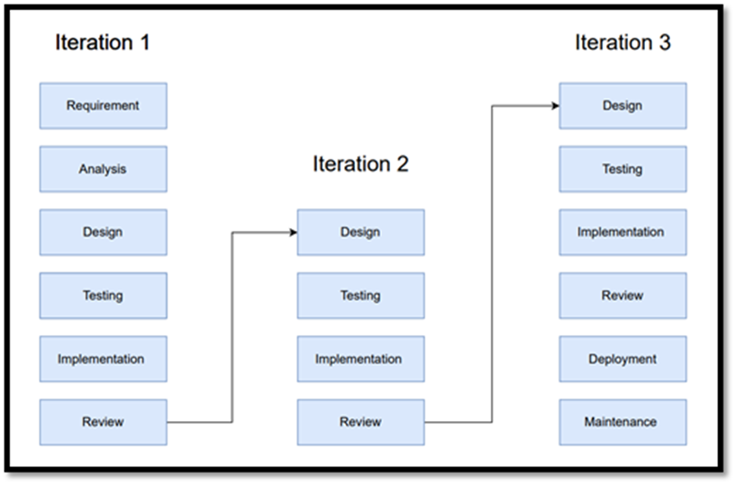
Methodology
Reference Software model
We will be using the Iterative Model to implement our project. The iterative method begins with a basic implementation of a limited set of software requirements in the iterative model, then repeatedly improves the evolving versions until the entire system is built and prepared for deployment.

Slide 9
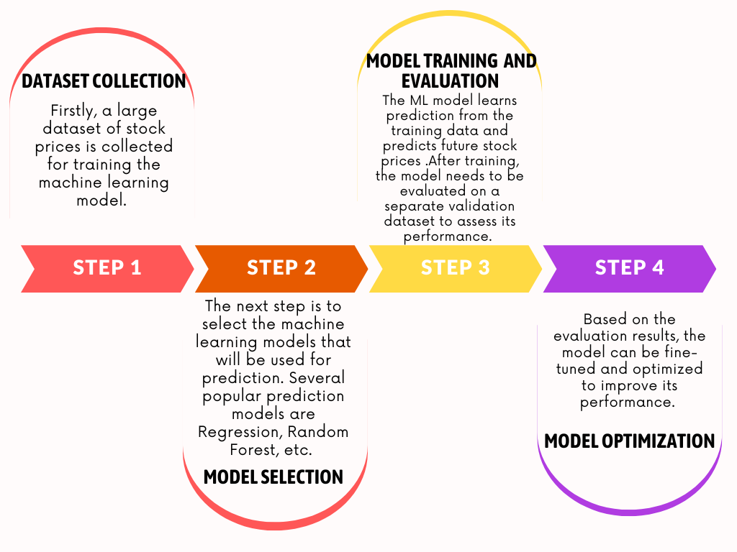
Methodology
Steps:

Slide 10
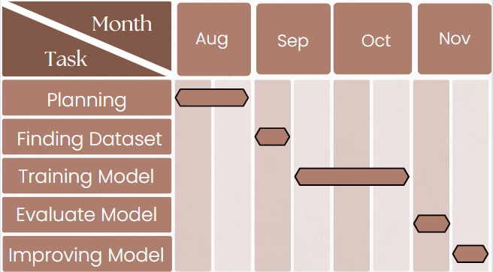
Methodology
Timeline

Slide 11
Working Model
Requirement analysis (Link of SRS)
SRS
Technical Diagram
Data Collection
Collect historical stock market data, such as open, close, high, and low prices, as well as other relevant data, such as news and economic indicators.
Pre-processing
Clean and prepare the data for machine learning. This involved tasks such as removing outliers, imputing missing values, and scaling the data.
Model Selection
Select a machine learning model that is appropriate for the task of stock price prediction. There are many different machine learning models that can be used for this task, such as linear regression, support vector machines, and random forests.
Model Training
Train the selected machine learning model on the pre-processed data. This involves feeding the data into the model and allowing it to learn the relationships between the input features (date) and the target variable (stock prices).
Model Evaluation
Evaluate the performance of the trained model on a held-out test set. This helps to ensure that the model is not overfitting the training data.
Model Utilization
Once the model has been trained and evaluated, it can be utilized to production. This involves making the model available to users so that they can generate predictions.

Slide 12
Working Model
//linear regression
#include <iostream>
#include <stdio.h>
#include <vector>
using namespace std;
class regression {
vector<float> x; vector<float> y; float coeff; float constTerm; float sum_xy;
float sum_x;
float sum_y;
float sum_x_square;
float sum_y_square;
public:
regression()
{
coeff = 0;
constTerm = 0;
sum_y = 0;
sum_y_square = 0;
sum_x_square = 0;
sum_x = 0;
sum_xy = 0;
}
void calculateCoefficient()
{
float N = x.size();
float numerator
= (N * sum_xy - sum_x * sum_y);
float denominator
= (N * sum_x_square - sum_x * sum_x);
coeff = numerator / denominator;
}
void calculateConstantTerm()
{
float N = x.size();
float numerator
= (sum_y * sum_x_square - sum_x * sum_xy);
float denominator
= (N * sum_x_square - sum_x * sum_x);
constTerm = numerator / denominator;
}
int sizeOfData()
{
return x.size();
}
float coefficient()
{
if (coeff == 0)
calculateCoefficient();
return coeff;
}
float constant()
{
if (constTerm == 0)
calculateConstantTerm();
return constTerm;
}
void PrintBestFittingLine()
{
if (coeff == 0 && constTerm == 0) {
calculateCoefficient();
calculateConstantTerm();
}
cout << "The best fitting line is y = "
<< coeff << "x + " << constTerm << endl;
}

Slide 13
Working Model
float errorSquare()
{
float ans = 0;
for (int i = 0;
i < x.size(); i++) {
ans += ((predict(x[i]) - y[i])
* (predict(x[i]) - y[i]));
}
return ans;
}
float errorIn(float num)
{
for (int i = 0;
i < x.size(); i++) {
if (num == x[i]) {
return (y[i] - predict(x[i]));
}
}
return 0;
}
};
// Driver code
int main()
{
freopen("Data2.txt", "r",stdin);
regression reg;
int n;
cin >> n;
reg.takeInput(n);
reg.PrintBestFittingLine();
cout << "Predicted value at 2010.0316 = "
<< reg.predict(2014.01) << endl;
cout << "The errorSquared = "
<< reg.errorSquare() << endl;
cout << "Error in 2010.0316 = "
<< reg.errorIn(2014.01) << endl;
}
void takeInput(int n)
{
for (int i = 0; i < n; i++) {
char comma;
float xi;
float yi;
cin >> xi >> comma >> yi;
sum_xy += xi * yi;
sum_x += xi;
sum_y += yi;
sum_x_square += xi * xi;
sum_y_square += yi * yi;
x.push_back(xi);
y.push_back(yi);
}
}
int showData()
{
for (int i = 0; i < 62; i++) {
printf("_");
}
printf("\n\n");
printf("|%15s%5s %15s%5s%20s\n",
"X", "", "Y", "", "|");
for (int i = 0; i < x.size(); i++) {
printf("|%20f %20f%20s\n",
x[i], y[i], "|");
}
for (int i = 0; i < 62; i++) {
printf("_");
}
printf("\n");
}
float predict(float x)
{
return coeff * x + constTerm;
}

Slide 14
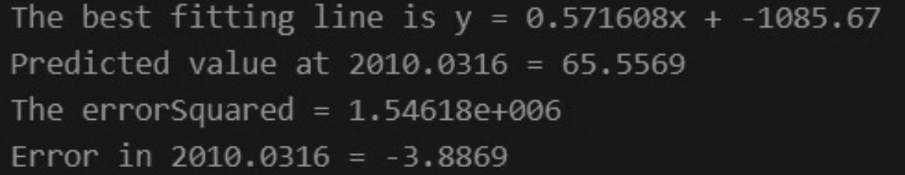

Results
Before Mid-Sem
After Mid-Sem

Slide 15

Conclusion
The model for stock market prediction implemented using linear regression model involved various steps including dataset collection and its preprocessing. The model worked well on the preprocessed dataset than the actual dataset.
We understood the working on preprocessed dataset and how it helped the model in getting the best fit line.

Slide 16
Reference
[1] Amit Gupta, T.J.Nagalakshmi. (2019). Stock Price Prediction using Linear Regression in Machine Learning.
[2]Seethalakshmi, Ramaswamy. (2018). Analysis of stock market predictor variables using linear regression. International Journal of Pure and Applied Mathematics.
[3]Karim, Rezaul & Alam, Md & Hossain, Rezaul. (2021). Stock Market Analysis Using Linear Regression and Decision Tree Regression.

Slide 17
Thank You

