Slide 1
DataSpark: Illuminating Insights for Global Electronics

Slide 2
Project Overview
Objective:
To analyze customer, product, sales, and store data.
To integrate data into a structured MySQL database.
Key Deliverables:
Data cleaning and preprocessing.
Data analysis and transformation.
Database creation and integration.

Slide 3
Data Overview
Datasets Used:
Customers: Customer demographic details.
Products: Product pricing and attributes.
Sales: Transactional sales data.
Stores: Store locations and metrics.
Exchange Rates: Currency exchange values.

Slide 4
Data Cleaning
Steps Taken:
Converted date fields into datetime format.
Handled null values:
Filled missing Square Meters with 0.
Dropped unnecessary columns like Delivery Date.
Reformatted numeric fields:
Removed special characters ($, ,) and converted to integers.

Slide 5
Data Analysis
Insights Derived:
Summary statistics using .describe() for each dataset.
Null value percentage across datasets.
Data types confirmed for efficient storage and processing.

Slide 6
Database Design
Database Name: miniproject2
Tables Created:
Customers
Products
Stores
Exchange
Sales
Schema Highlights:
Defined primary keys for relational integrity.
Ensured appropriate data types for columns.

Slide 7
SQL Table Creation
SQL Implementation:
Created tables using CREATE TABLE statements.
Optimization:
Used INT for numerical fields for storage efficiency.
Standardized date fields as VARCHAR(50) for compatibility.

Slide 8
Data Integration
Data Loading:
Merged Sales and Customers data.
Combined with Products for full analysis.
Date Formatting:
Standardized to "MM DD YYYY" format for Order Date and Birthday.

Slide 9
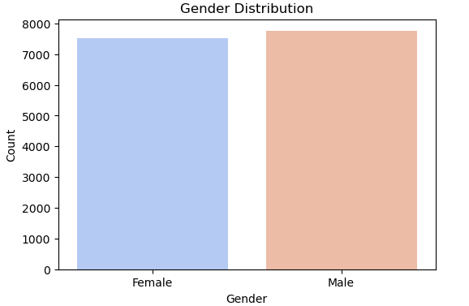
Data Visualization:
The distribution is fairly balanced between Male and Female.
Males slightly outnumber females, but the difference is not drastic.
Both genders have around 7500–7800 entries each.
There’s no significant gender imbalance, which is good for avoiding gender bias in modeling (if gender is used as a feature).
If this data relates to car buyers or owners, it suggests similar participation from both genders in the dataset.
This kind of demographic distribution can be useful in customer segmentation, behavior analysis, or targeted marketing.

Slide 10
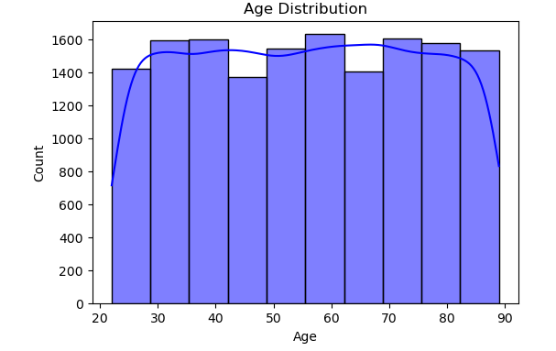
The distribution is fairly uniform, meaning there is a relatively even spread of individuals across different age groups.
There are fewer individuals in the youngest (20s) and oldest (90s) age groups.
The number of individuals in the 30-80 age range is consistently high (around 1500–1600 per group).
The KDE curve follows the histogram pattern closely, reinforcing the even distribution.
If this dataset relates to car sales, it suggests a balanced age distribution of car buyers.
The drop at lower (20s) and higher (90s) ages is expected since younger individuals might not afford cars yet, and older individuals may drive less.
If age is being used as a feature in a machine learning model, it might not be highly skewed, which is good for model performance.

Slide 11
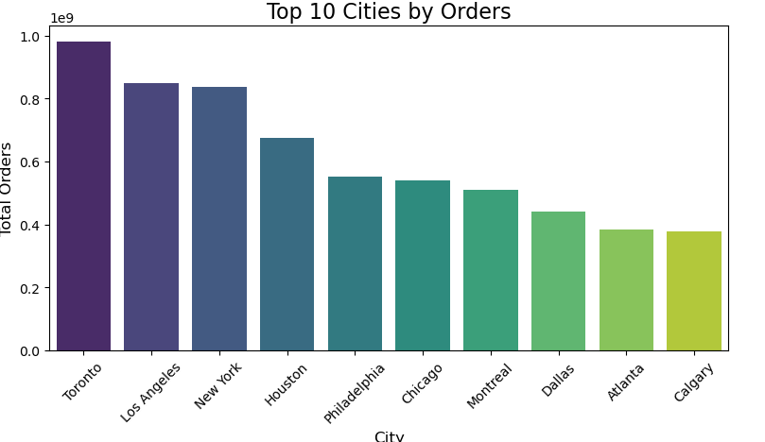
Toronto has the highest total orders, exceeding 1 billion.
Los Angeles and New York are close in total orders, ranking 2nd and 3rd.
Houston, Philadelphia, and Chicago have moderate order volumes.
Montreal, Dallas, Atlanta, and Calgary have lower order volumes but still rank in the top 10.
Toronto's dominance suggests it is a key market for orders, possibly due to a larger population or higher demand.
Los Angeles and New York also have strong markets, likely due to high urban density and purchasing power.
Montreal, Dallas, and Calgary have significantly lower order volumes compared to the top-ranked cities.

Slide 12
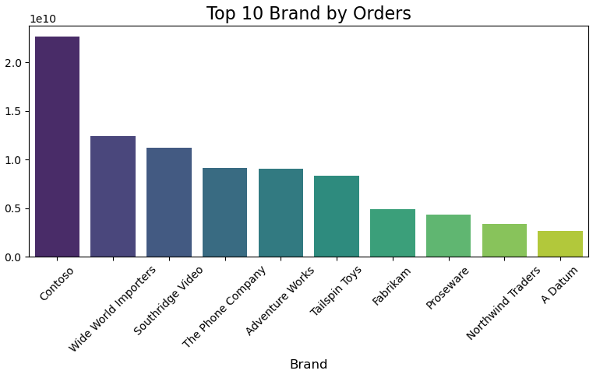
Contoso has the highest number of orders, exceeding 20 billion.
Wide World Importers and Southridge Video follow in 2nd and 3rd place, both having order volumes above 10 billion.
The Phone Company, Adventure Works, and Tailspin Toys have moderate order volumes.
Fabrikam, Proseware, Northwind Traders, and A Datum have the lowest order volumes among the top 10.
Contoso dominates the market significantly more than the other brands.
Wide World Importers and Southridge Video have similar order volumes, making them strong competitors.
The bottom-ranked brands (Proseware, Northwind Traders, and A Datum) have noticeably lower order counts, which may indicate smaller market reach or lower demand.

Slide 13
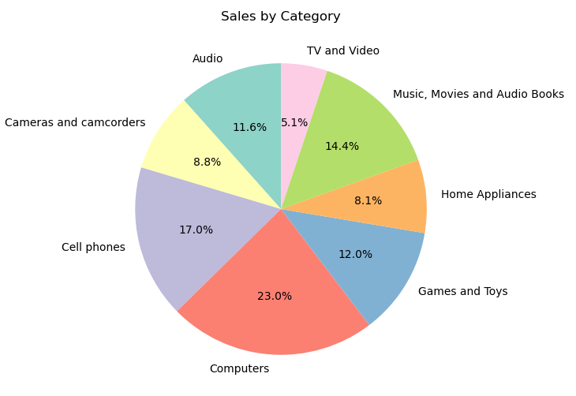
Computers account for the largest share (23.0%) of total sales.
Cell Phones (17.0%) and Music, Movies, and Audio Books (14.4%) are also significant contributors.
Games and Toys (12.0%) and Audio (11.6%) have moderate shares.
Home Appliances (8.1%), Cameras and Camcorders (8.8%), and TV and Video (5.1%) have the smallest sales shares.

Slide 14
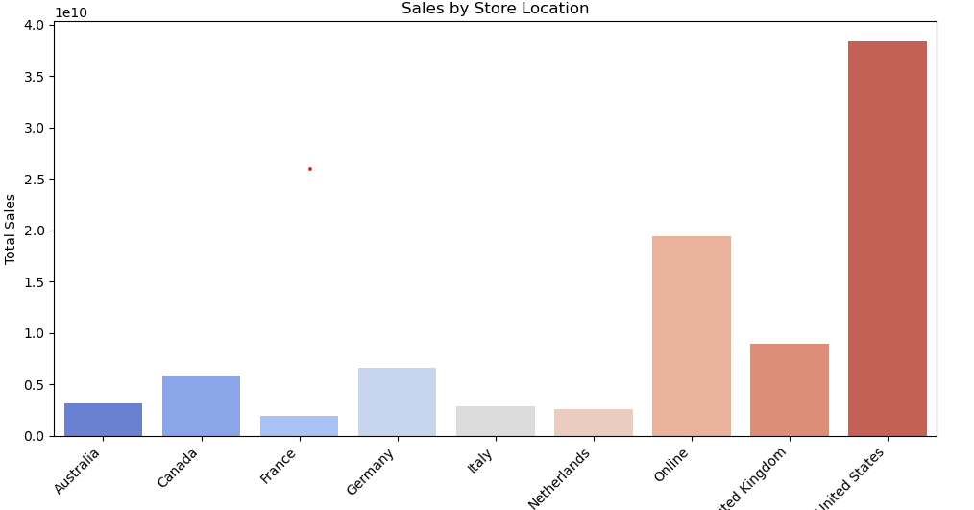
United States has the highest sales, significantly outpacing other locations.
Online sales are the second highest, indicating a strong e-commerce presence.
United Kingdom and Germany have moderate sales compared to the U.S. and online sales.
Australia, Canada, France, Italy, and Netherlands have the lowest sales among all store locations.
There's a red dot near Germany, possibly an outlier or incorrectly plotted data point.

Slide 15
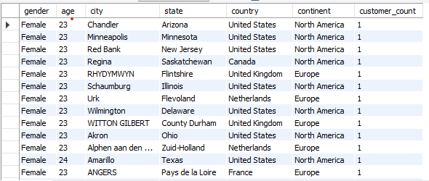
Customer Demographics Analysis: Age, Gender, and Geographic Distribution
SELECT
gender,
FLOOR(DATEDIFF(CURDATE(), birthday) / 365) AS age,
city,
state,
country,
continent,
COUNT(customerkey) AS customer_count
FROM
customers
GROUP BY
gender, age, city, state, country, continent;

Slide 16
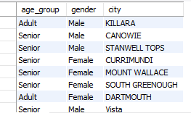
Customer Age Group Classification by Gender and City
SELECT
CASE
WHEN FLOOR(DATEDIFF(CURDATE(),
STR_TO_DATE(CONCAT(Birthday_Year, '-', Birthday_Month, '-', Birthday_Date), '%Y-%m-%d')
) / 365) < 25 THEN 'Young'
WHEN FLOOR(DATEDIFF(CURDATE(),
STR_TO_DATE(CONCAT(Birthday_Year, '-', Birthday_Month, '-', Birthday_Date), '%Y-%m-%d')
) / 365) BETWEEN 25 AND 40 THEN 'Adult'
ELSE 'Senior'
END AS age_group,
gender, city FROM customers WHERE
Birthday_Year IS NOT NULL AND Birthday_Month IS NOT NULL AND Birthday_Date IS NOT NULL
GROUP BY age_group, gender, city;

Slide 17
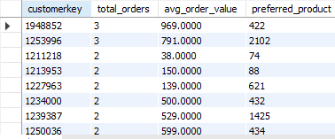
Customer Purchase Analysis: Total Orders, Average Order Value, and Preferred Products
SELECT a.customerkey,
COUNT(a.ordernumber) AS total_orders,
AVG(b.`Unit Price USD`) AS avg_order_value,
b.productkey AS preferred_product
FROM sales a JOIN
products b ON a.productkey = b.productkey
GROUP BY a.customerkey, b.productkey
ORDER BY
total_orders DESC;

Slide 18
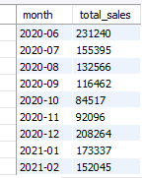
Monthly Revenue Analysis: Total Sales by Year and Month
SELECT
DATE_FORMAT(STR_TO_DATE(CONCAT(OrderYear, '-', OrderMonth, '-', OrderDay), '%Y-%m-%d'), '%Y-%m') AS month,
SUM(a.`Unit Price USD`) AS total_sales
FROM sales b JOIN
products a ON b.ProductKey = a.ProductKey
WHERE
OrderYear IS NOT NULL AND OrderMonth IS NOT NULL AND OrderDay IS NOT NULL
GROUP BY month
ORDER BY month;

Slide 19
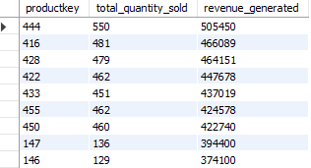
Top 10 Best-Selling Products by Revenue and Quantity Sold
SELECT b.productkey,
SUM(a.quantity) AS total_quantity_sold,
SUM(b.`Unit Price USD` * a.quantity) AS revenue_generated
FROM sales a JOIN
products b ON a.productkey = b.productkey
GROUP BY
b.productkey
ORDER BY
revenue_generated DESC
LIMIT 10;

Slide 20
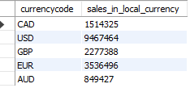
Top 5 Sales by Currency: Revenue in Local Currencies
SELECT
o.currencycode,
SUM(p.`Unit price USD`) AS sales_in_local_currency
FROM sales o
JOIN
products p ON o.productkey = p.productkey
GROUP BY
o.currencycode
LIMIT 5;

Slide 21
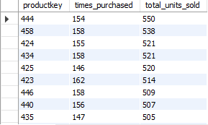
Top 10 Most Purchased Products by Sales Volume
SELECT
productkey,
COUNT(orderNumber) AS times_purchased,
SUM(quantity) AS total_units_sold
FROM sales
GROUP BY
productkey
ORDER BY
total_units_sold DESC
LIMIT 10;

Slide 22
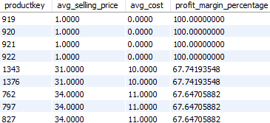
Top Products by Profit Margin: Average Selling Price, Cost, and Profitability
SELECT
productkey,
AVG(`unit price USD`) AS avg_selling_price,
AVG(`unit cost USD`) AS avg_cost,
(AVG(`unit price USD`) - AVG(`unit cost USD`)) / NULLIF(AVG(`unit price USD`), 0) * 100 AS profit_margin_percentage
FROM products
GROUP BY productkey
ORDER BY
profit_margin_percentage DESC;

Slide 23
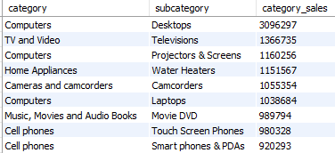
Sales Analysis by Category and Subcategory: Total Revenue Breakdown
SELECT
p.category,
p.subcategory,
SUM(p.`Unit Price USD`) AS category_sales
FROM products p
JOIN
sales oi ON p.productkey = oi.productkey
GROUP BY
p.category, p.subcategory
ORDER BY
category_sales DESC;

Slide 24
Tools Used
Python Libraries:
pandas for data manipulation.
seaborn for visualization.
Database:
MySQL for structured data storage.
mysql.connector for Python integration.

Slide 25
Conclusion
Summary:
Cleaned and transformed raw data into actionable formats.
Established a robust database for seamless integration.
Achieved project goals of analysis and automation.

