Slide 1



Abacus Institute of Engineering and Management
PRESENTATION ON
A Smart Farmland Using Arduino Crop Prevention And Animal Intrusion Detection System
DEPT. OF EE
NAME | ROLL NO
SHILPI MAITY | 24001620036
ARIJIT BHATTACHARJEE | 24001620038
ARNAB ROY | 24001620027
PRIYAM NANDI | 24001620040
SUMANA SHOM | 24001620043
TUHA MONDAL | 24001620042
SAMAR SARKAR | 24001620021
Under the Guidance of: Prof. Debabrata Mazumder (Assistant Professor)

Slide 2
Contents
INTRODUCTION
OBJECTIVES
BLOCKDIAGRAM
AURDINO AND GSM
COMPONENTS REQUIRED
WORKING PRINCIPAL
ANIMAL INTRUSION SYSTEM AND OTHER SENSORS
ADVANTAGES AND DISADVANTAGES

Slide 3
INTRODUCTION
Wild animals - real threat to the farmers
Wild animals exterminate – crop/farmland.
Huge financial problem to the farmers.
Farmer not get information about infertility, temperature, humidity
Project uses ARDUINO and utilizes the GSM
Wild animals - in the farm land - detect –message - farmers
Soil moisture level – infertility of the soil

Slide 4
OBJECTIVES
Main objectives:
To help the farmer to maximize his crop yield.
Prevent his farmland from animal intrusion
Effective utilization of natural resources

Slide 5
LITERATURE SURVEY
[1] Prevention of Wild Animals Entering Into the Agriculture Fields
Bindu D and Dilipkumar M D et al describes the conservation of crop field
The animals from the protected area[PAs] are continuously attacking the crop field over the years and the protection of this crop field has become a main concern.
The techniques that already being used is ineffective,
Presenting a practical procedure to ward off, by creating a system which studies the behavior of the animal, detects the animal and creates the different sound that irritates the animal
Alerts the authorized person by sending a message. Provide a multi-class classification by presenting zero false alarm rate and accurate species identification.

Slide 6
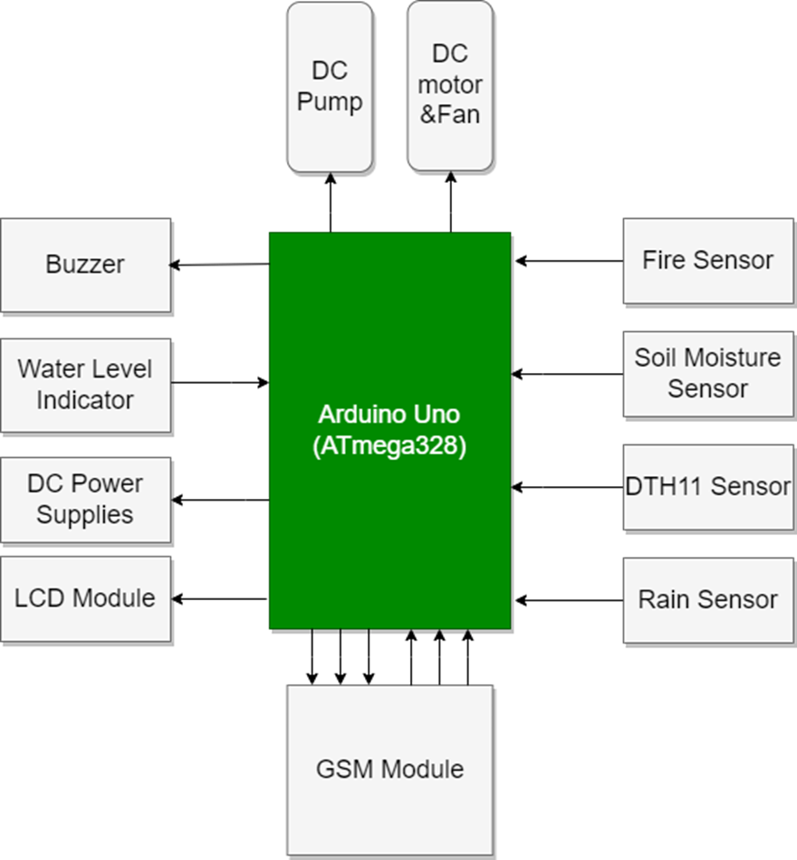
BLOCK DIAGRAM

Slide 7
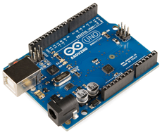
ARDUINO UNO
Open source microcontroller board
Micro controller- ATmega328
Operating Vtg-5v ( limit 6-20v)
Pins-14 Pins(6 are digital & 6 analog)-(VCC and gnd)

Slide 8
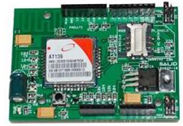
GSM modem
Specialized type of modem which accepts a SIM card, and operates over a subscription to a mobile operator, just like a mobile phone.
GSM modem looks just like a mobile phone.
When a GSM modem is connected to a computer, this allows the computer to use the GSM modem to communicate over the mobile network.

Slide 9
COMPONENTS REQUIRED
HARDWARE REQUIREMENTS
LCD Display
ARDUINO UNO
GSM Module (SIM900A)
Fire Sensor
Water Level Depth Sensor
Temperature And Humidity Sensor
Ultrasonic Sensor
Buzzer
Rain Sensor
Lcd Display
Dc Motor & fan
DC Pump
SOFTWARE REQUIREMENTS-
Aurdino Ide/embedded C
IOT

Slide 10
WORKING PRINCIPLE
Ultrasonic sensor - animals other than wild animal
After detecting - send SMS – farmer
Moisture sensor - monitors moisture level of the soil
Moisture level reduced – water pump On
DHT11 is a humidity sensor measures moisture and air temperature
Temperature more – Fan On
RAIN sensor monitors the rain falling
Raining – send SMS

Slide 11
WORKING PRINCIPLE
Water depth sensor – Below 50% Buzzer On
ARDUINO – Responsible for entire operation
The LCD display- proper notification of operation

Slide 12
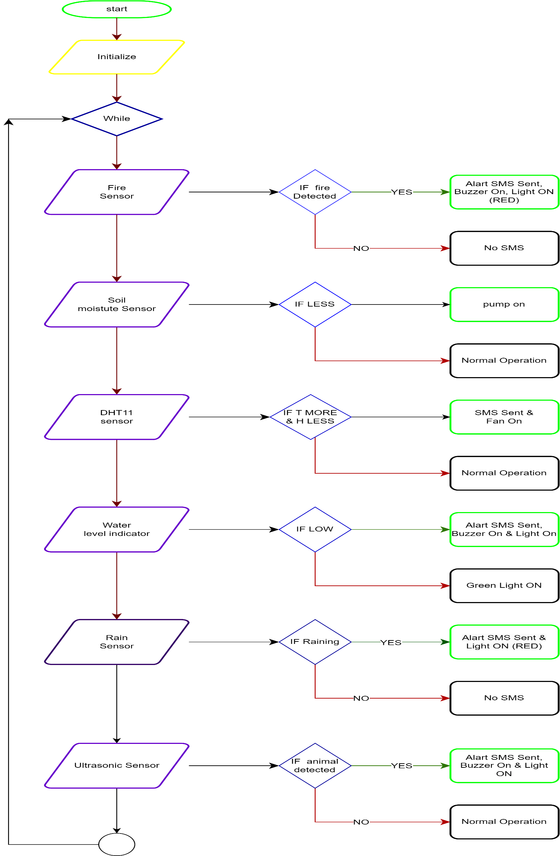

Slide 13
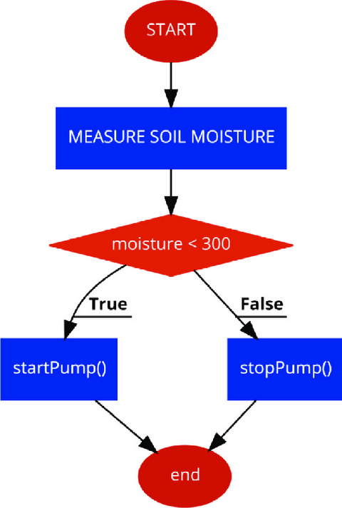
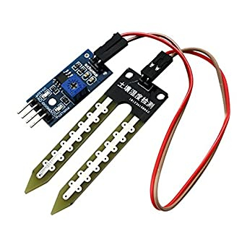
Moisture sensor

Slide 14
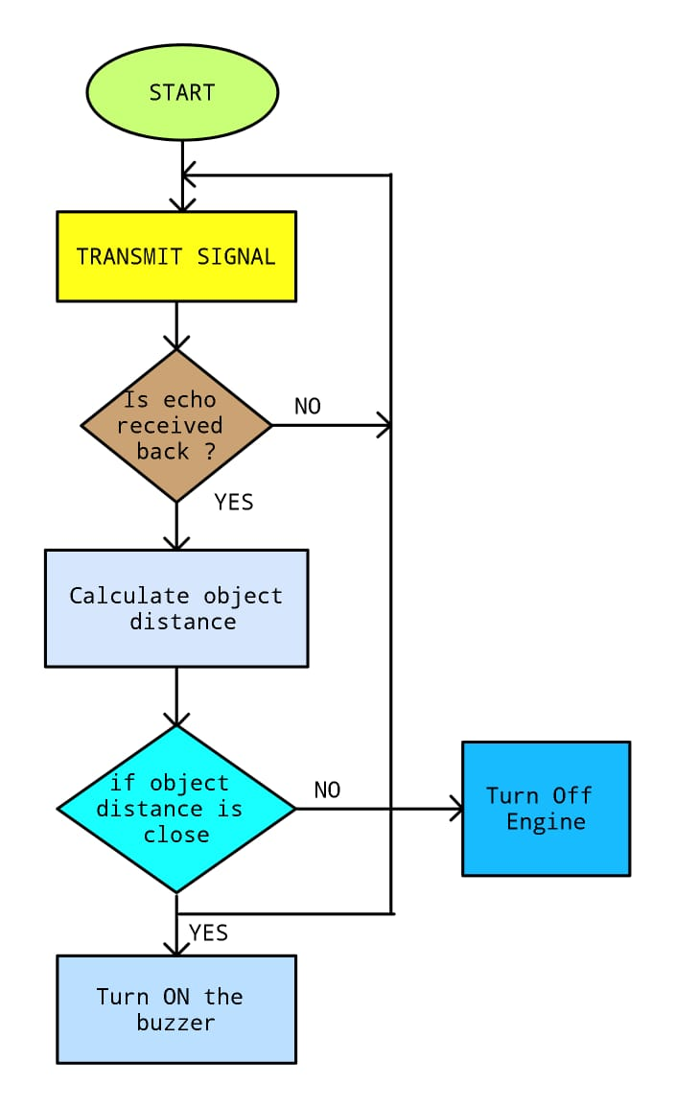
Flow chart
For
Ultrasonic Sensor
Turn Off Buzzer

Slide 15
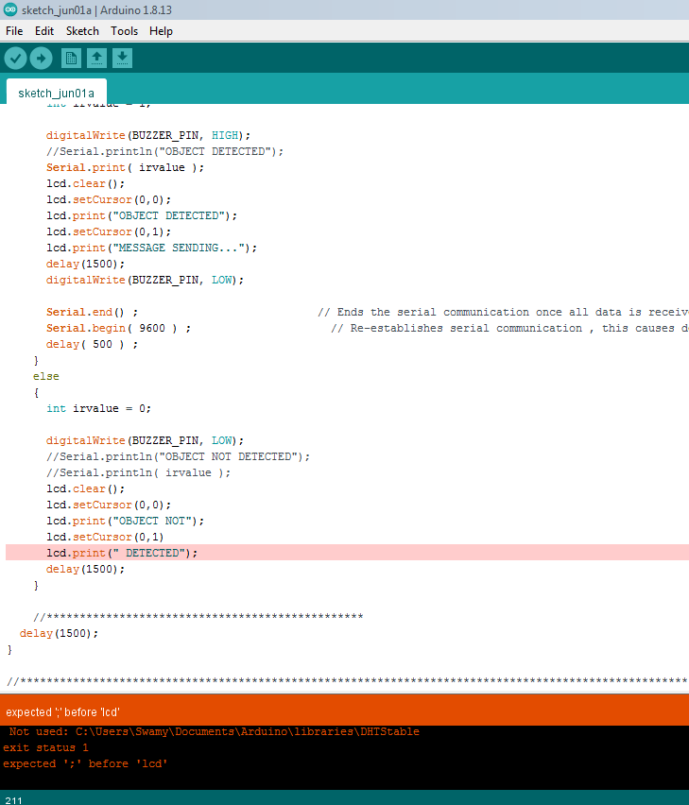
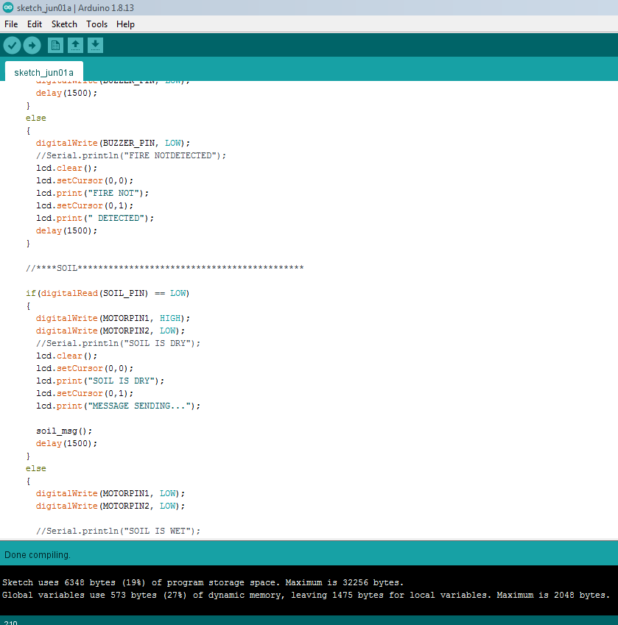

Slide 16
ADVANTAGES
This device is efficient in protecting crops from Wild animals. .
Smart and effective Irrigation system .
Cost effective & time efficient.
Overall helps in effective crop yield.
DISADVANTAGES
The results are often overestimated.
All sensors have to be tested regularly for their working condition.

Slide 17
CONCLUSION
Damaging crops by wild animals is a major issue
Requires urgent attention and an effective solution
Project aims to address the problem.
The proposed system based on Arduino is found to be more compact, user friendly and less complex
Process is fully automated and it does not cause any hurt to animal.
Future scope in this project is to detect the location of the animals by using RFID injector and GPS.

Slide 18
REFERENCES
[7] R. Radha, K. Kathiravan, V. Vineeth, J. Sanjay and S. Venkatesh, "Prevention of monkey trespassing in agricultural field using application agricultural specific flooding approach in wireless sensor network," 2015 IEEE Technological Innovation in ICT for Agriculture and Rural Development (TIAR), Chennai, 2015, pp. 106-111.
[8] IshaDua, Pushkar Shukla, Ankush Mittal” A vision based human - elephant collision detection system” IEEE International Conference on Image Processing. (25 Febraury, 2016) pp: 225-229
[9] Sheela.S, Shivaram. K., Chaitra. U, Kshama. P, Sneha. K, Supriya. K” Low Cost Alert System for Monitoring the Wildlife from Entering the Human Populated Areas Using IOT Devices” International Journal of Innovative Research in Science, Engineering and Technology. (10 May, 2016) Vol. 5, Special Issue 10, May 2016.

Slide 19
THANK YOU

