Slide 1
Sales Performance Dashboard
By Charu Sharma

Slide 2
Objective
To design an interactive dashboard for business stakeholders
To analyze sales and profit performance
To present insights using data visualization techniques

Slide 3
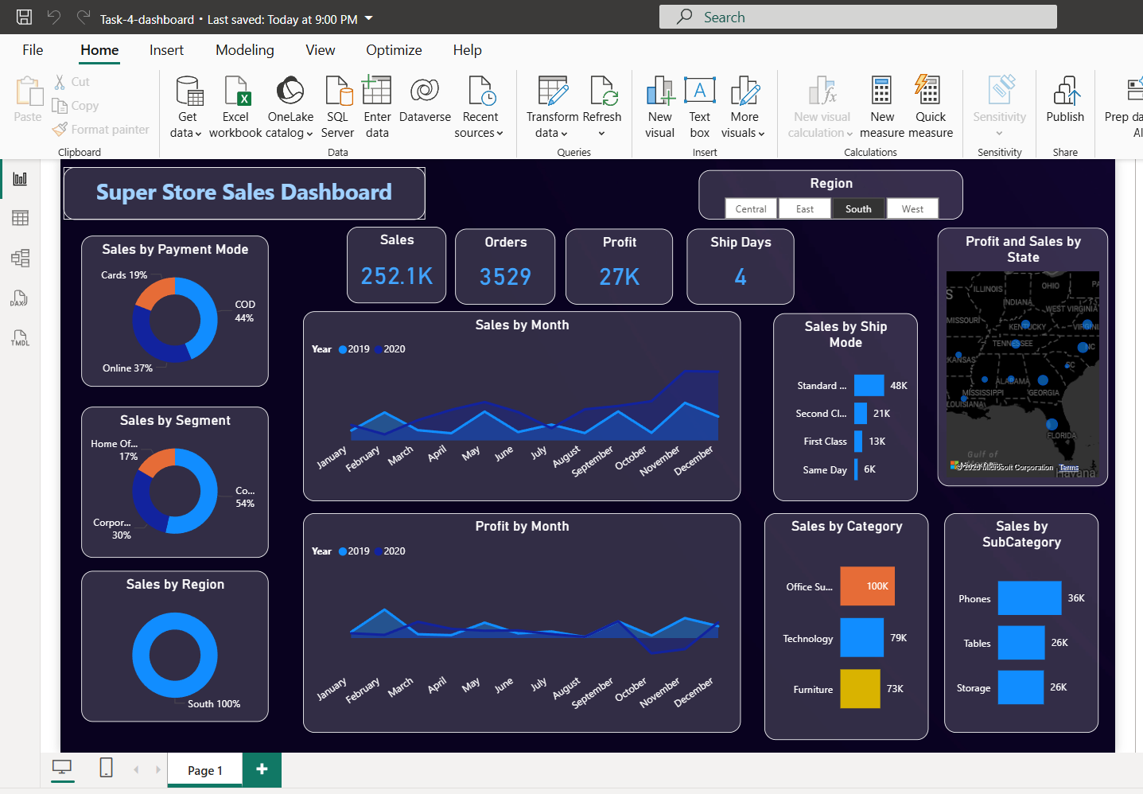
Dashboard Overview
Interactive dashboard created using Power BI
Provides a complete view of sales performance
Includes multiple visuals for better understanding

Slide 4
Dashboard Features
KPI Cards (Total Sales, Total Profit)
Time-Series Analysis (Monthly Sales & Profit Trend)
Sales by Category and Sub-Category
Sales by Ship Mode
Map Visualization (State-wise Sales)
Slicers for interactivity (Region, Category, Year)

Slide 5
Key Insights
Insights:
Sales show an overall increasing trend over time
Technology category contributes highest sales
Standard Class is the most used shipping mode
Certain regions/states generate higher revenue

Slide 6
Conclusion
Dashboard provides clear and meaningful business insights
Helps in data-driven decision making
Slicers improve user interaction and filtering
Can be enhanced further with forecasting in future

Slide 7
THANK YOU

