Slide 1

Exploring GDP Per Capita Growth Patterns: A Comprehensive Analysis
By Charu Kesarwani

Slide 2



Agenda
Introduction
Overview
Regional Analysis
Country Wise Analysis
Trends and Forecast
Income Group
Conclusion
Suggestion

Slide 3




Introduction
In-depth assessment of GDP per capita growth (annual %) across various countries.
Insightful overview of economic performance, regional trends, and income group disparities.

Slide 4

Overview
Evaluation of GDP per capita growth (annual %) data from the World Bank database.
Comprehensive analysis of visualizations, including regional bar charts, line charts, and tree maps.
Detailed examination of top and bottom 10 countries based on their GDP per capita growth rates.
Detailed Analysis of economic trends over 62 year.

Slide 5
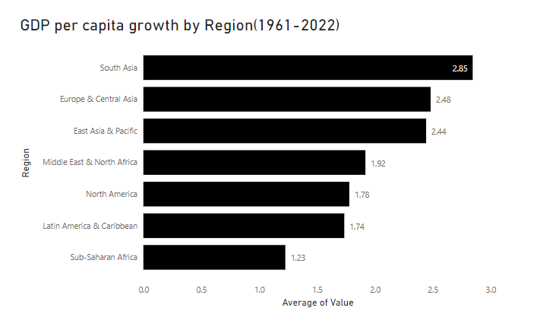
Regional Analysis
Factors Influencing GDP per Capita Growth Disparities Over 62 Years:
South Asia Pacific's GDP per capita growth of 2.85% is influenced by:
1. Successful export-oriented industrialization
2. Effective government policies promoting economic development
3. Investments in infrastructure, technology, and human capital development
Sub-Saharan Africa's GDP per capita growth of 1.23% reflects:
1. Political instability and weak governance
2. Inadequate infrastructure and limited access to education and healthcare
3. Persistent issues related to poverty, conflict, and underdeveloped institutions

Slide 6
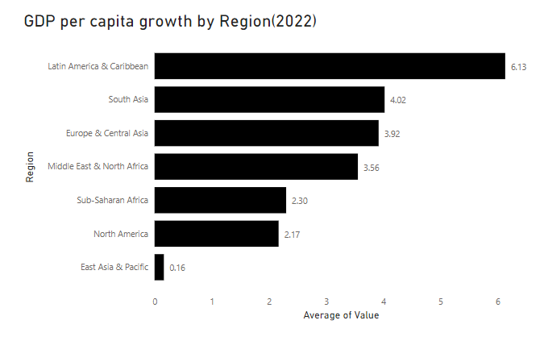
Regional Analysis
Contributions to GDP per Capita Growth in 2022:
Latin American and Caribbean's contribution of 6.13% is attributed to:
1. Effective economic policies and strategic industry diversification
2. Improved trade relations and investments in key sectors
The East Asia and Pacific region's lower contribution of 0.16% can be linked to:
1. Temporary challenges like supply chain disruptions
2. Potential global economic uncertainties impacting the region's growth trajectory

Slide 7
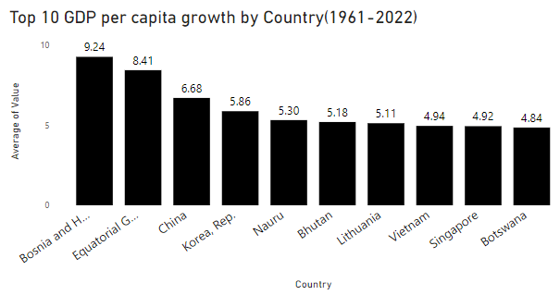
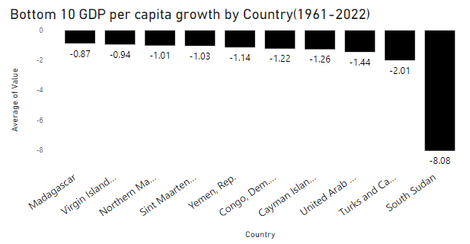
Top and Bottom 10 Country Analysis
Evaluation of countries based on GDP per capita growth (%) between the years 1961 to 2022
Bosnia and Herzegovina's highest GDP per capita growth of 9.24%:
Reason: The implementation of post-war reconstruction efforts, structural reforms, and foreign investments played a crucial role in driving economic growth and development in Bosnia and Herzegovina, contributing to its notable GDP per capita growth.
South Sudan's negative GDP per capita growth of -8.08%:
Reason: Prolonged civil unrest, internal conflicts, and political instability in South Sudan have significantly disrupted economic activities, leading to a sharp decline in the country's GDP per capita growth over the years.

Slide 8
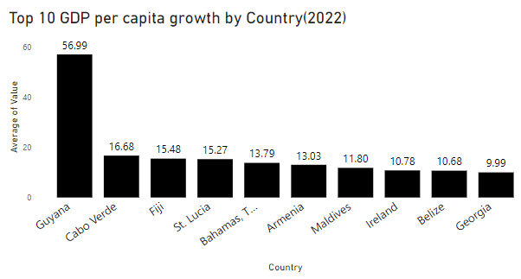
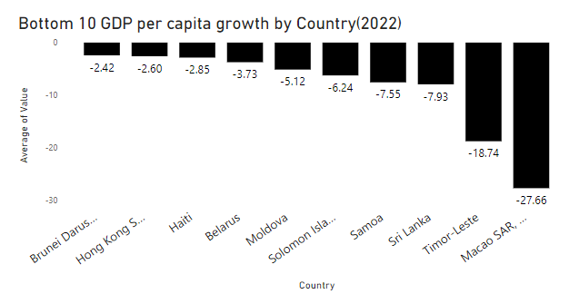
Top and Bottom 10 Country Analysis
GDP per capita growth (annual %) in 2022:
Guyana's GDP per capita growth of 56.99%:
Reason: Rapid expansion in the country's natural resource sector, particularly in the field of oil and gas, has significantly boosted Guyana's GDP per capita growth, leading to remarkable economic performance in 2022.
Macao SAR China's negative GDP per capita growth of -27.66%:
Reason: The significant impact of the COVID-19 pandemic on the tourism and entertainment industry, which are pivotal to Macao's economy, led to a substantial decline in the region's GDP per capita growth in 2022.

Slide 9
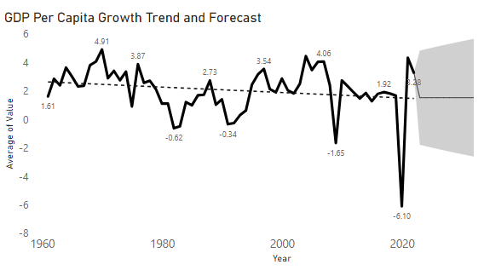
Trends and Forecast(Overall)
This section evaluates the trends in GDP per capita growth rates over 62 years (-6.10 to 4.91).
The highest growth in 1970 at 4.91(USA, 1/3rd) is evident in the line chart, providing insights into country-specific economic performance. Trend lines and forecasts suggest a potential decline, guiding future economic policies.
Notable global recessions include the 1975 stagflation due to the 1973 oil crisis, the 1982 recession resulting from Volcker's tight monetary policy, the 1991 economic downturn following the Soviet Union's collapse, the 2009 financial crisis from the U.S. housing market collapse, and the 2020 recession driven by the global impact of the COVID-19 pandemic.

Slide 10
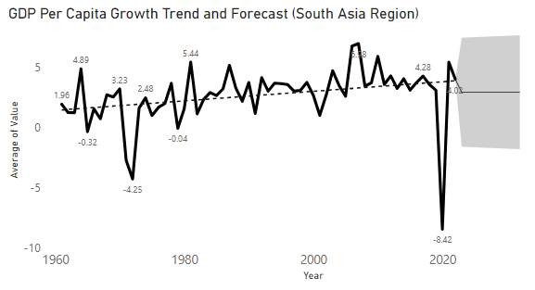
Trends and Forecast(Region wise)
The upward trend in GDP per capita growth in South Asia, contrasting with the downward trajectory in other regions, can be attributed to specific factors:
Economic reforms and policy measures implemented in South Asian countries.
Harnessing the demographic dividend through investments in education and healthcare.
Emphasis on technological advancements and innovation.
Regional integration and trade agreements fostering increased trade volumes.
Investments in social and human capital development, enhancing workforce productivity and efficiency.

Slide 11
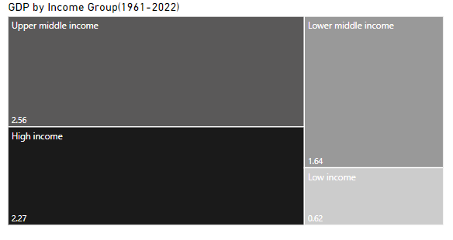
Income Group(1961-2022)
Over 62 years, the Upper Middle Income group saw the highest GDP per capita growth (2.56%), owing to robust economic policies, increased investments in infrastructure, and a conducive business environment.(Natural Resource Management, Globalization and Trade)
Low income group GDP per capita growth (0.62%) in low-income groups can be attributed to a complex interplay of factors, including limited industrialization, high population growth, colonial legacies.

Slide 12
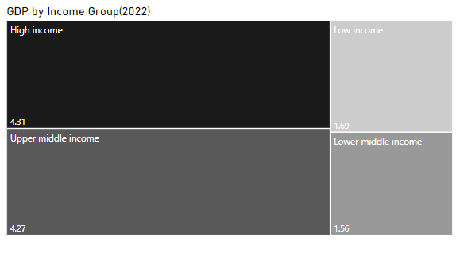
Income Group
In 2022, the High-Income group recorded the highest growth (4.31%), reflecting continued economic stability and effective policy implementation.(Economic Stability, Innovation and Technology)
Conversely(2022), the Lower Middle-Income group reported the lowest growth (1.56%), emphasizing persistent challenges in resource accessibility and limited institutional capacity.

Slide 13

Conclusion
Disparities in GDP growth: Stemming from successful industrialization in East Asia Pacific and challenges in Sub-Saharan Africa, including political instability and infrastructure deficits.
Contributions in 2022: Reflecting effective policies in Latin America and temporary challenges in East Asia, impacting GDP growth rates.
Trends and global recessions: Highlighting the complexities of economic development, with implications for future policy-making and planning.
South Asia's growth trajectory: Driven by demographic dividends and progressive policies, signalling the region's potential for sustained economic development.
Disparities among income groups: Underlining the critical role of robust policies and infrastructure investments in fostering sustained growth across different income segments.

Slide 14
Suggestion
Implement targeted initiatives for bolstering economic growth in regions with lower GDP per capita growth rates.
Foster collaborations between nations to promote knowledge-sharing and capacity-building for sustainable economic development.
Encourage investments in education, healthcare, and infrastructure to stimulate long-term economic growth and human capital development.
Prioritize research and development efforts to drive innovation and technology adoption, fostering productivity and competitiveness in global markets.
Advocate for inclusive policy frameworks that prioritize marginalized communities, aiming to reduce economic disparities and promote equitable growth.
Promote data-driven decision-making as a cornerstone of effective economic policy formulation, ensuring informed strategies that address evolving global economic challenges.

Slide 15


Thank You
Charu Kesarwani
thecharukesharwani@gmail.com

