Slide 1
a/B TEST ANALYSIS
GloBox Food and Drink Banner Test
Presented By: Charu Kesarwani

Slide 2
OBJECTIVE | TIMELINE | KEY METRICS
Amplify awareness and drive revenue growth within the food and drink category | 25 Jan to 07 Feb 2023, 13 Days | Conversion Rate Average Total Spent &
Group A: Control
Group B: Treatment
User Experience - Current State
Number of Users - 24343
User Experience - Banner Presence
Number of Users - 24600

Slide 3
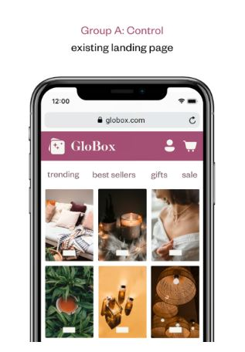
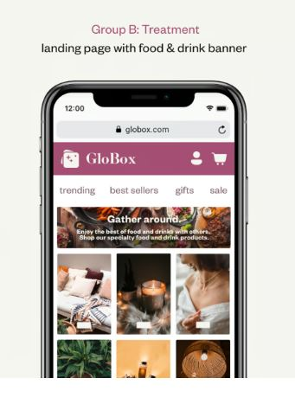



OUTCOME HIGHLIGHT
Recommend banner launch confidently, as A/B test indicates 18.02% conversion boost
----Vs----
Banner
Conversion Rate: 4.63%
Conversion Rate: 3.92%

Slide 4
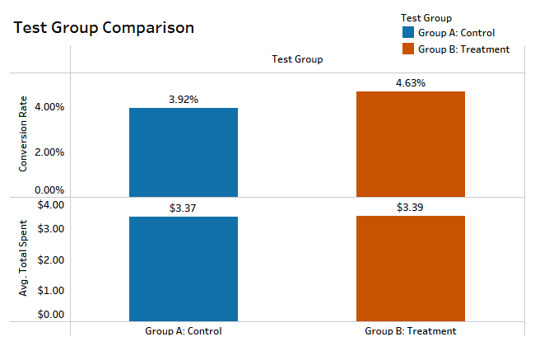
Key Metrics
We observed strong statistical evidence of a significant 18.02% difference in conversion rates between the two groups.
Lack of evidence in average total spend, as the difference is only 0.5%.

Slide 5
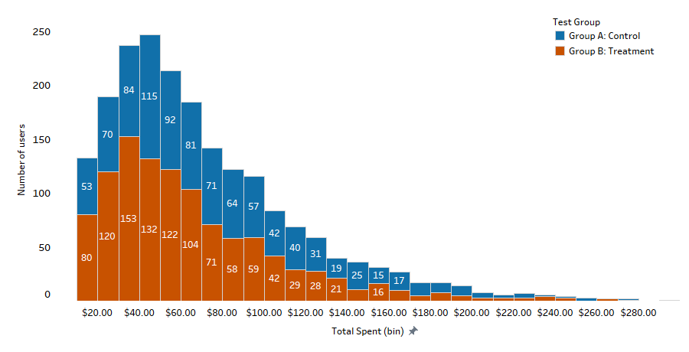
Total Spent Distribution
The Treatment group comprises a larger number of users than the Control group within the $30-$80 spending range.

Slide 6
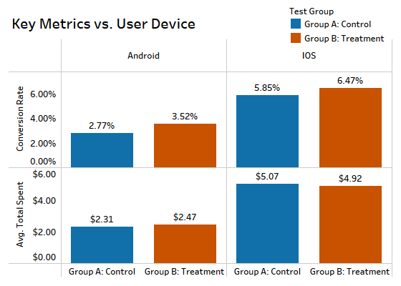
Differentiated by Device
Remarkable 11.40% Surge in iOS Conversion Rates, Alongside a Significant 28.78% Boost in Android Users.

Slide 7
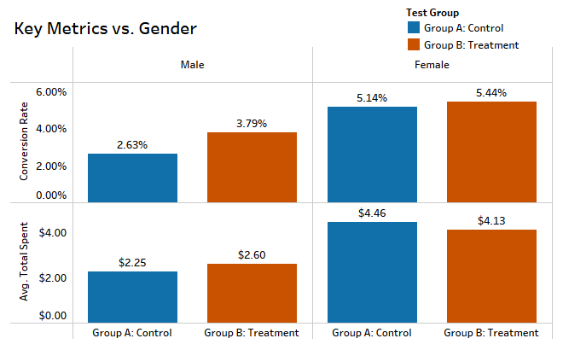
Differentiated by Gender
In the Treatment Group, Males Witnessed a Remarkable 46.97% Uplift and a Modest 5.60% Increase in Females Conversion Rate.
“This chart excludes 'Other' and 'Unknown’ gender for clarity.”

Slide 8
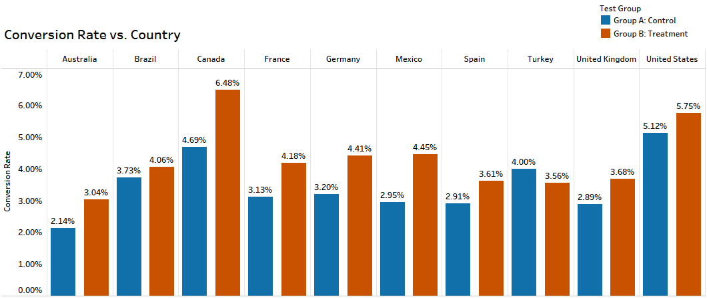
Differentiated by Country
Substantial Conversion Rate Improvements in Mexico (56.63%) and Canada (44.44%), Contrasted with Shifts in Turkey (-9.46%).

Slide 9
Recommendation
Launch the Food and Beverage Banner
Grounds for Implementation:
Implement the Food and Beverage Banner: The banner has demonstrated a positive impact on conversion rates.
Feasible and Resource-Efficient: forward Implementation poses minimal resource demands, making it a viable step.
Feasible Action:
Vigilant Performance Tracking: Monitor success metrics closely for consistent improvement.
User Behaviour Analysis: Examine user preferences and behaviours within the food and drink category for strategic insights.

Slide 10
THANK YOU
Charu Kesarwani
thecharukesharwani@gmail.com

