Slide 1
Pothole Detection And its Avoidance Using Machine Learning.
Project Guide:-
Prof. S N Bhosale
Submitted By:-
Deveyash Bhurat.
Charudatta Bangal.
Aryan Vaid.
Aditya Raj.
Siddharth Changede.

Slide 2
INTRODUCTION
Road conditions is a key part for safe and comfortable driving and also for maintaining traffic efficiency in one’s day to day life . It is desirable to have a mechanism by which people can know about the road conditions on the routes on which they wish to travel , in real time . Also understanding conditions of road surface is also very important for road maintenance and asset management .
Vehicle assistance will be given to driver , in case if potholes are detected.
Assistance includes giving directions to the driver , to move left or right in order to avoid potholes.
System will consist of camera and an IR sensor . Camera will be used to detect speed-breaker whereas IR sensor will be used to detect potholes.

Slide 3
PROBLEM STATEMENT
Detection of road anomalies such as potholes, bump, steep shoulders and objects on the road. Therefore, proposing a system by which people can know road conditions in the routes on which they wish to travel in real time.

Slide 4
OBJECTIVES
Drivers will be made aware of the further road anomalies such as potholes , so they can change their driving behaviors, ensuring the safety of the passengers and of the vehicle itself.
This system can also be used to avoid traffic jams , accidents thus, improving the experience of one’s journey and making drives hassle-free.
This system can also be used to prioritize the road re-construction.

Slide 5
PROPOSED SYSTEM
In this system there is an IR based sensing module and IR based user interface. The low-cost modules are placed on the vehicles so its efficient for users as they don't have to install an external sensing function when they get on or off the vehicles. Vehicles positioning on GPS with information includes latitudinal and longitudinal data.

Slide 6
MOTIVATION
This year’s prolonged monsoon deteriorated the condition of roads causing a tremendous increase in the number of potholes , resulting a gradual increase in death toll.
While different factors contribute to vehicle crashes, driver behavior is considered to be the leading cause of around 95% percent of all accidents. More recent data has identified inattention, including distraction, “looked but did not see” and falling asleep at the wheel as the primary cause of accidents, accounting for at least 25% of the crashes.

Slide 7
LITERATURE SURVEY
Sr No. | Year of publication | Title | Authors | Proposed System | Drawback
1 | 2019 | Pothole Detection Based on Disparity Transformation and Road Surface Modelling. | Rui Fan,Umar Ozunlap,Brett Hosking,Ming liu,loannis pitas. | Pothole detection system by using 3-D surface modelling , disparity maps | Uses 3D surface model which is costly due to use of lasers.

Slide 8
Sr No. | Year of publication | Title | Authors | Proposed System | Drawback
2 | 2018 | Detecting a pothole Using Deep CNN Models For An Adaptive Shock Observing In A Vehicle Driving. | Kwang Eun An,Sung Won Lee, Seung-Ki Ryu, Dongmahn Seo. | To investigate the performance of deep Convolutional neural network in detecting a pothole. | This is a survey paper.

Slide 9
Sr No. | Year of publication | Title | Authors | Proposed System | Drawback
3 | 2015 | Machine Learning Approach For Predicting Bumps On Road. | Manjusha Ghadge, Dheeraj pandey , Dhananjay kalbande. | This paper proposes a smart phone based method which uses Accelerometer and GPS sensors to analyze the road conditions. | Not a real time based system.

Slide 10
APPROXIMATE CALCULATIONS
The pothole and speed-breaker detection speed is approximately 10sec i.e. system will take 10sec to detect the humps and dumps.
The processing time is variable.

Slide 11
ALGORITHM
Convolutional neural networks(CNN)
A CNN consists of an input and an output layer, as well as multiple hidden layers.
CNN mainly consists of two parts:-1)Feature Learning
2)Classification
A CNN consists of an input and an output layer, as well as multiple hidden layers as :
Convolutional layer
Pooling layer
Activation Function layer
Fully connected layer

Slide 12

Functional Diagram Of CNN

Slide 13
Steps in Convolutional Neural Networks:-
Step 1:- Convolution Operation
Computer read images as pixels and it is expressed as a matrix(NxNx3)-(height by width by depth)Images makes use of three channels(RGB),so that is why we have depth of 3.The Convolutional layer makes use of a set of learnable filters. A filter is used to detect the presence of specific features or patterns present in the original image. This filter is convolved(slided) across the width and height of the input file,and a dot is computed to give an activation map
Step 1(b):- ReLU Layer(Activation Function)
The second part of this step will involve the Rectified Linear Unit or ReLU. In this step we apply the rectifier function to increase non-linearity in the CNN. Images are made of different objects that are not linear to each other. Without applying this function the image classification will be treated as a linear problem while it is actually a non-linear one.

Slide 14
Step 2:- Pooling
Pooling enables the CNN to detect features in various images irrespective of the difference in lighting in the pictures and different angles of the images.
There are different types of pooling, for example, max pooling and min pooling. Max pooling works by placing a matrix of 2x2 on the feature map and picking the largest value in that box. The 2x2 matrix is moved from left to right through the entire feature map picking the largest value in each pass.
These values then form a new matrix called a pooled feature map. Max pooling works to preserve the main features while also reducing the size of the image. This helps reduce overfitting, which would occur if the CNN is given too much information, especially if that information is not relevant in classifying the image.

Slide 15
Step 3:- Flattening
Once the pooled featured map is obtained, the next step is to flatten it. Flattening involves transforming the entire pooled feature map matrix into a single column which is then fed to the neural network for processing.
Step 4 :- Full Connection
After flattening, the flattened feature map is passed through a neural network. This step is made up of the input layer, the fully connected layer, and the output layer.
The information is passed through the network and the error of prediction is calculated. The error is then backpropagated through the system to improve the prediction.

Slide 16
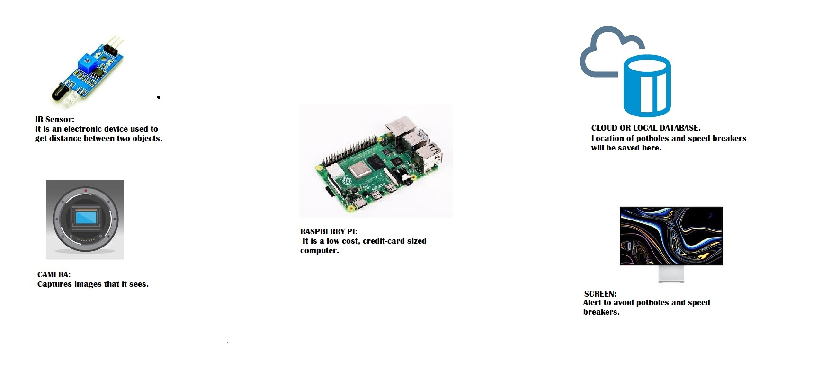
SYSTEM ARCHITECTURE

Slide 17
SYSTEM REQUIREMENTS
HARDWARE REQUIREMENTS
Raspberry Pi
Processor :- Intel i3
RAM :- 4 GB
Hard Disk :- 100 GB
Camera
IR sensors

Slide 18
SOFTWARE REQUIREMENTS
Operating System :- 32 Bit or 64 Bit Windows 7 and onwards.
Coding Language :- Python 3
IDE :- PyCharm
Database :- SQLITE

Slide 19
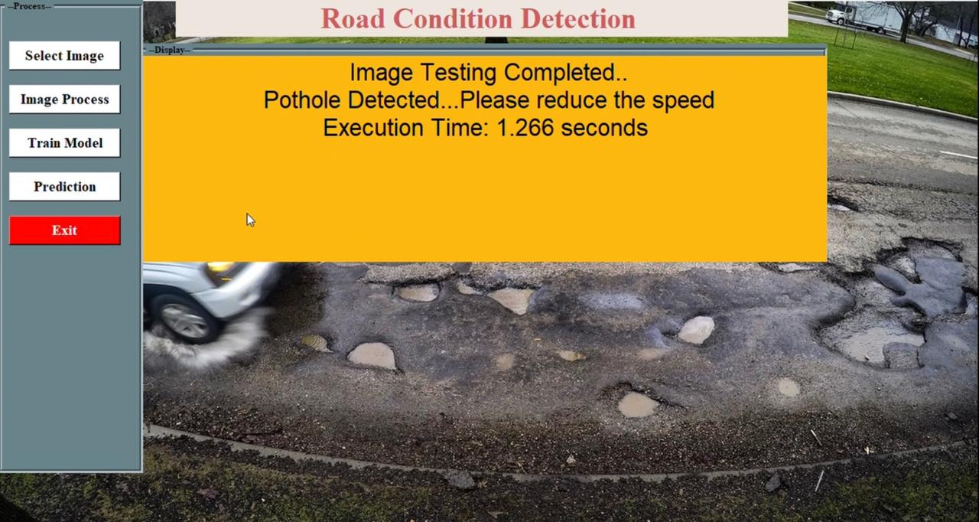
Testing

Slide 20
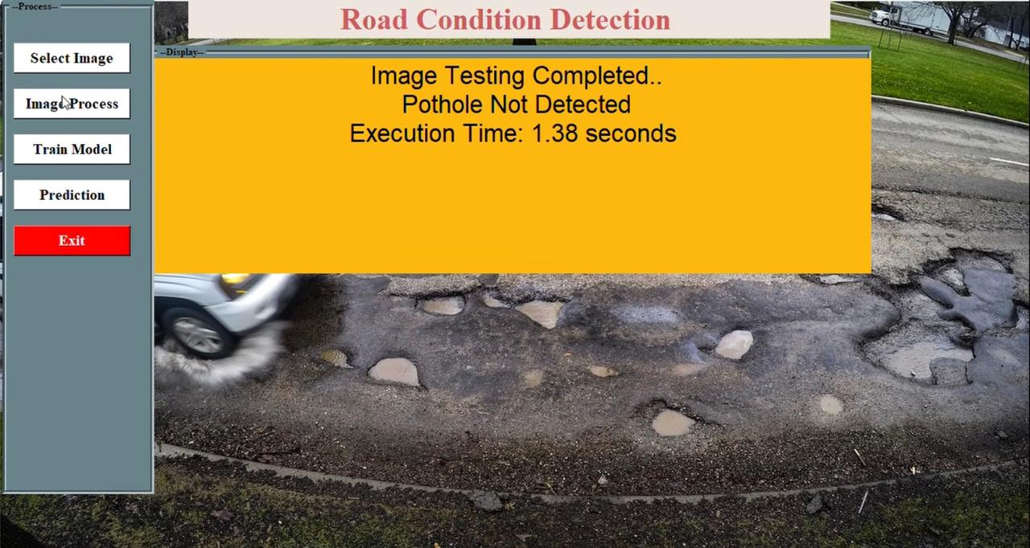
Testing

Slide 21
CONCLUSION
According to the real time road conditions evaluation, the abnormal road condition can be detected and saved in traffic center . The drivers of the vehicles will be made aware of the upcoming bad road conditions to manage their driving behaviors for improving driving safety , comfort and efficiency .Traffic congestion due to worst road conditions will reduce drastically . The road conditions will improve thus making one’s journey safe and comfortable.

Slide 22
FUTURE SCOPE
The system can be made useful as a part of smart city campaign.
Also, by applying machine learning techniques in classifying data can help the system to adapt to changing factors like nature of the road and vehicle type the users use. And the data collected can be sent to the government officials and help them in choosing the right person for the job.

Slide 23
REFERENCES
Rui Fan,Umar Ozgunalp,Brett Hosking,Ming Liu,Ioannis Pitas.” Pothole Detection Based On Disparity Transformation And Road Surface Modelling.”IEEE-2019
Kwang Eun An,Sung Won Lee,Seung-Ki Ryu,Dongmahn Seo,” Detecting A Pothole Using Deep Convolutional Neural Network Models For An Adaptive Shock Observing In A Vehicle Driving.”-2018
Manjusha Ghadge,Dheeraj pandey,Dhananjay Kalbande,”Machine Learning Approach For Prediciting Bumps On Road.”-2018
Karmel,Adhithiyan,Senthil Kumar,”Machine Learning Based Approach For Pothole Detection.”-2016
Sudarshan S Rode,Shonil Vijay,Prakhar Goyal,Purushottam Kulkarni,Kavi Arya,”Pothole Detection And Warning System:Infrastructure Support And System Design”-2015

Slide 24
Shambhu Hegde, Harish V. Mekali, Golla Varaprasad,” Pothole Detection and Inter Vehicular Communication.”
S Gayathri,Mamatha RG,Manasa B,Menita Patil,Sanjana BM,” Automatic Pothole Detection System.”
ArtisMednis,GirtsStrazdins,ReinholdsZviedris,GeorgijsKanonirs, Leo Selavo,"Real Time Pothole Detection using python.
AniketKulkarni,NitishMhalgi,SagarGurnani,Dr. NupurGiri,"Pothole Detection System using Machine Learning on Android",V.E.S. Institute of Technology, Mumbai-74 .
Syuan-Yi Chen1, Annie Shih2 and Chun-Yi Hsiao,"Road condition Detection Device Using IR Sensing Module and python", International Conference on Consumer Electronics-Taiwan (ICCE-TW).-2008

Slide 25
Publication Details
Journal Name : International Journal Of Advance Scientific Research and Engineering
Paper Name : A Survey on Pothole detection and IT’s Avoidance Using Machine
Learning
ISSN : 2456-0774

Slide 26
Publication Details
Journal Name : Open Access International Journal Of Science and Engineering
Paper Name : Pothole Detection And IT’S AVOIDANCE
ISSN : 2456-3293

Slide 27
LINKS
DOCUMENTS:
Idea Matrix Final - for merge.docx
SRS Final.docx
DIAGRAMS:
PNGSSS\UseCaseDiagram1.png
PNGSSS\SequenceDiagram1.png
PNGSSS\ClassDiagram12.png
PNGSSS\ActivityDiagram12.png

