Slide 1
D2C Warehouse Pre-Dispatch Teardown & Issue-Triage Playbook
CASE STUDY · SUPPLY CHAIN OPS
How an order moves from inbound stock to carrier handover, where that flow breaks, and how a first-line analyst fixes or routes each failure within SLA
Charukant · October 2026
Notes:
A model teardown built for the Assistant PM, supply chain ops tech role. Numbers come from a synthetic sample dataset, not a real company.

Slide 2

Most dispatch delays are two systems disagreeing
In a 37,401-order sample month, the fixes that matter are master data, sync and mapping, not new tools
93.8%
34%
3 SKUs
of orders picked up by the carrier within 24 h, against a 95% target
of late orders were blocked at inventory sync, the single largest cause
fail at the same step on 19–24% of their orders: a wrong bin, a combo mapping, a missing HSN
What this playbook covers
The 10-step pre-dispatch flow and the system that owns each step
Where each step breaks, what the floor sees, and who fixes it
A triage flow, P1–P4 SLA tiers and an escalation ticket template
An issue log and weekly review that turns repeat failures into fixes

Slide 3





Three systems and two outside parties touch every order
Knowing which system owns a record tells you who can fix it
ERP (SAP)
WMS
OMS (e.g. Unicommerce)
Carrier
GST portal
Purchase orders
GRN posting
SKU, HSN and tax master
Accounts and stock value
Bins and putaway
Pick and pack scans
Cycle counts
Physical stock
Channel orders and sync
Stock allocation
Picklists, invoices
Labels and manifests
AWB numbers
Serviceability by PIN
Pickup scan
Tracking
E-invoice IRN (B2B)
E-way bill
Part B vehicle details
Validity and cancellation

Slide 4
An order passes ten steps before a carrier scans it out
Each step leaves one record that proves it finished. That record is the first thing to check when an order is stuck
1
2
3
4
5
Inbound & GRN
Putaway
Inventory sync
Allocation
Picklist
WMS + ERP
WMS
OMS
OMS
OMS / WMS
Proof: GRN number
Proof: Stock at a bin
Proof: Channel stock = WMS
Proof: Order Allocated
Proof: Picklist assigned
6
7
8
9
10
Pick & pack
Invoice
Label & AWB
Manifest
E-way bill & handover
WMS
OMS → ERP
OMS + carrier
OMS
GST portal + carrier
Proof: Package Packed
Proof: Invoice no. (+ IRN)
Proof: AWB on package
Proof: Manifest closed
Proof: Pickup scan
Steps 1–3 make stock sellable; steps 4–10 turn an order into a parcel the carrier accepts

Slide 5
Where the flow breaks: stock and allocation
The analyst's first question is always which two records disagree
Step | Failure | What the floor sees | Likely root cause | Route to
Inbound & GRN | GRN not posting | Stock on the dock, not in the system | PO quantity or SKU mismatch; PO closed in ERP | ERP (SAP) support
Inbound & GRN | Partial or wrong GRN | Received count differs from invoice | Short or excess supply; QC rejects not recorded | Warehouse lead, procurement
Putaway | Stock not sellable | Item on shelf, shows zero available | Putaway not confirmed; bin inactive or quarantined | WMS / OMS support
Inventory sync | Overselling or false stock-outs | Orders for items not on the shelf | Sync job failed or delayed; buffer rules wrong | OMS, channel integration
Allocation | Orders stuck in Unfulfillable | Picklists missing today's orders | Old reservation blocking stock; facility or combo SKU mapping missing | OMS support
Picklist | Picklist not generating | Pickers idle at shift start | Orders on hold; picklist rules exclude a channel | OMS support, ops lead

Slide 6
Where the flow breaks: packing to handover
Late-stage failures hold up packed parcels, so they are usually the most urgent
Step | Failure | What the floor sees | Likely root cause | Route to
Pick & pack | Item not found in bin | Picker marks a short pick | Physical and system stock differ; wrong putaway | Warehouse lead + WMS
Invoice | Invoice fails | Packed, but cannot move to label | Missing HSN or tax rate; GSTIN error; IRN rejected (B2B) | ERP master data, OMS
Label & AWB | No AWB returned | Label printer idle; package stuck | Carrier API down; PIN not serviceable; weight rule | Carrier key account
Manifest | Manifest will not close | Carrier waiting at the dock | Package in wrong status; cancelled order in manifest | OMS support
E-way bill | E-way bill not generated | Truck cannot leave (B2B / transfer) | Value over threshold, no bill; Part B vehicle missing | Finance / tax
Handover | Shipped in OMS, not picked up | Customer sees no movement | Pickup scan missed; manifest not shared | Carrier key account

Slide 7
Fix it at first response or route it to the owning team
Every path ends in the same issue log, so self-fixed issues are counted too
Cause in SOP?
Issue reported
Set severity P1–P4
yes
Analyst fixes it at first response
no
Find the two records that disagree
ERP (SAP)
OMS / Unicommerce
WMS / floor
Carrier
Finance / tax
PO, GRN posting · SKU master, HSN · tax rates
Sync, allocation · picklists · manifests
Bins and putaway · short picks · cycle counts
AWB not issued · serviceability · missed pickup
IRN rejected · e-way bill · Part B, validity
Log it, track SLA, close when the backlog ships

Slide 8
Severity follows orders at risk, not bug difficulty
Proposed starting targets, to tune against the brand's own volumes. Workaround first, then root cause
P1
P2
P3
P4
Dispatch stopped for a facility or a top channel
One channel, carrier or SKU group blocked
A few orders or SKUs hit; workaround exists
No dispatch impact
Invoicing fails for every order; main carrier API down
Marketplace orders stuck in Unfulfillable after a sync failure
One SKU missing its HSN code, so its invoices fail
Report column wrong; label layout request
First response
15 min
First response
30 min
First response
4 hr
First response
1 day
Workaround
1 hr
Workaround
2 hr
Workaround
Same day
Workaround
None
Resolution
4 hr
Resolution
Same day
Resolution
2 days
Resolution
5 days
Escalate to: Vendor on call, Supply Chain PM, warehouse head
Escalate to: Vendor ticket, Supply Chain PM
Escalate to: Vendor or master-data team
Escalate to: Backlog, reviewed weekly

Slide 9
Every escalation carries the same seven fields
So SAP, OMS or carrier support can act without calling back
1
What is broken
Scope and since when
[P2] Orders stuck in Unfulfillable, WH-01
1 214 orders from one channel stuck since 09:40
2 Approx. Rs 3.1 L miss today's 16:00 ship-by
3 SO-1xxxxx: 40 units in WMS, 0 in OMS
4 Expected Allocated; actual Unfulfillable
5 Putaway confirmed; bin active; last sync 09:15
6 Manual allocation for top 50 orders by ship-by
7 Restore sync, re-run allocation by 13:00
Evidence: screenshots, order IDs (CSV), API error
Owner: analyst on shift · raised 10:05
2
Business impact
Orders and value at risk, ship-by time
3
Steps to reproduce
Order ID, SKU, screen
4
Expected vs actual
What the record should say
5
Already checked
So support skips the basics
6
Workaround in place
What is shipping meanwhile
7
Ask and deadline
The fix needed, by when

Slide 10
Log every issue, including the ones analysts fix themselves
Repeat failures only show up when the small ones are counted too
Weekly 30-minute review
1
SLA adherence by severity and support team, against last week
2
Top three failure types by count and by orders delayed
3
Anything seen 3+ times becomes a fix request with an owner and a date
4
Each new root cause becomes an SOP entry, so it is fixed at first response next time
Log fields: time raised · step · failure type · severity and orders at risk · routed to · workaround · response and resolution time · SLA met · root cause and fix

Slide 11

Two GST rules can stop a B2B or transfer load from leaving
Single B2C parcels rarely need either; replenishment, B2B orders and inter-warehouse transfers do
E-invoice (IRN)
IRN reporting window
Mandatory on B2B invoices when annual turnover is above Rs 5 Cr
Turnover of Rs 10 Cr or more: report invoices within 30 days (since 1 Apr 2025)
Check: IRN on every B2B invoice before label and manifest
Check: no old invoices left unreported until dispatch
E-way bill threshold
E-way bill validity
Inter-state consignments above Rs 50,000; intra-state limits vary by state
1 day per 200 km from Part B entry; documents must be under 180 days old; cancel within 24 h
Check: consignment value and state limit before loading
Check: generate close to dispatch; reissue old invoices
Sources: ClearTax, e-way bill rules (cleartax.in); CalcGuru, e-invoicing thresholds (calcguru.in). Checked October 2026.

Slide 12
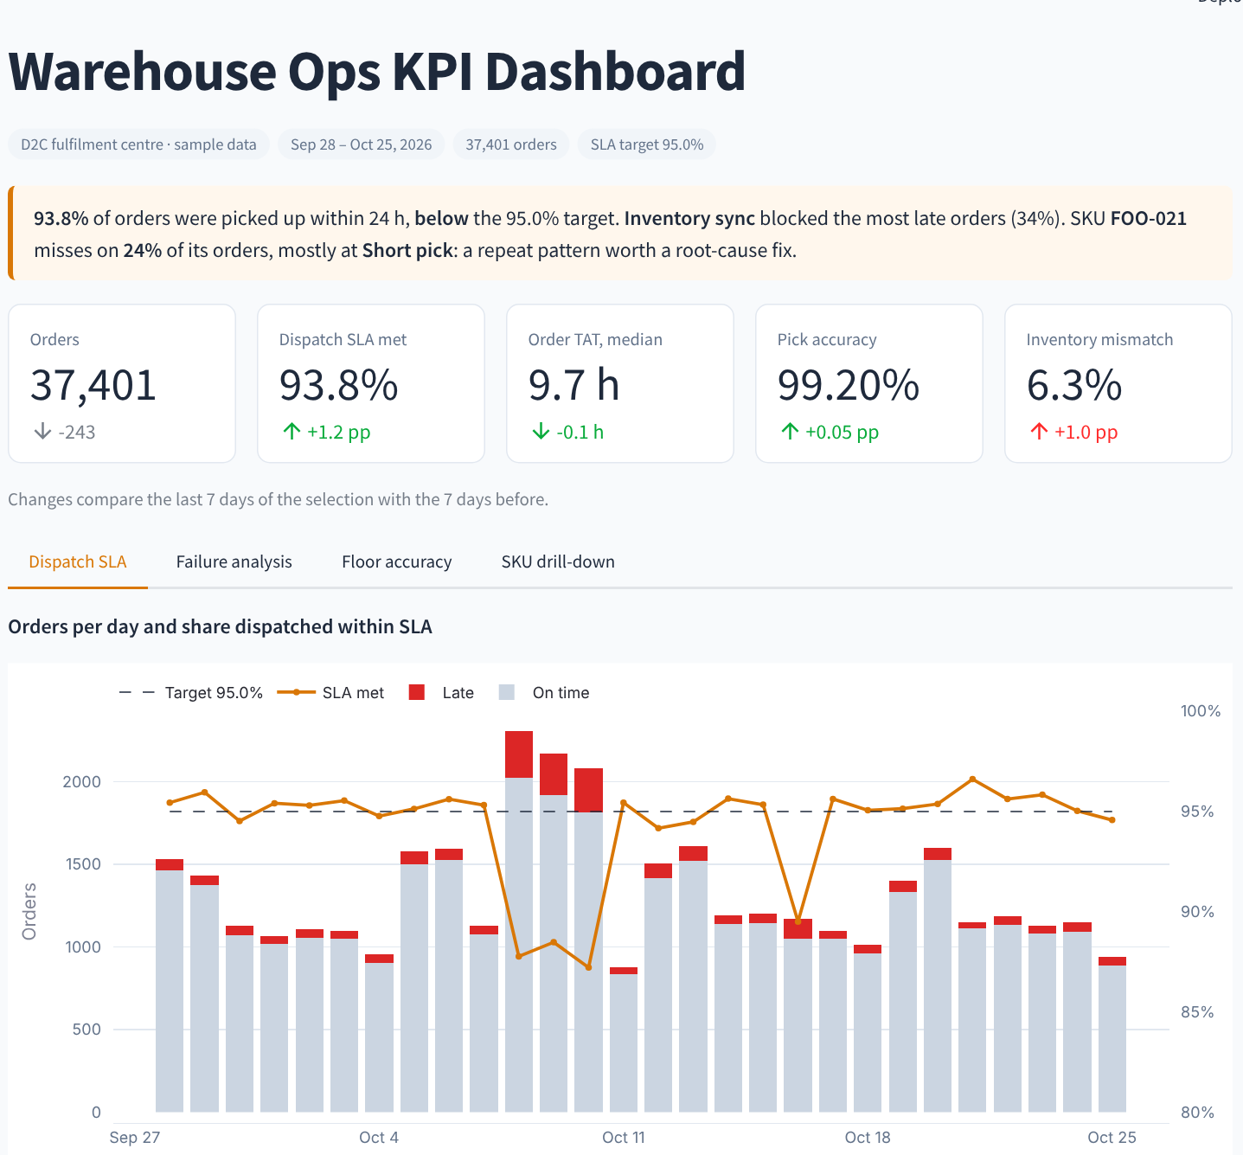
A KPI dashboard makes the patterns visible every morning
Built in Streamlit on a 37,401-order sample month: SLA, TAT, pick accuracy, stock mismatch, with drill-downs
93.8%
dispatch SLA met; festive-sale days and one carrier label outage drove the worst days
34%
of late orders blocked at inventory sync: fix the sync job and buffer rules first
9.0%
evening late rate on Flipkart, the worst channel-shift pair
3 SKUs
late on 19–24% of orders, each at one step: raise three fix requests

Slide 13
How I would run this in the first 30 days
WEEK 1
WEEK 2
WEEK 3
WEEK 4
Walk the floor
Start the log
Fix the repeats
Set the rhythm
Map the real pre-dispatch flow at each site; list every system hand-off and who owns it
Issue log live for every analyst; P1–P4 tiers and the escalation template agreed with SAP, OMS and UC support
Baseline SLA adherence; take the top three repeat failures to root cause and raise fix requests
Weekly review with the Supply Chain PM; KPI dashboard shared; SOPs updated from every new root cause
Outcome Flow map and owner list
Outcome Every issue logged
Outcome 3 fix requests raised
Outcome Weekly KPI review running
Charukant · Data in this deck is a synthetic sample, not from any company

