Slide 1
MEDIMAPPER : NAVIGATING THE HEALTHCARE
DATA FOR PRECISION MEDICINE
COLLEGE :
RAJIV GANDHI COLLEGE OF ENGINEERING AND TECHNOLOGY
THE TEAM :
BEENADEVI. A
CHARULATHA. K
NISHANTHAN. A

Slide 2
CONTENT
1. Objective
2. Project Overview
3. Technologies used
4. Methodology
5. Modules
6. Conclusion

Slide 3
OBJECTIVE
Medimapper : Navigating HealthCare Data for precision Medicine project attempts to create a system that recommends a specific prescription to patients by integrating machine learning with sophisticated data analytics techniques.

Slide 4
PROJECT OVERVIEW
The Project aim is to develop a predictive model for medication prescription patterns using healthcare data.
Conducting thorough data analysis to understand distributions, correlations, and patterns and preprocess data to create relevant features for medication modeling.
Utilizing machine learning techniques to build predictive models and evaluate their performance in predicting medication prescriptions accurately.

Slide 5

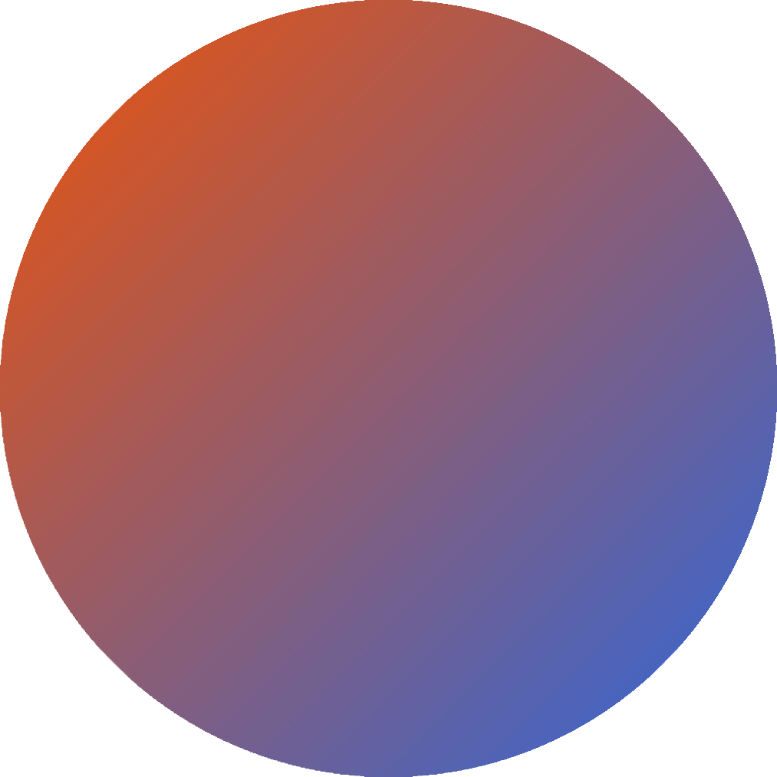



TECHNOLOGIES USED
JUPYTER NOTEBOOK
PYTHON
FLASK

Slide 6
METHODOLOGY
DATA COLLECTION
DATA UNDERSTANDING
EXPLORATORY DATA ANALYTICS
DATA CLEANING
DATA MODELLING
FLASK WEB APPLICATION
DATA PREPROCESSING

Slide 7





MODULES
1
3
EXPLORATORY DATA ANALYSIS
(EDA)
5
DATA COLLECTION
AND UNDERSTANDING
DATA MODELLING
2
DATA CLEANING
4
6
DATA PREPROCESSING
FINAL IMPLEMENTATION

Slide 8
1. Data collection and Understanding
Data collection and understanding are essential for acquiring relevant information and insights from diverse sources, ensuring accurate analysis and informed decision-making in various domains, including healthcare and machine learning.
2. Data Cleaning
The purpose of data cleaning is to identify and rectify errors, inconsistencies, and inaccuracies in datasets, ensuring data quality and reliability for analysis, modeling, and decision-making processes.
3. Exploratory Data Analysis
EDA guides model selection by revealing data distributions, patterns, and outliers, aiding in understanding relationships for effective feature selection and preprocessing, ultimately enhancing model effectiveness and interpretability.

Slide 9
5. Data Modelling
4. Data Preprocessing
Data preprocessing involves cleaning, transforming, and organizing raw data to enhance its quality, making it suitable for analysis and machine learning models, thereby improving model performance and accuracy.
Data modeling is conducted to construct predictive or descriptive models using machine learning techniques, enabling insights, predictions, and decision-making based on data, thereby achieving project objectives efficiently and effectively.
For this task, we have chosen four machine learning algorithms: decision tree classifier, random forest classifier, K-nearest neighbor, and support vector machines.
The training accuracy, cross-validation score, mean cross-validation score, and standard deviation of cross-validation scores for each algorithm are computed and presented.

Slide 10
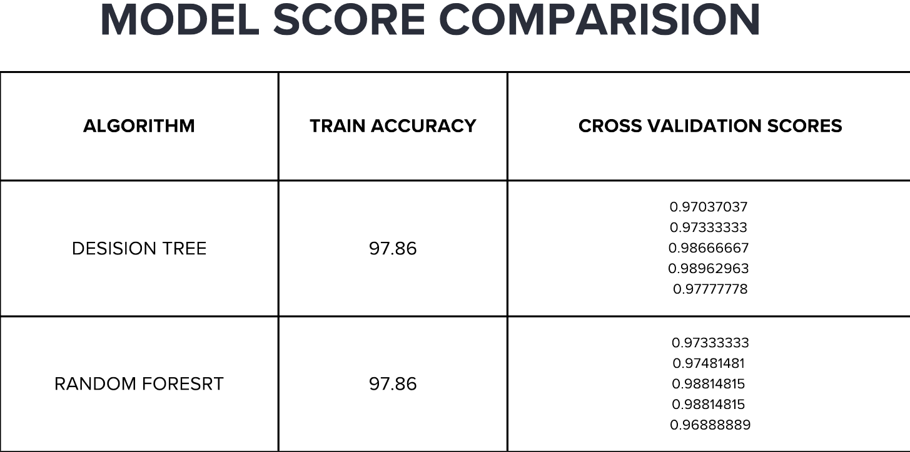
MODEL SCORE COMPARISON
DECISION TREE
RANDOM FOREST

Slide 11
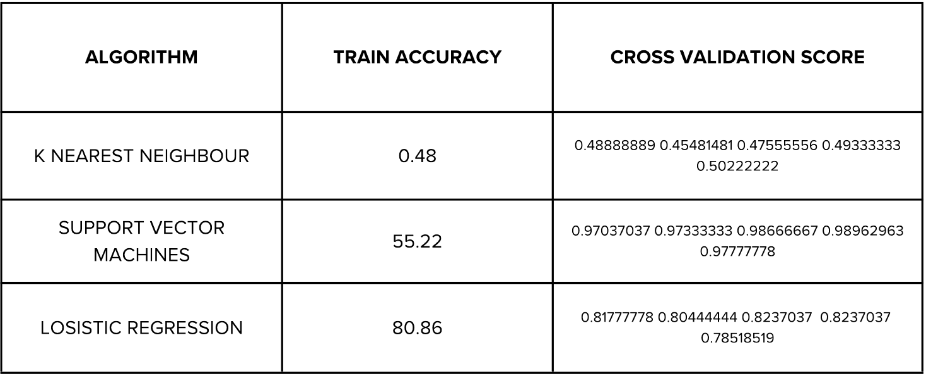
K NEAREST NEIGHBOUR
SUPPORT VECTOR MACHINES
LOGISTIC REGRESSION
Upon comparison of all four models, it is evident that the decision tree classifier exhibits higher accuracy and cross validation scores compared to the other three algorithms. Therefore, it is selected for our project

Slide 12
6. Final Implementation
The code for the Flask web application is written in a manner that ensures it is easily comprehensible for the user.
This web application is crafted to receive user input parameters such as age, disease and test results, forwarding them to the decision tree classifier for prediction.
Once the decision tree classifier predicts the medication, it is showcased to the user via the flask web application.

Slide 13
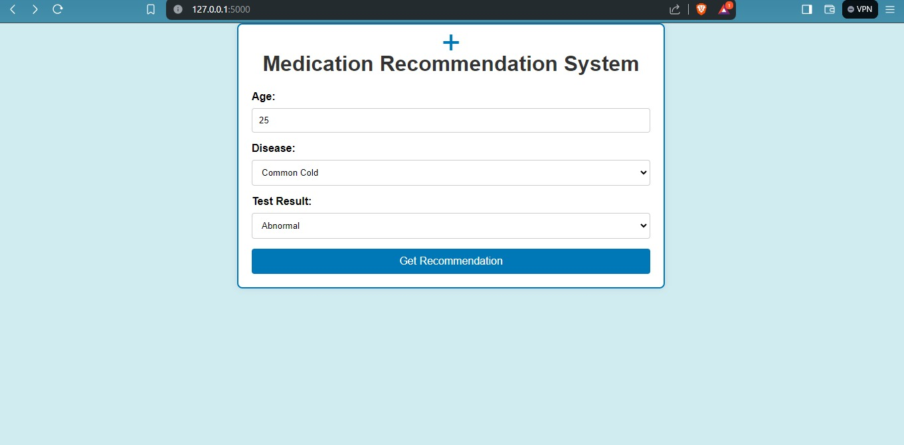

RESULTS

Slide 14
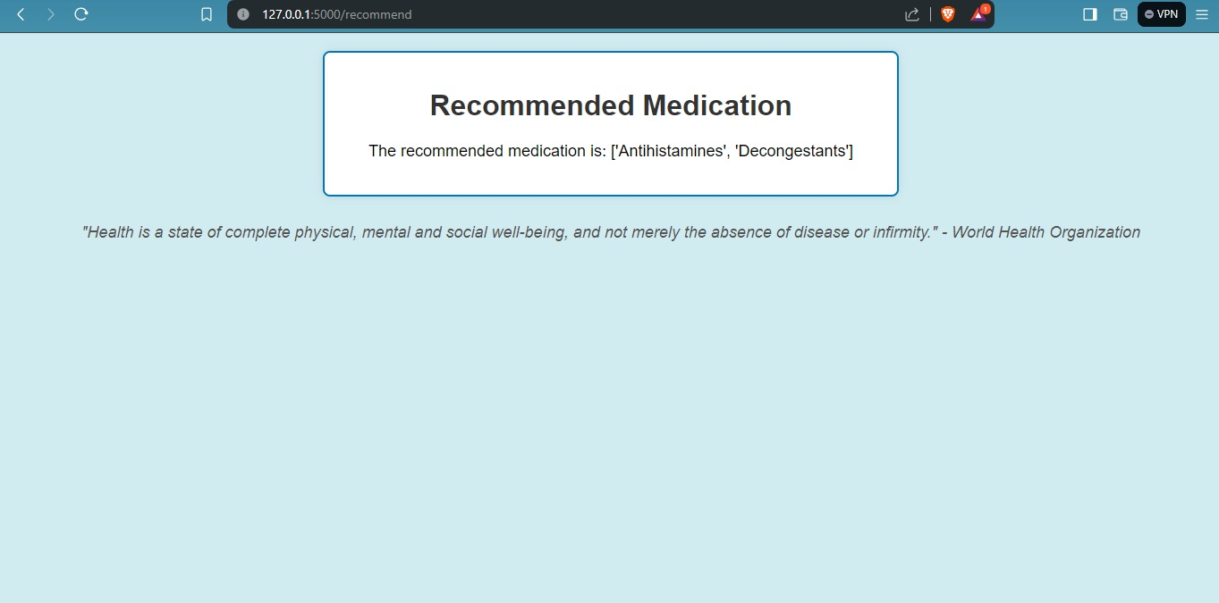
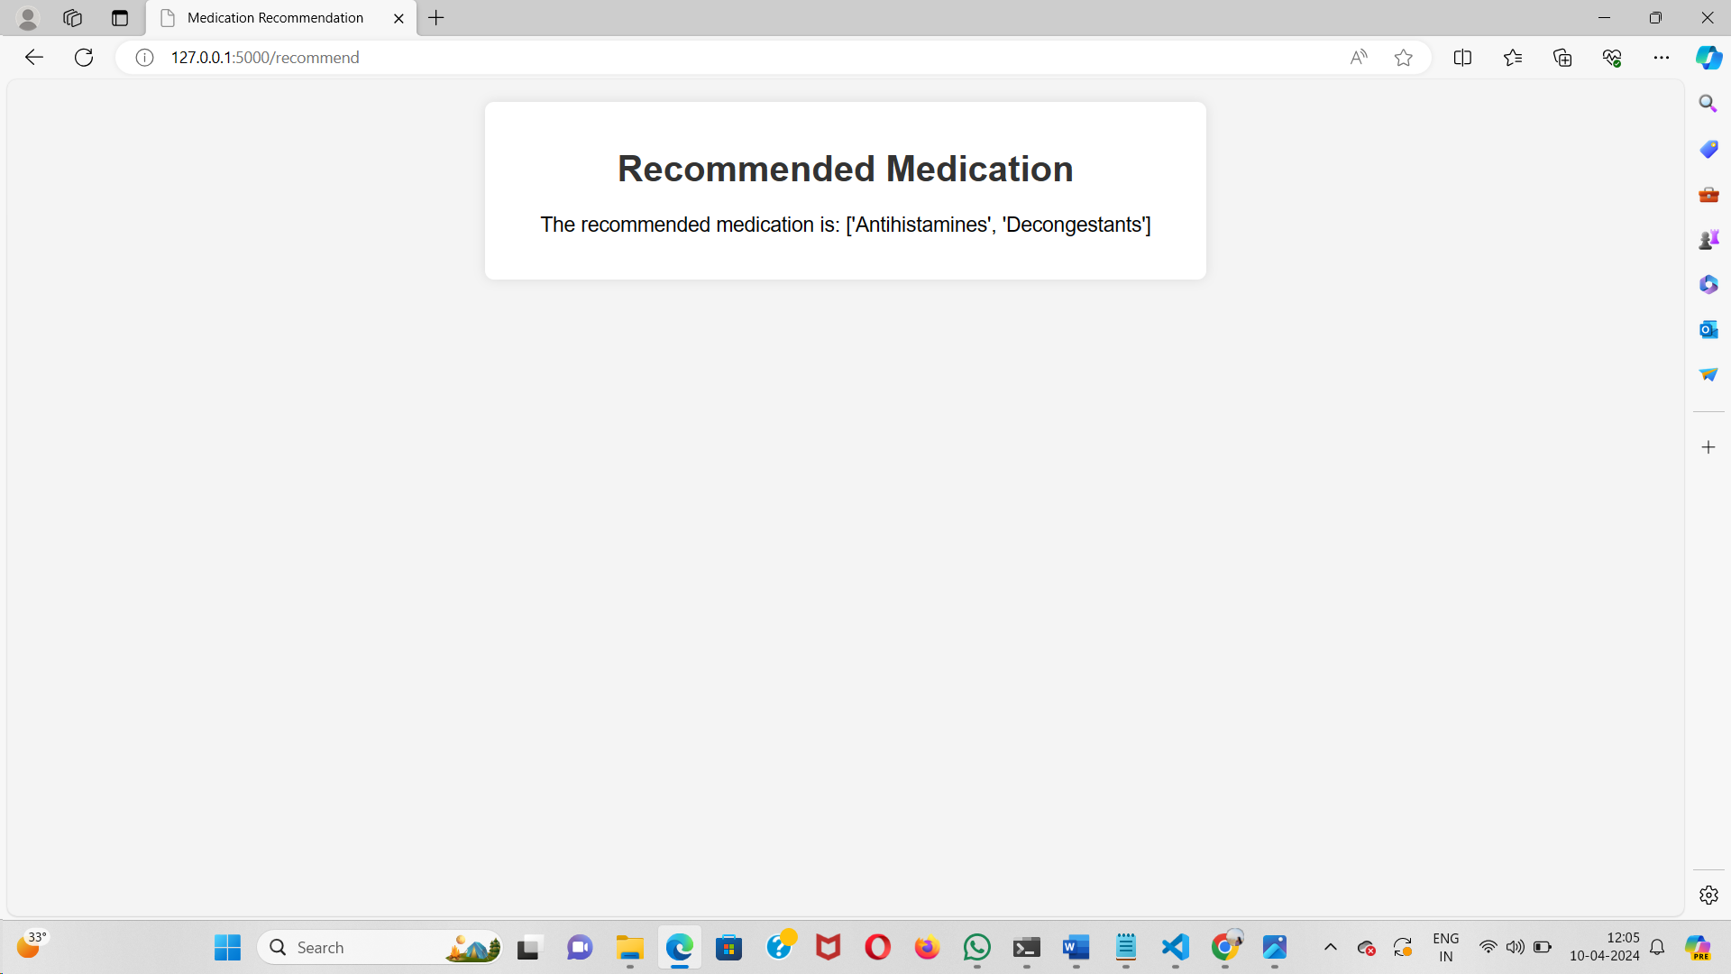

Slide 15
CONCLUSION
In conclusion, leveraging age, blood type, and test results, our model offers personalized medication recommendations, empowering individuals to actively engage in their healthcare. This user-friendly application serves as a bridge, providing tailored medication knowledge and fostering improved patient outcomes through personalized healthcare solutions.

Slide 16
THANK YOU!

