Slide 1
CLOUD ANALYTICS REFERENCE PROJECT
Superstore Sales Overview
& Geographic Insights
An end-to-end cloud analytics solution built with AWS S3, Glue, Athena, and Power BI
Presented by: P. Charumathy
Student ID: AF05251183
Batch Code: ANP-D6641
Course: DBA – Data and Business Analysis

Slide 2
01
Project Objective
What The Data Delivers
What This Project Builds
Clean, consistent data prepared with Power Query transformations
A two-page interactive Power BI dashboard connected to Athena
Page 1: Sales Overview with KPIs, charts, and profit metrics
Page 2: Geographic and Customer Insights with maps and rankings
An end-to-end cloud-based analytics solution using the Superstore dataset
Secure storage and management of raw data in Amazon S3
Controlled, role-based access to AWS resources through AWS IAM
Automatic schema discovery and cataloging using AWS Glue Crawler
2

Slide 3
02
Complete Project Workflow
Raw data moves through five AWS and Power BI stages to become a live dashboard
Superstore
Dataset
→
Amazon
S3
→
AWS
Glue
→
Amazon
Athena
→
Power
BI
→
Superstore
Dashboard
Storage → Access Control → Cataloging → SQL Analysis → Visualization → Business Insight
Each AWS service hands off clean, structured data to the next stage in the pipeline
3

Slide 4
03
Steps 1 & 2: AWS Setup and S3 Buckets
Step 1 — AWS Console Account
Step 2 — Create S3 Buckets
Signed in to the AWS Management Console using account credentials
Enabled Multi-Factor Authentication (MFA) for stronger account security
Verified successful sign-in and accessed the Console Dashboard
Created two buckets: charu-etl-source-bucket for raw data and charu-etl-results-bucket for query results
Downloaded the sample Superstore dataset in CSV format
Uploaded the dataset into the source bucket inside a dedicated folder
4

Slide 5
04
Step 3: Configure IAM Role
Granting AWS Glue secure access to Amazon S3
Policies Attached
Role Setup Process
Navigated to IAM → Roles → Create Role
Assigned permissions so the Glue service can access the S3 bucket
Selected AmazonS3FullAccess for bucket access
Selected AWSGlueServiceRole for Glue service access
AdministratorAccess may be used instead during learning and practice
Created and saved the IAM role for use by the Glue Crawler
AmazonS3FullAccess
AWS managed — bucket access
AWSGlueServiceRole
AWS managed — Glue service access
5

Slide 6
05
Step 4: AWS Glue — Database and Crawler
4.2 Create Crawler
4.1 Create Database
Created a crawler named charu-etl-crawler
Set the S3 data source path to the customer-data folder
Configured it to crawl all sub-folders on every subsequent run
Selected the IAM role from Step 3 for secure S3 and catalog access
Linked the crawler to the target database with an on-demand schedule
Opened AWS Glue → Data Catalog → Databases
Created a new database, superstore-db, to hold catalog metadata
Saved the database and verified it appeared in the Data Catalog
6

Slide 7
06
Step 4.3: Run Crawler and Verify Table
1
2
3
4
Run
Monitor
Verify
Confirm
Ran the crawler manually from the AWS Glue console
Checked crawler status until it displayed Completed
Confirmed a new table was created inside the Glue Data Catalog
Checked that the table schema matched the Superstore dataset structure
7

Slide 8
07
Step 5: Amazon Athena — Create Queries
Using serverless SQL to analyze the cataloged Superstore table
Query Techniques Used
Athena Preparation
Filtering with WHERE
Aggregate functions: MIN, MAX, AVG, SUM
GROUP BY for region and category
Opened Amazon Athena from the AWS Management Console
Set the query result location to the charu-etl-results-bucket
Selected the Glue Data Catalog database and table created by the crawler
Configured the S3 query-result location used by Athena
Executed SQL statements for region, category, and sub-category analysis
8

Slide 9
08
SQL Analysis — Basic Filtering and Aggregation
Part 1: Queries run against the superstore_dataset table
Aggregate Queries (Central Region)
Filtering Queries
Calculated the minimum sales value
Calculated the maximum sales value
Calculated the average sales value
Calculated the total (sum) of sales
Retrieved all records for the Central region
Retrieved all First Class shipping records
9

Slide 10
09
SQL Analysis — Grouping and Ranking
Part 2 & 3: Deeper aggregation across regions, categories, and orders
Part 2 — Aggregation & Grouping
Part 3 — Counts, Averages & Ranking
Calculated total profit for the Central region
Grouped total sales by region
Grouped total sales by category
Grouped total profit by category
Counted orders by region and by ship mode
Calculated average sales and average profit by category
Identified products with sales greater than 500
10

Slide 11
10
Step 6: Connect Athena to Power BI
Bridging cloud SQL results with a desktop BI tool
Simba Athena
ODBC Driver
→
Data Source
Name (DSN)
→
AWS Region,
Catalog & Workgroup
→
Power BI
Direct Query
Configuration Steps
Installed the Simba Amazon Athena ODBC driver on Windows
Configured a Data Source Name (DSN) with the AWS region, catalog, and workgroup details
This ODBC connection allows Power BI to query the Athena table directly, without manual exports
11

Slide 12
11
Step 7: Power BI — Visualize and Analyze
Measure & Visualize
Connect & Prepare
Created DAX measures for Total Sales, Total Profit, Profit Margin, and Loss Orders
Added Profit Margin %, Average Order Value, and Average Quantity per Order
Built a two-page interactive dashboard: Executive Overview and Profitability Analysis
Connected Power BI Desktop to Athena via Get Data → ODBC
Authenticated using the configured DSN and selected the Superstore table
Cleaned the data with Power Query: handled nulls, mixed date formats, and data types
12

Slide 13
12
Technology Stack Summary
Cloud Data Infrastructure (AWS)
Amazon S3
Scalable cloud storage for the source bucket (raw data) and results bucket (query results)
AWS IAM
Identity and Access Management for secure, role-based access control
AWS Glue
Database, Crawler, and Table setup for automated schema discovery and cataloging
Amazon Athena
Serverless SQL query execution used to generate the analysis results
Data Visualization
Power BI
Connectivity via ODBC (Open Database Connectivity) for interactive data visualization
13

Slide 14
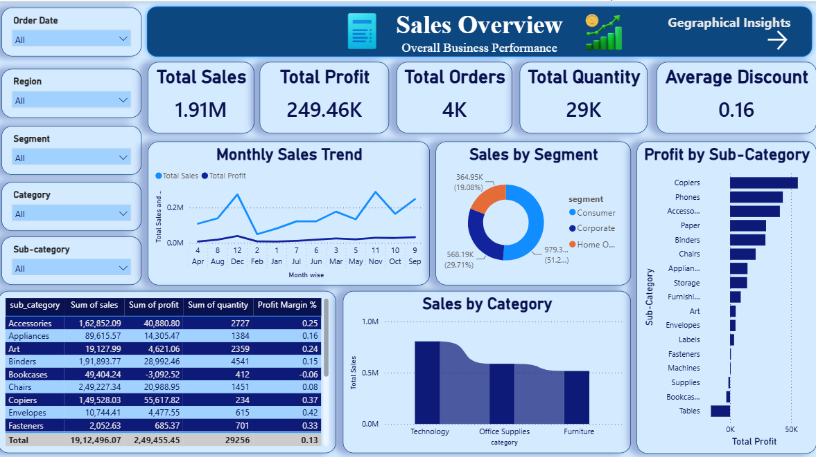
13
Dashboard — Sales Overview
Page 1 of the Power BI report: KPIs, trends, and category performance
14

Slide 15
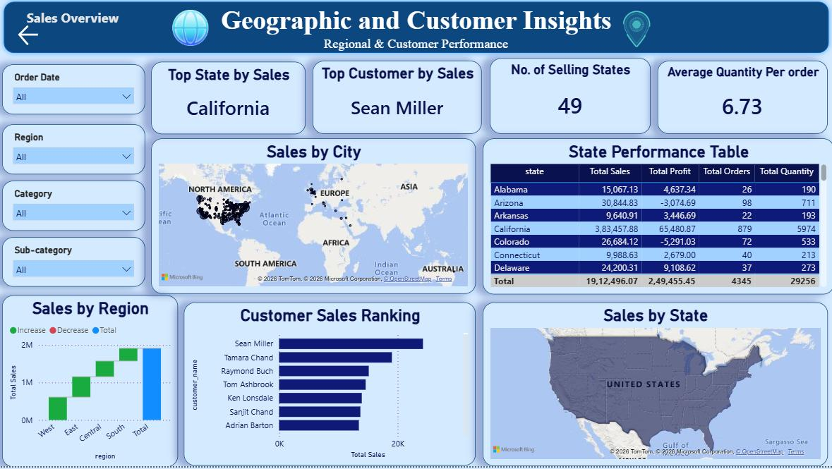
14
Dashboard — Geographic & Customer Insights
Page 2 of the Power BI report: regional performance and top customers
15

Slide 16
Thank You
Superstore Sales Overview & Geographic Insights
P. Charumathy | AF05251183 | ANP-D6641 | DBA – Data and Business Analysis

