Slide 1
Design and FPGA Implementation of a 100-Neuron Spiking Neural Network Functionality

Slide 2
COMPARISON
Feature | Single Neuron | Proposed System (3-100-2 Spiking)
Network Scale | 1 Neuron total | 102 Neurons total (100 Hidden + 2 Output)
Hardware Style | Basic parallel block | Time-Multiplexed FSM Pipeline (Advanced)
Output Type | Single static value / state | Spike Firing Frequency (Population Coding)
4-Bit Multiplier Use | Used only 3 times per cycle | Reused 300 times via the memory loop
Display Meaning | Shows a single raw result | Shows total system spikes (00 to 99)
Memory Footprint | Static registers; no ROM/RAM required | Embedded ROM Array required to store 300 independent weight parameters (100 X 3 )
Application Realism | Limited to basic logic gates (AND/OR); fails on non-linear data | True Edge-AI Pattern Classifier; capable of complex tasks like image edge detection

Slide 3


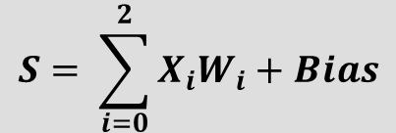



Input Layer
Hidden Layer
Output Layer
Spike 1
$$X_{0}$$
1
Spike 2
$$Y_{0}$$
2
$$S= \sum_{i=0}^{2}{X_{i}W_{i}}+Bias$$
Spike 3
$$X_{1}$$
3
…….
…..
S > Threshold
$$X_{2}$$
$$Y_{1}$$
100
Spike 100

Slide 4
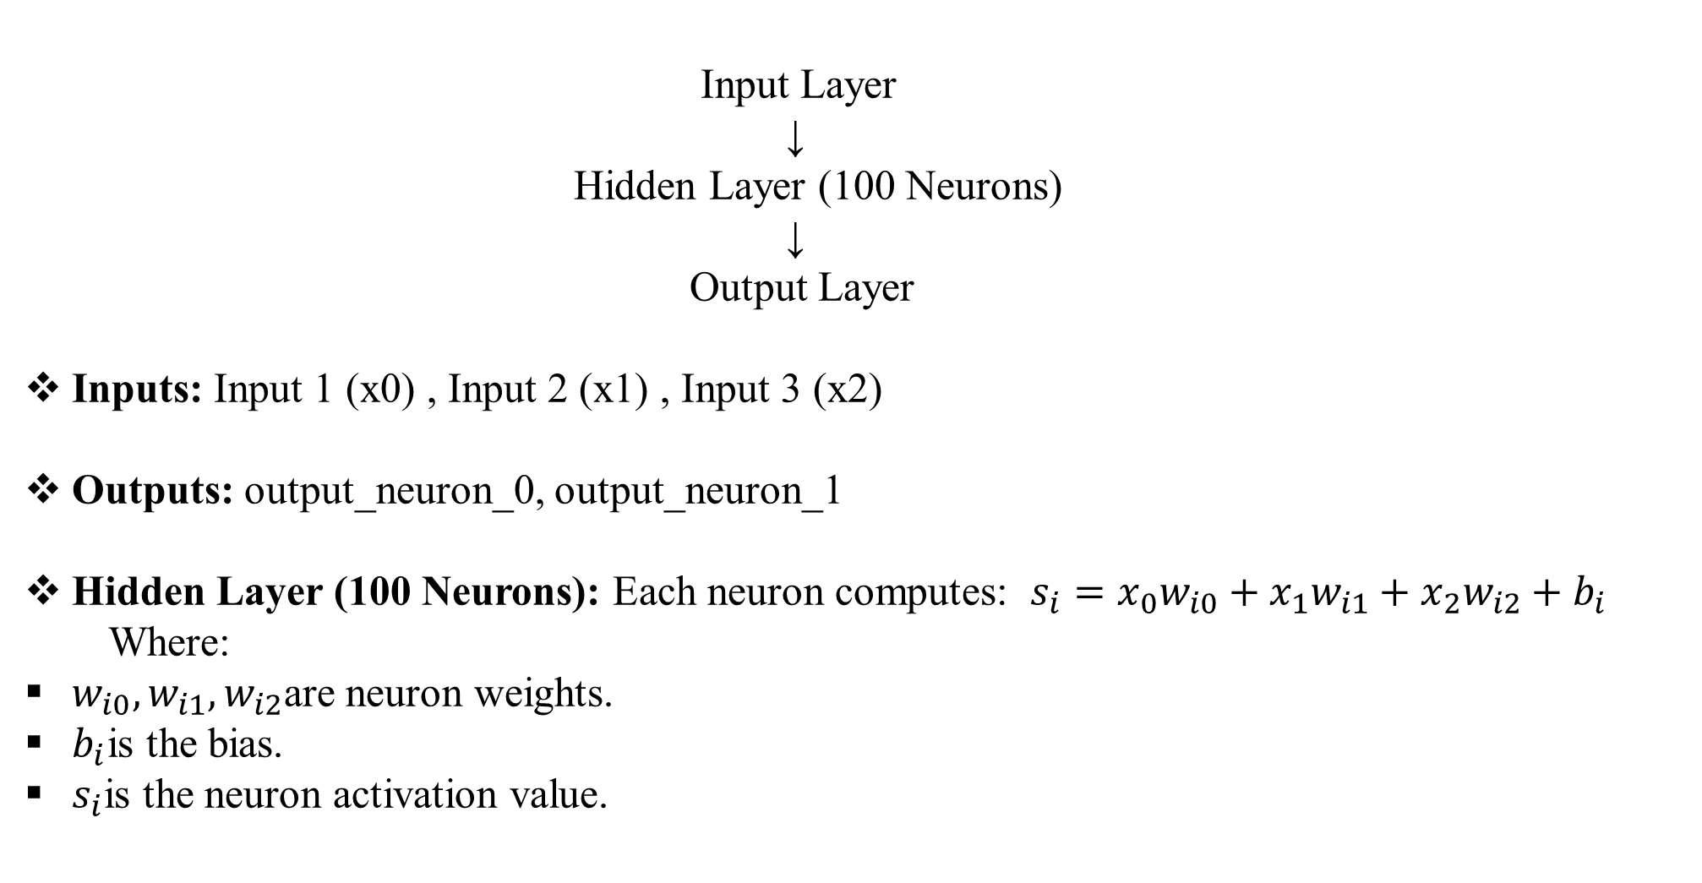
SYSTEM ARCHITECTURE
Input Layer ↓ Hidden Layer (100 Neurons) ↓ Output Layer
Inputs: Input 1 (x0) , Input 2 (x1) , Input 3 (x2)
Outputs: output_neuron_0, output_neuron_1
Hidden Layer (100 Neurons): Each neuron computes: $s_{i}=x_{0}w_{i0}+x_{1}w_{i1}+x_{2}w_{i2}+b_{i}$
Where:
$w_{i0},w_{i1},w_{i2}$are neuron weights.
$b_{i}$is the bias.
$s_{i}$is the neuron activation value.

Slide 5
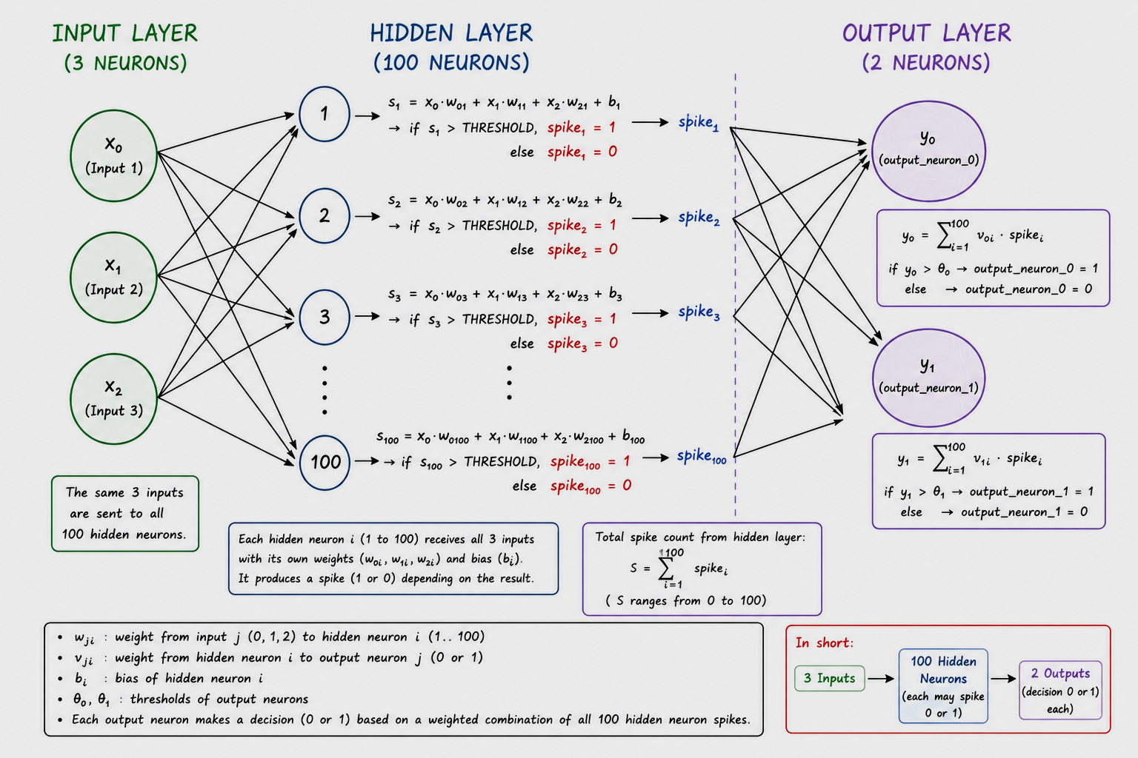

Slide 6
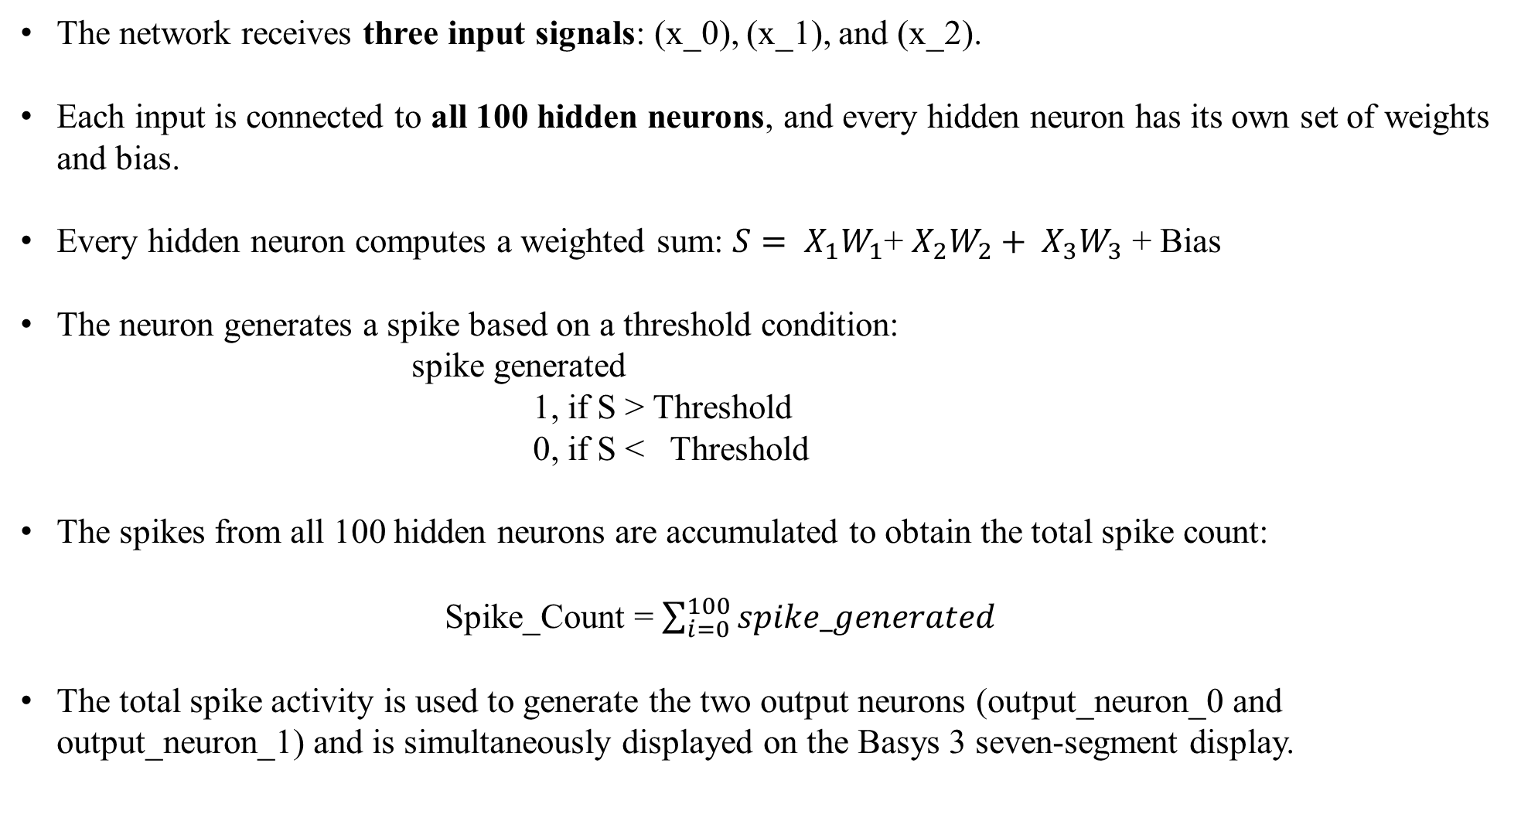
ARCHITECTURAL OVERVIEW
The network receives three input signals: (x_0), (x_1), and (x_2).
Each input is connected to all 100 hidden neurons, and every hidden neuron has its own set of weights and bias.
Every hidden neuron computes a weighted sum: $S= X_{1}W_{1}$+ $X_{2}W_{2}+ X_{3}W_{3}$ + Bias
The neuron generates a spike based on a threshold condition: spike generated 1, if S > Threshold 0, if S < Threshold
The spikes from all 100 hidden neurons are accumulated to obtain the total spike count:
Spike_Count = $\sum_{i=0}^{100}{spike_generated}$
The total spike activity is used to generate the two output neurons (output_neuron_0 and output_neuron_1) and is simultaneously displayed on the Basys 3 seven-segment display.

Slide 7
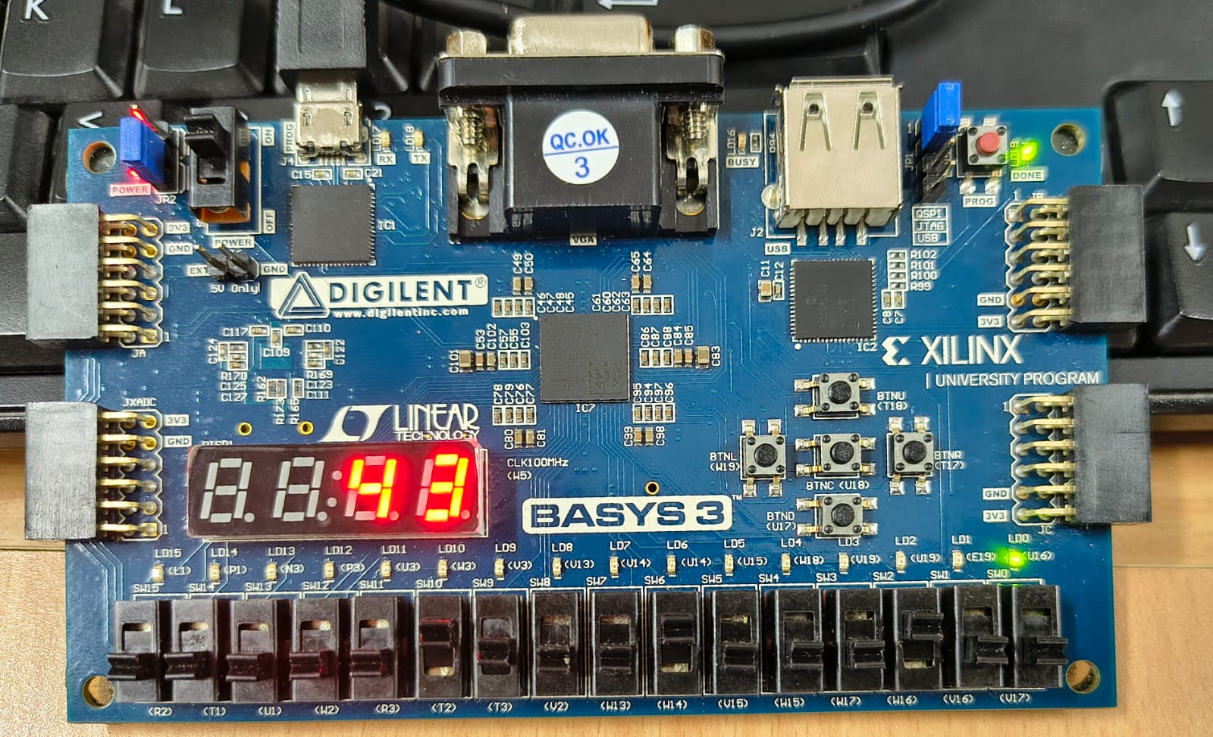
FPGA IMPLEMENTATION

Slide 8
POWER ANALYSIS
Ultra-Low Consumption: The system draws only 94 mW in total, which is less than a tenth of a watt.
I/O Dominance: 88% of the active (dynamic) power is spent driving the physical pins for your 7-segment display and LEDs, while the internal neuron math takes almost nothing.
Thermal Performance: The chip runs at 25.5°C (virtually room temperature), meaning it will never overheat.

Slide 9
UTILIZATION ANALYSIS
Tiny Resource Footprint: The entire project uses just 162 LUTs (logic gates) and 53 Registers (storage cells).
Time-Multiplexing Proof: Because your FSM loops a single physical neuron block 100 times instead of building 100 separate hardware neurons, the design takes up less than 1% of the available chip space.

Slide 10
TIMING ANALYSIS
Perfect Timing: There are zero failures or data corruption risks (TNS = 0.000 ns).
High-Speed Margin: Worst Negative Slack is +6.408 ns. Since the clock allows 10 ns for calculations, your circuits finish their math in just 3.592 ns—meaning your network runs nearly 3 times faster than required.

Slide 11
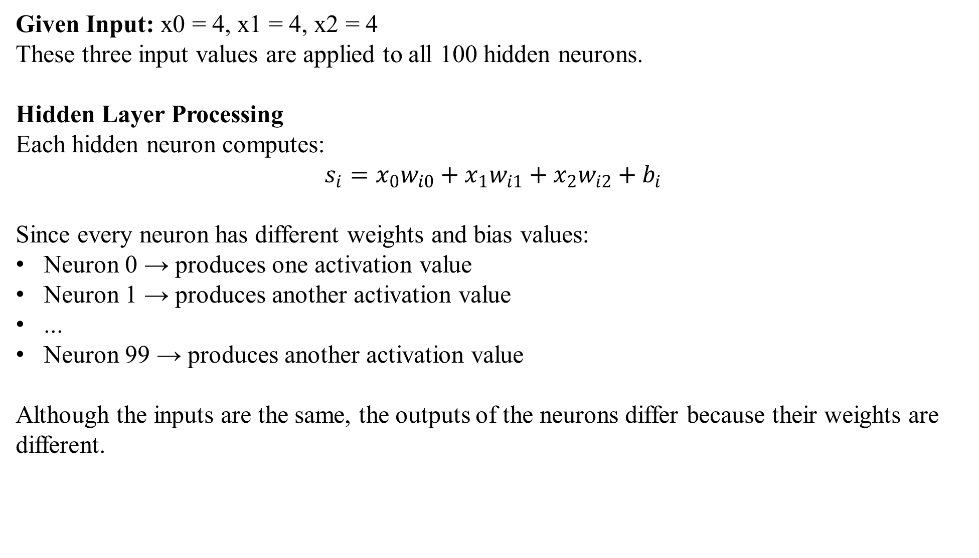
RESULT ANALYSIS
Given Input: x0 = 4, x1 = 4, x2 = 4
These three input values are applied to all 100 hidden neurons.
Hidden Layer Processing
Each hidden neuron computes:
$$s_{i}=x_{0}w_{i0}+x_{1}w_{i1}+x_{2}w_{i2}+b_{i}$$
Since every neuron has different weights and bias values:
Neuron 0 → produces one activation value
Neuron 1 → produces another activation value
...
Neuron 99 → produces another activation value
Although the inputs are the same, the outputs of the neurons differ because their weights are different.

Slide 12
RESULT ANALYSIS
Spike Generation
Each neuron compares its activation value with the threshold:
If activation > Threshold Spike = 1 Else Spike = 0
As a result: 43 neurons generated spikes 57 neurons remained inactive
Population Spike Count
The spikes from all 100 neurons are accumulated: Total Spike Count = Number of firing neurons = 43
Therefore: Seven-Segment Display = 43

Slide 13
THANK YOU

