Slide 1
Implementation of a single neuron on Basys 3 FPGA

Slide 2
STRUCTURE AND FUNCTIONALITY
The structure and the functionality of the architecture corresponds to the specific part of a real brain cell:
1. Inputs (Dendrites)
Dendrites receive and transmit signals from neighboring neurons to the cell body.
Five input channels acquire data from the Basys 3 slide switches and provide the initial inputs to the neuron.
2. Weights (Synaptic Strengths)
Synaptic connections determine the influence of incoming signals based on their strength.
Weight values define the relative importance of each input during signal processing.
3. Accumulator (Soma / Cell Body)
The soma integrates all incoming signals before generating a response.
An accumulator computes the weighted sum of all input signals.

Slide 3
STRUCTURE AND FUNCTIONALITY
4. Bias (Resting Membrane Potential)
The resting membrane potential establishes the neuron's baseline electrical state and affects its firing behavior.
A bias term shifts the activation threshold, enabling more flexible decision-making.
5. ReLU Activation (Axon Hillock)
The axon hillock determines whether the accumulated signals are sufficient to initiate an action potential.
The ReLU activation function determines whether the computed output is propagated or suppressed.
6. Output (Axon)
The axon transmits the neuron's final signal to other neurons or target cells.
The processed output is displayed through the Basys 3 LEDs, representing the neuron's final response.

Slide 4
SYSTEM ARCHITECTURE
1. Clock Synchronization and Scaling
The entire design is synchronized using the Basys 3 FPGA's onboard 100 MHz crystal oscillator.
A custom 26-bit clock divider reduces the clock frequency to 1 Hz, enabling real-time observation of neuron outputs through the onboard LEDs.
2. Input Data Representation
Input signals are mapped to the FPGA slide switches using 4-bit signed integers.
This representation supports values from −8 to +7, allowing both excitatory (positive) and inhibitory (negative) inputs.
3. Two-Stage Pipelined Processing
Stage 1 – Parallel Multiplication: Each 4-bit input is multiplied by its corresponding 8-bit signed weight, producing independent 12-bit signed product values.
Stage 2 – Accumulation and Bias Addition: The generated products are summed together with the bias using a 14-bit accumulator, ensuring accurate signal integration.

Slide 5
SYSTEM ARCHITECTURE
4. Sign Extension and Data Integrity
To maintain arithmetic accuracy during accumulation, the bias value is dynamically sign-extended using the Verilog replication operator.
This process converts the 8-bit signed bias into a 14-bit signed value, preserving its sign and preventing overflow or data corruption during addition.
5. ReLU Activation and Output Generation
A hardware-based ReLU activation function suppresses all negative accumulated values by forcing them to zero.
6. Output
The final output is stored in a 5-bit signed register, and is displayed directly through the Basys 3 onboard LEDs.

Slide 6
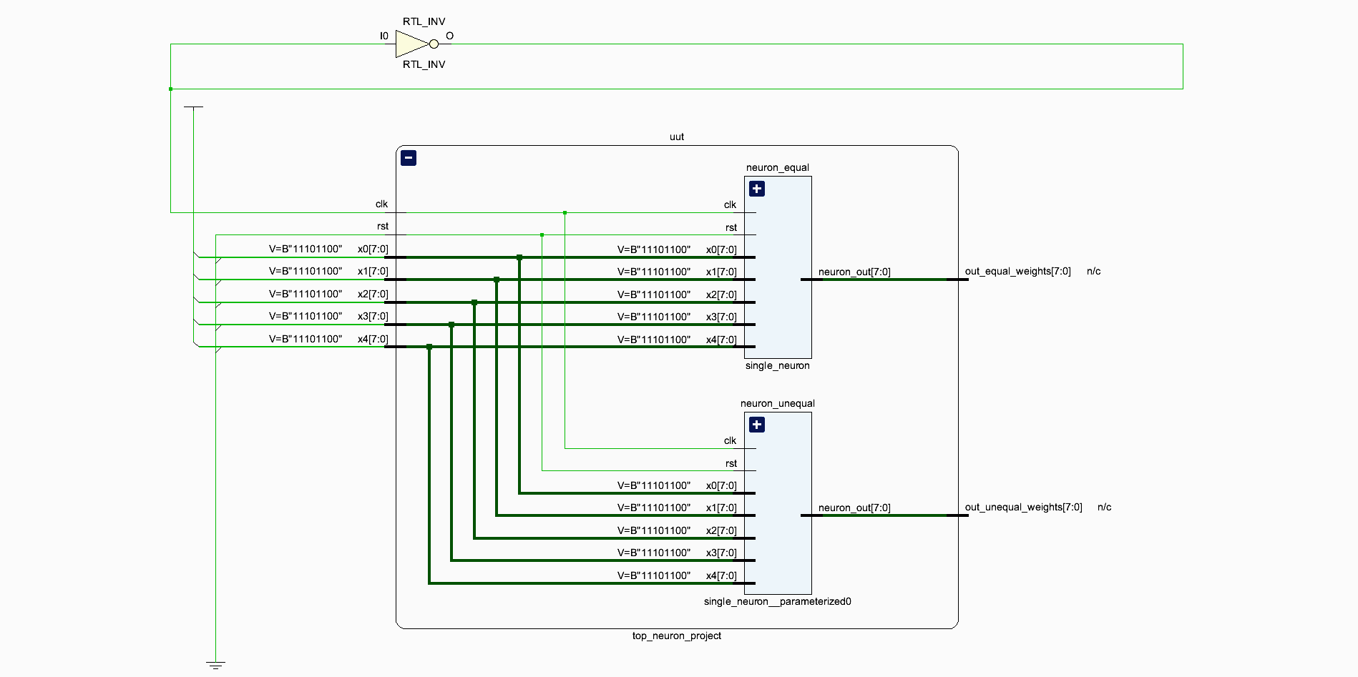
SYNTHESIS SCHEMATIC

Slide 7

MATHEMATICAL MODEL
The neuron output is calculated using the equation:
$$Sum= \sum_{i=0}^{2}{\left( x_{i . }w_{i}\right)+Bias}$$
Where:
X = Input values
W = Weights
B = Bias
Y = Output
The weighted inputs are summed together and then shifted by the bias value before passing through the activation function.

Slide 8
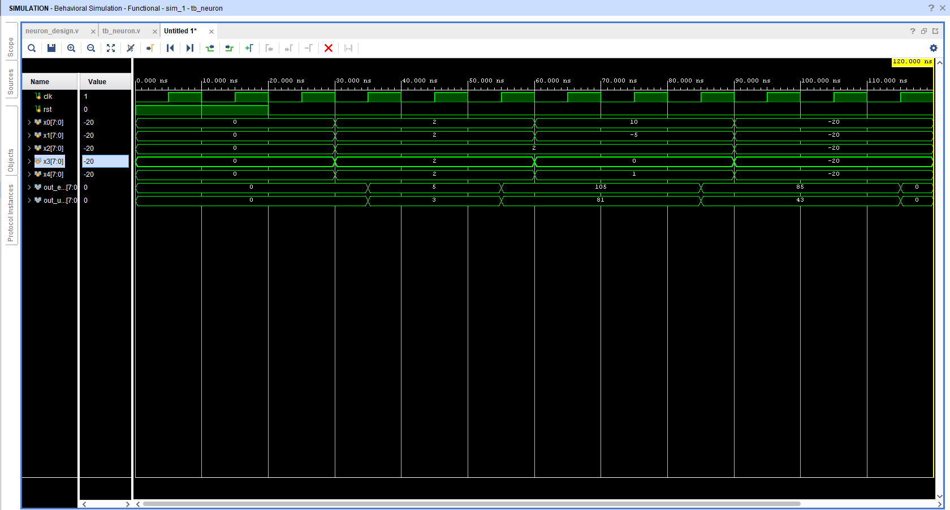
SIMULATION RESULTS USING VIVADO

Slide 9
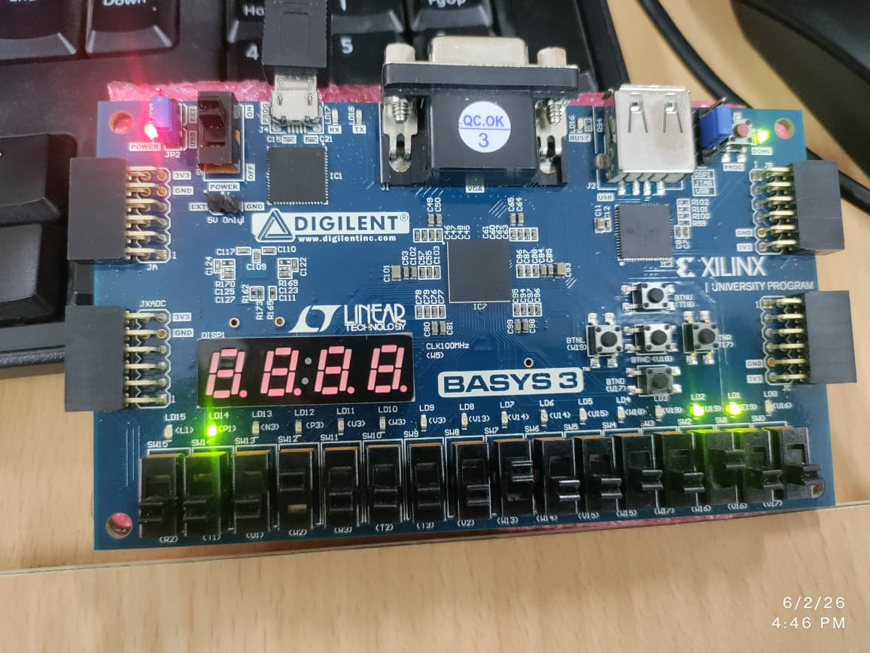
HARDWARE IMPLEMENTATION RESULTS

Slide 10
RESULTS ANALYSIS
Equal Weightage Profile Calculation
Inputs : X_0 = 1, X_1 = 1 , X_2 = 1
Hardware Parameters: W_0 = 1, W_1 = 1, W_2 = 1, BIAS = 1
Step 1: Parallel Multiplication (Stage 1)
prod0 = 1 x 1 = 1
prod1 = 1 x 1 = 1
prod2 = 1 x 1 = 1
Step 2: Accumulation & Biasing (Stage 2)
Sum = 3+ 1 ( bias)
Sum = 4
Output State: Since 4 is positive, it passes through the ReLU activation function completely unfiltered. The Basys 3 LEDs will display the 5-bit signed binary value of 00100.

Slide 11
RESULTS ANALYSIS
2. Unequal Weightage Profile Calculation
Inputs : x_0 = 1, x_1 =1 , x_2 = 1
Hardware Parameters: W_0 = 1 , W_1 = 2, W_2 = 3, BIAS = 0
Step 1: Parallel Multiplication (Stage 1)
prod0 = 1 x 1 = 1
prod1 = 1 x 2 = 2
prod2 = 1 x 3 = 3
Step 2: Accumulation & Biasing (Stage 2)
Sum = 6 + 0(bias)
Sum = 6
Output State: Since 6 is positive, the ReLU activation layer remains completely open. The Basys 3 LEDs will display the 5-bit signed binary value of 00110.

Slide 12
THANK YOU

