Slide 1
Analyzing the Neighborhoods in Mumbai for Starting a Restaurant

Slide 2
Introduction
Mumbai is the financial capital of India and is one of the most densely populated cities in the world.
The multi-cultural nature of the city brings with it numerous cuisines from all over the globe.
Business owners and entrepreneurs might be looking to start a new restaurant in Mumbai.
The task is to identify neighborhoods that have the potential of being good locations for starting a new restaurant.

Slide 3
Data
To find a solution to the questions and build a recommender model, we need data and lots of data.
The data of the neighborhoods in Mumbai was scraped from https://en.wikipedia.org/wiki/List_of_neighborhoods_in_Mumbai.
The data is read into a pandas data frame using the html method.
The data was then cleaned to produce the final datasets shown in the upcoming slides.

Slide 4
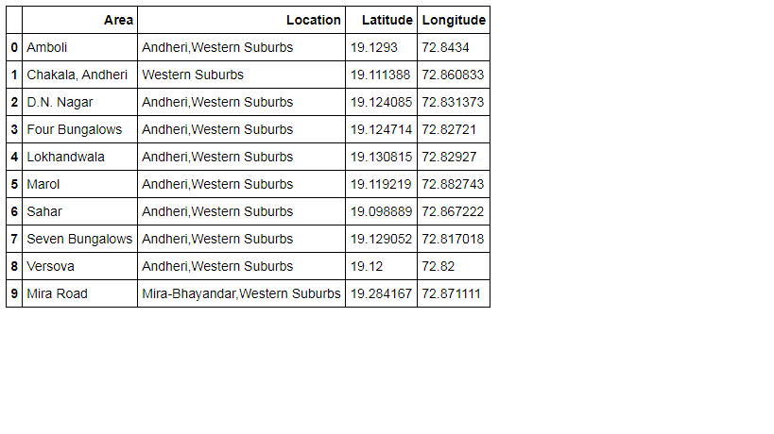
Dataframe for Neighborhoods

Slide 5
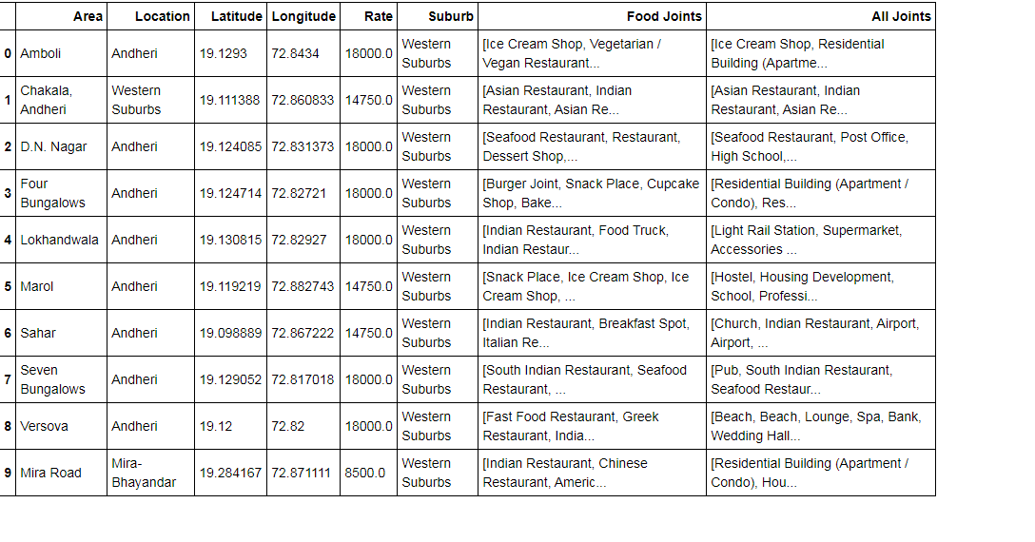
Using Foursquare API

Slide 6
Methodology
Exploring the dataset is important because it gives you initial insights and may help you to get partial idea of the answers that you are looking to find out from the data.
Using folium, a map was plotted to show how the different neighborhoods are spread all across Mumbai.
In order to understand the data obtained for Mumbai neighborhoods, basic visualization was carried out.

Slide 7
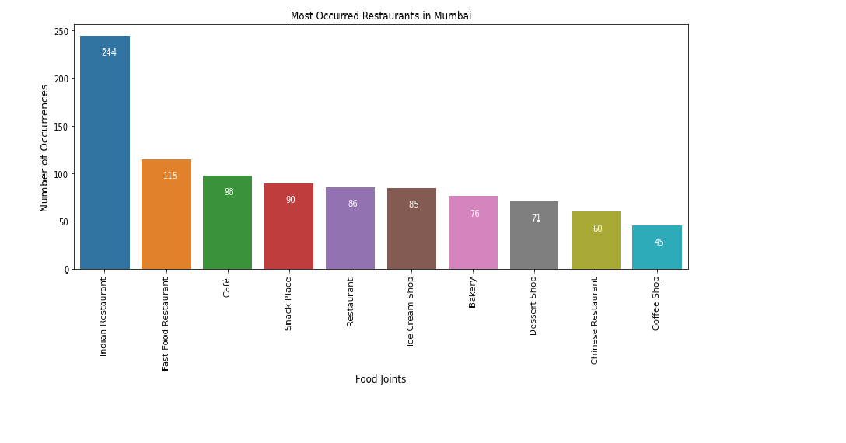
Data Visualization

Slide 8
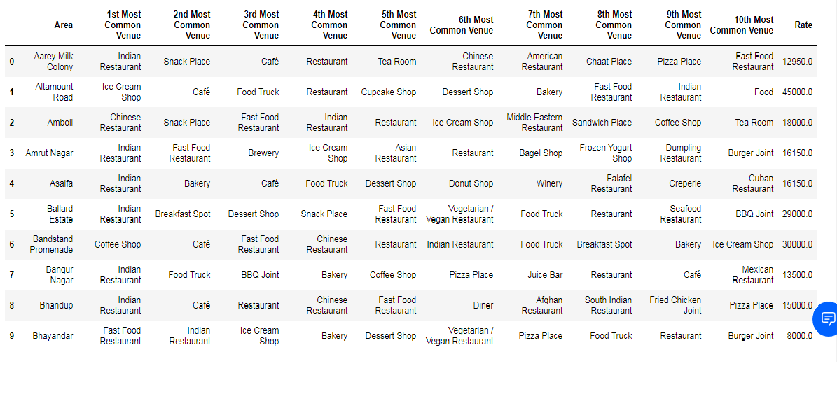
Dataset for Top 10 Most Common Venues

Slide 9
Result
Each neighborhood received a cluster label based on clustering by the KMeans algorithm.
The Cluster Label column along with the Location, Latitude, and Longitude columns were added to the top 10 most common venues dataframe to provide the final results.
This dataframe is shown on the next slide,

Slide 10
Result Continued..

Slide 11
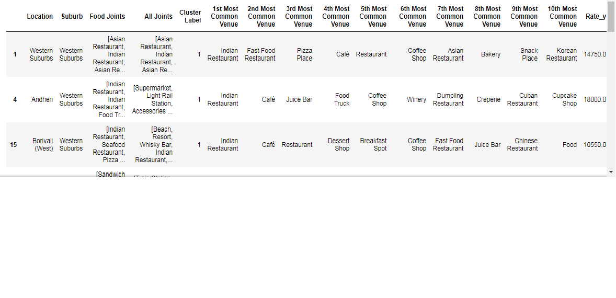
Cluster 1

Slide 12
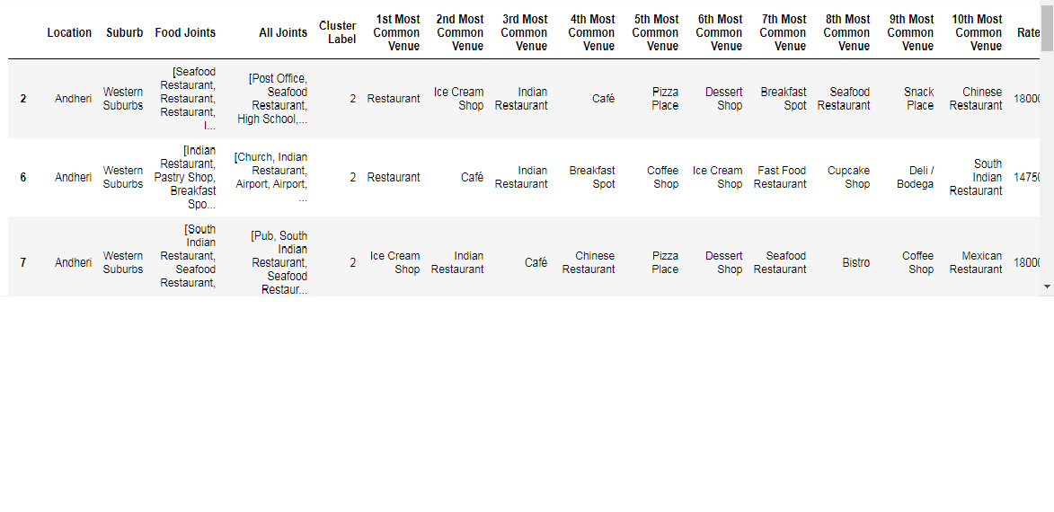
Cluster 2

Slide 13
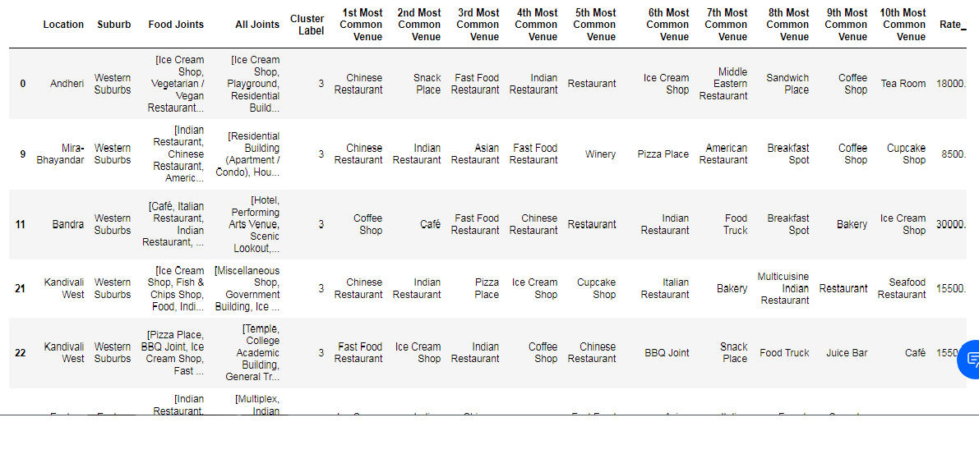
Cluster 3

Slide 14
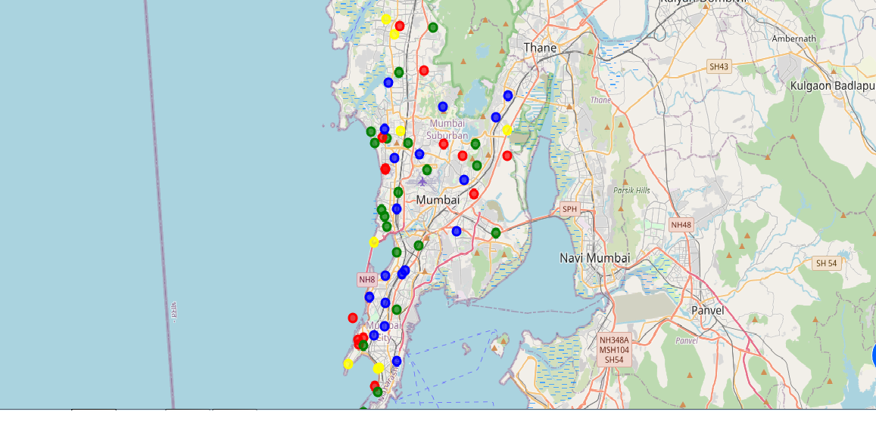
Results Continued: Visualization of neighborhood clusters was done using Folium

Slide 15
Discussion
Since there was a nonlinear relationship between income and population, it can be concluded that we must always perform inferential approach to find relationship among different set of features. Also during clustering, similar neighborhoods must be dumped into the right cluster.

Slide 16
Conclusion
In this project, the neighborhoods in Mumbai, India have been successfully analyzed for determining which would be the best neighborhoods for opening a new restaurant. Based on the analysis carried out, neighborhoods in cluster 3 are recommended as locations for the new restaurant. The stakeholders and investors can further tune this by considering various other factors like transport, legal requirements, and costs associated. These were out of the scope for this project and thus were not considered.

