Slide 1

EMPLOYEE RETENTION
This Photo by Unknown Author is licensed under CC BY-SA-NC

Slide 2

Project Name : Crowdfunding-Analytics Project Members : Gayatree Panda Mr. Siddartha Reddy Donapati Ms. Vaishnavi Ashok Lavankar Suhas Gowda L Jaikishan Vishwakarma Mrs. Charu Sinha Tej Salil Lad
This Photo by Unknown Author is licensed under CC BY-NC-ND

Slide 3

AGENDA :
Introduction & Problem Statement
Business Objective
KPIs
Dashboard
Conclusion

Slide 4
Introduction: Crowdfunding is the practice of funding a project or venture by raising small amounts of money from a large number of people, typically via the Internet. Crowdfunding is a form of crowdsourcing and alternative finance. In 2015, over US$34 billion was raised worldwide by crowdfunding.
Problem Statement:
Projects Overview KPI :
Total Number of Projects based on outcome
Total Number of Projects based on Locations
Total Number of Projects based on Category
Total Number of Projects created by Year , Quarter , Month
Successful Projects
Amount Raised
Number of Backers
Avg Number of Days for successful projects
Top Successful Projects based on Number of Backers
Top Successful Projects based on Amount Raised.
Percentage of Successful Projects overall
Percentage of Successful Projects by Category
Percentage of Successful Projects by Year , Month etc..
Percentage of Successful projects by Goal Range

Slide 5
Business Objective:
The aim of this project is to analyze crowdfunding with the organization and provide insights for developing effective strategies. Through data analysis and visualizations, we will identify factors that contribute to :
Capital Raising.
Evaluate the effectiveness of Marketing and Exposure
To verify the satisfaction level of Customer Engagement
Provide recommendations to improve crowdfunding

Slide 6

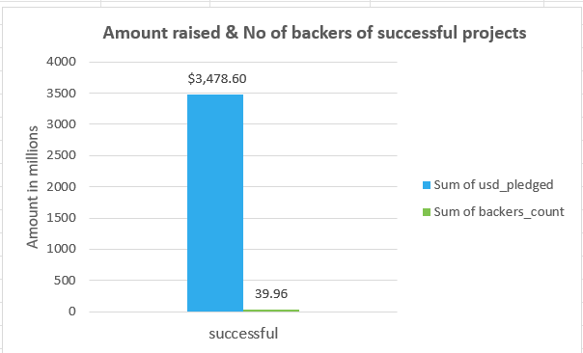
Successful Projects: . Amount Raised . Number of Backers . Avg Number of Days for successful projects
In this KPI Amount raised is
$3,478.60 usd_pledged & No of backers of successful projects is 39.96 backers count, and Avg no of days for successful project is 80.37

Slide 7
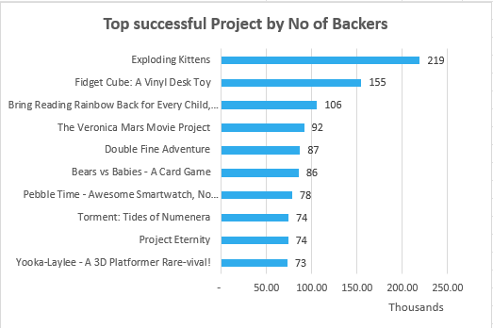
Top Successful Projects based on Number of Backers
In this KPI we found that Exploding Kittens is the Top Successful project by no Backers followed by Fidget Cube.

Slide 8
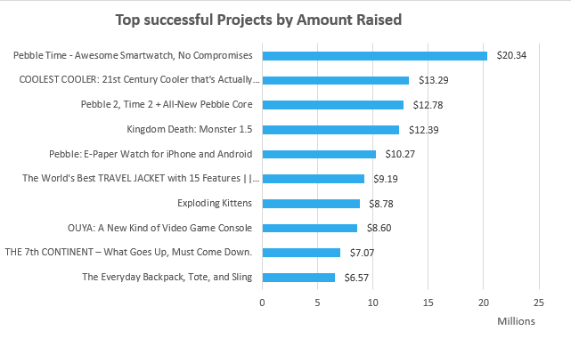
Top Successful Projects based on Amount Raised.
In this KPI we found that Pebble Time is the Top Successful project by Amount Raised.

Slide 9
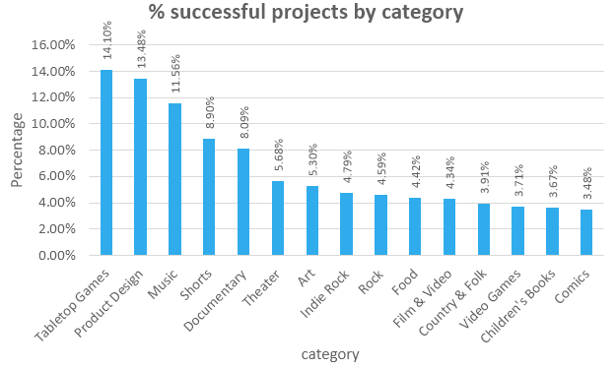
Percentage of Successful Projects by Category
This KPI shows that Tabletop Games comes in the highest percentage of successful projects by category

Slide 10
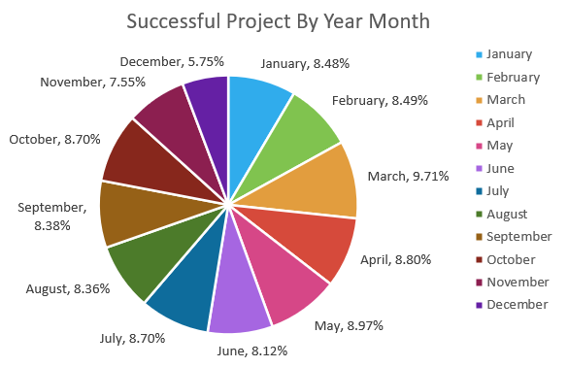
Percentage of Successful Projects by Year , Month etc..
This KPI shows that March comes in the highest percentage of successful projects by Year and Month with 9.71% of success rate.

Slide 11
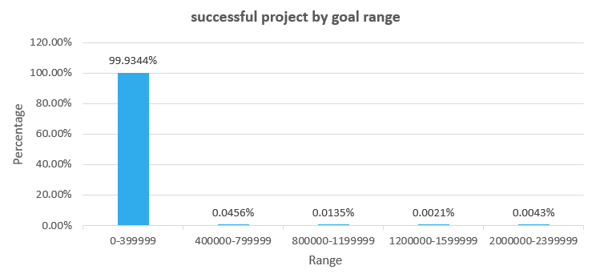
Percentage of Successful projects by Goal Range
This KPI shows that successful projects by Goal Range is 99.93% in 0-399999 range

Slide 12
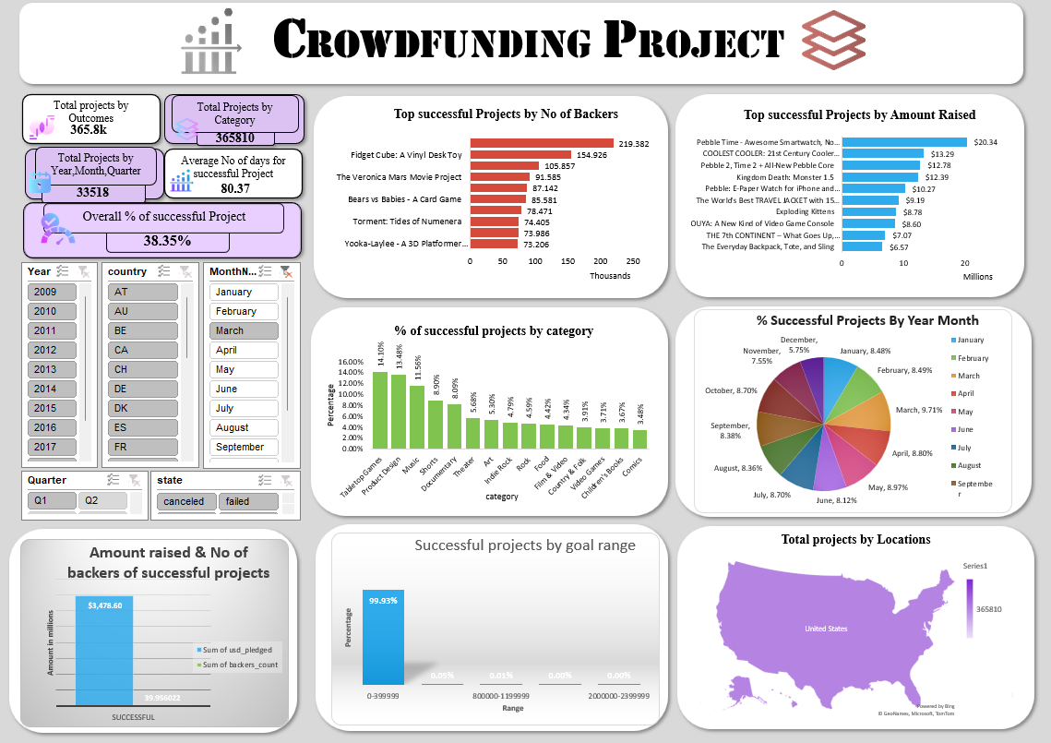

Slide 13
Conclusion :
Crowdfunding projects provide a powerful platform for validating market demand, engaging with a supportive community, and securing essential funding without traditional financial constraints.
Marketing and Visibility: Successful campaigns can enhance visibility, drive innovation, and build long-term customer relationships
Community Engagement : Crowdfunding fosters a dedicated community of early adopters and
. supporters.
Product Development and Innovation : This enables creators to bring new products to market more quickly than they might through conventional funding avenues..
Long-Term Relationships: Building a loyal customer base through crowdfunding can lead to long-term relationships. Backers who feel involved and valued are more likely to become repeat customers.

Slide 14

Thank you

