Slide 1
A MINI PROJECT ON MACHINE LEARNING

Slide 2

HOUSE PRICE PREDICTION
DONE BY:
225229106
CHARUMATHI M
I MSC DS A

Slide 3
Problem Definition
Predicting the House Prices with the help of Housing Data.
The predicted price of house depends upon various factors like avg area, avg bed room size, area population and price.

Slide 4
Implementation Steps
Importing Data
Data Cleaning
Feature Engineering
Removal of Outliers
Model Building
Testing different models and deciding upon the best one

Slide 5
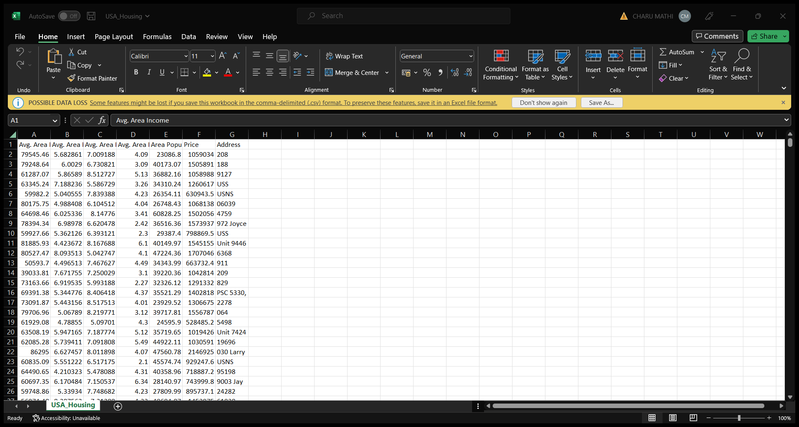
Dataset

Slide 6
1) Data Cleaning Steps
1) Dropping Unnecessary Columns
2) Filling missing values column
3) Dropping remaining rows with missing values
4) Creating a bhk column to store number of bedrooms.
5) Cleaning Total_Sq_Ft column

Slide 7
2) Feature Engineering Steps
Create a new column price_per_sq_ft which will help in dimensionality reduction
Any location which has number of houses < 10, will be labelled as 'other’

Slide 8
3) Outlier Detection and Removal
Removal of Houses where price of 2bhk is greater than 3bhk for same location
Removing houses where number of bathrooms is greater than number of bedrooms + 2
Data visualization
Performing One Hot Encoding

Slide 9
4) Model Building
Split
Split the data into columns which are dependent and independent.
Split
Split the data into Training and Testing.
Build
Build the model.
Use
Use K Fold cross validation to measure accuracy

Slide 10
5) Testing different models and deciding upon the best one
Use GridSearchCV to test and compare different models.
Predict the Price.

Slide 11
A) Linear Regression
Linear regression attempts to model the relationship between two variables by fitting a linear equation to observed data. One variable is considered to be an explanatory variable, and the other is considered to be a dependent variable.
The most common method for fitting a regression line is the method of least-squares. This method calculates the best-fitting line for the observed data by minimizing the sum of the squares of the vertical deviations from each data point to the line
A linear regression line has an equation of the form Y = a + bX, where X is the explanatory variable and Y is the dependent variable. The slope of the line is b, and a is the intercept (the value of y when x = 0).

Slide 12
B) Decision Tree
Decision tree builds regression or classification models in the form of a tree structure. It breaks down a dataset into smaller and smaller subsets while at the same time an associated decision tree is incrementally developed. The final result is a tree with decision nodes and leaf nodes.
A decision node has two or more branches, each representing values for the attribute tested.
Leaf node represents a decision on the numerical target.
The topmost decision node in a tree which corresponds to the best predictor called root node.
Decision trees can handle both categorical and numerical data.

Slide 13
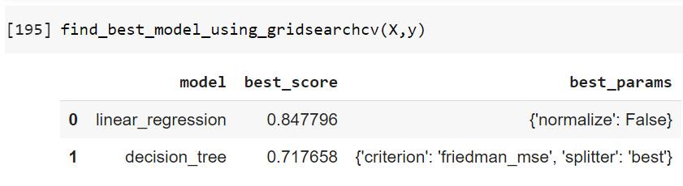
Comparison of Models

Slide 14
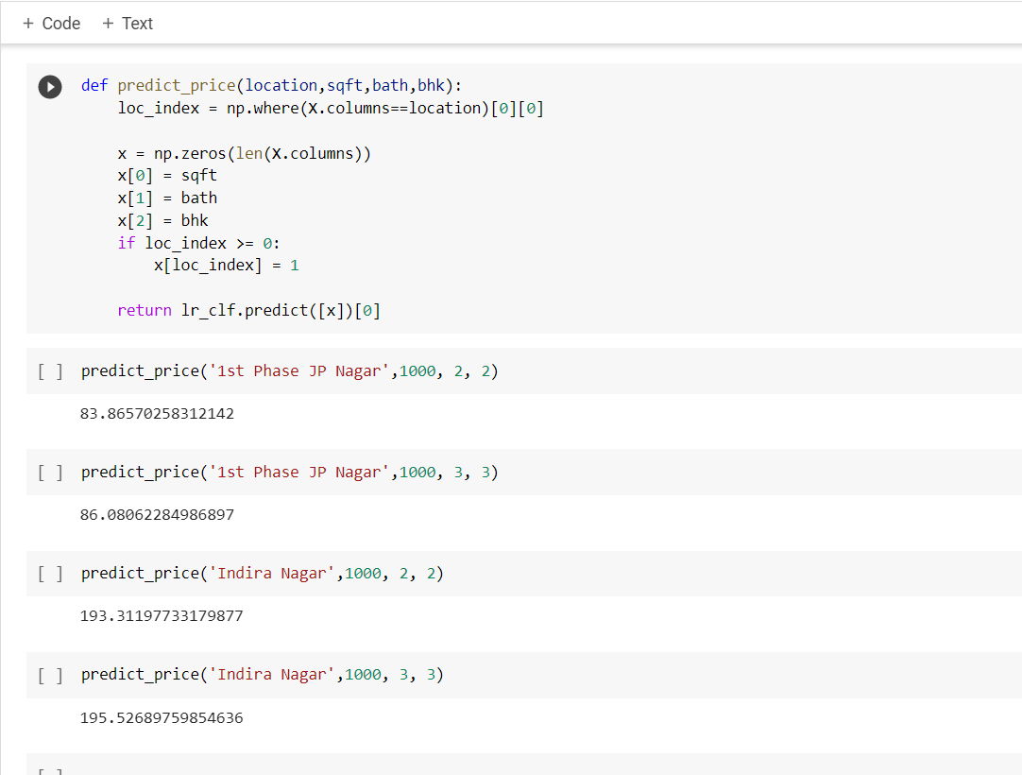
House Price Prediction

Slide 15
THANK YOU

